Slide 1
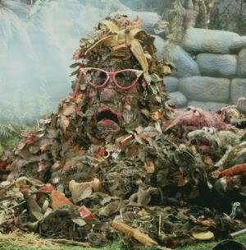
Global Model of Municipal Solid Waste (GMMSW)
Morgan Eichwald

Slide 2
Cochabamba, Bolivia
Objective: Model the spatial accumulation and pollution generated from the collection of Municipal Solid Waste (MSW).

Slide 3
Other waste models
WARM (EPA)
GHG in relation to waste of 26 materials-management tool
(landfill, recycling, energy capture, source reduction, composting)
Landgem (EPA)
US, landfill gas, EPA guidelines
Only accounts for 10% of landfills
Notes:
WARM-US only, does not include dumpsites, does not account for land or water pollution
Landgem-no unsound disposal sites, only gas, only US

Slide 4
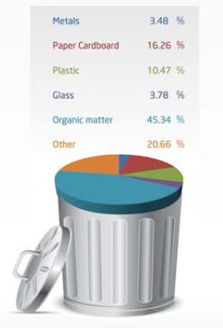
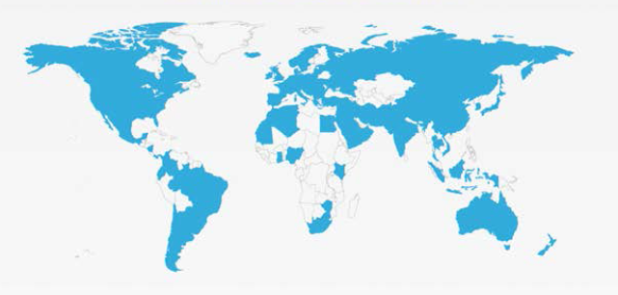
Free, crowd-sourced online map and collection of data from 164 countries, 1,799 cities, and 2,500 waste management facilities. It is an international initiative supported by a group of organizations and individuals which compile data from government and private reports, academic journals, and independent scientists.
Definiton of MSW: Waste produced by households, businesses, offices and public institutions.
Does NOT include industrial, agriculture, biomedical, nuclear, toxics, or sewage

Slide 5
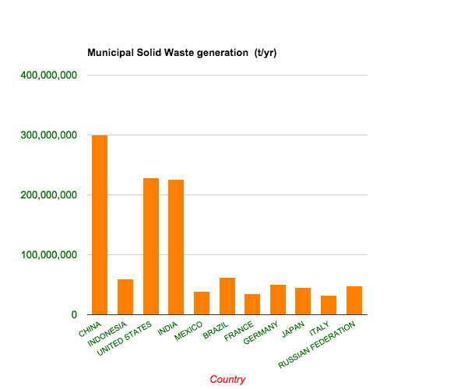
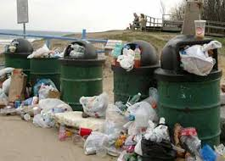
Top 20 Countries with Highest Annual Quantity of MSW
Countries | MSW (t/yr) | MSW per Capita (kg/yr) | Percent Collected | Recycling Rate (%)
China | 300,000,000 | 299.4 | 49.3 | NA
US | 228,614,990 | 733.7 | 95 | 23.8
India | 226,572,283 | 182.5 | 51.1 | NA
Brazil | 62,730,096 | 383.2 | 89.7 | 1
Indonesia | 59,100,000 | 255 | 69 | 6.5
Germany | 50,034,692 | 611 | 100 | 45
Russia | 48,256,200 | 340 | NA | NA
Japan | 45,360,000 | 356.2 | 100 | 20.8
Mexico | 39.385,595 | 343.1 | 93.2 | 3.3
France | 35,082,032 | 534 | 100 | 18
Italy | 32,225,610 | 529 | 100 | NA
UK | 29,843,392 | 472
Turkey | 28,858,880 | 390
Canada | 26,793,119 | 777
Thailand | 25,374,273 | 365
Nigeria | 25,000,000 | 153.9
Bangladesh | 22,528,901 | 149.7
Spain | 21,445,134 | 464
Egypt | 21,100,000 | 255.6
Pakistan | 20,000,000 | 127
*Bold text shows the top ten countries with largest populations

Slide 6
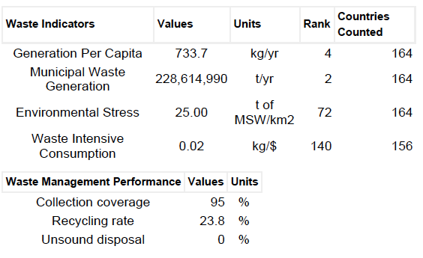
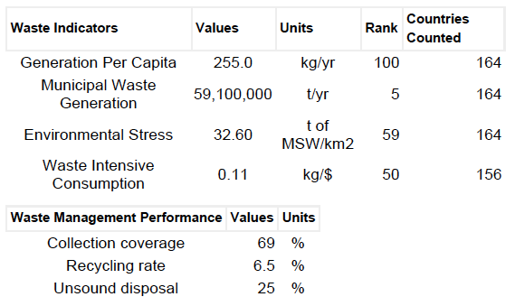
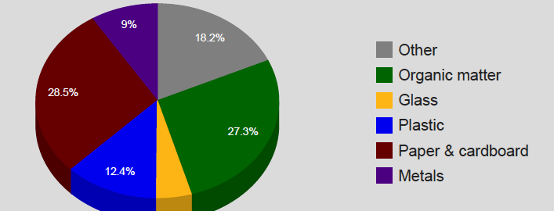
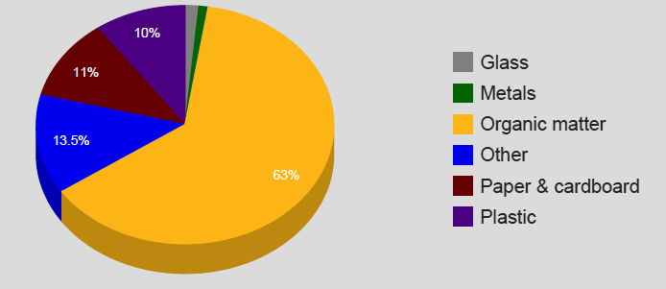
United States Waste Profile
Indonesia Waste Profile
US Waste Composition
Indonesia Waste Composition

Slide 7
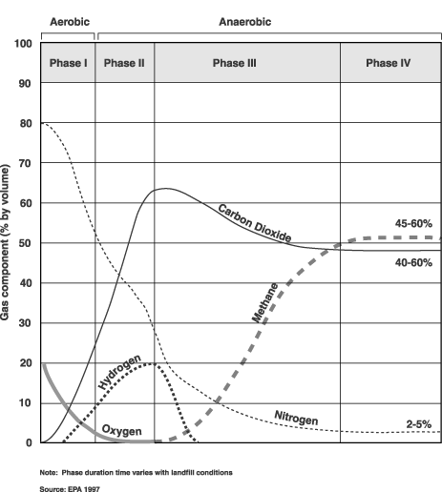
Types of Pollution:
All are dependent on climate (temp., moisture),
oxygen, MSW composition, and time.
Mass (Land)
Sanitary Landfill
Unsound Disposal
Composition
Decomposition
Recycled/Compost
Gas (Air)
Bacterial decomposition
Volatalization
Chemical reactions
Burning
Methane Capture
Leachate (Water)
Captured?
Treated-> waste H₂0
Ground/surface
N, C, (dissolved metals, salts, VOC’s)
Notes:
Leachate-pollution depends on amount of moisture and whether it is collected/treated
Gas-dependent on percent of organics-directly related to Methane and whether exposed to oxygen
Land-two types
Vol=liquid/solid->gas
http://www.atsdr.cdc.gov/HAC/landfill/html/ch2.html
organics directly proportional to gas quantity and type
Time-two graphs
Oxygen-> aerobic or not, methane only produced when no oxygen
Moisture: increases bacterial decomp., and sometimes chemical reactions
Temp: up is up in bact decomp. , chem reactions
http://www.waterencyclopedia.com/La-Mi/Landfills-Impact-on-Groundwater.html

Slide 8
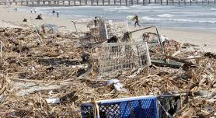
Unsound Disposal
“Sanitary” landfill

Slide 9
Estimates of Decomposition Times (with oxygen and light)
Paper: 2-6 weeks
Organics: 2-8 weeks
Plastic bag: 10-20 years
Tin can: 50 years
Aluminum can: 80-100 years
Plastic bottle: 450 years
Glass: 1,000,000 years
Styrofoam: Virtually never
Notes:
http://des.nh.gov/organization/divisions/water/wmb/coastal/trash/documents/marine_debris.pdf
http://www.ways2gogreen.com/DontThrowThisAwayDecompositionRates.html
http://epa.gov/climatechange/wycd/waste/downloads/landfilling-chapter10-28-10.pdf

Slide 10
Domain/Inputs
Time (years)
Climatic Data: precip and evaporative demand, temperature
Topographic map of country
Population distribution
Waste Atlas Country or Global Profile
MSW (annual quantity and composition)
Percent recycled (or composted)
MSW composition (glass, plastic, paper/cardboard, metal, organics, other)
Country landfill and dump sites: location and quantity at t_{o}

Slide 11
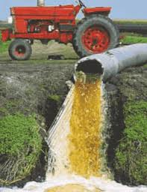
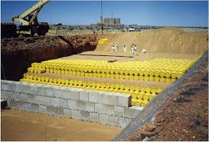
Assumptions: Recycled/composted items removed waste stream. Does not include pollution resulting from transport of refuse Country data is accessible: Waste Atlas or elsewhere MSW Composition is constant Waste will accumulate at existing sites, in relation to centers of population Waste is stationary once deposited at a landfill or dumpsite
CAUTION!
MSW does not account for all waste

Slide 12
Annual increase in V of MSW
Existing volume
at t_{o}
Burned/capture
AIR
Flared
Gas
Not Burned
Stationary
waste
Decomposition
Wind
patterns
Recycling/compost
Carbon
storage
Climate
Composition
Land
Leachate
Not treated
Treated
Topo
map
Surface
H₂0
H₂0
movement
Existing
sites
Population
Distribution
Ground
H₂0

Slide 13
More potential layers
Industrial, agriculture, biomedical, nuclear (water and land), toxics, or sewage
Transits (OECD, legality)
Recycling/composting
Cost benefits (price, energy)

Slide 14
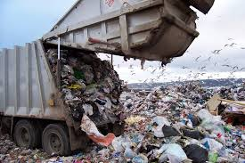
Applications
Waste management
Government standards
Personal responsibility/decisions

