Slide 1
MAST-1D
Morphodynamic and Sediment Tracers in One-Dimension
Michael Jahnke

Slide 2
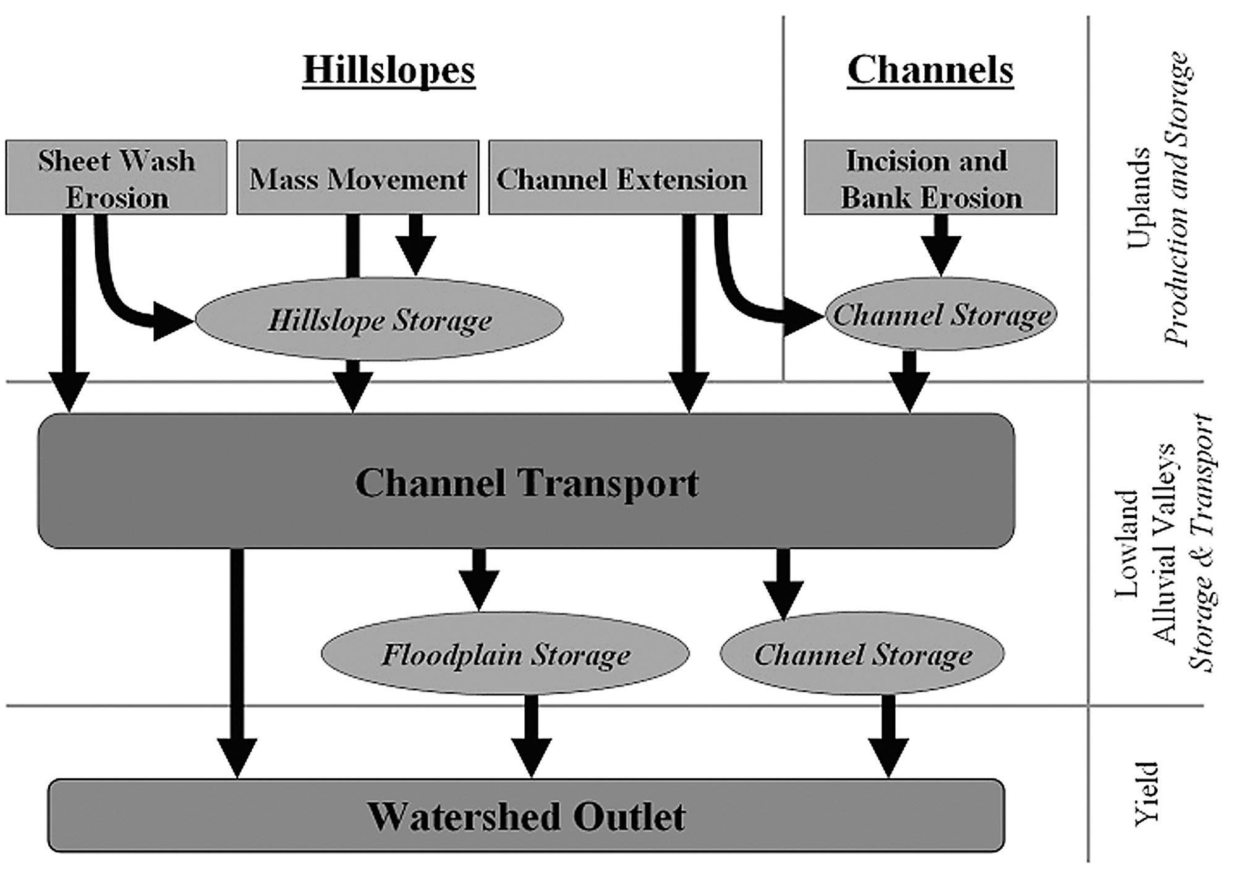
Sediment Budgets
I + O = ΔS
Conservation of mass
Net erosion or deposition?
Mountain watersheds
Hillslope-channel connectivity
From Smith and Wilcock, 2011
Notes:
Sediment budgets have had a long history in fluvial geomorphology in gaining a better understanding of sediment dynamics in a watershed. They allow for insight into erosion versus deposition and the change in sediment storage that may occur. In mountain watersheds, we can develop a framework of processes at work and quantify the mass transport at each, showing if there is net erosion or deposition in the occurring in the channel. Knowing how these processes work together, we can get a better sense of how hillslopes and channel are connected.

Slide 3
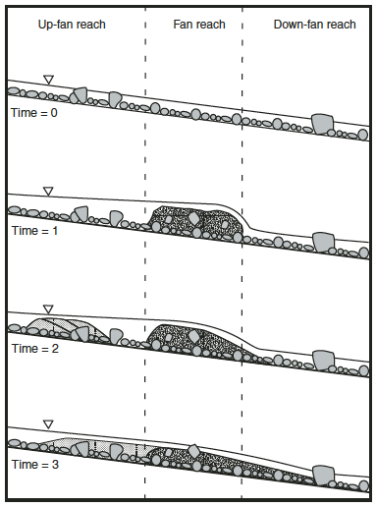
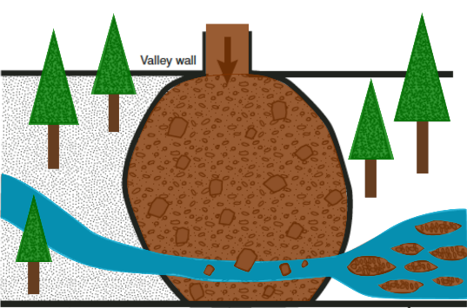
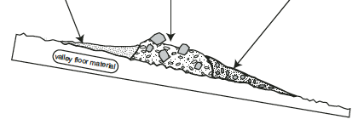
Post-fire Debris Flows
Hoffman and Gabet (2007)
Conceptual model of processes
Processes have a specific order, but timing is unknown
Debris Flow
Flow
From Hoffman and Gabet, 2007
Notes:
Hoffman and Gabet developed a conceptual model of the processes that occur when a pulse of sediment is delivered to the channel, at their study site of Sleeping Child Creek, near to my proposed field site – similar processes are at work in both locations
Sand is quickly winnowed and carried downstream to the next fan
Gravel and cobble is transported as bed load much shorter distances
Sediment accumulates upstream of the fan and decreases slope, sediment accumulates downstream of the fan and increases slope
These processes occur over some timescale but the relative timings of each event are not known

Slide 4
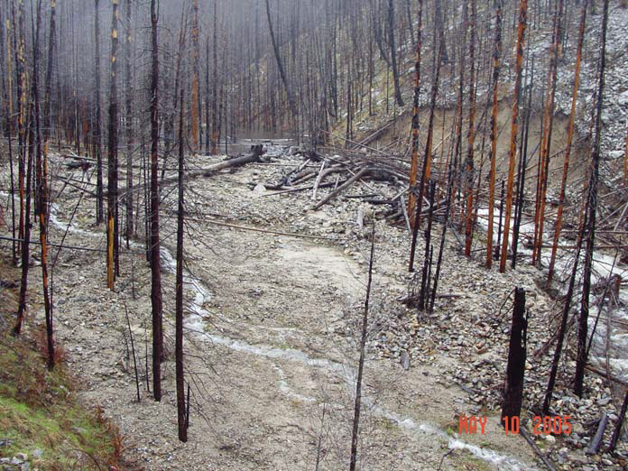
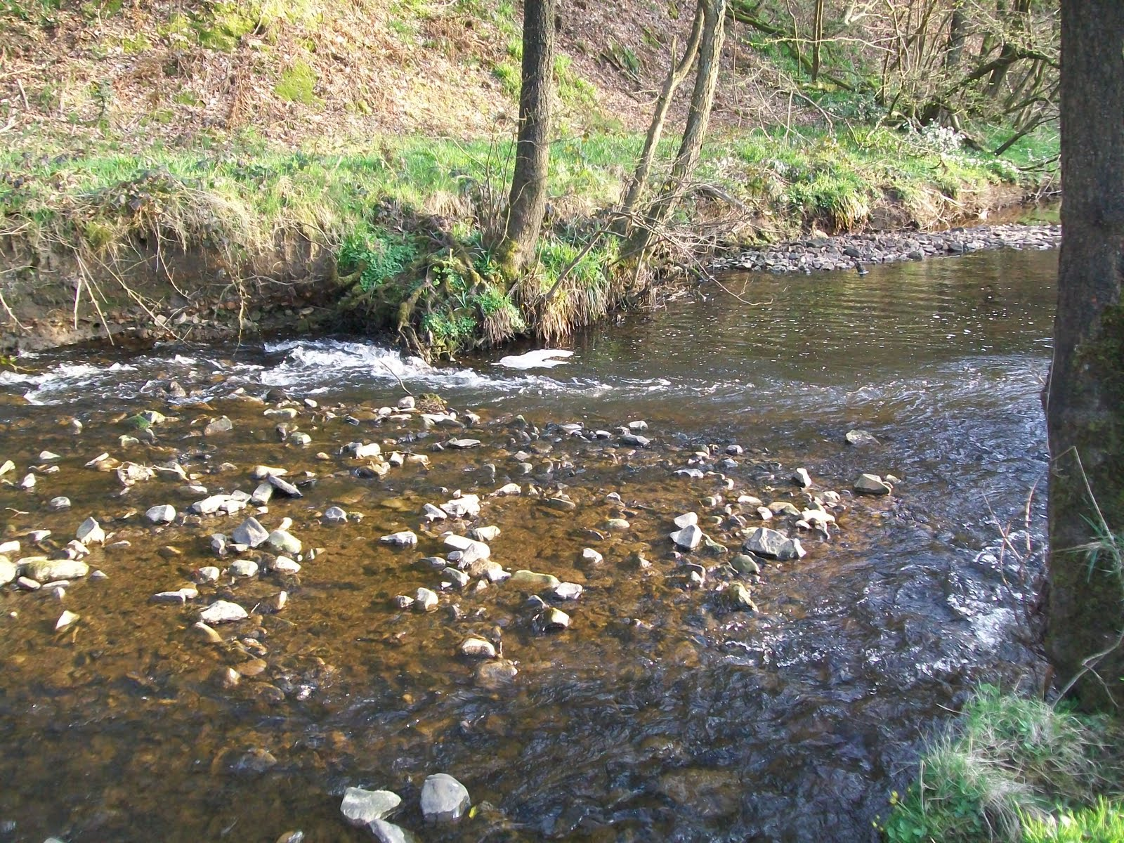
Questions
Post-fire debris flows
  What is the persistence of geomorphic impacts on channels?
Sediment routing
  Timescale of grain movement downstream

Slide 5
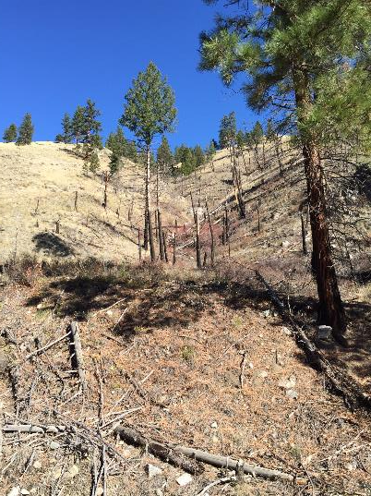
Challenges
Large spatial variability in erosion and deposition (Smith and Wilcock, 2011)
Debris flows are not regularly scheduled events (Benda, 1997)
Sediment storage is variable, especially when considering different timescales
Relict debris fan at Rye Creek, SW Montana.
Notes:
There are challenges in developing a sediment budget in mountain watersheds. 1. There is large spatial variability in erosion and deposition in these environments; large events occur over small areas in a short time period. 2. Specifically, debris flows are not a regularly scheduled mechanism of erosion; they occur at variable intervals and deliver large pulses of sediment to the channel. In their simulation, variation in the location and timing of wildfires led to periods of between 100 and 1300 years between debris flows with an average of 600 years. 3. Due to spatial variability in erosion and deposition, sediment storage duration is highly variable, especially when considering different timescales

Slide 6
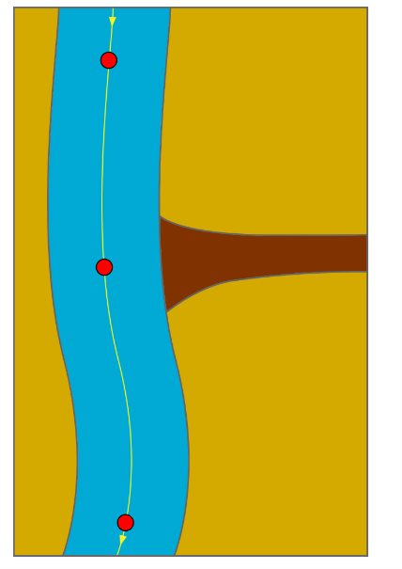
Research Approach
Field measurements as input parameters
Apply a numerical model to simulate sediment routing and morphodynamic evolution
MAST-1D couples channel and hillslope processes to model over decadal or longer timescales (Lauer et al., 2014)
  Allows lateral exchange of sediment
  Used to model sediment paths from debris flows
Input nodes
Stage/discharge
Suspended/Bed Load
Debris fan
Grain sizes
Channel geometry
Notes:
Investigate sediment routing by developing simple sediment flux estimates and applying a numerical model. Collect field measurements of coarse and fine sediment transport. Measure the bed load and suspended load. I will determine a stage/discharge relationship.
I will use these field measurements to apply a numerical model to Rye Creek. MAST-1D is a numerical model for size-specific sediment transport and morphodynamic evolution. It couples channel and hillslope processes over decadal or longer timescales. Allows for lateral exchange of sediment and multiple grain sizes of transport. Grain size distributions will be determined both for the channel and the debris fans. By quantifying grain size distributions in the debris fans and their entrainment into the fluvial system, I will be able to introduce them to the numerical model as lateral sediment inputs which can be varied along the reach in MAST-1D. This key feature will allow me to model debris flows along the reach to explain how sediment delivered to the channel from post-fire debris flows is routed downstream.
I’m aiming to simulate and quantify hillslope-channel connectivity through sediment routing from hillslope to channel and downstream. By creating a predictive model of sediment routing, I will also investigate how the pulses of material from debris flows are processed by the stream.

Slide 7
MAST-1D
Objective – Create a routing model to develop long-term sediment budgets based on isotope fingerprints
  Describe movement of sediment in the channel and floodplain
  Account for production and decay of isotopes in storage
  Account for multiple sources of sediment
Isotopic fingerprints are measured fallout radionuclide concentrations
Sediment sources include in-channel, floodplain, and debris flows

Slide 8
Uses
Rapid initial sensitivity analysis
  Informing the choice of a more complicated numerical model
Fast run time allows for simulation of longer time periods
Morphologic response to change in sediment supply
  Dam removal
  Post-fire debris flows
    Climate impact on discharge/fire frequency

Slide 9
Assumptions
Fundamental assumption – Sediment deposited on the floodplain is equal to that which is eroded from the floodplain
  Mass balance: Inputs = Outputs
Simplified geometry – channel and floodplain cross sections are rectangular and smoothly vary downstream
Channel exchanges sediment with the substrate and surface active layer
Steady and uniform flow

Slide 10
Temporal/Spatial Scale
Timestep normally weeks – one month
  Dependent on hydrograph quality and rapidity of analysis
Spatial scale of river channel plus floodplain
  Reliant on frequency of cross section survey data

Slide 11
Input Drivers

Slide 12
Model cross section
Input parameters specified at each red node
Sediment exchange via migration, width change, or vertical change

Slide 13
Computations
I + O = ΔS
Bed elevation – modified Exner equation
Total sediment volume in all reservoirs

Slide 14
Key Outputs
A
Bed elevation and median active layer sediment size (D50)
Bank response to sediment starvation or influx
B
C
A
Migration rate input for each run
Bed change relative to initial bed position
D50 in active layer
B
C

Slide 15
Channel evolution
A
B
A
Below-capacity run, bed elevation is fixed
At-capacity run, bed elevation can evolve
B

Slide 16
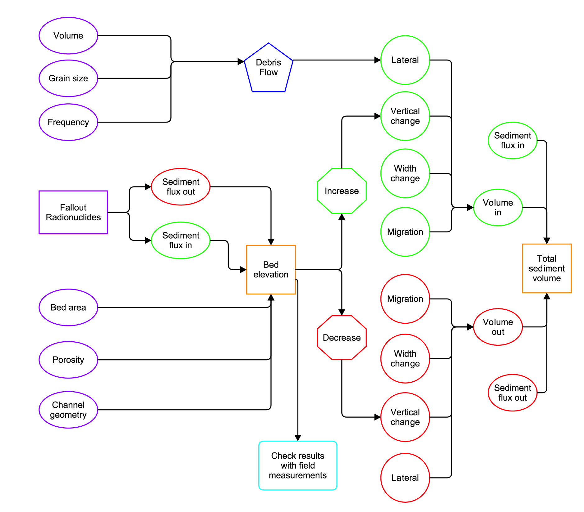

Slide 17
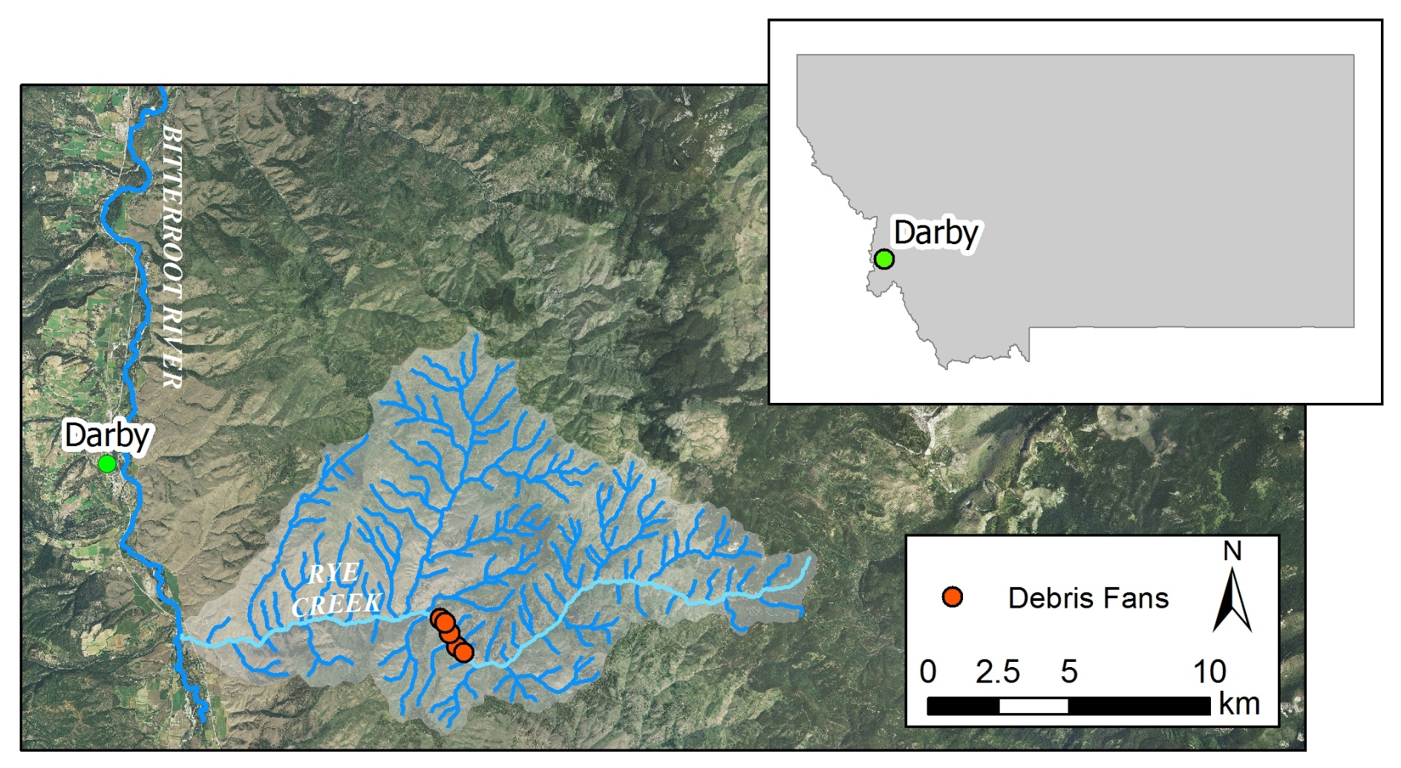
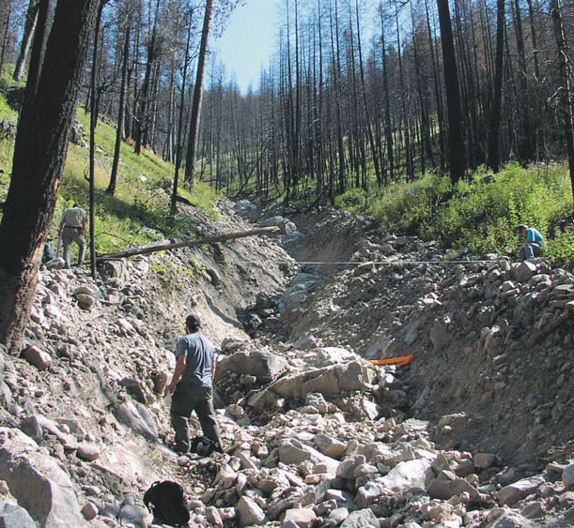
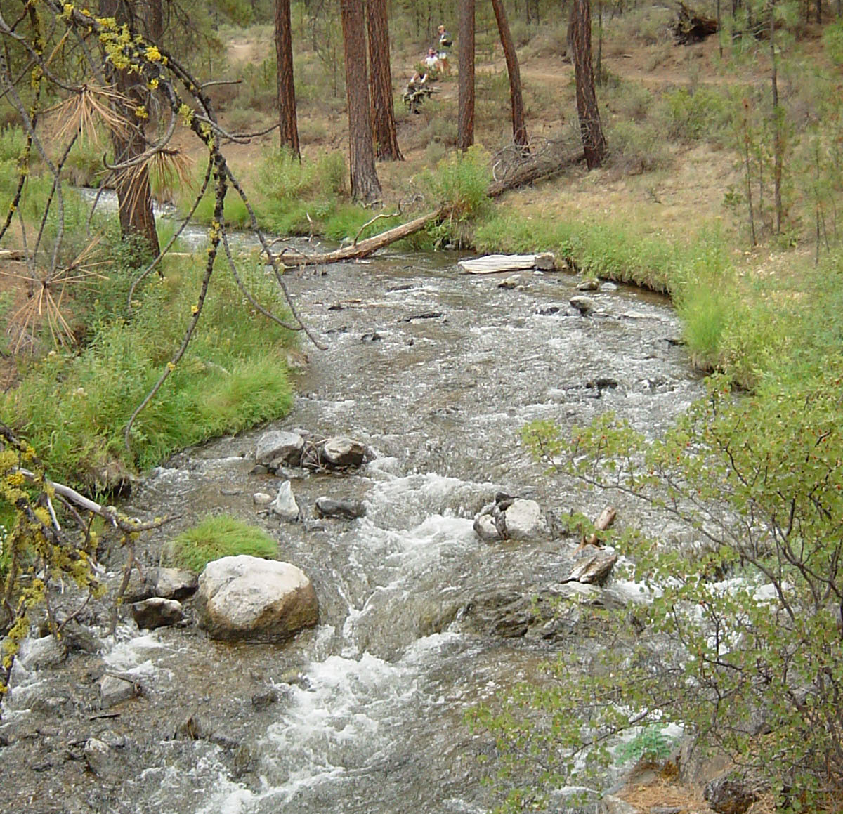
Questions?

