Slide 1
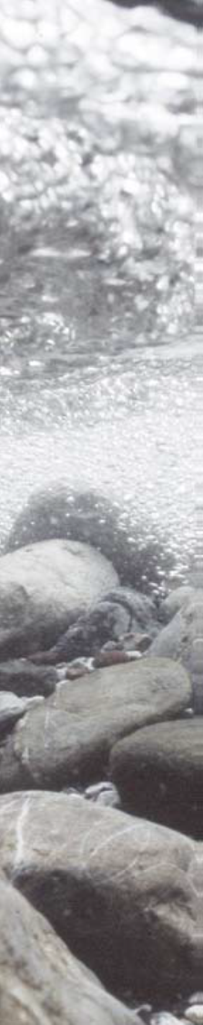
Computer Aided Simulation Model for Instream Flow and Riparia
CASiMiR-Vegetation
  University of Stuttgard-Dept. of Hydraulic Engineering and Water Resources Mgmt.
  http://www.casimir-software.de/ENG/index_eng.html
CASiMiR is an advanced simulation system for the study of aquatic habitats (fish, benthos, hydropower).
CASiMiR-Vegetation forecasts the development of flood plain vegetation under changing flow regimes.
Requirements: digital elevation model (DEM), selected results from a 2D hydraulic model such as the maximum shear stress and submergence time.
Key Assumptions
-Vegetation development depends on the functional relationship between hydrology and physical processes.
-The topography does not change throughout time.
-Vegetation growth is constant
Temporal/Spatial Scale
  CASiMiR-Vegetation utilizes a yearly time step.
  The spatial scale is defined by the DEM used.

Slide 2
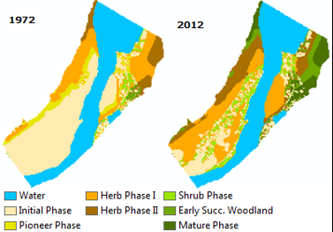
Structure of CASiMiR-Vegetation
The model is characterized as dynamic because it takes different inputs for each simulated year and the outputs of each model run is fed again to the model as input for the next iteration.
The simulation results are in form of maps and tables.

Slide 3
Model Flowchart
Input Drivers
Topography-DEM
Initial Vegetation
Water Level
Shear Stress
Flood Duration
Key Outputs
Spatial GIS Map
Tables

Slide 4
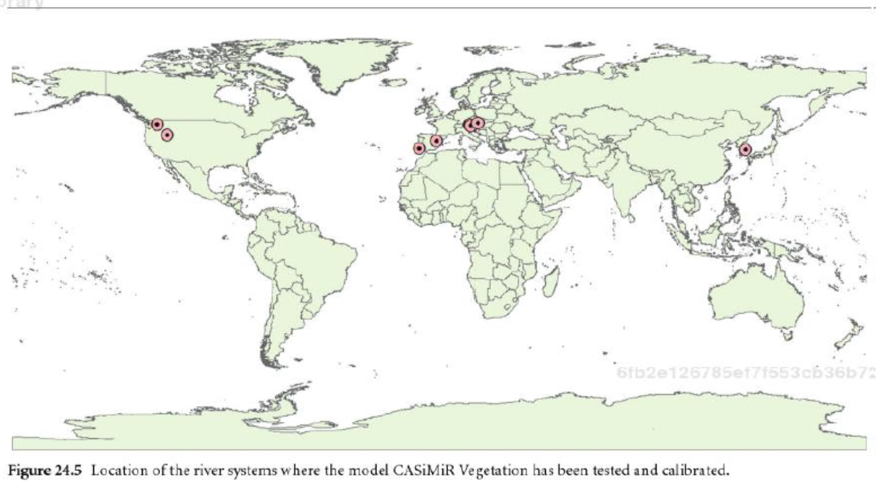
Model Applications
Kootenai River, Idaho
Drau River, Austria
Notes:
Kootenay River Habitat assessment
Boise side river channel fish habitat study

Slide 5
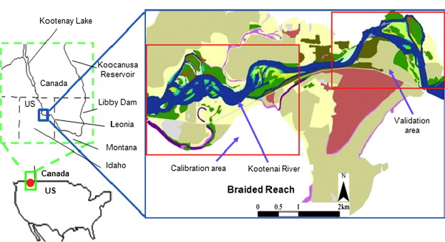
Kootenai River CASiMiR-Vegetation Model Testing/Calibration
The model simulates the changing vegetation patterns on an annual basis from an initial condition based on spatially distributed physical parameters such as shear stress, flood duration and height-over-base flow level.
Study site including calibration and the validation area at the braided reach, which is located just upstream of the town of Bonners Ferry, Idaho.

Slide 6
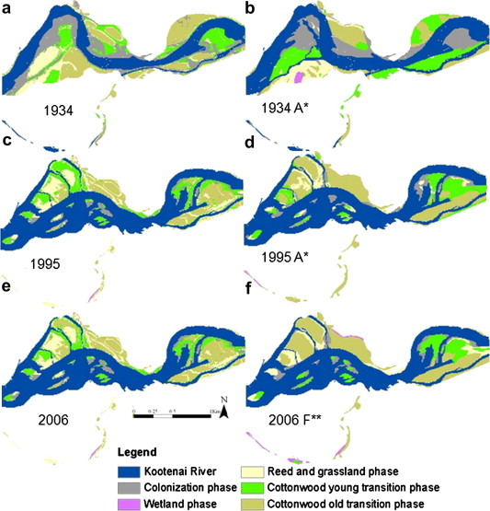
Issues:
The model assumes that Cottonwood and Willow establishment can only take place on newly developed gravel and sand bars within a bank zone.
This was the main reason that the model over predicted reed, forbs and shrub, where young and old cottonwood forest was observed.
Simulated, field surveyed and aerial photo interpreted vegetation for different years.
Notes:
In fact, cottonwood and willow may establish and survive anywhere on the floodplain such as agricultural fields, cleared forests or land along the upper floodplain terrace when favorable conditions are available, such as seed availability, open spaces, and soil moisture

Slide 7

Solutions:
The model was calibrated by modifying threshold values of critical shear stress and height-over-base flow level (HBFL).
Vegetation types were merged into specific phases such as wetland, colonization, cottonwood young transition, cottonwood old transition, reed and grassland.

Slide 8
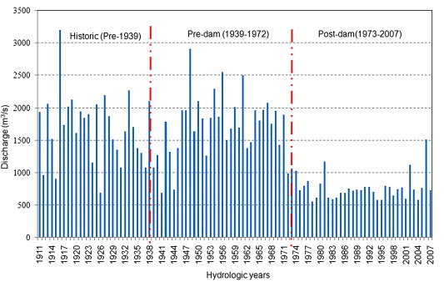
Yearly maximum discharges at Libby Dam from 1911 to 2007

Slide 9
Kootenai River
The vegetation returns back to the earliest stage of succession frequently due to flood disturbance in historic (natural hydrology and topography) and pre-dam (natural hydrology) conditions.
The average age had significant increase in the post-dam condition.
The study shows that when the natural hydrological pattern is altered by dam operation and flow management, riparian vegetation follows succession toward mature vegetation, due to the lack of disturbance in the system.
The modeled vegetation changes help to explain human influences on the Kootenai River hydrological system and the impact on riparian vegetation dynamics.

Slide 10
Drau River, Austria
During the 20th century, it was canalized, resulting in loss of habitats and species decline.
The study site was restored in 2002, which included the removal of bank protection and subsequent loss of vegetation
Observed and simulated vegetation maps for the validation period in the Kleblach reach (Drau River, Austria).

Slide 11
Succession Submodel Flowchart for Drau River, Austria

Slide 12
Running the Model
The model is built upon Microsoft.Net framework, and requires the Visual Studio power pack version 3.
Windows 7 or 8 systems are usually equipped.
GIS Mapping Program (ArcMap)

Slide 13
Demo Project: Inputs
Inputs:
Succession Series
Scour Disturbance Parameters (ex: shear Stress N/m2)
Flood Duration
Start Condition (ex: DEM, height over mean water)

Slide 14
Output: Raster Map and .csv Spreadsheet

Slide 15
Weaknesses
Model may be too generalized to replicate ecosystem parameters.
No change in topography
Assumes a constant rate of vegetation growth.
  Soil
  Climate
  Nutrient/Moisture Availability

