Slide 1
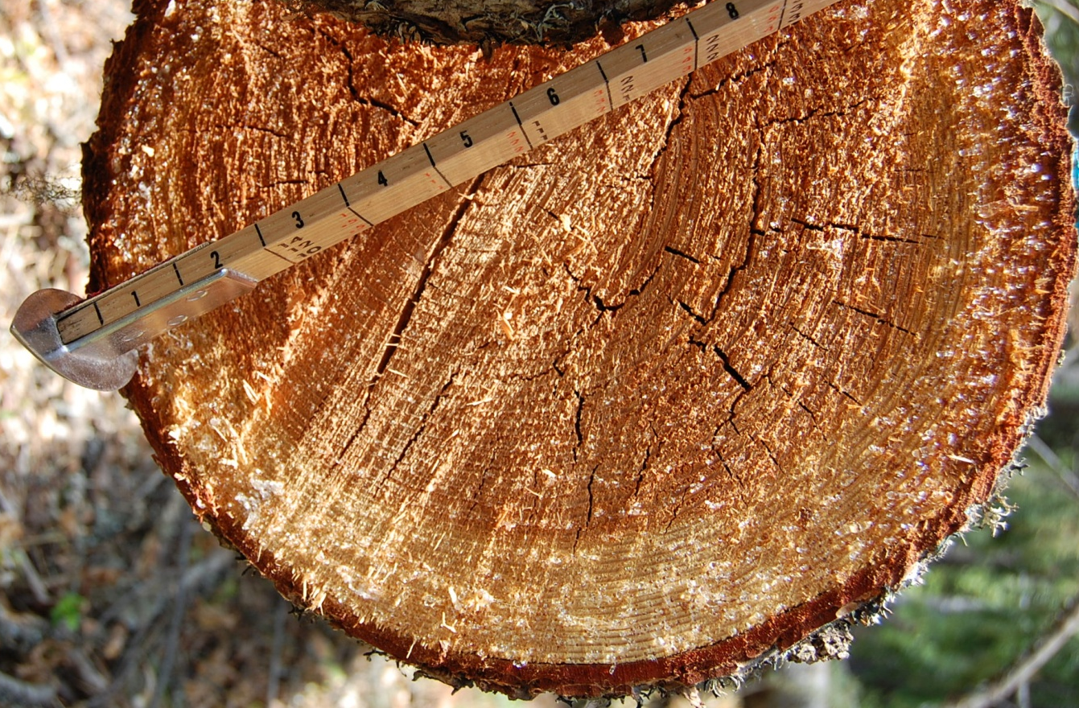
Estimating Forest Productivity at a Landscape Scale Using Site Quality Index Model
Forest Ecosystem Analysis – Spring 2015
Jarred Saralecos – University of Montana, Graduate Research Assistant

Slide 2
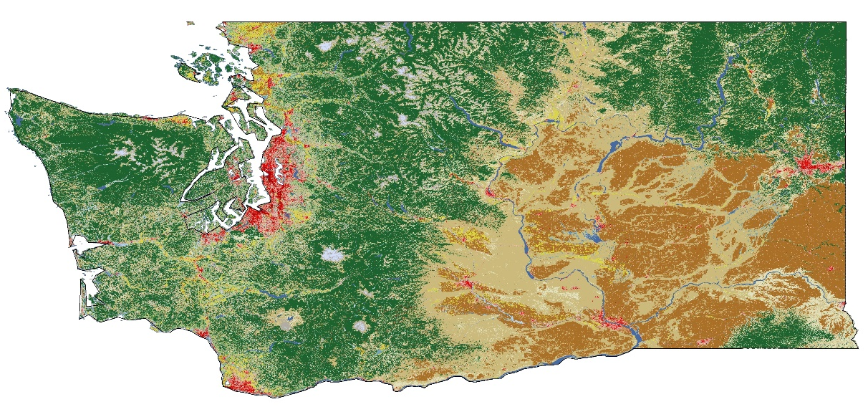
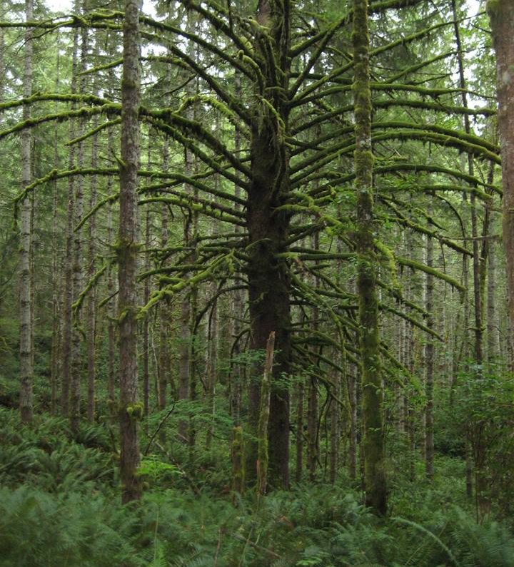
Overview
There is a need to accurately and efficient estimate forest productivity across the forests for planning and management purposes
Stipulations:
Not time consuming
Cost effective
Produces a meaning output metric
Flexible over diverse terrain and climate
Applicable across all forest types, successional stages, and management types

Slide 3
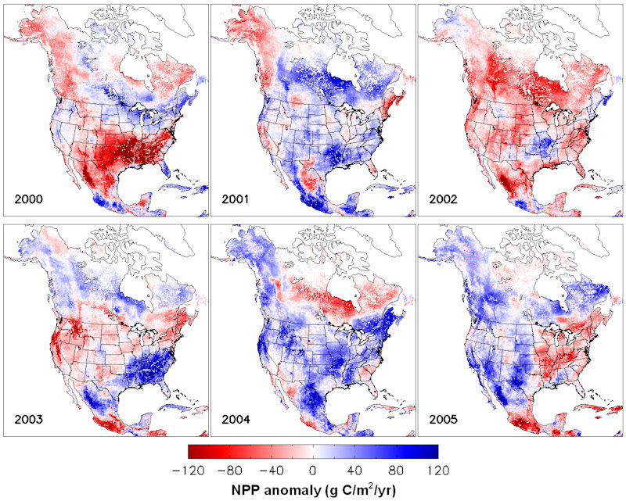
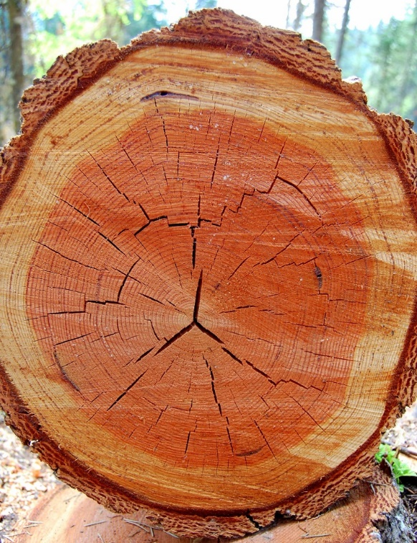
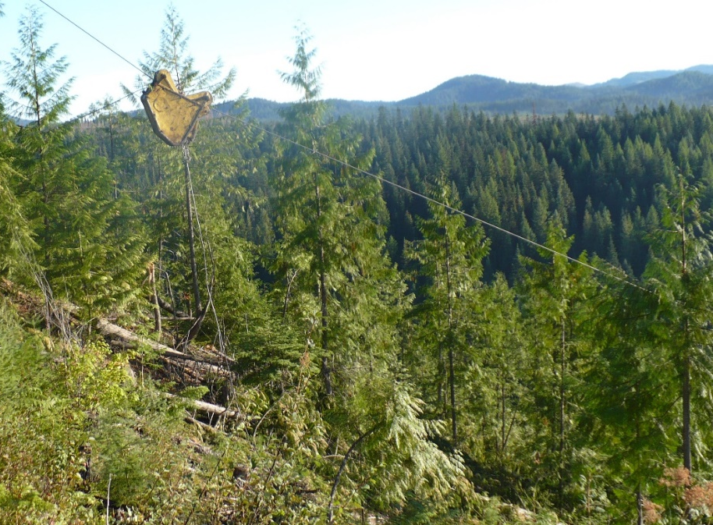
Objective: Dynamic, hybrid model for assessing forest quality model that is distance independent and bridges the gap between C-balance models and growth and yield models
Key Assumptions: Sites are not nutrient deficit, individual plants are not defined, and assumes a 1kph wind speed for measuring PET, soil type is reflected by annual site aridity
Temporal and Spatial Scale: Yearly time step/ spatially undefined and based solely on the scale of the input data

Slide 4
Ability to assess site quality regardless of current status or vegetation structure
Creates an index for assessing potential productivity based on growing season energy input into a system
C/m²/yr (not applicable for forest managers, diameter growth/yr (highly affected by density)
Compares a site quality index to site index measurements (height based)
Uneven aged
Diseased
Wildfire
Seedlings
Even aged (young)
Even aged

Slide 5
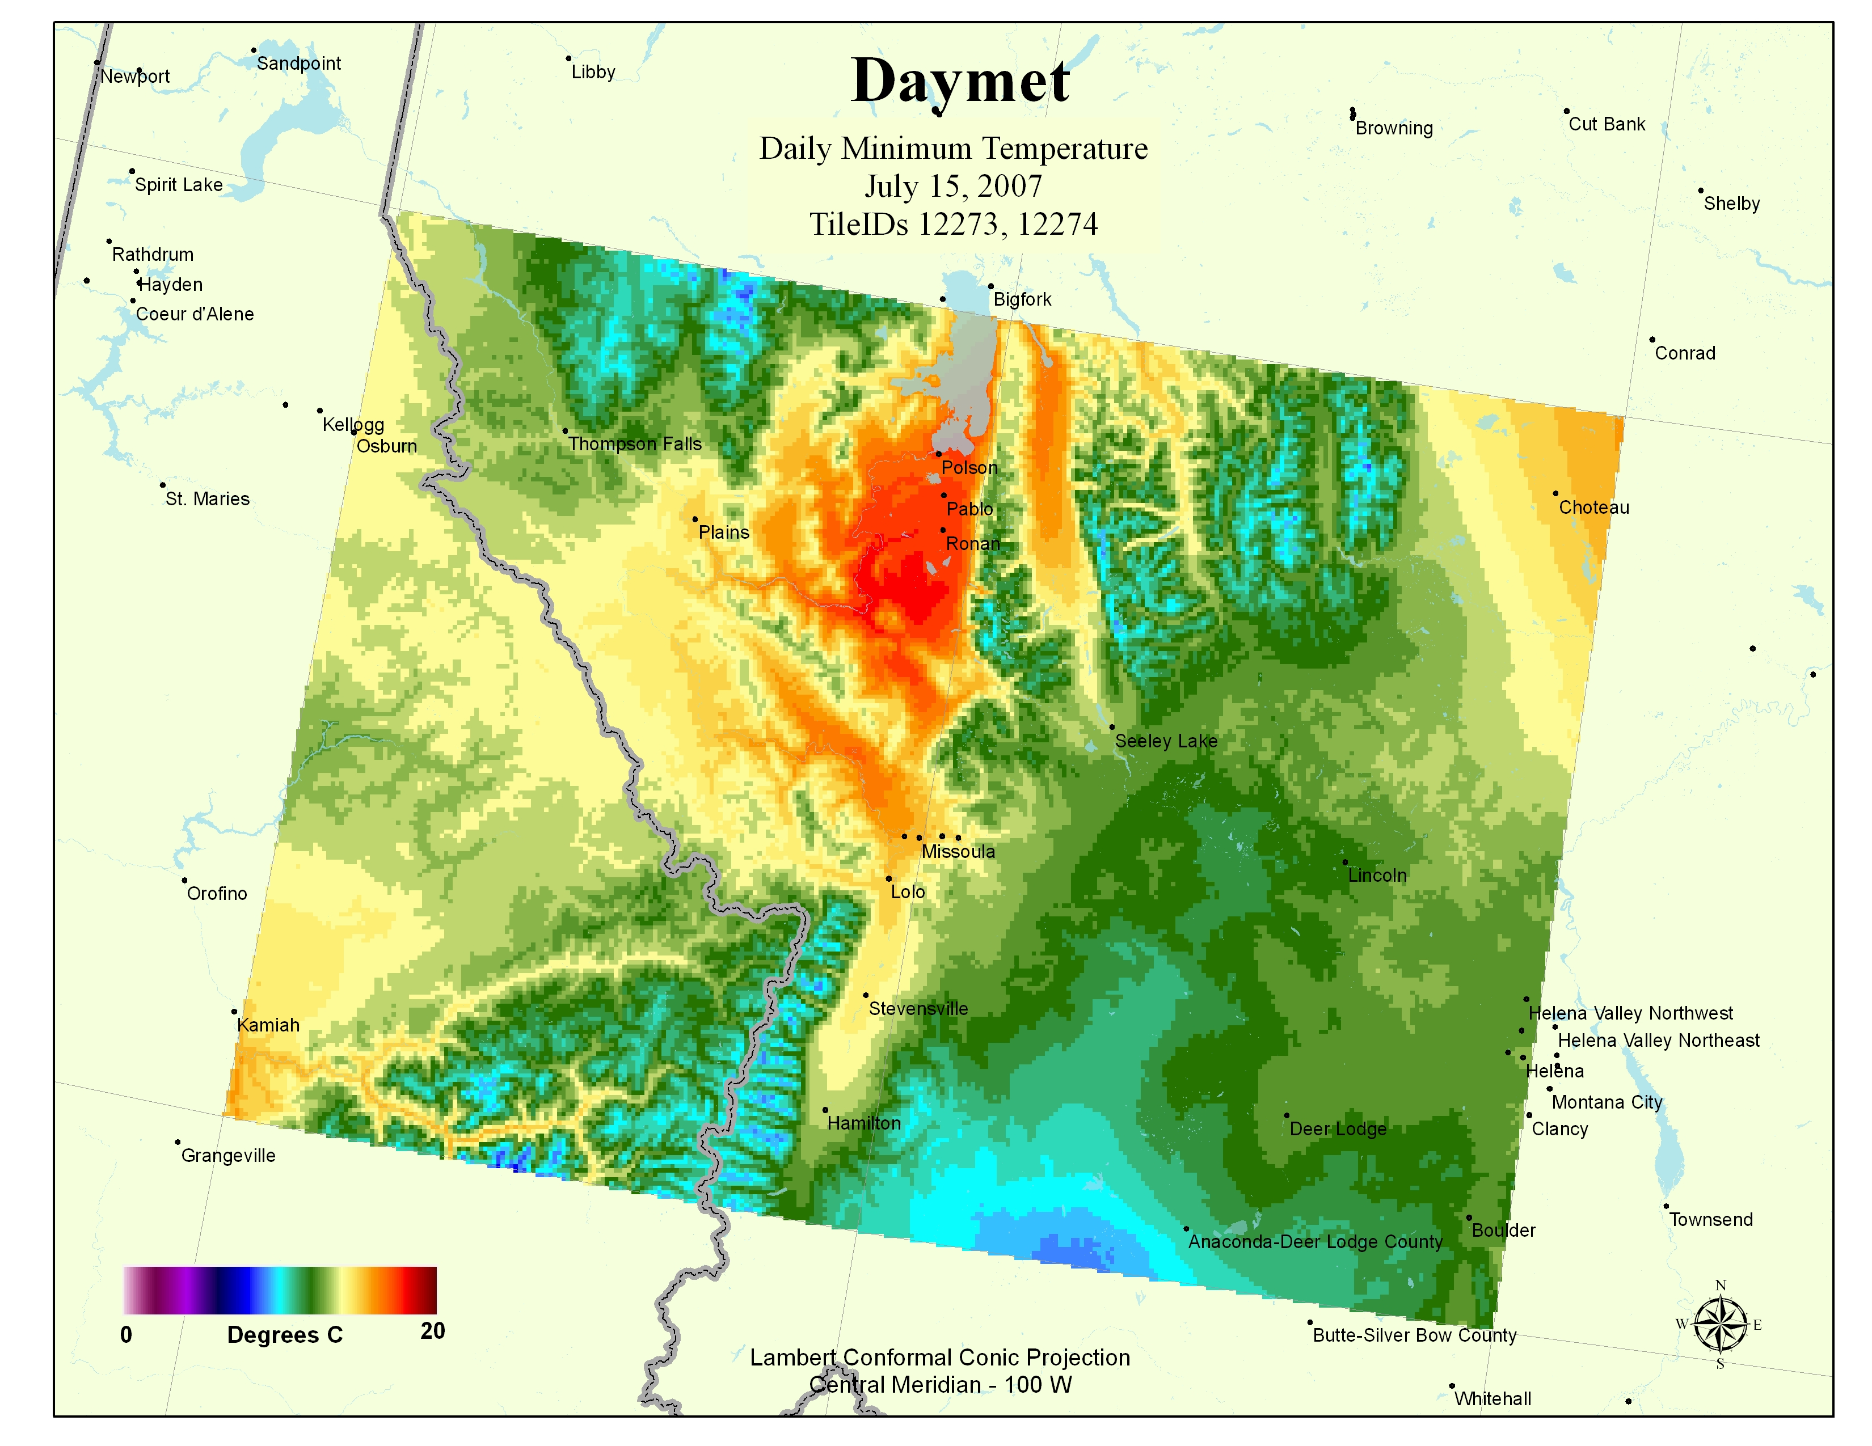
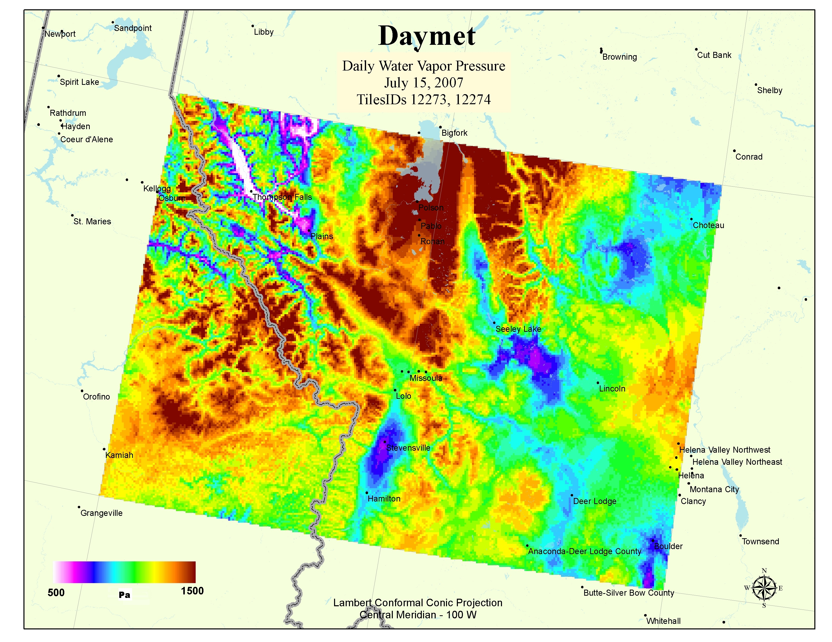
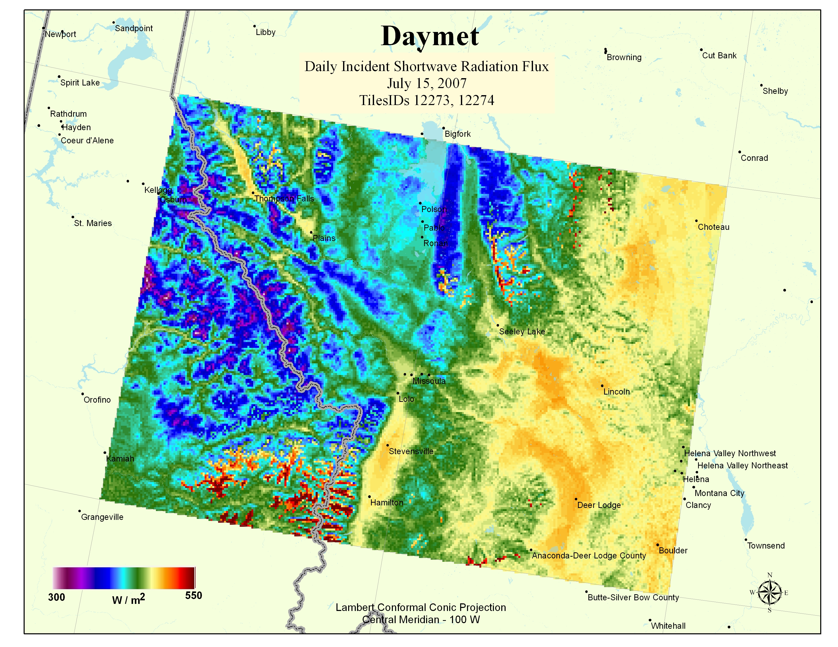
Site Quality Index Model (SQI)
Hybrid growth model designed to evaluate a sites energy balance suitable for vegetation growth
Simple and utilizes readily available climate data
Evaluates the total energy input into a system during the growing season
Produces a standardized scale of 0-1 representing the quality of a site to establish and sustain forest growth

Slide 6
T_{min} ≥ -2°C
((T_{max} - T_{min})0.47) during days meeting step 1 & 2
(PAR)
Annual site aridity index for days meeting step 1
Cumulative day length (seconds)
Cumulative growing degree days
Mean annual growing season (decadal average)
Mean annual precitiation
Mean annual PET
Site Quality = f (mean growing season + mean growing season aridity index + mean growing season PAR)
SQI model design:
Input variables
Daily T_{min} and T_{max}
Daily precipitation
Daily potential evapotranspiration (PET)
Input data consists of decadal measurements collected at a daily time step
Output
A standardized 0-1 undefined metric representative of site quality

Slide 7
Average number days/year where daily temperature ≥ -2°C (calculated over a rolling decade)
Average days/year * average day length (seconds)
0-1
0-1
3) On days meeting #1, number of days where
precipitation/PET (aridity index) ≥ determined threshold
(such as wilting point)
0-1
4) On days meeting #’s 1&2, average daily incident radiation (T_{max} – T_{min} )

Slide 8
Example of SQI and SI relationship
Model Results
Each sites derived metric will be compared to direct site index measurements and formed relationships will allow for future measures of SQI to predict site index
SQI will be a fluid measure over time, changing with the climate at a given site
This application of site index will change it from a Ht/Age metric to a ranking system when applied over uneven aged stands
.0
.05
.10
.15
.20
.25
.30
.35
.40
.45
.50
.55
.60
.65
.70
.75
.80
.85
.90
.95
1.0
38
53
54
58
59
68
70
75
76
79
83
84
86
89
92
94
99
105
112
121
45
61
63
66
66
75
75
82
84
86
90
92
93
96
98
101
104
109
114
128
43
59
61
64
64
73
73
80
82
84
88
90
91
94
96
99
102
107
112
126
SQI DF₅₀ PP₅₀ WL₅₀

Slide 9
5
Model Results
This application of site index will also allow comparisons of uneven aged forest stands, changing site index from a Ht/Age metric to a ranking system
Also allow comparison of all sites under a single ranking system
Stand Number | Site Quality Index | Site Index
1 2 3 4 5 | 2 4 5 1 3 | 3 5 4 1 3
4
1
2
3

Slide 10
Testing and Validation
Output and accuracy are validated through backcasting
Previous climate data is run and relationships with Site Index are derived, then those projections are compared to current forest measurements
Using USFS Forest Inventory Analysis plots (FIA) and climate data beginning in 1980 we can assess model accuracy today
Climate Driven Site Quality
Site Index Measures
1980
1990
2000
2010

Slide 11
Understanding of future trends in species habitat will allow forest managers to adjust accordingly
Forest management and planning is a 50+ year forecasting process unlike perennial crops such as wheat and decisions today must work under current and future conditions
Douglas-fir current species range ↑ and in 2090 under IPCC, A1B climate scenario ↓

Slide 12
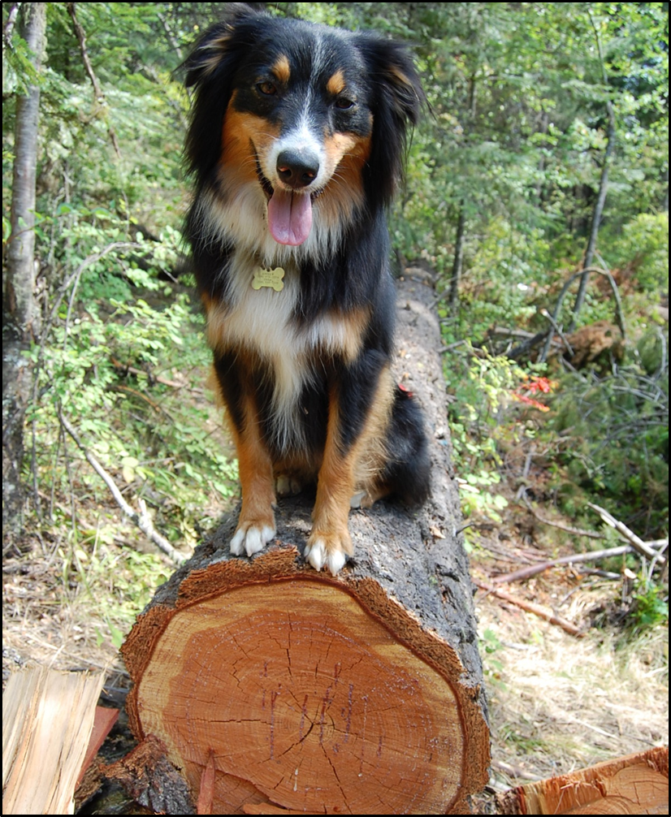
Questions?

