Slide 1
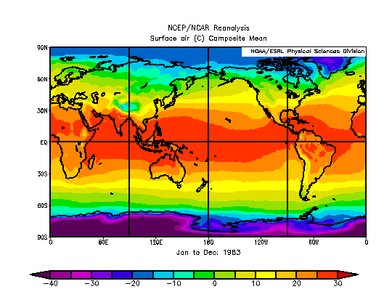
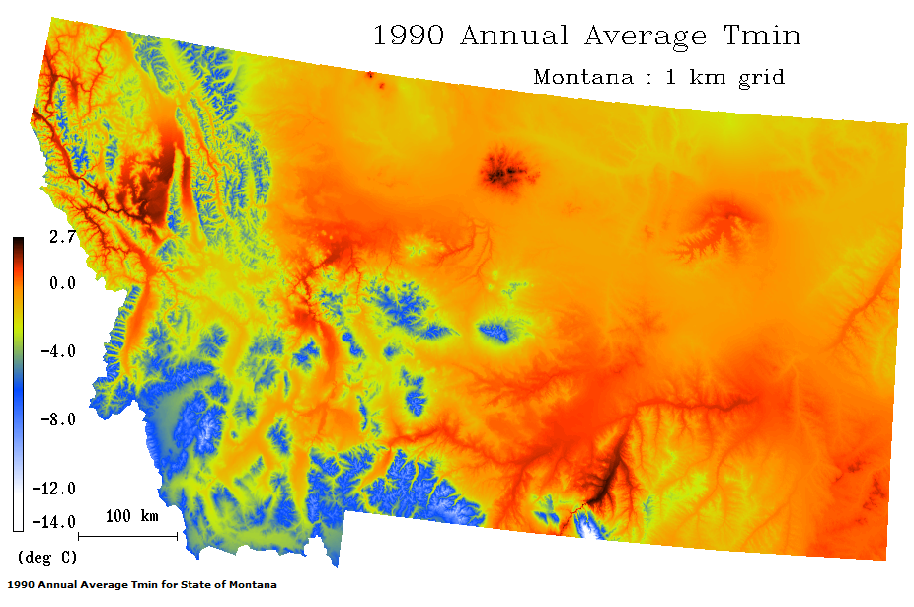
Weather and Climate Data

Slide 2
Weather and Climate
Climate is a key driver of ecological and hydrological processes
Climate variables form one of the most important set of inputs for environmental models
Surface air temperature
Precipitation
Surface air humidity
Incident shortwave radiation
Problems:
Meteorological variables rarely observed at locations of interest
Weather observation points have relatively low spatial density
Spatial data products often do not match spatial and/or temporal scale of research

Slide 3
Scales of Weather and Climate
Scale | Time Scale | Spatial Scale | Example
Macroscale | Weeks or longer | 1000 – 40,000 km | Westerlies, Trade Winds
Synoptic | Days to weeks | 500 – 5000 km | Mid-latitude cyclones, anticyclones
Mesoscale | Minutes to hours | 1 – 100 km | Land-sea and mountain/valley breezes
Microscale | Seconds to minutes | < 1 km | Dust devils, gusts

Slide 4
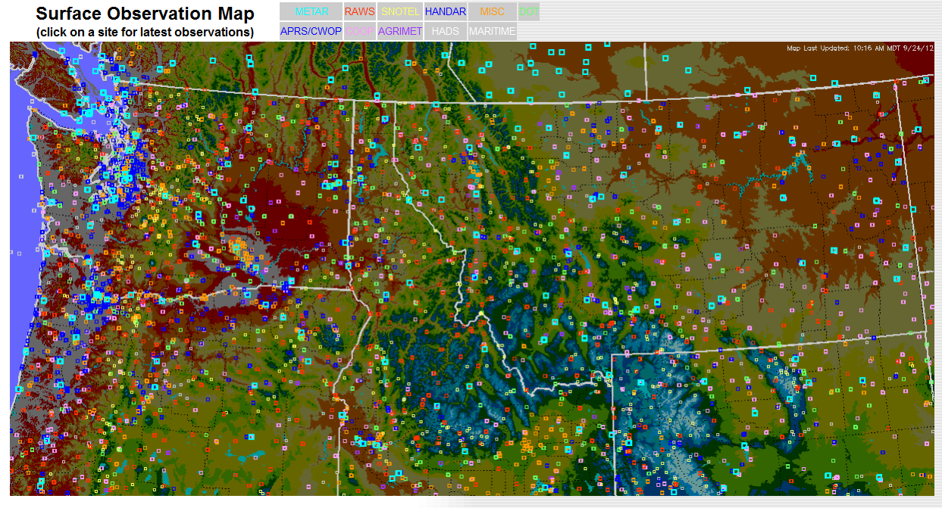
Point Source Weather/Climate Observations
Weather Stations
NOAA NWS
NCDC
SNOTEL
RAWS

Slide 5
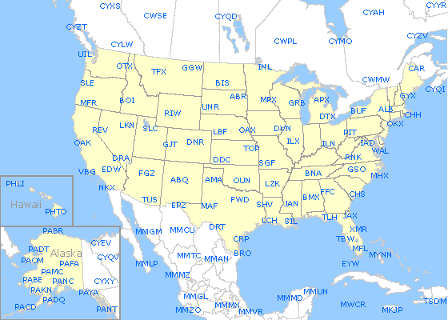
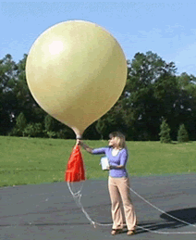
Point Source Weather/Climate Observations
Radiosondes: Provide vertical profile measurements of the atmosphere
Pressure
Temperature
Humidity
Winds

Slide 6
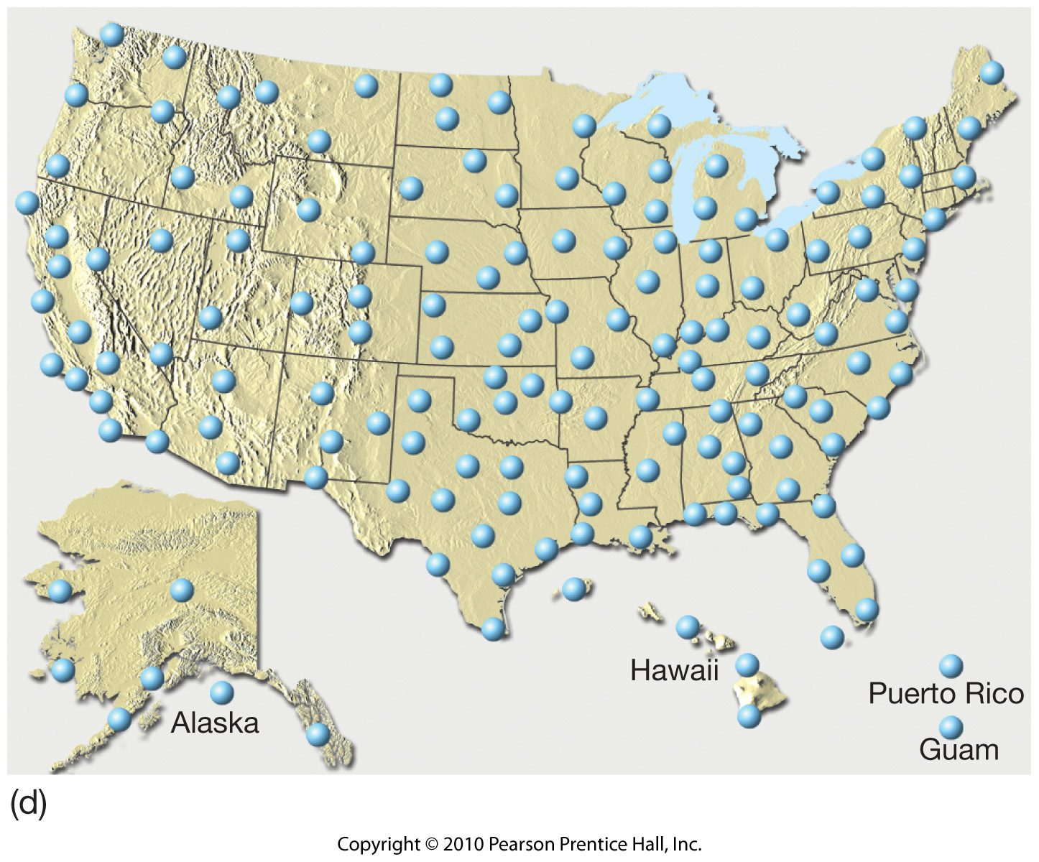
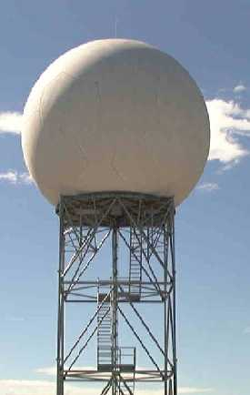
Spatially Continuous Weather/Climate Observations
Doppler Radar: a type of radar that has the capacity to not only detect the occurrence of precipitation, but also its velocity towards or away from the radar
Conventional radar transmits short pulses of microwaves. The strength and timing of the return signal indicates precipitation intensity and location.

Slide 8
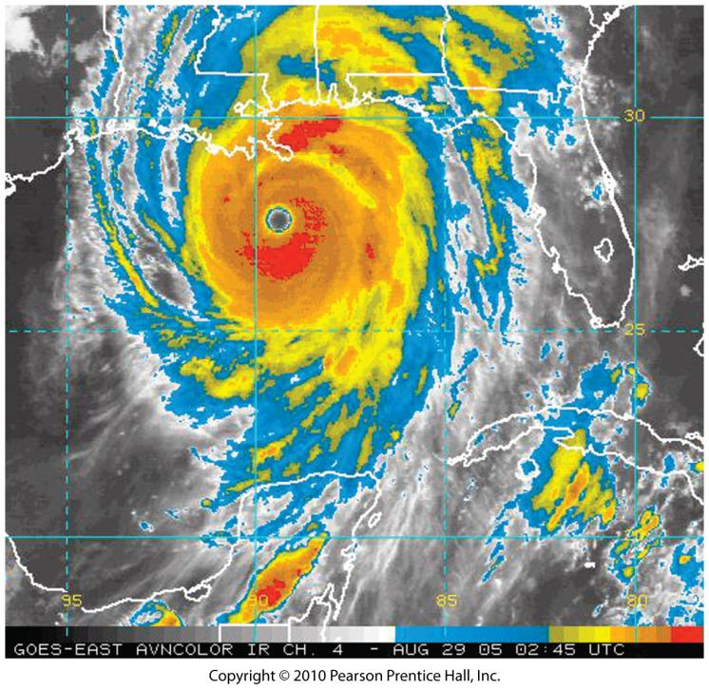
Spatially Continuous Weather/Climate Observations
Satellite
Color enhanced Infrared (IR)
Cold cloud tops of most intense storms are easily seen in this image of Katrina
GOES-East Satellite

Slide 9
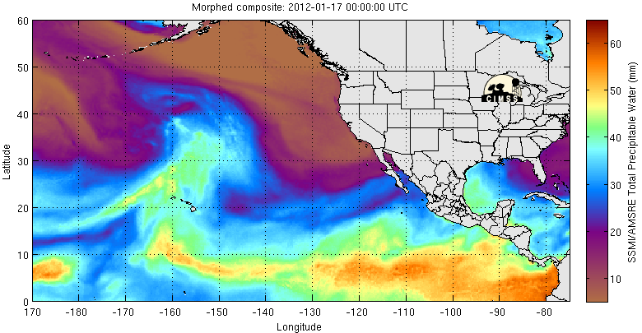
Spatially Continuous Weather/Climate Observations
Satellite
Microwave: water vapor

Slide 10
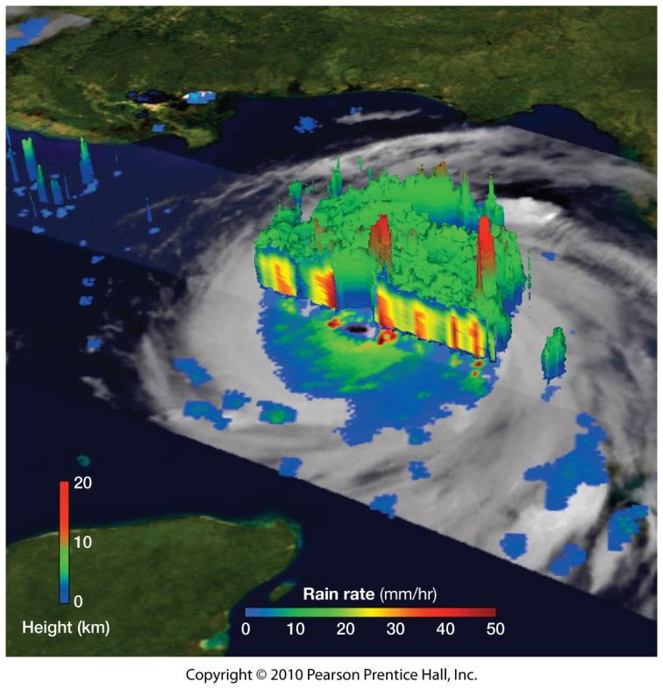
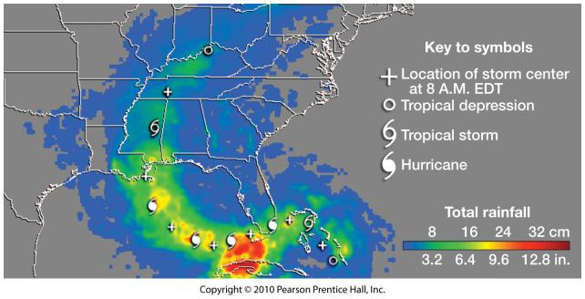
Spatially Continuous Weather/Climate Observations
Satellite
NASA Tropical Rainfall Measuring Mission (TRMM)
NASA TRMM

Slide 11
MODELS

Slide 12
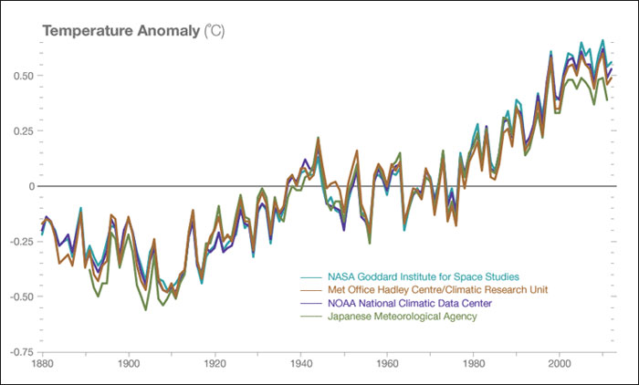
Models: Interpolated Datasets
Station interpolations for looking at trends

Slide 13
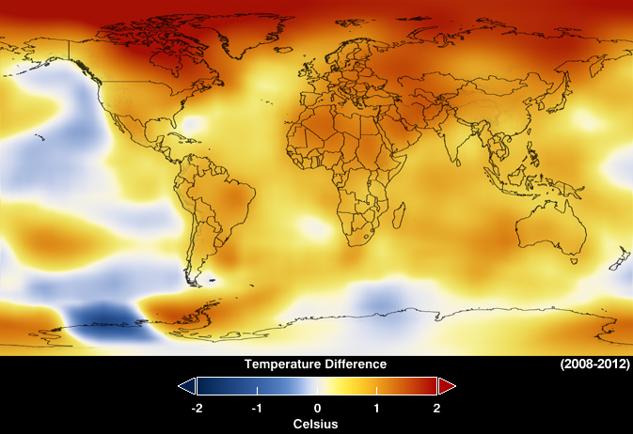
Models: Statistically Interpolated Datasets
Station interpolations for looking at trends

Slide 14
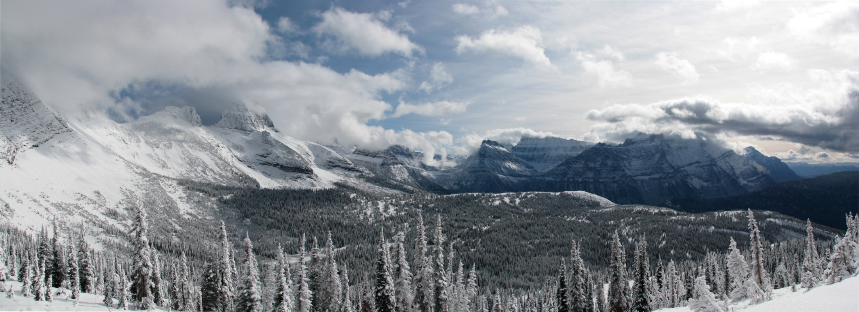
Models: Statistically Interpolated Datasets
Landscape scale interpolations
PRISM
DAYMET
wxTopo (NTSG and Montana Climate Office)
Site
I wonder what the weather is like up there?
Extrapolate
Base Station

Slide 15
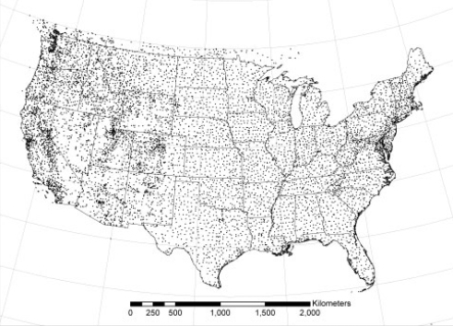
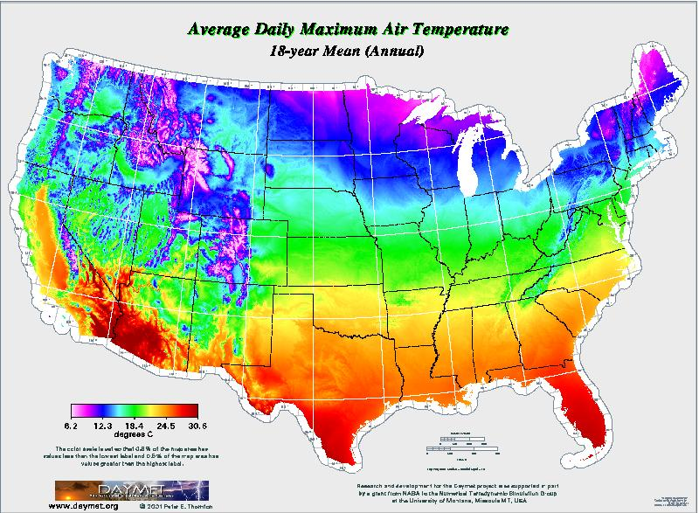
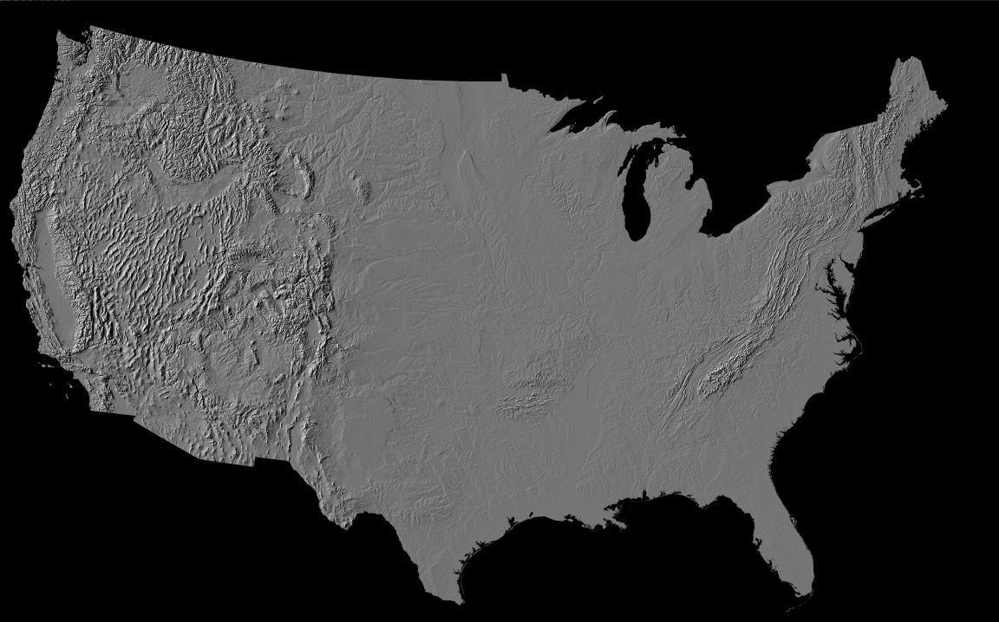
Models: Statistically Interpolated Datasets
Station Data
Basic Process: Daymet example
Digital Elevation Model

Slide 16
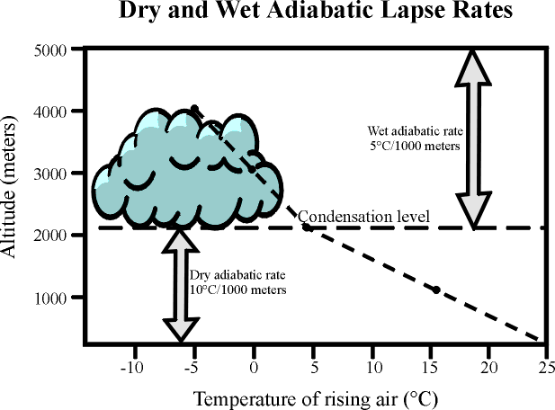
Models: Statistically Interpolated Datasets
Standard Environmental Lapse Rate
6.5°C/1000m

Slide 17
Models: Statistically Interpolated Datasets
Climate-Forcing Factors at landscape scales
Elevation
Cold Air Drainage Potential
Slope/aspect
Land cover
Water Bodies

Slide 18
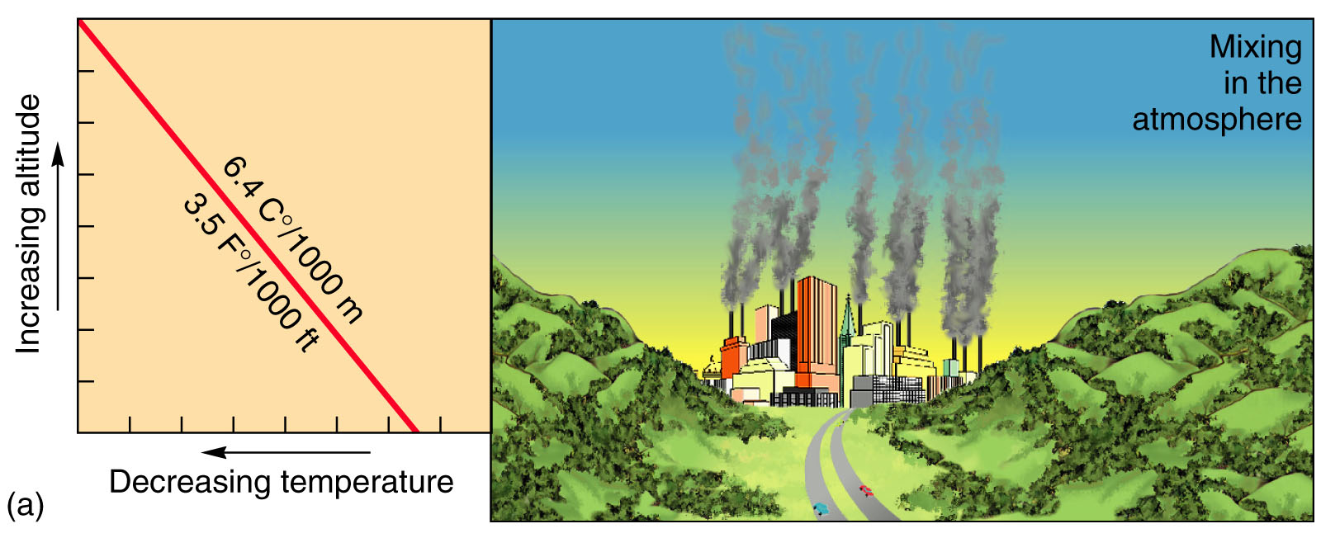
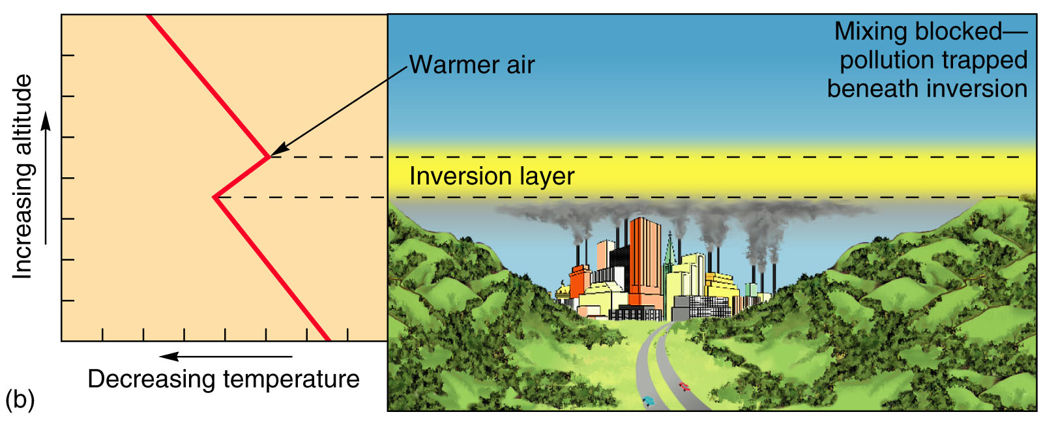
Temperate Inversions
How does an inversion form?
Radiation Inversion: on cold clear calm nights LWR can radiate from the ground quickly, escape into upper atmosphere and the air near the surface will be very cool (usually very shallow).

Slide 19
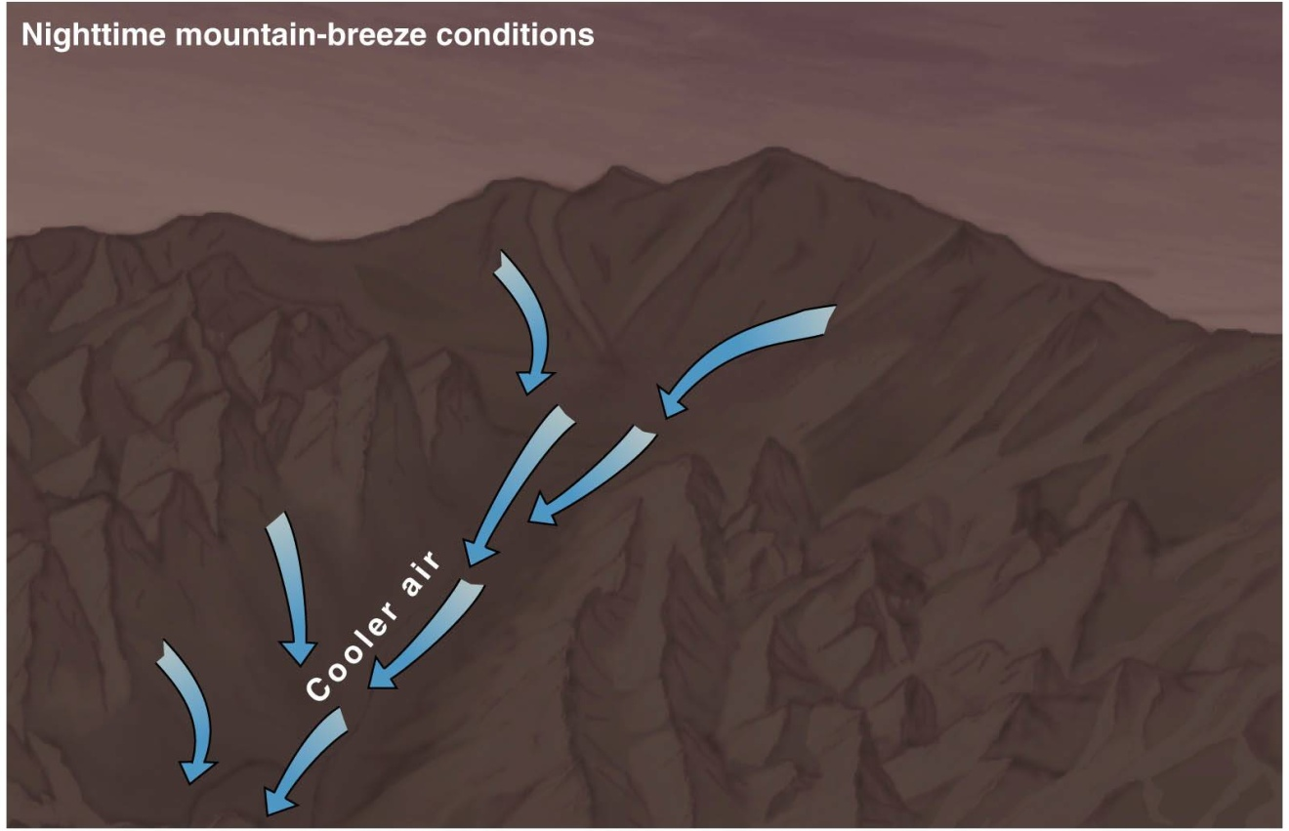
Temperature Inversions
How does an inversion form?
Cold-Air Drainage: cold air sinking into valleys can lead to inversions. Cold air is more dense than warm air. This causes the cold air to “drain” (like water) downhill!

Slide 20
Thermal Belts

Slide 21
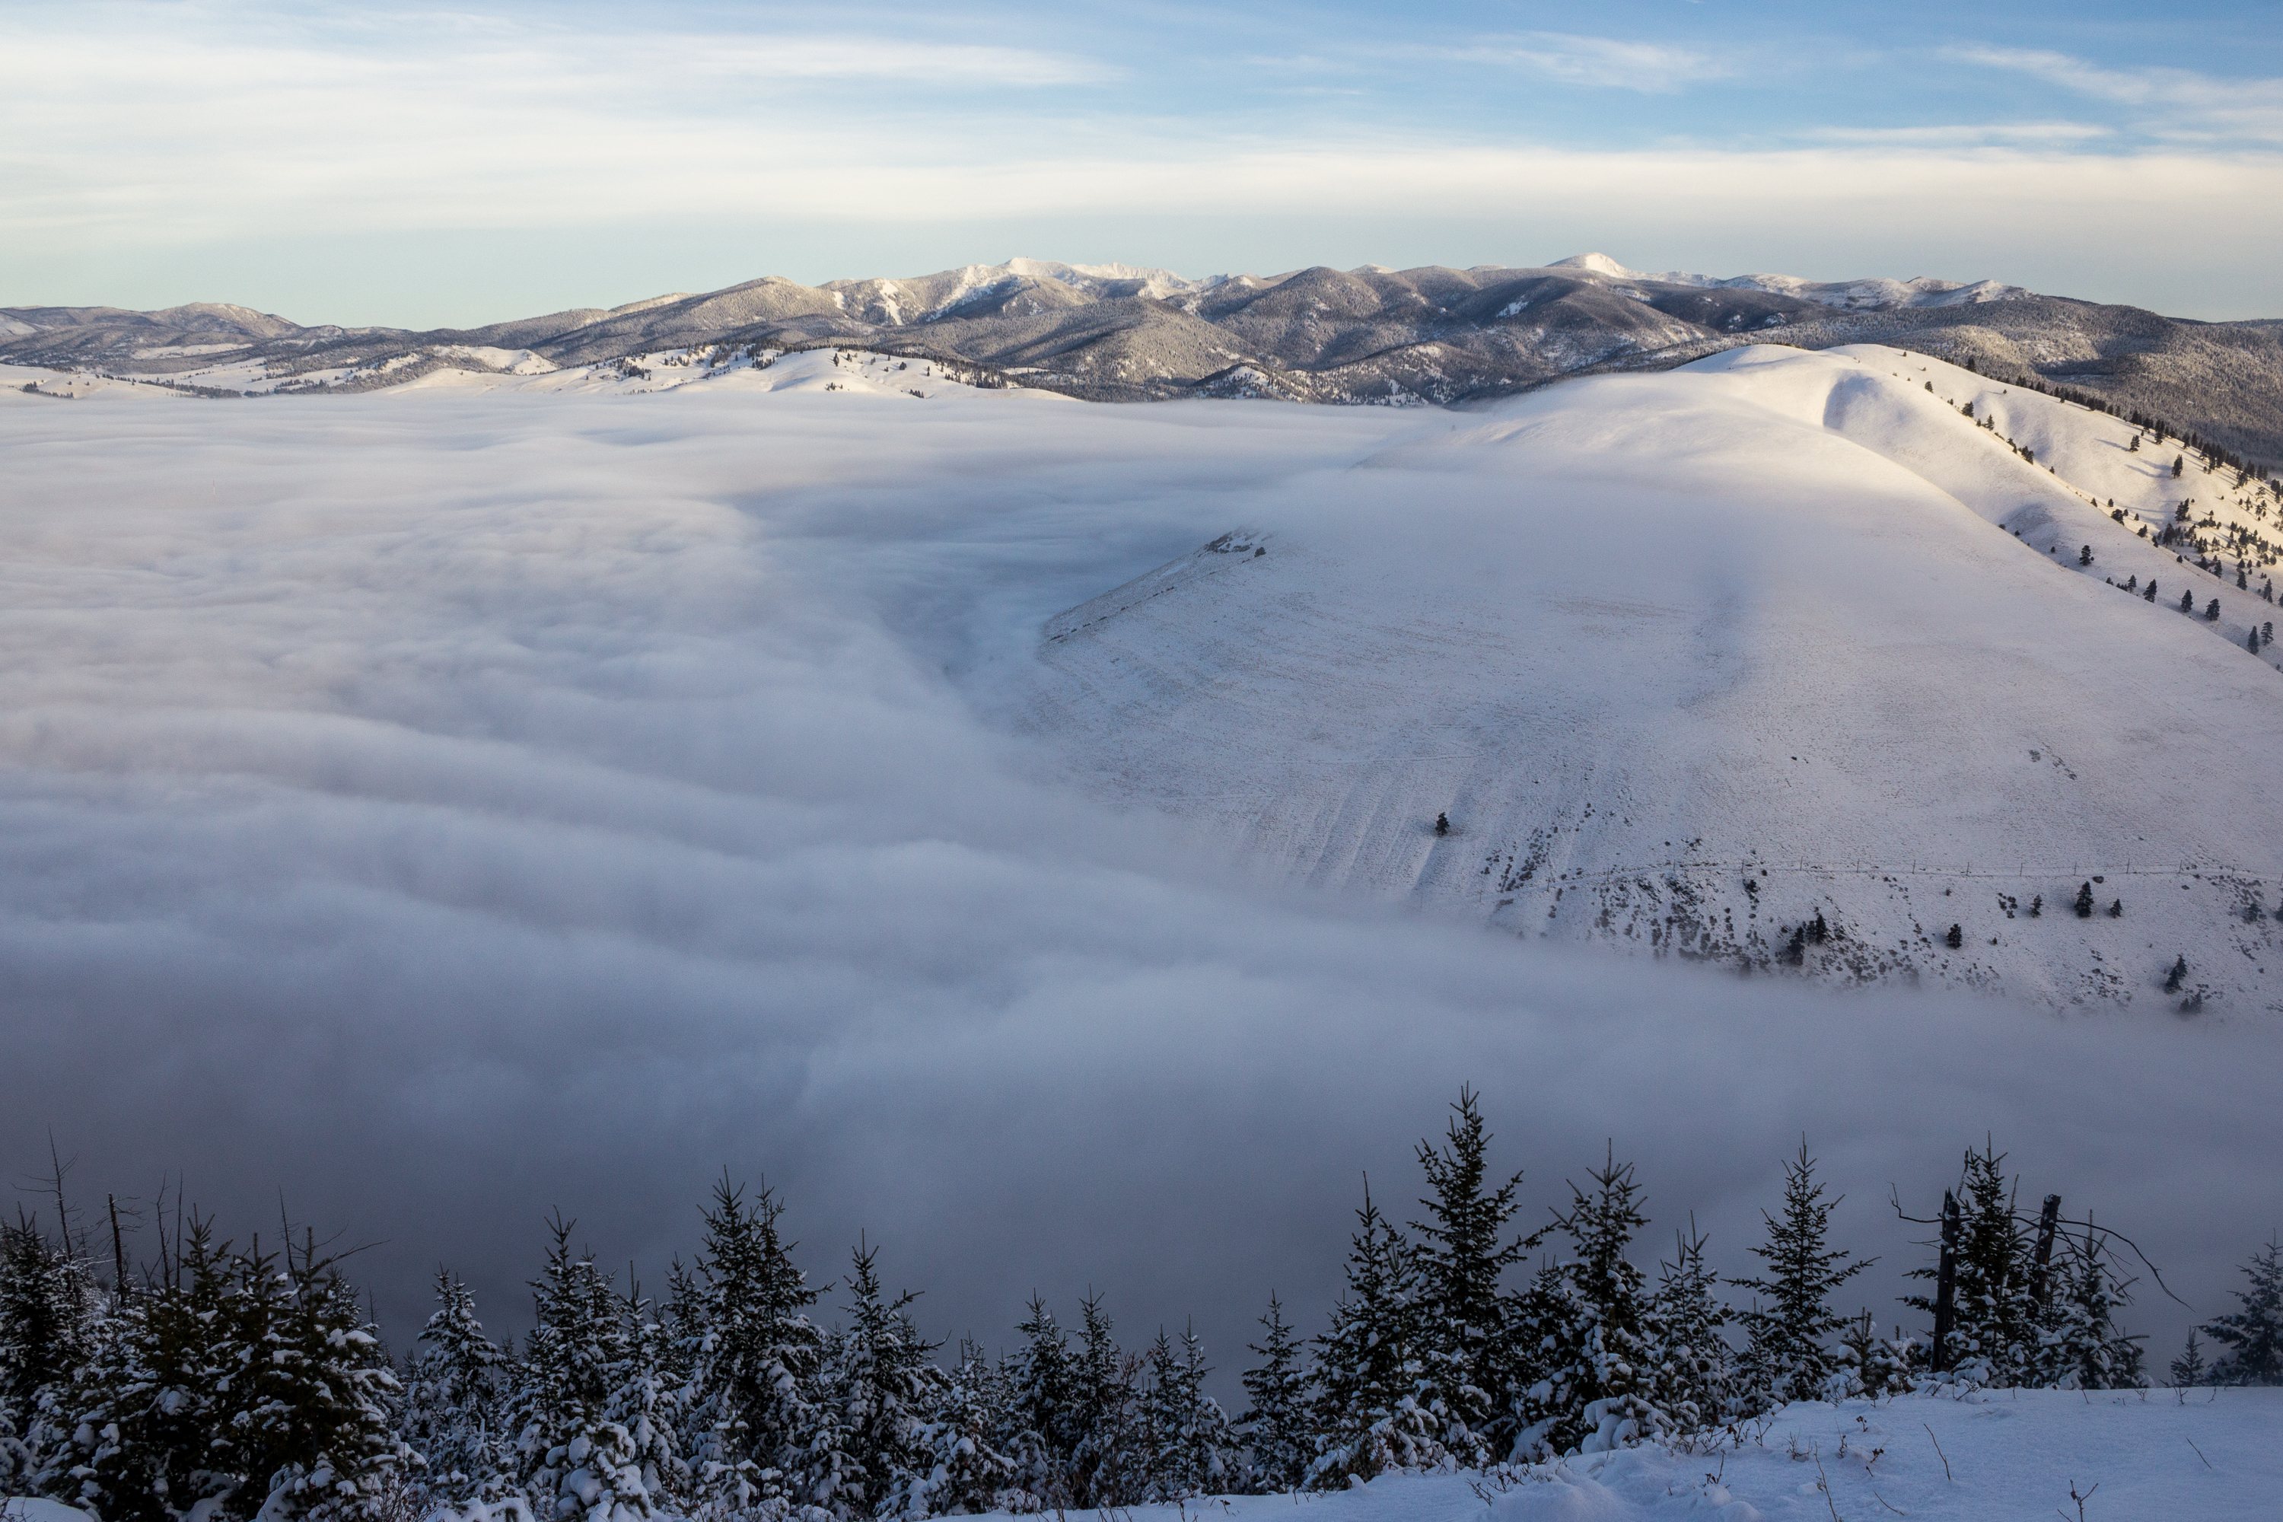

Slide 22
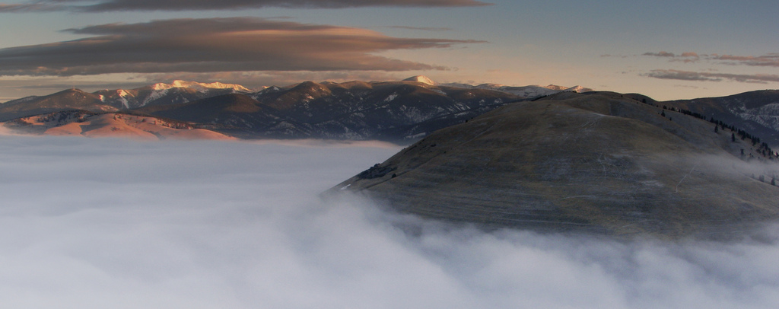
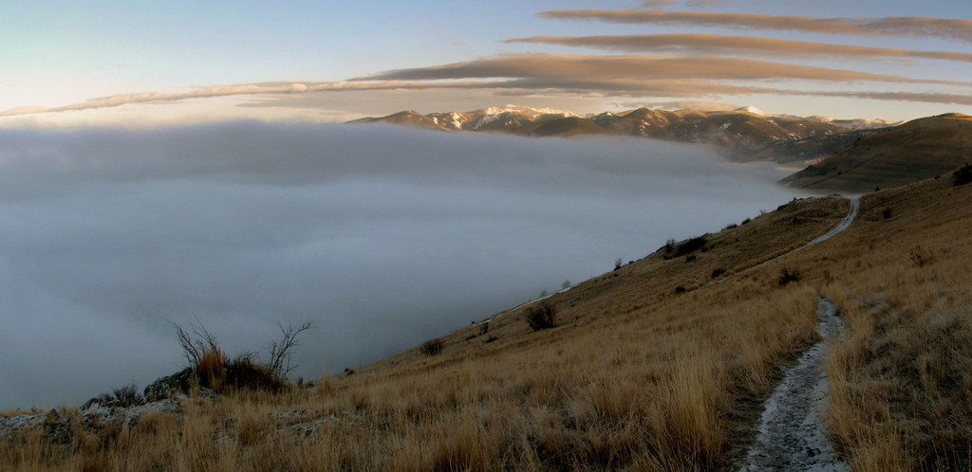

Slide 23
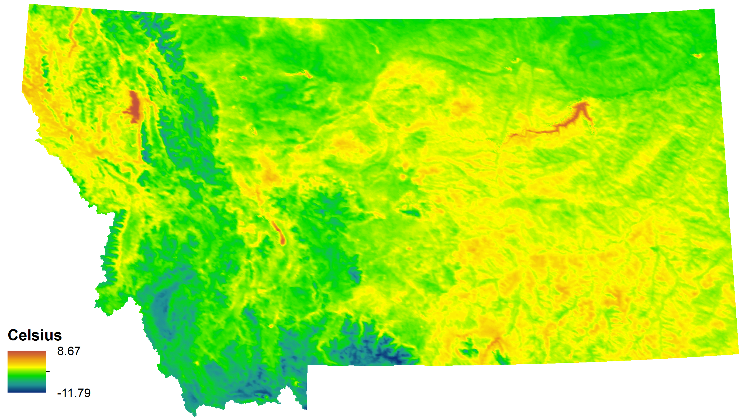
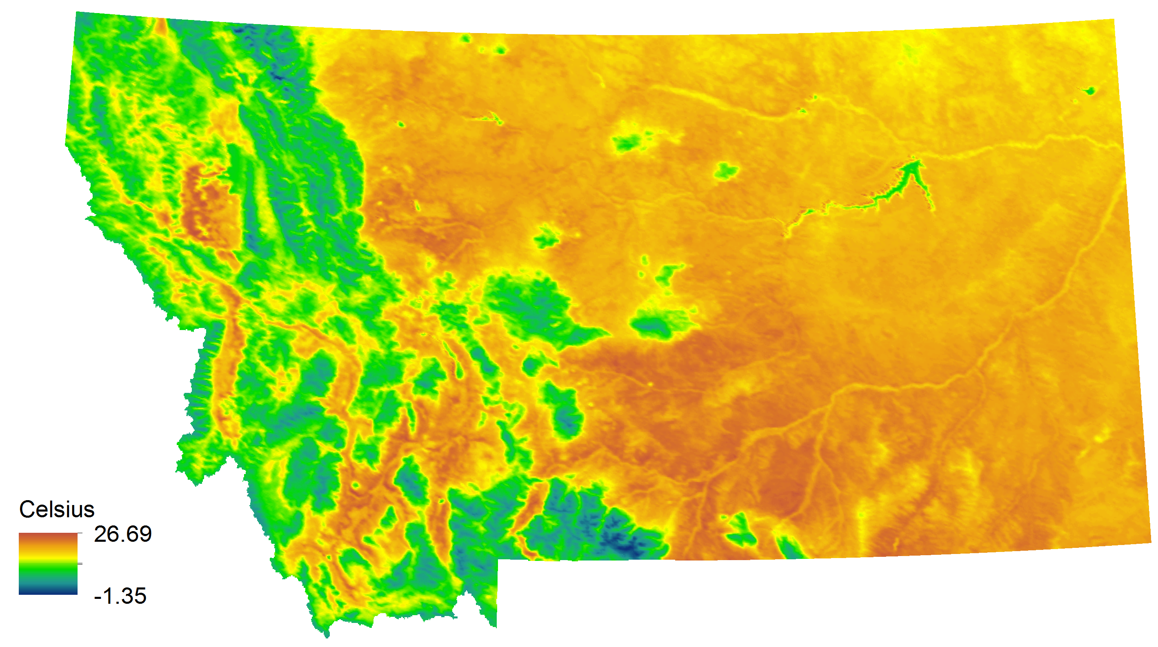
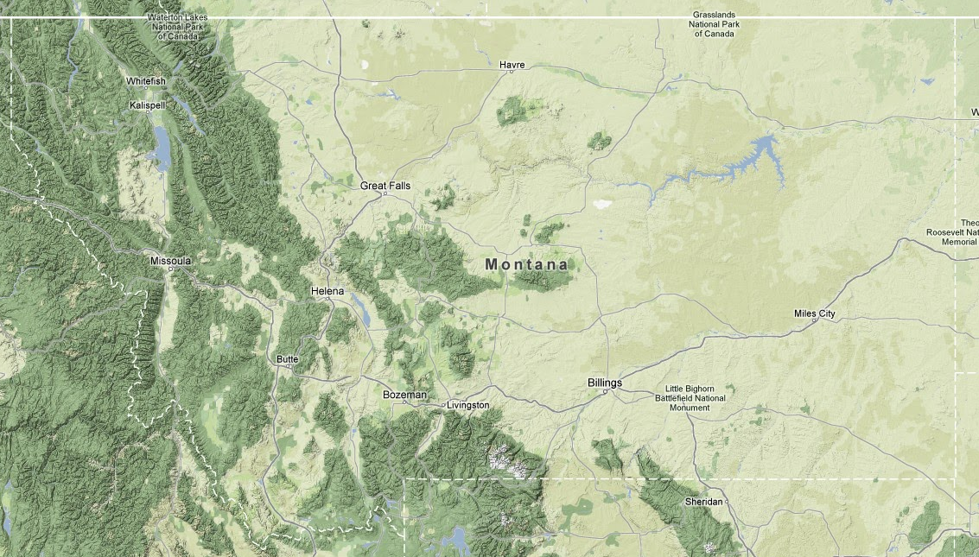
2002-2012 Avg. Land “Skin” Temperature
Tmin
Tmax

Slide 24
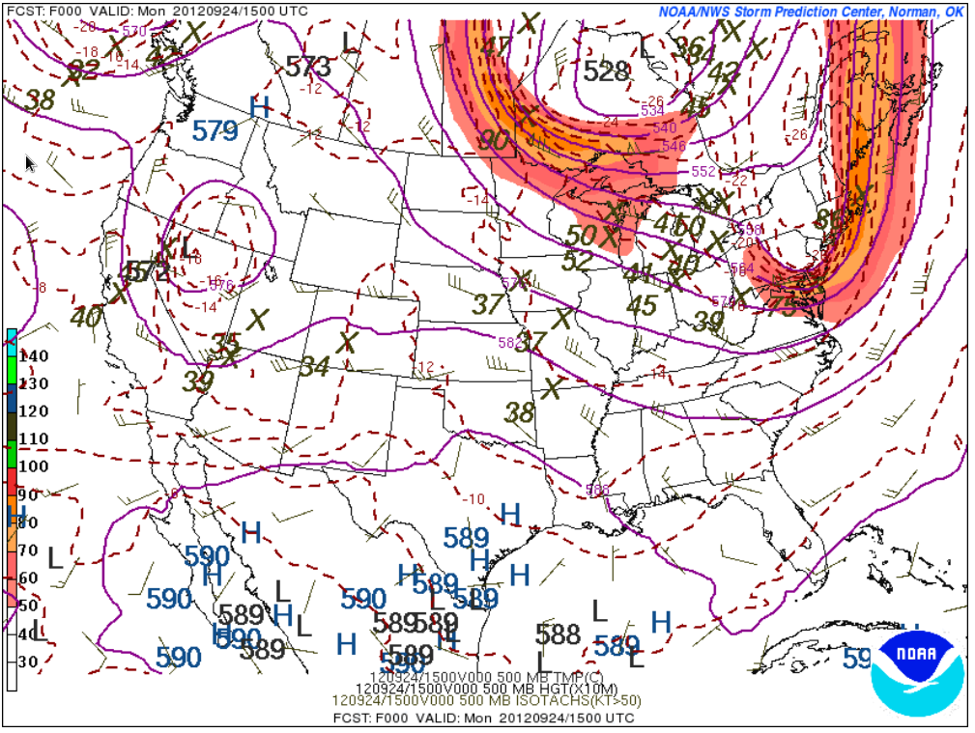
Process-Based Models
Numerical Weather Prediction Models
Used to provide typical weather forecasts Medium-Range (~ 7 days out)
Global Forecast System (GFS)
ECMWF Integrated Forecast System (IFS)
Canadian Global Environmental Multiscale Model (GEM)
Short-Range (~3 days)
North American Mesoscale Model (NAM)

Slide 26
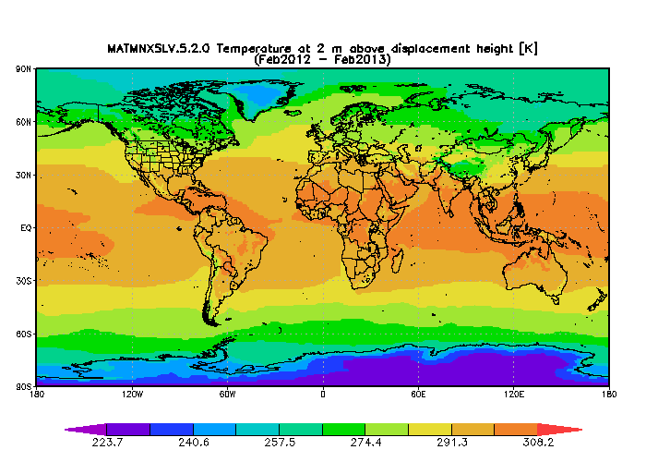
Reanalysis Data
Reanalysis Datasets: combine assimilation of past observations and a numerical weather prediction model to produce an historical 3-D spatial dataset
Synoptic/mesoscale
http://reanalyses.org/

Slide 27
GCMs
Global Circulation Model (GCM): physically-based complex mathematical representations of the planet’s atmosphere, ocean, atmosphere, land, and ice
Modern GCMs have fully coupled atmosphere and ocean components and are referred to as atmosphere-ocean general circulation models (AOGCMs).
First AOGCM was produced in the 1970s at the NOAA Geophysical Laboratory in Princeton, NJ while the development of atmosphere models first evolved in the 1960s from weather prediction models.
Numerically integrating physical, chemical, and biological principles and equations into a 3-dimensional grid, GCMs can be used to simulate the planet’s past, present, and future climate
Next generation models are moving into the realm of full Earth System Models

Slide 28
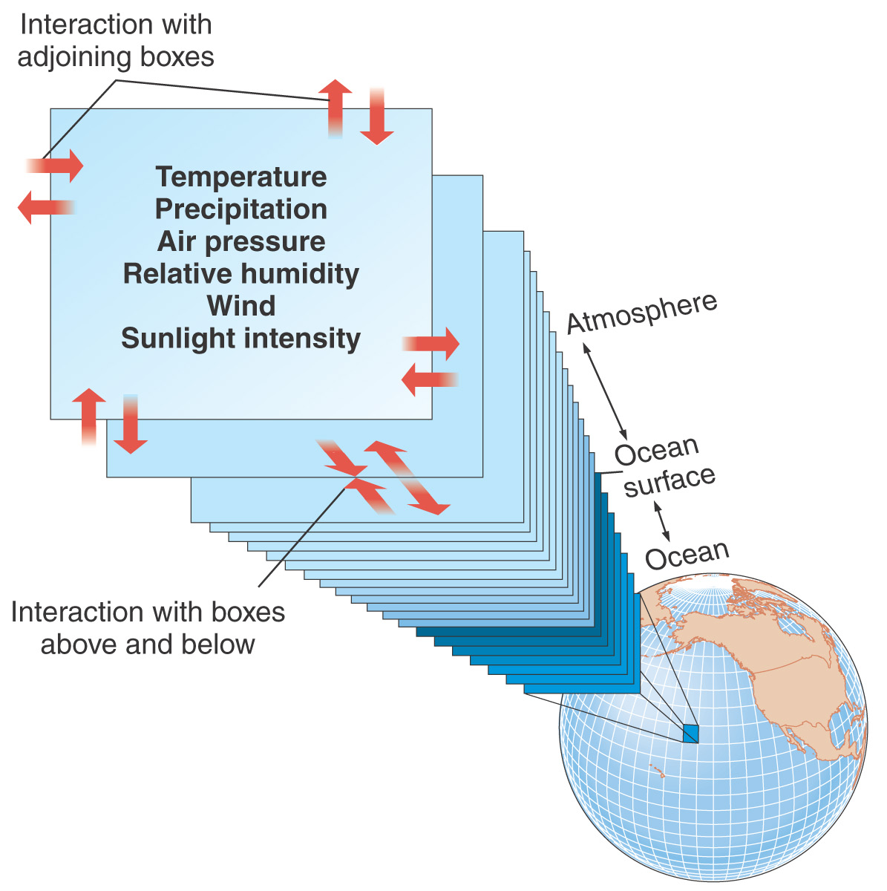
Global Circulation Models

Slide 29
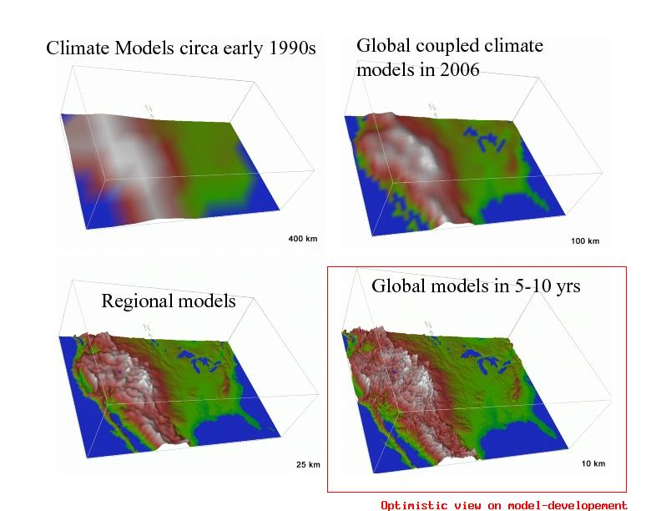
Global Circulation Models
GCMs tend to have relatively coarse resolution (100+ km)
Limitation: they can’t represent local climate very well, especially in complex terrain
Horizontal Resolution (i.e.– grid box size)

Slide 30
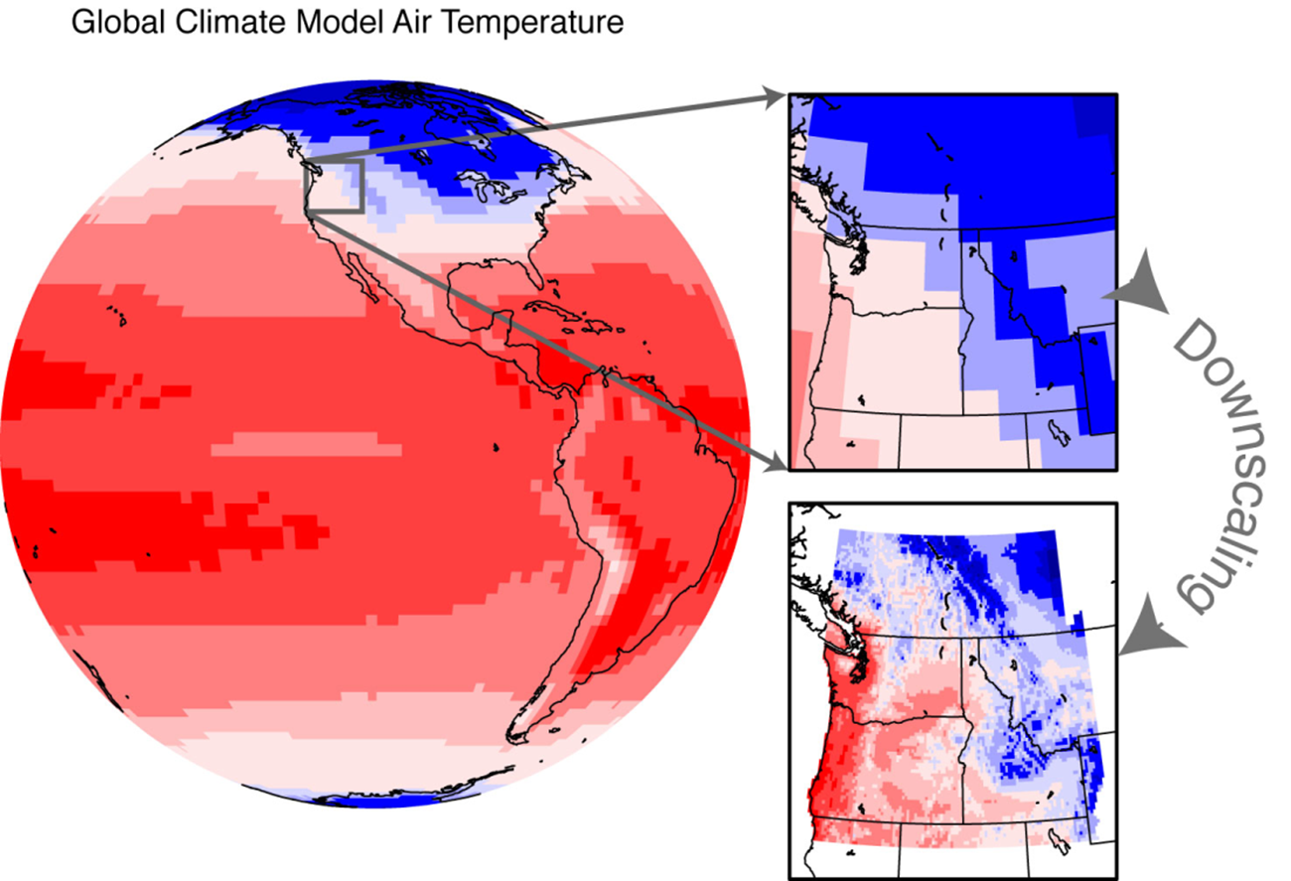
Global Circulation Models
Downscaling: refining coarse GCM data to a finer resolution for regional and local climate impact assessments
Dynamic Downscaling
Statistical Downscaling

Slide 31
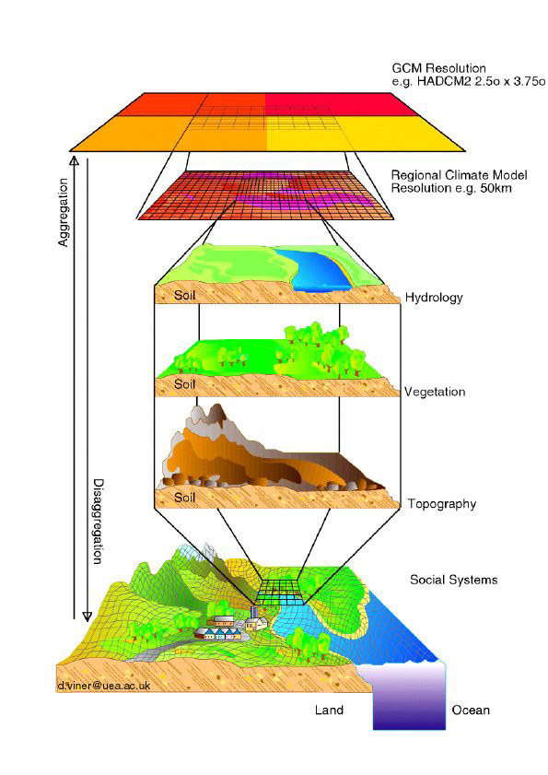
Dynamic Downscaling
Nest a regional climate model within a GCM
The GCM forms the boundary conditions for the regional model
Advantages:
Physically consistent—based on fundamental physical principles
Disadvantages:
Passes along biases of GCM
Computationally intensive

Slide 32
Statistical Downscaling
Downscale via empirical statistical relationships
Example: develop relationship between local variables (temperature, precipitation) and synoptic model output variables (pressure heights, temperature, humidity, winds, etc.)

Slide 33
Statistical Downscaling
Advantages:
Fast
Can develop whole ensemble of projections
Disadvantages
Assumes statistical relationships are constant in time
Heavily dependent on predictor variables used

Slide 34
Readings
Deser, C., Knutti, R., Solomon, S. & Phillips, A. S. Communication of the role of natural variability in future North American climate. Nature Climate Change 2, 775–780 (2012).
Wiens, J. A. & Bachelet, D. Matching the Multiple Scales of Conservation with the Multiple Scales of Climate Change. Conservation Biology 24, 51–62 (2010).
Further optional reading
Pederson, G. T., Graumlich, L. J., Fagre, D. B., Kipfer, T. & Muhlfeld, C. C. A century of climate and ecosystem change in Western Montana: what do temperature trends portend? Climatic Change 98, 133–154 (2010).
Dobrowski, S. Z. A climatic basis for microrefugia: the influence of terrain on climate. Global Change Biology (2010).
Glick, P., B.A. Stein, and N.A. Edelson, editors. (2011). Scanning the Conservation Horizon: A Guide to Climate Change Vulnerability Assessment. National Wildlife Federation, Washington, D.C.

