Slide 1
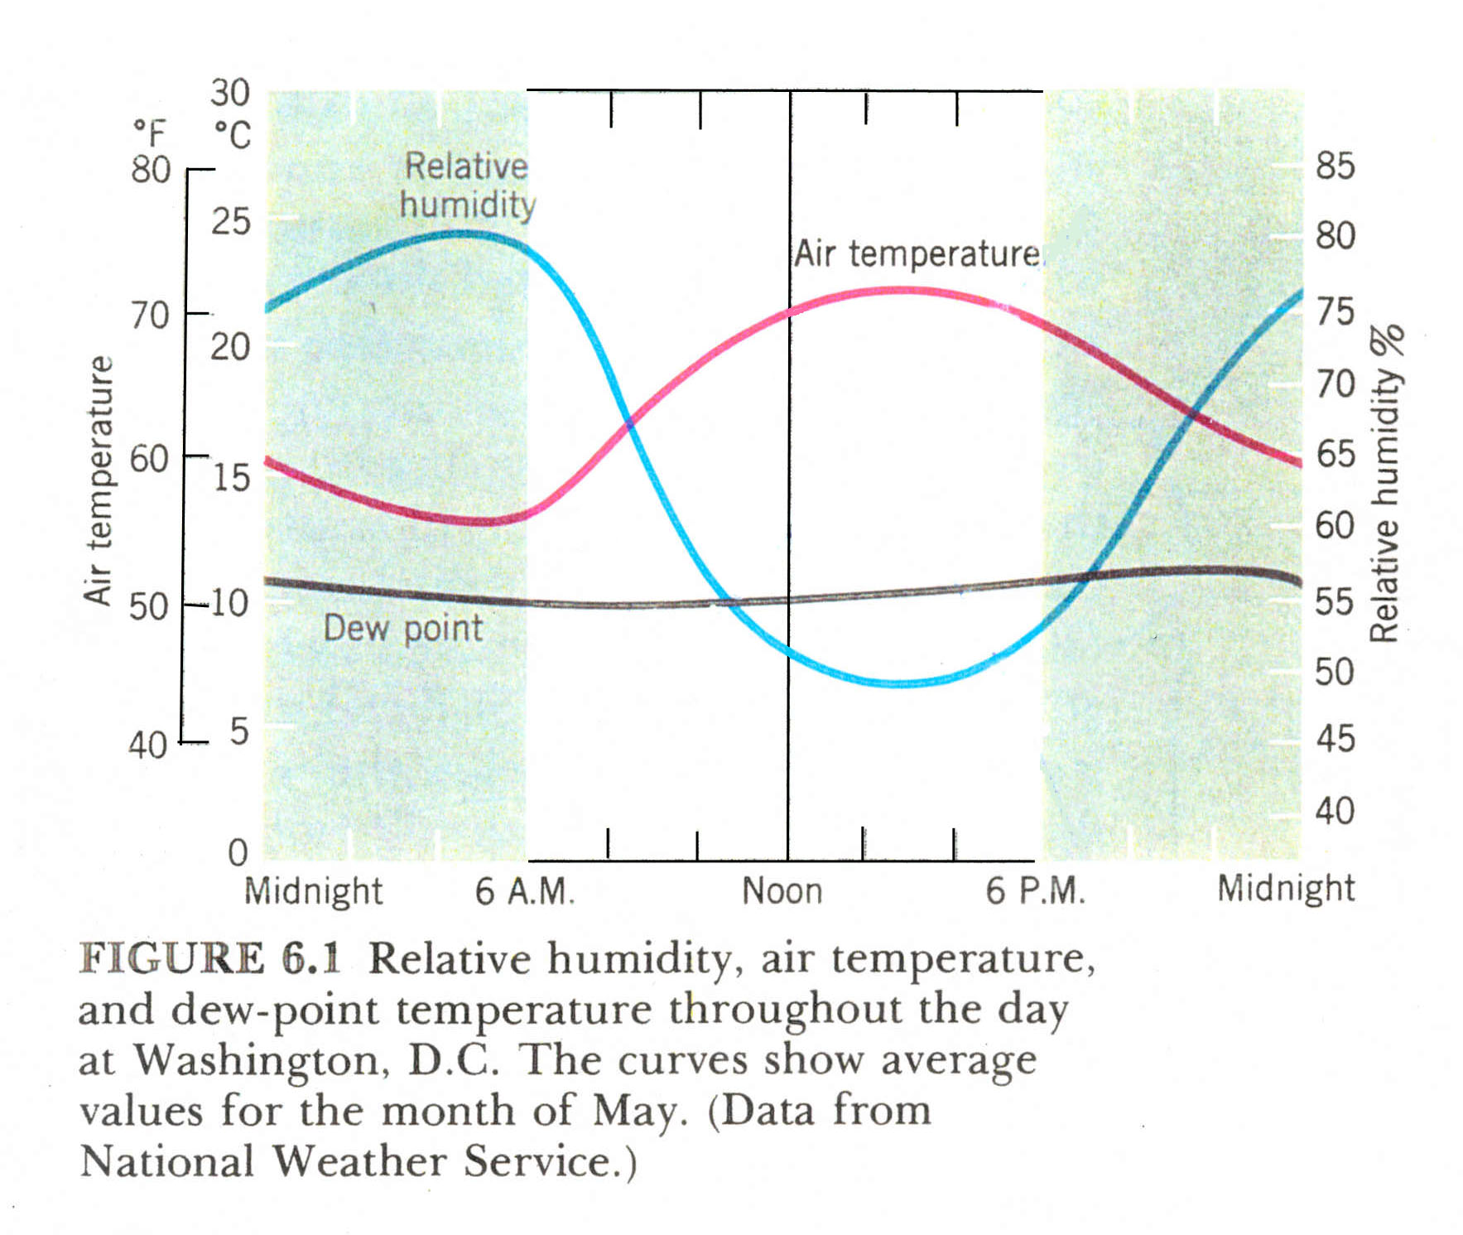

Slide 2
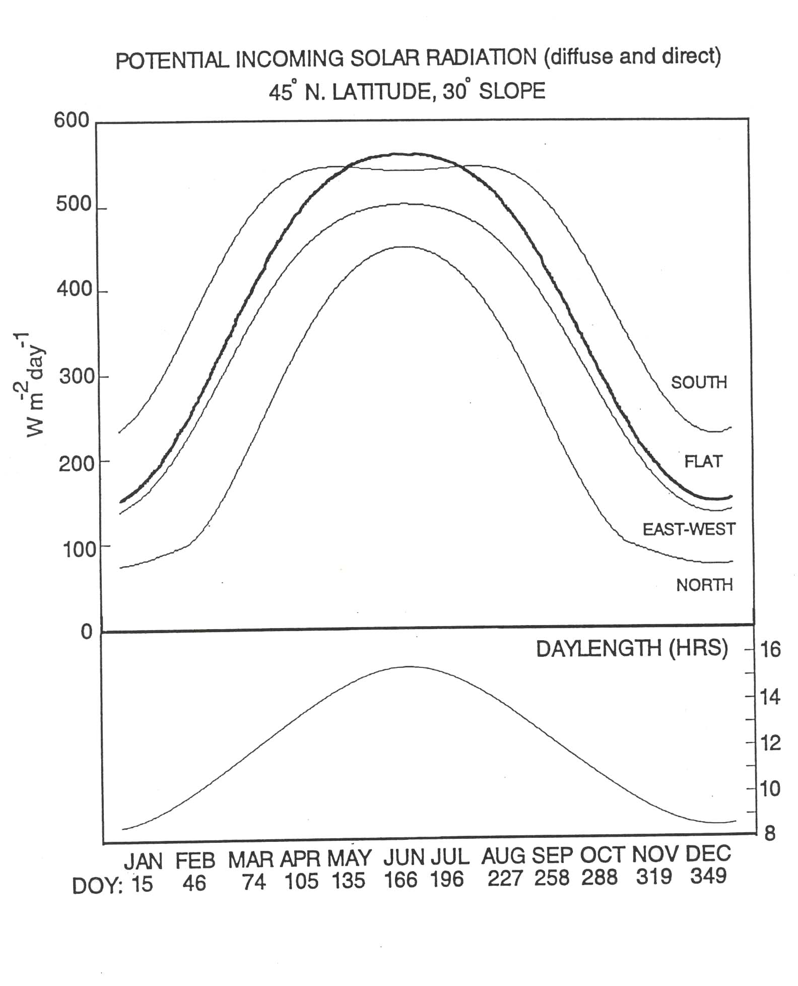

Slide 3
Daylength

Slide 4
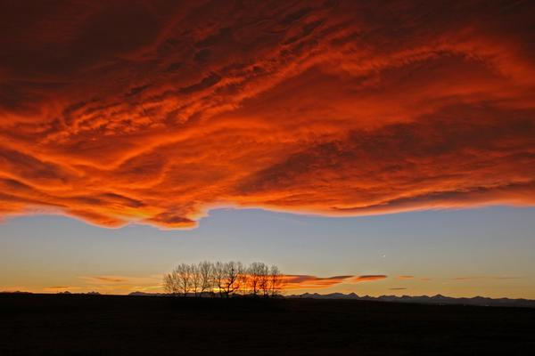
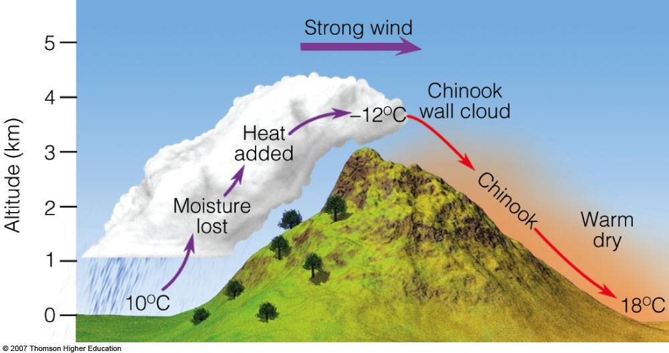
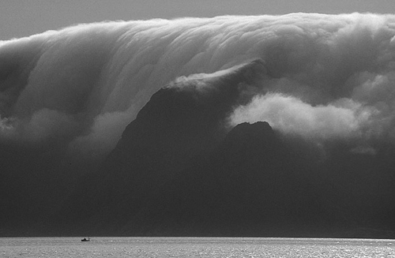
Local Mesoscale Winds
Chinook Winds (Foehn)
Loma, MT: January 15, 1972, the temperature rose from -54 to 49°F (-48 to 9°C),
a 103°F (58°C) change in temperature

Slide 5
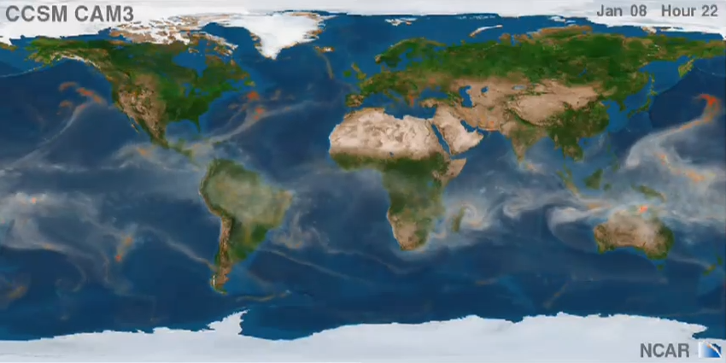
Global Circulation Animation from a GCM

Slide 6
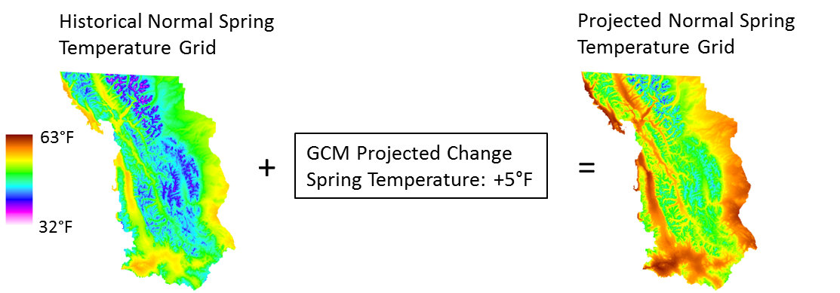
GCM Downscaling
Simplest statistical approach: the delta method
Simply add on projected changes to high resolution climate grid

Slide 7
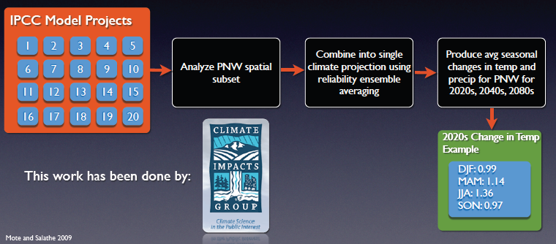
GCM Downscaling
Delta Method Step 1
Synthesize the regional GCM model projections for the region

Slide 8
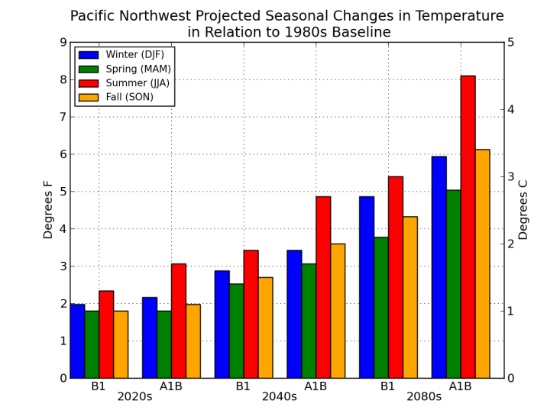
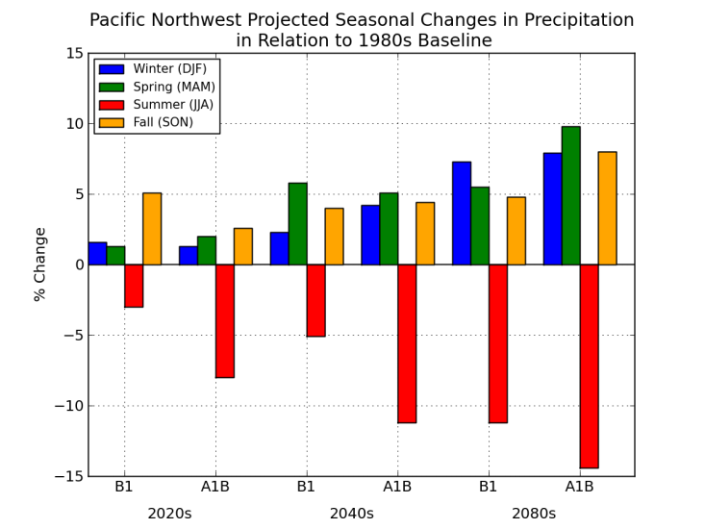
GCM Downscaling

Slide 9
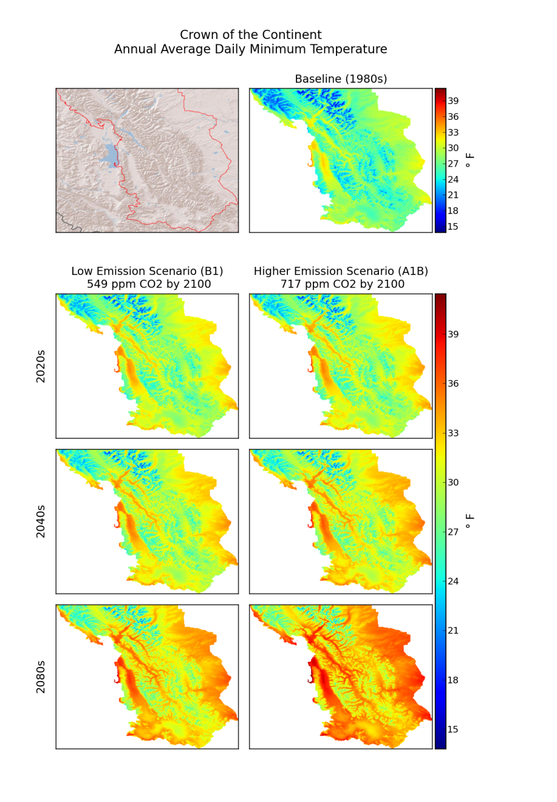
GCM Downscaling
Delta Method Step 2
Perturb fine-scale historical observations with the projected seasonal/decadal regional changes to produce climate change scenarios
Provides climate data sequences that preserve the historically observed fine-scale spatial/temporal variability but are modified for a climate change scenario

Slide 10
GCM Downscaling
Delta Method Advantages
  Quick and easy
  Easy comparison to historical conditions
Delta Method Disadvantages
  Does not account for changes in variability or extremes
  Assumes entire landscape will change by the same amount
  High resolution != realism

Slide 11
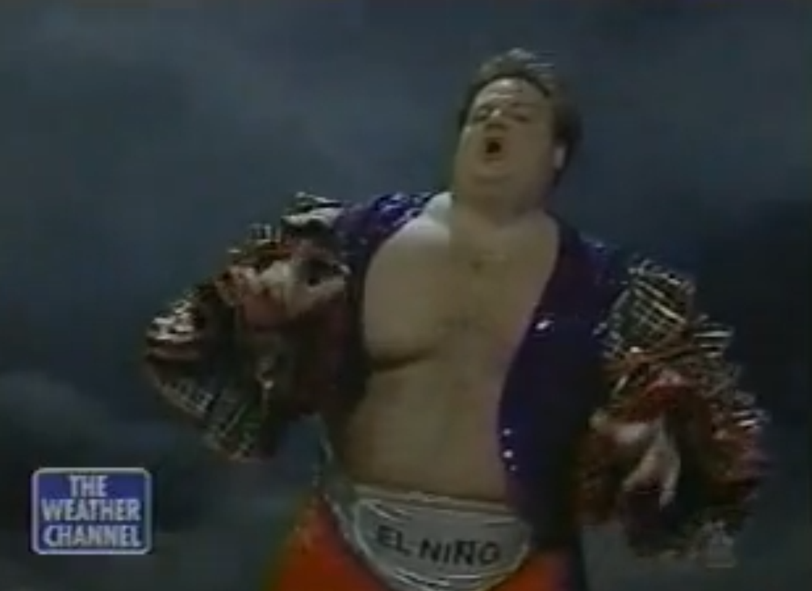
El Niño-Southern Oscillation (ENSO)

Slide 12
El Niño-Southern Oscillation (ENSO)
A system of interactions between the tropical Pacific Ocean and the atmosphere above it
  El Niño: warm phase
  La Niña: cold phase
Interval of El Niño occurrence is 3 – 5 years but can be anywhere from 2 – 12 years
Produces the greatest interannual variability of temperature and precipitation on a global scale

Slide 13
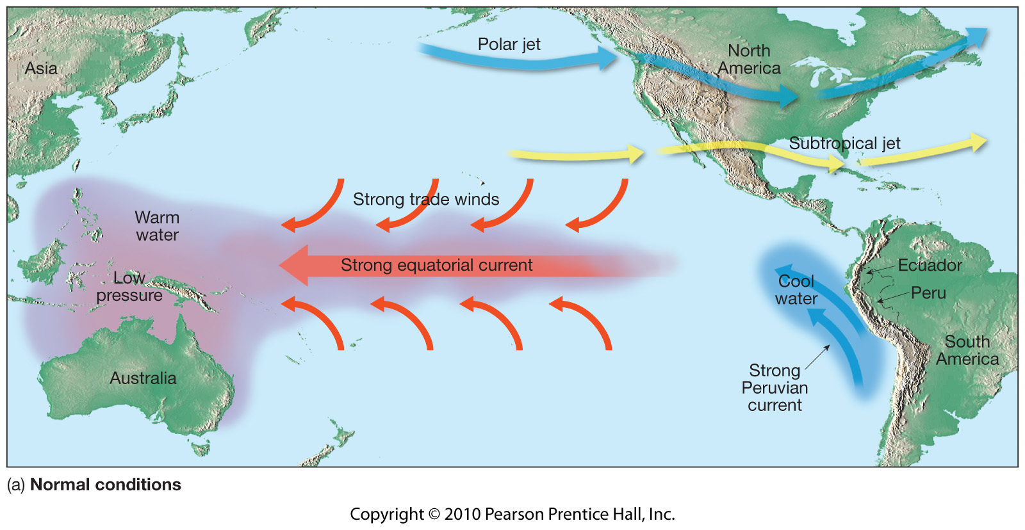
ENSO
“Normal” tropical Pacific conditions
Notes:
The strength and location of the jet streams over both the North and South Pacific. This influence on the jet streams tends to be most pronounced during the respective hemisphere's winter season, when both the location and eastward extent of the jets (to just east of the date line) exhibit a strong relationship to the pattern of tropical heating. These jet streams are then a major factor controlling the winter weather patterns and storm tracks in the middle latitudes over both North and South America.
For both El Niño and La Niña the tropical rainfall, wind, and air pressure patterns over the equatorial Pacific Ocean are most strongly linked to the underlying sea-surface temperatures, and vice versa, during December-April. During this period the El Niño and La Niña conditions are typically strongest, and have the strongest impacts on U.S. weather patterns.
El Nino and La Niña episodes typically last approximately 9-12 months. They often begin to form during June-August, reach peak strength during December-April, and then decay during May-July of the next year. However, some prolonged episodes have lasted 2 years and even as long as 3-4 years. While their periodicity can be quite irregular, El Niño and La Niña occurs every 3-5 years on average.

Slide 14
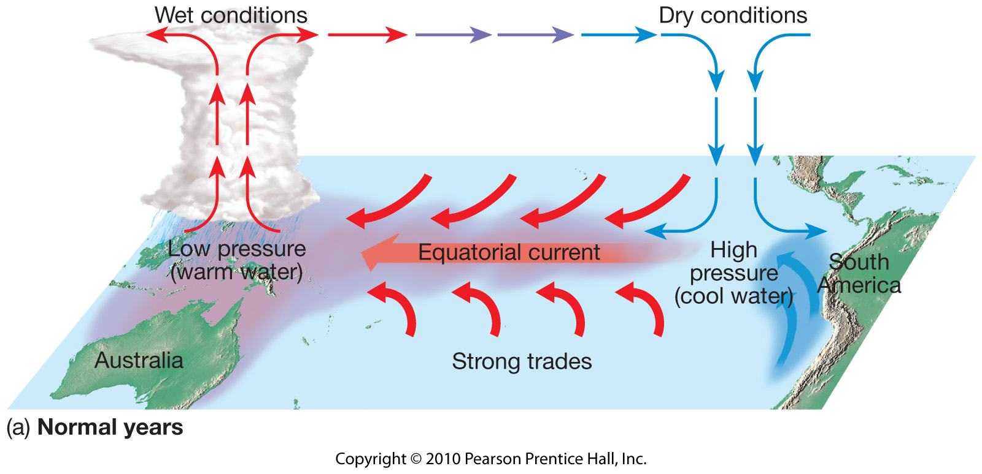
ENSO
“Normal” tropical Pacific conditions

Slide 15
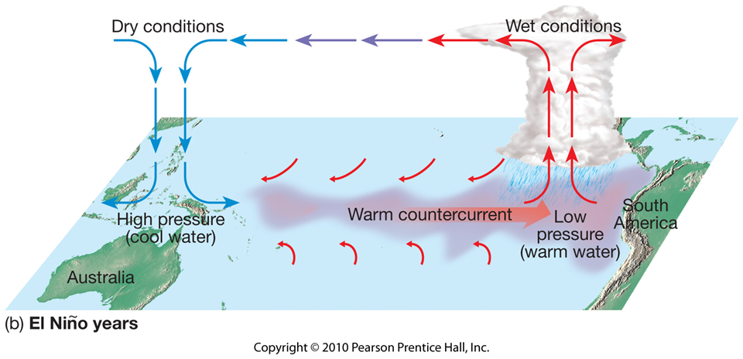
ENSO
El Niño Conditions

Slide 16
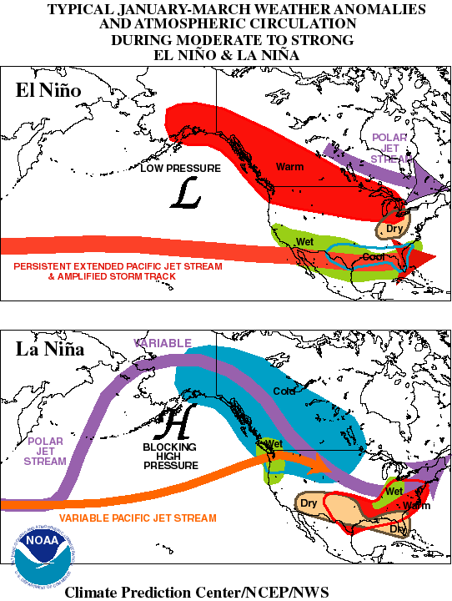
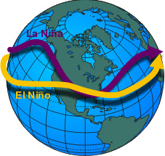
El Niño/
La Niña
Impacts
Shift in jet streams

Slide 17
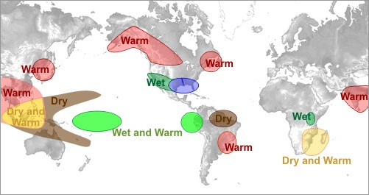
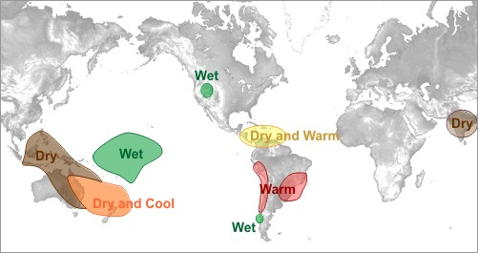
El Niño Impacts
El Niño effect during December through February
El Niño effect during June through August
http://www.srh.noaa.gov/jetstream/tropics/enso_impacts.htm

Slide 18
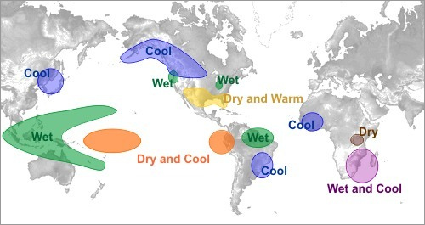
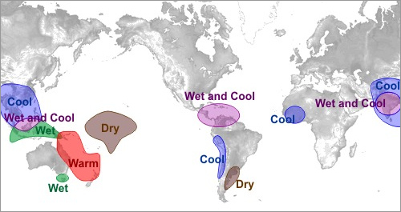
La Niña Impacts
La Niña effect during December through February
La Niña effect during June through August

Slide 19
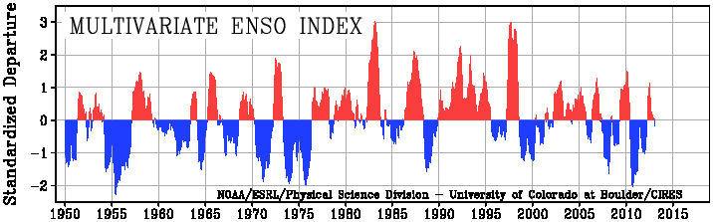
ENSO
Multivariate ENSO Index
Outlook
Currently in ENSO-neutral conditions
Enso-neutral is favored into summer 2013
http://www.cpc.ncep.noaa.gov/products/analysis_monitoring/enso_advisory/
http://www.bom.gov.au/climate/enso/

