Slide 1
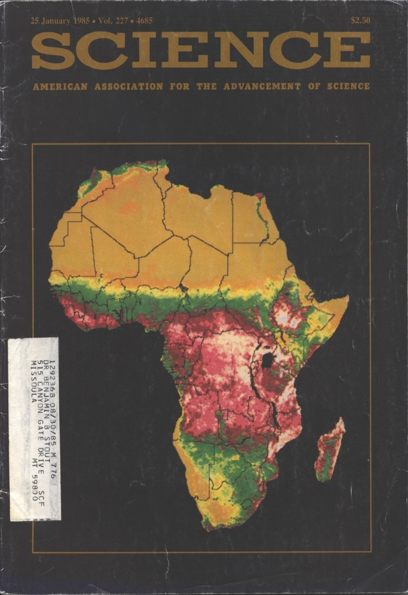
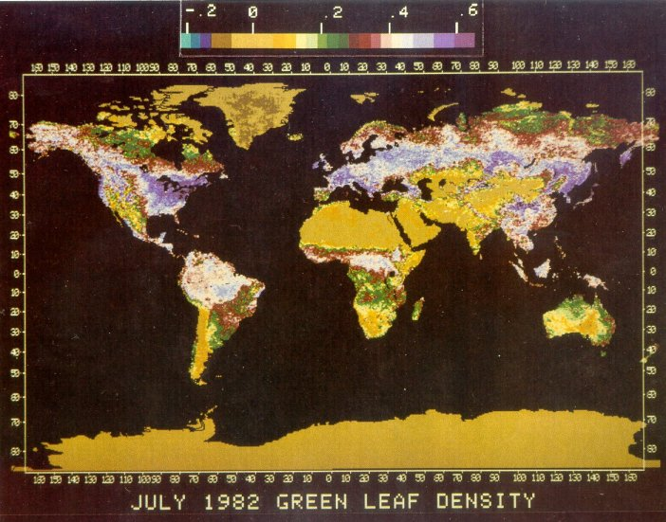
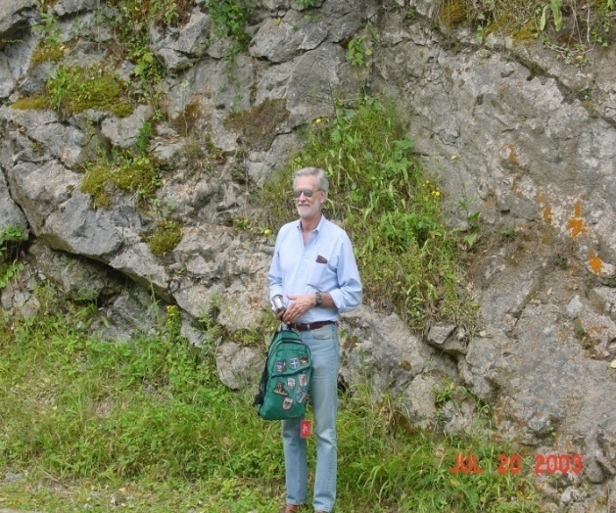
Remote Sensing Vegetation Indices
NRSM532 Systems Ecology

Slide 2
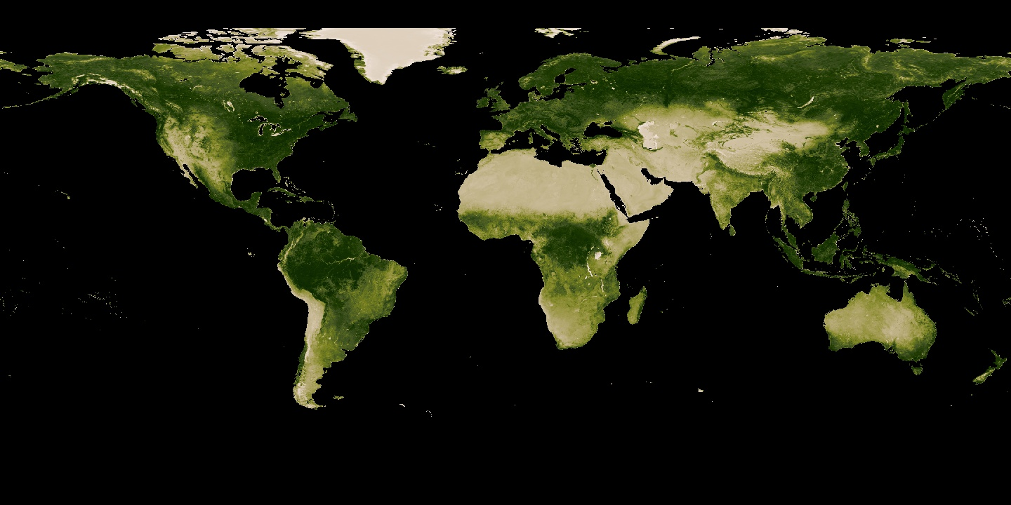
Vegetation Indices
Radiometric measures of the amount, structure, and condition of vegetation
Precise monitoring tool
  phenology
  inter-annual variations
  change detection (anthropogenic/climate)
Serve as intermediaries in the assessment of various biophysical parameters
  green cover
  biomass
  leaf area index (LAI)
  fAPAR (fraction of absorbed photosynthetically active radation)
  vegetation water content
NDVI July 2014

Slide 3
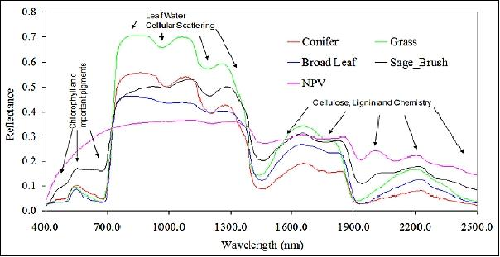
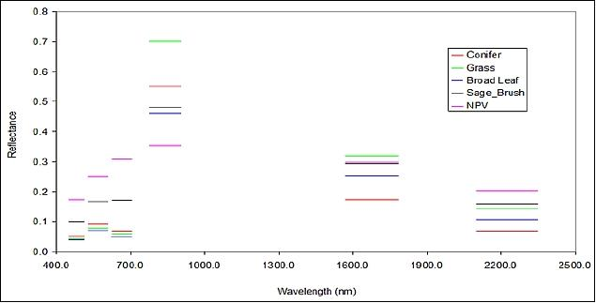
Vegetation Spectral Properties
VIs are often derived from band ratios (e.g. NDVI)
Based on vegetation spectral properties
AVIRIS Hyperspectral
MODIS Multispectral

Slide 4
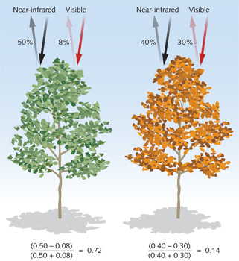
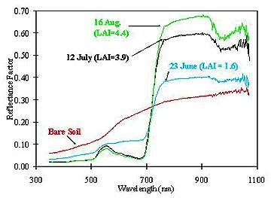
Normalized Difference Vegetation Index
The NDVI is a normalized ratio of the NIR and red bands.

Slide 5
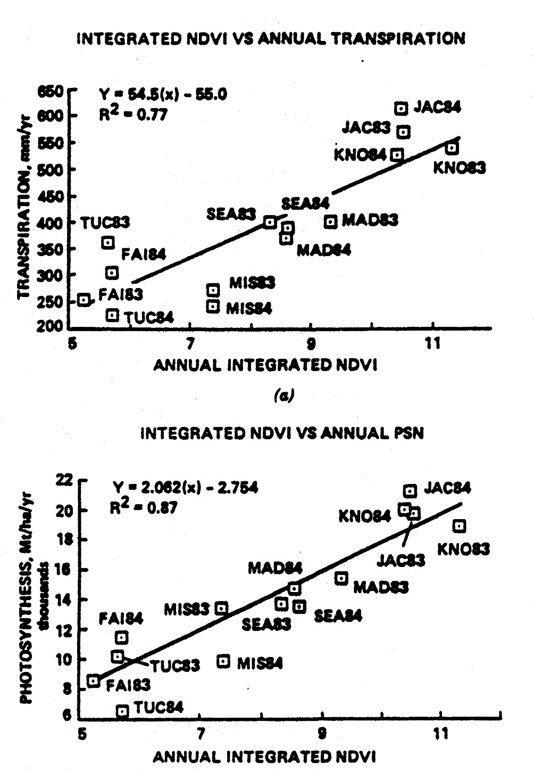
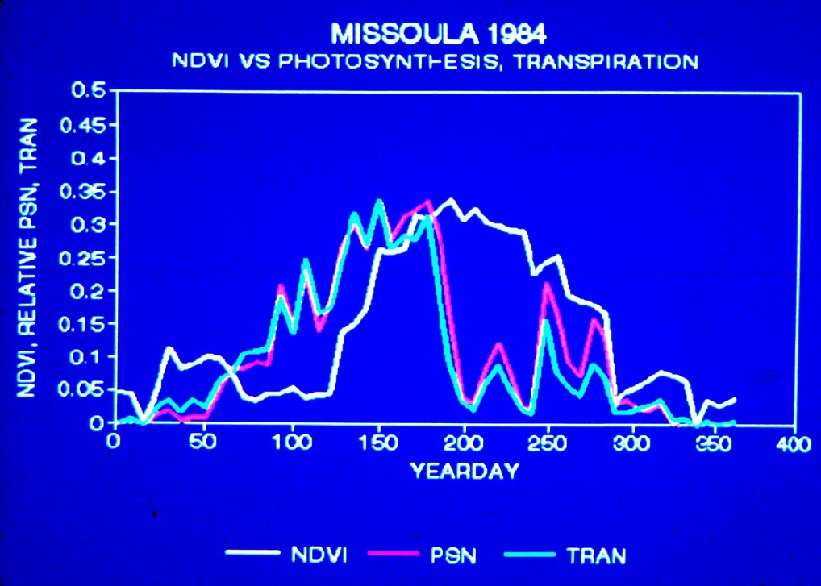

NDVI and Canopy Properties

Slide 6
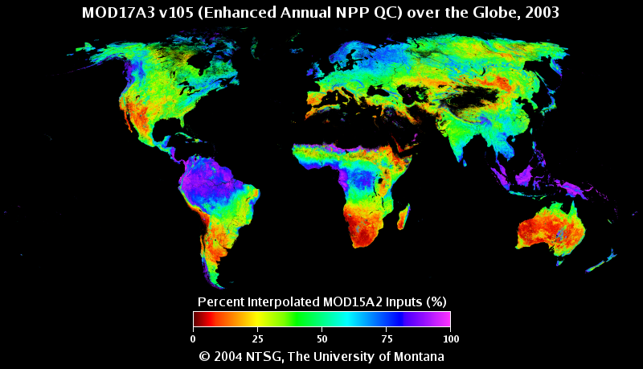
Optical/IR Remote Sensing – Clouds & Aerosols
Percent Cloud Cover

Slide 7
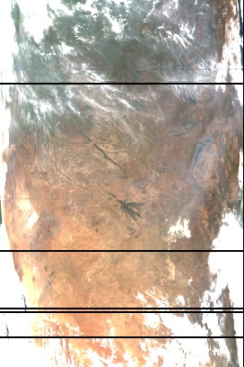
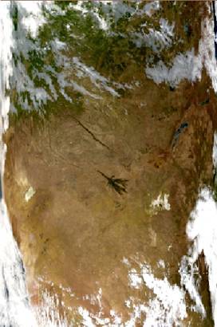
Optical/IR Remote Sensing – Clouds & Aerosols
Aerosol Correction
No Correction

Slide 8
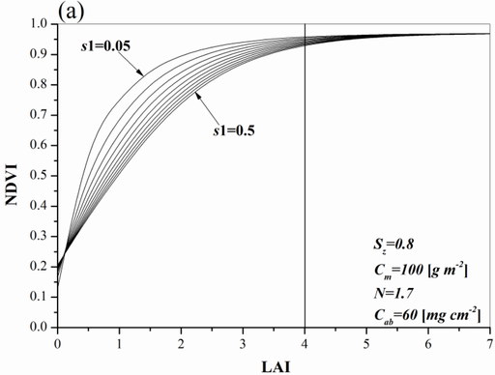
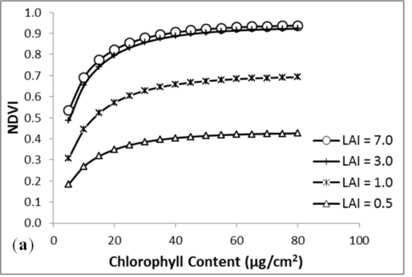
NDVI Saturation
NDVI will saturate at high levels of Leaf Area (LAI)
NDVI also saturates at high levels of Chlorophyll content.

Slide 9
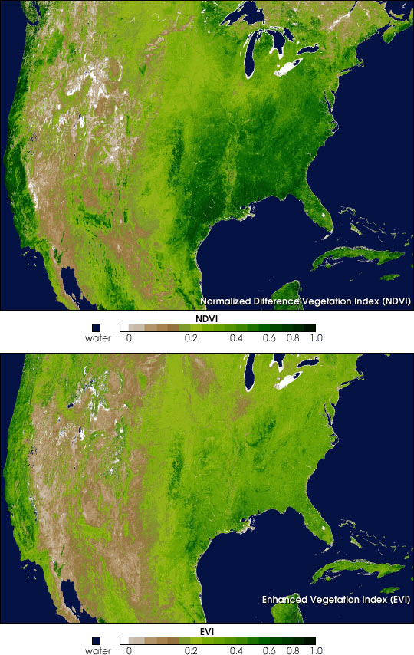
Enhanced Vegetation Index
Reduces both atmosphere and canopy background contamination.
Increased sensitivity at high biomass levels (less saturation)
ρ_{NIR} - ρ_{red}
EVI =
  L + ρ_{NIR} + C₁ ρ_{red} + C₂ ρ_{blue}
L = canopy background adjustment (1.0)
C₁ and C₂ are parameters for aerosol correction and feedback (6.0 and 7.5)
G = gain factor (2.5)
x G

Slide 10
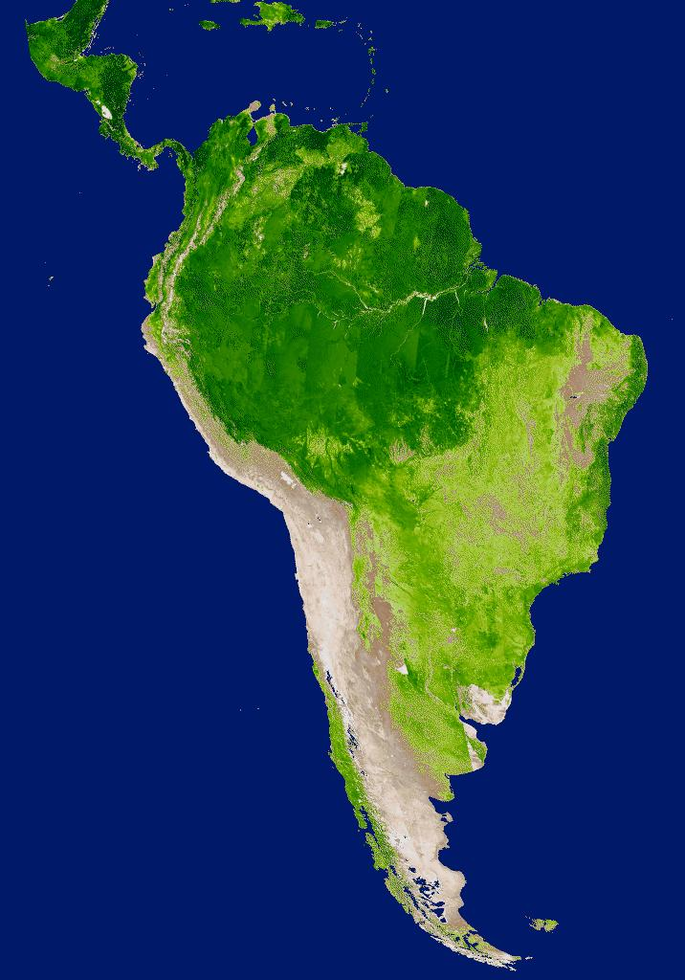
Enhanced Vegetation Index & High Biomass
NDVI
Percent (%)
EVI
Percent (%)
South America (August 12 to August 27, 2000)

Slide 11
NDVI and Soil Sensitivity
In areas of low vegetation cover, the soil reflectivity and properties can adversely affect NDVI values.
1
0.9
LAI=2.7
0.8
0.7
LAI=1.6
0.6
0.5
NDVI
0.4
LAI=1.1
0.3
LAI=0.5
0.2
0.1
Soil
0
0
0.05
0.1
0.15
0.2
0.25
0.3
0.35
0.4
Soil Albedo

Slide 12
SAVI
Adjusting for soil reflectivity (or brightness), SAVI provides a more consistent VI measure across vegetation cover gradients.
The value of the constant L varies in relation to vegetation cover density:
Low Veg: L = ~1.0
Med. Veg: L = ~0.5
High Veg: L = ~0.25
0.7
LAI=2.7
0.6
0.5
LAI=1.6
0.4
LAI=1.1
SAVI
0.3
LAI=0.5
0.2
0.1
Soil
0
0
0.05
0.1
0.15
0.2
0.25
0.3
0.35
0.4
Soil Albedo

Slide 13
Relationships between Spectral VIs
VIs behave similarly to each other under a ‘constant’ set of conditions.
If soils are not varying or fraction of vegetation cover is dominant then NDVI and SAVI are well correlated.
If aerosol differences are minimal, then similarly there is minimal difference between EVI and SAVI.

Slide 14
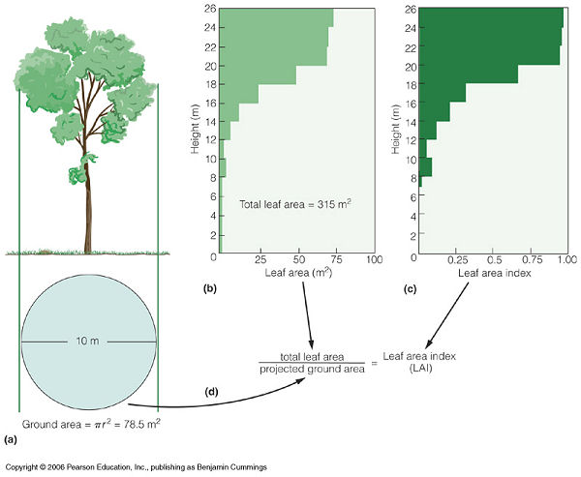
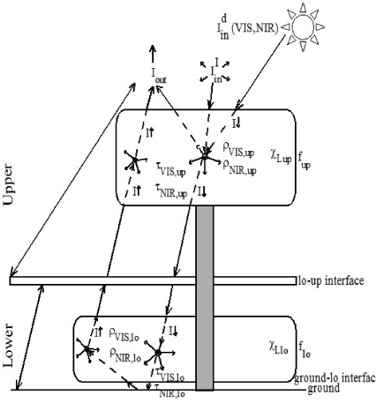
Biophysical Measures – FAPAR & LAI
LAI and FAPAR are estimated via radiative transfer models and algorithms.
Schematic of radiative transfer model in IBIS (Integrated Biosphere Simulator)

Slide 15
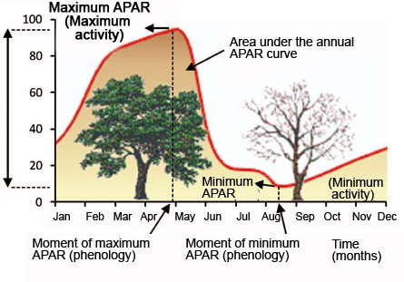
Biophysical Measures – FAPAR & LAI
LAI and FAPAR are estimated via radiative transfer models and algorithms.

Slide 16
VIs can be used to approximate LAI and FAPAR

Slide 17
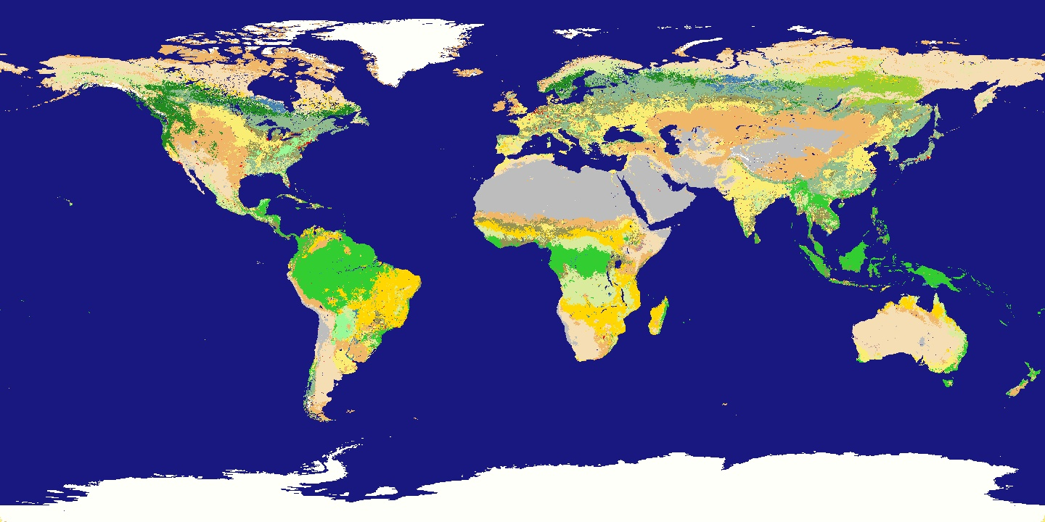
LAI and FAPAR in the MODIS GPP/NPP product
MODIS land cover type or biome
GPP = FPAR ^{x} (ε_{max} ^{x} T ^{x} W)
PSNet = GPP – R_lr
PAR Conversion Efficiency
Temperature and Water constraints from Daily Meteorology
MODIS LAI Product and Look-up table allometry values
Notes:
R_lr = leaf and fine root maintenance respiration

Slide 18
Hyperspectral & LIDAR RS of Vegetation
HS and LIDAR can provide detailed information on vegetation composition and structure.
Sample spectral images (0.45 m pixel size) of (a) radiance and (b) atmospherically-corrected reflectance. Insets show example radiance and reflectance spectra from indicated circle for wavelengths spanning 367-1052 nm
Asner et al., 2007

Slide 19
Hyperspectral & LIDAR RS of Vegetation
Sample LiDAR image of same area. Extracted waveform and a pseudo-waveform from canopy pixel in the black circle.
LIDAR provides a means to map sunlit vs. shaded canopy
Asner et al., 2007

Slide 20
Hyperspectral & LIDAR RS of Vegetation
(a) Photosynthetic (green), non-photosynthetic (blue), and shade/soil fractions (red). (b) Same as left image, but with all shadows, intra-crown shade and vegetation < 1 m masked by LiDAR. Notice the standing dead vegetation in blue in the right image
Asner et al., 2007

Slide 21
Hyperspectral & LIDAR RS of Vegetation
Following the determination of sunlit pixels dominated by live foliage, these portions of the canopies can then be analyzed for expressed pigments, water content and nutrients
(a) PRI or light-use efficiency and (b) leaf N concentration derived from the reflectance image.
Asner et al., 2007

Slide 22
Hyperspectral & LIDAR RS of Vegetation
(a) Aboveground live tree biomass and (b) GPP derived from the combined hyperspectral and LIDAR data.
Asner et al., 2007

Slide 23
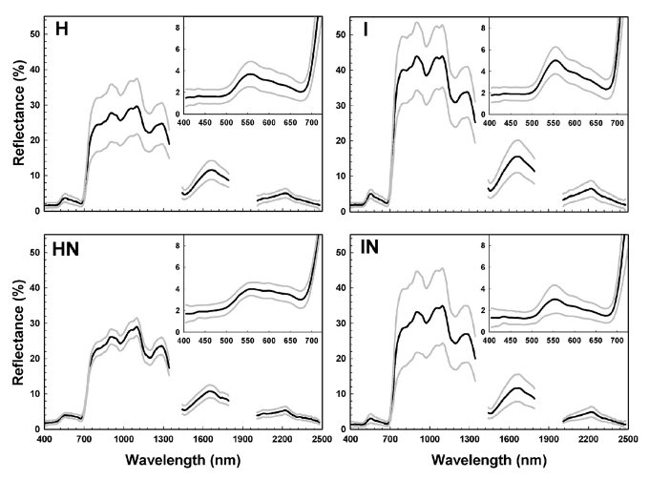
Hyperspectral & LIDAR RS of Vegetation
Hyperspectral for Invasive Species Detection
Mean (±S.D.) spectral reflectance of Hawaiian non-nitrogen-fixer (H) and nitrogen-fixer (HN), and introduced non-fixer (I) and fixer (IN) species. Insets show zoom of visible spectral region
Asner et al., 2008

Slide 24
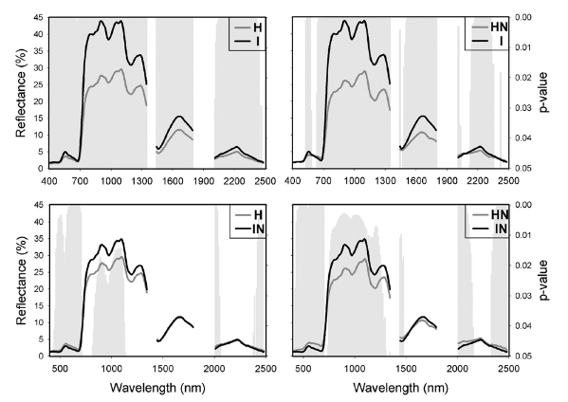
Hyperspectral & LIDAR RS of Vegetation
Hyperspectral for Invasive Species Detection
Band-by-band t-tests showing significant differences in grey bars (p-values ≤ 0.05)
Asner et al., 2008

Slide 25
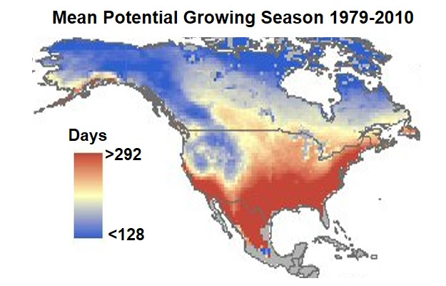
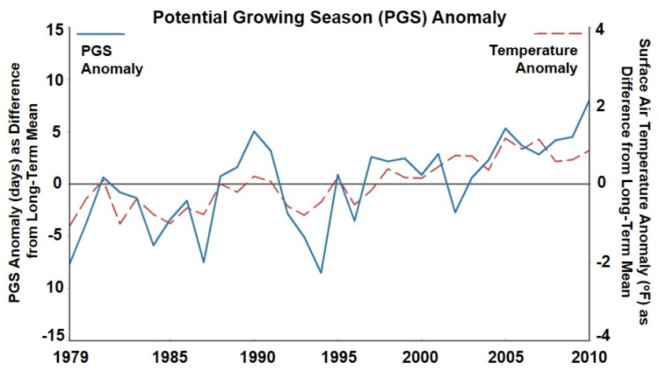
Microwave Estimates of Potential Growing Season
Microwave retrievals are very sensitive to frozen versus non-frozen land surface conditions.
Map of the mean annual Potential Growing Season (PGS) from 1979-2010 for North America.
Plot of PGS and surface air temperature anomalies (as difference from the long-term mean) for Alaska and the Contiguous U.S. for the 1979-2010 period.
Kim et al., 2012, 2014

Slide 26
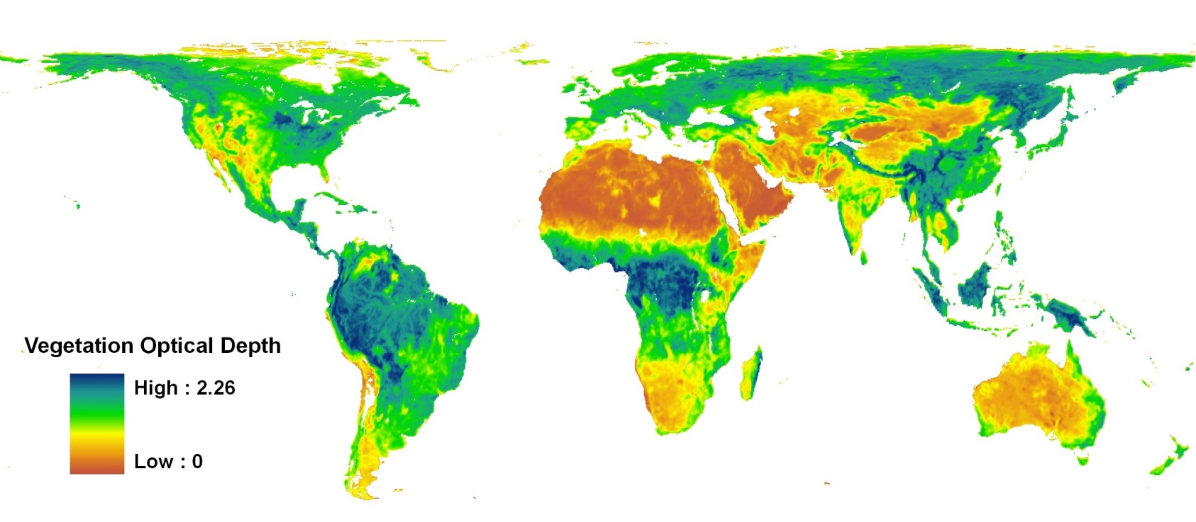
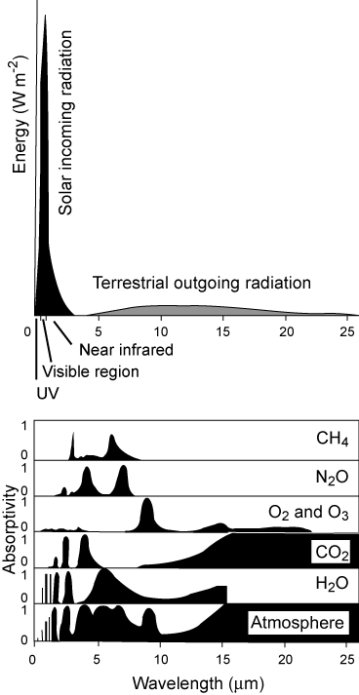
AMSR-E Microwave Vegetation Optical Depth (VOD)
August 2005
$$T_{b}=T_{s}e_{r}Γ+\left(1−ω\right)T_{s}\left(1−Γ\right)+\left(1−e_{r}\right)\left(1−ω\right)T_{s}\left(1−Γ\right)Γ$$
Estimates vegetation canopy attenuation of land surface microwave emissions.
Sensitive to changes in canopy water content and both photosynthetic and woody biomass.
Insensitive to clouds and atmospheric effects.
Well correlated with satellite optical-infrared vegetation indices (NDVI, EVI, LAI).
25km vs 1km pixels
Jones M. O. et al., Remote Sensing of Environment, 2011, 2013

Slide 27
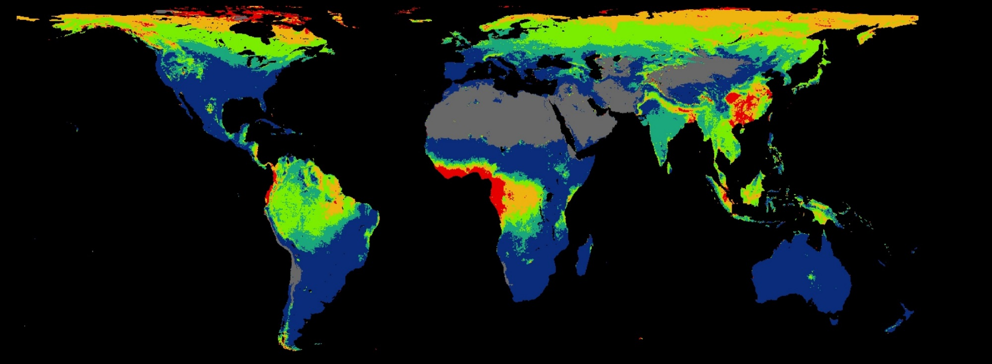
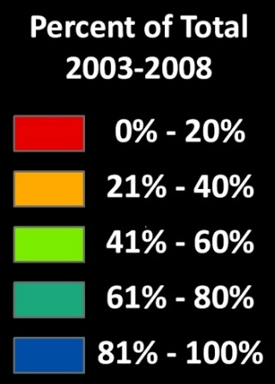
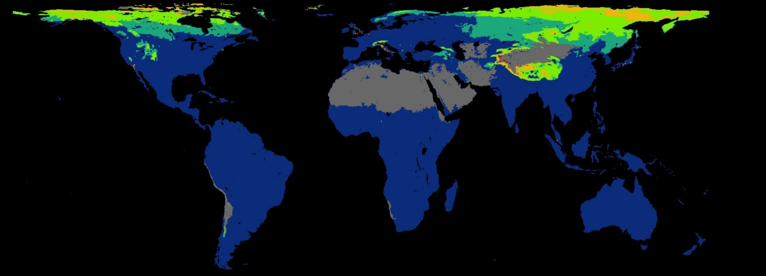
Why Use Microwave?
Data Availability 2003-2008 (16-day, Best QC)
NDVI
VOD
Microwave is largely insensitive to clouds and other atmospheric & solar illumination constraints, giving greater temporal fidelity.

Slide 28
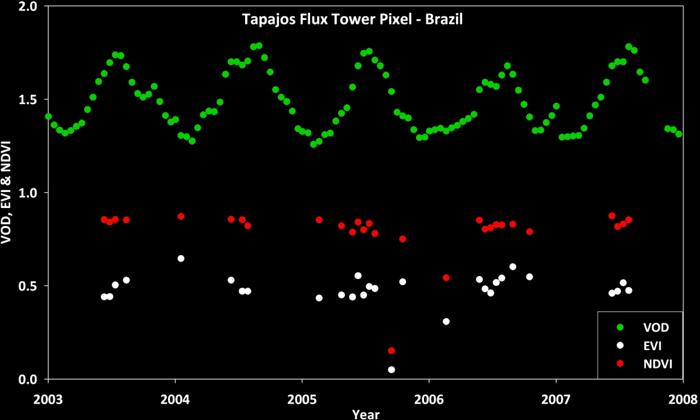
Why Use Microwave?
Data Availability 2003-2008 (16-day, Best QC)
NDVI
VOD
VOD is largely insensitive to clouds and other atmospheric & solar illumination constraints, giving greater temporal fidelity.

Slide 29
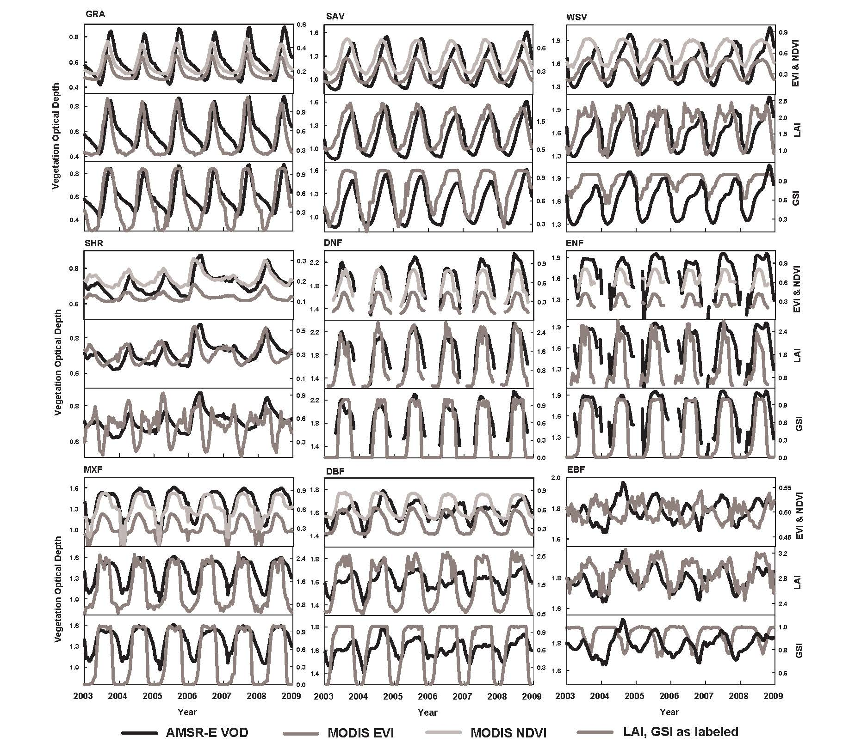
VOD and MODIS LAI Time Series by Land Cover
Phase shifts and growth onset/offset slopes track the changes in vegetation water content and total biomass versus the photosynthetic leaf area from LAI.
WSV
MXF
VOD
LAI
EBF
Amazon Evergreen Broadleaf Forest
Jones M. O. et al., Remote Sensing of Environment, 2011

Slide 30
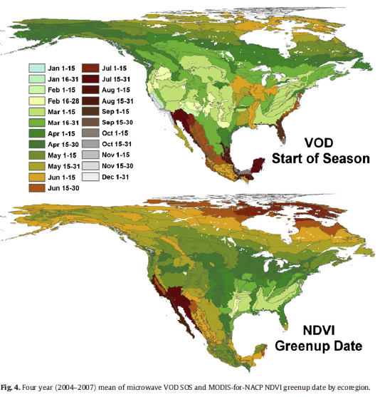
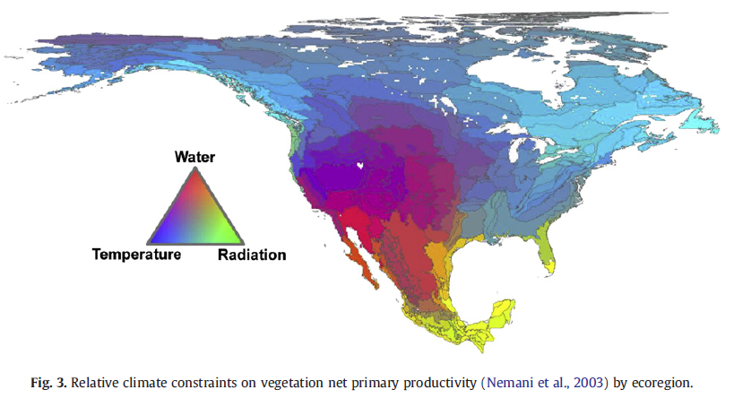
VOD and NDVI Phenology
Differences in Greenness onset (NDVI) vs. increases in vegetation water content (VOD).
Earlier VOD start of season coincided with temperature constrained regions
Earlier NDVI Greenup coincides with water constrained regions

Slide 31
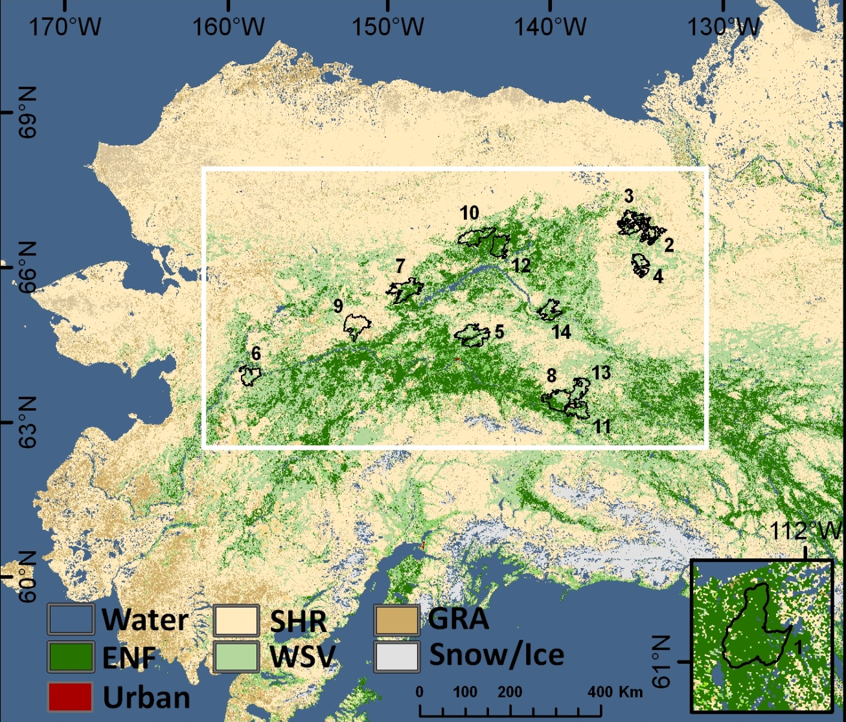
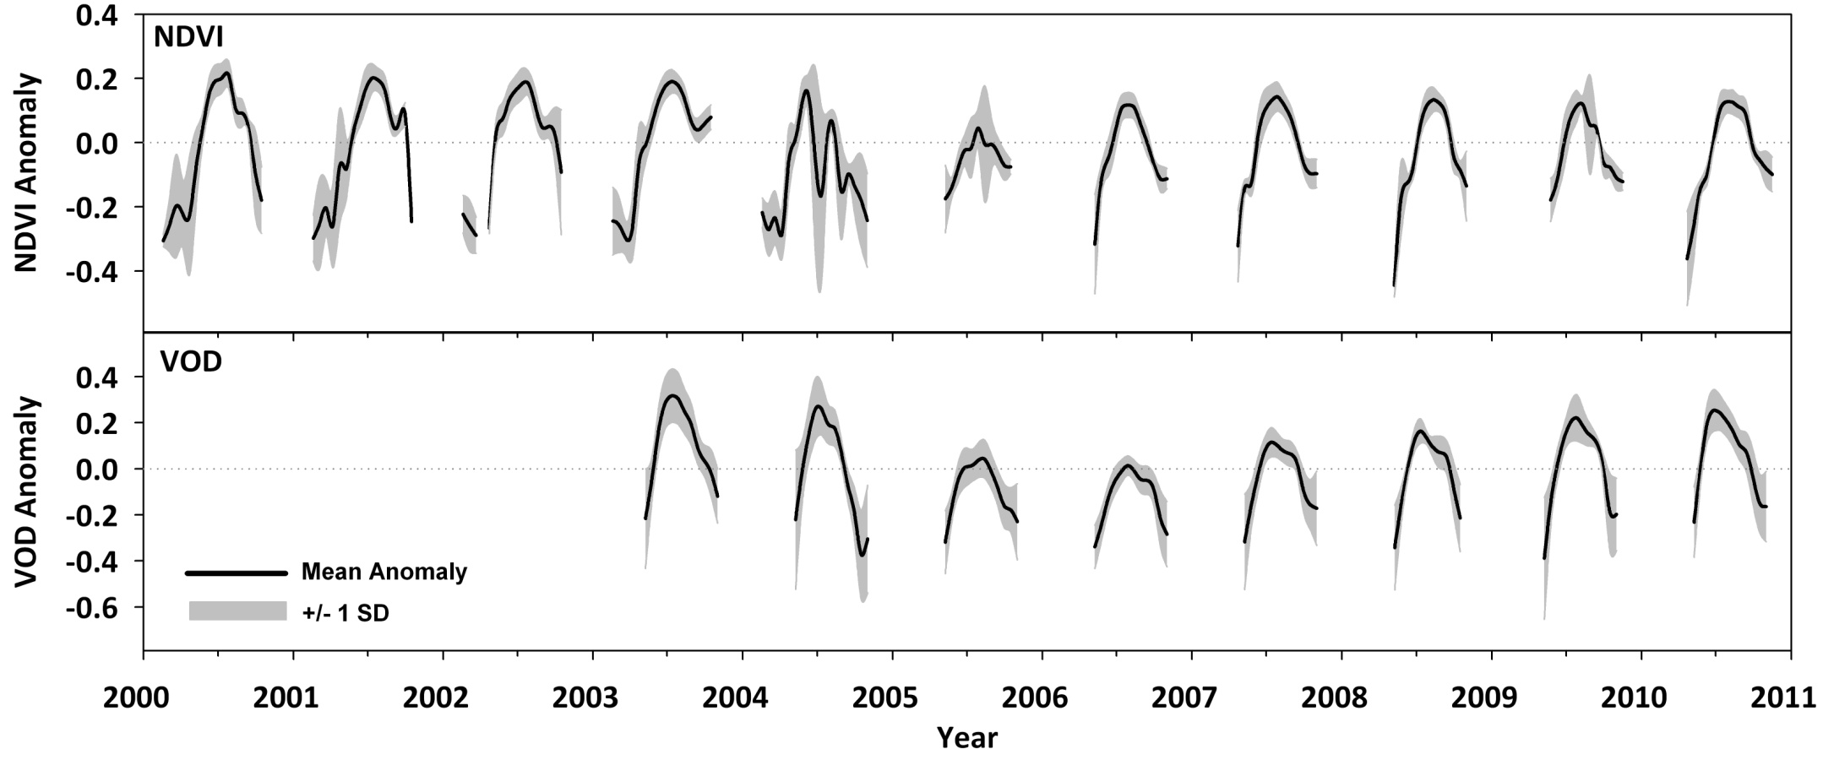
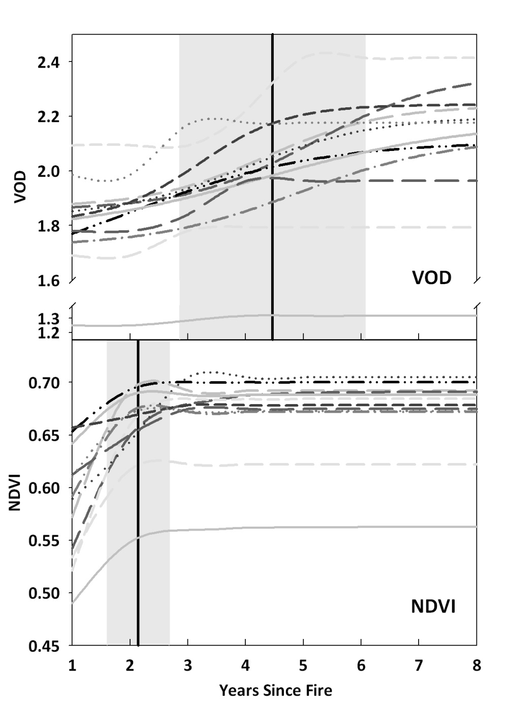
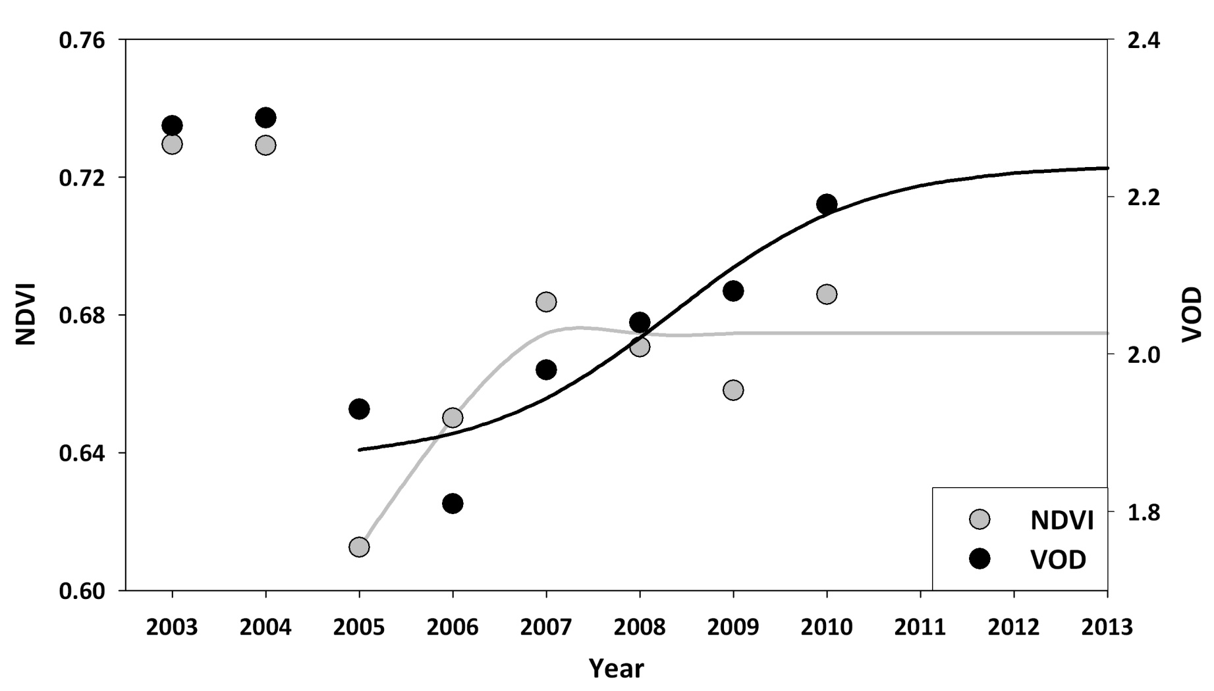
Vegetation Indices and Change Detection/Vegetation Recovery
VOD and NDVI Burned Area Time Series
VOD reached post-fire steady-state conditions in 3 to 7 years (mean=4.6) with considerable variation across fires.
Yearly maxima from the Porcupine Fire
NDVI reached post-fire steady-state conditions in 1 to 3 years (mean=2.1) with minimal variation across fires.

Slide 32
Vegetation Indices and Phenology Metrics
Remote Sensing VIs provide a means to measure phenological stages. But validating the phenology metrics and equating them to specific biophysical stages is challenging.

Slide 33
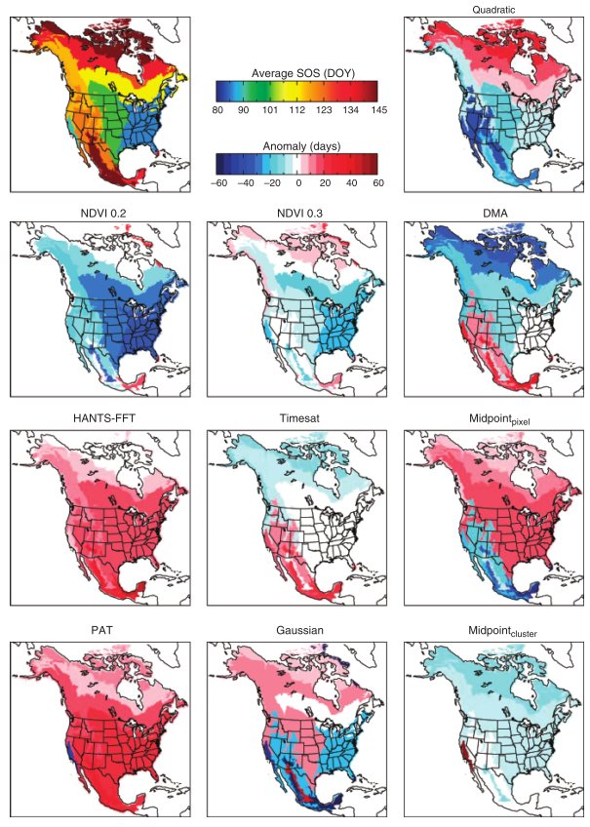
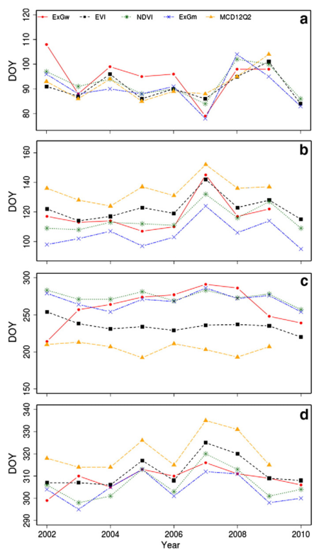
Phenology Land Product Validation
Results highlight the need for accuracy requirements and validation protocols
One Dataset, Many Methods
One Method, Many Datasets
Greeness Increase
Greeness Maximum
Greeness Decrease
Greeness Minimum
White et al., 2009, Global Change Biology
Hufkens et al., 2011, Remote Sensing of Environment

Slide 34
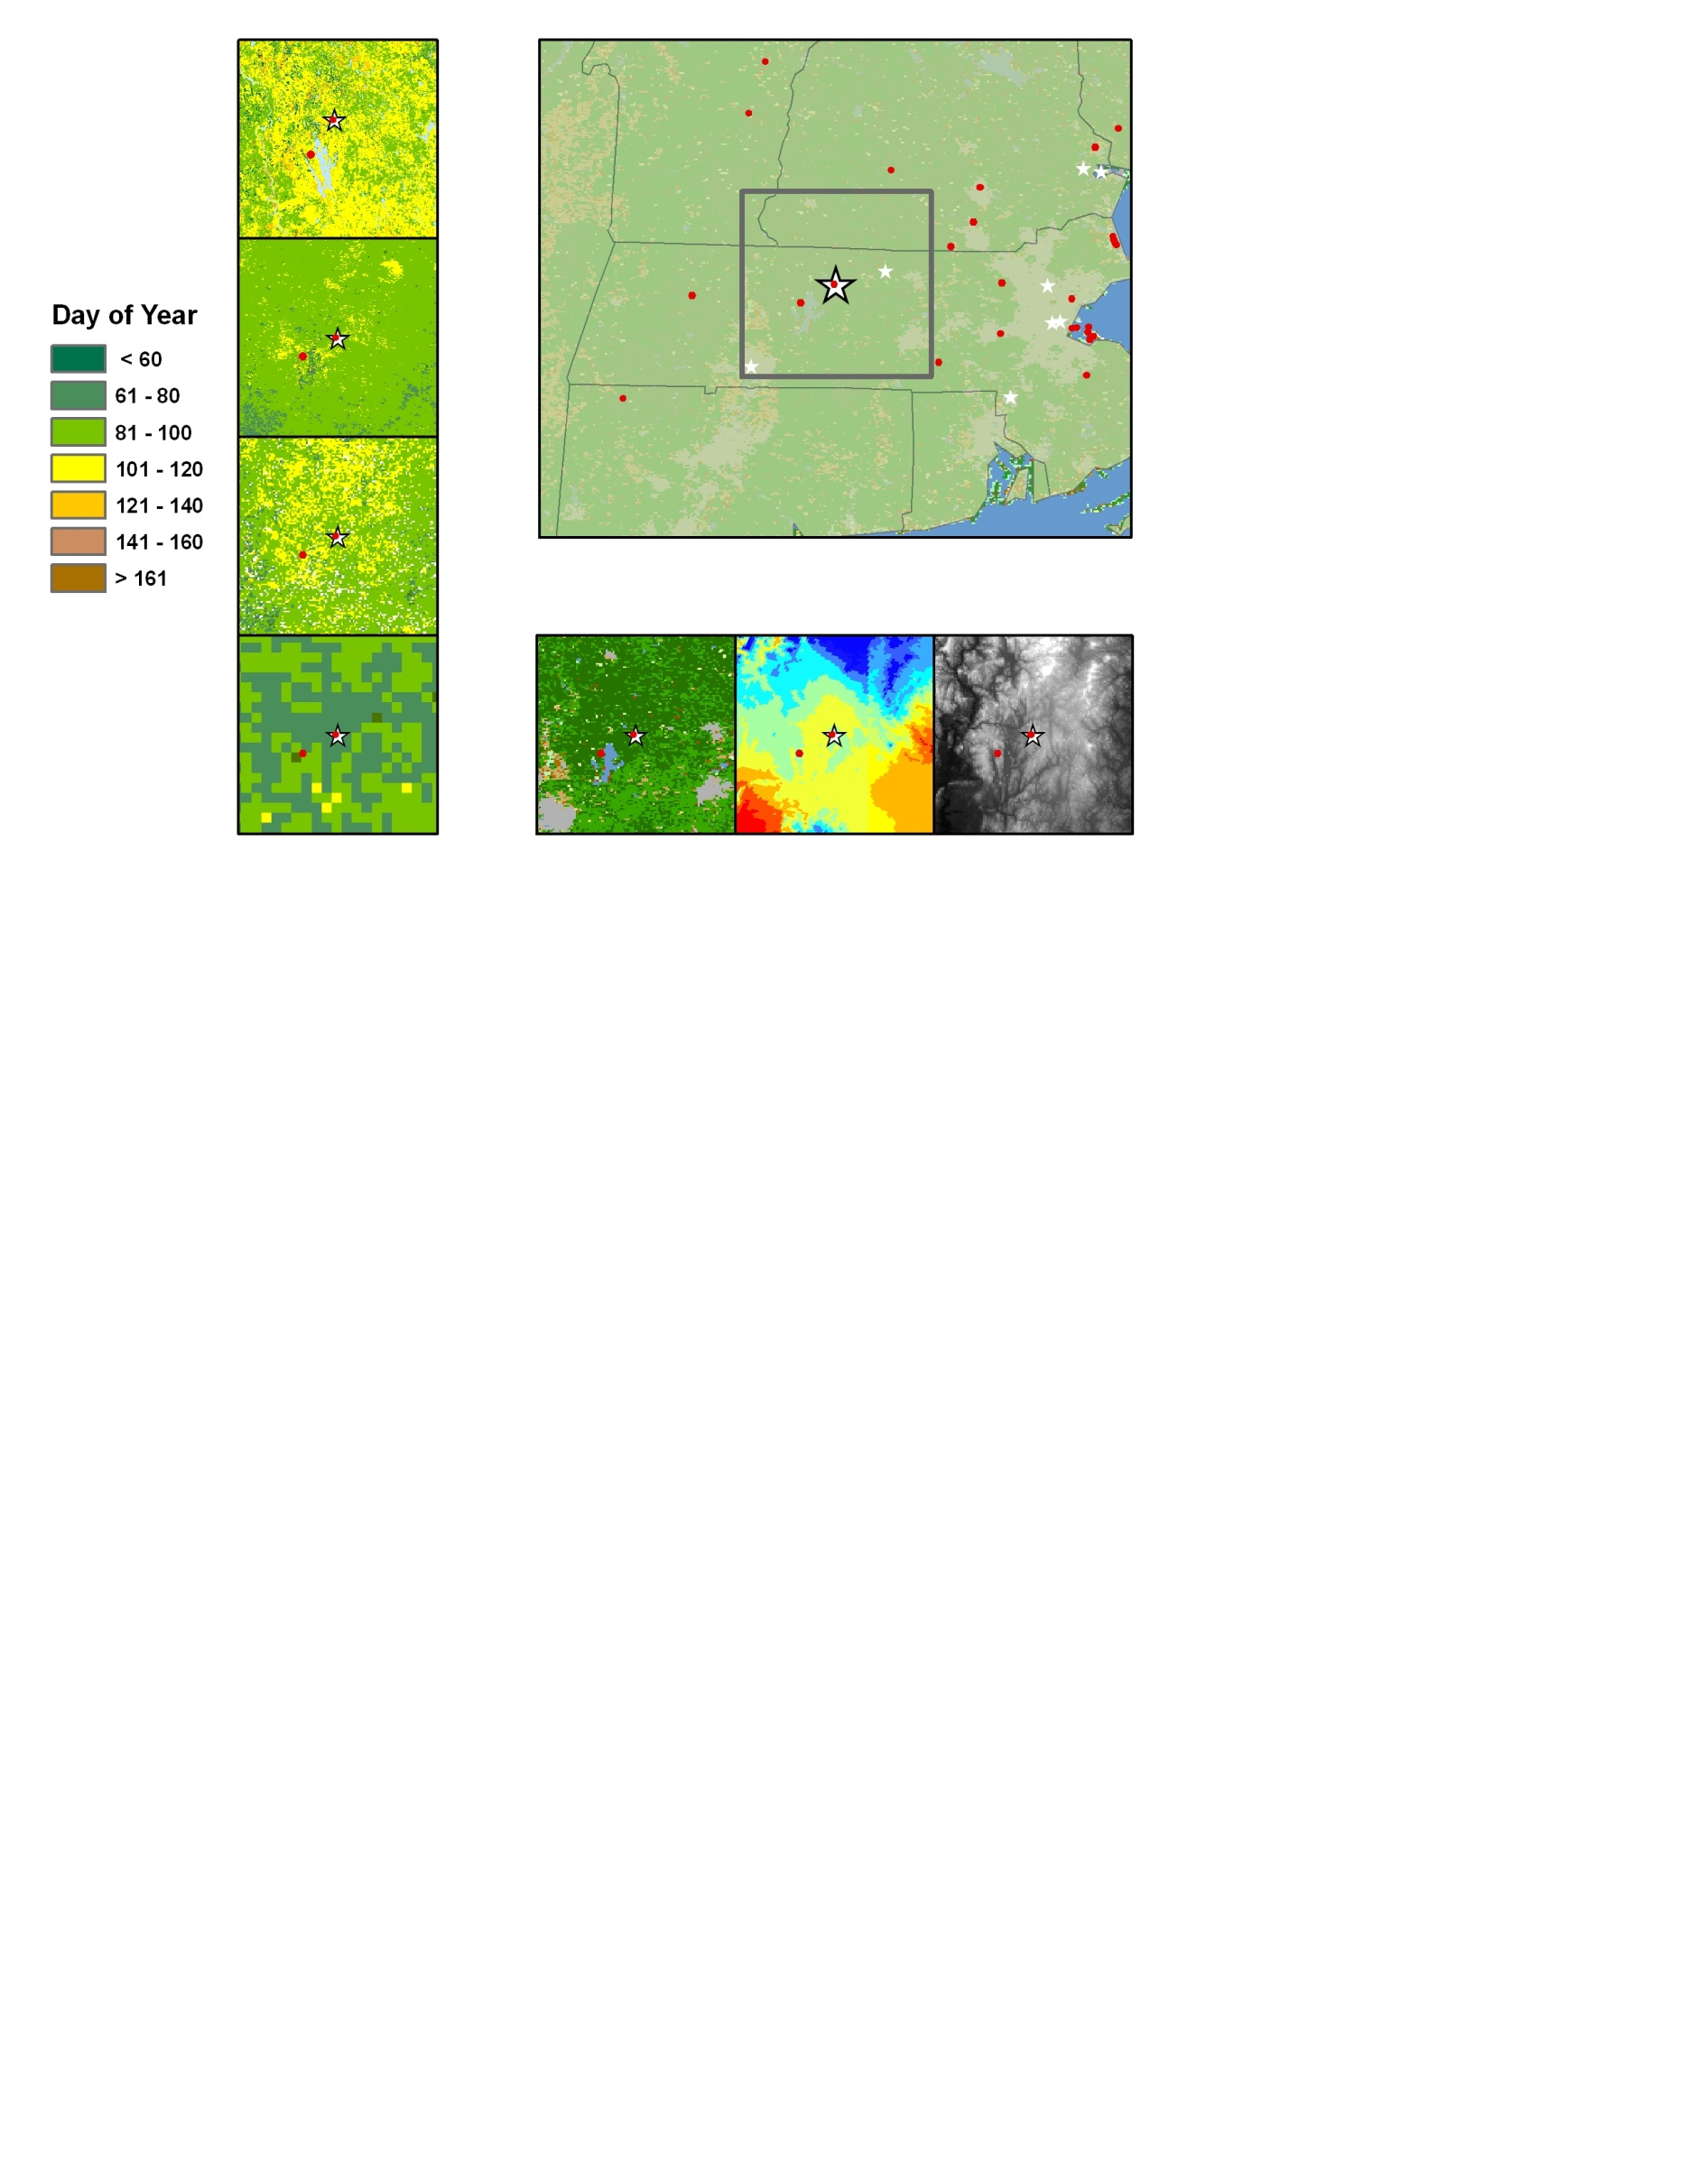
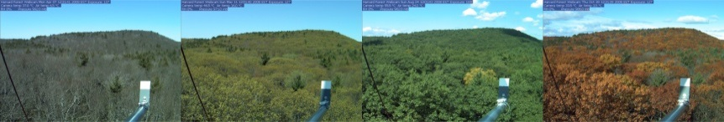
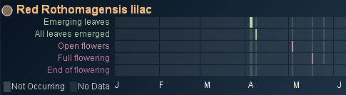
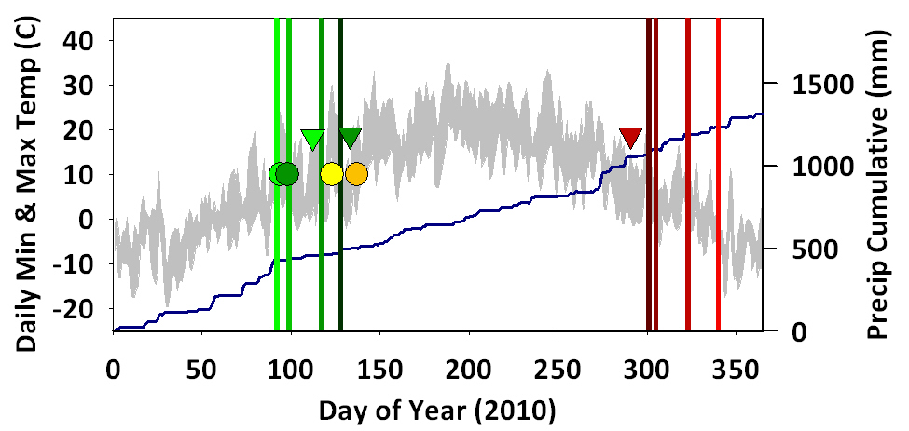
Satellite Derived Remote Sensing Phenology
Near-Surface Remote Sensing Phenology
PhenoCam – Harvard Forest
USGS
Season Onset
2010
2010
50% Budburst
Green Chromatic
Full Leaf
NACP
50% Leaf Color
Remote Sensing Land Surface Phenology Metrics
PhenoCam Sites
Apr
Jul
Oct
USA-NPN Observations
In Situ Phenology
MCD12Q2
Ancillary Data Sets…
USA-NPN Species Observation - 2010
VIP
Land Cover
Daymet (Tmax)
DEM
Season Onset
End of Season
Defining the start and end of season at a single site (Harvard Forest) varies depending on the data and methods applied.
PhenoCam Metrics
NACP
VIP
VIP
USGS
USGS
MCD12
NACP
MCD12
50% Budburst
Full Leaf Out
50% Leaf Color
NPN Phenophases
Emerging Leaves
All Leaves
Temperature
Open Flowers
Precipitation
Full Flower

Slide 35

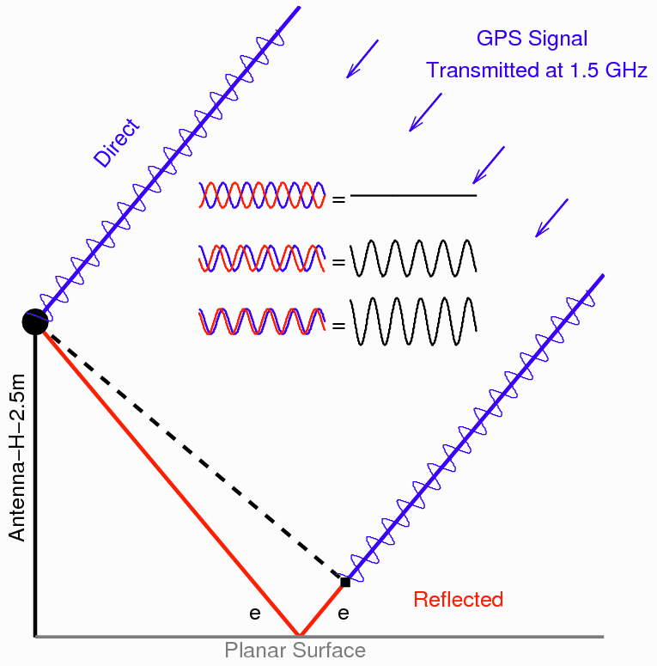
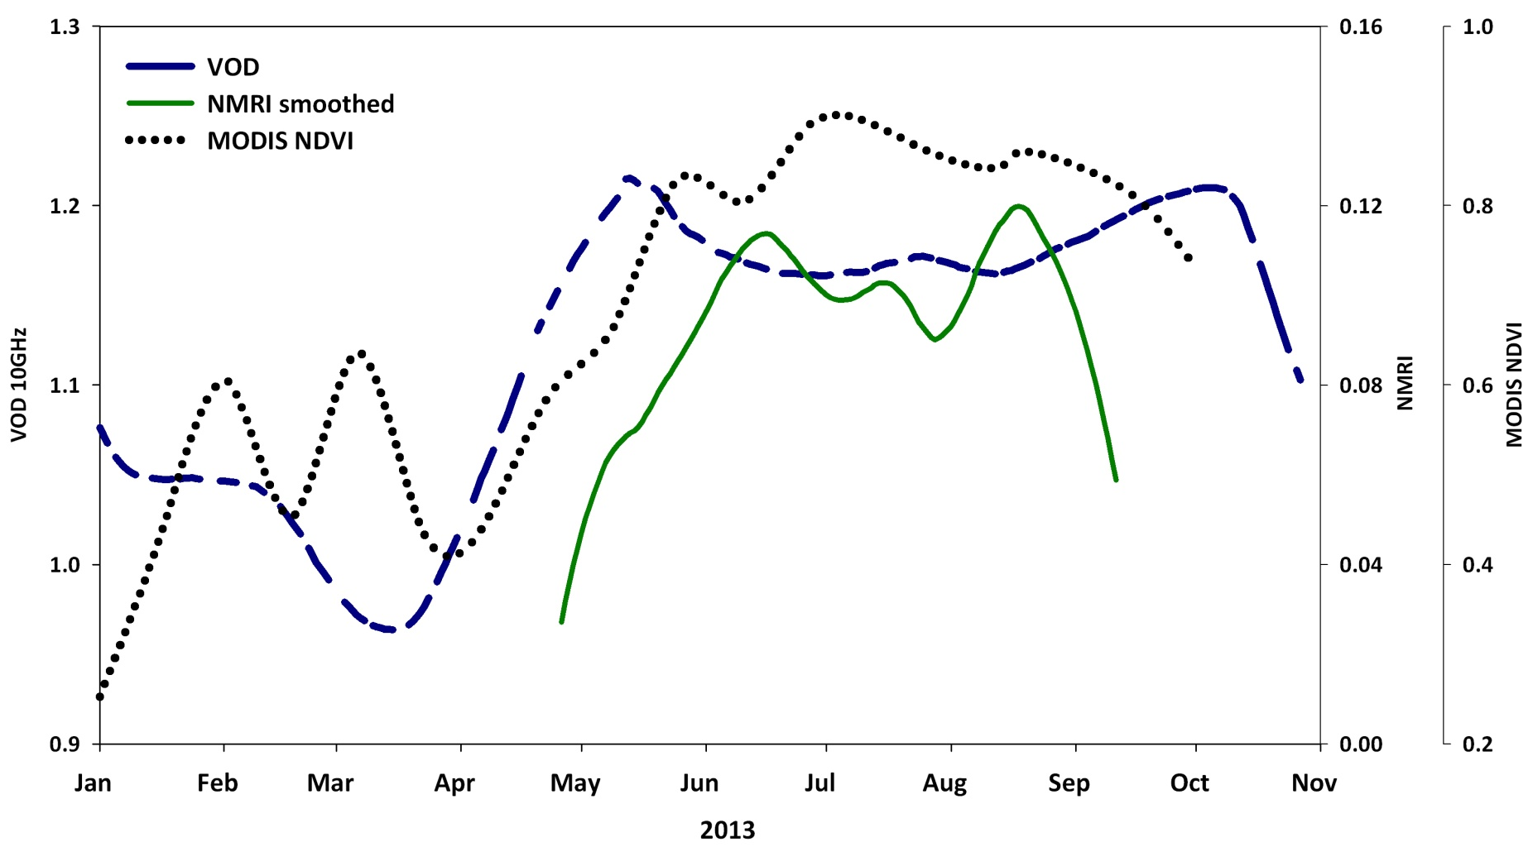
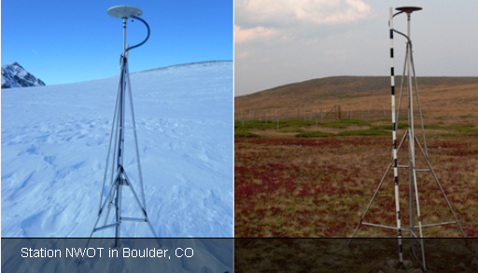


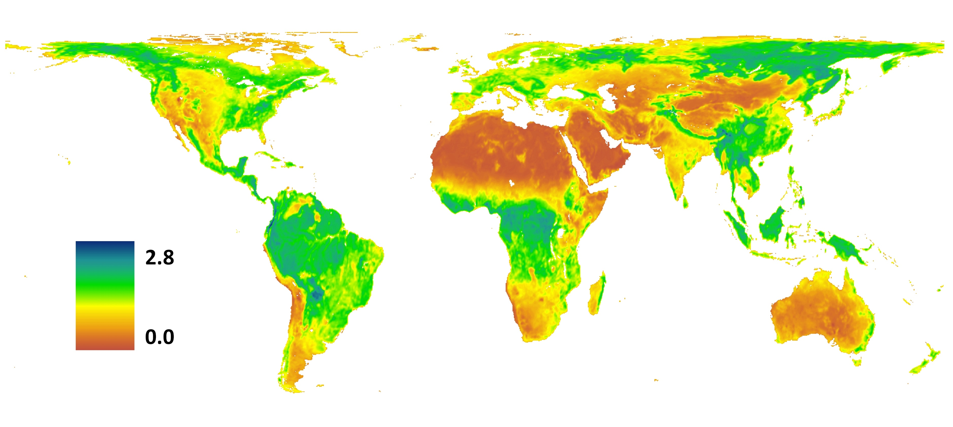
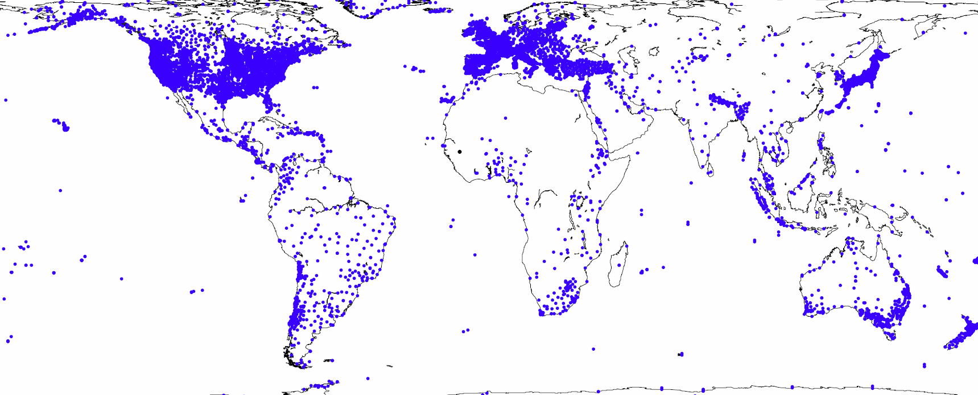
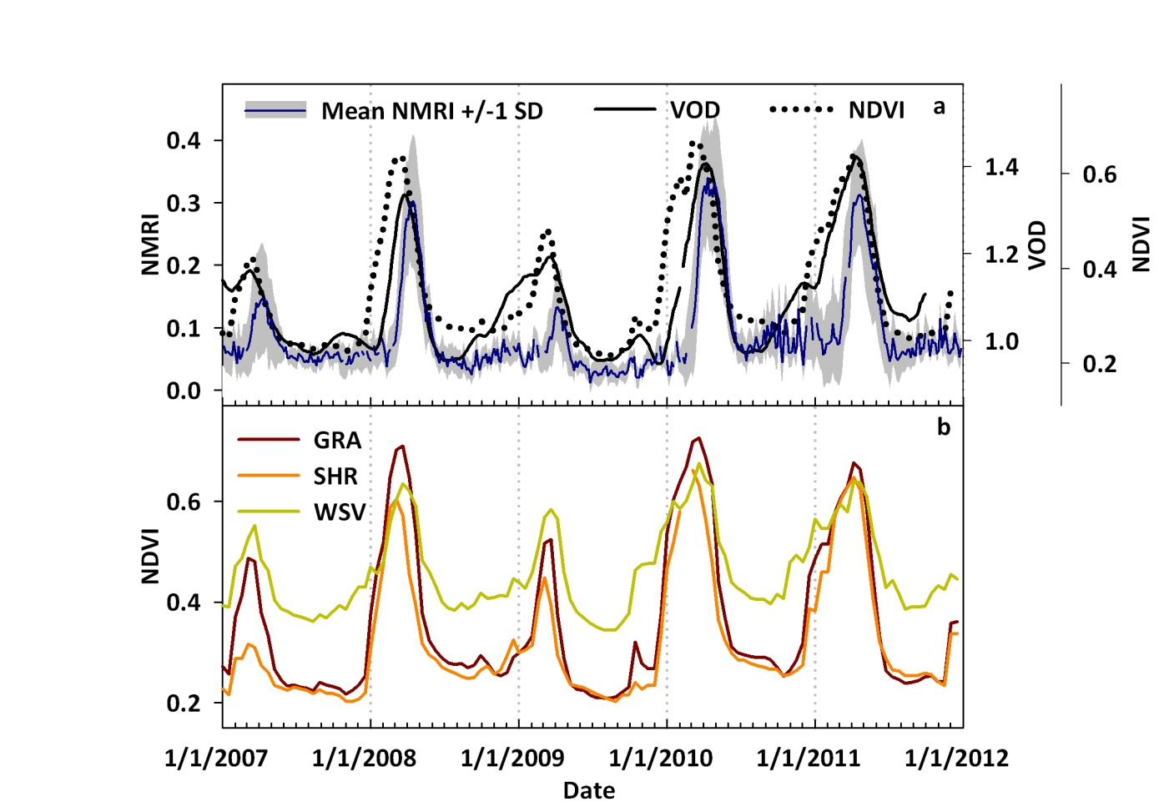
Changes in Canopy Water Content
VOD, NDVI, and the GPS Normalized Microwave Reflection Index (NMRI)
The Future of GPS NMRI
Experimental Tower Mounted GPS at Harvard Forest provides larger footprint retrievals and first look at GPS NMRI over forested systems
VOD, NMRI and NDVI over a mixed landcover VOD pixel containing 9 GPS sites.
Global Distribution of GPS
Jones et al., International Journal of Biometeorology, 2013

Slide 36
Review
Radiometric measures of the amount, structure, and condition of vegetation
Serve as intermediaries in the assessment of various biophysical parameters
  green cover (NDVI, EVI, SAVI)
  biomass
  leaf area index (LAI)
  FAPAR (fraction of absorbed photosynthetically active radiation)
  vegetation water content (VOD, NMRI, NDWI)
Precise monitoring tool
  phenology
  inter-annual variations
  change detection (anthropogenic/climate)
VIs provide essential parameters in estimates of higher-order ecosystem scale processes
  Gross and Net Primary Productivity
  Energy, Water and Carbon fluxes along the Soil-Vegetation-Atmosphere continuum
  Detection of ecosystem responses to climate and climate change.

Slide 37


Soil Adjusted Vegetation Index
A transformation technique to minimize soil brightness from spectral vegetation indices involving red and near-infrared (NIR) wave lengths.
A. Huete, 1988

Slide 38

Spectral Properties
McDowell and Kruse, remote sensing, 2016

