Slide 1
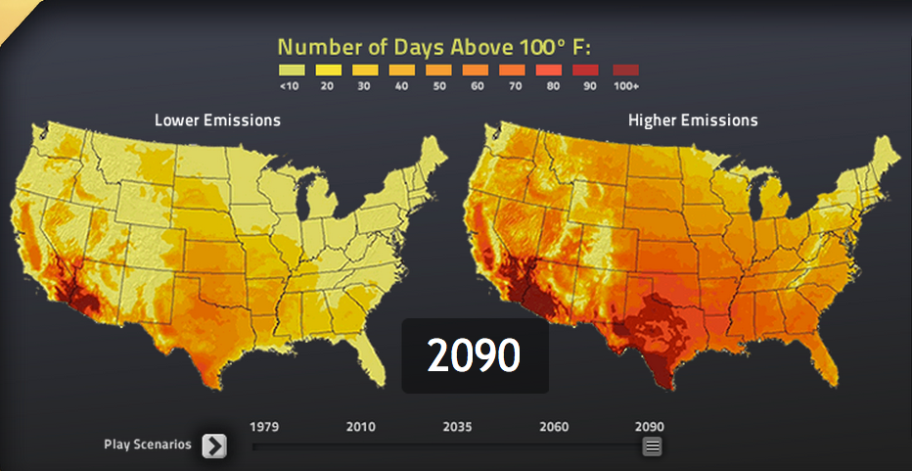
Telling the Climate Change Story
Susan Joy Hassol
climatecommunication.org @climatecomms

Slide 2
Effective communication
is a conversation
Engage rather than lecture
Connect on values
Establish trust

Slide 3
Simple, clear messages, repeated often, by a variety of trusted sources

Slide 4
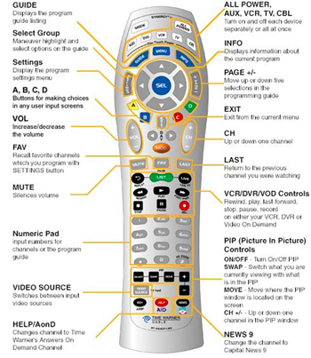
The more you say, the less they hear
Notes:
Resist the temptation to cram in too much – more facts and figures and more details will not help. More than that, they will really hurt. Craft a few simple messages and repeat them.

Slide 5
The Short Story
Climate change is happening now.
People are causing it this time.
It is affecting Americans (and others).
Virtually all climate scientists agree on these points.
We can act to limit it if we choose to.

Slide 6
The Even Shorter Story
It’s happening.
It’s us.
It’s harmful.
Scientists agree.
There’s hope.

Slide 7
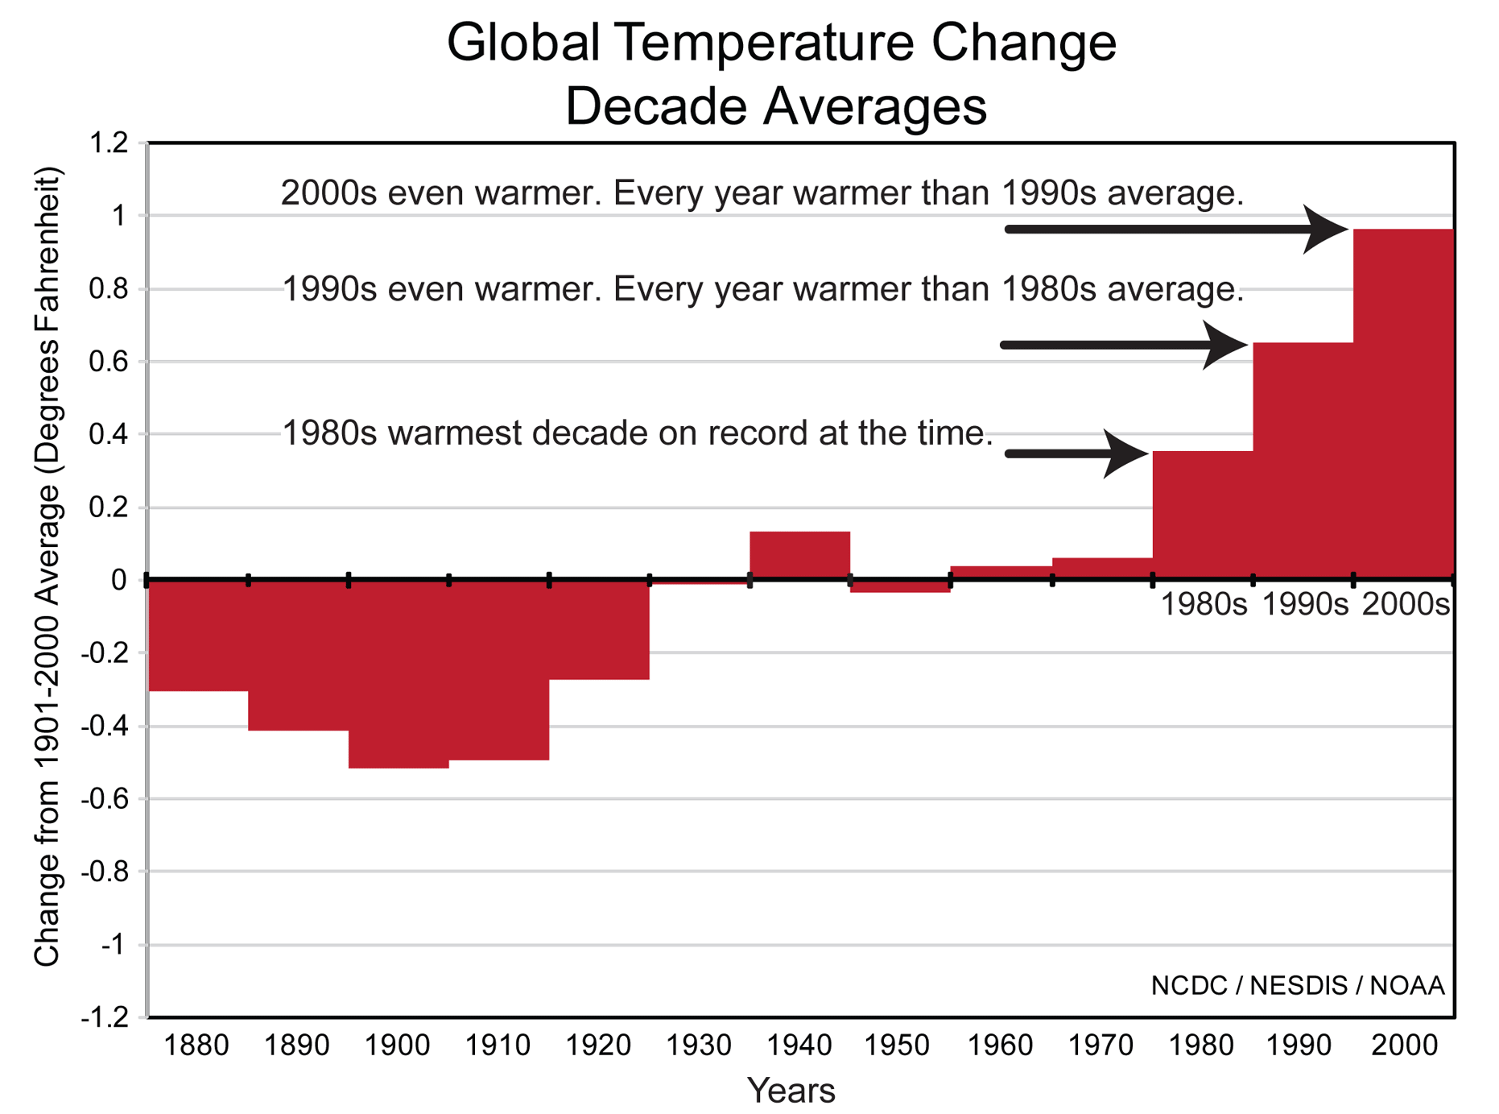

Slide 8
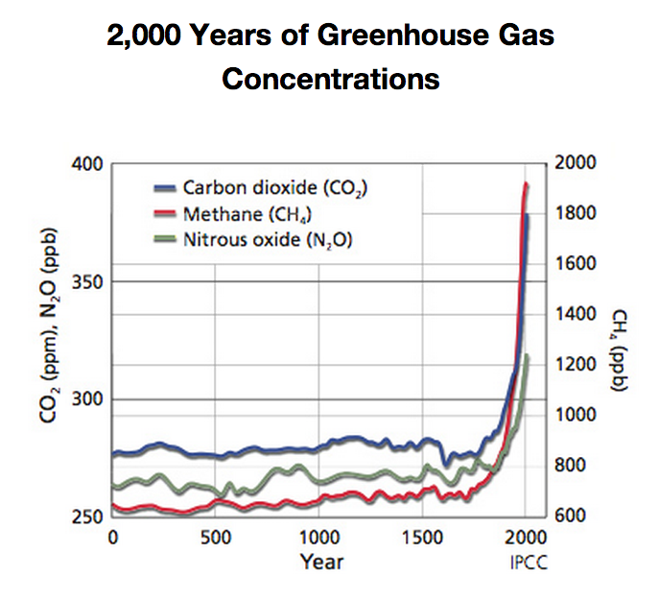

Slide 9
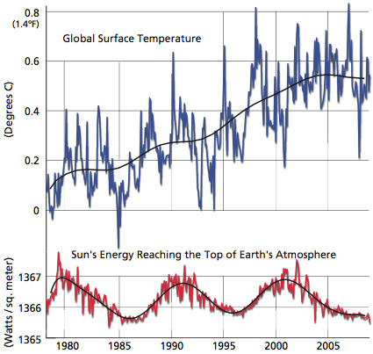
It’s Not the Sun

Slide 10
Humanity is the Dominant Cause

Slide 11
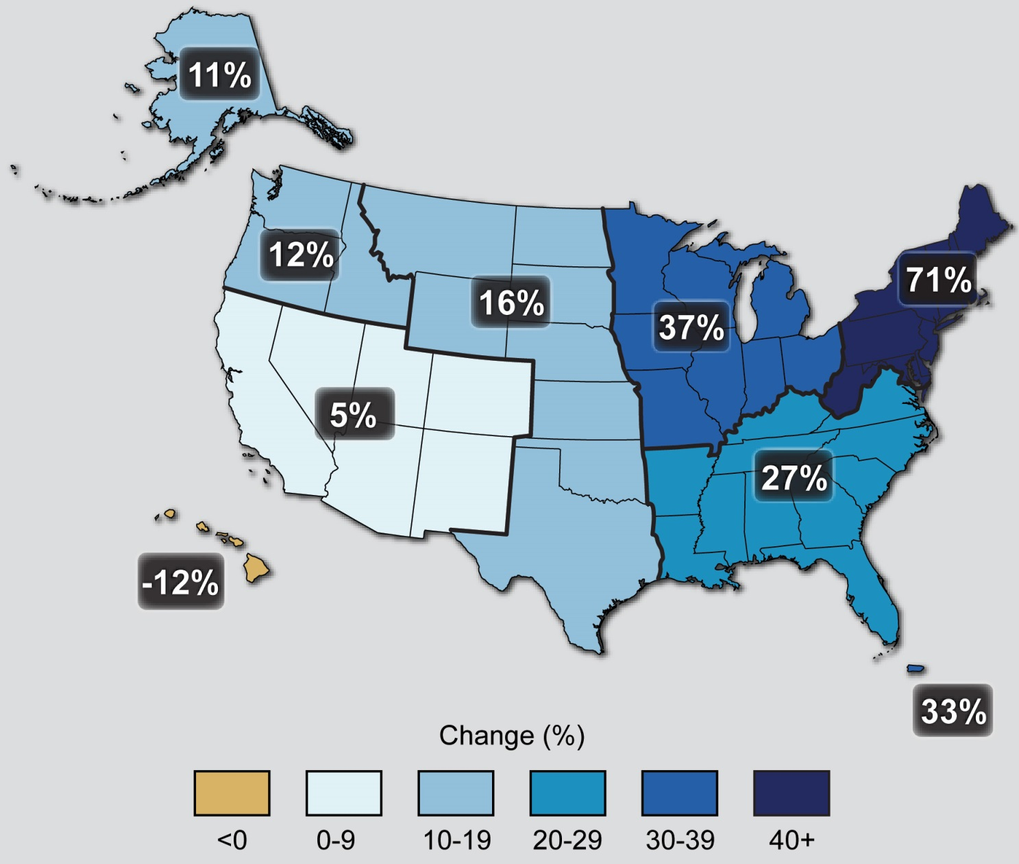
Observed Change in Very Heavy Precipitation
Notes:
Percent changes in the amount of precipitation falling in very heavy events (the heaviest 1%) from 1958 to 2012 for each region. There is a clear national trend toward a greater amount of precipitation being concentrated in very heavy events, particularly in the Northeast and Midwest. (Figure source: updated from Karl et al. 2009^{c} ).

Slide 12
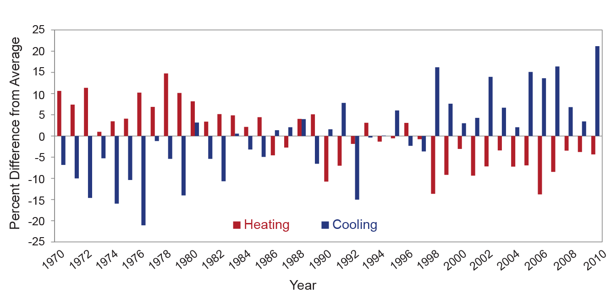
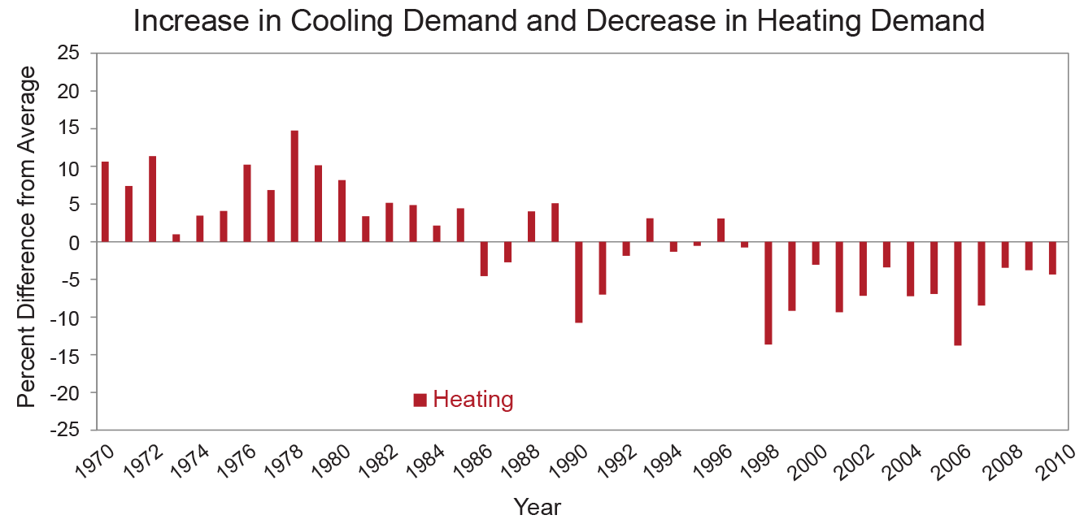
Increase in Cooling Demand and
Decrease in Heating Demand
Notes:
The observed increase in cooling energy demand has been greater than the decrease in heating energy demand. Figure shows observed increases in population-weighted cooling degree days, which result in increased air conditioning use, and decreases in population-weighted heating degree days, meaning less energy required to heat buildings in winter, compared to the average for 1970-2000. Cooling degree days are defined as the number of degrees that a day’s average temperature is above 65ºF, while heating degree days are the number of degrees a day’s average temperature is below 65ºF. (Data from EIA 2008, 2009; U.S. Department of Energy 2012; and NOAA NCDC 2012⁸).
Just one example from one sector. CC is having affects across the economy.

Slide 13
Based on the evidence, 97% of climate scientists have concluded that human-caused climate change is happening.

Slide 14
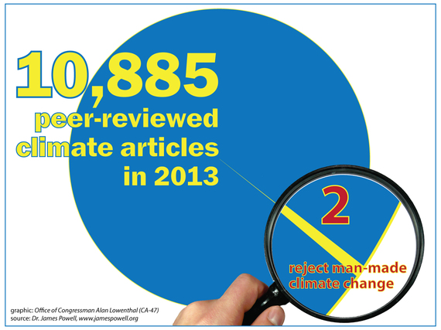

Slide 15
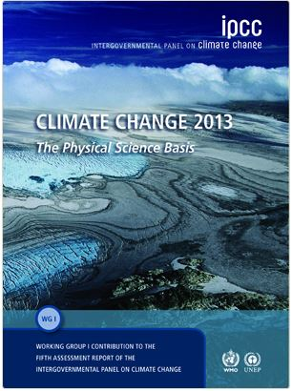
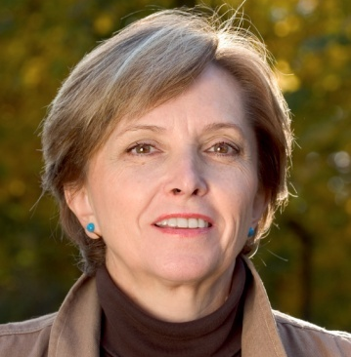
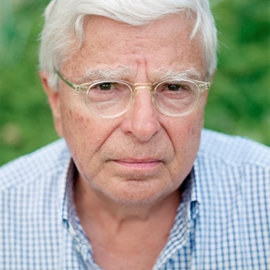
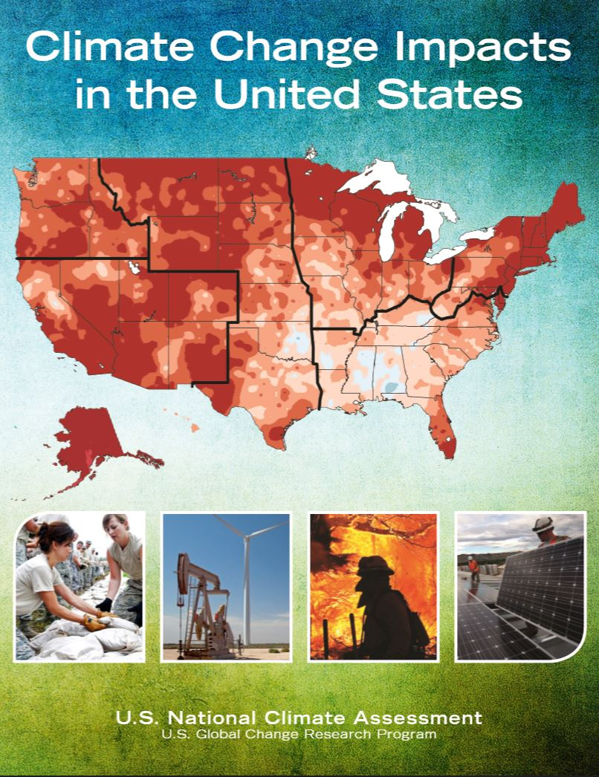
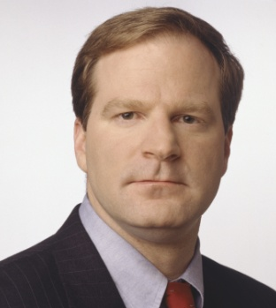
Two Worlds
Science
Public Opinion

Slide 16
Why?
Economy
Disinformation
Media
Cultural/political
How science is communicated

Slide 17
Notes:
Pew Poll Oct 2013. And there is also a large difference between moderate R’s and Tea party. Majority of tea party say warming is not even occurring.

Slide 18
Nov. 4, 2014 NYT Exit Polls
Do you think climate change is a serious problem?
Notes:
However, the midterm electorate is smaller, older, and whiter than the general election, so treat this poll with caution.

Slide 19
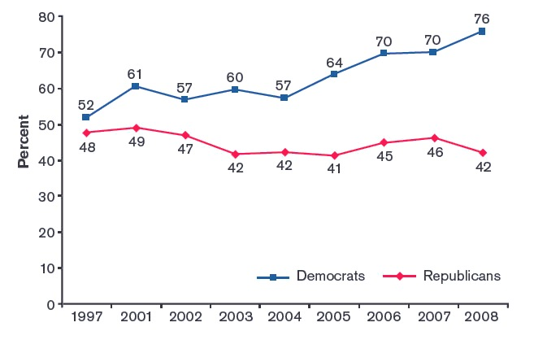
“Effects of global warming have begun”
Gallup, in Dunlap and McCright, 2008
Notes:
Kyoto Protocol was adopted in 1997.

Slide 20
Traditional
Less Polarizing
Regulate
Reduce
Cut
Control
Conserve
Restrict
Limit
Sacrifice
Ingenuity
Innovation
Entrepreneurship
Harness free market
Rise to challenge
Overcome constraint
Compete
Exceptionalism
Notes:
Solutions have often been framed in ways that are anathema to conservatives. Can be much more positive and inspirational.
The Moral: When global warming is posed as a problem that can be solved by human ingenuity rather than by limiting growth, support for action can be found in surprising places.

Slide 21
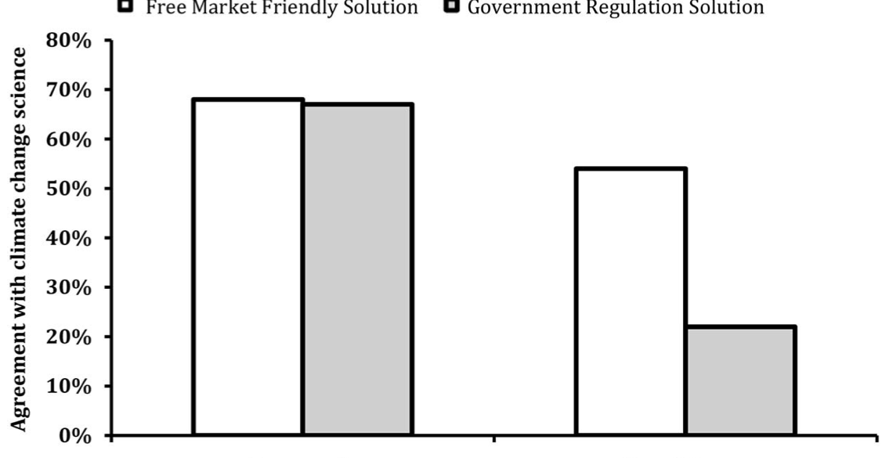
Solution Aversion
Free Market Friendly Solution
Agreement with climate change science
Gov’t Regulation Solution
Democrats
Republicans
Campbell and Kay, Nov. 2014
Notes:
IPCC statistic projecting the world warming 3.2 F over this century was paired with two different solutions in this experiment. Half of each group got a speech that said the US could help stop climate change and profit from leading the world in green energy technology. The other half got a speech that paired the stat with idea that US could help stop cc and lead the world in restrictive emissions policies. You can see that Rs with free market solution accepted the science almost as much as Ds, whereas those with the regulation solution largely rejected the science. This offers evidence that it is aversion to the perceived solutions that causes so much rejection of the science among Rs. Similarly, Kahan found that mentioning geoengineering and nuclear power as solutions to climate change increased conservatives acceptance of the basic science of climate change. (But efficiency and green energy have also been polarized – depending on how they’re marketed.)

Slide 22
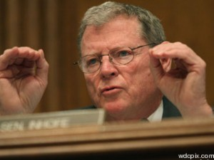
“I thought it must be true, until I found out what it would cost.”
James Inhofe, 2012

Slide 23
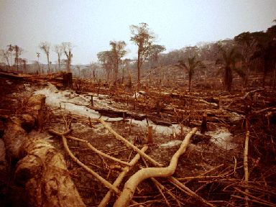
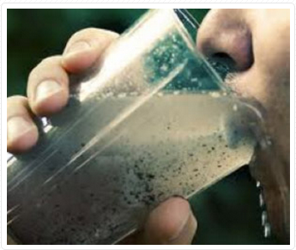
Conservatives
Liberals
Sustainability; care for the environment
Destruction of nature images are most repellant
Purity, sanctity, patriotism, reverence for higher authority
Most repellant images are human oriented: smoggy city, dirty water
Feinberg and Willer, 2012
Notes:
MORAL issue for both, but different. Psychological Science article – for both it’s a moral issue, but the specific nature of that issue differs

Slide 24
Words Matter
Notes:
Science does not speak for itself. You have to speak for it. And the words you choose matter because words evoke emotions and emotions lead to action (or not).
For example: Don’t say “blame” or “fault” -- say “cause” or “responsibility” – want to invoke interest, concern worry and hope. Not fear, not hopelessness

Slide 25
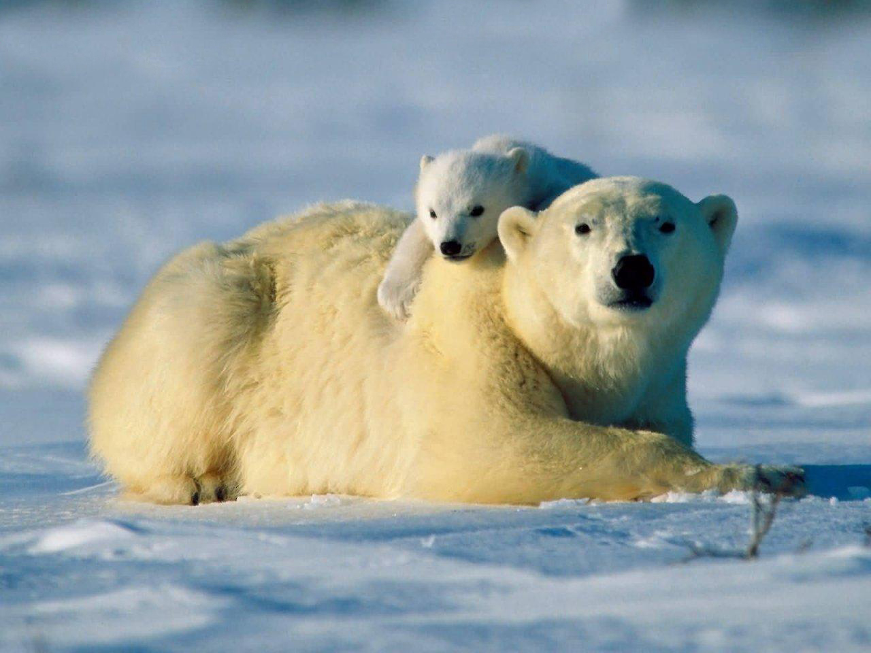
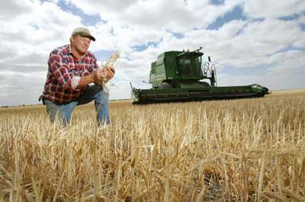
Climate change is NOT an Environmental problem
Planet / Earth
Environment
Polar Bears
People
Economy
Way of Life
Notes:
It’s not about “saving the Earth”
Classifying it that way is far too narrow and leaves out much of the public

Slide 26
Words Can Feed Misconceptions
Believe and feel (versus evidence and fact)
Humans contribute, at least in part
Natural factors alone can’t explain
Inevitable, no matter what we do

Slide 27
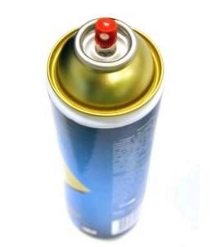
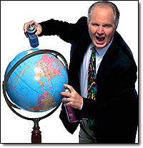
Words that mean different things
Aerosol
Notes:
Worse than jargon

Slide 28
Enhance
Before
After

Slide 29
Positive Feedback

Slide 30
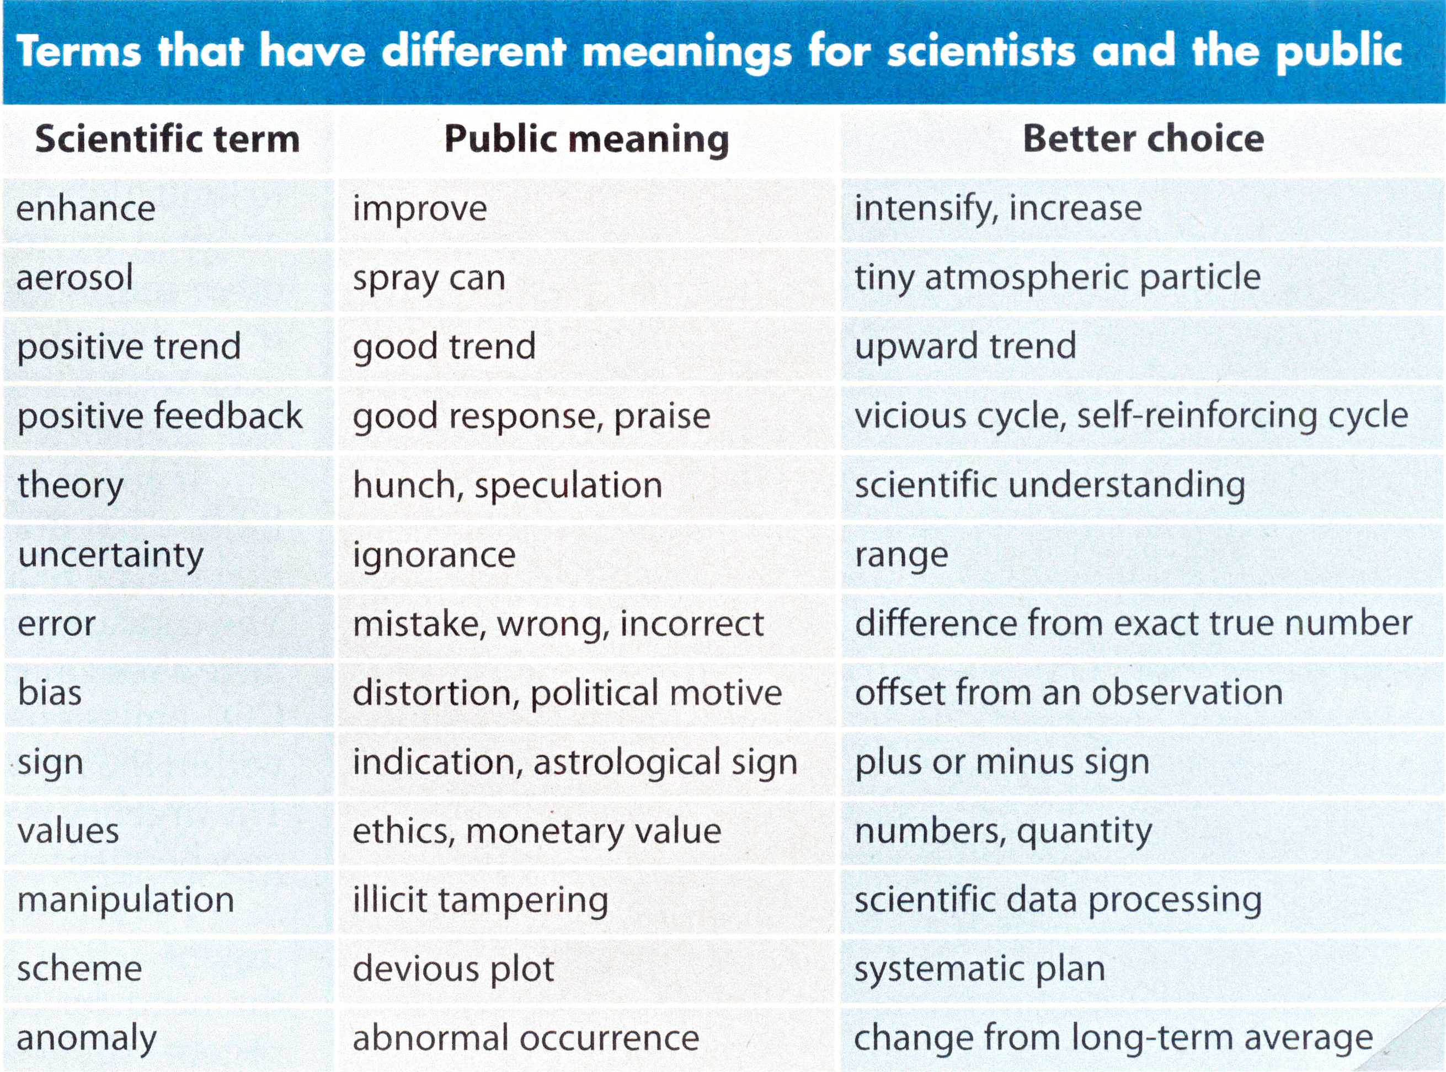
Somerville and Hassol, Physics Today, Oct. 2011

Slide 31
Words that mean different things
 | Aerosol | Uncertainty | Anomaly
 | Enhance | Risk | Disruptive
 | Positive | Bias | Extra
 | Negative | Exotic | Proposal
 | Feedback | Agent | Sequestration
 | Radiation | Species | Literature
 | Theory | Organic | Regime
 | Error | Enrichment | Sign
 | Ozone | Nutrient | User
 | Model | Commitment | Mean
 | Sensitivity | Fix | Discipline
 | Reservoir | Transient | Manipulation
 | Ecology | Idealized | Scheme
 | Settlement | Driver | Trick
Notes:
Acronyms: PDF, SLR, CAFE

Slide 32
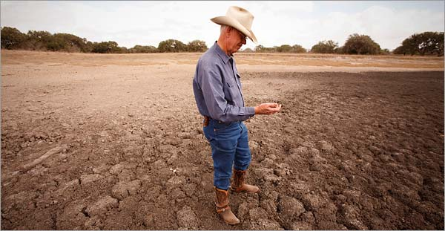
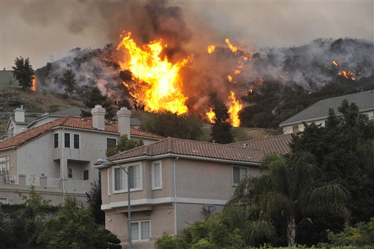
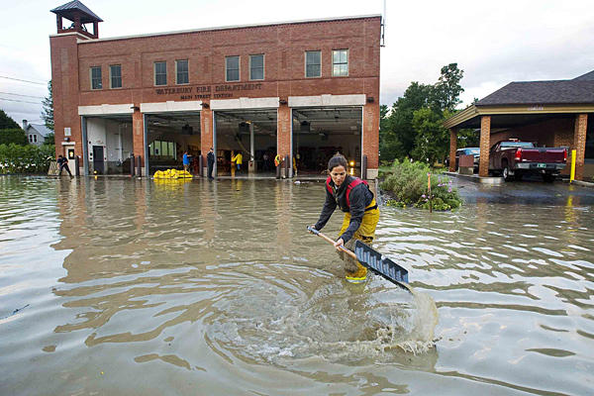
Close to Home
Notes:
Not about polar bears. It’s about you and what you care about. It is a long lived problem and a moral issue that effects the world we leave for our children. The question is: what kind of people are we?

Slide 33
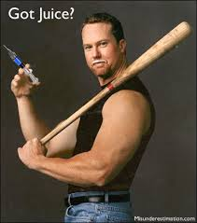
Metaphors
Notes:
GHGs are the steroids of the climate system.

Slide 34
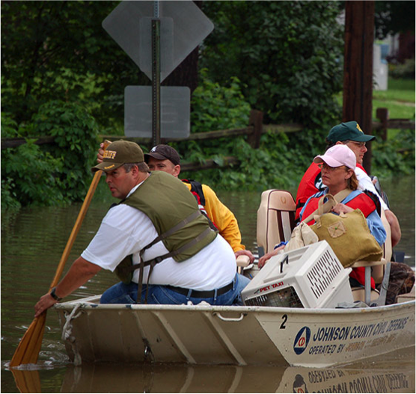
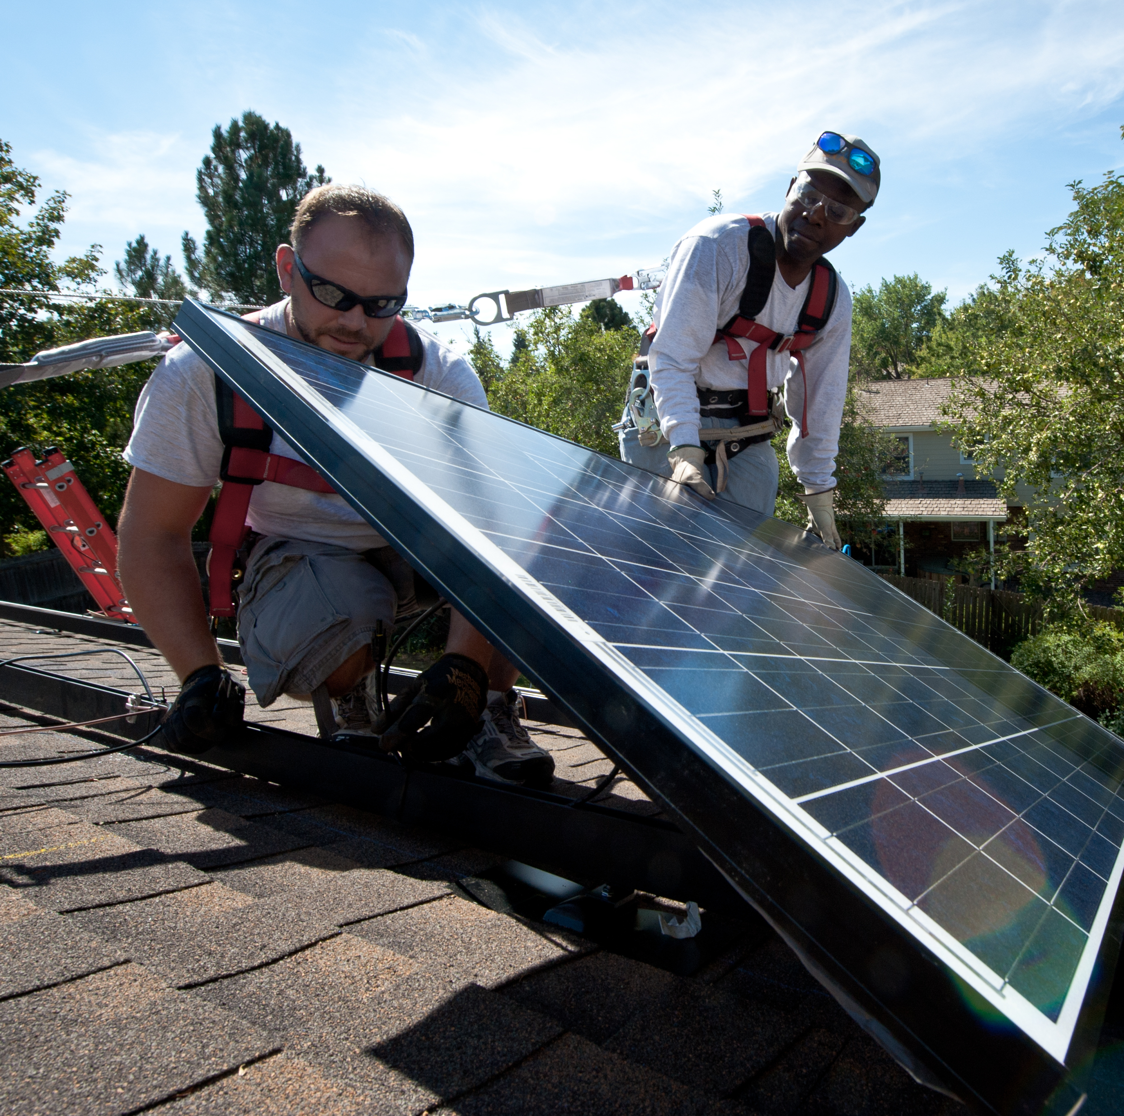
Threat and Opportunity

Slide 35
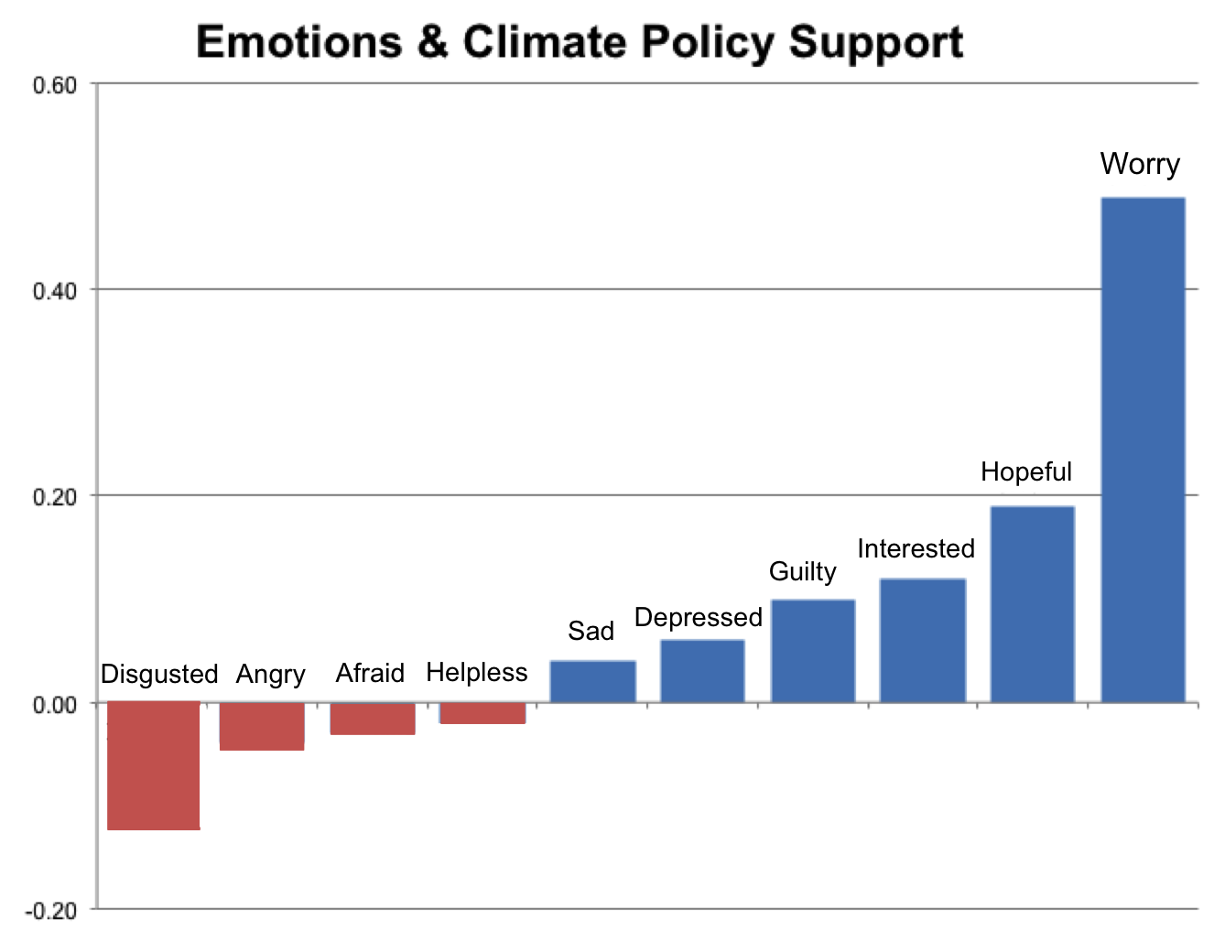
Data from Smith & Leiserowitz, 2013

Slide 36
Smartening Up Communication
Consider audience’s values & concerns
Craft a few simple messages
Avoid jargon and too much detail
Choose words with care
Use imagery, metaphor, story
Anticipate misunderstandings
Describe both the threat and opportunity
Notes:
Values: connect there. We all want to take responsibility for our mess, leave our children a better world.
Imagery: mercury in thermometer, blanket, moving state, pancakes
Metaphor: steroids, kicking the can
Audience: what do they care about – snowmobiling and skiing, water managers, farmers, fishing

Slide 37
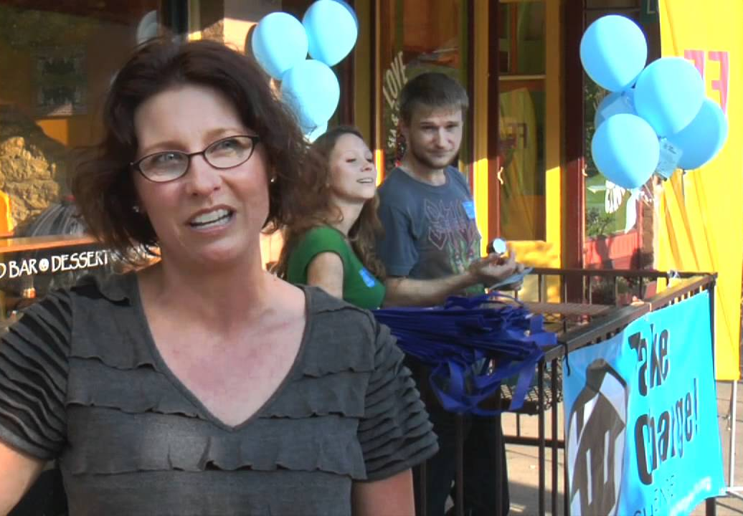
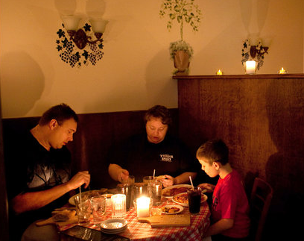
How to tell this story…
…depends on your audience and their world view.
Notes:
When you understand how your audience perceives the world, you can deliver a message in a way the audience will understand.
Know thy audience, know thyself, know thy stuff – Steve Schnedier

Slide 38
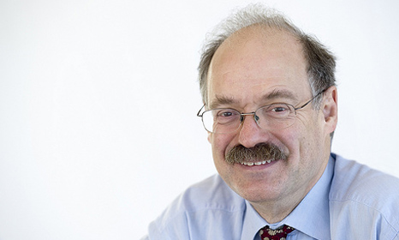
“Science is not finished until it’s communicated.”
- Sir Mark Walport, UK’s Chief Scientific Advisor
Notes:
http://www.rtcc.org/2013/10/03/science-is-not-finished-until-its-communicated-uk-chief-scientist/
Can’t show IPCC or journal graphs. Can’t use the same language you do with colleagues. Must learn to communicate to wider audiences.
“What’s the use of having developed a science well enough to make predictions if, in the end, all we’re willing to do is stand around and wait for them to come true?” – Sherwood Roland

Slide 39
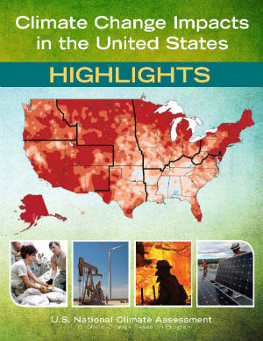
Happening Now
Affecting Americans
Important Opportunities
nca2014.globalchange.gov

Slide 40
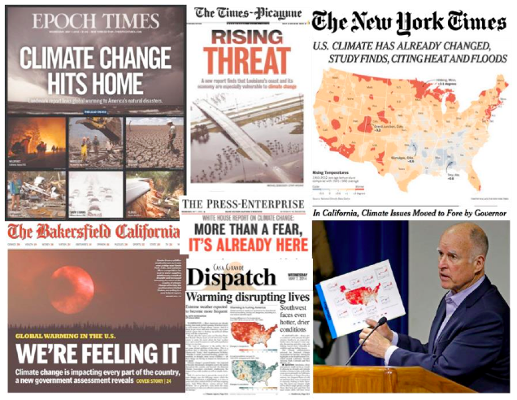

Slide 41
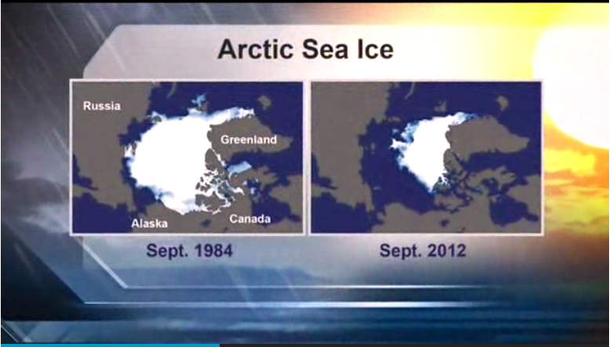
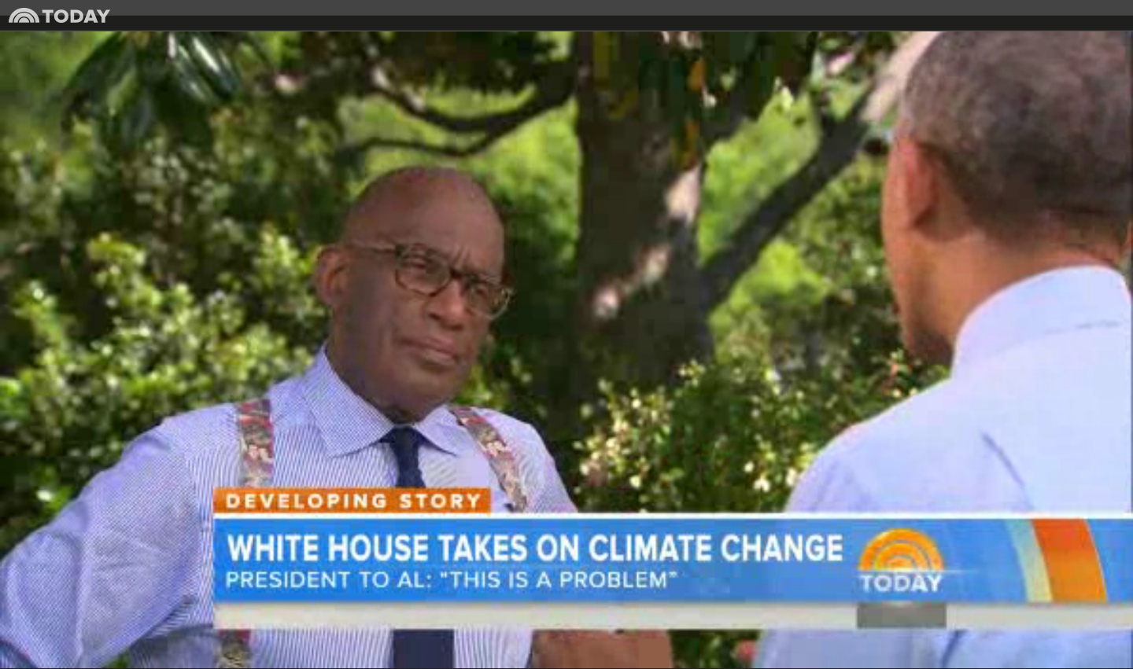

Slide 42
Good News It’s a man-made problem…
…and it has man-made solutions.

Slide 43
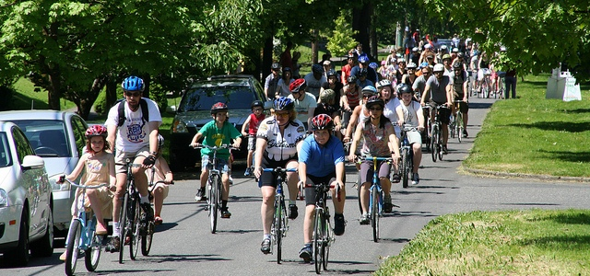
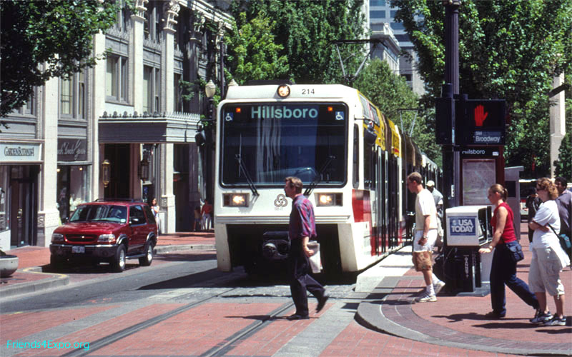
Multiple Benefits

Slide 44
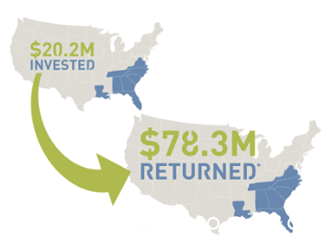
Southeast Energy Efficiency Investment Yielded 387% Returns, 2010-2013
Southeast Energy Efficiency Alliance
Notes:
Energy efficiency retrofits carried out in 16 cities across 8 Southeast US states from 2010-2013 created a 387% return on investment (ROI), according to a recent report from the Southeast Energy Efficiency Alliance (SEEA).
The retrofit effort spurred millions in economic input, created new jobs, reduced energy costs, and created economic growth associated with newfound money through worker income or utility bill savings.

Slide 45
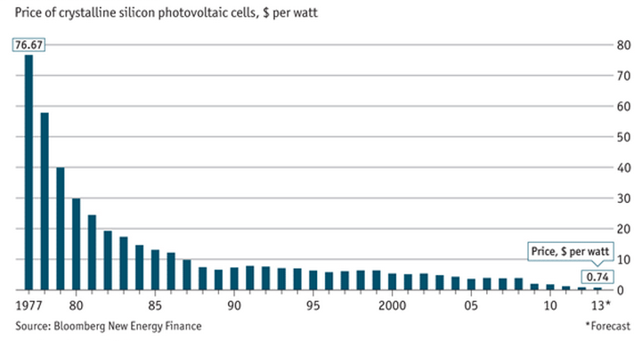
Solar Prices Dropping
Notes:
In 2013, U.S. solar companies added 20 percent more jobs in the 12 months through November. http://www.bloomberg.com/news/2014-01-27/u-s-solar-jobs-grow-20-to-more-than-142-000-last-year.html

Slide 46
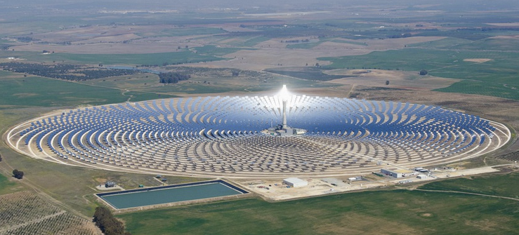
Solar is on track to be as cheap or cheaper than average electricity bill prices in 47 states by 2016
Notes:
solar electricity is on track to be as cheap or cheaper than average electricity-bill prices in 47 U.S. states -- in 2016
http://www.bloomberg.com/news/2014-10-29/while-you-were-getting-worked-up-over-oil-prices-this-just-happened-to-solar.html

Slide 47
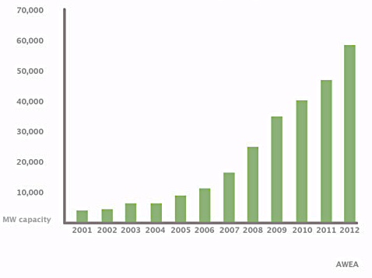
U.S. Wind Power Capacity

Slide 48
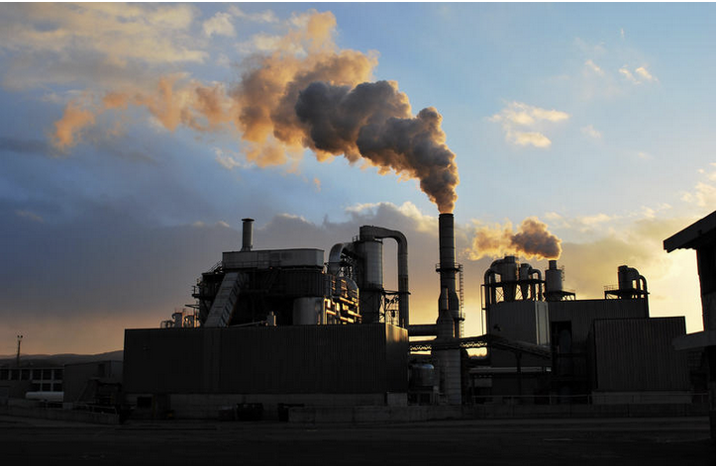
Good News on The Global Stage
Notes:
40% of global emissions. Ramps up the ambition for other leading emitters in the run up to global talks that will conclude next year in Paris, lights a fire under energy innovation everywhere. China is already making enormous investments in non fossil energy and with this agreement commits to 20% non fossil energy by 2030. So this was the best news in long time…

Slide 49
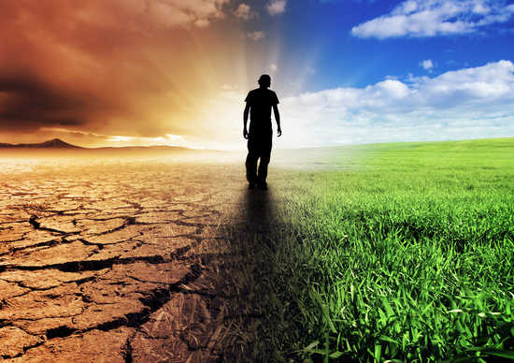
The Future is in Our Hands

Slide 50
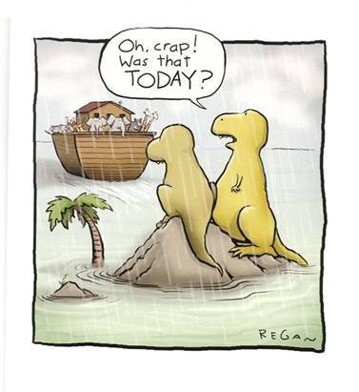

Slide 51
The Climate Change Story
Susan Hassol
Susan Joy Hassol
www.climatecommunication.org

