Slide 1
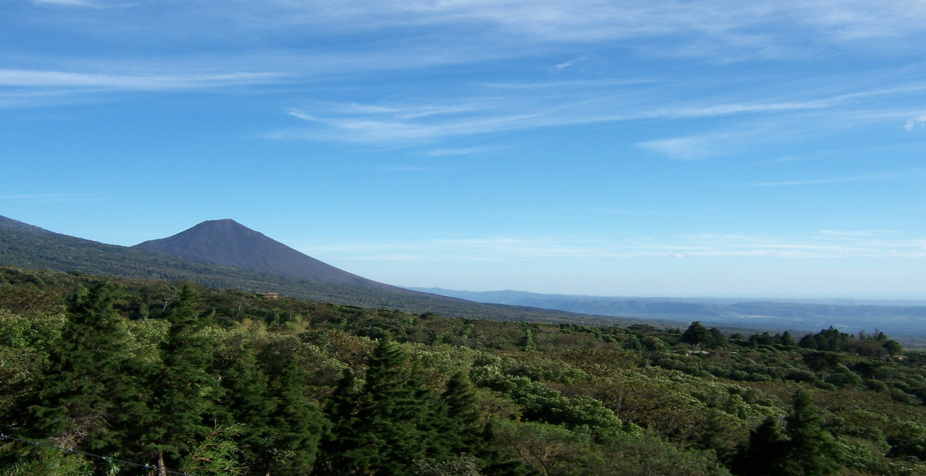

Carbon Credit Projects in the Forestry Sector
The role of science, international status, terrestrial sinks, markets,
and mitigation
November 30, 2009
Keegan Eisenstadt, ClearSky Climate Solutions
Notes:
I have been asked to cover an introduction to the climate change, carbon cycle and carbon policy and then talk about how your company's forestry sector (and other projects) are designed to mitigate climate change.

Slide 2
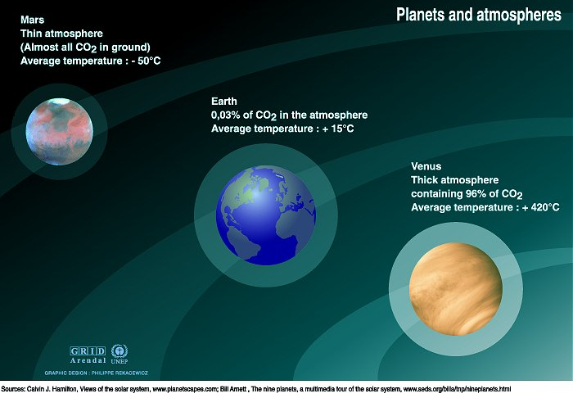
Notes:
A planet's climate is decided by its mass, its distance from the sun and the composition of its atmosphere. Mars is too small to keep a thick atmosphere. Its atmosphere consists mainly of carbon dioxide, but the atmosphere is very thin. The atmosphere of the Earth is a hundred times thicker. Most of Mars' carbon dioxide is frozen in the ground. Mars' average surface temperature is about –50°C. Venus has almost the same mass as Earth but a thicker atmosphere, composed of 96% carbon dioxide. The surface temperature on Venus is +460°C. Earth’s atmosphere is 78% nitrogen, 21% oxygen, and 1% other gases. Carbon dioxide accounts for just 0.03 - 0.04%. Water vapour, varying in amount from 0 to 2%, carbon dioxide and some other minor gases present in the atmosphere absorb some of the thermal radiation leaving the surface and emit radiation from much higher and colder levels out to space. These radiatively active gases are known as greenhouse gases because they act as a partial blanket for the thermal radiation from the surface and enable it to be substantially warmer than it would otherwise be, analogous to the effect of a greenhouse. This blanketing is known as the natural greenhous effect. Without the greenhouse gases, Earth's average temperature would be roughly –20°C. The climates on Mars and Venus are very different, but very stable and highly predictable. The Earth’s climate is unstable and rather unpredictable as compared with that of the other two planets.
A planet's climate is decided by its mass, its distance from the sun and the composition of its atmosphere.
Mars is too small to keep a thick atmosphere. Its atmosphere consists mainly of carbon dioxide, but the atmosphere is very thin. Mars' average surface temperature is about –50°C. Most of Mars' carbon dioxide is frozen in the ground.
The atmosphere of the Earth is a hundred times thicker. Earth’s atmosphere is 78% nitrogen, 21% oxygen, and 1% other gases. Carbon dioxide accounts for just 0.03 - 0.04%.
Venus has almost the same mass as Earth but a thicker atmosphere, composed of 96% carbon dioxide. The surface temperature on Venus is +460°C.
This blanketing is known as the natural greenhouse effect. Without the greenhouse gases, Earth's average temperature would be roughly –20°C. The climates on Mars and Venus are very different, but very stable and highly predictable. The Earth’s climate is unstable and rather unpredictable as compared with that of the other two planets.

Slide 3
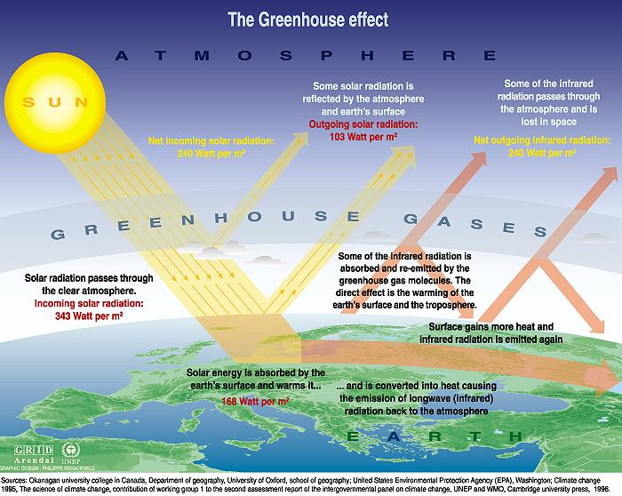
Notes:
The Earth has a natural temperature control system. Certain atmospheric gases are critical to this system and are known as greenhouse gases. On average, about one third of the solar radiation that hits the earth is reflected back to space. Of the remainder, some is absorbed by the atmosphere but most is absorbed by the land and oceans. The Earth's surface becomes warm and as a result emits infrared radiation. The greenhouse gases trap the infrared radiation, thus warming the atmosphere. Naturally occurring greenhouse gases include water vapor, carbon dioxide, ozone, methane and nitrous oxide, and together create a natural greenhouse effect. However, human activities are causing greenhouse gas levels in the atmosphere to increase. Note: Greenhouse gases are mixed throughout in the atmosphere. For pedagogical reasons they are depicted here as a layer.

Slide 4
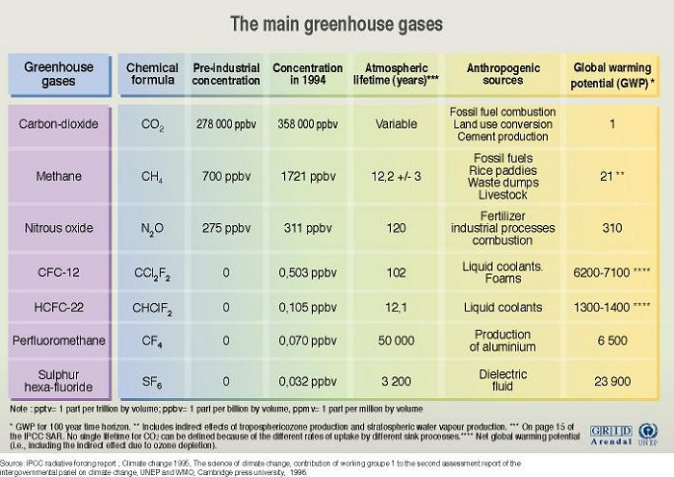
Notes:
The table lists some of the main greenhouse gases and their concentrations in pre-industrial times and in 1994; atmospheric lifetimes; anthropogenic sources; and Global Warming Potential (GWP). GWP is an index defined as the cumulative radiative forcing between the present and some chosen time horizon caused by a unit mass of gas emitted now, expressed relative to a reference gas such as CO2, as is used here. GWP is an attempt to provide a simple measure of the relative radiative effects of different greenhouse gases. The future global warming commitment of a greenhouse gas can be calculated over a chosen time horizon (such as 100 years) by multiplying the appropriate GWP by the amount of gas emitted. The choice of time horizon will depend on policy considerations. There are several other points that need to be kept in mind when using GWPs: (i) the typical uncertainty value is +/-35%, not including the uncertainty in the CO2 reference; (ii) GWPs are based on the radiative forcing concept and are therefore difficult to apply to radiatively important constituents that are unevenly distributed in the atmosphere; and (iii) GWPs need to take into account any indirect effects of the emitted gases if they are to correctly reflect future warming potential.

Slide 5
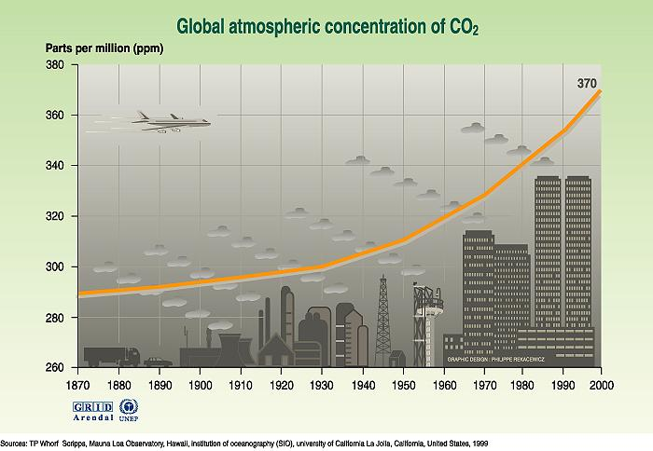
Notes:
Atmospheric CO2 has increased from a pre-industrial concentration of about 280 ppmv to about 385 ppmv at present, spring 2008 It was 375 in 2005! (ppmv= parts per million by volume). CO2 concentration data from before 1958 are from ice core measurements taken in Antarctica and from 1958 onwards are from the Mauna Loa measurement site. The smooth curve is based on a hundred year running mean. It is evident that the rapid increase in CO2 concentrations has been occurring since the onset of industrialization. The increase has closely followed the increase in CO2 emissions from fossil fuels.

Slide 6
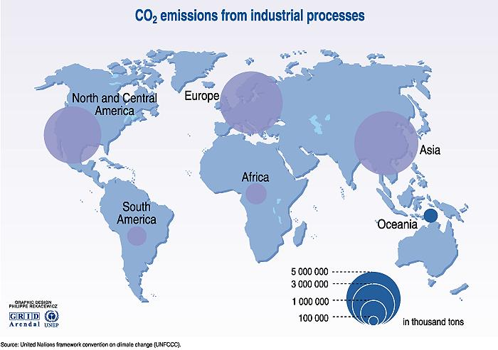
Notes:
This map depicts the unequal distribution of industry in the world. The significant part of carbon dioxide emissions comes from energy production, industrial processes and transport. The industrialised countries consequently must bear the main responsibility of reducing emissions of carbon dioxide.

Slide 7
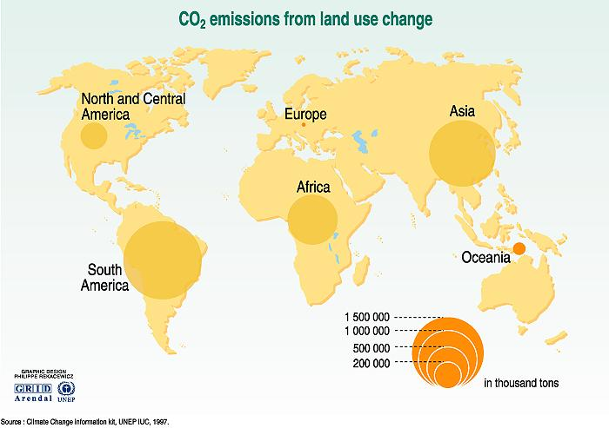
Notes:
Emissions of carbon dioxide due to changes in land use mainly come from the cutting down of forests and instead using the land for agriculture or built-up areas, urbanisation, roads etc. When large areas of rain forests are cut down, the land often turns into less productive grasslands with considerably less capacity of storing CO2.

Slide 8

What is Copenhagen About?
  How do we organize ourselves to solve a common problem? Country level, economic sector, multinationals?
  What issues need to be considered? Markets? Command and control?
  Who has the money, time, expertise and passion to handle this problem?
  What is fair?
  Emissions from fossil fuels/land use-forestry…

Slide 9
CO₂ Fossil Fuel Emissions
Annex B (Kyoto Protocol) Developed Nation
Le Quéré et al. 2009, Nature Geoscience; CDIAC 2009
Notes:
The biggest increase in emissions has taken place in developing countries (with close to 6 billion people) while developed countries (with less than 1 billion people), on average, show rather steady emissions for the last decade. About one quarter of the recent growth in emissions in developing countries resulted from the increase in international trade of goods and services produced in developing countries but consumed in developed countries. The largest regional shift in 2008 was India overtaking Russia as the third largest CO2 emitter. China and the US remain in first and second position.
From a historical perspective, developing countries with 80% of the world’s population still account for about 20% of the cumulative emissions since 1751; the poorest countries in the world, with 800 million people, have contributed less than 1% of these cumulative emissions. Uncertainty of emissions from CO2 fossil fuel is large in some countries and about ±0.5 PgC globally.

Slide 10
Fossil Fuel Emissions: Top Emitters (>4% of Total)
2000
China
1600
USA
1200
Carbon Emissions per year
(tons x 1,000,000)
800
Russian Fed.
India
400
Japan
0
1990
03
05
07
99
01
03
05
2008
Time
Global Carbon Project 2009; Data: Gregg Marland, CDIAC 2009
Notes:
Top emitters with a global share bigger than 4%
2008 highlights:
China emissions don’t slow down as a result of the financial crisis
USA emissions show a small decline in total emissions
India overtakes Russia as the third top emitter
Russia emissions still below pre-1990s collapse levels

Slide 11
Fossil Fuel Emissions: Profile Examples (1-4% of Total)
UK
160
Canada
South Africa
120
Carbon Emissions per year
(tons x 1,000,000)
80
Brazil
Australia
Spain
40
Denmark
0
1990
03
05
07
99
01
03
05
2008
Time
Global Carbon Project 2009; Data: Gregg Marland, CDIAC 2009
Notes:
Examples of countries accounting for 1 to 4% of global share of emissions
Young economies such as Canada, South Africa, Spain and Australia show strong growth in emissions while emissions from older economies such as the UK and Denmark show a rather stable or declining levels; some of the decline is due to the outsourcing of CO2 emissions to developing countries. Australia emissions have been steady for the last three years.

Slide 12
Cumulative Fraction of Total FF Emissions 2008
Number of Countries
Country
Cumulative Fraction
1
2
3
4
5
6
7
8
9
10
20
50 (2005)
100 (2005)
210
China .232
USA .419
India .477
Russia .530
Japan .573
Germany .599
Canada .617
UK .633
South Korea .652
Iran .668
Poland .800
Belarus .941
Moldova .992
1.00
3 countries
50% Global Emissions
10 countries
2/3 Global Emissions
Top 5 + EU
80% Global Emissions
Gregg Marland, CDIAC 2009

Slide 13
Components of FF Emissions
4
40%
3
Oil
36%
Coal
CO₂ emissions (PgC y⁻¹)
2
Gas
1
Cement
0
1990
2000
2010
Le Quéré et al. 2009, Nature Geoscience

Slide 14
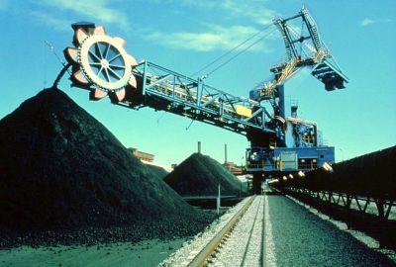
Change in CO₂ Emissions from Coal Emissions
2006-2008
300
250
90% of growth
200
CO₂ emissions (TgC y⁻¹)
150
100
50
0
China
India
US
World
-50
CDIAC 2009; Global Carbon Project 2009

Slide 15
Per Capita CO₂ Emissions
Developed countries continue to lead with the highest emission per capita
1.3
1.2
1.1
Per Capita Emissions (tC person⁻¹ y⁻¹)
1990 1995 2000 2005 2010
Le Quéré et al. 2009, Nature Geoscience; CDIAC 2009

Slide 16
Fossil Fuel Emissions: Actual vs. IPCC Scenarios
Raupach et al. 2007, PNAS, updated; Le Quéré et al. 2009, Nature Geoscience; International Monetary Fund 2009
Notes:
The current financial crisis had a small but probably discernable impact on the emissions growth rate in 2008 (growth rate of 2.0% down from 3.4% per year average over the previous 7 years). Despite this slowdown, fossil fuel emissions continue to track the average of the most carbon-intensive scenario of the Intergovermental Panel on Climate Change. In 2009, we project emissions to decline to levels observed in 2007 with negative growth of -2.8%. Positive growth is expected return in 2011 as the change in global Gross Domestic Product goes positive.
We have estimated emissions for 2009 based on the projection of -1.1% GDP growth rate provided by the International Monetary Fund (October 2009) and assuming a continue global decline in the carbon intensity of the GDP as seen over the last 30 years (-1.7% per year).

Slide 17
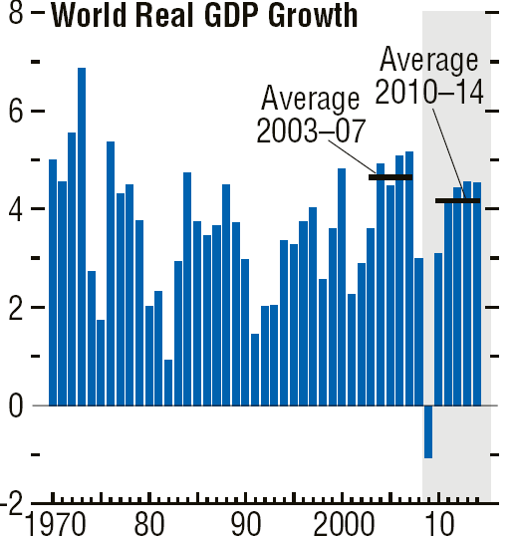

Economic Crisis Impact on World GDP Growth
-1.1%
International Monetary Fund, October 2009

Slide 18
Fossil Fuel Emissions: Actual vs. IPCC Scenarios
Projection 2009
Emissions: -2.8%
GDP: -1.1%
C intensity: -1.7%
Raupach et al. 2007, PNAS, updated; Le Quéré et al. 2009, Nature Geoscience; International Monetary Fund 2009
Notes:
The current financial crisis had a small but probably discernable impact on the emissions growth rate in 2008 (growth rate of 2.0% down from 3.4% per year average over the previous 7 years). Despite this slowdown, fossil fuel emissions continue to track the average of the most carbon-intensive scenario of the Intergovermental Panel on Climate Change. In 2009, we project emissions to decline to levels observed in 2007 with negative growth of -2.8%. Positive growth is expected return in 2011 as the change in global Gross Domestic Product goes positive.
We have estimated emissions for 2009 based on the projection of -1.1% GDP growth rate provided by the International Monetary Fund (October 2009) and assuming a continue global decline in the carbon intensity of the GDP as seen over the last 30 years (-1.7% per year).

Slide 19
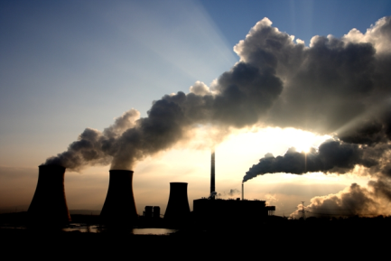
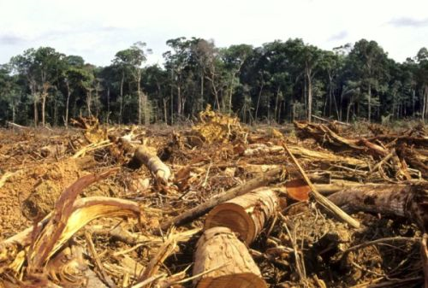
CO₂ Emissions from Land Use Change
Fossil fuel
Land use change
Le Quéré et al. 2009, Nature Geoscience; Data: CDIAC, FAO, Woods Hole Research Center 2009

Slide 20
Net CO₂ Emissions from LUC in Tropical Countries
2000-2005
600
500
Brazil
60%
400
Indonesia
CO₂ emissions (TgC y⁻¹)
300
Colombia
Cameroon
Venezuela
200
Peru
Nicaragua
Rep.Dem.Congo
India
100
Nigeria
Philippines
Nepal
0
4-2%
2-1%
<1%
RA Houghton 2009, unpublished; Based on FAO Global Forest Resource Assessment
Notes:
Land use change was responsible for estimated net emissions of 1.5 PgC per year over the last 15 years. In 2008, estimated emissions declined to 1.2 Pg C. Wet La Niña con­ditions probably contributed to limited fire use and deforestation rate in Southeast Asia. Emissions from Brazil and Indonesia account for 61% of all emissions from land use change. The contribution of land use change emissions to the total emissions from human activities was 12% in 2008, down from 20% in the 1990s.
CO2 emissions from land use change were calculated by using a book-keeping method with the revised data on land use change from the Food and agriculture Organization of the United Nationals Global Forest Resource Assessment. Emissions after 2005 were extrapolated from the previous 25-year trend of 1.5 PgC per year. Gross emissions from land use change come almost exclusively from deforestation in tropical countries with an estimated 41% from South and Central America, 43% from South and Southeast Asia, and 17% from Africa. We used fire emissions from the Global Fire Emissions Database vs.2 over tropical forests to provide inter-annual variability on emissions over the last three years. Uncertainty of the global estimate of land use emissions is large and considered to be ±0.7 PgC in this analysis. Emission uncertainties at the country level can be large.

Slide 21
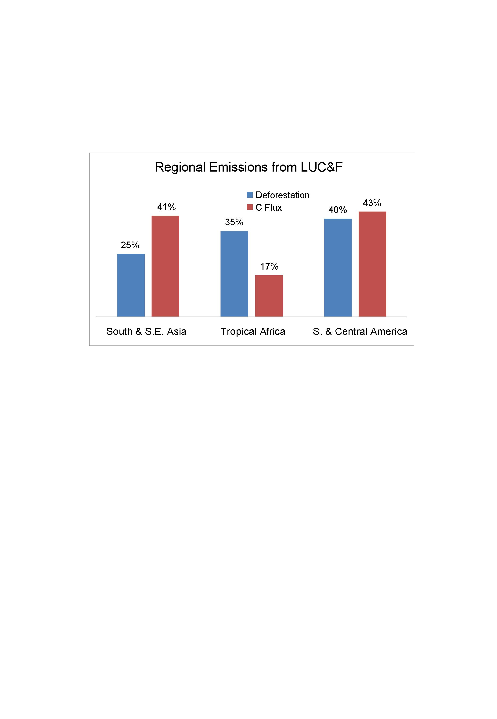
Emissions from Land Use Change (2000-2005)
(Area)
Canadell et al. 2009, Biogeosciences
Notes:
Tropical Africa has relatively low C emissions (17%) compared to its global deforestation share (35%). It is likely that this is the result that deforestation in Africa includes large areas of dry tropical forest which has lower carbon density. Contrary, South & SE Asia, largely Indonesia, has a much larger global share of emissions than of the area deforested. It is thought it is due to forest regions with high carbon density.

Slide 22
Total Anthropogenic Emissions 2008
Fossil fuel
Land use change

Slide 23
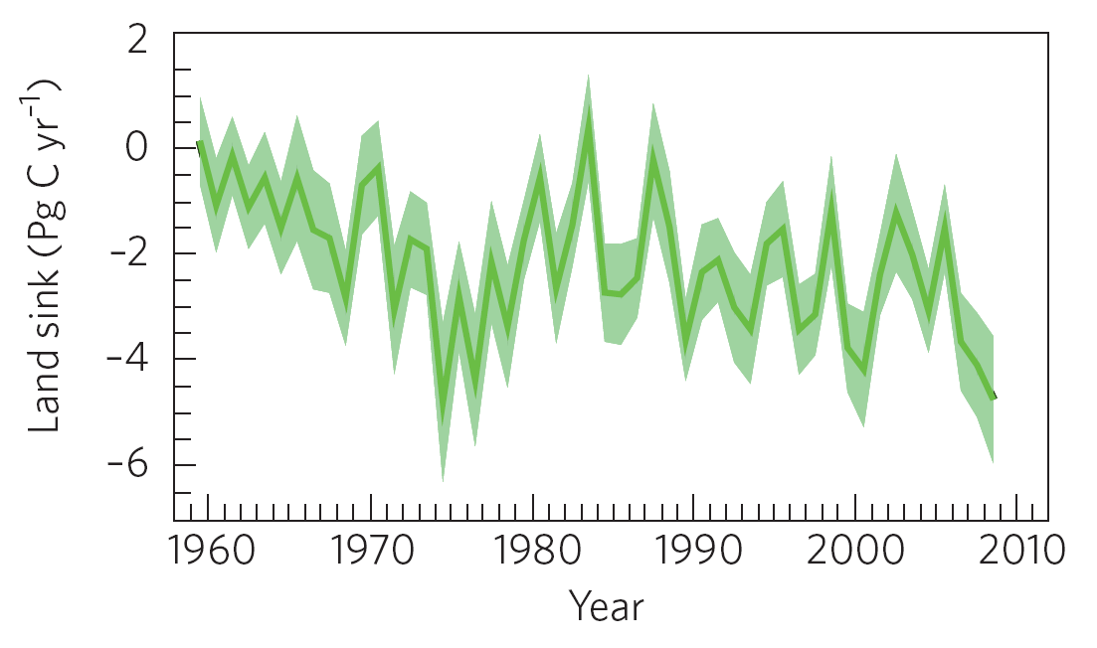
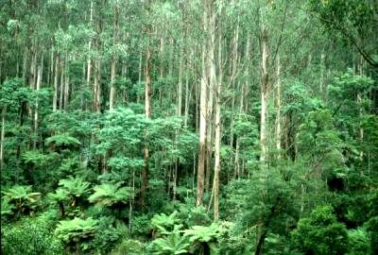
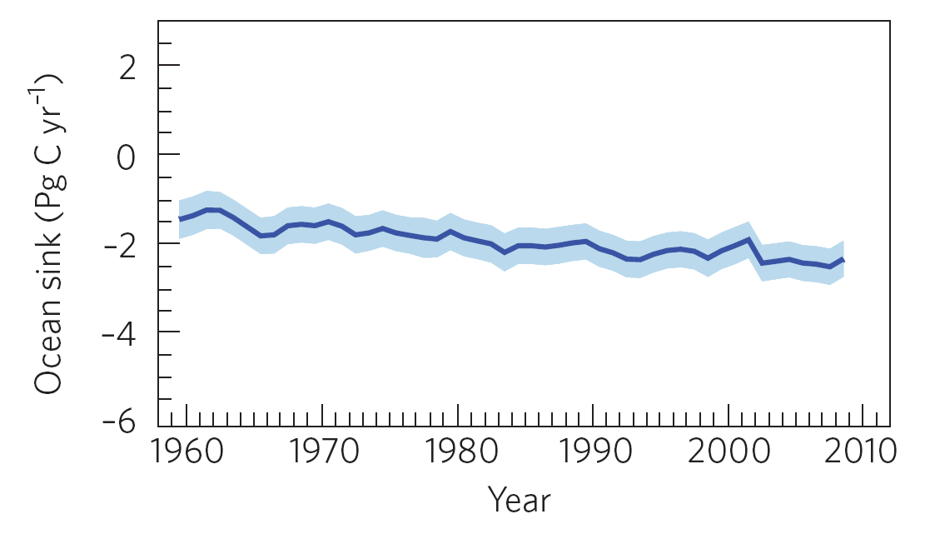
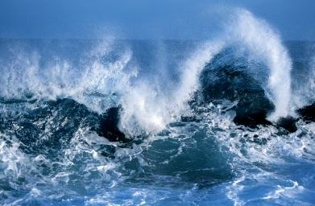
Modelled Natural CO₂ Sinks
Le Quéré et al. 2009, Nature Geoscience
Notes:
Terrestrial CO2 sinks removed 29% of all anthropogenic emissions for the period 2000-2008, equivalent to an average of 3 PgC per year. In 2008, terrestrial ecosystems removed 4.7 PgC, significantly higher than the long term average owing to the wetter conditions brought about by La Niña. An analysis of the long term trend of the terrestrial sink shows a growing size of the CO2 sink over the last 60 years but not discernable change in the efficiency of the sink
The terrestrial sink was estimated using an ensemble of 5 global vegetation models forced by observed CO2 concentration and a combination of meteorological data from the Climatic Research Unit and US National Centers for Environmental Prediction.

Slide 24


Fate of Anthropogenic CO₂ Emissions (2000-2008)
1.4 PgC y⁻¹
4.1 PgC y⁻¹
45%
+
3.0 PgC y⁻¹
29%
7.7 PgC y⁻¹
26%
2.3 PgC y⁻¹
Le Quéré et al. 2009, Nature Geoscience; Canadell et al. 2007, PNAS, updated
Notes:
Residue is included in the land sink

Slide 25
Possible Reasons for a Positive Trend in Airborne Fraction
Emissions are rising faster than the time scales regulating the rate of uptake by sinks.
Sinks are becoming less efficient at high CO₂
  Land: saturation of the CO₂ fertilization effect
  Ocean: decrease in [carbonate] which buffers CO₂
Land and/or ocean sinks are responding to climate change and variability.
We are missing sink processes in models that are contributing to the observed changes.
Notes:
Of the four possible explanations for the positive trend in the airborne fraction we believe that emissions rising faster than sinks can keep up is a very important one. Model experiments suggest that the sinks are also responding to climate change and variability.

Slide 26
Fossil Fuels, Forestry, Politics
The actors emitting GHGs from fossil fuels are different from those emitting GHGs from Forests.
There is a large ‘manifest destiny’ issue to be negotiated between developed and developing countries.
We MUST wean off Fossil Fuel.
Forests and conservation are an opportunity.
Transfer of funds, capacity, skill, knowledge….

Slide 27
Forestry & Climate Change
What is the role of forestry in climate change? What can be done?
Payment for Environmental Services
Regulatory and Voluntary markets for environmental services
  Kyoto, EUTS, AusTS vs. international voluntary market, CCX, WCI, etc.
Forestry has potential to increase carbon that can be traded and/or sold from:
  Afforestation/Reforestation,
  Reducing Emissions from Deforestation and Degradation (REDD)
  Improved, sustainable forest management in the voluntary carbon markets
Clear protocols for baseline, monitoring, duration of carbon activity, credit tenure, distribution of benefits (USFS?)
Notes:
How can we solve this problem?
Talk a bit about the Kyoto process……the experiences with markets to solve enviro problems – like PES.
How these markets are developing – and how the products change in a voluntary market and a regulatory market.
Like water markets. Paying for clean water in a utility is a regulatory issue…….
Kyoto is legal/regulatory – and developed country can use CDM or JI to comply with 10% of their reduction target. The rest is in ‘national action’.
Voluntary market is for people wanting to make a difference, but not to comply with a law.

Slide 28
What needs measuring?
Carbon Pools
  Above ground biomass (DBH and height - to build allometric curves)
  Fine above ground biomass (branches, twigs, leaves – subsampled pool)
  Below ground biomass (roots coarse and fine - typically extrapolated from literature)
  Necromass (downed woody debris and leaf litter – subsampled pool)
  Soil (organic carbon – depths to 30 cm, either sampled or extrapolated from literature)
  Trends through time (REDD) and baseline assessments of biomass

Slide 29

Global Characteristics for Carbon Credits
A high quality carbon market project can demonstrate:
  Additionality
  Baseline Determination
  Benefit Quantification
  Permanence or certainty of duration for temporary credits
  Ownership
  Monitoring and Verification
  Registration
Non-technical variables that are important:
  Cost
  Timing of Delivery
  Bundling of environmental and social externalities
Notes:
Additionality - has a number of tests, Environmental and Financial and potentially barrier analysis
Baseline - is a technical question
Benefit quantification - is the GHG sequestration relative to the baseline, as well as an assessment for leakage.
Permanence – difficult with LULUCF, easy with avoided emissions. Certainty for temporary credits tCERs or tVERs
Ownership – this is an issue of clear tenure. In our case, land tenure typically leads to carbon tenure.
Monitoring and Verification – according to approved methods and by reliable sources. Confidence in the market.
Registration – to provide a paper trail to offset serial #s.
Cost – an important variable, especially for the regulatory market. Not necessarily as critical in the voluntary market. In fact, there is very little correlation in the voluntary market between price and quality.
Timing of Delivery – Whether the project is selling a large stock of inventory at once, whether it will deliver the credits as a stream of commodities as created, or whether the project is selling futures or options.
Bundling of externalities – these are the non-priced enviro and social goods that are bundled with the product to improve the ‘story’ and the value to the customer, and hopefully the price. Water quantity & quality, erosion control, biodiversity habitat, corridor benefits, local microclimate regulation, employment generation, reduction in rural-urban migration, reduced delinquency, north-south climate equity, etc.

Slide 30
Forests make High Quality Carbon Sinks
Biomass and Forest Sinks
  International certifications for both timber and Carbon credits
  Social benefits (governance, transfer of forest asset, migration patterns, education, training)
  Local economic benefits (wages, cottage industry, long-term revenue generation, etc.)
  Environmental benefits
    biodiversity, water, air, and soil

Slide 31

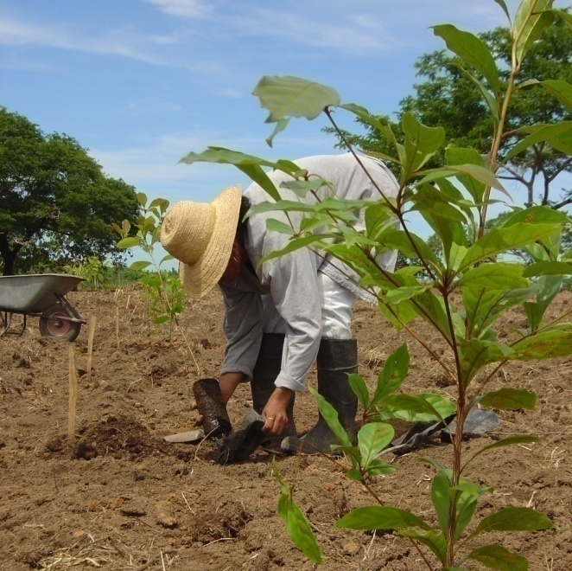
ClearSky Offsets
Panama Re-forestation Project
Re-planting native rainforest trees on degraded land
Annual measurement and monitoring
High biodiversity benefits
Positive social impacts
Certified carbon offsets (CCBA & pre-CDM)
www.clearskyclimatesolutions.com
415 N. Higgins Ave., Suite 117 ● Missoula, MT 59802 ● P: (406) 721-3000

Slide 32
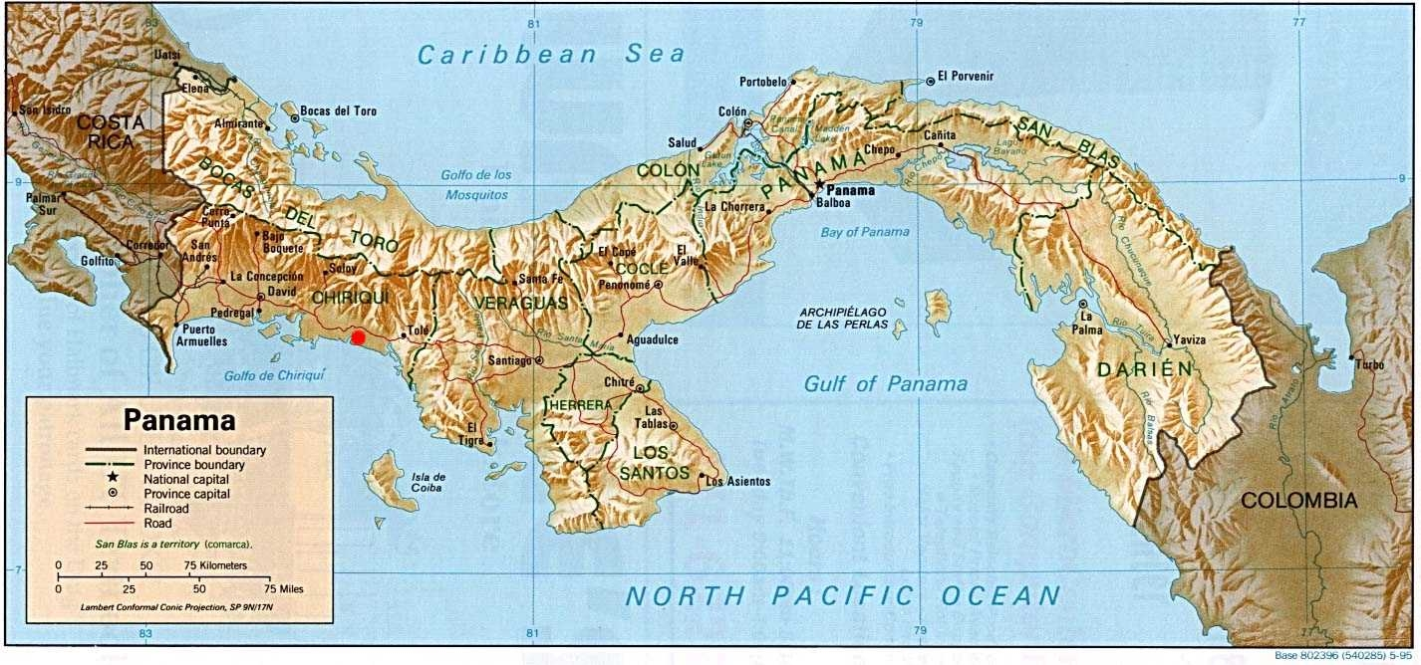
The Panama Project Location

Slide 33
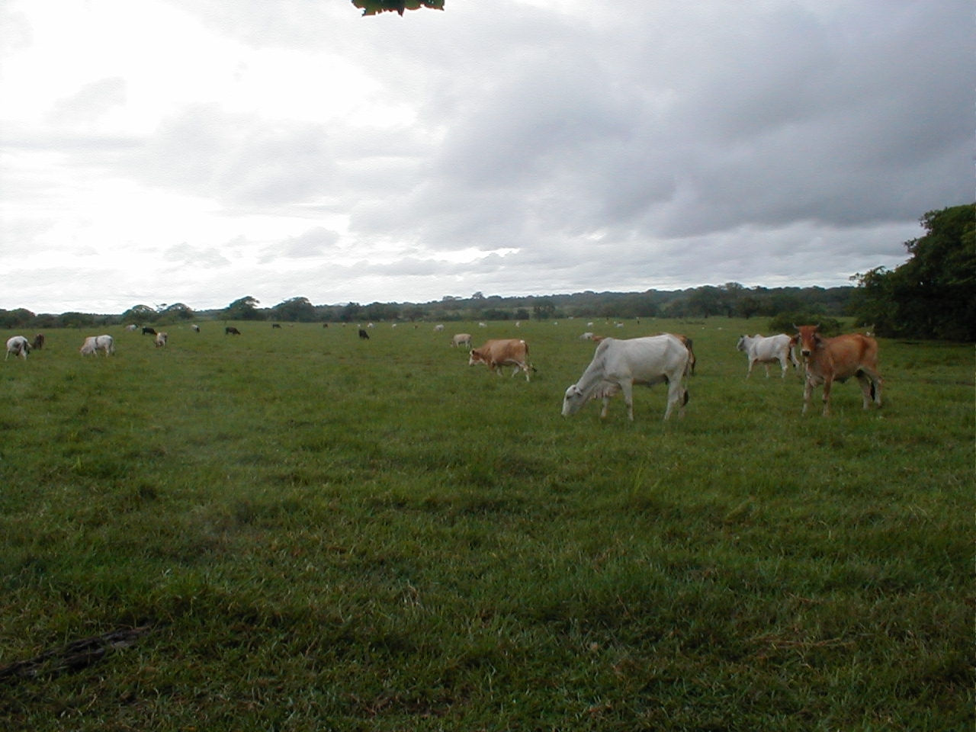
Baseline Land Use Activities

Slide 34
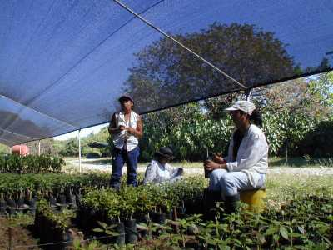
Nursery Activities
Working with up to 57 species
Scientifically Unknown species
Seed collection, treatment, scarification, planting practices, etc.
Outplanting – when, how, etc.
Notes:
A number of operational issues…….including allometry for non-market tree species.
Working with the Smithsonian, CATIE, Zamorano, Univ. of Panama, Yale School of Forestry, Wageningen, and UM.

Slide 35
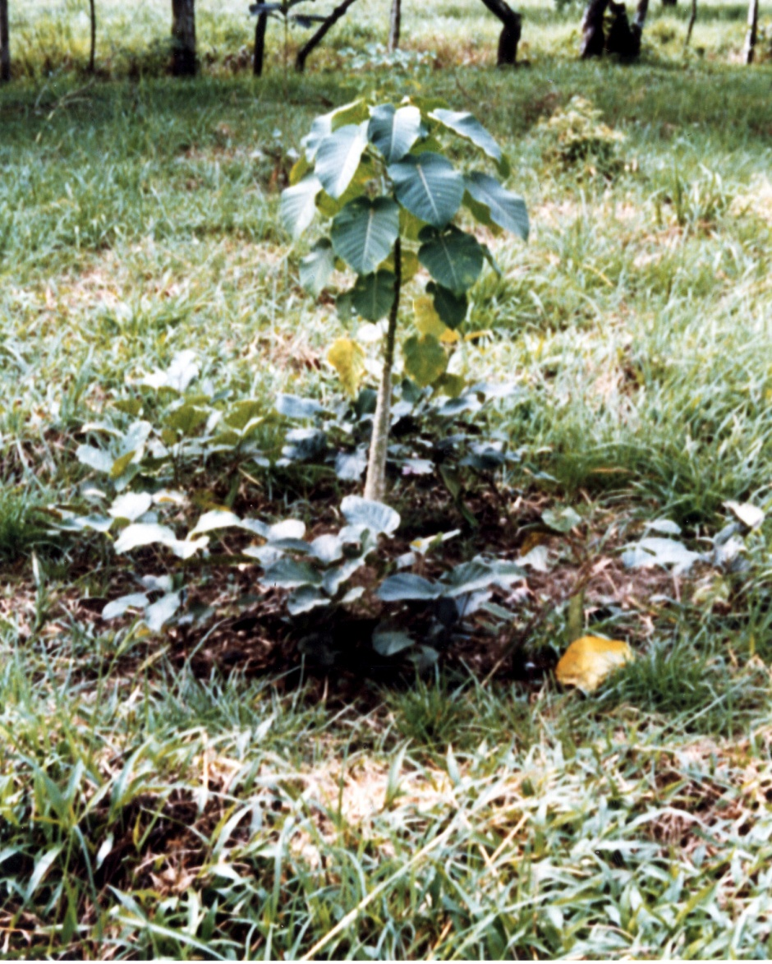
Seedling Outplanting
Outplanting of high quality, good provenance seedlings
Planted in bocachi and with nitrogen fixing cover crops

Slide 36
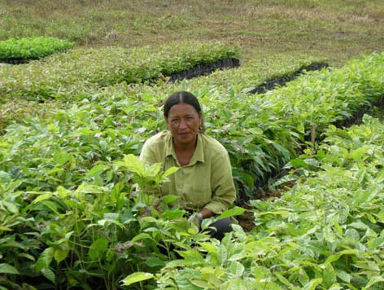
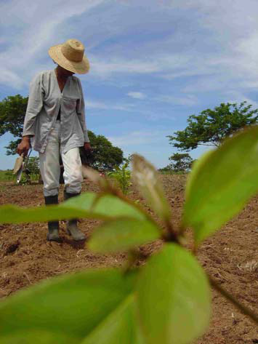
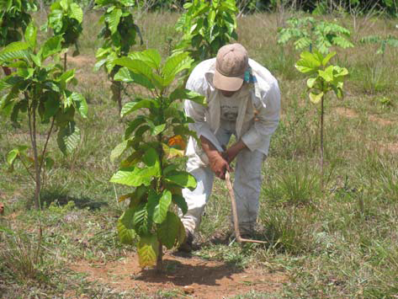
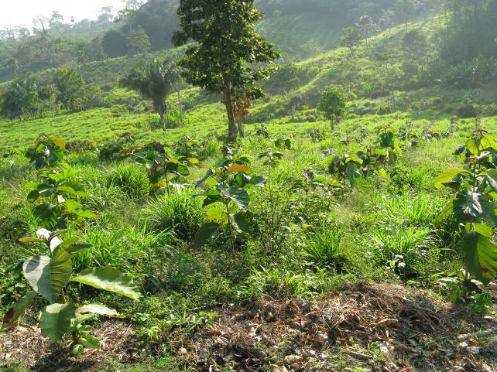
Nursery to Plantation

Slide 37
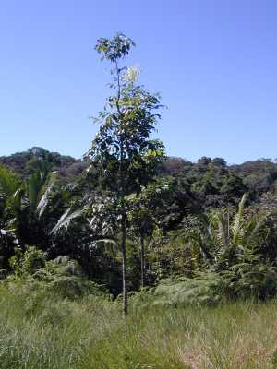
Forest Establishment
Amarillo: Terminalia Panamensis
10 months old

Slide 38
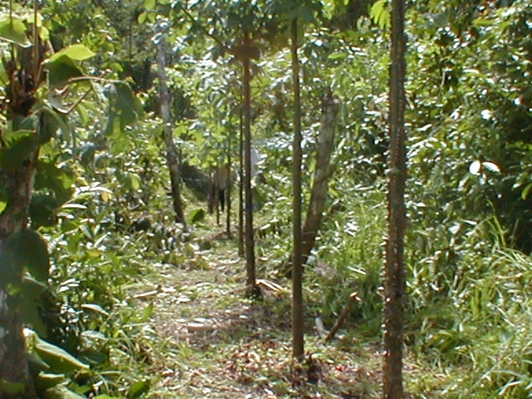
Enrichment Line Planting
‘Corona de Dios’ Cedro Espino
2 years old

Slide 39
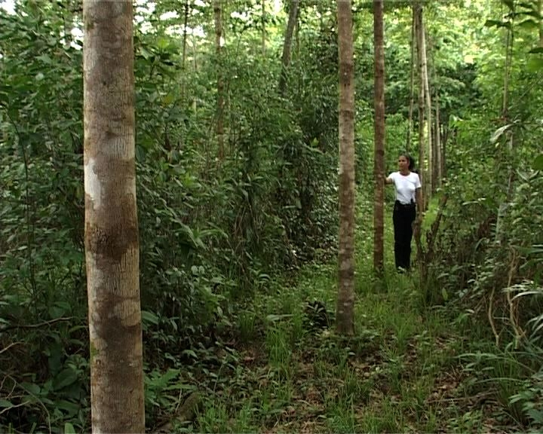
Amarillo: Terminalia Panamensis
5 years old

Slide 40
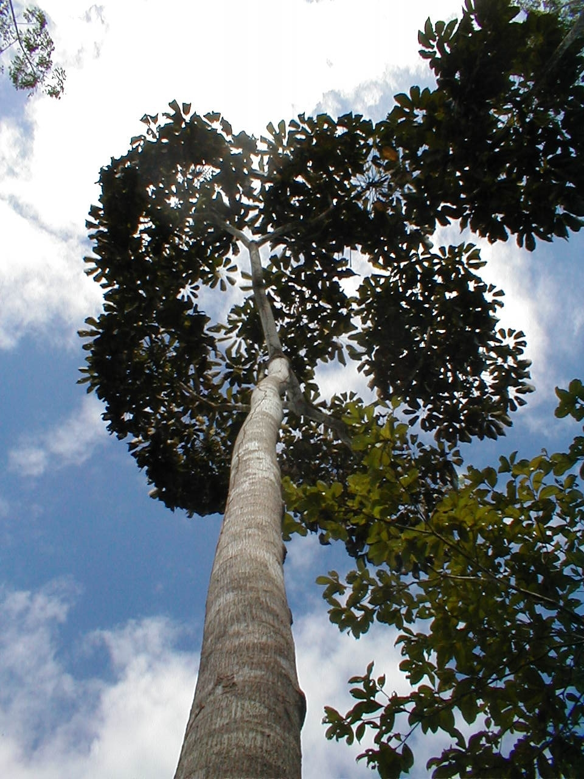
Amarillo:
Terminalia Panamensis
5 years old

Slide 41
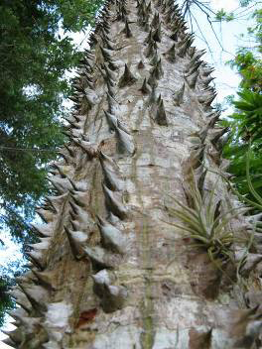
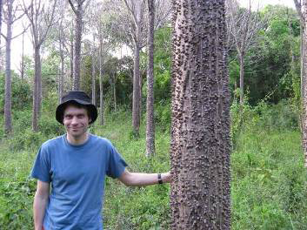
Cedro Espino:
Bombacopsis
9 years old

Slide 42
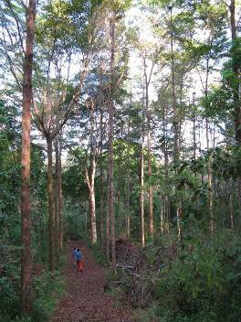
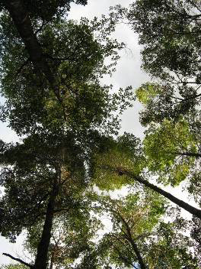
Amarillo:
Terminalia Panamensis
9 years old

Slide 43

Spider monkeys back in the forest after 9 years

Slide 44

Ocelots returned to the forest after 7 years. About twice the size of the average house cat, the dappled fur of the ocelot serves as camouflage in the jungles of South and Central America.

Slide 45
Baseline Land Use Activities

Slide 46
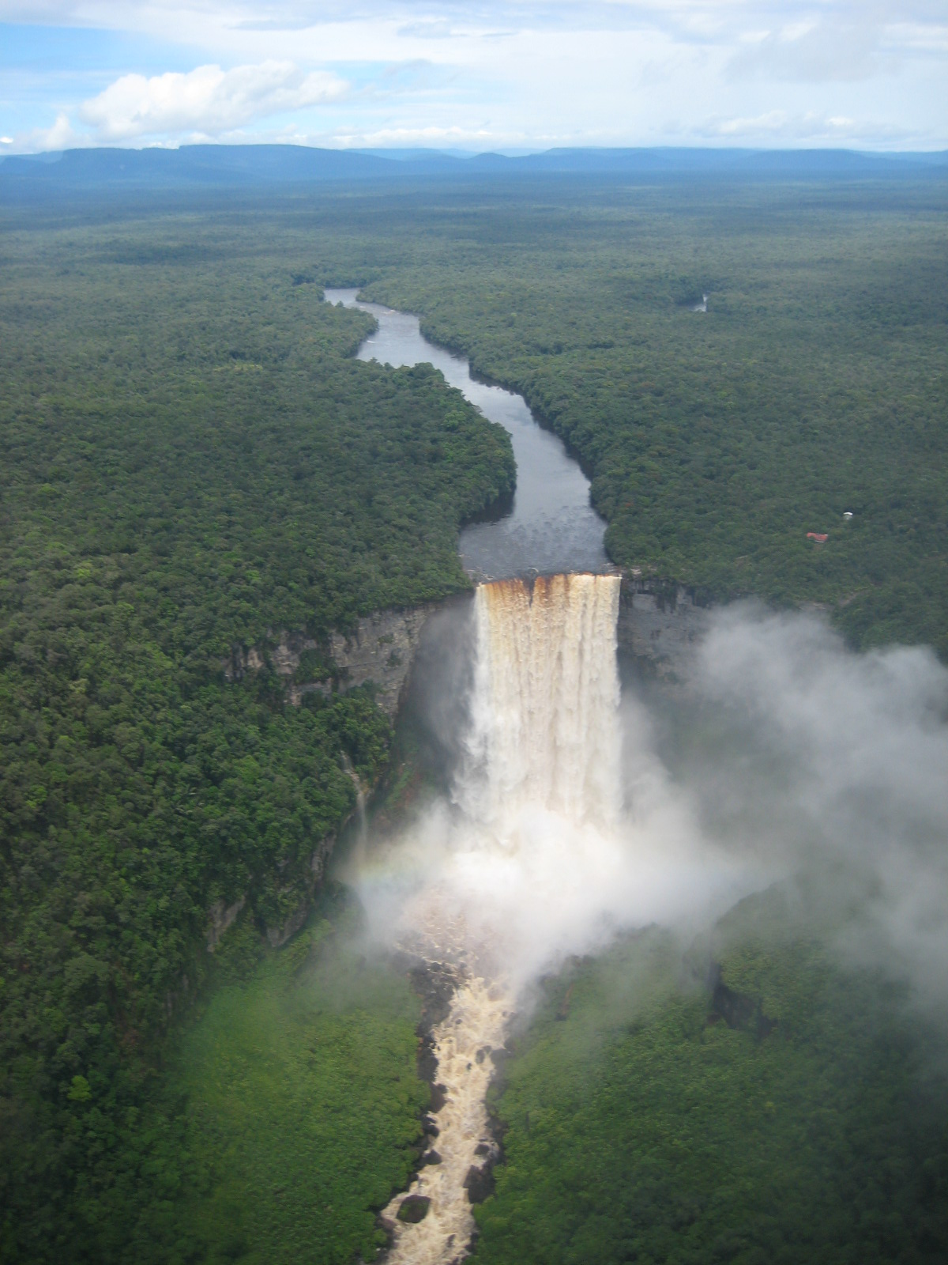

Carbon Credit Projects in the Forestry Sector
Don’t forget to offset your studies and your parents trips to visit!
www.clearskyclimatesolutions.com
Notes:
I have been asked to cover an introduction to the carbon cycle and carbon policy and then talk about how your company's forestry sector (and other projects) are designed to mitigate climate change.

