Slide 1
John Broome, “The Ethics of Climate Change”
“What should we do about climate change? The question is an ethical one.”
“When interests conflict the questions are ethical ones.”
Rich versus poor
Living versus future
Humans versus Non-humans

Slide 2
Elementary moral principle:
“you should not do something for your own benefit if it harms another person.”
Those who benefit from some course of action should not impose the costs on others who do not benefit.

Slide 3
Ethics of Costs and Benefits
Weighing the cost to some people versus the benefits to others is an ethical matter.
What are the costs of mitigating climate change and who will pay those costs?
What are the benefits of mitigating climate change and who will receive those benefits?

Slide 4
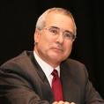
The Stern Review
The benefits of mitigating climate change will far outweigh the costs.

Slide 5
Strong Reactions:
First, some economists think economic conclusions should not be based on ethical premises.
Second, the review favors strong and immediate action to control emissions, whereas other economic studies, such as the one by William Nordhaus, have concluded that the need to act is not so urgent.

Slide 6
Economics and Ethics
Discount Rate:
Nordhaus chooses a discount rate of roughly 6 percent
Stern chooses a discount rate of 1.4 percent
Two ethical theories:
Utilitarianism: benefits have the same social value whoever receives it. This justifies a lower discount rate.
Prioritarianism: Give priority to the least well off. $100 of benefit to a poor person should have greater social value (given priority in social decision making) than $100 of benefits to a rich person. This justifies a higher discount rate.

Slide 7
Market and Discount Rates
Stern’s choice of discounts rates is based on the ethics.
Some market decisions are appropriately a matter of taste (apples and oranges). “But the value that should be attached to the well-being of future generations is not determined by tastes. It is a matter of ethical judgment.”

Slide 8
Consumers and Citizens
“The economists who criticize Stern claim the democratic high grown and accuse him of arrogantly trying to impose his own ethical beliefs on others. They misunderstand democracy. Democracy requires debate and deliberation as well as voting.”
“Ethical considerations cannot be avoided in determining the discount rate.”

Slide 9
UN REDD

Slide 10
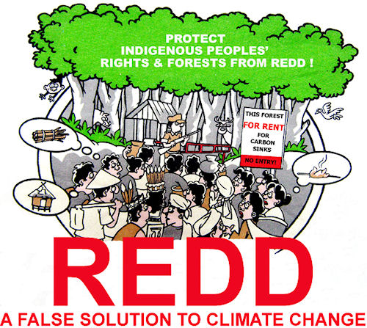
Opposition

Slide 11
A Few Ethical Issues Raised By REDD
Criterion of “additonality” gives raise to several ethical questions.
It requires the inclusion of only forests that are targeted for deforestation, allowing developing countries to sell carbon credits gained by reducing their deforestation rates against a baseline deforestation rate. This insures that carbon payments are additional benefits by excluding forests that would store carbon without these payments.

Slide 12
Short-term increase in deforestation
First, some suggest that basing credits on historical deforestation rates could create short-term increases in deforestation rates. The worry is countries and groups of people with low deforestation rates would see this as an incentive to increase deforestation in order to establish a higher baseline rate.

Slide 13
Second, using baseline deforestation rates rewards countries with high deforestation rates over those with low deforestation rates. Countries like Costa Rica that have relatively low rates of deforestation would receive fewer benefits than a country that is currently mismanaging its forests. It is possible that REDD would favor countries that practice unethical and unsustainable forestry.

Slide 14
Third, in a similar way, it’s possible that REDD could advantage developers who are currently acting unethically Large developers who are currently violating existing laws could see carbon payments as an opportunity for profits. This creates a situation where people are getting paid for what they should be doing in the first place. Further, in some countries with high deforestation rates wealthy, questionable developers are well-placed to take advantage of poor REDD governance. It seems dubious to pay people to stop practices that are outlawed or unethical.

