Slide 1
Climate Change
The Cryo
sphere &
Fall 2010 Textbook pp.75-105
Notes:
Todays lecture is on the Cryosphere. To give you an idea of where we will be heading first we will cover the main component of the Cryosphere, then we will talk about measurement technique, followed by a brief summary regarding the status of each of the components of the Cryosphere. Finally we will talk about some of the mechanisms driving the observed changes in the Cryosphere. To get us into lecture mode we will start off with a couple videos.

Slide 2
http://www.youtube.com/watch?v=bYH2Df-evNs
Notes:
Can anyone tell me what process was captured in this video?

Slide 3
http://www.youtube.com/watch?v=_2NvwlnKVtU
Notes:
Here is one more because most of these videos always cut the wave that result from an iceberg calving. This is a small tsunami that resulted from an iceberg calving in Greenland in 1995. Keep your eyes on these small boats. Alright now here is a kind of trick question, is this process a result of climate change?? No, your right this process is not a result of climate change however the frequency with these processes occur can be impacted by climate change which we will discuss later in this lecture.

Slide 4
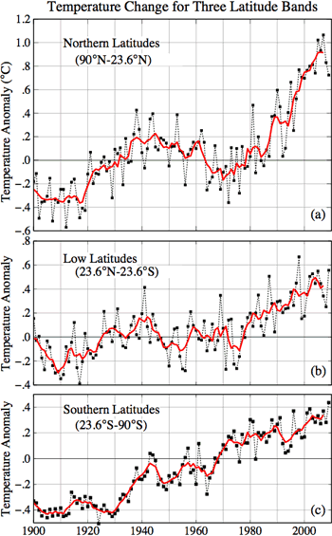
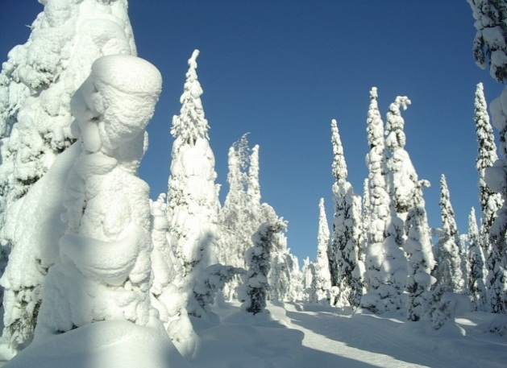
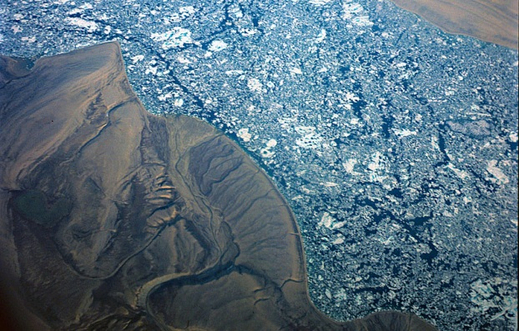
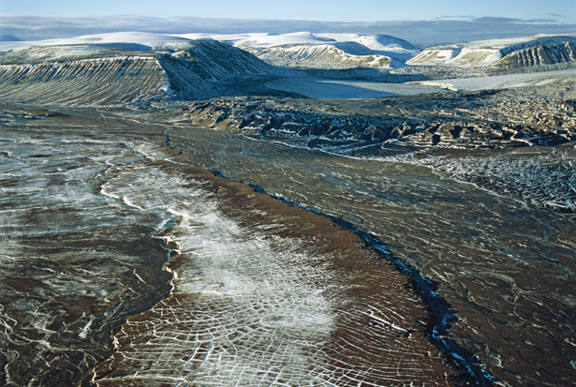
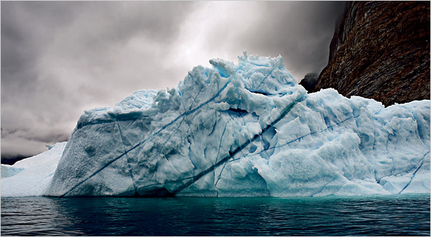
Is the Cryosphere Sending Signals About Climate Change?
Snow
Glaciers
Sea Ice
Permafrost
Ice Sheets
Notes:
The main question we will try to address in this lecture is … Before we can do that however we need to know the components of the Cryosphere. Does anyone know what the main components are? On the left is the temperature record over the past 100 years and we all know by now that temperatures are rising. However in this figure we can see that temps are actually increasing significantly more at northern latitudes. I wanted to show this figure now so that while we dicuss the components we can keep in mind this increase and think about why we are seeing the trend.

Slide 5
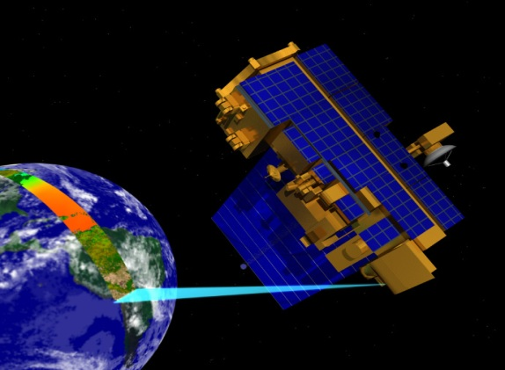
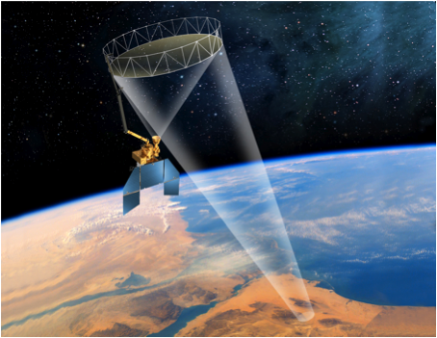
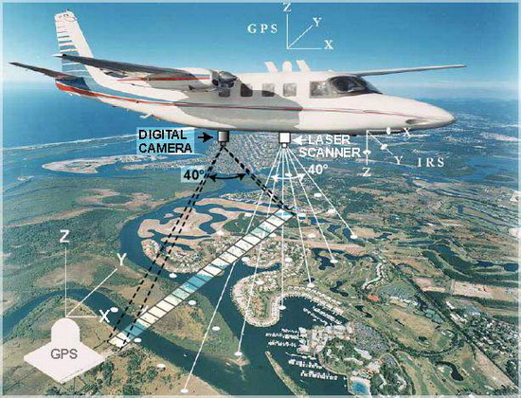
Current Measurement Techniques
The dawn of the satellite era (1960’s).
Passive NIR (MODIS)
Snow is relatively cold (+)
No cloud penetration (-)
No nighttime monitoring (-)
Passive Microwave
Cloud Penetration (+)
Nighttime Monitoring (+)
Microwave Energy level is low (-)
Active Microwave (RADAR)
Snow/Ice Depth (+)
Limited Range (-)
Notes:
Now that we know the main component of the Cryosphere lets talk about how we monitor the Cryosphere. Since the 60’s we have had satellites monitoring the earths surface from space. Since about the late 70’s we had an adequate method for monitoring the main components of the Cryosphere. Therefore we have a satellite record of the Cryosphere that extends back over 30 yrs. There are a few important distinctions to make regarding how satellites work.

Slide 6
Current Measurement Techniques

Slide 7
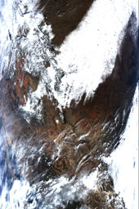
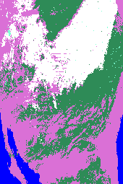
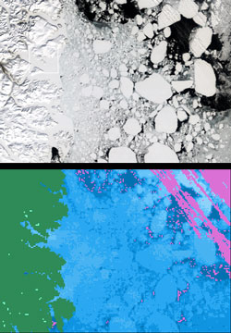
Passive Microwave Example
Image Color Legend
white | snow
pink | cloud
grey | no data / night
green | snow/cloud free land
blue | water

Slide 8
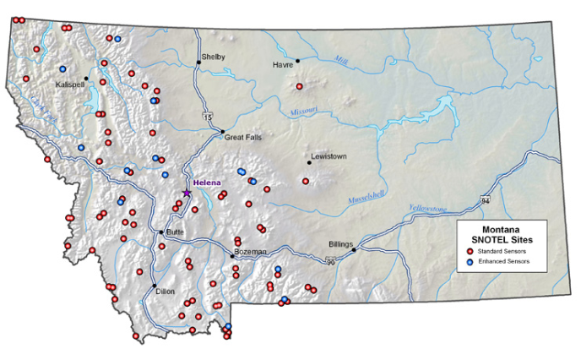
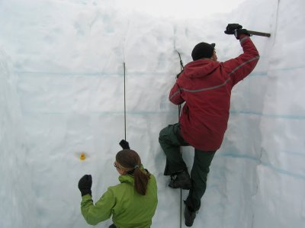
Past Measurement Techniques
Submarine Data
Sea Ice
1950’s
Snowtel Data
Snow Depth
1940’s
Field Measurement
Glacier Mass Balance
1940’s

Slide 9
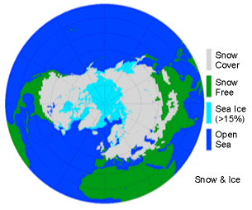
Snow Cover Extent
Seasonal Snow cover is the largest single component of the Cryosphere.
Areal extent of 47 million km².
Snow can cover > 40% of the NH’s land surface.
98% located in the Northern Hemisphere!
Northern Hemisphere snow extent map: Image from Northern Hemisphere EASE-Grid Weekly Snow Cover and Sea Ice Extent Version 3 product.

Slide 10
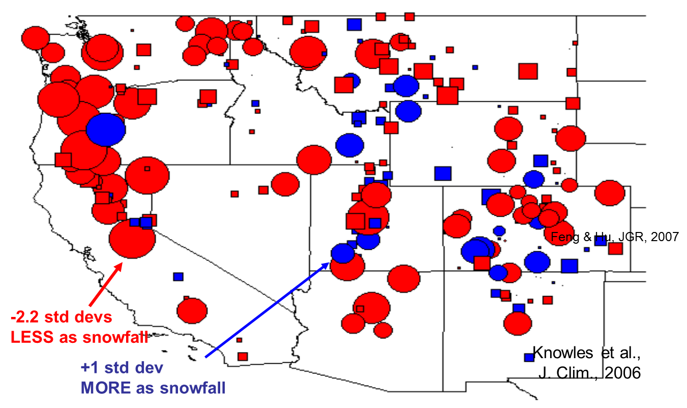
Montana Snow Cover Anomaly

Slide 11
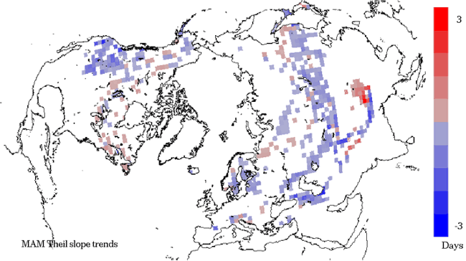
Global Snow Cover Anomaly
Spring duration of snow cover: This map shows per decade trends derived from visible and passive microwave satellite data, 1978-2006.
Image by Richard Armstrong and Mary Jo Brodzik, National Snow and Ice Data Center, University of Colorado, Boulder.

Slide 12
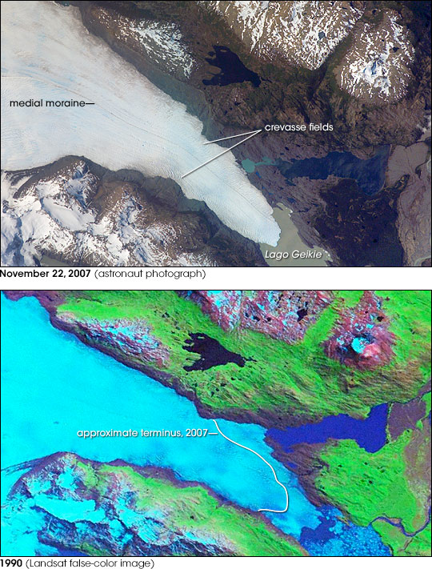
Glacial Extent
Occur on all continents except Australia.
Total Area: 525,000 km².
Glaciers Continually Move:
Carry mass downhill
Advance/retreat
Mass Balance:
Winter Accumulation
Summer ablation
Tyndall Glacier, located in the Torres del Paine National Park in Chile, has a total area of 331km² and a length of 32km.

Slide 13
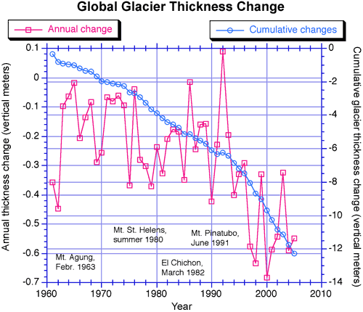
Global Glacial Mass Anomaly
Since 1946 more than 300 glaciers have been monitored via mass balance techniques.
With few exceptions, glaciers have retreated at unprecedented rates.
Global Glacier Thickness Change: This shows average annual and cumulative glacier thickness change, measured in vertical meters, for the period 1961 to 2005. Mark Dyurgerov, Institute of Arctic and Alpine Research, University of Colorado, Boulder

Slide 14
Montana Glaciers

Slide 15
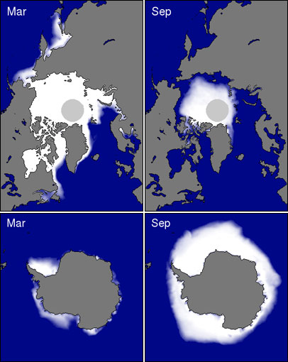
Sea Ice Extent
Sea Ice is the frozen sea water that floats on the ocean surface.
Forms and melts with polar season, affecting both human activity and biological habitats.
Arctic
Max: 14-16 million km²
Min: ~7million km²
Antarctic
Max: 17-20 million km²
Min: 3-4 million km²
Arctic and Antarctic sea ice concentration at the approximate seasonal maximum and minimum levels based on passive microwave satellite data. Image provided by National Snow and Ice Data Center, University of Colorado, Boulder.

Slide 16
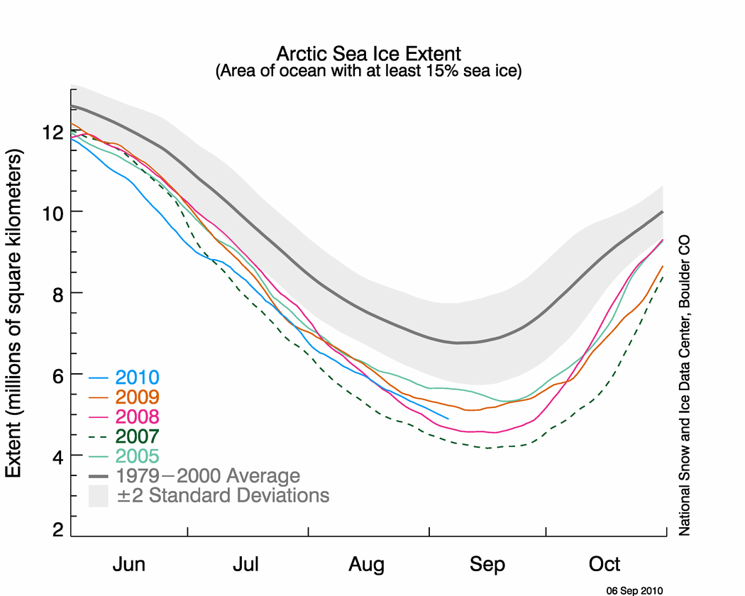
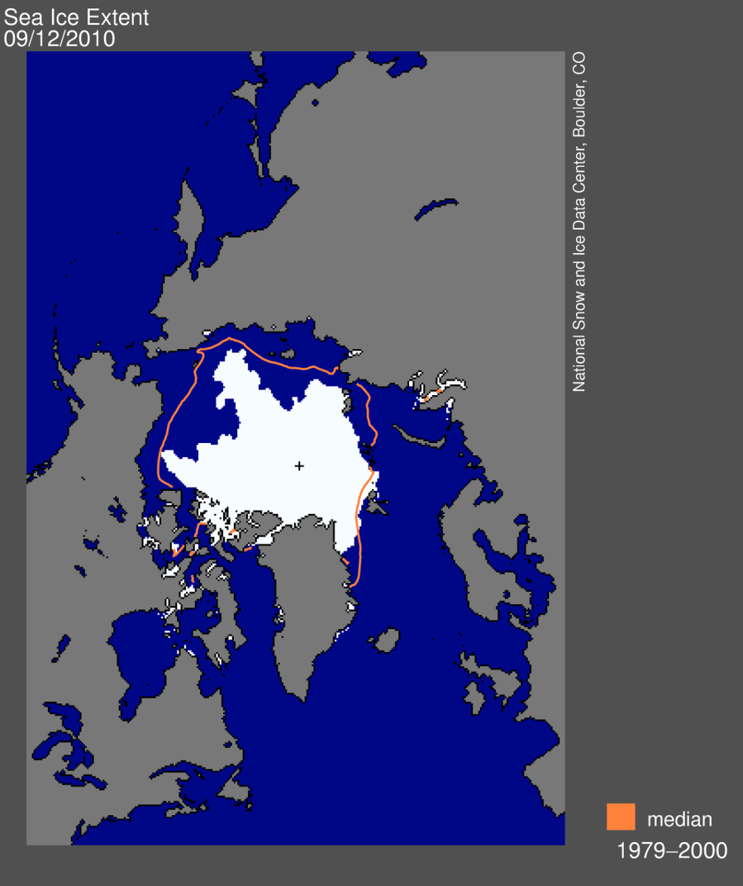
NH Sea Ice Seasonal Dynamic
Extent comparisons: This graph compares 5-day running means for Arctic sea ice extent (area of ocean with ice concentration of at least 15 percent) to the long-term mean (1979-2000). Image provided by National Snow and Ice Data Center, University of Colorado, Boulder

Slide 17
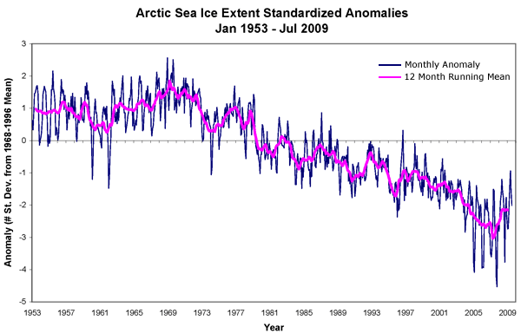
Sea Ice Area Anomaly
Since 1979 winter Arctic ice extent has decreased by about 4.2 % per decade. Interestingly, Antarctic sea ice is increasing but the trend is small.
The September minimum sea ice extent reached new record lows in 2002 (15.3%), 2005 (20.9%), and 2007 (39.2%).
Image by Walt Meier and Julienne Stroeve, National Snow and Ice Data Center, University of Colorado, Boulder.

Slide 18
Sea Ice Mass Anomaly

Slide 19
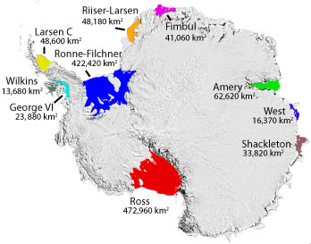
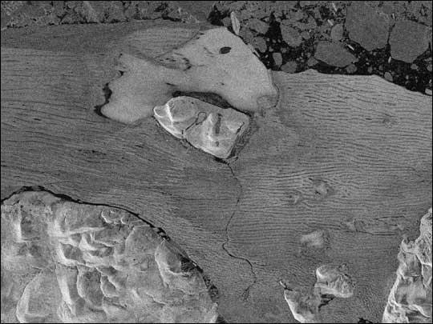
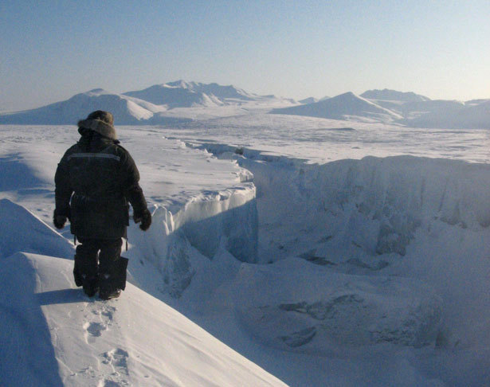
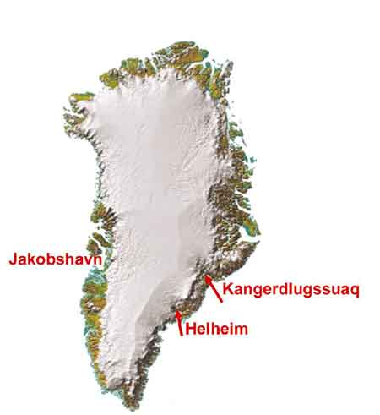
Ice Shelves
Three Categories:
Glacier Fed
Created by Sea Ice
Composite
Most of the world's ice shelves are fed by glaciers.
Two types of events occur on ice shelves:
Calving
Disintegration
Ward Hunt Ice Shelf, Ellesmere Island, Nunavut, Canada: This ice shelf is an example of a shelf made from compressed sea ice.

Slide 20
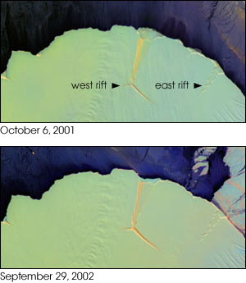
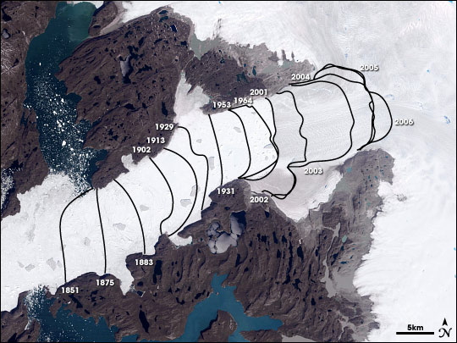
Ice Shelves Calving
Rift Calving
Huge tabular icebergs
Decadal timescale
Crevasse Calving
Armadas of smaller icebergs
Tracked by the National Ice Center

Slide 21
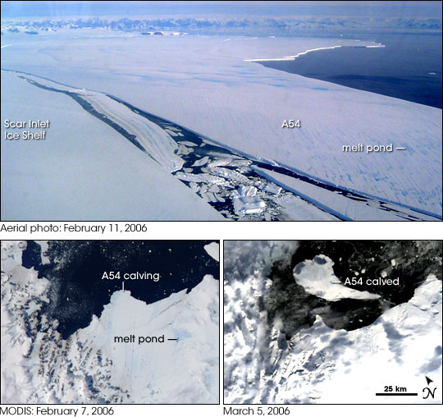

Slide 22
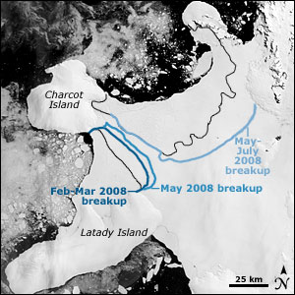
Ice Shelve Disintegration
While calving is a natural event, disintegration has only been observed as a result of warming.
Wilkins Ice Shelf: Black lines indicate the approximate ice shelf front at the beginning of 2008. Blue lines indicate new shelf fronts after retreat events in 2008. Image courtesy Antarctic Glaciological Data Center.
Wilkins Ice Shelf Disintegration, summer 2008: The summertime breakup of the western Wilkins Ice Shelf occurred in a matter of days. NASA Moderate Resolution Imaging Spectroradiometer images courtesy NASA Earth Observatory.

Slide 23
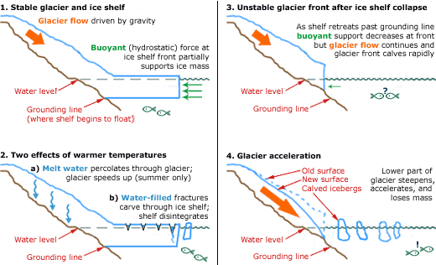
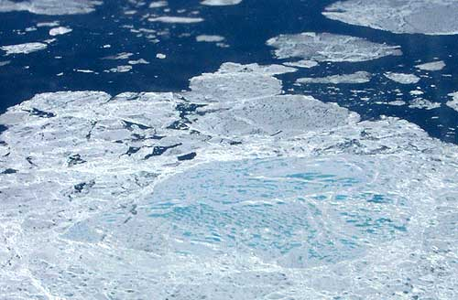
Climate and Ice Shelves
Calving Rate
Warming ocean water
Basal Melting
Increased rifting
0.1°C = 10 m/yr
Disintegration
Melt Ponds
6 m deep crevasses can crack through full shelf thickness

Slide 24
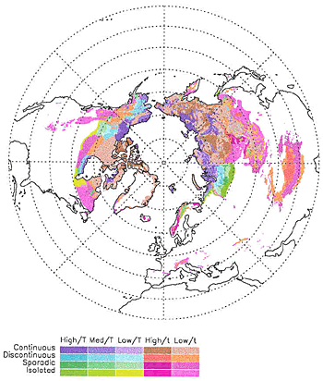
Permafrost
Soil, sediment, or rock that remains at below 0°C > 2 yrs.
22.79 Mkm² (24% NH)
Exists close to its melting point!
In Summer, an upper layer of permafrost can thaw creating an active layer.
Characterization
Continuous
Discontinuous
Sporadic
Isolated

Slide 25
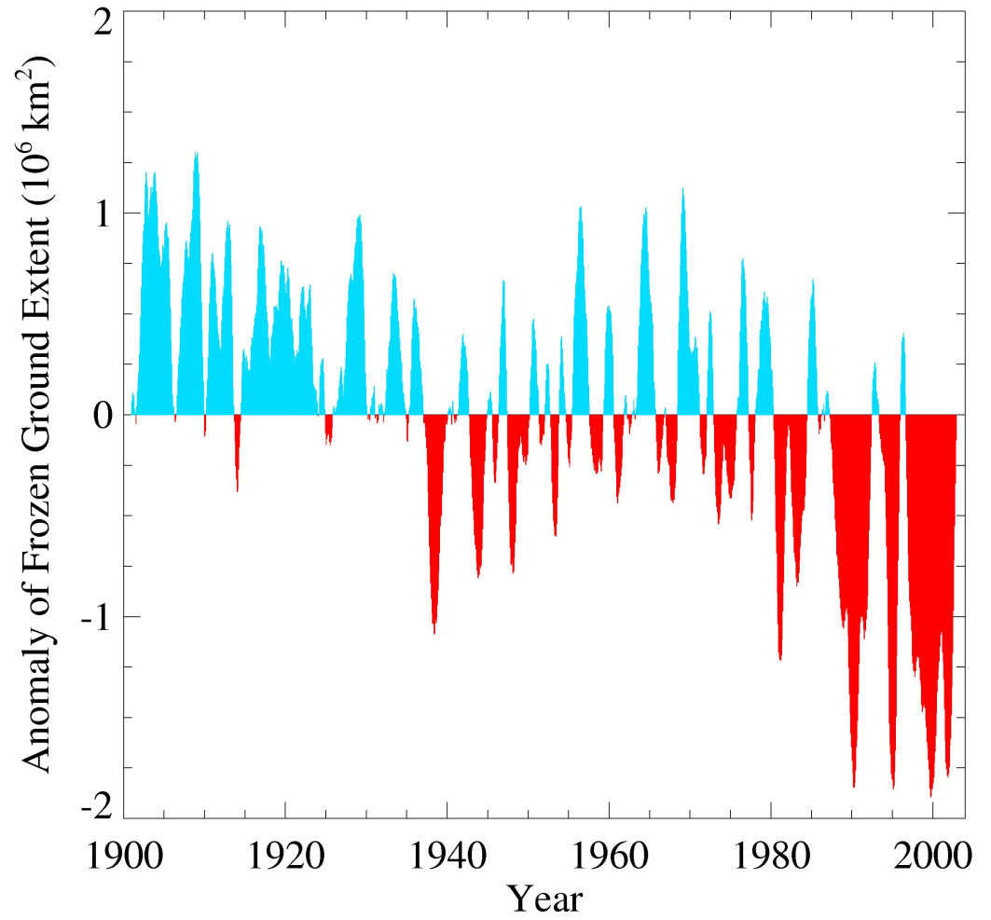
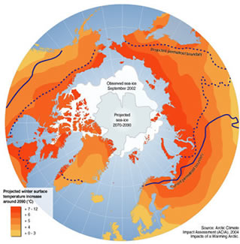
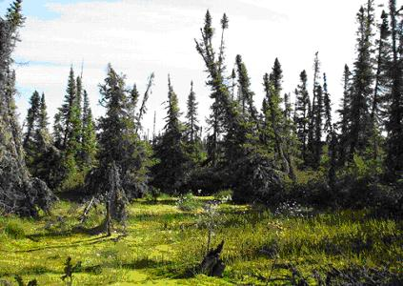
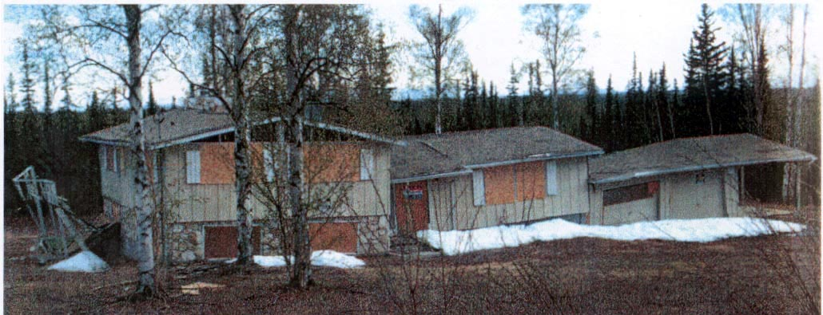
Permafrost Anomaly

Slide 26
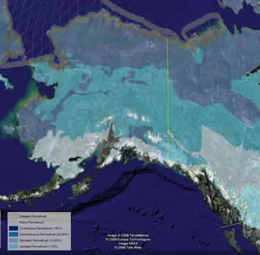
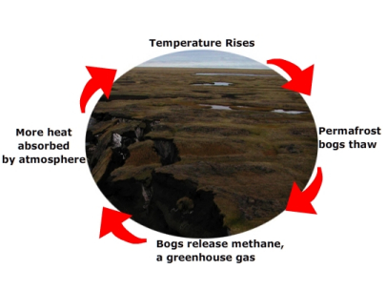
Permafrost and the Carbon Cycle
During the Pleistocene period (1.8 Mya – 10 Kya) carbon was trapped in permafrost (relict permafrost).
Positive Feedback
Relict permafrost thaws and releases CO2 and methane to the atmosphere.
Further driving warming

Slide 27
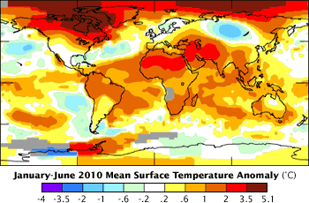
Why is the Arctic Warming Faster than Lower Latitudes?

Slide 28
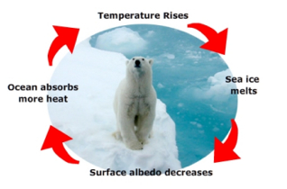
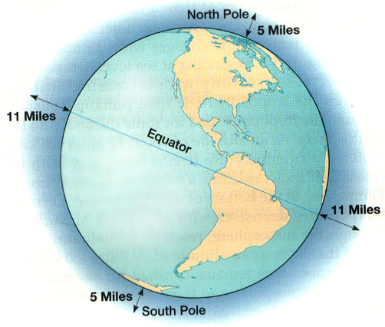
Ice / Albedo Feedback
http://www.youtube.com/watch?v=fJ999LIWvJk
Other processes driving Increased polar warming:
Reduced Polar Evaporation Rates
Polar Atmospheric Depth
Increased summertime energy storage

Slide 29
http://www.youtube.com/watch?v=r2RGQfmLl4E

Slide 30
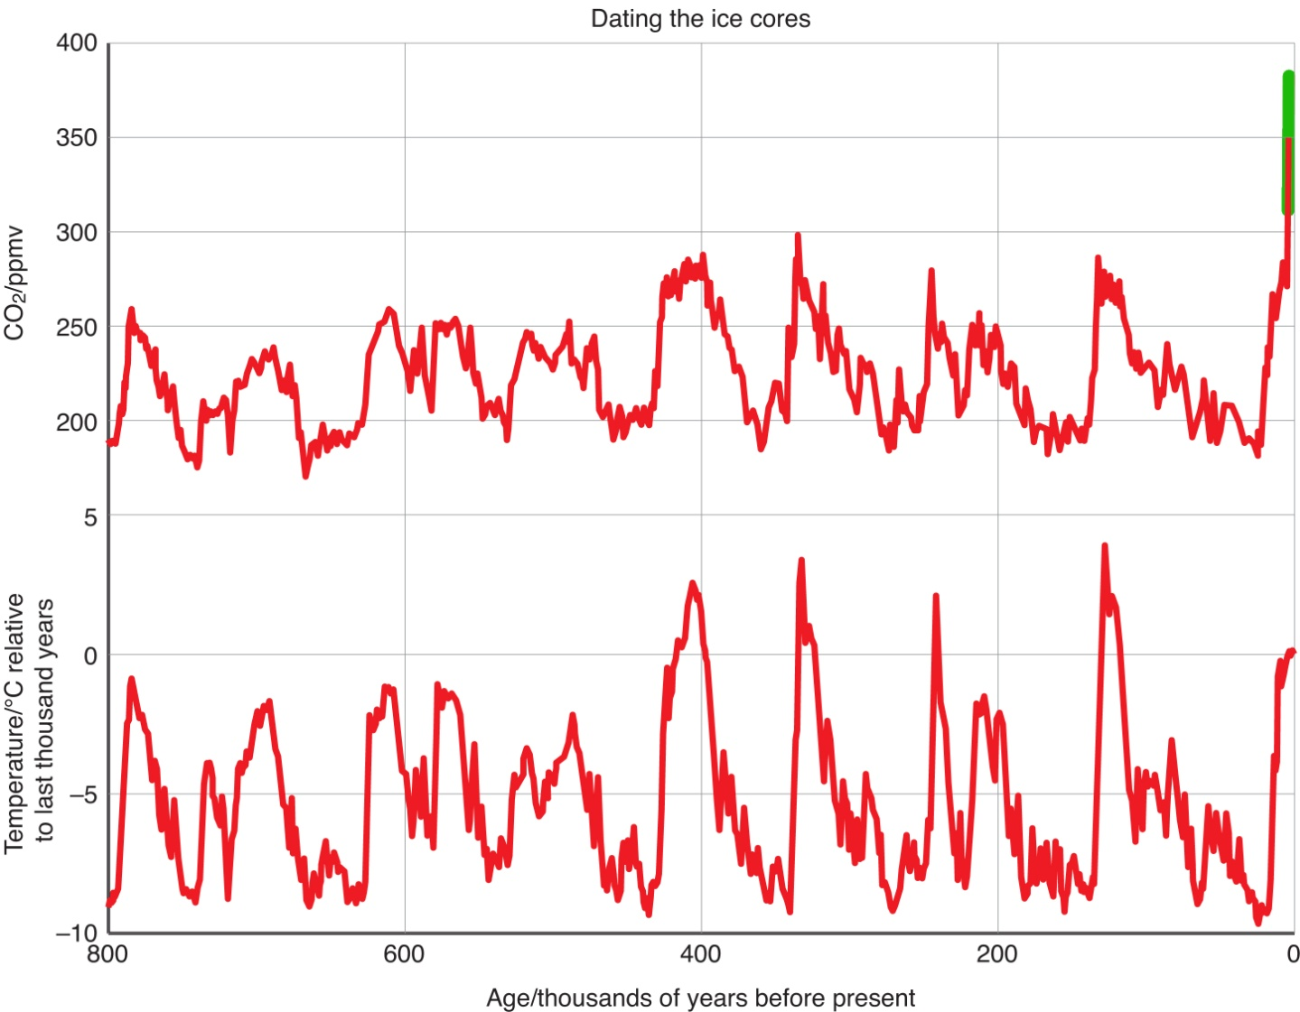
Evidence of positive feedback in the long-term climate record
383 ppm in 2007
Plots courtesy of EPICA. Data from Luethi et al 2008 (CO₂) and Jouzel et al 2007 (temperatures).

Slide 31
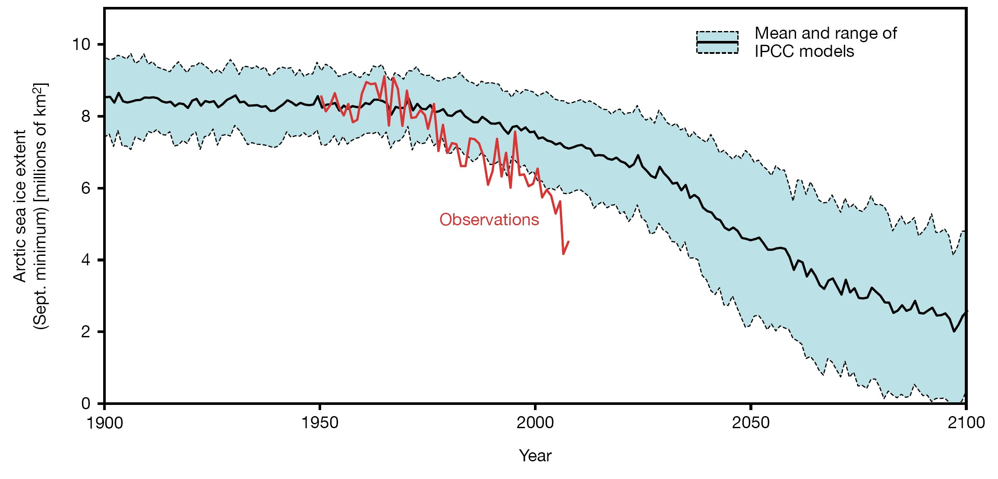
Projected Sea Ice Extent

Slide 32
Projected Glacial Melt
http://www.nrmsc.usgs.gov/files/norock/research/glacier_animation.gif

Slide 33
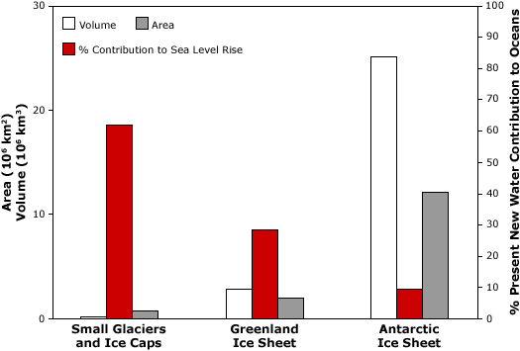
Sea Level Rise
60%
10%
30%
Sea level rise contributors: Comparison of volume (white), area (grey) and percent contribution to sea level rise (red) by small glaciers and ice caps, and the Greenland and Antarctic Ice Sheets. Image courtesy (Meier et al., 2007).

Slide 36
