Slide 1
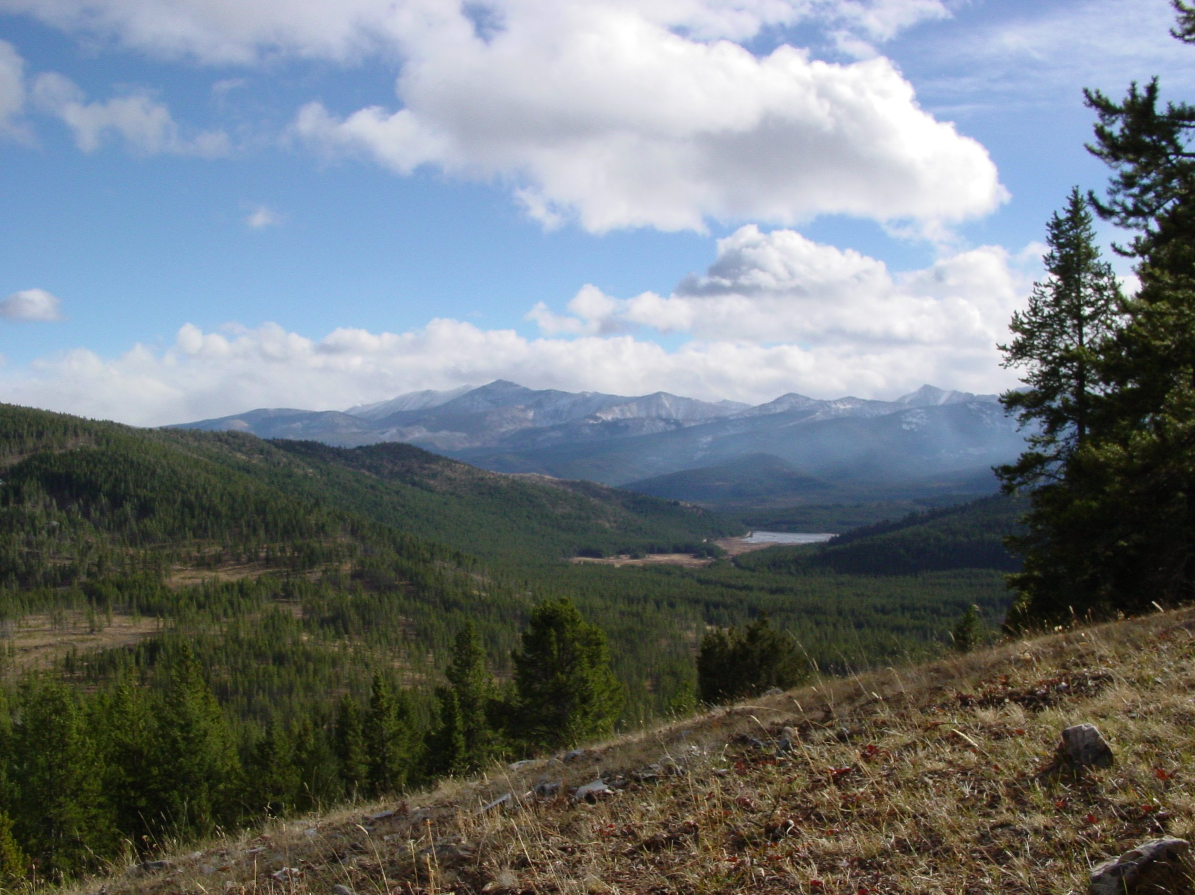


Climate Change of the
Past 2000 Years
Dr. Faith Ann Heinsch
Missoula Fire Sciences Lab
U.S. Forest Service
September 22, 2010
Image Credit: Saxon Holbrook

Slide 2

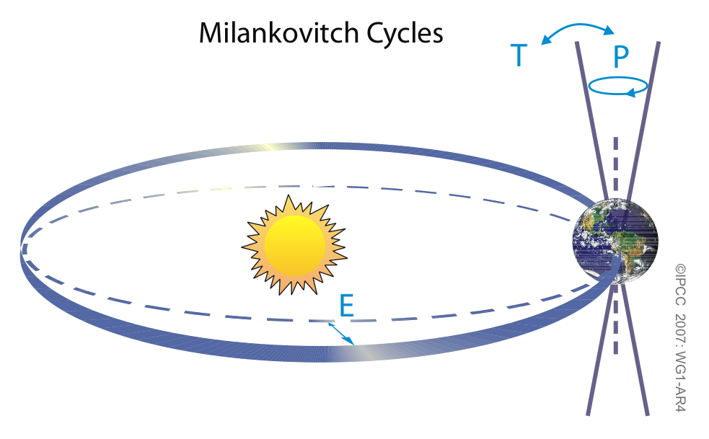
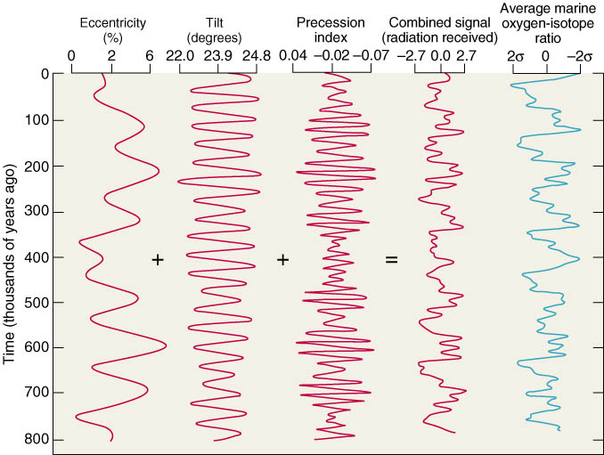
Paleoclimate:
Milankovitch
Cycles
1911: Milutin Milankovitch proposes:
  All 3 cycles (23, 41, & 100 KYA) together control ice ages
  Summer insolation is driver
Credit: Anna Klene,
U. of Montana

Slide 3
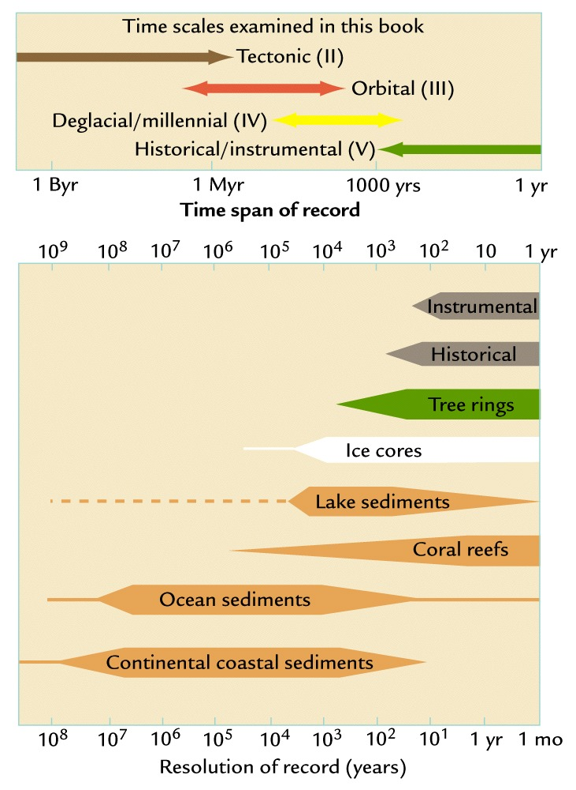
Time scales for Proxy Data

Slide 4
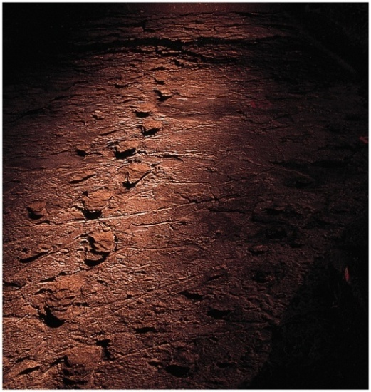

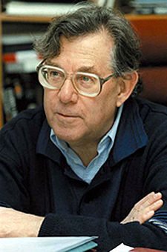

Anthropocene
Term used for climate where
humans are the dominate controlling mechanism…
  Concept first proposed in 1979 by Sagan
  Phrase coined by Crutzen in 2000
    Nobel prize winning chemist for his work on ozone depletion
  No precise start date.
  May be considered to start in late 18th century
    “Start” of Industrial Revolution
  Ruddiman proposes it started much earlier…8,000 years ago

Slide 5
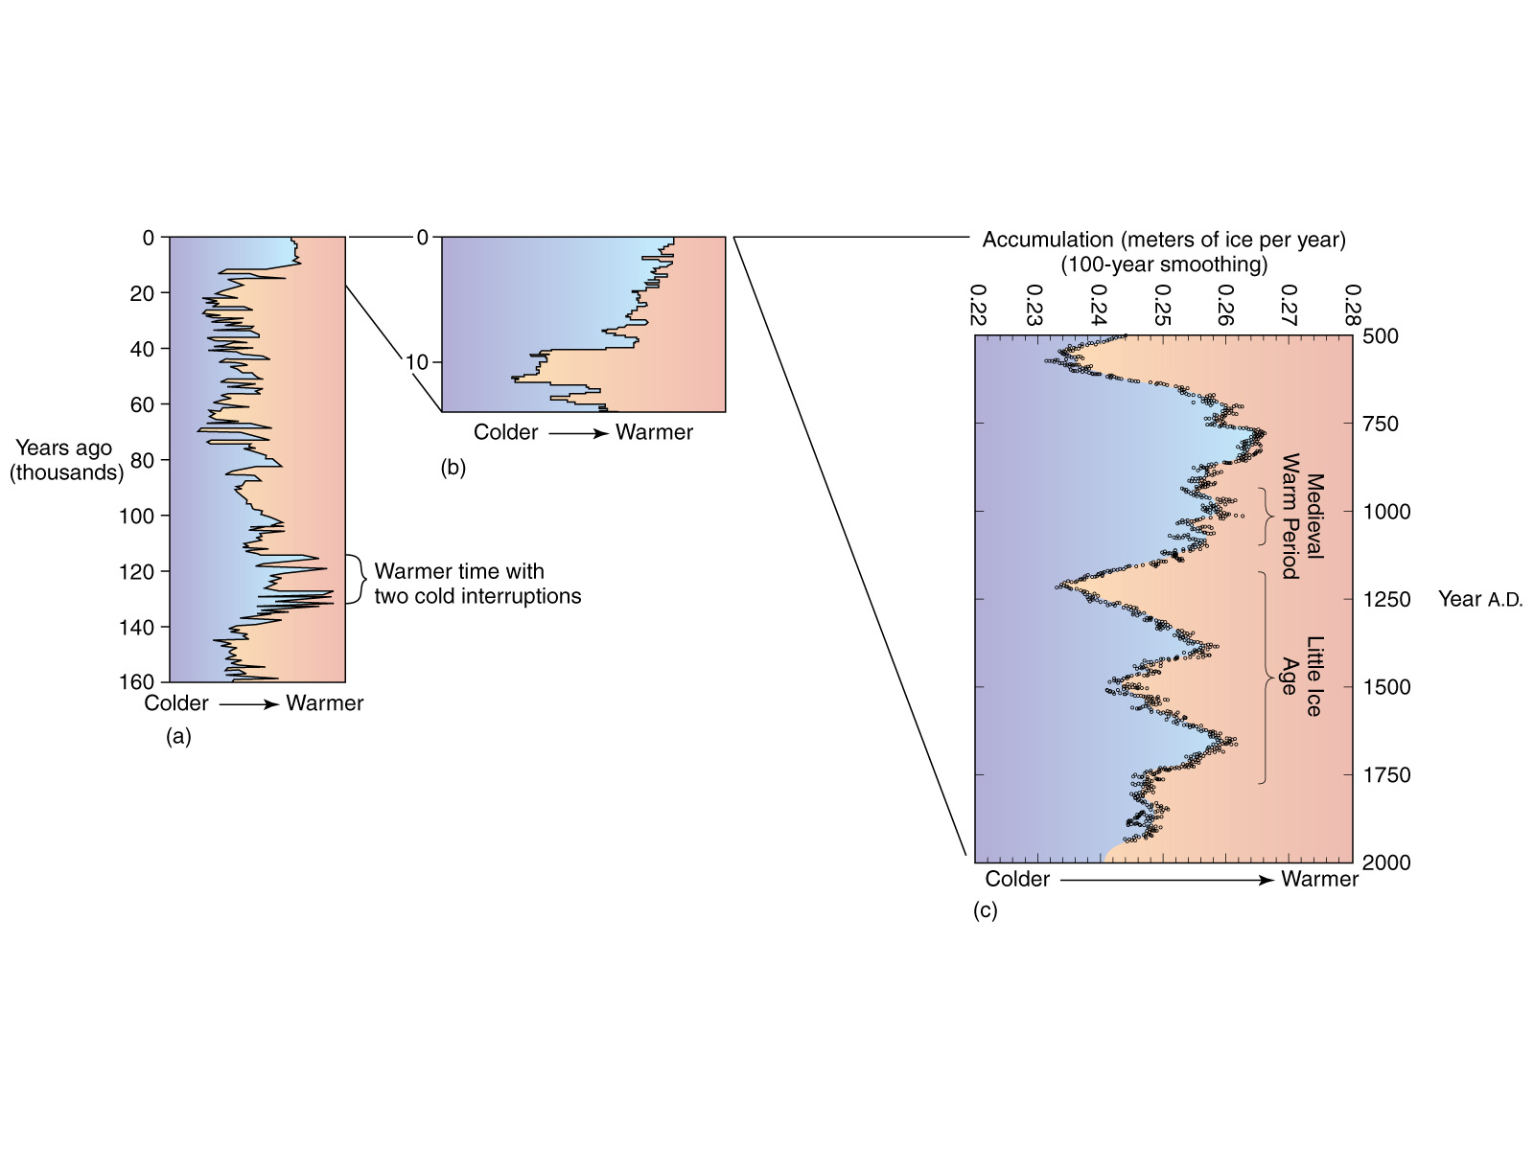
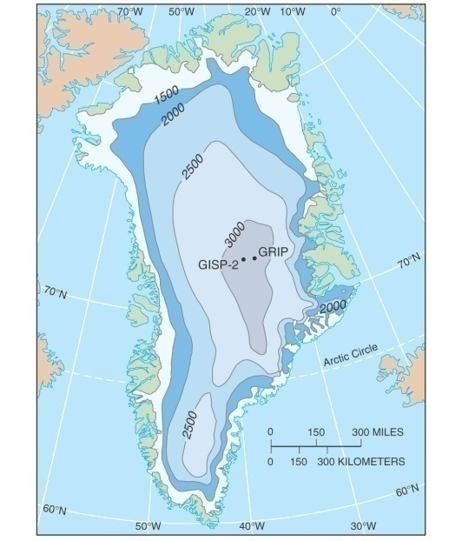
Last 2000 years….
Greenland Ice Cores:
  High resolution record of temps near Europe…
Notes:
Looking at the long view of 160,000 years ago, there were times of glacial and interglacial cycles.
Since the last glacial maximum (about 21,000 years ago), we have been in an overall warming trend. However, climate has been remarkably stable during the last 10,000 years or so.
If we look at just the last 2000 years, however, we can see that even in an overall cooling trend, there are warmer and cooler periods.
So, how do we know the current trend is anthropogenic? And, what about those peaks and valleys? We’ll talk about them in more detail in a few minutes.

Slide 6
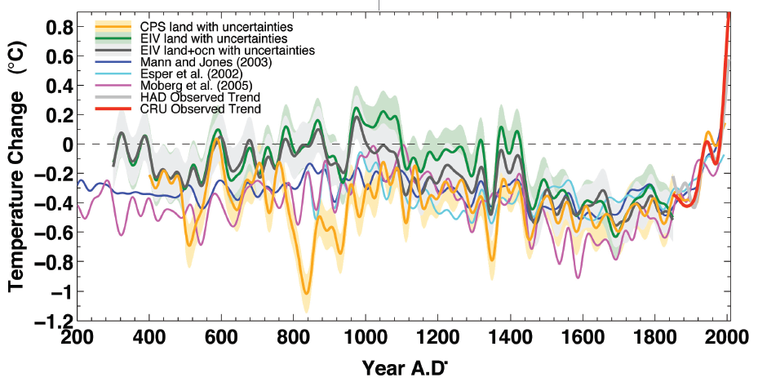
Comparison of Northern Hemisphere
Temperature Reconstructions
Changes in glaciers suggest global average temperature change in the 20th century consistent with the
thermometers…
and the corals…
and the tree rings…
and the boreholes…
and the ice cores.
Mann et al. 2008

Slide 7
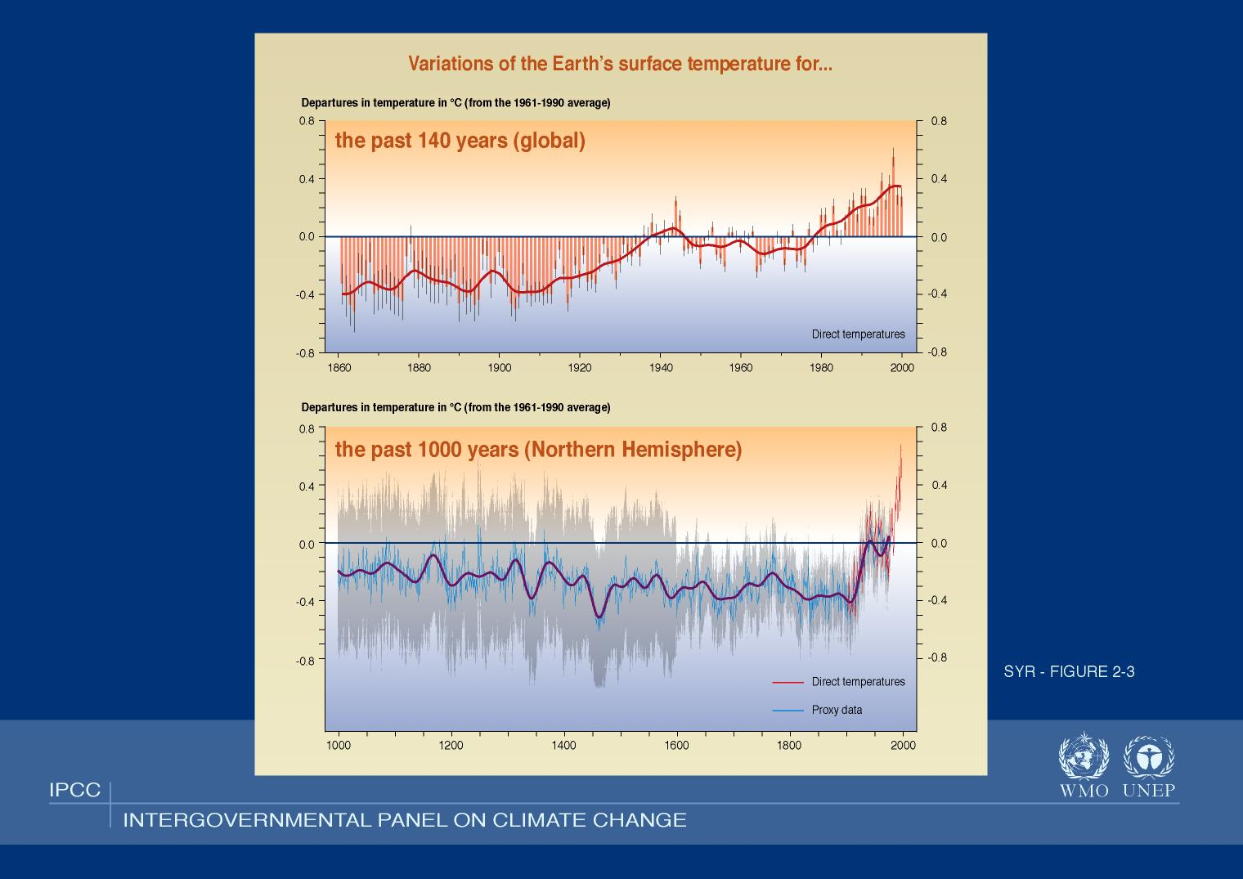
Notes:
Note tightening of the error bars because of increased confidence in the data.
Proxies – tree rings, boreholes, ice cores
There is a new ice core from Antarctica that goes back 800,000+ years!

Slide 8
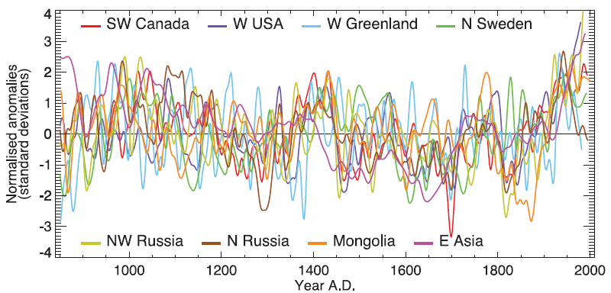
Last 2000 years….
IPCC 2007
Notes:
The heterogeneous nature of climate during the ‘Medieval Warm Period’ is illustrated by the wide spread of values exhibited by the individual records that have been used to reconstruct NH mean temperature. These consist of individual, or small regional averages of, proxy records collated from those used by Mann and Jones (2003), Esper et al. (2002) and Luckman and Wilson (2005), but exclude shorter series or those with no evidence of sensitivity to local temperature. These records have not been calibrated here, but each has been smoothed with a 20-year filter and scaled to have zero mean and unit standard deviation over the period 1001 to 1980.

Slide 9

Last 2000 years….
Image Credit: Robert A. Rohde,
Global Warming Art
Notes:
The medieval warm period and little ice age are labeled at roughly the times when they are historically believed to occur, though it is still disputed whether these were truly global or only regional events.
http://upload.wikimedia.org/wikipedia/commons/c/c1/2000_Year_Temperature_Comparison.png
Temperature variations during the preceding 12000 years. Note that present day is placed at the left hand side
This image is a comparison of 10 different published reconstructions of mean temperature changes during the last 2000 years. More recent reconstructions are plotted towards the front and in redder colors, older reconstructions appear towards the back and in bluer colors. An instrumental history of temperature is also shown in black. The single, unsmoothed annual value for 2004 is also shown for comparison.
For the purposes of this comparison, the author is agnostic as to which, if any, of the reconstructions of global mean temperature is an accurate reflection of temperature fluctuations during the last 2000 years. This plot is a fair representation of the range of reconstructions appearing in the published scientific literature. For each reconstruction, the raw data has been decadally smoothed with a σ = 5 yr Gaussian weighted moving average. Also, each reconstruction was adjusted so that its mean matched the mean of the instrumental record during the period of overlap. The variance (i.e. the scale of fluctuations) was not adjusted (except in one case noted below).
Except as noted below, all original data for this comparison comes from [1] and links therein. It should also be noted that many reconstructions of past climate report substantial error bars, which are not represented on this figure.
Reconstructions
The reconstructions used, in order from oldest to most recent publication are:
(dark blue 1000-1991): P.D. Jones, K.R. Briffa, T.P. Barnett, and S.F.B. Tett (1998). High-resolution Palaeoclimatic Records for the last Millennium: Interpretation, Integration and Comparison with General Circulation Model Control-run Temperatures, The Holocene, 8: 455-471.
(blue 1000-1980): M.E. Mann, R.S. Bradley, and M.K. Hughes (1999). Northern Hemisphere Temperatures During the Past Millennium: Inferences, Uncertainties, and Limitations, Geophysical Research Letters, 26(6): 759-762.
(light blue 1000-1965): Crowley and Lowery (2000). Northern Hemisphere Temperature Reconstruction, Ambio, 29: 51-54. Modified as published in Crowley (2000). Causes of Climate Change Over the Past 1000 Years, Science, 289: 270-277.
(lightest blue 1402-1960): K.R. Briffa, T.J. Osborn, F.H. Schweingruber, I.C. Harris, P.D. Jones, S.G. Shiyatov, S.G. and E.A. Vaganov (2001). Low-frequency temperature variations from a northern tree-ring density network, J. Geophys. Res., 106: 2929-2941.
(light green 831-1992): J. Esper, E.R. Cook, and F.H. Schweingruber (2002). Low-Frequency Signals in Long Tree-Ring Chronologies for Reconstructing Past Temperature Variability, Science, 295(5563): 2250-2253.
(yellow 200-1980): M.E. Mann and P.D. Jones (2003). Global Surface Temperatures over the Past Two Millennia, Geophysical Research Letters, 30(15): 1820. DOI:10.1029/2003GL017814.
(orange 200-1995): P.D. Jones and M.E. Mann (2004). Climate Over Past Millennia, Reviews of Geophysics, 42: RG2002. DOI:10.1029/2003RG000143
(red-orange 1500-1980): S. Huang (2004). Merging Information from Different Resources for New Insights into Climate Change in the Past and Future, Geophys. Res Lett., 31: L13205. DOI:10.1029/2004GL019781
(red 1-1979): A. Moberg, D.M. Sonechkin, K. Holmgren, N.M. Datsenko and W. Karlén (2005). Highly variable Northern Hemisphere temperatures reconstructed from low- and high-resolution proxy data, Nature, 443: 613-617. DOI:10.1038/nature03265
(dark red 1600-1990): J.H. Oerlemans (2005). Extracting a Climate Signal from 169 Glacier Records, Science, 308: 675-677. DOI:10.1126/science.1107046
(black 1856-2004): Instrumental data was jointly compiled by the w:Climatic Research Unit and the UK Meteorological Office Hadley Centre. Global Annual Average data set TaveGL2v [2] was used.
Documentation for the most recent update of the CRU/Hadley instrumental data set appears in: P.D. Jones and A. Moberg (2003). Hemispheric and large-scale surface air temperature variations: An extensive revision and an update to 2001, Journal of Climate, 16: 206-223.
Copyright
The original version of this figure was prepared by Robert A. Rohde from publicly available data, and is incorporated into the Global Warming Art project.

Slide 10
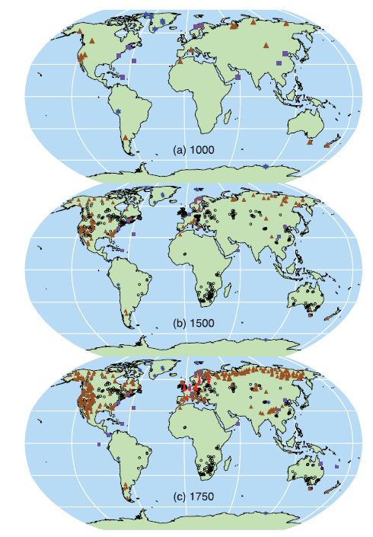


Proxy Records
–
Where do they come from?
Instrumental record
Tree rings
Boreholes
Ice core/ice borehole
Other
IPCC 2007

Slide 11

Medieval Warm Period (~800-1300)
(a.k.a. Medieval Climate Optimum a.k.a. Medieval Climatic Anomaly)
Notes:
Pinot blanc - http://www.its.edu.mt/images/big_white_pinotblanc_grapes.jpg
Grapes in Vineland (http://www.grist.org/article/vineland-was-full-of-grapes/)
As with the Greenland story, Vineland's name was most likely a kind of marketing ploy. This 1988 article by Robert McGhee for Canadian Geographic had this to say:
There has been much argument over the location of Vinland, with scholars and local enthusiasts placing it anywhere between Labrador and Florida, and even in the Great Lakes or the Mississippi Valley. The geographical descriptions in the Norse sagas are too vague to allow certain placement on a modern map, but there is growing consensus that they best fit Newfoundland and Labrador (formerly Newfoundland). The main problem with a Newfoundland and Labrador (formerly Newfoundland) site is the absence of wild grapes. Still, there is a strong suspicion that what Leif found were only berries, and that he followed the practice of his father in "giving a land a good name so that men would want to go there".
Grapes England (http://www.realclimate.org/index.php/archives/2006/07/medieval-warmth-and-english-wine/)
…much early winemaking in England was conducted in Benedictine monasteries for religious purposes – changing rites and the treatment of the monasteries by the crown (Henry VIII in particular [dissolution]) clearly impacted wine production there. Societal factors range from the devastating (the Black Death) to the trivial (working class preferences for beer over wine). The wider trade environment is also a big factor i.e. how easy was it to get better, cheaper wine from the continent? The marriage of Eleanor of Aquitaine and the English King in 1152 apparently allowed better access to the vineyards of Bordeaux, and however good medieval English wine was, it probably wasn’t a match for that!
…what does the history of English vineyards show? The earliest documentation that is better than anecdotal is from the Domesday Book (1087) – an early census that the new Norman king commissioned to assess his new English dominions, including the size of farms, population etc. Being relatively ‘frenchified’, the Normans (who had originally come from Viking stock) were quite keen on wine drinking (rather than mead or ale) and so made special note of existing vineyards and where the many new vines were being planted. Sources differ a little on how many vineyards are included in the book: Selley quotes Unwin (J. Wine Research, 1990 (subscription)) who records 46 vineyards across Southern England (42 unambiguous sites, 4 less direct), but other claims (unsourced) range up to 52. Lamb’s 1977 book has a few more from other various sources and anecdotally there are more still, and so clearly this is a minimum number.
Of the Domesday vineyards, all appear to lie below a line from Ely (Cambridgeshire) to Gloucestershire. Since the Book covers all of England up to the river Tees (north of Yorkshire), there is therefore reason to think that there weren’t many vineyards north of that line. Lamb reports two vineyards to the north (Lincoln and Leeds, Yorkshire) at some point between 1000 and 1300 AD, and Selley even reports a Scottish vineyard operating in the 12th Century. However, it’s probably not sensible to rely too much on these single reports since they don’t necessarily come with evidence for successful or sustained wine production. Indeed, there is one lone vineyard reported in Derbyshire (further north than any Domesday vineyard) in the 16th Century when all other reports were restricted to the South-east of England.
Wine making never completely died out in England, there were always a few die-hard viticulturists willing to give it a go, but production clearly declined after the 13th Century, had a brief resurgence in the 17th and 18th Centuries, only to decline to historic lows in the 19th Century when only 8 vineyards are recorded. Contemporary popular sentiment towards English (and Welsh) wine can be well judged by a comment in ‘Punch’ (a satirical magazine) that the wine would require 4 people to drink it – one victim, two to hold him down, and one other to pour the wine down his throat.

Slide 12
Medieval Warm Period (~800-1300)
Image Credit: Robert A. Rohde,
Global Warming Art
Notes:
The medieval warm period and little ice age are labeled at roughly the times when they are historically believed to occur, though it is still disputed whether these were truly global or only regional events.
http://upload.wikimedia.org/wikipedia/commons/c/c1/2000_Year_Temperature_Comparison.png
Temperature variations during the preceding 12000 years. Note that present day is placed at the left hand side
This image is a comparison of 10 different published reconstructions of mean temperature changes during the last 2000 years. More recent reconstructions are plotted towards the front and in redder colors, older reconstructions appear towards the back and in bluer colors. An instrumental history of temperature is also shown in black. The single, unsmoothed annual value for 2004 is also shown for comparison.
For the purposes of this comparison, the author is agnostic as to which, if any, of the reconstructions of global mean temperature is an accurate reflection of temperature fluctuations during the last 2000 years. This plot is a fair representation of the range of reconstructions appearing in the published scientific literature. For each reconstruction, the raw data has been decadally smoothed with a σ = 5 yr Gaussian weighted moving average. Also, each reconstruction was adjusted so that its mean matched the mean of the instrumental record during the period of overlap. The variance (i.e. the scale of fluctuations) was not adjusted (except in one case noted below).
Except as noted below, all original data for this comparison comes from [1] and links therein. It should also be noted that many reconstructions of past climate report substantial error bars, which are not represented on this figure.
Reconstructions
The reconstructions used, in order from oldest to most recent publication are:
(dark blue 1000-1991): P.D. Jones, K.R. Briffa, T.P. Barnett, and S.F.B. Tett (1998). High-resolution Palaeoclimatic Records for the last Millennium: Interpretation, Integration and Comparison with General Circulation Model Control-run Temperatures, The Holocene, 8: 455-471.
(blue 1000-1980): M.E. Mann, R.S. Bradley, and M.K. Hughes (1999). Northern Hemisphere Temperatures During the Past Millennium: Inferences, Uncertainties, and Limitations, Geophysical Research Letters, 26(6): 759-762.
(light blue 1000-1965): Crowley and Lowery (2000). Northern Hemisphere Temperature Reconstruction, Ambio, 29: 51-54. Modified as published in Crowley (2000). Causes of Climate Change Over the Past 1000 Years, Science, 289: 270-277.
(lightest blue 1402-1960): K.R. Briffa, T.J. Osborn, F.H. Schweingruber, I.C. Harris, P.D. Jones, S.G. Shiyatov, S.G. and E.A. Vaganov (2001). Low-frequency temperature variations from a northern tree-ring density network, J. Geophys. Res., 106: 2929-2941.
(light green 831-1992): J. Esper, E.R. Cook, and F.H. Schweingruber (2002). Low-Frequency Signals in Long Tree-Ring Chronologies for Reconstructing Past Temperature Variability, Science, 295(5563): 2250-2253.
(yellow 200-1980): M.E. Mann and P.D. Jones (2003). Global Surface Temperatures over the Past Two Millennia, Geophysical Research Letters, 30(15): 1820. DOI:10.1029/2003GL017814.
(orange 200-1995): P.D. Jones and M.E. Mann (2004). Climate Over Past Millennia, Reviews of Geophysics, 42: RG2002. DOI:10.1029/2003RG000143
(red-orange 1500-1980): S. Huang (2004). Merging Information from Different Resources for New Insights into Climate Change in the Past and Future, Geophys. Res Lett., 31: L13205. DOI:10.1029/2004GL019781
(red 1-1979): A. Moberg, D.M. Sonechkin, K. Holmgren, N.M. Datsenko and W. Karlén (2005). Highly variable Northern Hemisphere temperatures reconstructed from low- and high-resolution proxy data, Nature, 443: 613-617. DOI:10.1038/nature03265
(dark red 1600-1990): J.H. Oerlemans (2005). Extracting a Climate Signal from 169 Glacier Records, Science, 308: 675-677. DOI:10.1126/science.1107046
(black 1856-2004): Instrumental data was jointly compiled by the w:Climatic Research Unit and the UK Meteorological Office Hadley Centre. Global Annual Average data set TaveGL2v [2] was used.
Documentation for the most recent update of the CRU/Hadley instrumental data set appears in: P.D. Jones and A. Moberg (2003). Hemispheric and large-scale surface air temperature variations: An extensive revision and an update to 2001, Journal of Climate, 16: 206-223.
Copyright
The original version of this figure was prepared by Robert A. Rohde from publicly available data, and is incorporated into the Global Warming Art project.

Slide 13
Medieval Warm Period (~800-1300)
Scattered evidence exists in Europe and the high latitudes surrounding the North Atlantic.
  Cultivation of Greenland & Iceland
  Grapes in England?
  Medieval temperatures were probably
  1-2°C above early 20th century levels at various European locations
  Evidence in Japan, Alaska
  Regional in nature
    There were both warmer and colder areas
Drought was evident in western U.S. (Anasazi), Central America (Mayan) & Africa

Slide 14
Medieval Warm Period (~800-1300)
“Evidence is not sufficient to support a conclusion that hemispheric mean temperatures were as warm, or the extent of warm regions as expansive, as those in the 20th century as a whole, during any period in medieval times.” (IPCC 2007)

Slide 15
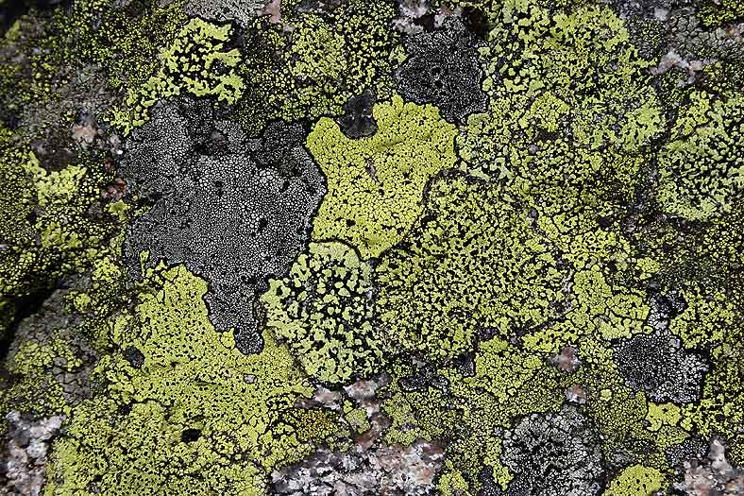
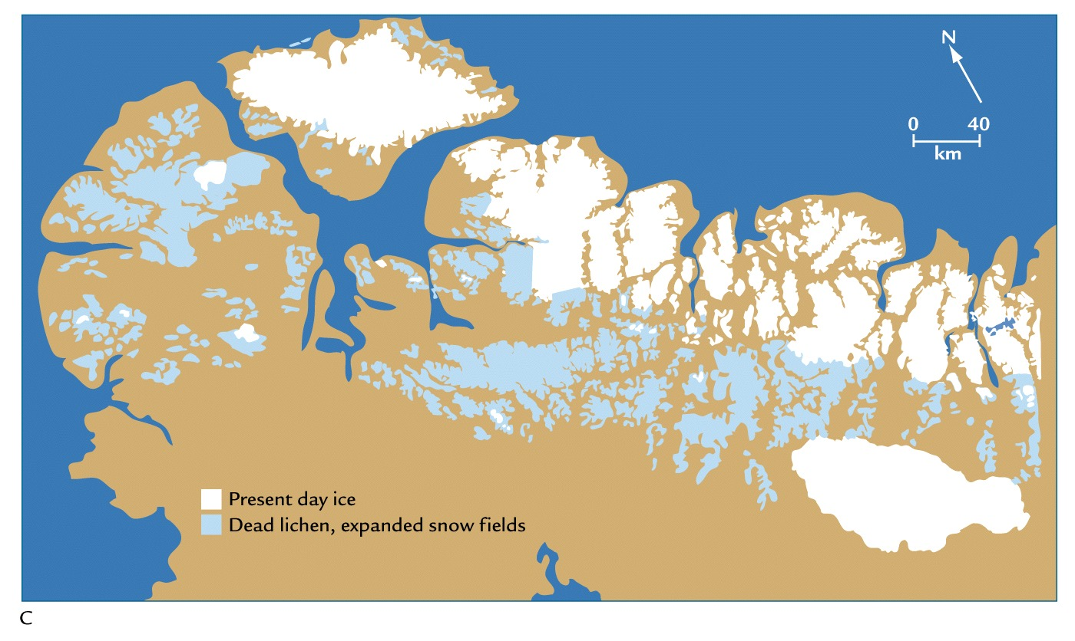
The Little Ice Age (1400-1900)
Notes:
The Little Ice Age (LIA) was a period of cooling occurring after a warmer era known as the Medieval climate optimum. Climatologists and historians find it difficult to agree on either the start or end dates of this period. Some confine the Little Ice Age to approximately the 16th century to the mid 19th century.
Evidence – lichen die-offs – burial beneath snow fields that blocked sunlight (they can take extreme cold).
Lichen image from http://www.arcticimages.com/extra_images_for_the_arctic_book.htm

Slide 16
The Little Ice Age (1400-1900)
Image Credit: Robert A. Rohde,
Global Warming Art
Notes:
http://upload.wikimedia.org/wikipedia/commons/c/c1/2000_Year_Temperature_Comparison.png
Temperature variations during the preceding 12000 years. Note that present day is placed at the left hand side
This image is a comparison of 10 different published reconstructions of mean temperature changes during the last 2000 years. More recent reconstructions are plotted towards the front and in redder colors, older reconstructions appear towards the back and in bluer colors. An instrumental history of temperature is also shown in black. The single, unsmoothed annual value for 2004 is also shown for comparison.
For the purposes of this comparison, the author is agnostic as to which, if any, of the reconstructions of global mean temperature is an accurate reflection of temperature fluctuations during the last 2000 years. This plot is a fair representation of the range of reconstructions appearing in the published scientific literature. For each reconstruction, the raw data has been decadally smoothed with a σ = 5 yr Gaussian weighted moving average. Also, each reconstruction was adjusted so that its mean matched the mean of the instrumental record during the period of overlap. The variance (i.e. the scale of fluctuations) was not adjusted (except in one case noted below).
Except as noted below, all original data for this comparison comes from [1] and links therein. It should also be noted that many reconstructions of past climate report substantial error bars, which are not represented on this figure.
Reconstructions
The reconstructions used, in order from oldest to most recent publication are:
(dark blue 1000-1991): P.D. Jones, K.R. Briffa, T.P. Barnett, and S.F.B. Tett (1998). High-resolution Palaeoclimatic Records for the last Millennium: Interpretation, Integration and Comparison with General Circulation Model Control-run Temperatures, The Holocene, 8: 455-471.
(blue 1000-1980): M.E. Mann, R.S. Bradley, and M.K. Hughes (1999). Northern Hemisphere Temperatures During the Past Millennium: Inferences, Uncertainties, and Limitations, Geophysical Research Letters, 26(6): 759-762.
(light blue 1000-1965): Crowley and Lowery (2000). Northern Hemisphere Temperature Reconstruction, Ambio, 29: 51-54. Modified as published in Crowley (2000). Causes of Climate Change Over the Past 1000 Years, Science, 289: 270-277.
(lightest blue 1402-1960): K.R. Briffa, T.J. Osborn, F.H. Schweingruber, I.C. Harris, P.D. Jones, S.G. Shiyatov, S.G. and E.A. Vaganov (2001). Low-frequency temperature variations from a northern tree-ring density network, J. Geophys. Res., 106: 2929-2941.
(light green 831-1992): J. Esper, E.R. Cook, and F.H. Schweingruber (2002). Low-Frequency Signals in Long Tree-Ring Chronologies for Reconstructing Past Temperature Variability, Science, 295(5563): 2250-2253.
(yellow 200-1980): M.E. Mann and P.D. Jones (2003). Global Surface Temperatures over the Past Two Millennia, Geophysical Research Letters, 30(15): 1820. DOI:10.1029/2003GL017814.
(orange 200-1995): P.D. Jones and M.E. Mann (2004). Climate Over Past Millennia, Reviews of Geophysics, 42: RG2002. DOI:10.1029/2003RG000143
(red-orange 1500-1980): S. Huang (2004). Merging Information from Different Resources for New Insights into Climate Change in the Past and Future, Geophys. Res Lett., 31: L13205. DOI:10.1029/2004GL019781
(red 1-1979): A. Moberg, D.M. Sonechkin, K. Holmgren, N.M. Datsenko and W. Karlén (2005). Highly variable Northern Hemisphere temperatures reconstructed from low- and high-resolution proxy data, Nature, 443: 613-617. DOI:10.1038/nature03265
(dark red 1600-1990): J.H. Oerlemans (2005). Extracting a Climate Signal from 169 Glacier Records, Science, 308: 675-677. DOI:10.1126/science.1107046
(black 1856-2004): Instrumental data was jointly compiled by the w:Climatic Research Unit and the UK Meteorological Office Hadley Centre. Global Annual Average data set TaveGL2v [2] was used.
Documentation for the most recent update of the CRU/Hadley instrumental data set appears in: P.D. Jones and A. Moberg (2003). Hemispheric and large-scale surface air temperature variations: An extensive revision and an update to 2001, Journal of Climate, 16: 206-223.
Copyright
The original version of this figure was prepared by Robert A. Rohde from publicly available data, and is incorporated into the Global Warming Art project.

Slide 17
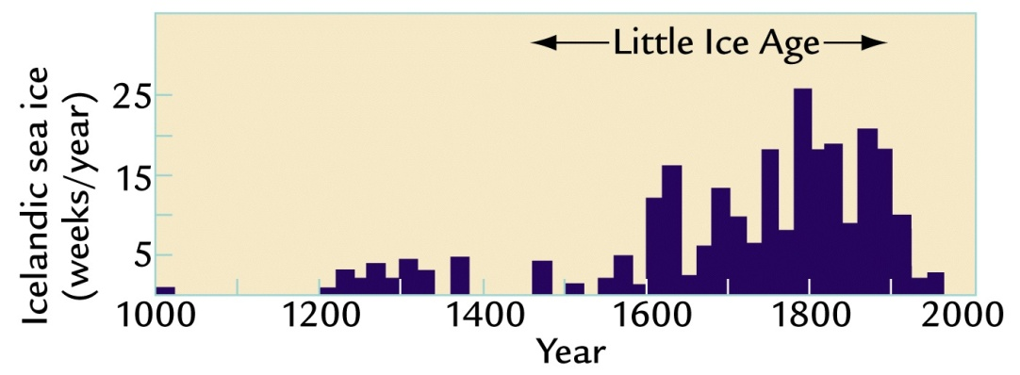
Little Ice Age (1400-1900)
A modest cooling of the Northern Hemisphere of less than 1°C
  Glaciers grew in Europe (1000 m lower than in 1850s)
  Sea ice expansion
Three minima, each separated by slight warming intervals beginning
  About 1650
  About 1770
  About 1850
Initially believed to be a global phenomenon; now less clear

Slide 18
Little Ice Age (1400-1900)
Colder winters & shorter growing season meant crop failure and localized famine in northern regions of Europe
  Great Famine of 1315-1317 (full recovery in 1322)
  By the 1700s, cultivated land (MWP) in Iceland was covered by ice
Settlements in Greenland were abandoned
  Marginal climate?
  Conflicts with native peoples?
Large-scale advances of glaciers
Not a “true” ice age since major ice sheets did not form

Slide 19
Transition from MWP to LIA
OR
Proposed causes of climate change from 1000-1850
Orbital forcing
  Decreasing summer insolation (tilt and precession cycles)
  Only explains about half the amount observed in reconstruction for northern hemisphere (0.1°C)
Millennial bipolar seesaw
  Antarctica warm when Greenland is cold
    Typical of large glacial-age oscillation
  Insufficient proxy data in southern hemisphere to test
Notes:
Millennial bipolar seesaw
Longer-term evidence during current interglaciation generally suggests that climatic trends have been highly irregular and local in scope.
If north polar cooling into LIA was part of a small oscillation linked to the bipolar seesaw, it should have been accompanied by an even smaller warming in the Antarctic region.

Slide 20
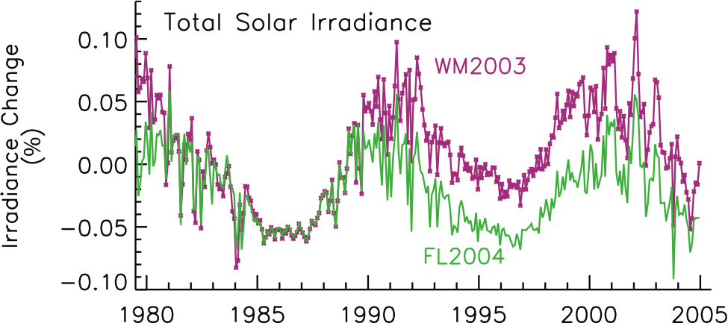
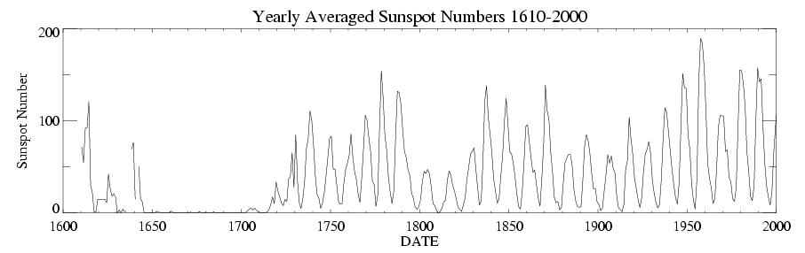
Proposed causes of climate change from 1000-1850
If the sun were the primary driver of climate change, we would expect to see (1) increasing daytime temperatures and (2) increasing summer temperatures. Instead, we are seeing just the opposite.
Solar variability
  Maunder Minimum
  11-year Sunspot cycle
  Recent research minimizes this
  effect
Improved assessment:
a) no observed trend in solar irradiance since 1978 using high quality inter-calibrated data; b) spectral information c) solar magnetic flux model rather than proxy data; d) re-evaluation of variations in Sun-like stars.
Solar irradiance forcing much smaller than GHG.

Slide 21
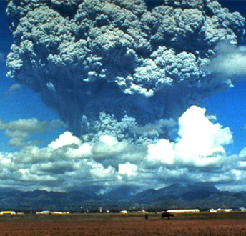
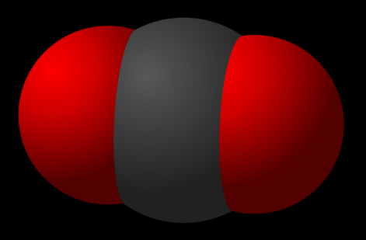
Proposed causes of climate change from 1000-1850
Volcanic eruptions
  Sulfate aerosols
  The more frequent clusters of eruptions after 1300 could have constributed to the small cooling trend in the LIA
Greenhouse-Gases
  Drop in CO₂ concentration by 7-8 ppm from 100-1200 to 1600-1800
    Solar-volcanic changes
    Anthropogenic hypothesis
      Reforestation of agricultural land
      The “Black Death” (bubonic plague)
      The American Pandemic (host of diseases)
CO₂
Notes:
Picture credits
Volcanic Eruption: http://www.pbs.org/wgbh/nova/sun/dimm-nf.html
CO2 Molecule: http://en.wikipedia.org/wiki/File:Carbon-dioxide-3D-vdW.svg

Slide 22


Proposed causes of climate change from 1000-1850
Recent research (Trouet et al. 2009) suggests
  MWP is associated with persistent positive North Atlantic Oscillation
  A clear shift to weaker NAO conditions into the LIA
  This is one aspect of the MWP-LIA climate transition
  Stay tuned….. Few records exist to extend the NAO record into the MWP; new records might challenge this
Notes:
NAO: largely atmospheric oscillation (unlike ENSO) caused by pressure difference between Icelandic low and Azores high; affects North Atlantic/European sector, mostly in winter; controls strength and direction of westerly winds and storm tracks across the North Atlantic; highly correlated with Arctic Oscillation.
Positive phase (increased difference in pressure): increased westerlies -> cool summers, mild and wet winters; eastern US has mild wet winter conditions
Negative phase (decreased difference in pressure): suppressed westerlies -> northern areas suffer cold winters; storms track southerly toward Mediterranean Sea; US east coast has more cold air outberaks and snowy weather conditions
Used 2 stations
tree rings from Morocco (1049-2002)
speleothems from Scotland (900-1993)
Persistent Positive North Atlantic Oscillation Mode Dominated the Medieval Climate Anomaly
Valérie Trouet, Jan Esper, Nicholas E. Graham, Andy Baker, James D. Scourse and David C. Frank
Science 3 April 2009: Vol. 324. no. 5923, pp. 78 - 80, DOI: 10.1126/science.1166349

Slide 23
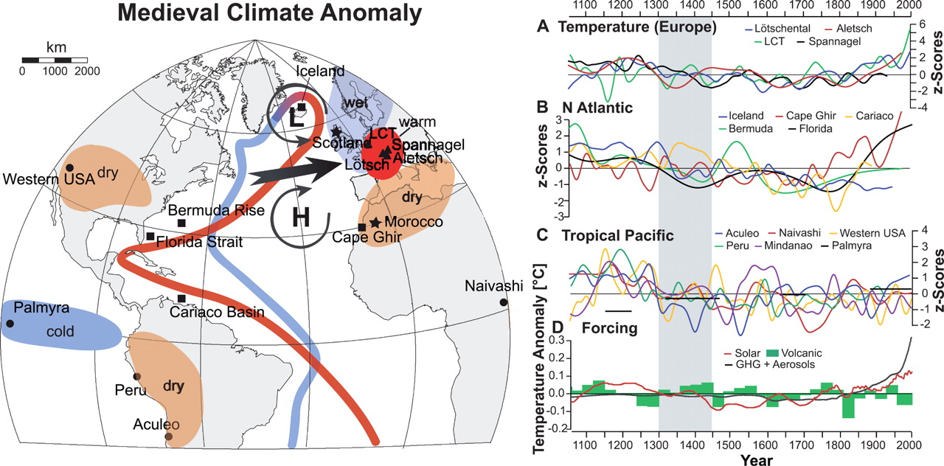
Proposed causes of climate change from 1000-1850
Notes:
NAO: largely atmospheric oscillation (unlike ENSO) caused by pressure difference between Icelandic low and Azores high; affects North Atlantic/European sector, mostly in winter; controls strength and direction of westerly winds and storm tracks across the North Atlantic; highly correlated with Arctic Oscillation.
Positive phase (increased difference in pressure): increased westerlies -> cool summers, mild and wet winters; eastern US has mild wet winter conditions
Negative phase (decreased difference in pressure): suppressed westerlies -> northern areas suffer cold winters; storms track southerly toward Mediterranean Sea; US east coast has more cold air outberaks and snowy weather conditions
Used 2 stations
tree rings from Morocco (1049-2002)
speleothems from Scotland (900-1993)
Persistent Positive North Atlantic Oscillation Mode Dominated the Medieval Climate Anomaly
Valérie Trouet, Jan Esper, Nicholas E. Graham, Andy Baker, James D. Scourse and David C. Frank
Science 3 April 2009: Vol. 324. no. 5923, pp. 78 - 80, DOI: 10.1126/science.1166349

Slide 24
Proposed causes of climate change from 1000-1850
Recent research (Trouet et al. 2009) suggests
  MWP is associated with persistent positive North Atlantic Oscillation
  A clear shift to weaker NAO conditions into the LIA
  This is one aspect of the MWP-LIA climate transition
  Stay tuned….. Few records exist to extend the NAO record into the MWP; new records might challenge this
Notes:
NAO: largely atmospheric oscillation (unlike ENSO) caused by pressure difference between Icelandic low and Azores high; affects North Atlantic/European sector, mostly in winter; controls strength and direction of westerly winds and storm tracks across the North Atlantic; highly correlated with Arctic Oscillation.
Positive phase (increased difference in pressure): increased westerlies -> cool summers, mild and wet winters; eastern US has mild wet winter conditions
Negative phase (decreased difference in pressure): suppressed westerlies -> northern areas suffer cold winters; storms track southerly toward Mediterranean Sea; US east coast has more cold air outberaks and snowy weather conditions
Used 2 stations
tree rings from Morocco (1049-2002)
speleothems from Scotland (900-1993)
Persistent Positive North Atlantic Oscillation Mode Dominated the Medieval Climate Anomaly
Valérie Trouet, Jan Esper, Nicholas E. Graham, Andy Baker, James D. Scourse and David C. Frank
Science 3 April 2009: Vol. 324. no. 5923, pp. 78 - 80, DOI: 10.1126/science.1166349

Slide 25
Proposed causes of climate change from 1000-1850
Evidence for MWP is uncertain
  Fewer records; larger uncertainties
Estimated cooling from 1000 years ago into the LIA is small

Slide 26
Proposed causes of climate change from 1000-1850
Any or all of several factors could have played a causal role
Far greater geographic coverage is needed to define the global climatic response
  Notion of MWA & LIA is valid for trends across eastern Canada, Greenland, Iceland, northern Europe – what about rest of earth’s surface (90-95%)?
No such ambiguity exists about the large, rapid and global warming since 1850

Slide 27

SYR - FIGURE 2-3a
Notes:
Note tightening of the error bars because of increased confidence in the data.
Proxies – tree rings, boreholes, ice cores
There is a new ice core from Antarctica that goes back 800,000 years!

Slide 28

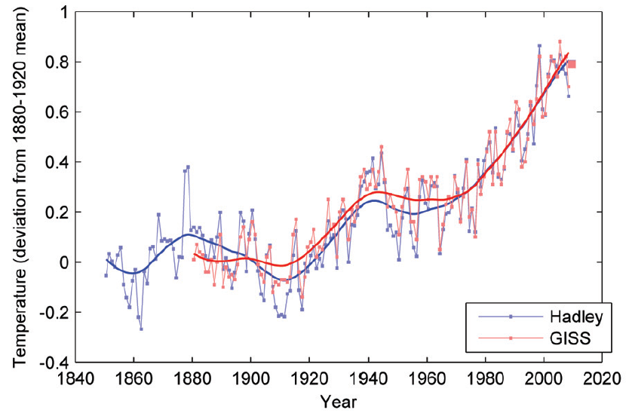
Global Average Temperature, 1850-2009 (relative to the baseline of 1880-1920)
■ Preliminary values for 2009 based on data up to and including August.
Source: The Copenhagen Diagnosis, 2009

Slide 29
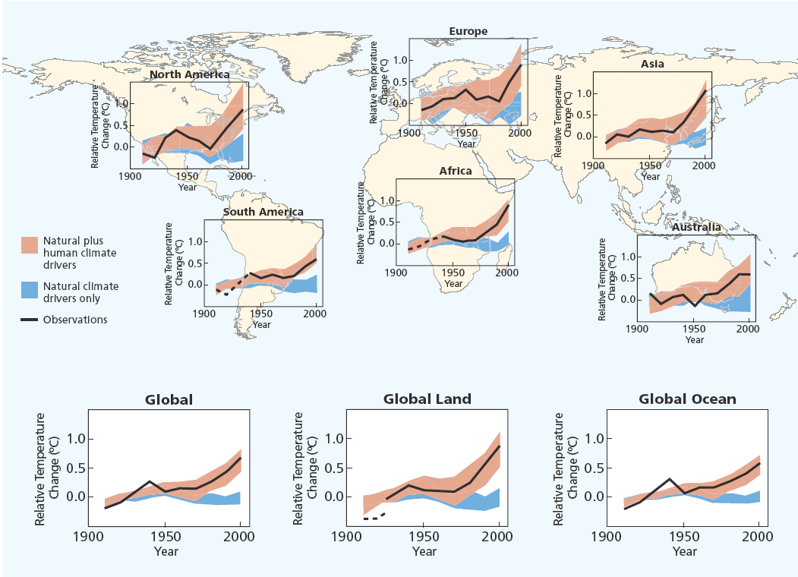
Source: IPCC Climate Change 2007: The Physical Science Basis—Summary for Policymakers.

Slide 30
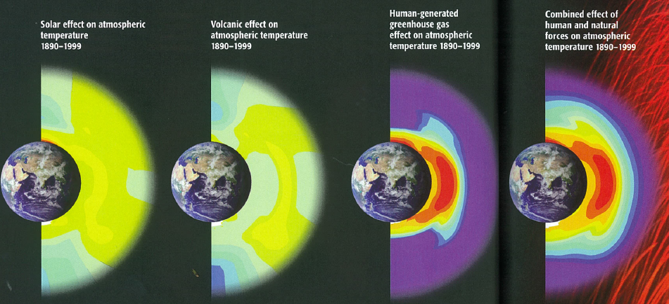
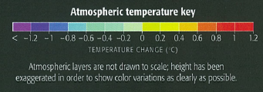
Atmospheric Fingerprints
1890-1999
Mann & Kump, 2008
Notes:
Pattern of expected changes:
Increased solar output is predicted to warm essentially the whole atmosphree
Volcanoes are expected to slightly cool the lower atmosphere and slightly warm the mid-level atmosphere
Human-generated GHGs warm the lower atmosphere at the expense of cooling the stratosphere and above.
Combining all of the effects together (far right) looks a lot like the impacts of human activity and matches the pattern of change we’ve seen in recent decades.

Slide 31
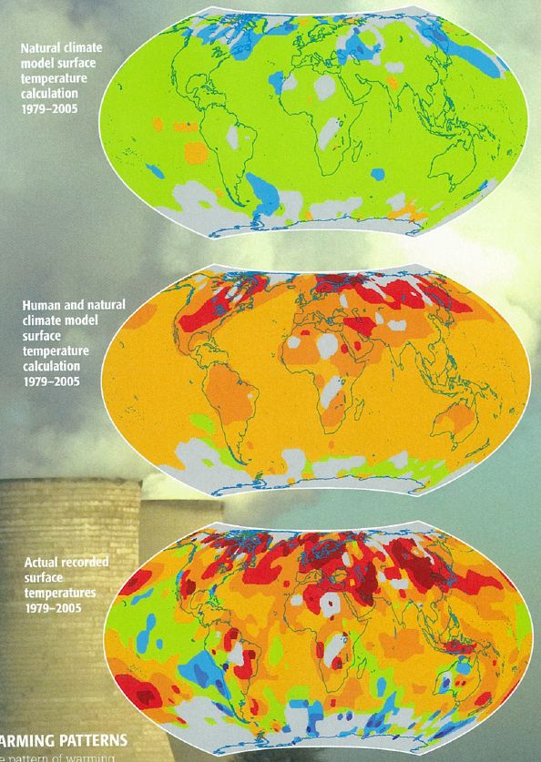
“Fingerprints”
Human and Natural Impacts on Climate,
1975-2005
Mann & Kump, 2008
Notes:
The pattern of warming (bottom panel) is not reflected in models that only take into account the impacts of natural forces alone (top).
It corresponds closely (but not exactly) to a map of combined human and natural impacts. Why is it not perfect match?

Slide 32
Temperature Trends: 1880 to 2000
(Hansen et al., Journal of Geophysical Research, 2001)

Slide 33
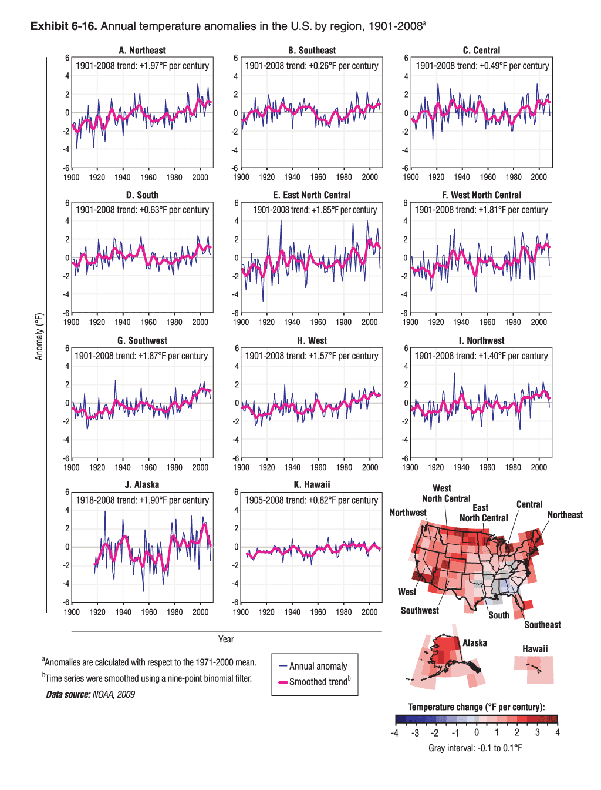

Annual Temperature Anomalies in the U.S., 1901-2008
Notes:
33

Slide 34
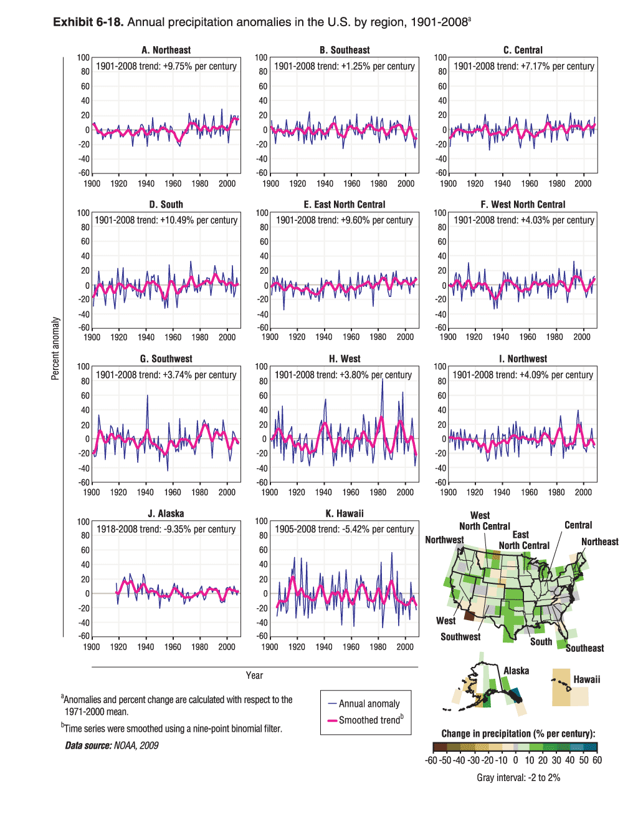
Annual Precipitation Anomalies in the U.S., 1901-2008

Slide 35
What about the cool temperatures from ~1945 to ~1980?
SYR - FIGURE 2-3a
Notes:
Note tightening of the error bars because of increased confidence in the data.
Proxies – tree rings, boreholes, ice cores
There is a new ice core from Antarctica that goes back 800,000 years!

Slide 36
Global Dimming or
“Long Term Trends in Solar Radiation”

Slide 37
What is global dimming?
Global dimming is the gradual reduction in the amount of global direct irradiance at the Earth's surface.
  Measurements began in the 1950s.
    Most data are from NH, and all taken on land
    Data quality?
Effect varies by location
  Worldwide: ~4% reduction during 1960–1990
Notes:
Independent research in Israel and the Netherlands in the late 1980s showed an apparent reduction in the amount of sunlight, despite widespread evidence that the climate was actually becoming hotter (see global warming). The rate of dimming varies around the world but is on average estimated at around 2–3% per decade, with the possibility that the trend reversed in the early 1990s. It is difficult to make a precise measurement, due to the difficulty in accurately calibrating the instruments used, and the problem of spatial coverage. Nonetheless, the effect is almost certainly present.
A reduction in downward solar radiation of about 4% or about 7W/m2 from 1961 to 1990 was found at stations worldwide by Gilgen et al., (1998). Gilgen et al. did a quick analysis and used all the available data with increasingly shorter records for their trend statistics. Stanhill and Cohen (2001) calculated a stronger reduction of about 8% per decade. The reason for the discrepancy might be that only 30 records were used in the latter study and it seems only the ones with the declining trend. My own analysis was based on 110 continuously recording stations worldwide from 1961 to 1990 (Liepert 2002). I confirmed Gilgen et al.'s estimate of a reduction of about 4% in three decades. Since the late 1980s a recovery seems to be occurring but the studies demonstrating this are not yet published. (Liepart, http://www.realclimate.org/index.php?p=110)

Slide 38
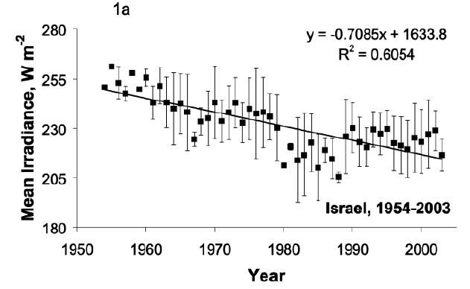
50 years of Radiation Data - Israel
Notes:
Fifty years of global radiation measurements in Israel, 1954–2003. Based on 233 mean
annual values of Eg↓ measured with calibrated thermopile pyranometers at 20 sites, the spatial
variation around the mean annual values is indicated by vertical bars representing ±1 standard
deviation, W m-2.

Slide 39
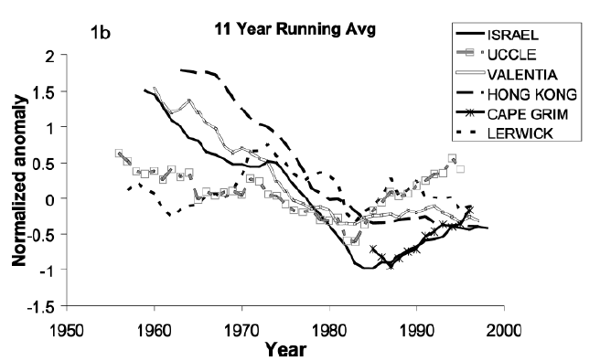
Incoming Shortwave Radiation
Anomalies in the annual mean
Notes:
Eleven-year running mean of normalized anomalies of annual means of Eg↓
measured with calibrated thermopile pyranometers at Israel, 1954–2003; Uccle, Belgium, 1951–2000;
Valentia, Ireland, 1955–2002; Hong Kong, China, 1958–2000; Cape Grim, Australia, 1980–2001; and
Lerwick, United Kingdom, 1952–2002

Slide 40
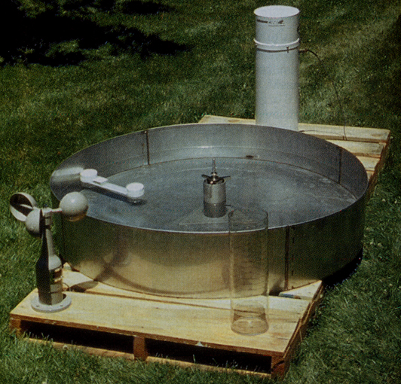
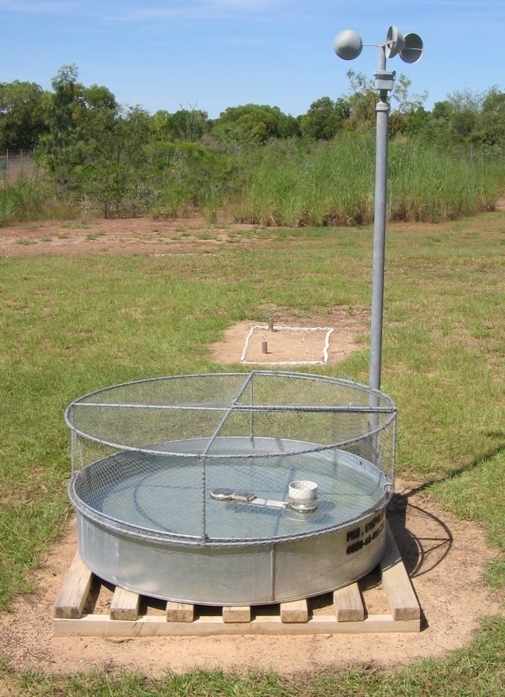
Supporting Evidence
Worldwide decline in the “pan evaporation rate.”
  Sunlight, humidity, and wind are dominant factors

Slide 41
Where does it come from?
Effect of global dimming is probably due in part to the increased presence of aerosol particles in the atmosphere.
  Aerosol particles and other particulate pollutants absorb solar energy and reflect sunlight back into space.
  Increased pollution, resulting in more particulates, creates clouds with a greater number of smaller droplets, making them more reflective.
With global warming, there is a similar effect.
  Water vapor and cloud feedback
    Same effect as aerosols, but different cause
For more information: http://www.climate.noaa.gov/pdf/Aerosol_Factsheet_Sept_2009_FINAL.pdf

Slide 42
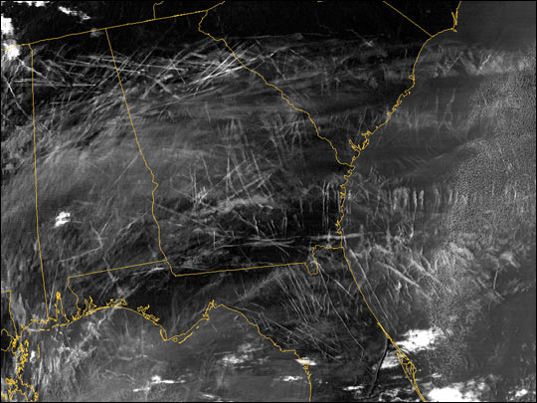

Aircraft Contrails, Jan 29 2004 MODIS
Notes:
Aircraft contrails
constant air traffic meant that this could not be tested.
Sept. 11, 2001
near-total shutdown of civil air traffic for three days
rare opportunity in which to observe the climate of the US absent from the effect of contrails.
An increase in diurnal temperature variation of >1 °C was observed in some parts of the U.S.
Aircraft contrails may have been raising nighttime temperatures and/or lowering daytime temperatures by much more than previously thought

Slide 43
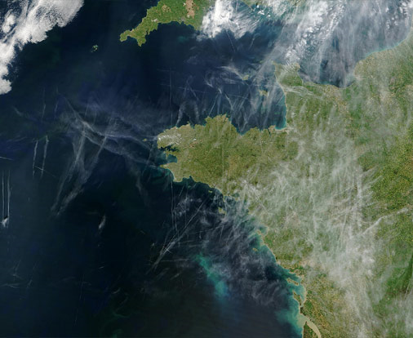
Aircraft Contrails over Europe
Notes:
Look at difference between land/ocean…

Slide 44
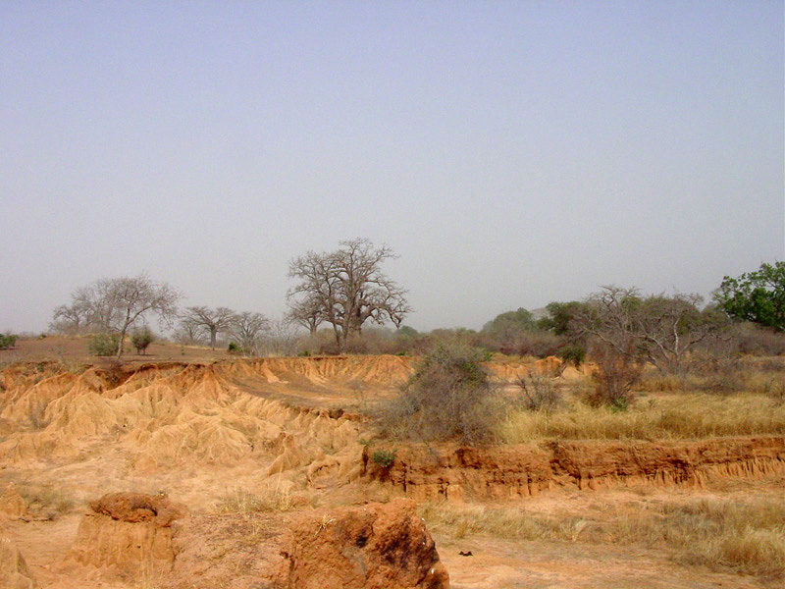
Effects are mostly regional
Regions that are downwind from major sources of air pollution (specifically sulfur dioxide emissions) have generally cooled.
  may help explain the cooling of the Eastern U.S. relative to the warming Western U.S.
  examined effects in the Maldives
Extreme regional effect
  the Sahel
Notes:
Maldives: The Maldives, a nation of a thousand tiny islands in the middle of the Indian Ocean: it was here that Veerabhadran Ramanathan, one of the world's leading climate scientists, began to unravel the mystery of what's causing global dimming. He had first noticed declining sunlight over large areas of the Pacific Ocean in the mid-1990s. The Maldives seem unpolluted, but in fact the northern islands sit in a stream of dirty air descending from India. Only the southern tip of the long island chain enjoys clean air, coming all the way from Antarctica.
So, by comparing the northern islands with the southern ones, Ramanathan and his colleagues would be able to see exactly what difference the pollution made to the atmosphere and the sunlight.
Sahel: The Sahel is the transition zone between the Sahara desert and the more humid tropical regions of Africa. Sahel comes from the Arabian "sahil", meaning "edge" or "coastline". The Sahel is the northern part of the transitional climatic zone with a precipitation of 150 to 450 mm and 8 to 10 months without any rainfall. As regards vegetation, the Sahel consists of semi-desert in the north and the Sahel savanna in the south. In this area the plant life is predominantly briars, shrubs and single trees, mostly Acacia albida and Acacia senegal. More vegetation grows after rainfall, but the plants very soon wither in the desiccated soil. The biggest problem of the Sahel region is desertification.
Modeling Exercise:
Pollution from Europe & NA affects cloud properties in the NH
the clouds reflected more sunlight back to space cooling the oceans of the northern hemisphere
The result? Tropical rain bands moved southward
A cause of droughts in the Sahel, in the 1970s and 1980s?
Disrupted the monsoon cycle
Potential for air pollution to have far reaching effects on rainfall
50 million people affected
Asia also has a monsoon cycle
What if it had a similar impact on the Asian monsoons?
3.6 billion people or roughly half the world's population

Slide 45
Trend Reversal – 1990-2006
The “dimming” trend reversed
  part of this change is due to decreases in pollution.
    particularly over Europe
Most developed nations have done more to reduce aerosols released into the atmosphere than to reduce CO₂ emissions.
Notes:
It may be suggested that increasing aerosol might be a possible solution to global warming. However, aerosol has negative effects (acid rain) which is why nations have made efforts to reduce it. Also, the aerosol has a very short lifetime (weeks).

Slide 46
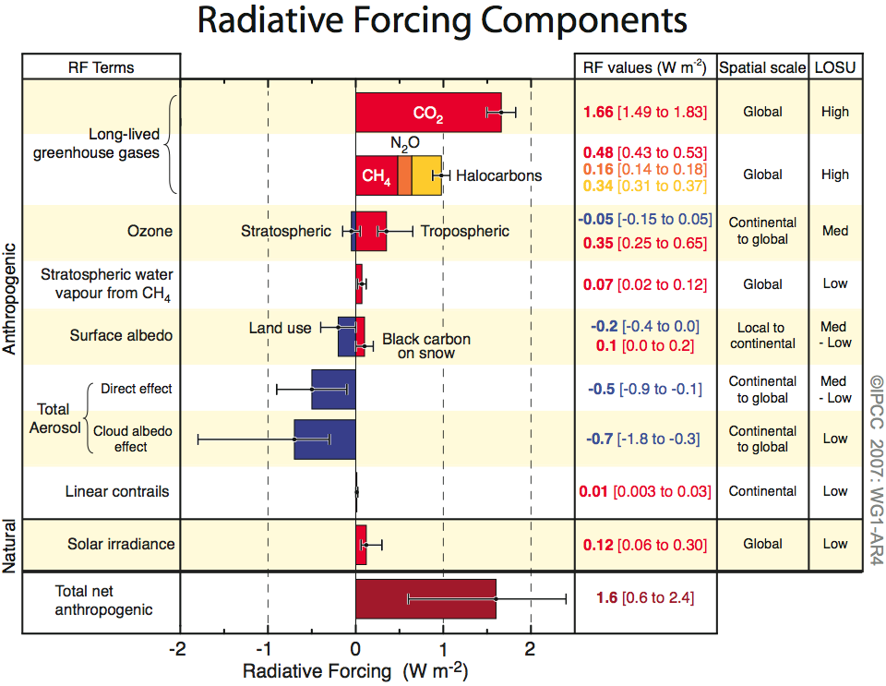
Human and Natural Drivers of Climate Change

Slide 47
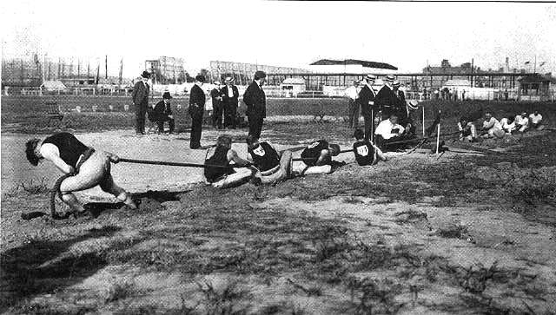
Effects on Climate Systems
Climate change, to the current date, appears to have been a tug of war, really, between two manmade pollutants.
  greenhouse gases are pulling the system towards a warmer state (+2.6-3.0 W m⁻²)
  particles from pollution that are cooling it down (-1.5 W m⁻²)
JAMES HANSEN: “If the particle forcing is what we estimate, that would imply that removing that forcing would cause a global warming of more than 1°C. That's more than the warming that we've seen already, so this is a huge factor.”
Notes:
Some scientists now consider that the effects of global dimming have masked the effect of global warming to some extent
resolving global dimming may lead to increases in predictions of future temperature rise
Image (copyright expired) from http://en.wikipedia.org/wiki/Image:1904_tug_of_war.jpg.

Slide 48
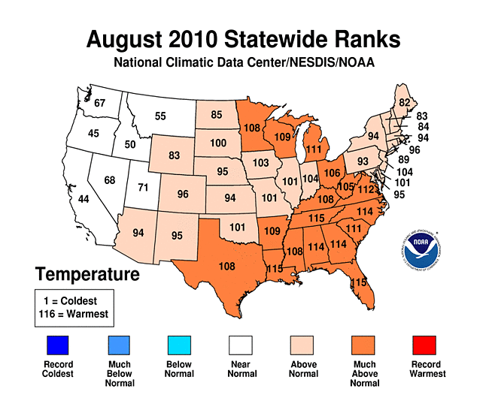
Setting Records?
Notes:
It was the fourth warmest summer on record in the United States. Three climate regions had temperatures in the top five: the Southeast (warmest), the Central (third warmest) and the Northeast (fourth warmest). Abnormal warmth dominated much of the east, where a record warm summer occurred in Rhode Island, New Jersey, Delaware, Maryland, Virginia, North Carolina, Tennessee, South Carolina, Georgia and Alabama. Nineteen other states experienced “much above normal” average temperatures. Several cities broke summer temperature records, including New York (Central Park); Philadelphia; Trenton, N.J.; Wilmington, Del.; Tampa, Fla. (tied); and Asheville, N.C.

Slide 49

Weather vs. Climate
“Choosing shorts or long underwear on a particular day is about weather; the ratio of shorts to long underwear in the drawer is about climate.”
Charles Wohlforth. The Whale and the Supercomputer
1950
2007
Global Warming: The Greatest Threat © 2006 Deborah L. Williams

Slide 50
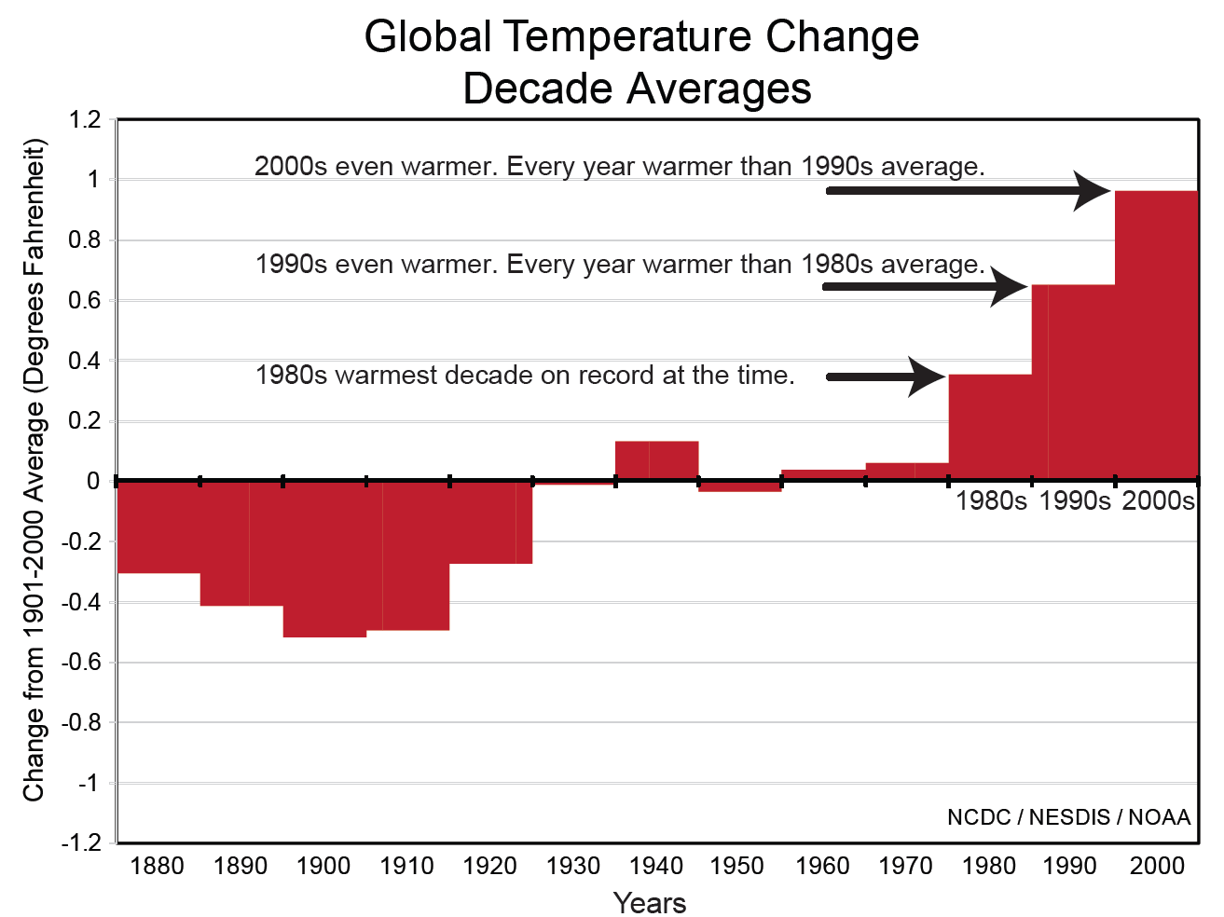
Setting Records?
Notes:
It was the fourth warmest summer on record in the United States. Three climate regions had temperatures in the top five: the Southeast (warmest), the Central (third warmest) and the Northeast (fourth warmest). Abnormal warmth dominated much of the east, where a record warm summer occurred in Rhode Island, New Jersey, Delaware, Maryland, Virginia, North Carolina, Tennessee, South Carolina, Georgia and Alabama. Nineteen other states experienced “much above normal” average temperatures. Several cities broke summer temperature records, including New York (Central Park); Philadelphia; Trenton, N.J.; Wilmington, Del.; Tampa, Fla. (tied); and Asheville, N.C.

