Slide 1
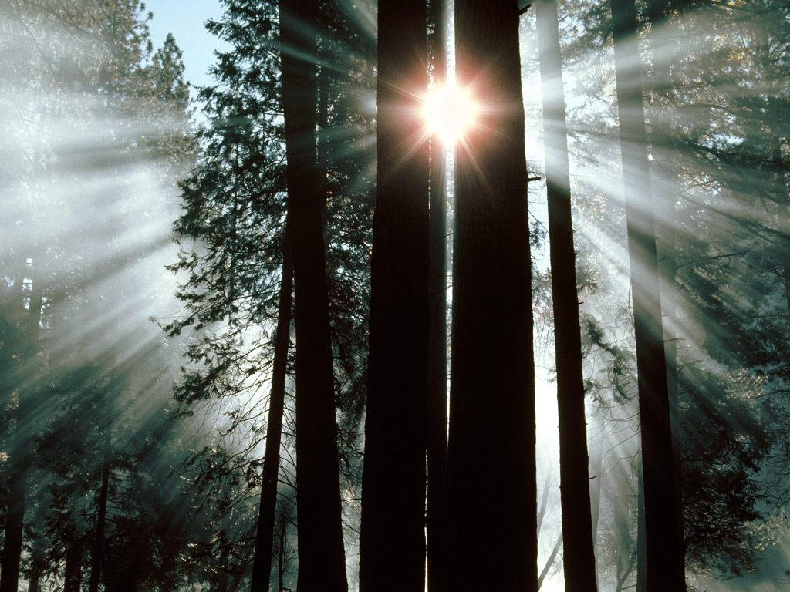
Forest Dynamics
& Climate Change
Bill Smith
CCS203
September 29th, 2010
Notes:
First we will look at some forest statistics and talk a little about the importance of forest not only for economic reasons but for their role in the carbon cycle.
Then we are going to move into a discuss on what recent research is telling us concerning the influence of climate change on forest dynamic
Finally we will end up look at a global picture of net change in vegetation dynamics.

Slide 2
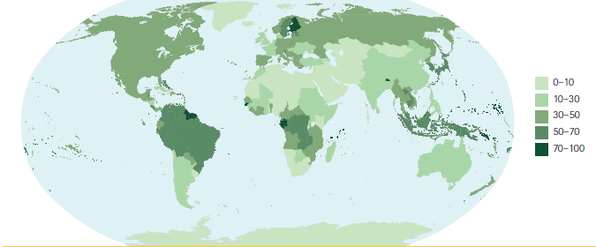
Global Forest Extent
30% of land area
~40 Mkm²
6200 m² / person
Global Forest Resource Assessment 2010,
Food & Agriculture Organization of the United Nations
Forest Classification:
  Boreal
    Temperate
    Tropical
United Nations Environment Program –
World Conservation Monitoring Center, 2000
Only ~36% of forest is classified as primary forest
Notes:
Globally forests comprise over 30% of total terrestrial land area which works out to about 6200 m2 per person.
The top map put together by the Food & Agriculutural Organization shows forst cover by region as a percentage:
The most forest rich countries include Russia, Brazil, Canada, the united states, and china and they account for more that half of total forest area
Only ten countries have no forest.
Forests are classified in a number of different ways. For example the UNEP-WCMC has 26 classifications based on factors such as conifer/deciduous, elevation, latitude, ect.
For the purposes of this lecture we will mainly focus on a very general classification based on climate. Including Boreal forest in the far north, temerate forests in the mid-latitudes, and tropical forest in the equatorial region.
As a side, currently only ~36% of forest is classified as primary forest or forest area largely undisturbed by human influence!

Slide 3
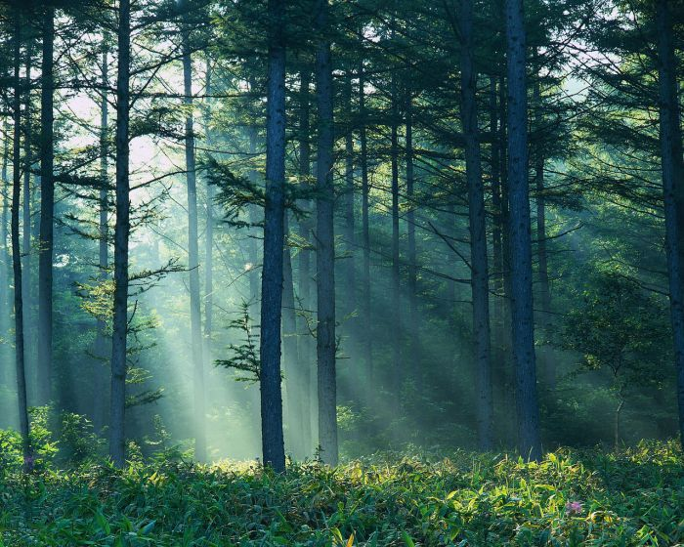
Forest Ecosystems as Sources of Goods and Services

Slide 4
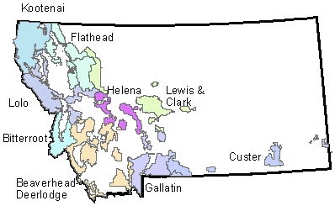
Montana’s Forest Industry

Slide 5
Global Forest Industry
Global wood removals valued just over $100 billion annually.
Non-wood forest products valued at $18.5 billion.
Montana contributes only slightly over 1% to North and Central American Forest Industry.
Global Forest Resource Assessment 2010,
Food & Agriculture Organization of the United Nations

Slide 6
Montana’s Soci-Economic
Utilization of Forests
Approximately 10 million people are employed in forest management & conservation.
More that 60,000 university students graduate in forestry annually.
Notes:
Forest are not only important as a source of good but they are also important as a source of tourism and recreation.

Slide 7
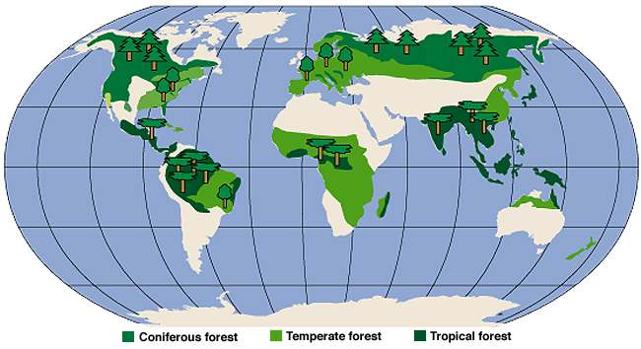
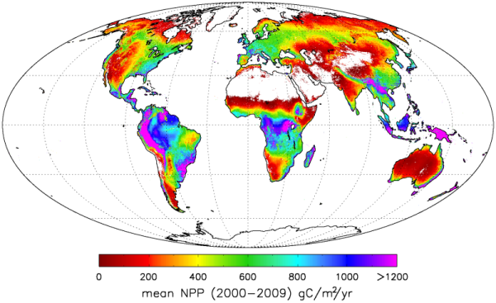
Forests Also Store A LOT of Carbon in Their Biomass…
For the 1.42 billion hectares of Northern forests, roughly above the 30th parallel, we estimate the biomass sink to be 0.68 billion tons of carbon per year.
—Myneniet al (2001), PNAS
Image from: Zhao & Running, Science 2009

Slide 8
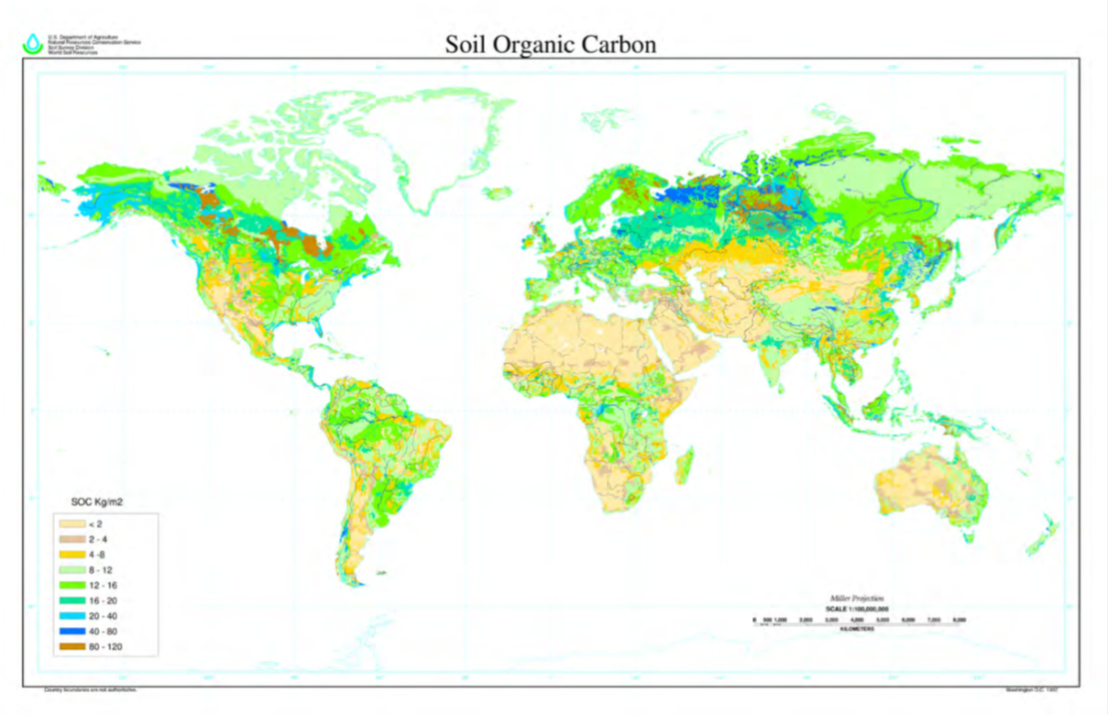
…And In Their Soils
FAO-UNESCO, Soil Map of the World, digitized by ESRI. Soil climate map, USDA-NRCS, Soil Survey Division, World Soil Resources, Washington D.C.

Slide 9

The Global Carbon Cycle
Fossil Fuels
5.3 Pg/yr
The Atmosphere
760 Pg
Photosynthesis
90 Pg/yr
Land Use Change
1.8 Pg/yr
Photosynthesis
120 Pg/yr
Respiration
88 Pg/yr
Land Use Change
1.8 Pg/yr
Respiration
60 Pg/yr
Oceans
38,000 Pg
Decomposition
55 Pg/yr
Vegetation
650 Pg
Litter Fall
60 Pg/yr
Soils
1,500 Pg

Slide 10
Net Change in Forest Area 2005-2010
For the world as a whole, carbon stocks in
forest biomass decreased by an estimated 0.5 Gt
annually during the period 2005–2010, mainly
because of a reduction in the global forest area.

Slide 11
What Regulates Forest Tree Distribution?

Slide 12
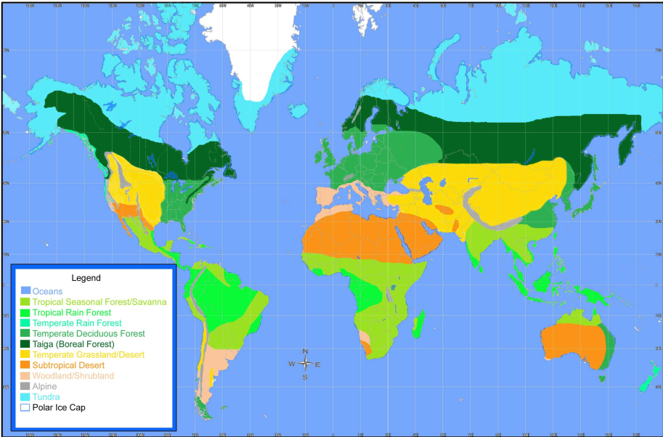
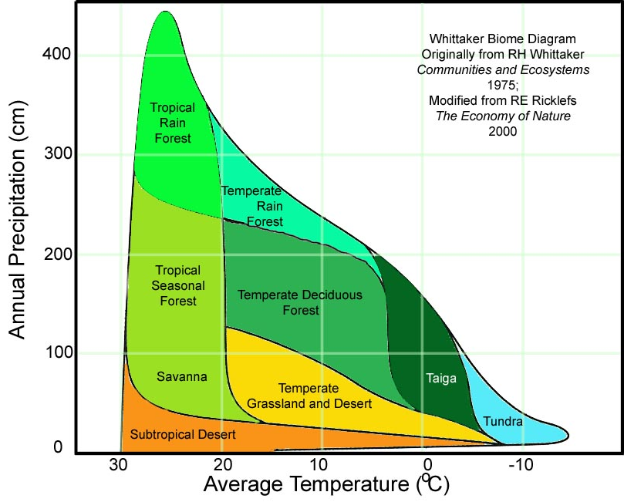
The Relationship Between Climate & Vegetation

Slide 13
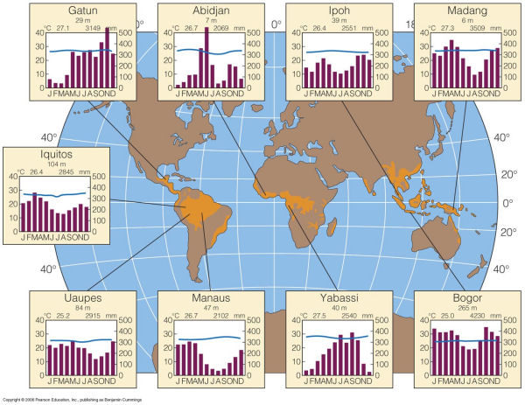
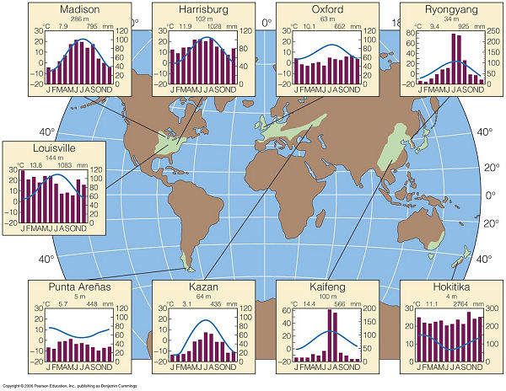
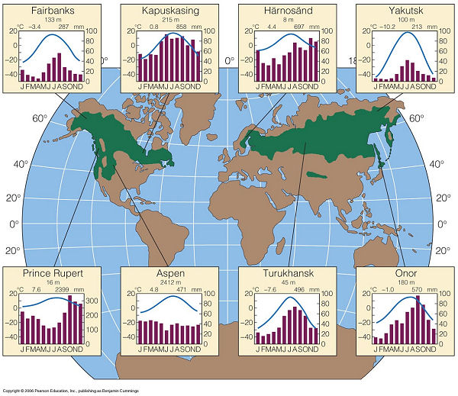
Climate & Vegetation
Climate & Distribution:
  Tropical
  Temperate
  Boreal

Slide 14
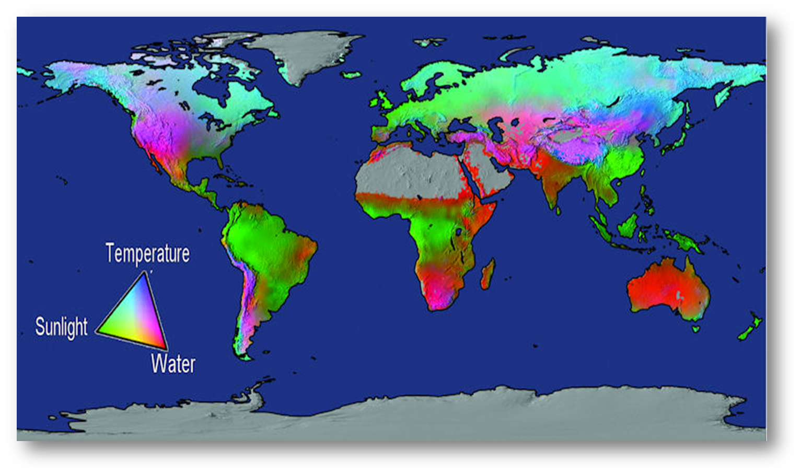
Biophysical Limits to Productivity
(Churkina & Running, 1998; Nemani et al., 2003; Running et al., 2004)

Slide 15
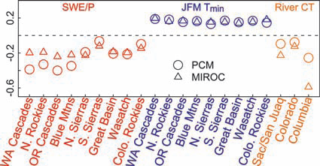
Climate Change & Forest Dynamics

Slide 16
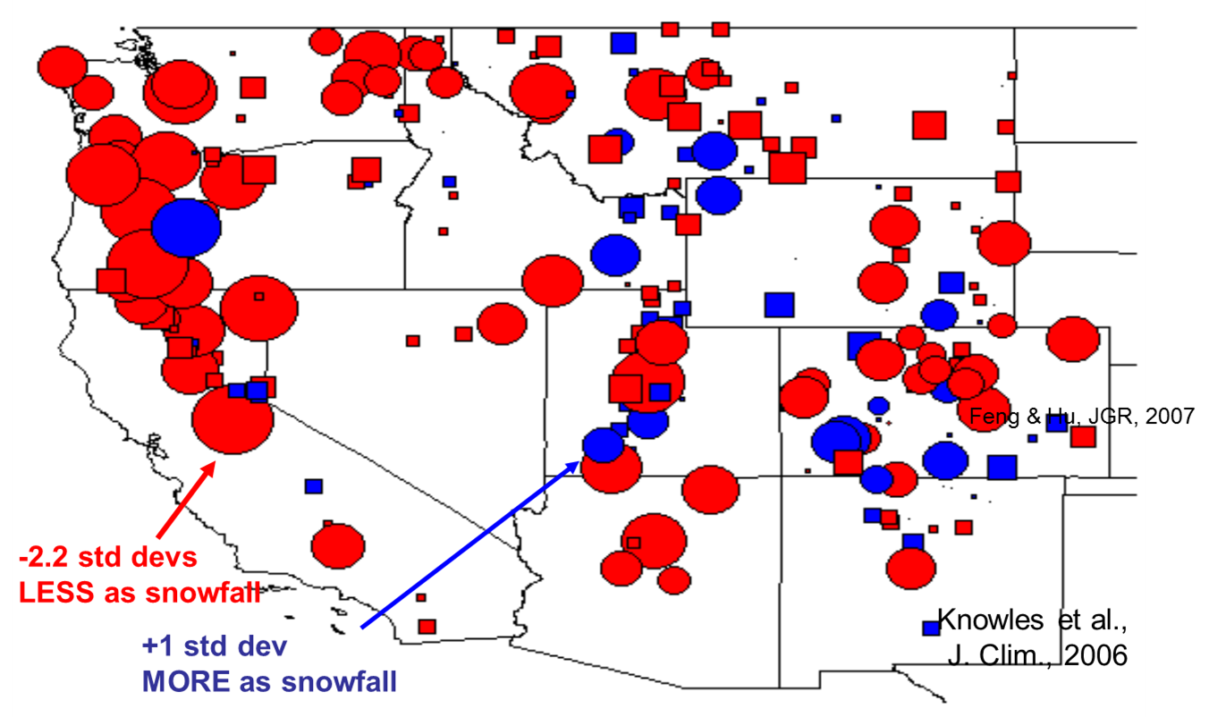
Climate Change & Forest Dynamics

Slide 17
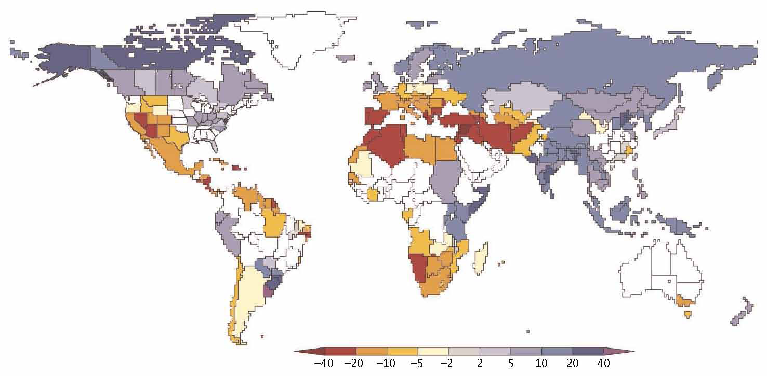
Spring Runoff Dynamics
Milly et al., Science 2008
Projected change in annual runoff volume by the middle of the 21st century, relative to the historical period 1900-1970. Presence of color indicates that at least 8 of 12 models agreed on the direction (increase or decrease) of runoff change under the Intergovernmental Panel on Climate Change (IPCC) "SRES A1B" emissions scenario.

Slide 18

The strong relationship between forest cover and climate suggests that climate change could have profound consequences for forest dynamics.
Forest Growth/Mortality
Forest Pest Dynamic
Wildfire Dynamic
Carbon Storage Dynamic

Slide 19
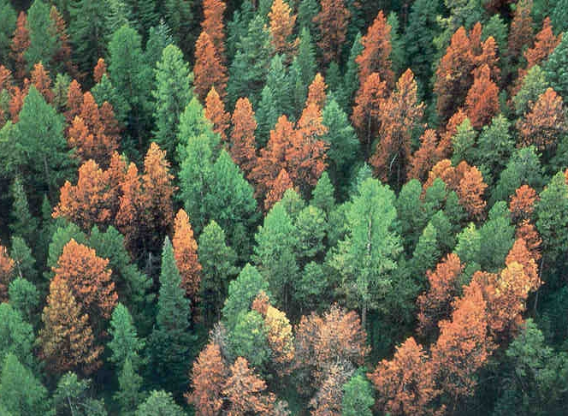
Is there evidence that climate change is affecting forest dynamics:
Forest Decline?

Slide 20
Climate-Driven Increases in Ecosystem Productivity from 1982 to 1999
R. R. Nemani et al., Science 300, 1560 (2003).
From 1982 to 1999, climate constraints were relaxing with increasing temperature and solar radiation, allowing an upward trend in NPP.
The past decade has been the warmest since instrumental measurement which could imply continued increases in NPP.

Slide 22
Forest Mortality
Background Mortality: Non-catastrophic mortality.
87% of plots showed increased mortality rates.
Regional Warming and consequent increases in water deficit are likely contributors to this trend.
P. J. van Mantgem et al., Science 323, 521 -524 (2009)

Slide 23
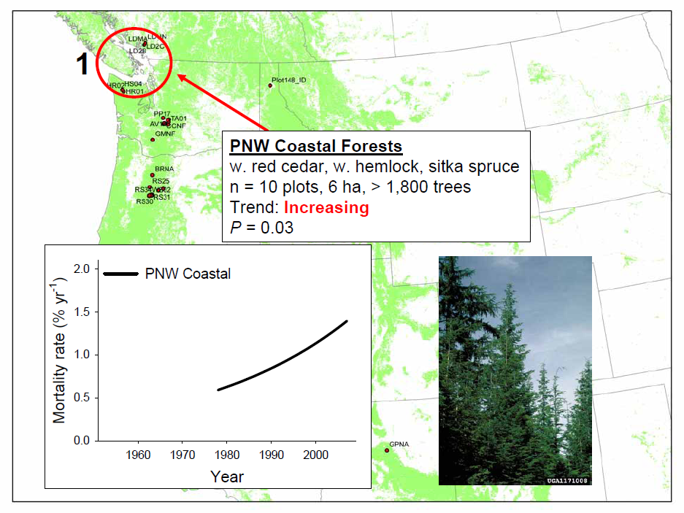
Slide from P. J. van Mantgem et al., Widespread increases of tree mortality rates in the western United States

Slide 24
Slide from P. J. van Mantgem et al., Widespread increases of tree mortality rates in the western United States

Slide 25
Slide from P. J. van Mantgem et al., Widespread increases of tree mortality rates in the western United States

Slide 26
Slide from P. J. van Mantgem et al., Widespread increases of tree mortality rates in the western United States

Slide 27
Slide from P. J. van Mantgem et al., Widespread increases of tree mortality rates in the western United States

Slide 28
Slide from P. J. van Mantgem et al., Widespread increases of tree mortality rates in the western United States

Slide 29
Slide from P. J. van Mantgem et al., Widespread increases of tree mortality rates in the western United States

Slide 30
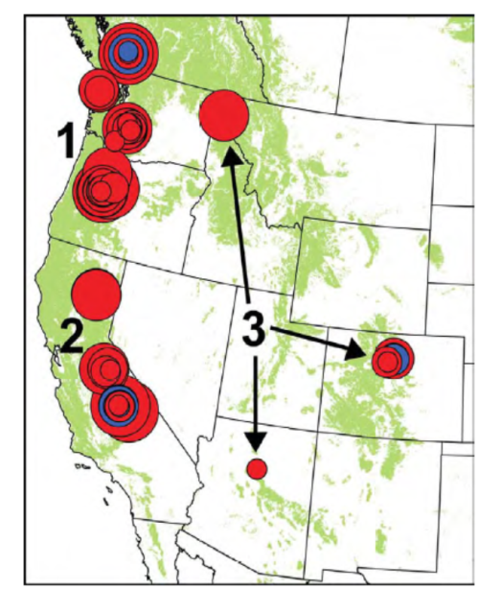
Forest Mortality
Modeled trends in tree mortality rates for (A) regions, (B) elevational class, (C) stem
diameter class, (D) genus, and (E) historical fire return interval class.
Image from P. J. van Mantgem et al., Science 323, 521 -524 (2009)

Slide 31
Forest Mortality

Slide 32
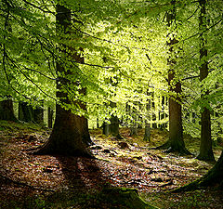
Forest Mortality
European Beech distribution is largely drought limited similar to many deciduous forests.
Recently, significant growth declines have been observed at the lower growth limit.
Image From Jump et al. (2006), Global Change Biology

Slide 33
Forest Mortality
Analysis of climate-growth relationships suggests that the observed decline in growth is a result of warming temperatures and that, as precipitation in the region has not increased, precipitation is now insufficient to ameliorate the negative effects of increased temperatures on tree growth.
Image From Jump et al. (2006), Global Change Biology

Slide 34
Is there evidence that climate change is affecting forest dynamics:
Forest Decline?
Yes, Compelling Evidence

Slide 35
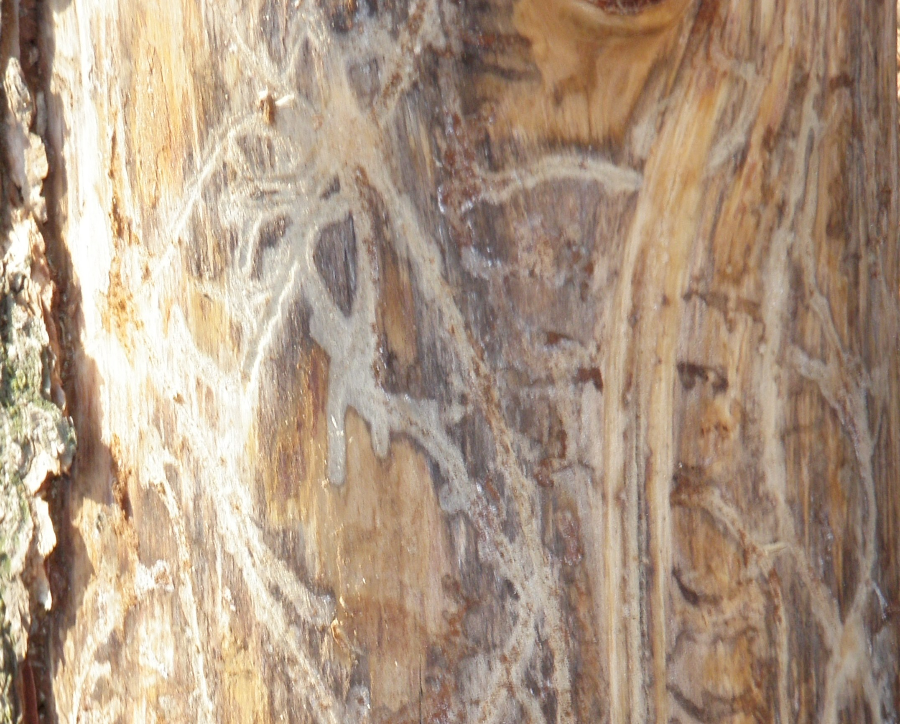
Is there evidence that climate change is affecting forest dynamics:
Forest Pest Dynamic?

Slide 36
“Montana lost a million acres of trees to beetles [in 2007]”
“In Wyoming and Colorado in 2006 there were a million acres of dead trees. [2007] it was 1.5 million. [2008] it totaled over 2 million”
“British Columbia has lost over 33 million acres of lodgepole pine forest …”

Slide 37
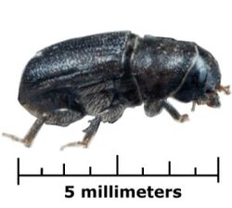
Climate & Pest Dynamic
The mountain pine beetle is a native insect of the pine forests of western North America.
The current outbreak in British Columbia is an order of magnitude larger than all previously recorded outbreaks.
Maximum annual beetle impact (20 Mt C) is of similar magnitude to forest fire emissions from all of Canada during 1959–1999 (27 Mt C).
W. A. Kurz et al., Nature 452, 987 (2008).
Notes:
Several species of bark beetles – such as mountain pine beetle (Dendroctonus ponderosae), piñon ips beetle (Ips confusus), and spruce beetle (Dendroctonus rufipennis) – are attacking and devastating the predominantly conifer forests of western North America from British Columbia to New Mexico. Tens of millions of acres of western forests have been affected by die-offs of infected trees the past few years, causing more than $1 billion in damage annually in the United States alone.
Bark Beetles
Bark beetles kill trees by boring through the bark into the phloem layer on which they feed and in which eggs are laid. Pioneer female beetles initiate attacks, producing pheromones that attract more beetles. The trees respond to attack by increasing their resin output to discourage or kill the beetles. Pine beetles carry blue stain fungi which, if established, will block the tree resin response. Within about two weeks of a beetle attack, the trees starve to death as the phloem layer is damaged enough to cut off the flow of water and nutrients. Older trees usually succumb first. After particularly hot summers, the mountain pine beetle population can increase dramatically, deforesting large areas. After an outbreak, entire groves of trees will appear red when viewed from above.

Slide 38
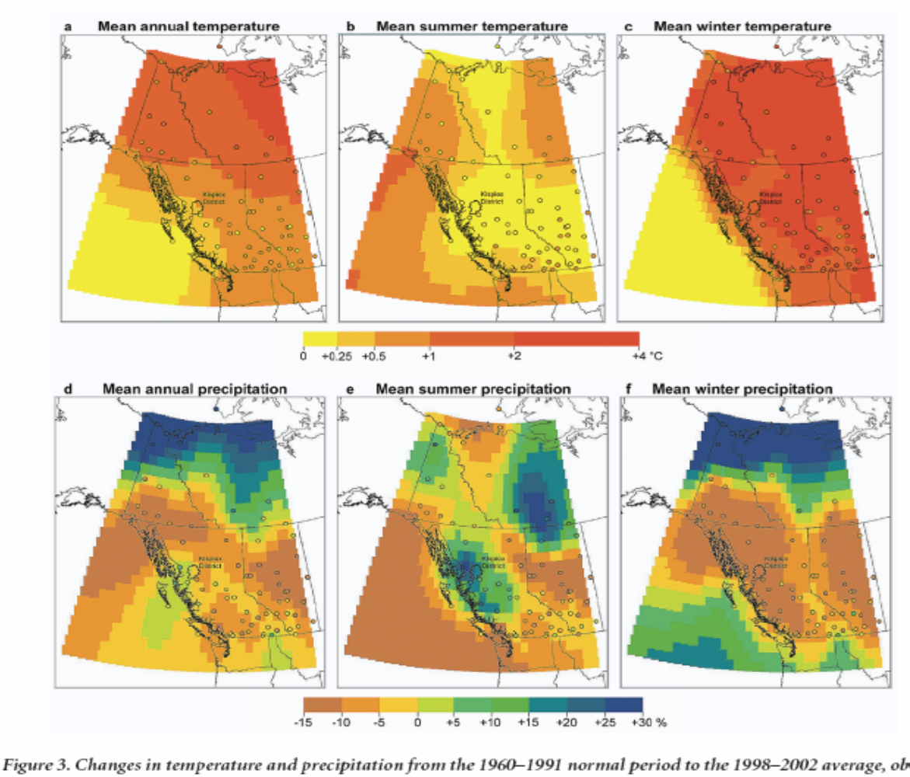
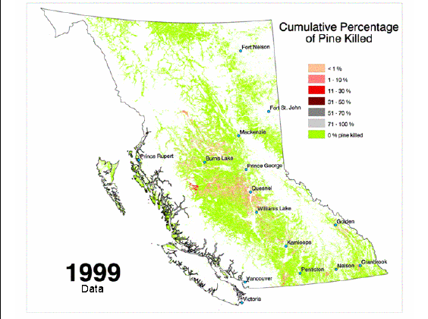
Climate & Pest Dynamic
Figure 3. Changes in temperature and precipitation from the 1960–1991 normal period to the 1998–2002 average, observed by weather stations (circles) and interpolated using thin plate spline techniques (colored areas).
Woods et al., Bioscience 2005

Slide 39
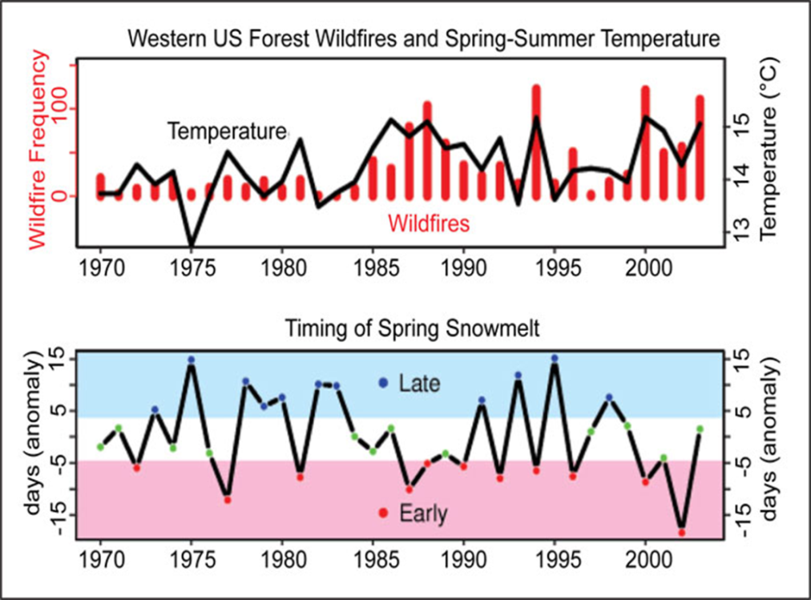
How Does Climate Influence Pest Dynamic?
Climate change influence frequency, intensity, and distribution of outbreak.
Elevated Temperature:
  Reduces wintertime bark beetle mortality.
  Reduces the time needed to complete a lifecycle.
Drought Stress:
  Weakened tree defense.
  Younger trees become susceptible to infestation.

Slide 40
Climate & Pest Dynamic
Raffa et al Bioscience 2008
Notes:
Figure 1. Recent mortality of major western conifer biomes to bark beetles. (a) Map of western North America showing regions of major eruptions by three species. (b) Sizes of conifer biome area affected by these three species over time. Data are from the Canadian Forest Service, the British Columbia Ministry of Forests and Range, and the US Forest Service

Slide 41
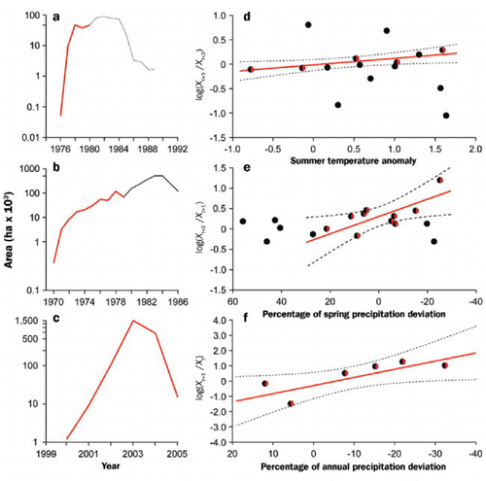
Climate & Pest Dynamic
(a) spruce beetle in central British Columbia, Canada
(b) mountain pine beetle in southern British Columbia
(c) pinyon ips beetle in the US Southwest
Raffa et al Bioscience 2008
Notes:
Figure 5. Interaction of external drivers and endogenous feedback in landscape-scale eruptions by bark beetles. Shown is the annual area (hectares) of forest affected during recent eruptions by (a) spruce beetle in central British Columbia, Canada, (b) mountain pine beetle in southern British Columbia, and (c) pinyon ips beetle in the US Southwest. The annual rates of change are shown as black and black/red circles in relation to variation in critical climatic conditions known to affect populations: (d) summer temperature anomaly for spruce beetle (Hansen and Bentz 2003), (e) deviation in spring precipitation for mountain pine beetle (Thomson and Shrimpton 1984), and (f) deviation in annual precipitation for the pinyon ips beetle (Breshears et al. 2005). The rate of change in populations is log(x_{t + 1}/ x_{t}), where x_{t} represents area affected in year t. For spruce and mountain pine beetles, this was determined as log(x_{t + 3}/x_{t + 2}) or log(x_{t + 2}/x_{t + 1}) to account for the resultant “lag” in the response associated with semivoltine or univoltine development, respectively. Pinyon ips is multivoltine, so no lag was incorporated. Sequential elimination of annual observations from the preceding year was used for regression analyses between variation in climate and subsequent rate of change in beetle populations until a significant (P < 0.05) relationship emerged (r² = 0.47 – 0.81). Regression lines and the points to which they were ultimately fit are indicated in red; dotted lines denote 95% confidence intervals. The portion of the outbreak periods (a, b, and c) over which significant relationships between climatic conditions and rates of change in populations occurred are overlain in red. Population data are from the Canadian Forest Service, the British Columbia Ministry of Forests and Range, and the US Forest Service. Annual deviations in climatic conditions are based on means calculated for the 30-year period preceding the start of each outbreak. Summer temperature anomalies during the spruce beetle outbreak in British Columbia were determined as means from stations reporting from within the outbreak area, Barkerville, Prince George, and Fort St. James. Deviations in spring precipitation during the mountain pine beetle outbreak were calculated similarly from reports from Kelowna, Kamloops, Clinton, Williams Lake, and Prince George. Data are courtesy of Environment Canada, Historical Adjusted Climate Database. Deviations in annual precipitation during the pinyon ips outbreak were determined from regional values, courtesy of the US Department of Commerce, National Oceanic and Atmospheric Administration, National Climatic Data Center, Southwest Region.

Slide 42
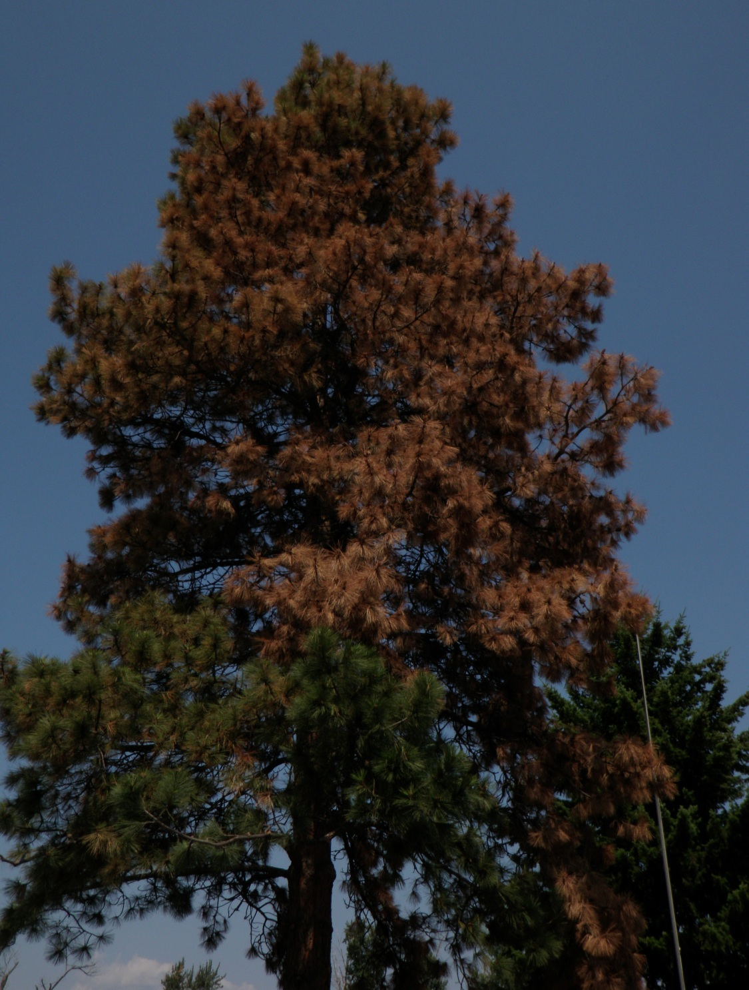
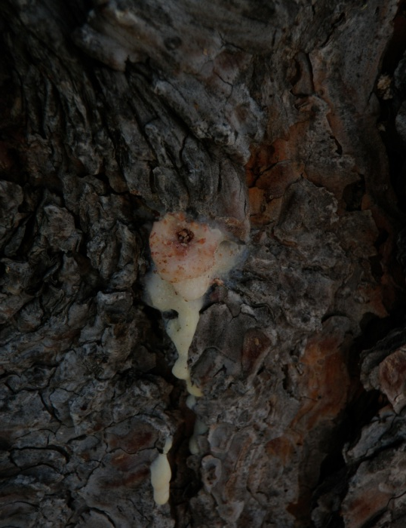
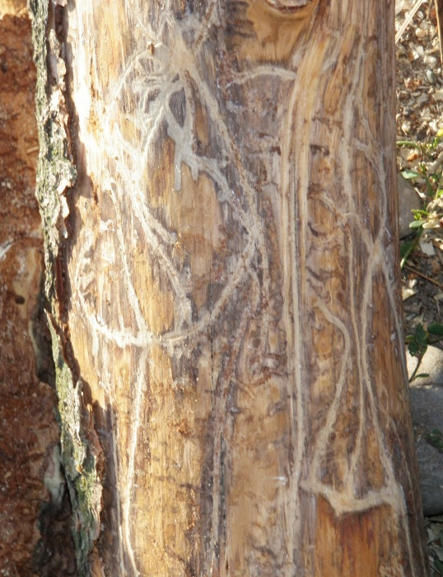
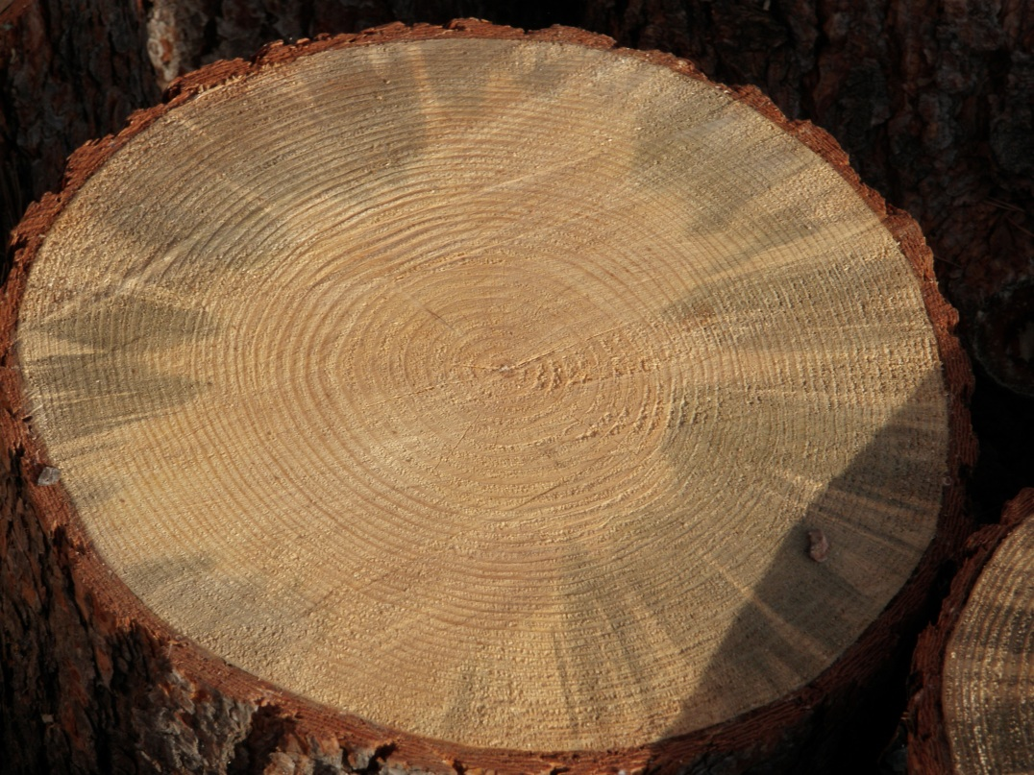
Mountain Pine Beetle In Missoula

Slide 43
Is there evidence that climate change is affecting forest dynamics:
Forest Pest Dynamic?
Yes, Compelling Evidence

Slide 44
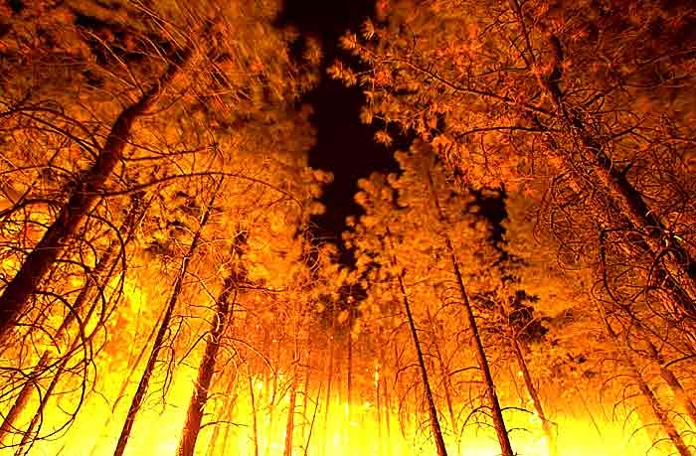
Is there evidence that climate change is affecting forest dynamics:
Wildfire Dynamic?

Slide 45
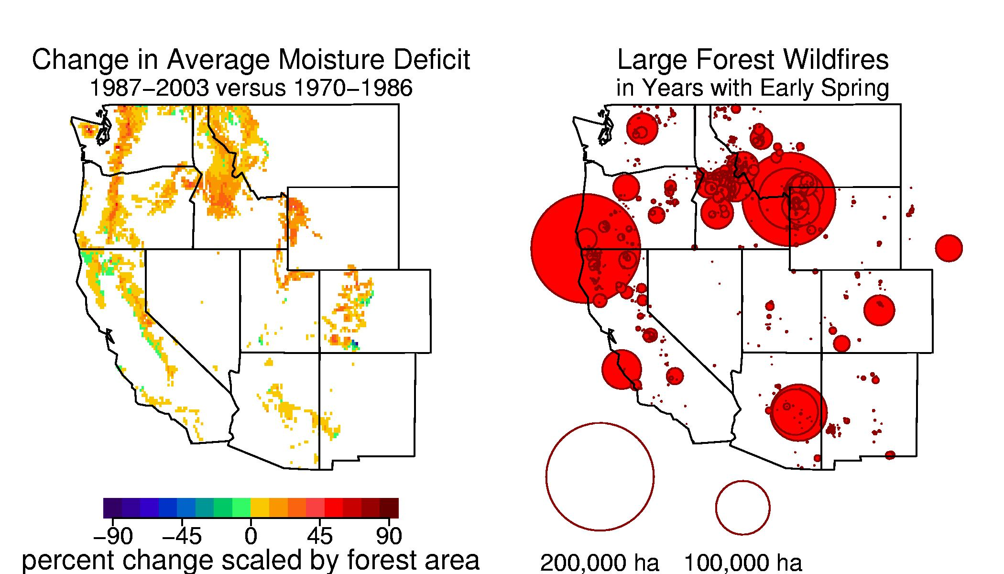
Wildfire Dynamic
Less moisture—more fires. Between 1970 and 2003, spring and summer moisture availability declined in many forests in the western United States. During the same time span, most wildfires exceeding 1000 ha in burned area occurred in these regions of reduced moisture availability.
Westerling et al. Science 2006; Running, Science 2006

Slide 46
NASA Video: MPB / Fire Interaction??

Slide 47
Is there evidence that climate change is affecting forest dynamics:
Wildfire Dynamic?
Yes, Compelling Evidence

Slide 48
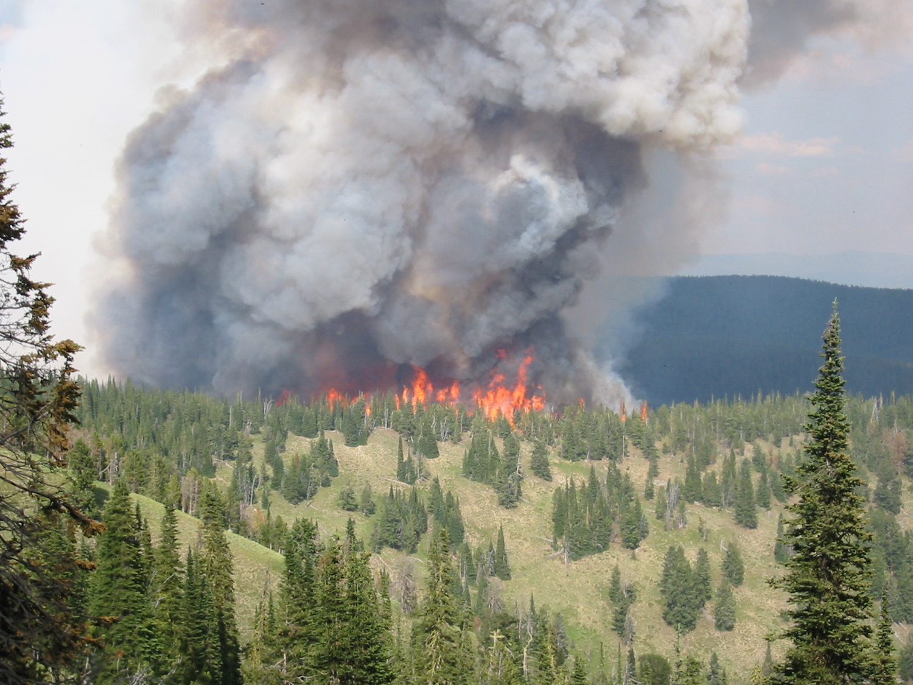
Is there evidence that climate change is affecting forest dynamics:
Carbon Storage?

Slide 49
What Would Cause a Shift from Carbon Sink to Source??
The Atmosphere
A carbon sink can be converted to a carbon source when the amount of CO₂ respired to the atmosphere is greater than the amount fixed during photosynthesis (a net reduction of the source pool and a net increase in the atmospheric pool). Processes that can drive the conversion of a system from a sink to a source include wildfire, insect infestation, and drought.
Photosynthesis
Respiration
Vegetation
Soils
Decomposition

Slide 50
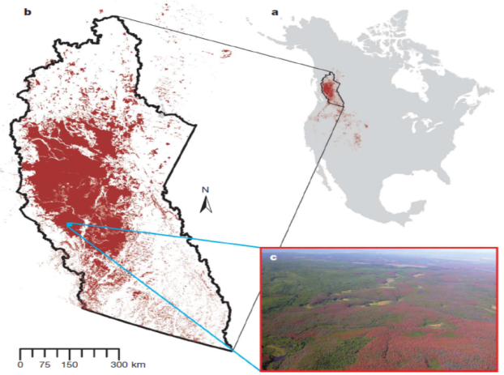
Carbon Sink to Source
Image From W. A. Kurz et al., Nature 452, 987 (2008).

Slide 51
Climate-Driven Increases in Global Terrestrial Net Primary Production from 1982 to 1999
Nemani et al., Science 2003

Slide 52
Drought-Induced Reduction in Global Net Primary Production from 2000 Through 2009
Zhao & Running, Science 2009

Slide 53
Plant Productivity in a Warming World

Slide 54
Global Net Primary Production
From 1982 to 1999, climate constraints were relaxing with increasing temperature and solar radiation, allowing an upward trend in NPP.
The Past decade has been the warmest since instrumental measurement which could imply continued increases in NPP.
However, research suggests large scale droughts have reduced NPP.
A continued decline in NPP would weaken the terrestrial carbon sink

Slide 55
Time Lag in Biospheric Responses to Changing Climate
700
Relative Change
CO2 Concentration (ppm)
CO₂
Phenology, NPP
Disturbance
Biome Shifts
Land Temperature
360
2000
2100
2150
Year

Slide 56
Summary
Evidence from long-term forest plots that forest mortality rates are increasing, and warming seems to be the dominant contributor.
Pest infestations are becoming more common, and climate change appears to be partially responsible, although there are multiple interactions.
3. Climate change indices are correlated with increases in fire frequency and magnitude, but there are also other controlling factors (e.g., fire suppression).
4. A little bit of global warming could be good for northern hemisphere forest C storage (with some important caveats).

