Slide 1
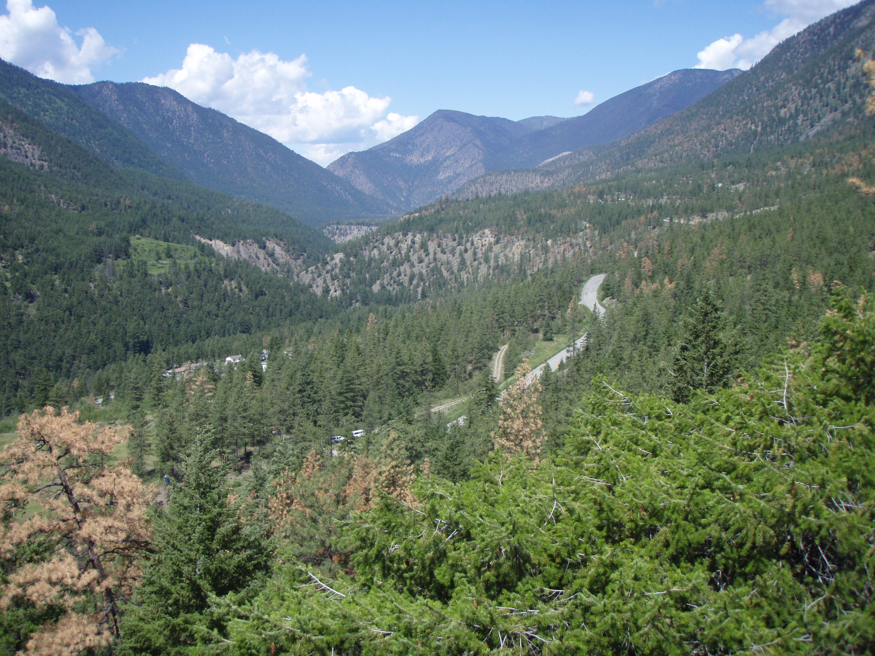
Climate Change and the Rise and Fall of Large Villages in
the Middle Fraser Canyon, B.C.

Slide 2
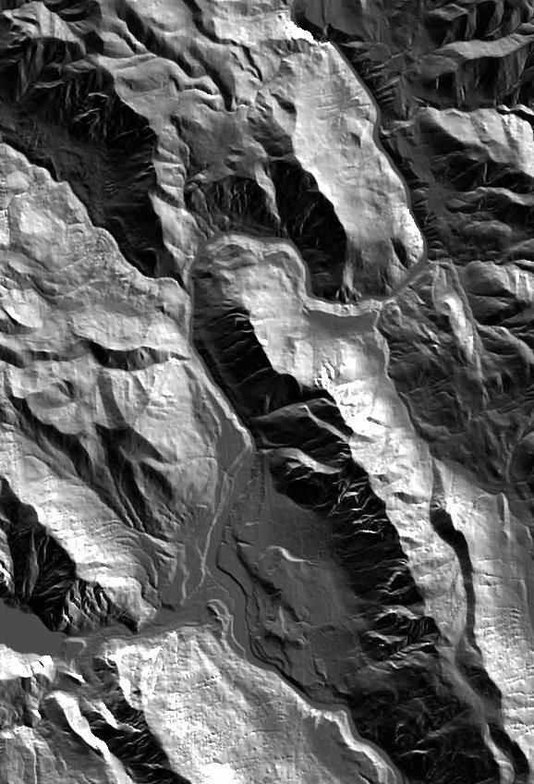
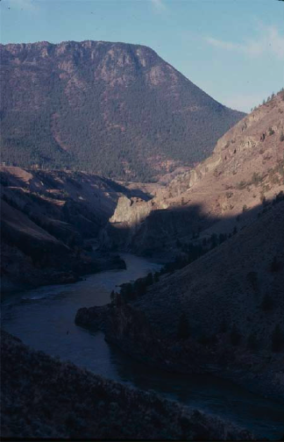

Keatley
Creek Site
Bridge
River Site
Bell Site
FountainSite
Lillooet Site
Seton
Lake
Middle Fraser Canyon
0 km 2.5

Slide 3
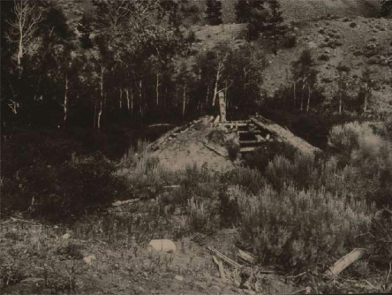
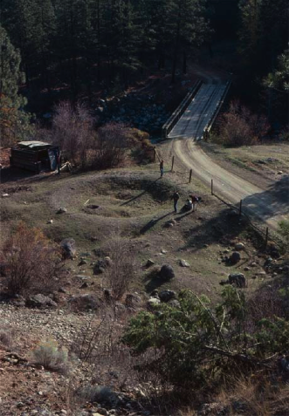
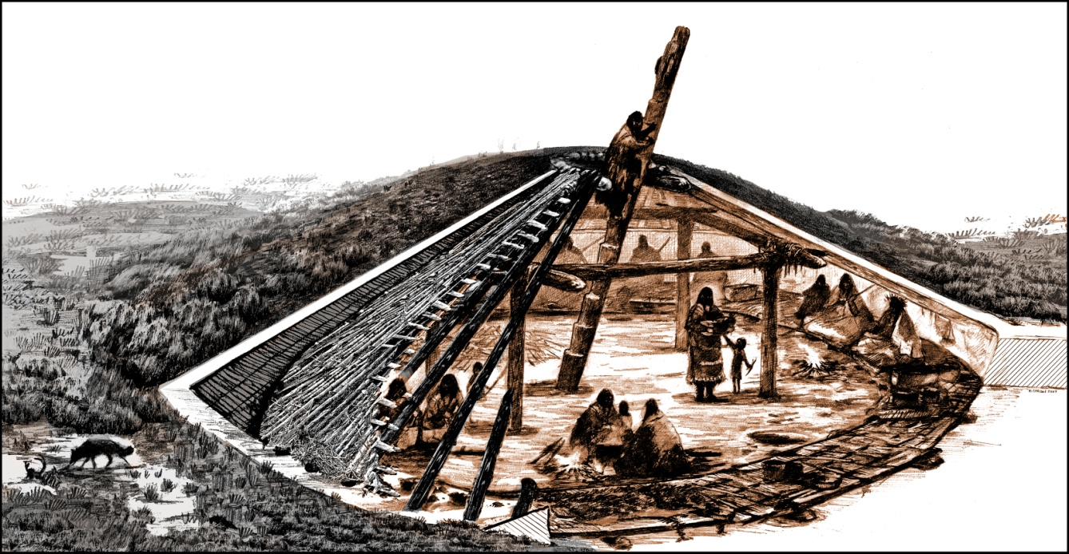
Mid-Fraser Housepits

Slide 4
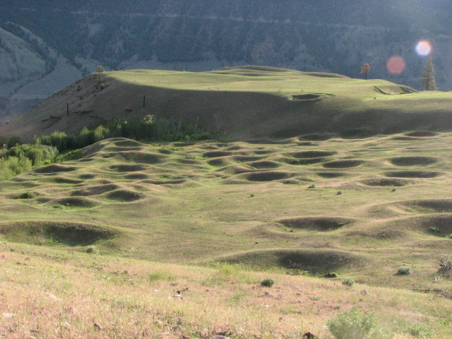
Large Villages: Keatley Creek site
Photograph by Duggan Backhouse-Prentiss

Slide 5
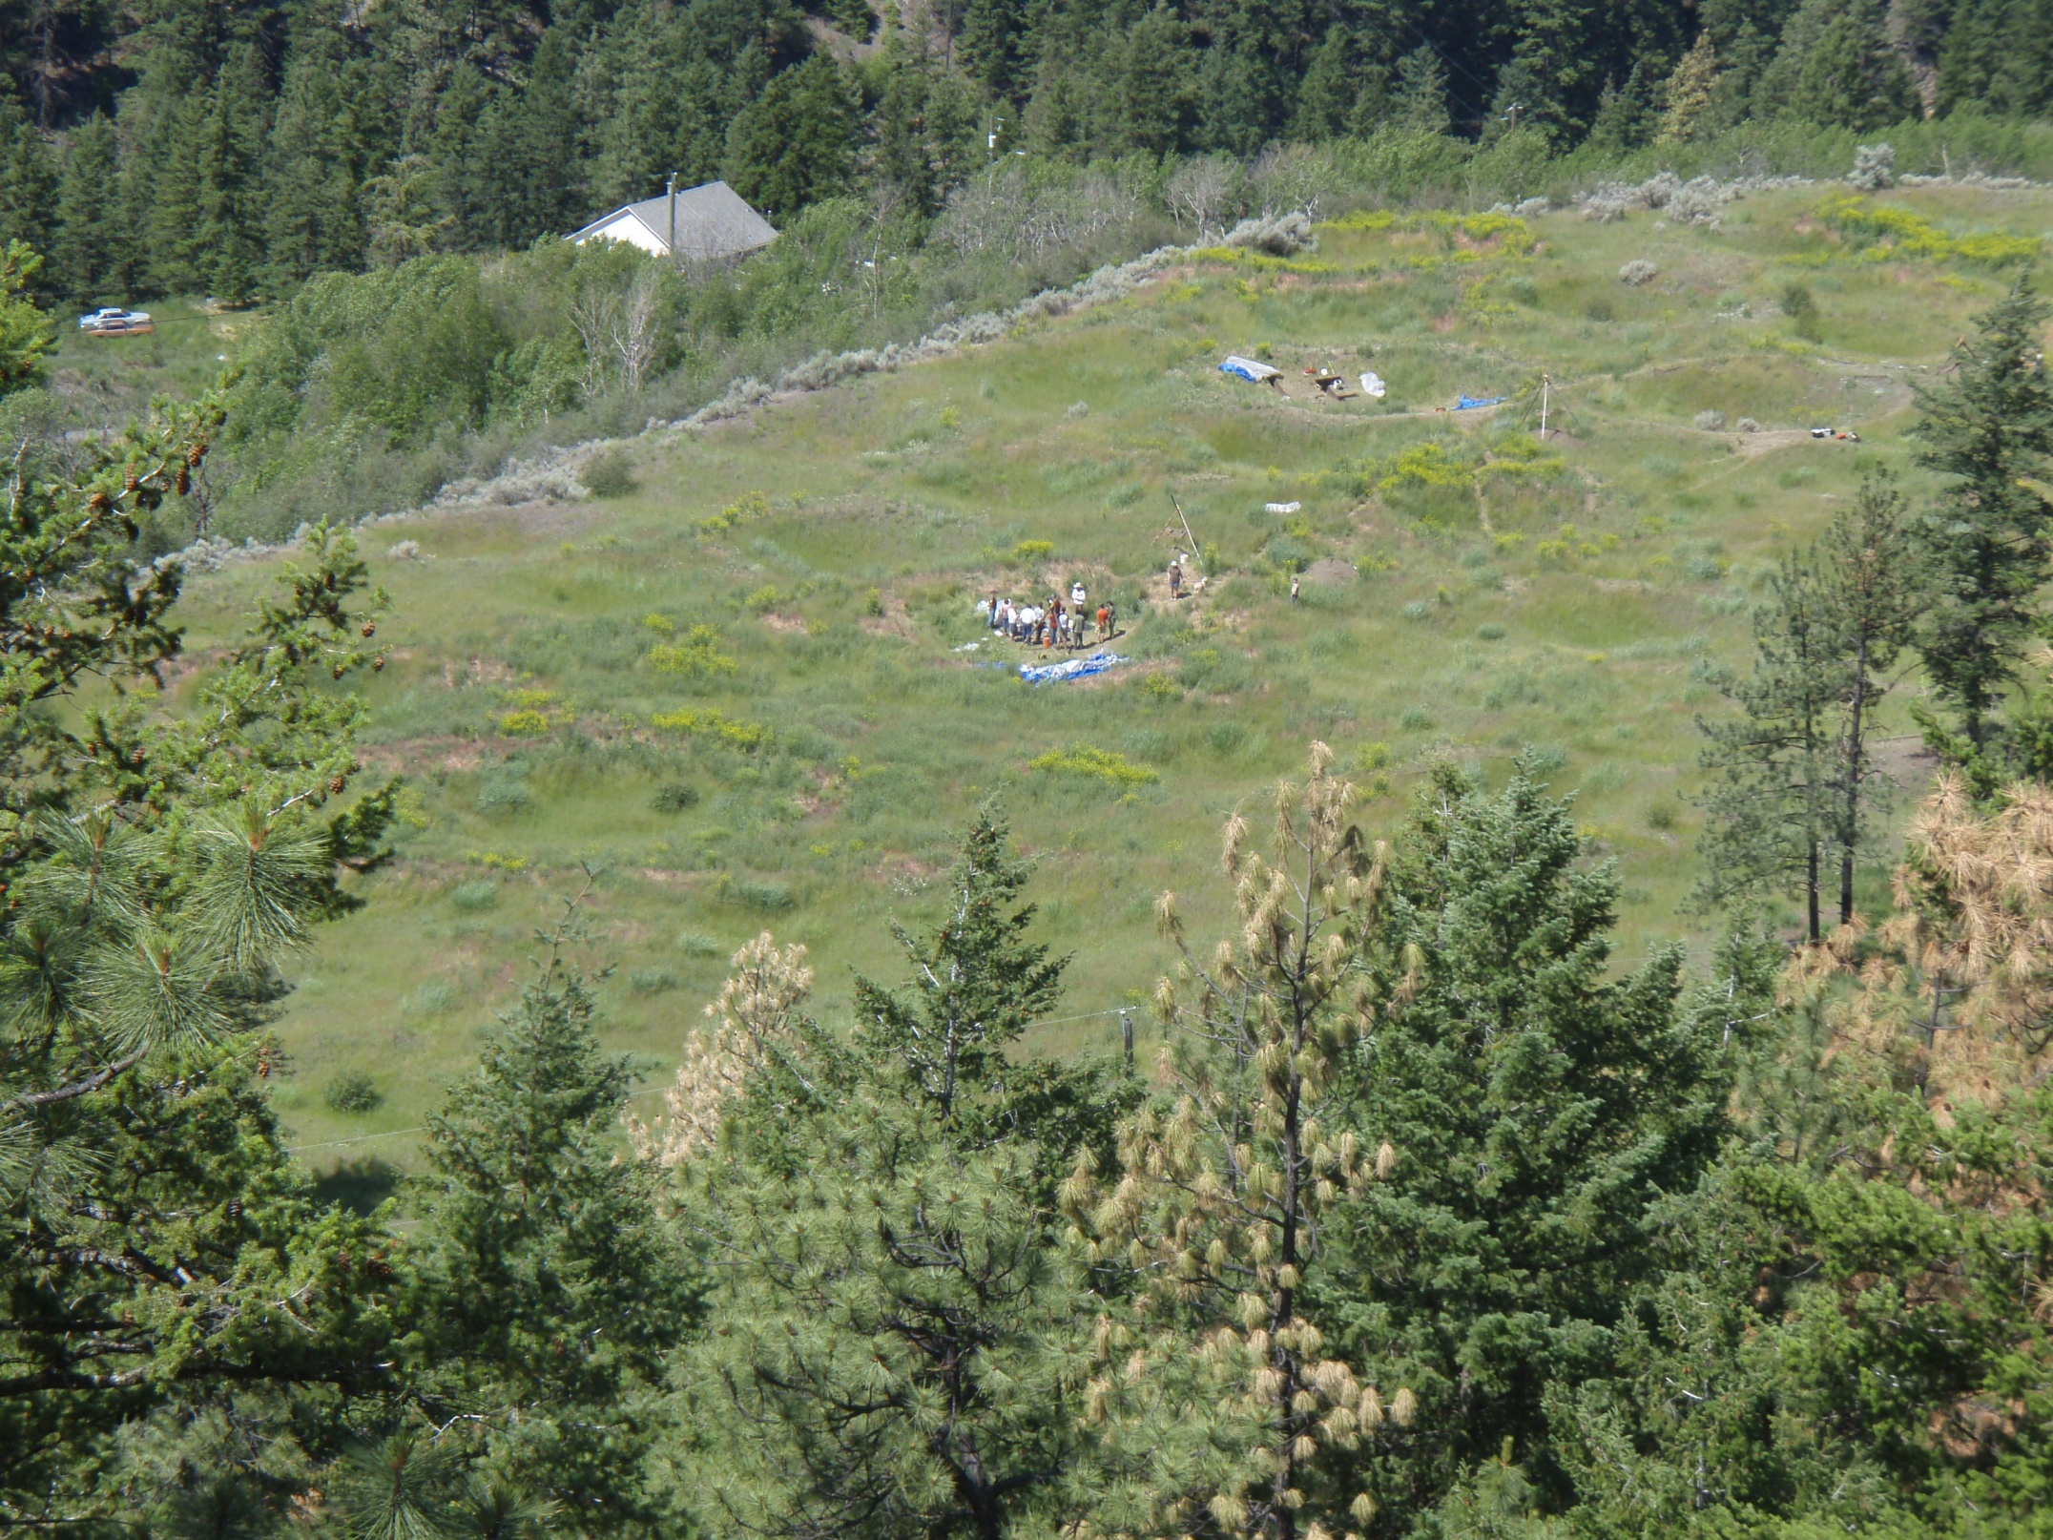
Bridge River
Site

Slide 6
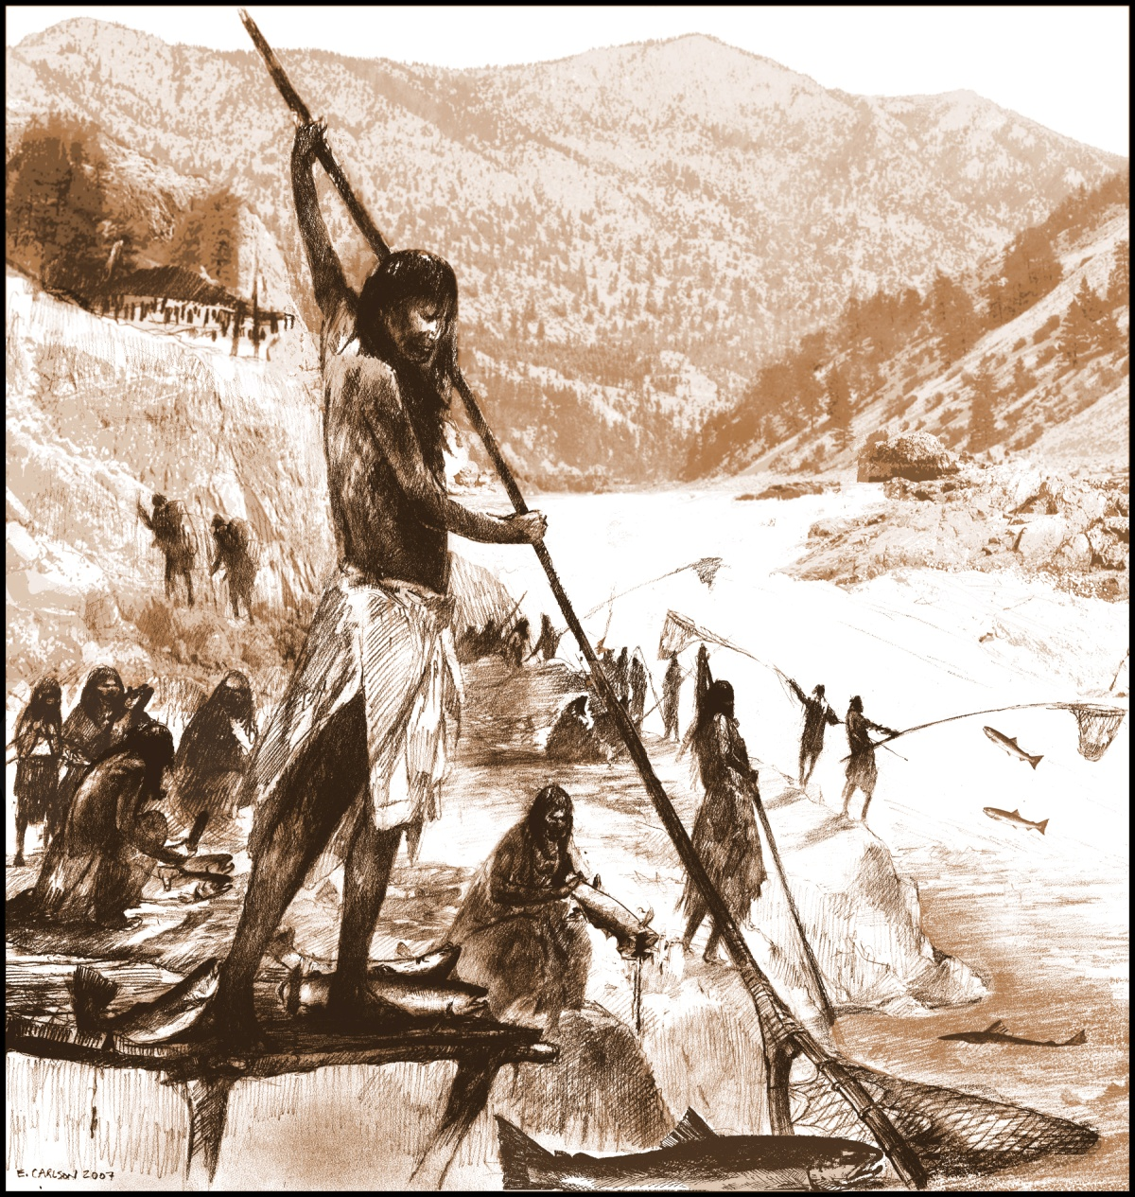
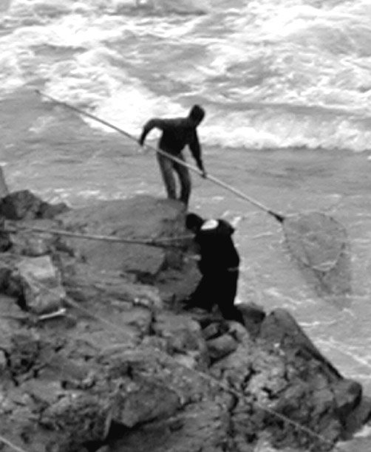
Mid-Fraser Salmon
Fishing

Slide 7
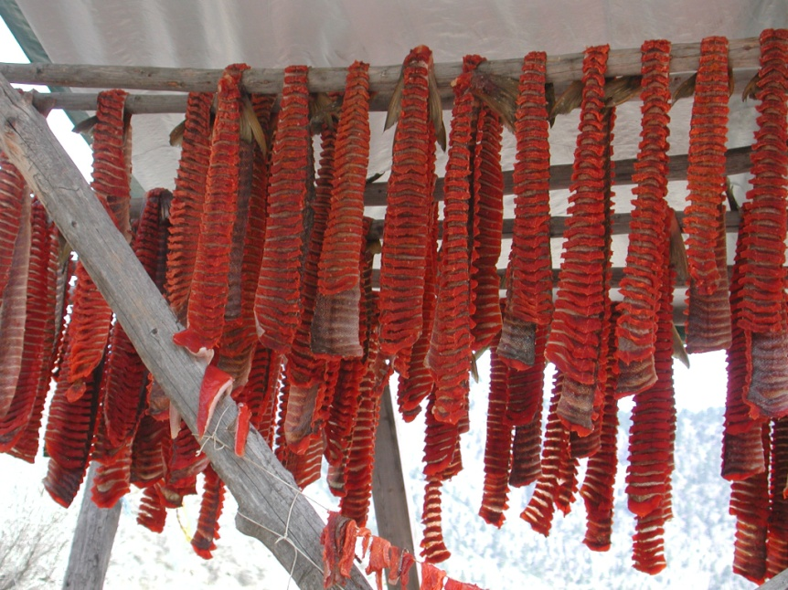
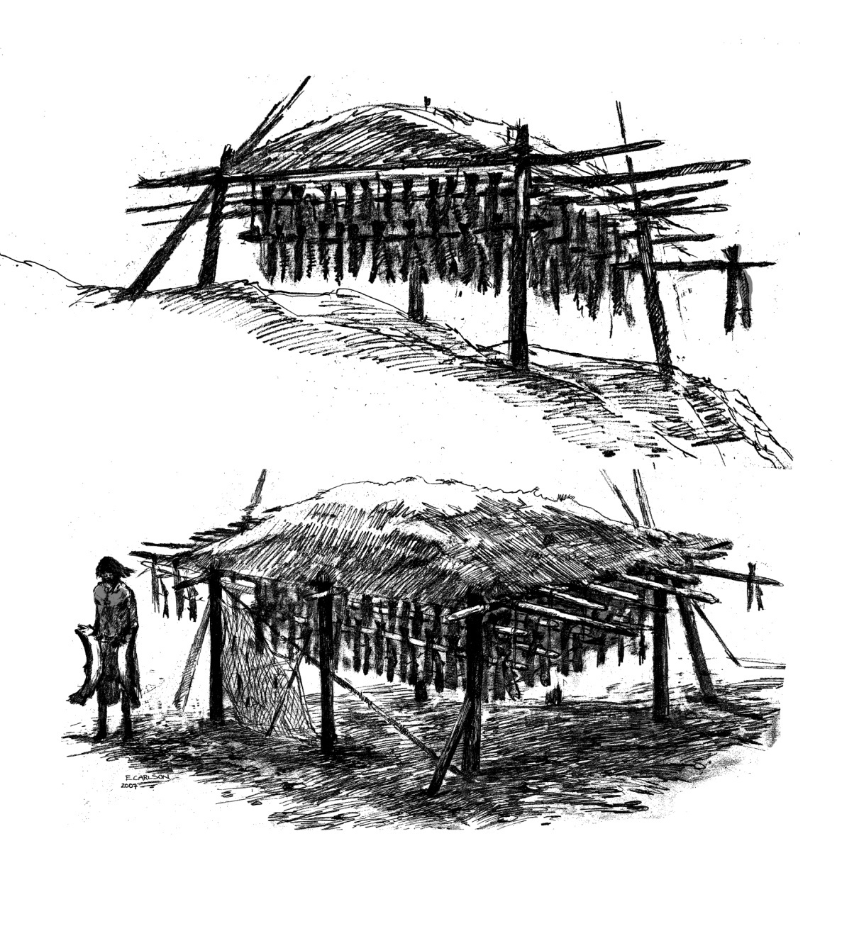
Heat and Wind Dried Salmon

Slide 8
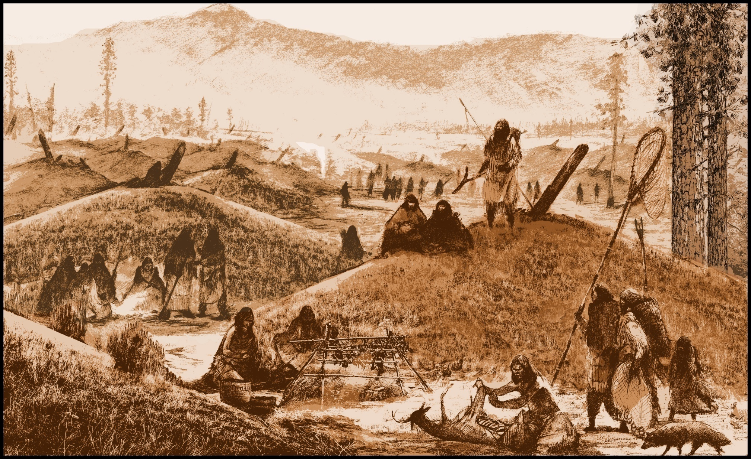
Hunting and Game Processing

Slide 9
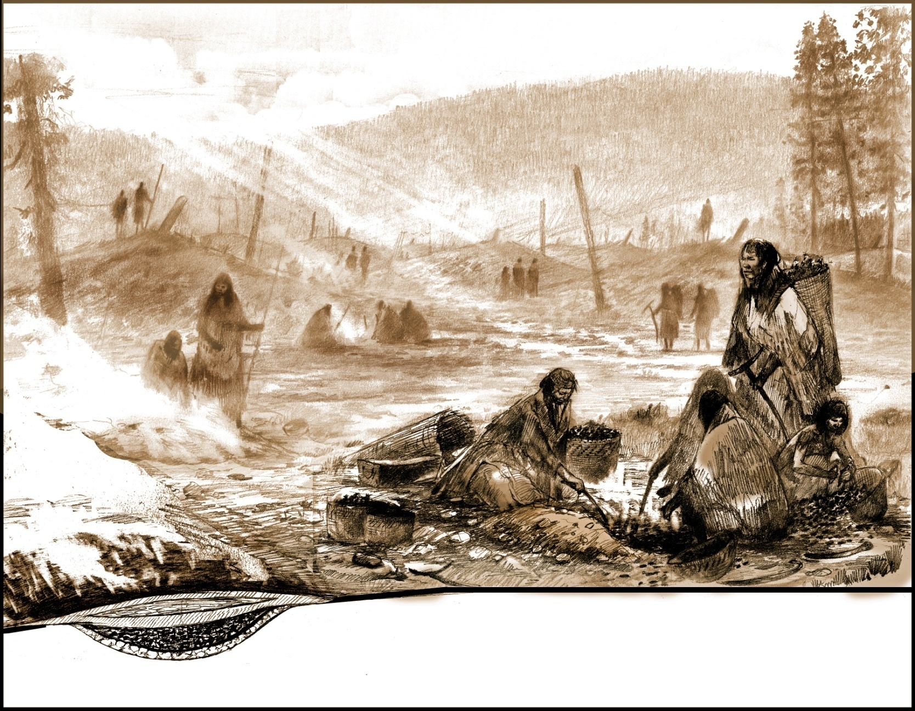
Outdoor Cooking (roots, meat, fish)

Slide 10
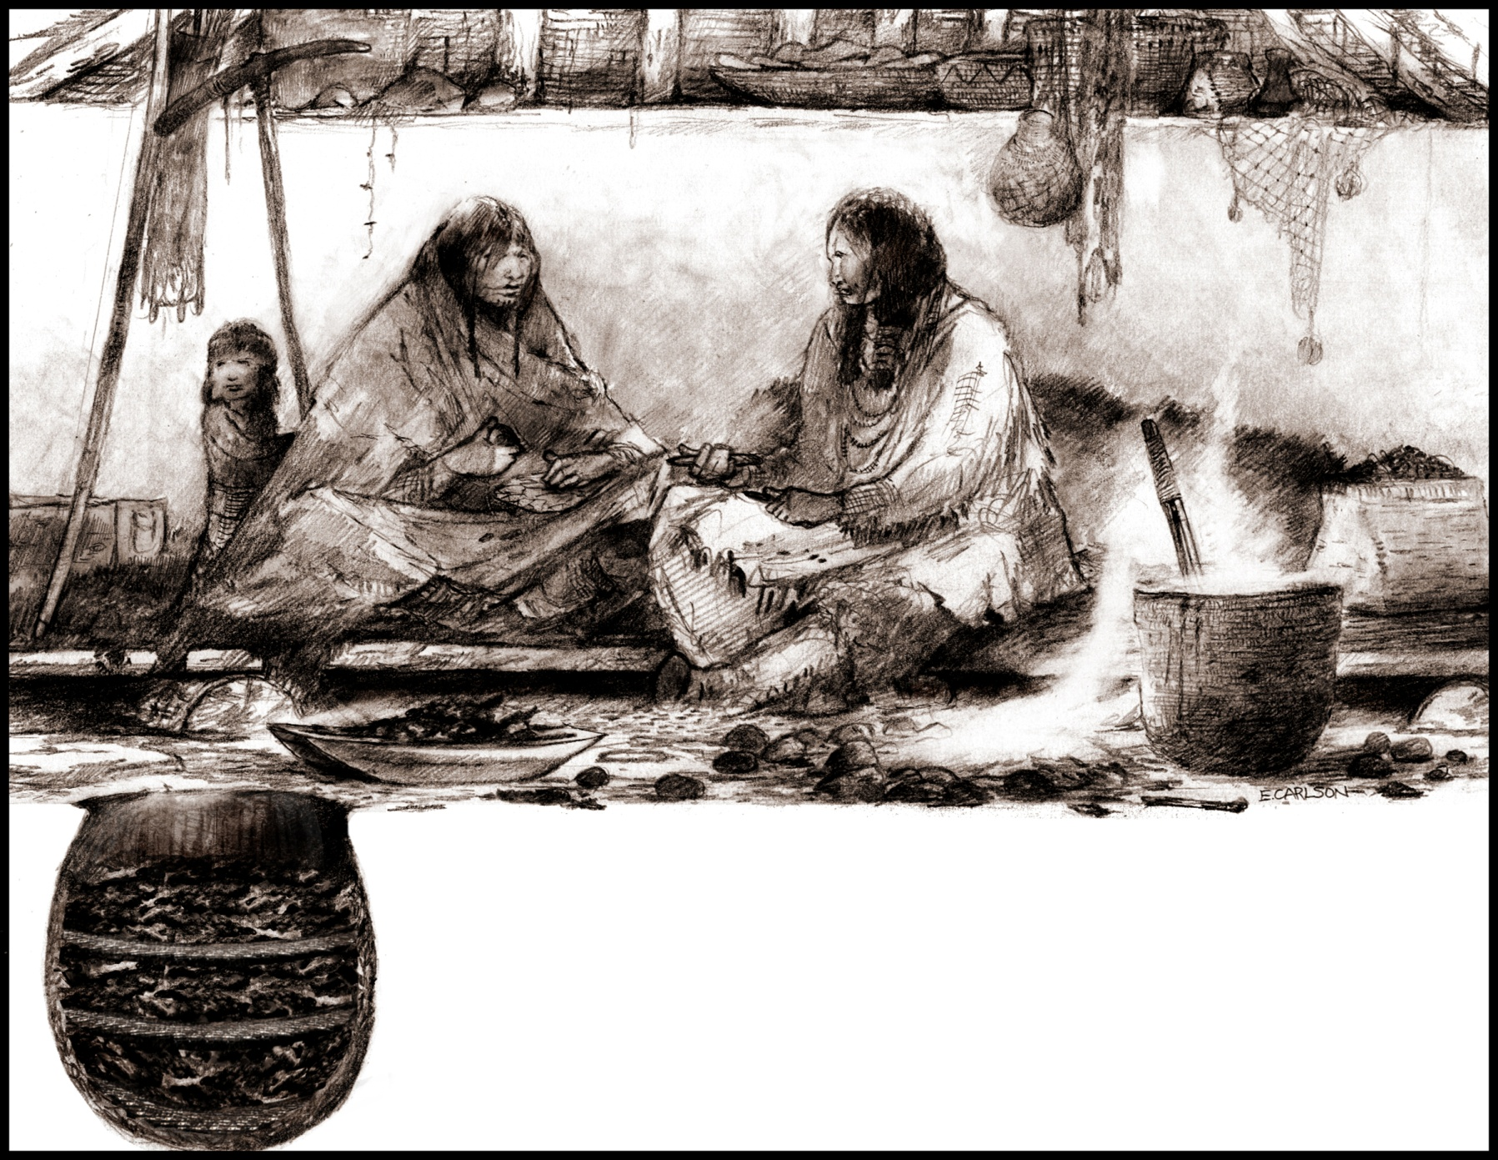
Household Storage and Cooking

Slide 11
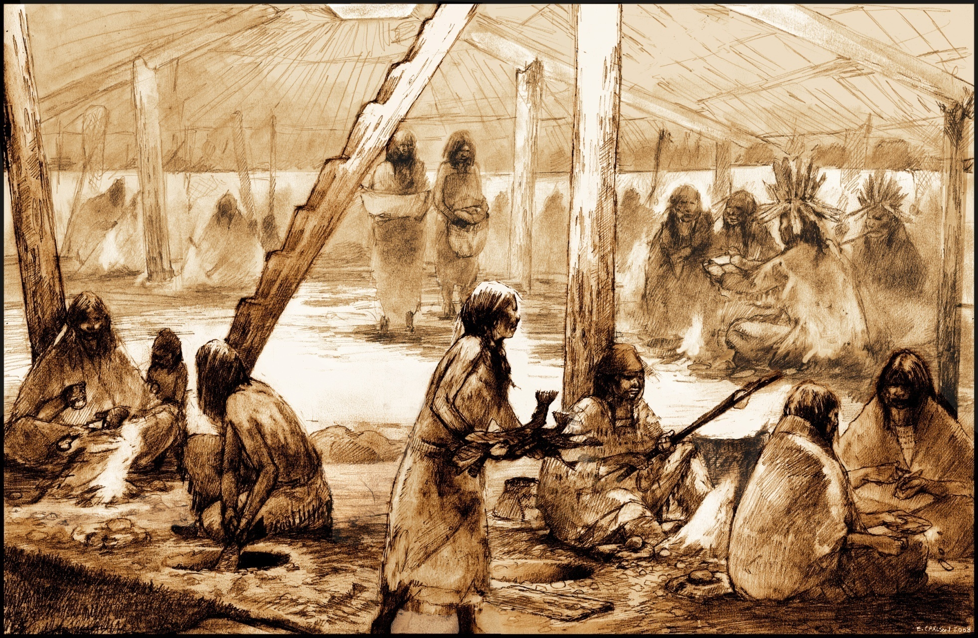
Social Complexity in the Mid-Fraser

Slide 12
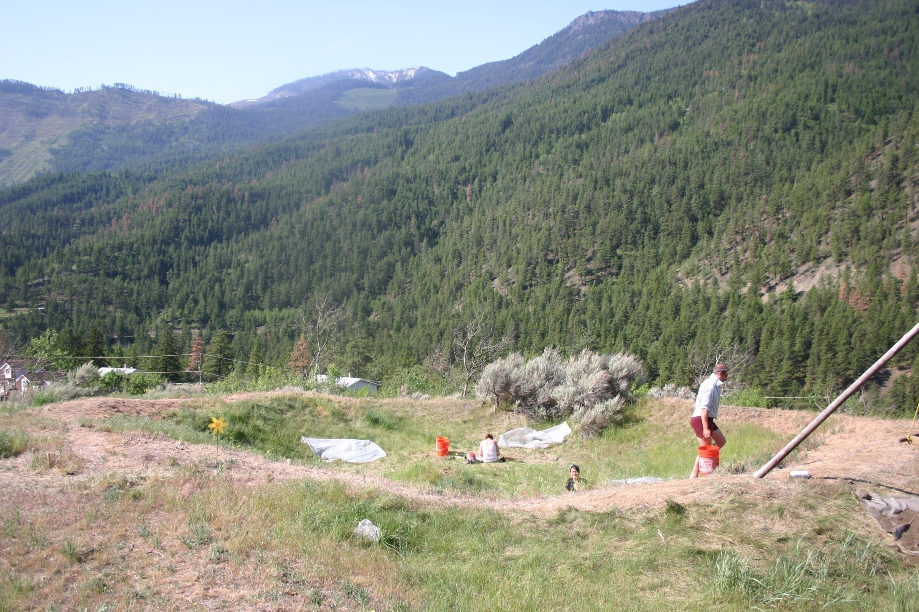
Excavations at Bridge River in 2003-2009
Why did the “Classic” (pre-1000 B.P.) Mid-Fraser villages grow,
change, and eventually collapse?

Slide 13
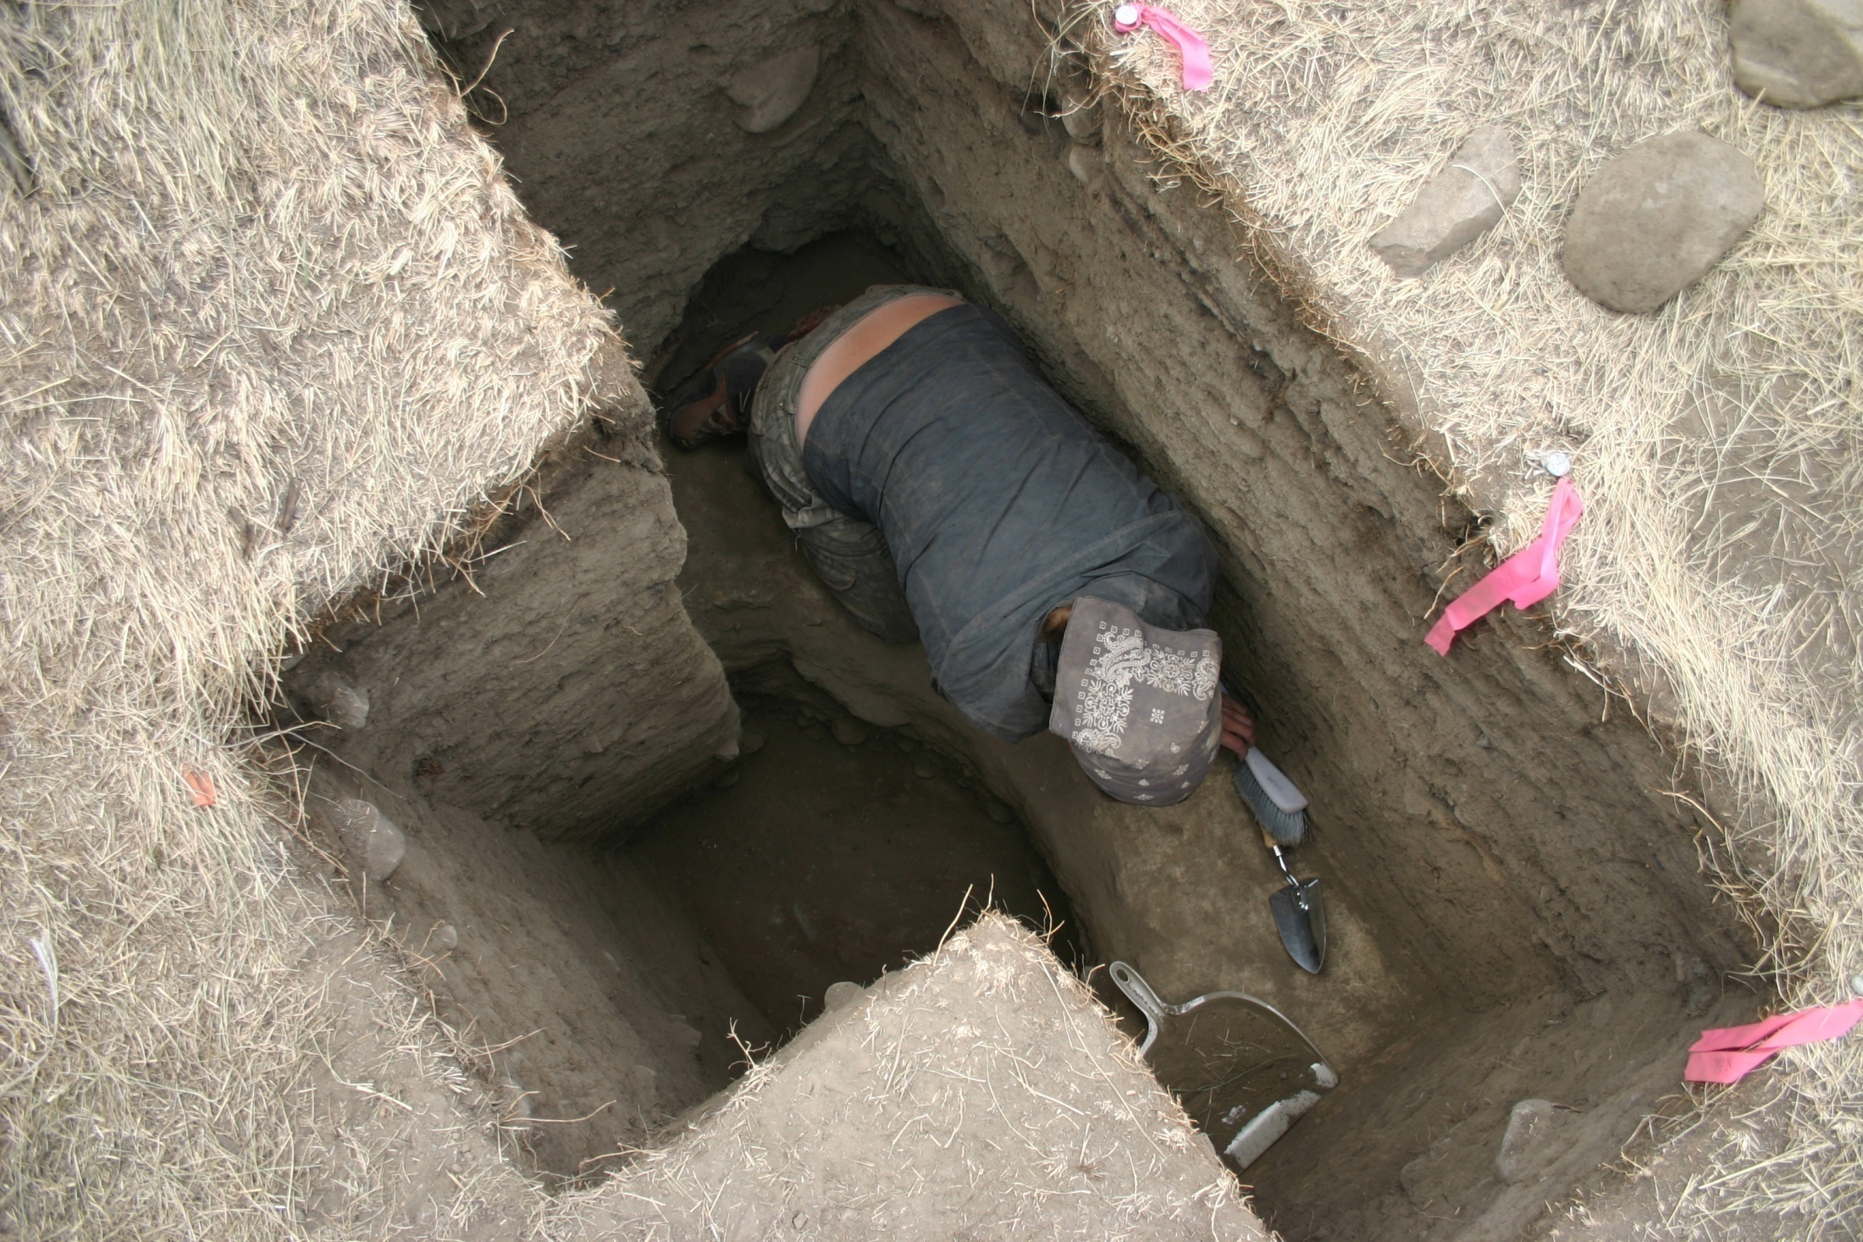
Excavating at
Bridge River in
2009: Complex
stratigraphy
accumulated over time.

Slide 14
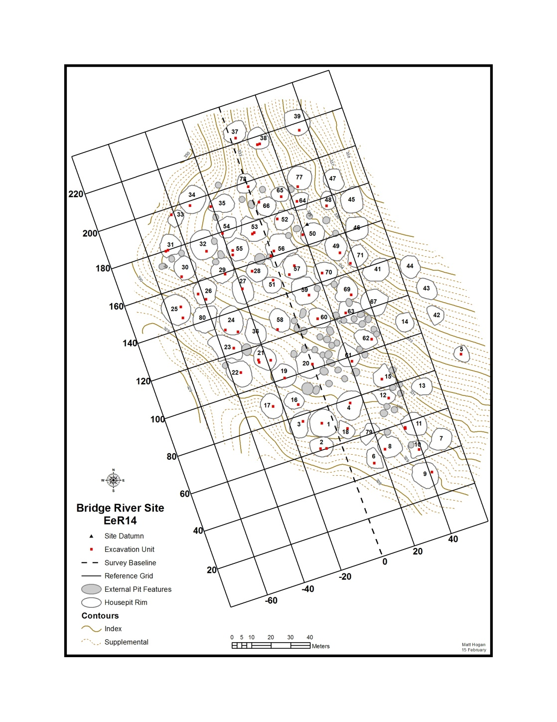
Bridge River Project
Phase I
Studying village
emergence, growth,
and decline.

Slide 15
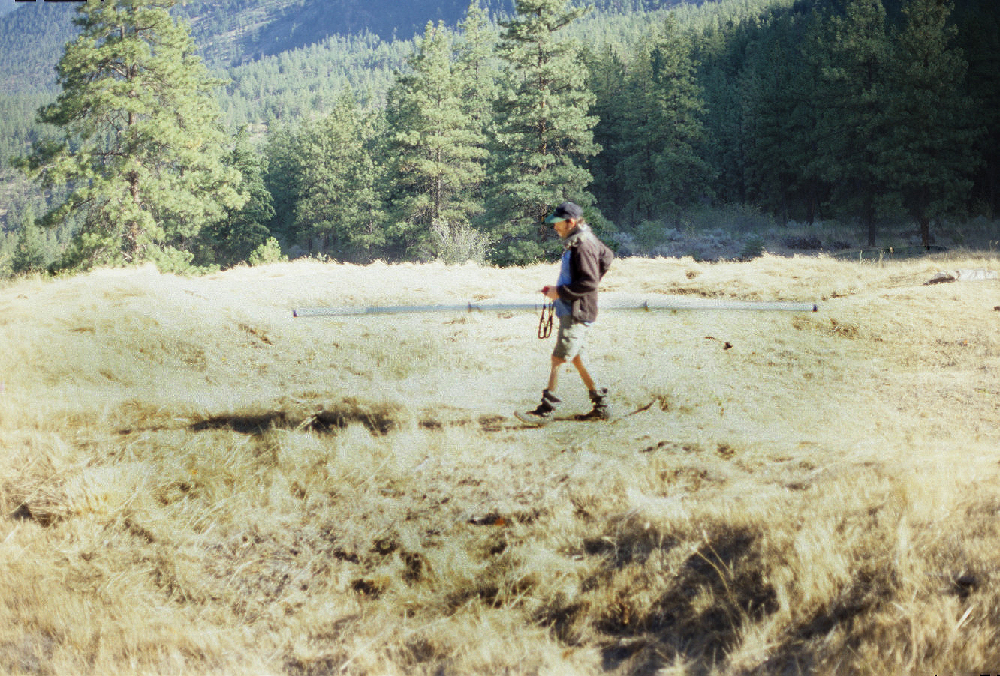

Slide 16
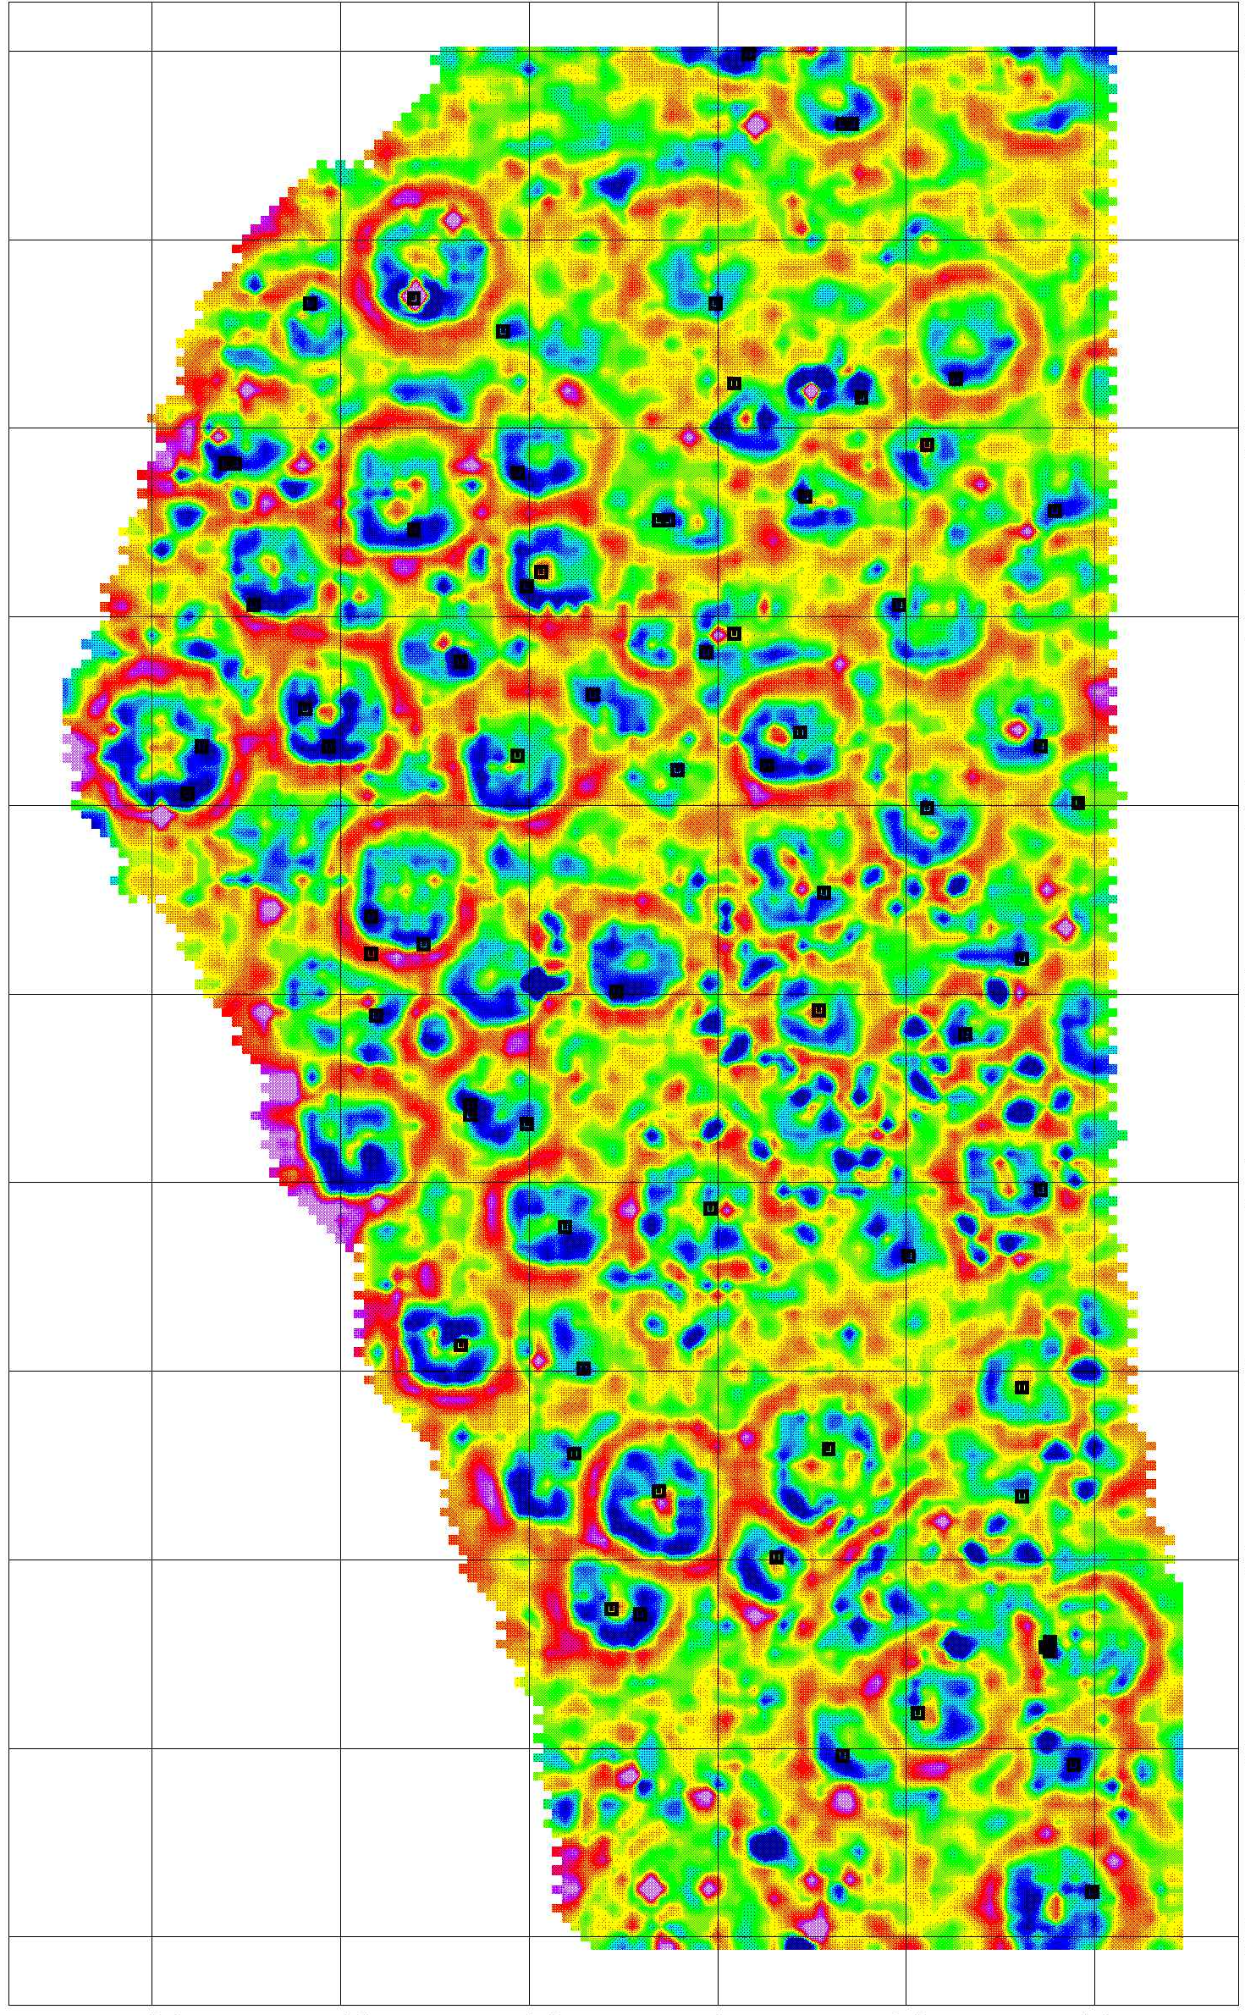
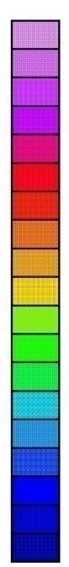

220
-60
-40
-20
0
20
40
220
200
200
180
180
80.0
160
160
60.0
Magnetic Susceptibility Map
40.0
140
140
20.0
0.0
120
120
-20.0
-40.0
100
100
-60.0
-80.0
80
80
nT/m
60
60
40
40
20
20
-60
-40
-20
0
20
40

Slide 17
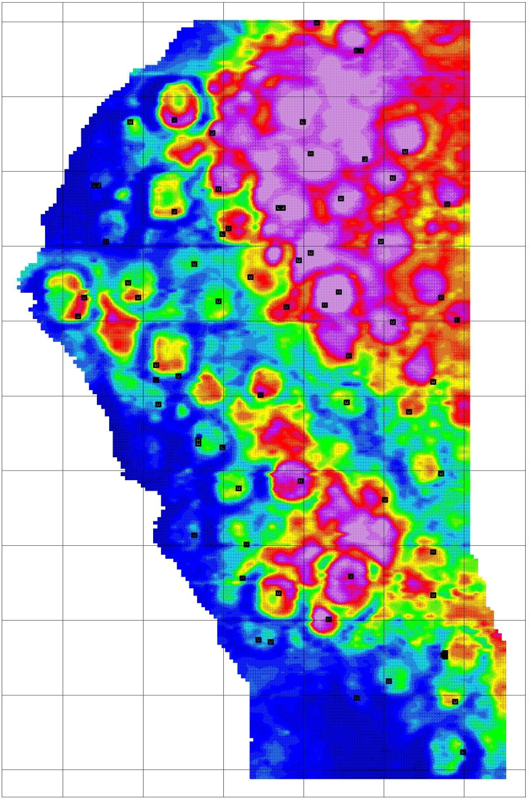
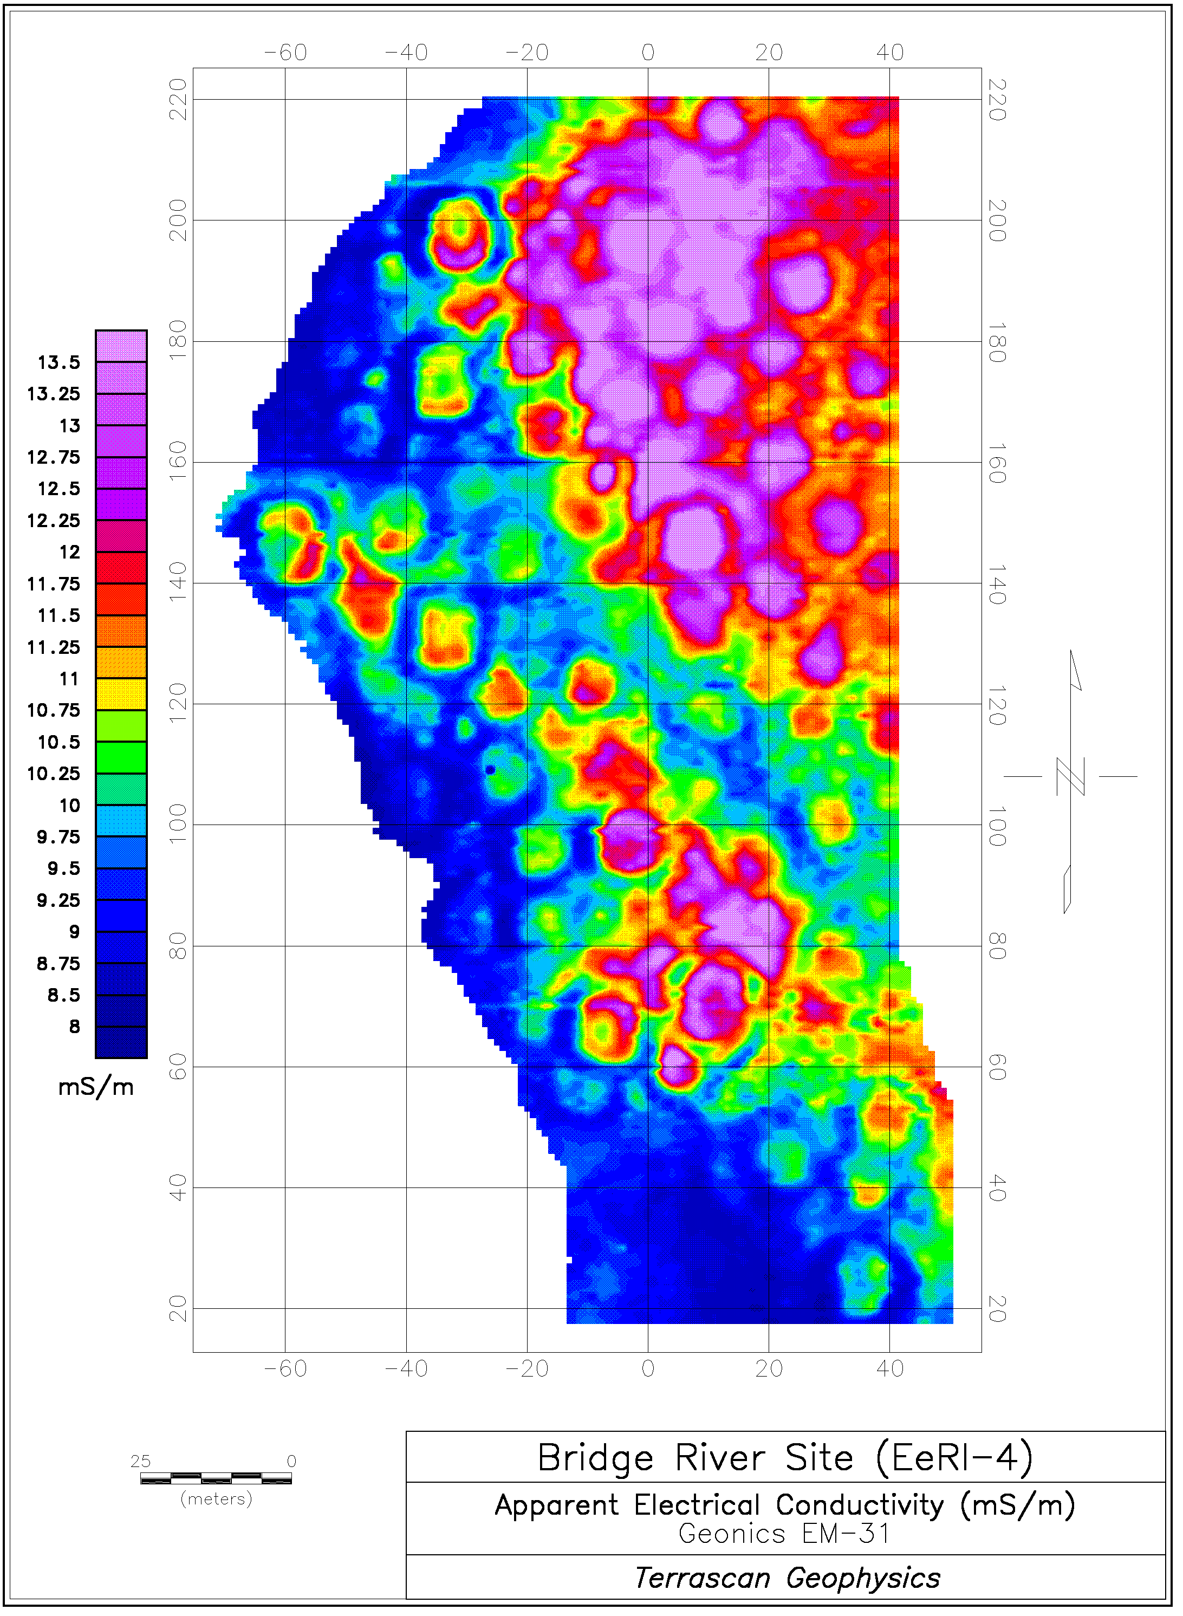

220
-60
-40
-20
0
20
40
220
200
200
180
180
13.0
160
160
12.5
12.0
140
140
11.5
11.0
Conductivity Map
120
120
10.5
10.0
100
100
9.5
9.0
80
80
8.5
8.0
60
60
mS/m
40
40
20
20
-60
-40
-20
0
20
40

Slide 19
Cumulative probability distributions for all housepit (lower) and external
pit feature (upper) radiocarbon dates.

Slide 20
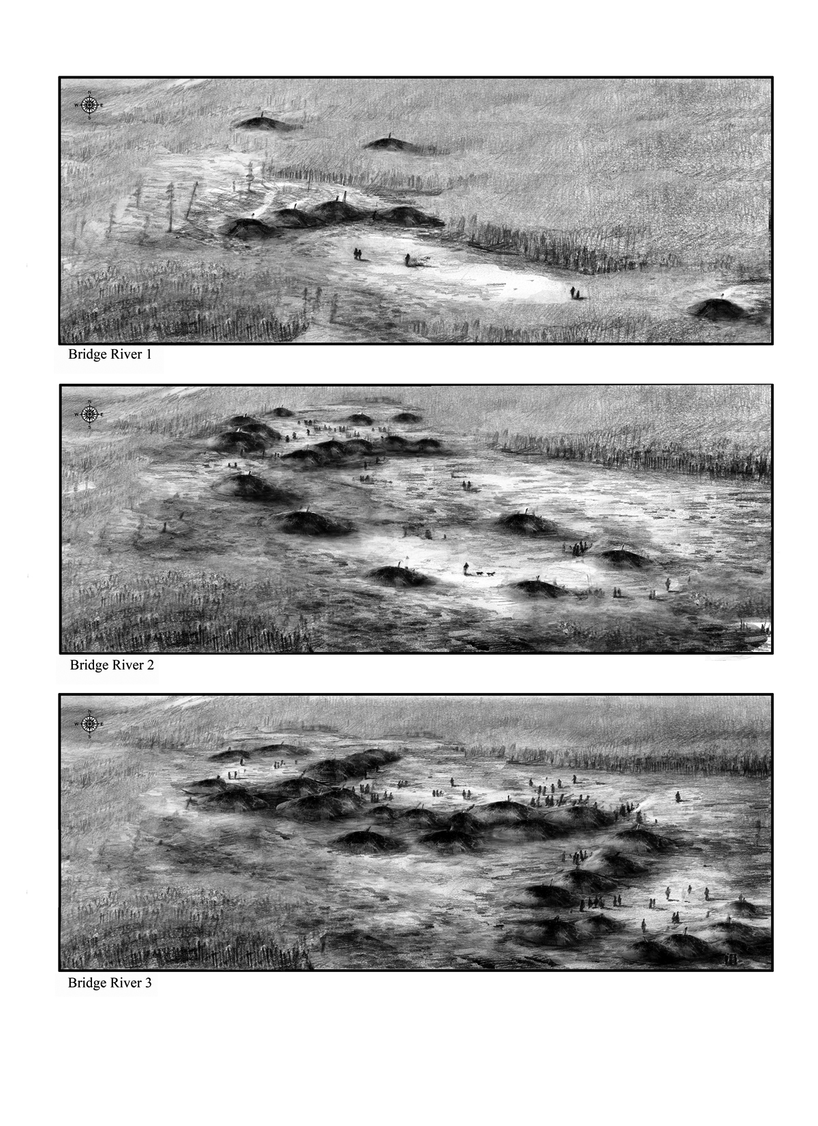

Slide 21
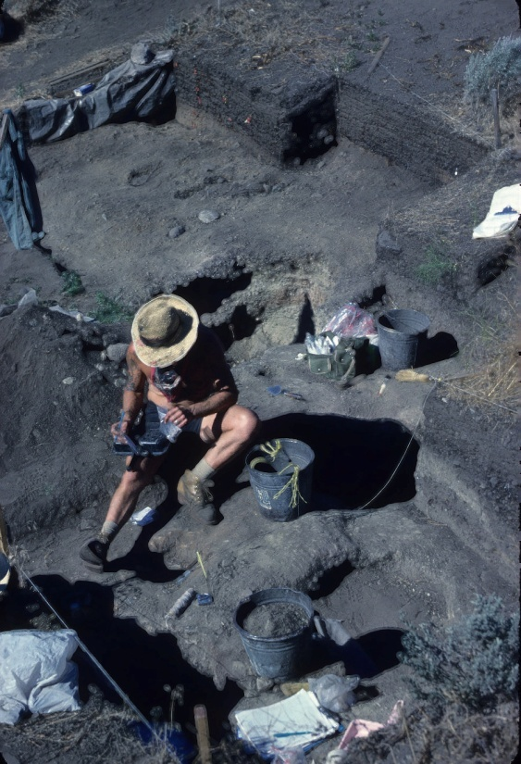
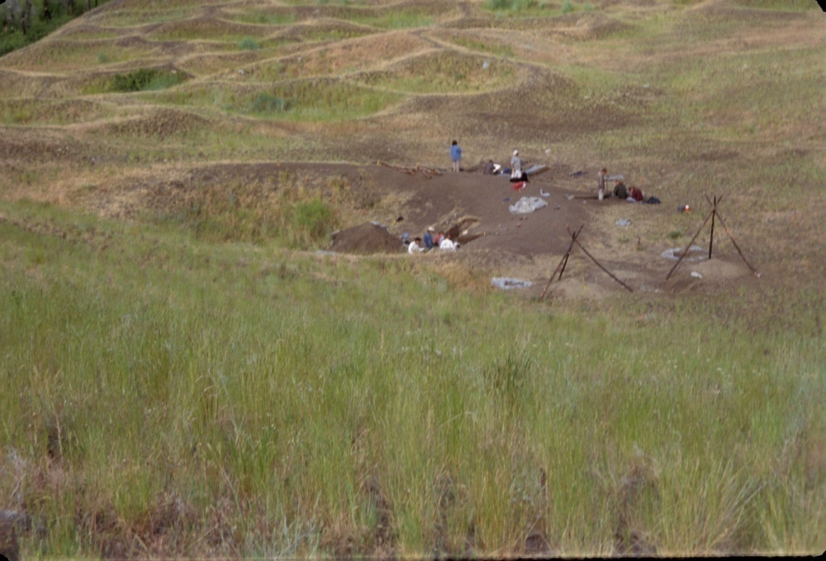
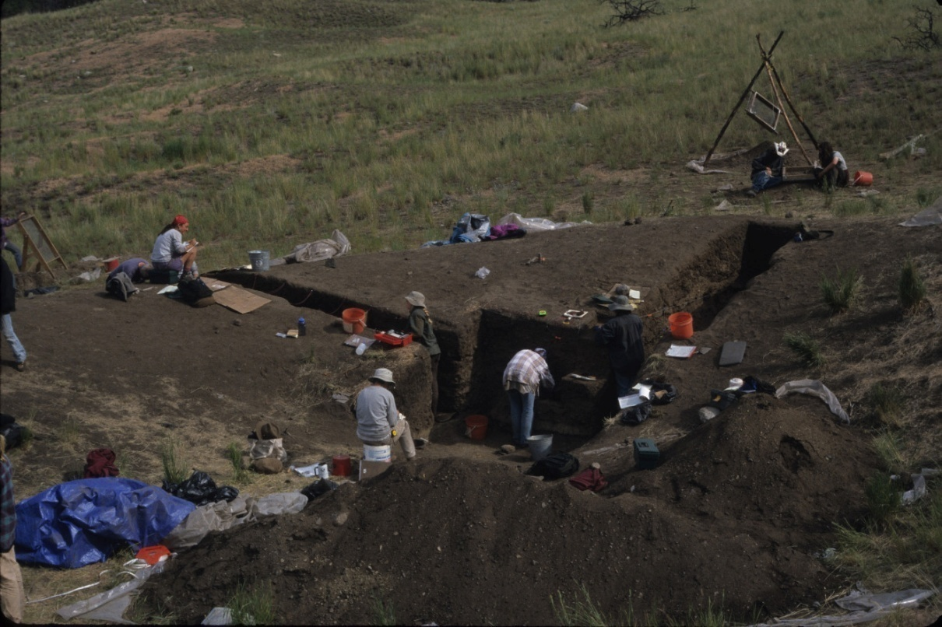
Keatley Creek:
Montana Excavations,
1999-2002
Is demographic and social
Change reflected in the histories
Of individual houses?

Slide 23
Proxies for population packing at
Housepit 7

Slide 24
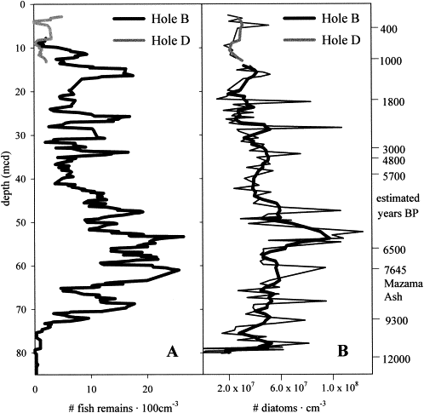
Figure 5 from Tunnicliffe et al.
(Marine Geology 174:197-210)
Variability in Fish Remains and
Diatoms From Saanich Inlet,
Vancouver Island,
B.C.
Does change in climate and
marine productivity correlate
with change in the
Mid-Fraser villages?

Slide 25
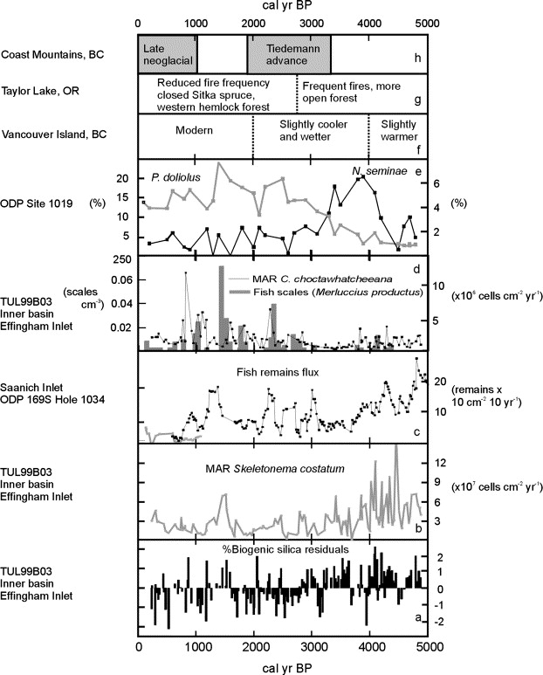
Figure 7 from Hay et al.
(Quaternary Research 67:33-49)
Evidence for effects of Climate
Change on Central Northwest Coast
0-5000 years ago.

Slide 26
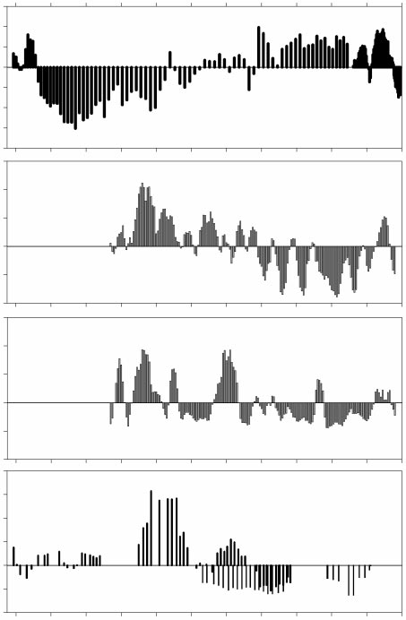
Karluk Lake (Kodiak island)
Isotopic Proxy for Salmon Abundance
Santa Barbara Basin Anchovy Scales
Santa Barbara Basin Sardine Scales
1200 BP
1200
1000 BP
800 BP
Saanich Inlet Fish Remains
Data from Finney et al. (2002)
(Nature 416:729-733)
1200 BP
800 B.P.

Slide 27
Change in Prey Choice at Keatley Creek

Slide 28
Subsistence Change at
Bridge River

Slide 29
Evidence for material wealth
at Housepit 7, Keatley Creek
Site

Slide 30
Emergent wealth-based inequality
At Bridge River after ca. 1250 B.P.

Slide 31
Summary
Optimal Resource Access and Population Growth in aggregated villages
Warming and decline in salmon
Population Imbalance and wider diet
Socio-economic and political competition
Population Dispersal
Later Return and Aggregation

Slide 32
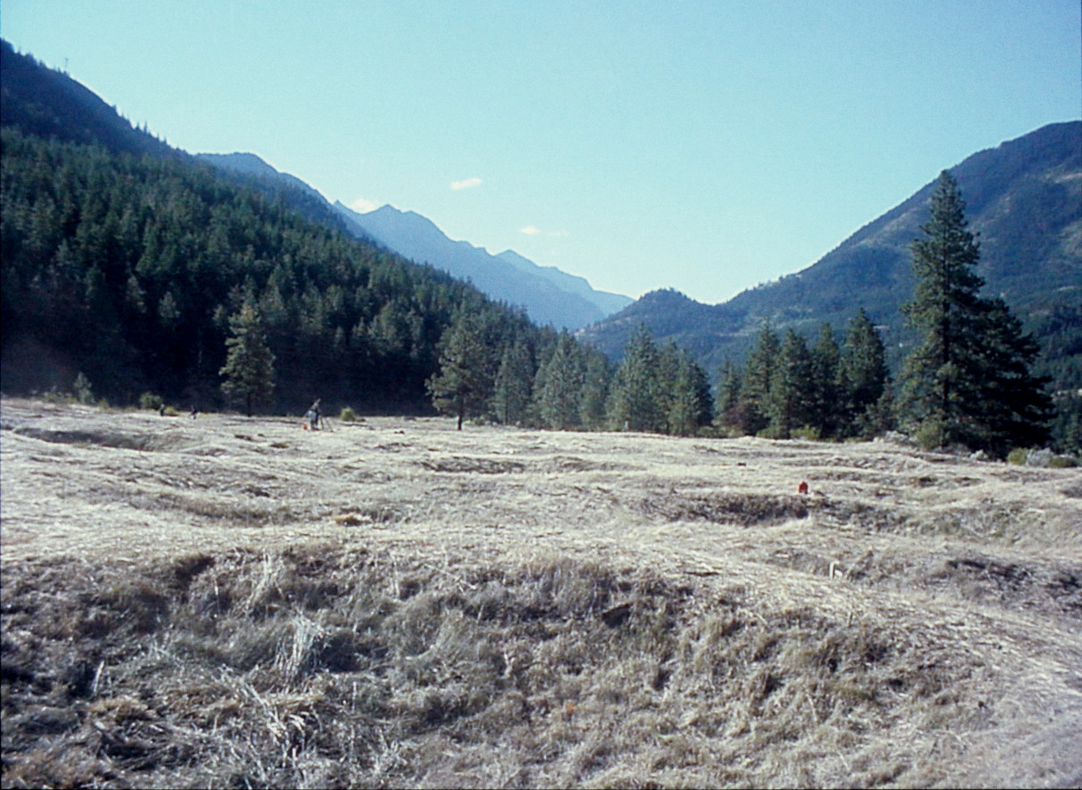
Acknowledgements: Keatley Creek and Bridge River excavations
were generously funded by the National Science Foundation,
the Wenner-Gren Foundation, and The University of Montana.
Our research is also the result of an on-going partnership and
collaboration with the Stl’átl’imx Nation, the original people of
the Middle Fraser Canyon.
Thank you very much!

