Slide 1
Policy Options
Cap and Trade: A market based system where the right to pollute is either sold or given away to industry by government and then those rights can be traded in a free market.
Cap and Dividend: A cap is placed on emissions and polluters pay a fee to the government for the right to pollute that is then redistributed to the public through federal programs
Carbon Tax: Those that mine or develop carbon sources and release carbon into the atmosphere pay a tax to the government on their production or release in proportion to the amount of carbon produced or released.

Slide 2
Politics
Taxes are VERY unpopular
Free market mechanisms have bi-partisan support
Appeal to conservatives
Promise reductions
Create a new industry: carbon traders
Therefore, cap and trade has dominated the discussion

Slide 3
Upstream vs. Downstream
Bill | Van Holland 2009 | Waxman-Markey 2009 | Cantwell-Collins 2010 | Obama Admin. 2009
Upstream or Downstream | Upstream and downstream- Mining companies and fossil fuel production companies | Partial upstream and full Downstream- Refiners and manufacturers covered in addition to utilities | Upstream | Unknown

Slide 5
Allocation Options
Bill | Van Hollen 2009 | Waxman-Markey 2009 | Cantwell-Collins 2009 | Obama Admin. 2009
Allocation | 100% auction | Mixed | 100% Auction | 100% auctioned-revenue to federal govt- $646 billion revenue rebated to consumers

Slide 6
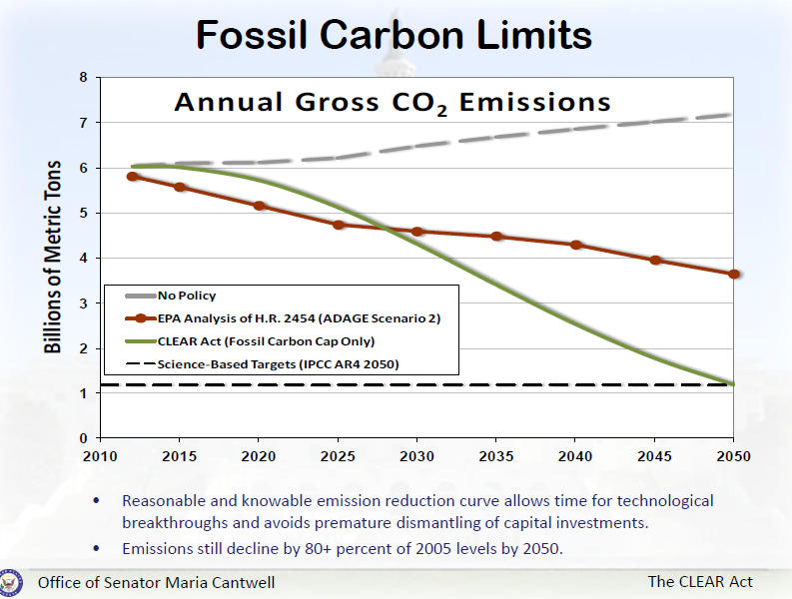

Slide 8
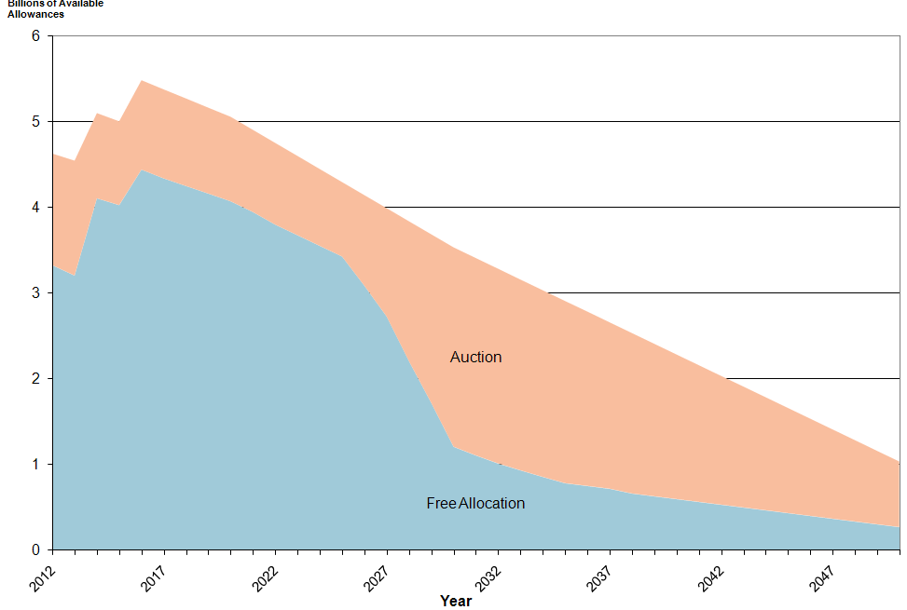
ACESA Allocation scheme

Slide 9
Banking
Banking allows emitters to carry over unused allowances into the next cap period
Emitters can either reduce emissions below the cap and hold the allowances that they generate if there is free allocation OR
Emitters can buy extra allowances gambling that the price is lower now than it will be next period- this reduces the allowances available on the market for others

Slide 10
Banking Proposals
Bills | Van Hollen 2009 | Cantwell-Snowe 2010 | Markey-Waxman 2009
Banking | Allowed-unlimited | Allowed -10 years | Allowed-unlimited

Slide 11
Borrowing
Borrowing is allowing emitters to borrow from future years to satisfy current allowance needs
Allows higher emissions now, with the presumption that emissions will be reduced in the year borrowed from
Likely that there will be appeals for relief in years borrowed from- delays compliance

Slide 12
Borrowing
Bill | Van Hollen 2009 | Cantwell- Collins 2009 | Waxman-Markey 2009
Borrowing Provisions | Auction price goes up 100%+ triggers sale of additional allowances that are borrowed from 2030-2050 and cap reduced accordingly in those years (8% of cap limit) | No borrowing | 15% borrowing 5 year limit-8% interest

Slide 13
Safety Valve
Places a cap on the price of allowances=price controls
Converts from cap and trade to a flat tax in reality
Reduces the internalizing of emission costs and allows less cost efficient emitters to persist

Slide 14
Safety Valve Provisions
Bill | Van Hollen | Waxman-Markey 2009 | Cantwell-Collins 2009
Safety valve provision | See borrowing provision | Reserve price of $28 in 2012 | Reserve price of $7-21

Slide 15
Offsets
Allows substitution of credits for reducing emissions in uncovered sectors
Issue is verifying that the reductions would not have happened without the investment and that the reductions do indeed occur

Slide 16
Offset Provisions
Bill | Van Hollen 2009 | Cantwell-Collins 2009 | Waxman –Markey 2009
Offset provisions | Carbon capture credit (1 for 1) | No direct offsets-separate funding for mitigation projects | ceiling of 2 billion credits, 1 billion domestic and 1 billion international, though international can substitute for domestic up to 1.5 total international credits.

Slide 17
Last Session Bills

Slide 18
Current Session
American Clean Energy and Security Act
Waxman and Markey developed
Cap and trade system:
Regulates electric utilities, oil companies, large industrial sources that emit 25,000+ tons of CO2 equivalent (85% of GHG emissions)
3% below 2005 by 2012, 17% below 2005 by 2020 and 80% below 2005 in 2050
Allows banking and borrowing
Offsetting allowed( 5 tons offset/4 tons credit)

Slide 19
ACESA continued
Energy Efficiency: incentives, harmonization and rebates
Utility energy efficiency: companies must demonstrate customer savings (1% by 2012 to 15% by 2015 for electricity)
Clean Energy
Renewable Energy: retail energy suppliers must have 6% renewable in 2012- 25% in 2025
Carbon Capture: demonstration program, incentives and performance standards for new coal plants 1,100 tons per megawatt limit on GHG, then 800 tons
Clean Fuels and Vehicles: low carbon fuel standard
And more! Adaptation, consumer assistance, green jobs/training, rebates for additional costs over other countries

Slide 20
Boxer Climate Principles
1. Reduce emissions to levels guided by science to avoid dangerous global warming.
2. Set short and long term emissions targets that are certain and enforceable, with periodic review of the climate science and adjustments to targets and policies as necessary to meet emissions reduction targets.
3. Ensure that state and local entities continue pioneering efforts to address global warming.
4. Establish a transparent and accountable market-based system that efficiently reduces carbon emissions.

Slide 21
Public Attitudes
Constituent perceptions drive political decisions- need to be re-elected
Special interest group lobbying does as well, but without public support there is risk to politicians

Slide 22
Voters View Renewable Energy as the Best Solution
What are the ONE or TWO most important things that can be done to solve America’s energy problems and high gas prices?
How to Address America’s Energy Problems
What the Government Should Do About the High Gas Prices
Greenburg Quinlan Rosner Research Survey, June 2006

Slide 23
Recent Perception
Has it changed?

Slide 24
Now I'd like to ask you about some specific energy proposals being considered by Congress. For each, please tell me whether you favor or oppose including this in an energy bill. . . ."
Favor % Oppose% Unsure%
Requirements that utilities produce more energy from wind, solar or other renewable sources
July 2010 78 17 5
June 2010 87 9 4

Slide 25
Now I'd like to ask you about some specific energy proposals being considered by Congress. For each, please tell me whether you favor or oppose including this in an energy bill. . . ."
Favor % Oppose% Unsure%
Limits on carbon dioxide and other greenhouse gas emissions
July 2010 65 28 7
June 2010 66 29 6

Slide 26
Now I'd like to ask you about some specific energy proposals being considered by Congress. For each, please tell me whether you favor or oppose including this in an energy bill. . . ."
Favor % Oppose% Unsure%
Expanded exploration for coal, oil and gas in the US
July 2010 72 23 5
June 2010 68 26 5

Slide 27
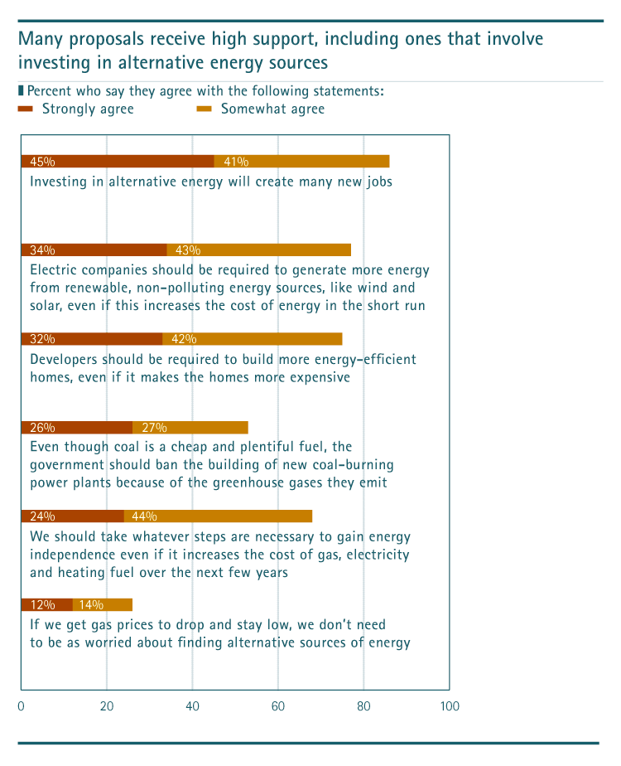

Slide 28
"And please tell me if you approve, disapprove or neither approve nor disapprove of the way Barack Obama is handling each of the following issues. How about [see below]?" If unsure: "If you had to choose, do you lean more toward approving or disapproving of the way Barack Obama is handling [see below]?"
 |  | Approve | Disapprove | Neither
 |  | % | % | %
 | "Energy"
 | 8/11-16/10 | 47 | 43 | 10
 | 6/9-14/10 | 52 | 36 | 12
 | 5/7-11/10 | 52 | 36 | 11
 | 4/7-12/10 | 51 | 36 | 13
 | "Gas prices"
 | 8/11-16/10 | 39 | 40 | 21
 | 6/9-14/10 | 40 | 37 | 23
 | 5/7-11/10 | 33 | 47 | 19
 | 4/7-12/10 | 33 | 46 | 21
"Do you favor, oppose, or neither favor nor oppose increasing drilling for oil and gas in coastal areas around the United States?"
 |  | Favor | Oppose | Neither | Unsure
 |  | % | % | % | %
 | 8/11-16/10 | 48 | 36 | 15 | 1
 | 6/9-14/10 | 45 | 41 | 13 | 1
 | 5/7-11/10 | 50 | 38 | 10 | 1

Slide 29
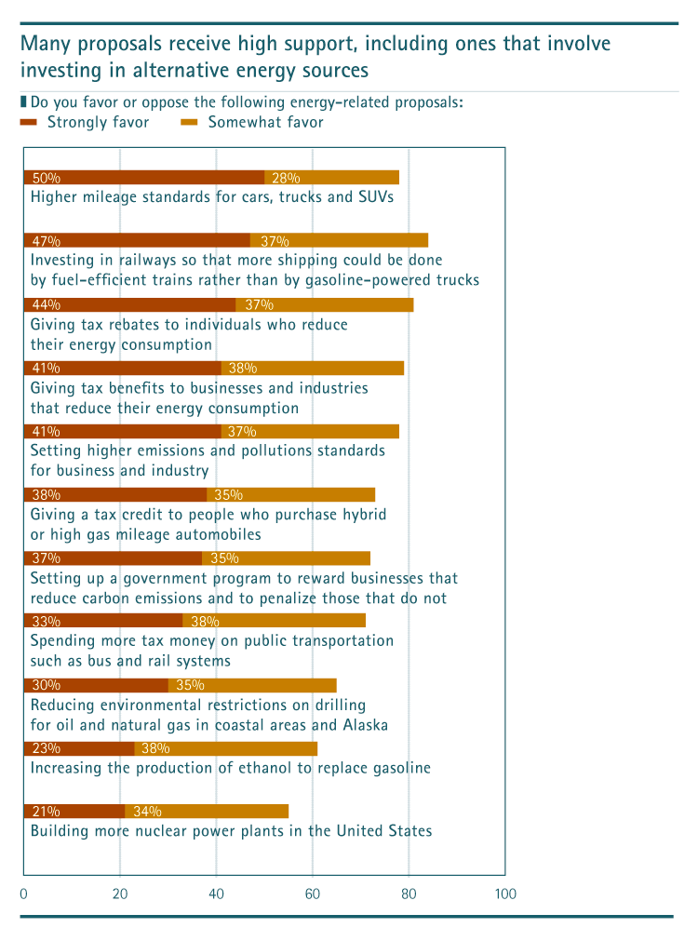

Slide 31
Solutions-Personal
Cut back on leisure driving Very 39% Somewhat 39%
Have a 55 mph speed limit Very 37% Somewhat 27%
>½ the time:
Carpool Very 32% Somewhat 23%
Use public transit Very 25% Somewhat 19%
Bike or walk Very 20% Somewhat 20%

Slide 32
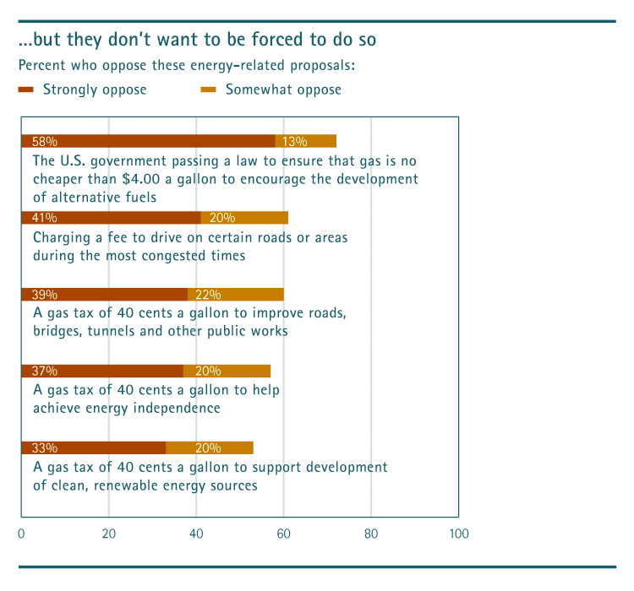

Slide 33
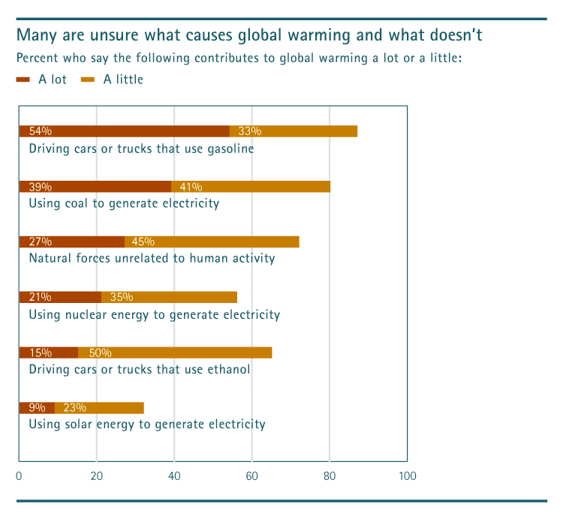

Slide 34
Major Public Attitude Groups
Disengaged (19%): not connected to energy issue
Climate Change Doubters (17%): reject idea
The Anxious (40%): know enough to be worried (91% worry “a lot” about cost of electricity)
The Greens (24%): worry about all elements of the energy problem

Slide 35
Common Ground?
Both the Anxious and the Greens support alternative energy, but for entirely different reasons
The Anxious believe with heavy investment alternative energy could be a major part of our energy consumption in 10 years or less (85%)
The Greens believe we need to find alternative energy sources even if gas stays low (>90%, 77% strongly

