Slide 1
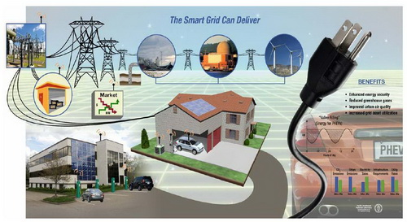
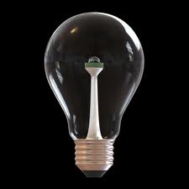
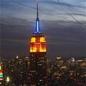
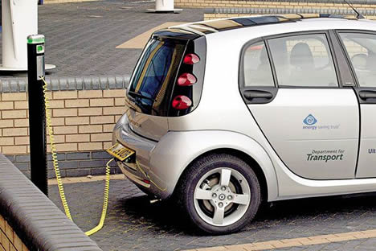
Stabilizing Climate:
An Energy Efficiency Revolution
November 15, 2010
Nicky Phear

Slide 2
Climate Change Internship Opportunities Spring Semester, 2011
Partnering organizations include:
Ecology Project International
The UM Office of Sustainability
UM ASUM Sustainability Center
Climate Ride
Missoula City Greenhouse Gas Advisory Committee
The Sustainable Business Council
City of Missoula Conservation Lands Management
US Forest Service Northern Region
Aldo Leopold Research Institute
Woody Biomass Utilization Program
Clear Sky Climate Solutions
The Clark Fork Coalition

Slide 3
Climate Stabilization and the Wedge Solution
1) What target should we set and why?
2) How many wedges will this require, and which ones do you think we should be use?
3) Discuss the pros and cons of the wedges you select.
4) Choose someone to present your proposal to the class.

Slide 4
Group #2
Group #5
Group #1
Johnson | Haley
Durglo | Jacob
Shafer | Stephen
Salo | Colton
Sylling | Hannah
Parks | Ryan
Garrow | Kimberly
Dudek | Brianna
Lombard | Brian
Micus | Joshua
Lewis | Casey
Sinnema | Sarah
Burns | Justin
Group #4
Frost | Hannah
Mobley | John
Hartford Newman | Morgen Emile
Group #3
 | Bossler | Lea
Klessens |  | Darcy
Schaad |  | David
Silva |  | Benjamin
Leyva |  | Ryan
Group #6
Miller | Jennifer
Caponi | Emily
Franz | Justin
Stoner | Ian
Butterworth | Andrew
Group #7
Group #10
Donachie | Kevin
Menahan | Mara
Grossman | Jessie
Ryan | Justin
Johnson | Marine
Schulte | Jason
Ryan | Hannah
Wenzel | James
Group #8
Berry | Erik
Motroni | Dylan
Crystal | Ruth
Stockman | Evan
Group #12
Group #11
Winer | Jed
Corrick | Stephen
McNally | Timothy
Jokisch | Aleta
Buss | Brendan
Snieder | Julia
Reid | John
Licitra | Stephan
Barker | Tess
Group #9
Brandt | Ivar
Weinrich | Kadin
Farrell | William
Idler | Kelsea

Slide 5
Stabilizing Climate:
An Energy Efficiency Revolution
November 15, 2010
Nicky Phear

Slide 6
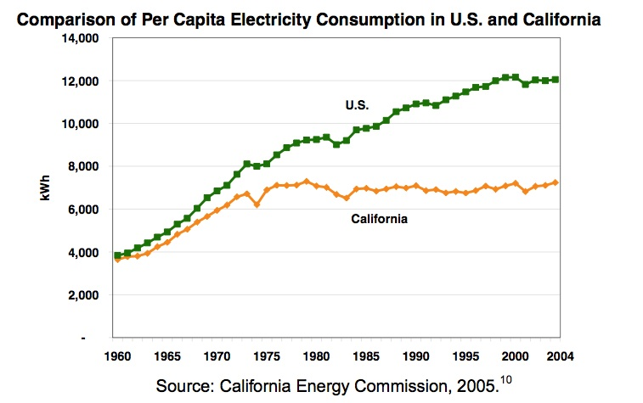

Slide 7
California’s 40 year flat line energy per capita:
Four reasons:
1. Late 1970’s CA adopted first energy efficiency standards for appliances, equipment, and then new buildings (residential and commercial). These are updated on a regularly scheduled basis.
2. Late 1970’s CA also adopted system benefits charge. 3% surcharge on all utility bills – heating and electric – residential and commercial.
Pays for:
CA Energy Commission
Research and Dev – including Berkeley lab
Subsidizes for retrofits/weatherization
Subsidizes renewable energy
3. “Flex Your Power” program of rebates – with plenty of advertizing so consumer awareness in these rebates is vast. Utilities required by law to send out info with energy bill. Easy and user-friendly rebate programs.
4. DECOUPLING – first state to do this. Profits linked to how effective energy efficient programs are. Very aggressive.

Slide 8
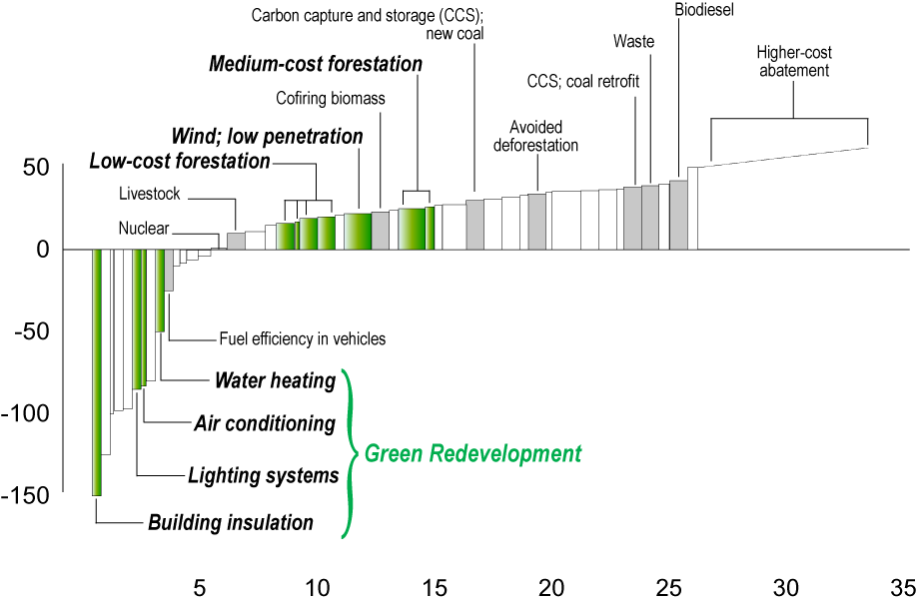
Opportunities & GHG Reduction Costs
Source: McKinsey Global Institute, 2007
Cost of Abatement, € per GtCO₂e²
Abatement beyond ‘business as usual,’ GtCO₂e¹ per year in 2030

Slide 9
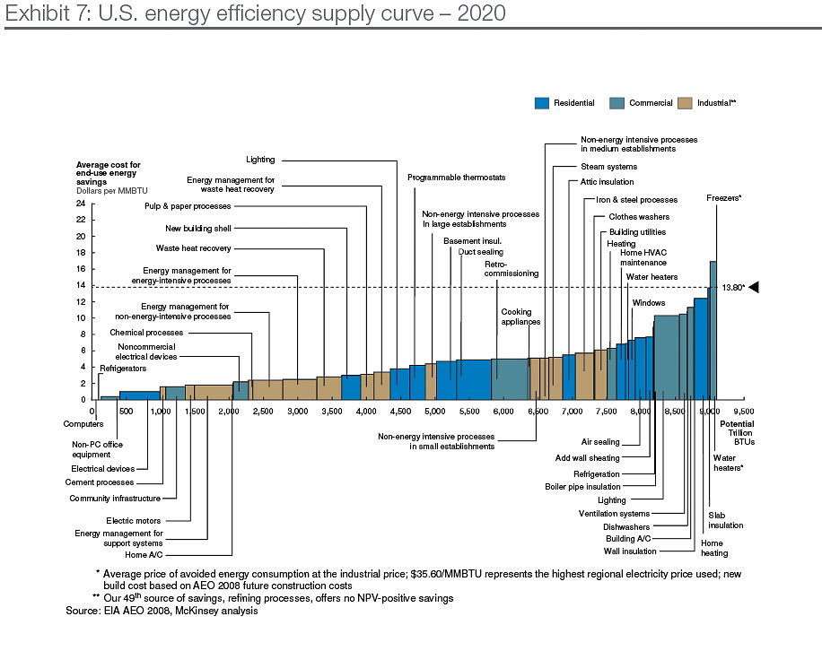
McKinsey Study: Unlocking Energy Efficiency in the U.S. Economy

Slide 10
Energy Efficiency
Barriers (why haven’t we done all this yet?)
Measures require substantial upfront investment for savings that accrue over the lifetime of the investment.
Efficiency potential is highly fragmented across millions of locations and billions of devices.
Measuring energy not consumed is by its nature difficult
Inertia
Consider solutions to these barriers…
Opportunities:
Cheapest way to reduce emissions.
Low technical, economic, and political hurdles.
Benefits start immediately.
Methods lead to job creation.

Slide 11
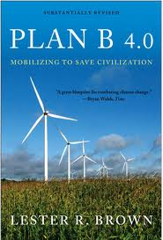
Climate Action Plan
Lester Brown
Plan B 4.0: Mobilizing to Save Civilization
2009 Earth Policy Institute
Cut Global Net CO₂ Emissions 80% by 2020
Three components:
Raising energy efficiency and restructuring transportation
Replacing fossil fuels with renewables
Ending net deforestation and planting trees to sequester carbon
…to prevent global atmospheric CO₂ concentrations from exceeding 400 parts per million, minimizing future temperature rise.

Slide 12
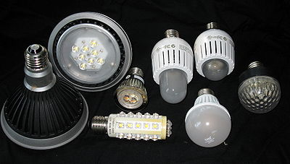
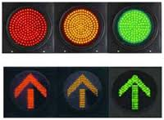
Lighting
A worldwide switch to highly-efficient lighting would cut electricity use 12%, equivalent to closing 705 of the world’s 2,670 coal-fired power plants.
Traffic light retrofit to LEDs saves New York City $6,000,000/year.
Lester Brown, Plan B 4.0: Mobilizing to Save Civilization, 2009

Slide 13
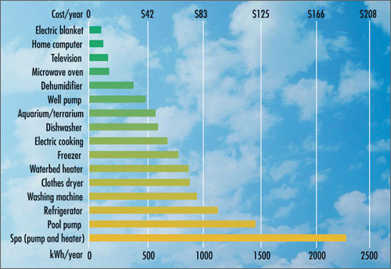
Appliances
Energy used in appliances in standby mode worldwide account for up to 10% total electricity consumption.
S. Korea is mandating a 1-watt limit on standby for many appliances.
Japan has a world-leading program that raised efficiency standards boosting computer efficiency by 99%.
Flat screen plasma TVs use easily twice as much electricity as traditional TVs; UK considering banning. TVs account for about 10% of residential energy use in CA.
Lester Brown, Plan B 4.0: Mobilizing to Save Civilization, 2009

Slide 14
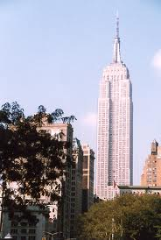
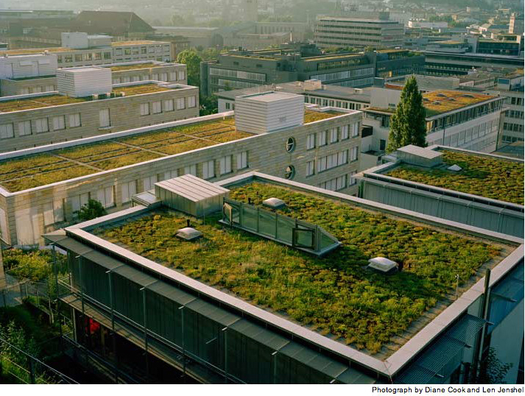
Buildings
Retrofits with better insulation and more efficient appliances can cut energy use 20-50%.
A retrofit of the Empire State Building expected to reduce energy use by 38% and energy costs by $4.4 million annually.
Lester Brown, Plan B 4.0: Mobilizing to Save Civilization, 2009

Slide 15
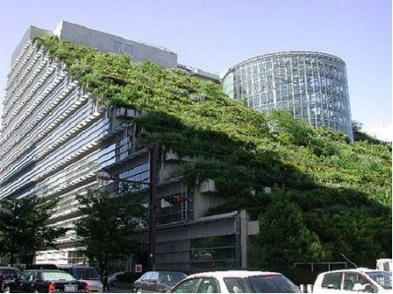
Living Buildings

Slide 16
Transportation
Plug-in hybrid electric vehicles running primarily on electricity generated by the wind and the sun could draw most of their energy during “off peak” hours.
Lester Brown, Plan B 4.0: Mobilizing to Save Civilization, 2009

Slide 17
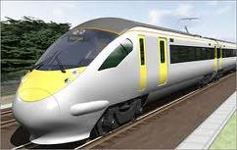
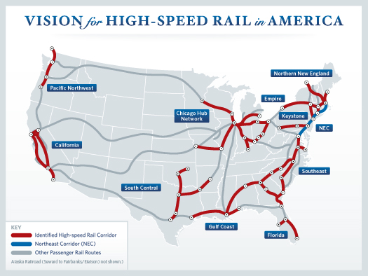
Transportation
Japan’s high speed rail :
carries a million passengers a day
travels 3 times faster than cars
late arrivals average 6 seconds
create 1/3 fewer emissions than car travel
Lester Brown, Plan B 4.0: Mobilizing to Save Civilization, 2009

Slide 18
Smart Grid
Link regions rich in wind, solar, and geothermal energy with consumption centers, allow for two way metering, and “smarter” energy use.
Reduce peak power demand:
dishwasher can be programmed to run at 2 am when power is cheaper
turning off all refrigerators in UK for brief periods of time would save 2,000 MW in the UK, enough to close 4 coal-fired power plants.
Lester Brown, Plan B 4.0: Mobilizing to Save Civilization, 2009

Slide 19
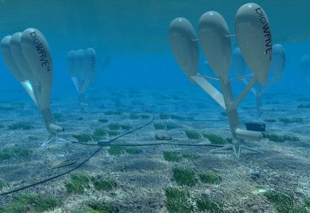
A New Materials Economy

Slide 20
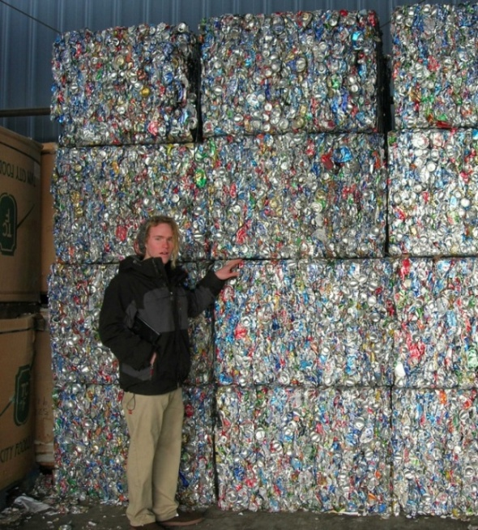
Recycling
Currently only 29% of garbage in USA is recycled. Florida has boldly set a goal of recycling 75% of waste by 2020.
Finland has banned the use of one-way soft drink containers.
San Francisco mayor has banned the use of city funds to purchase bottled water.
Lester Brown, Plan B 4.0: Mobilizing to Save Civilization, 2009

Slide 21
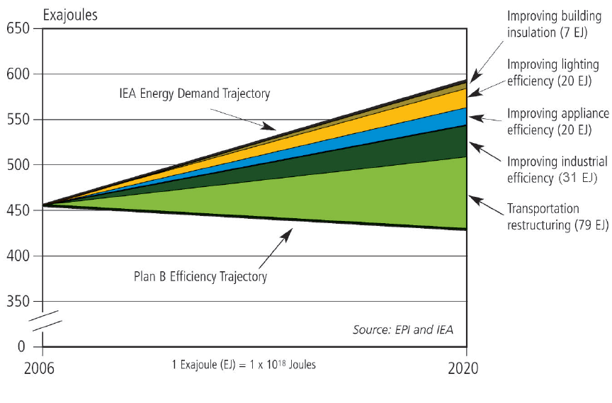
Plan B Energy Efficiency Measures

Slide 22
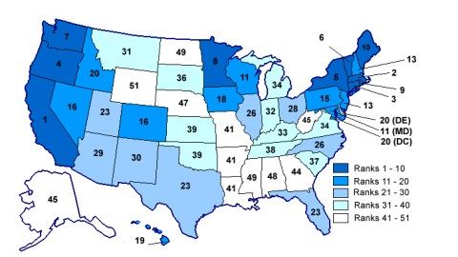
The American Council for an Energy Efficient Economy has released new rankings for state efficiency efforts. California is No. 1. Wyoming last.
(October 21, 2009)

