Slide 1
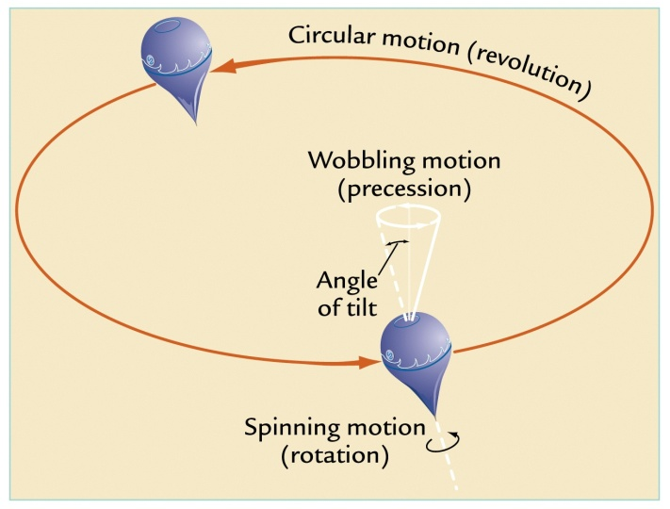
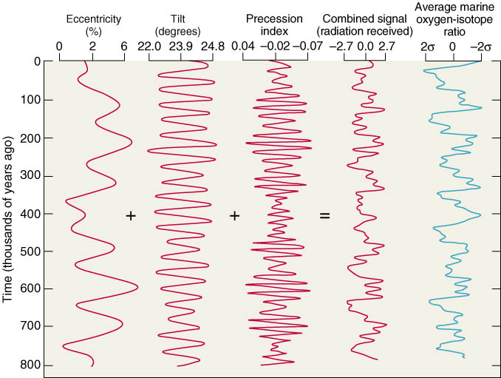
1911: Milutin Milankovitch proposes:
All 3 cycles (23, 41, & 100 KYA) together control ice age
Summer
insolation
is driver
Credit: Anna Klene

Slide 2
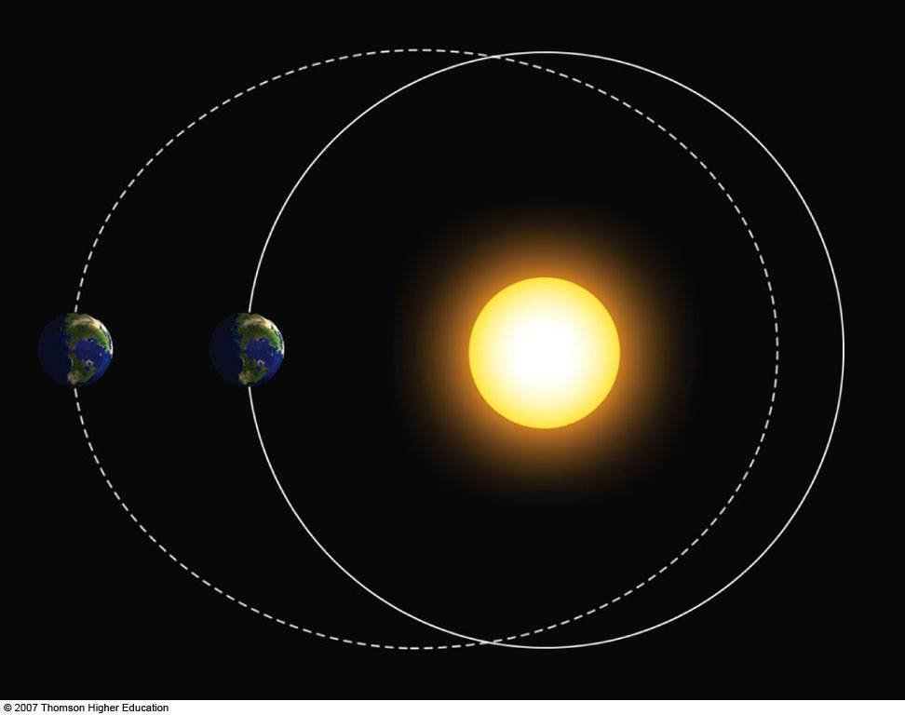
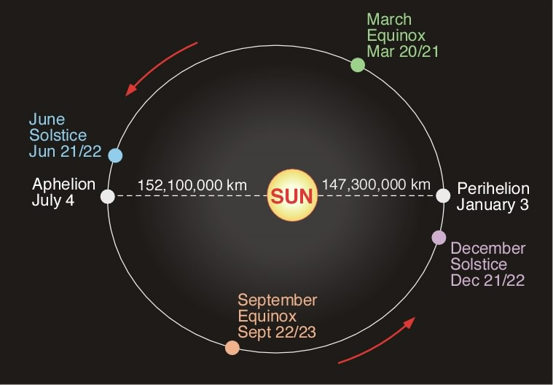
Currently orbital eccentricity is at a minimum meaning the orbit is near circular.
However changes in eccentricity occur on a 100,000 year cycle.

Slide 3
Sunspot Cycles
Lean, J.L. Cycles and trends in solar irradiance and climate. Clim Change 2010, 1 111-122.

