Slide 1
Additional Courses Teaching Aspects of Paleoclimatology
GEOS 108N – Climate Change: Past&Future
GEOG 322N – Weather & Climate
GEOS 382 – Global Change
FOR 407 – Biogeochemistry
GEOG 550 – Seminar in Paleoclimate & Global Change

Slide 2
5 billion years of Earth’s climate history – take home message
What is the importance of proxy data?
Why do scientists study paleoclimate?
What can paleoclimates tell us about our current climate?
Any questions on what was covered last time?
Notes:
Proxy data is very important to our understanding of climate.
We are improving our ability to read these signals and what they tell us about the Earth’s past.
They are revealing a complicated but fascinating story about our Earth’s climatic evolution.
We still have a great deal to learn.

Slide 3
Climate Change of the Last 2000 Years
Dr. Faith Ann Heinsch
September 9, 2008

Slide 4
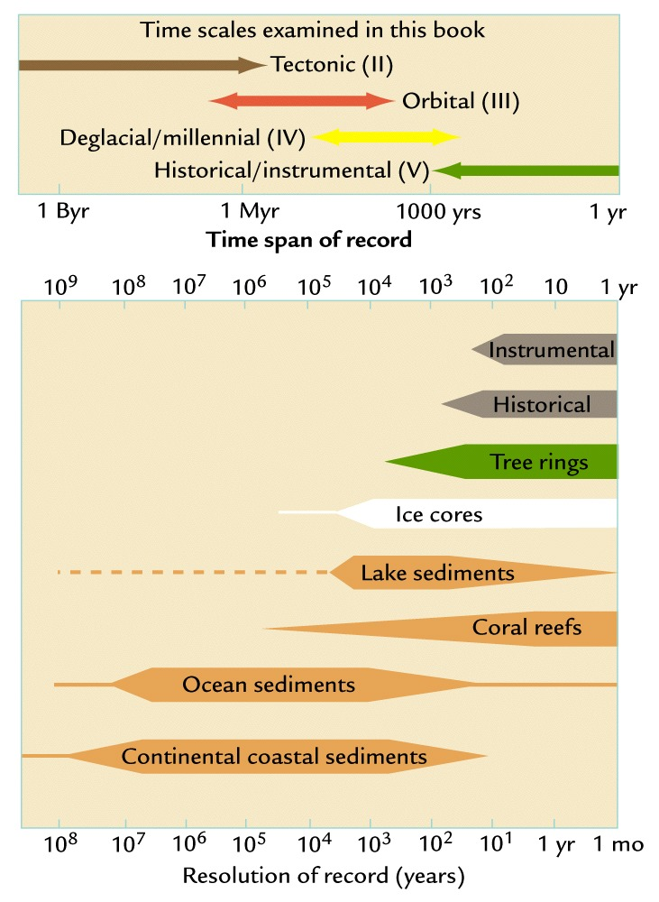
Time scales for Proxy Data

Slide 5
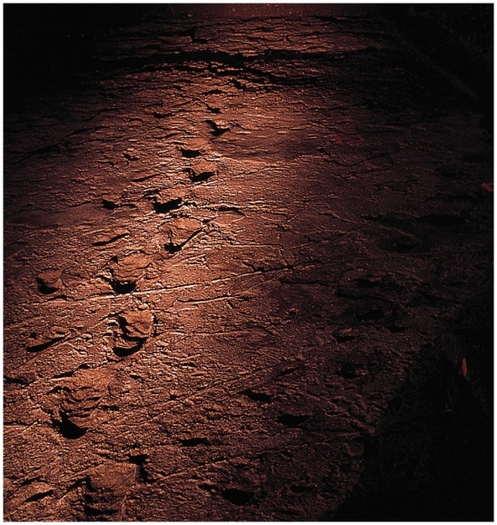

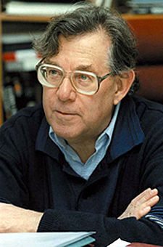

Anthropocene
Term used for climate where
humans are the dominate controlling mechanism…
  Concept first proposed in 1979 by Sagan
  Phrase coined by Crutzen in 2000
    Nobel prize winning chemist for his work on ozone depletion
  No precise start date.
  May be considered to start in late 18th century
  Ruddiman proposes it started much earlier…8,000 years ago

Slide 6
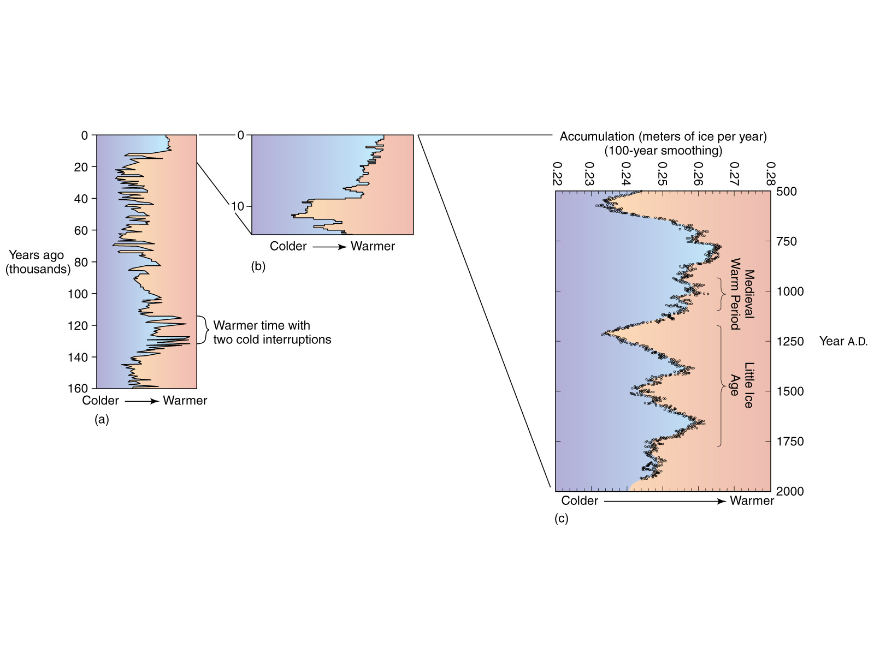
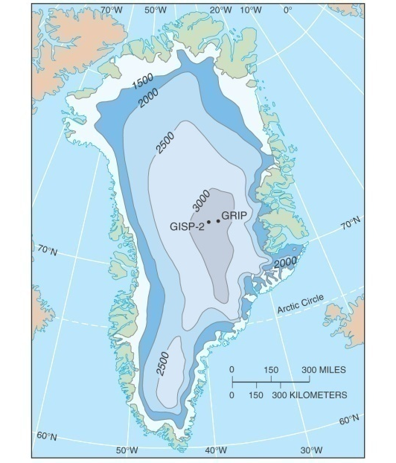
Last 2000 years….
Greenland Ice Cores:
  High resolution record of temps near Europe…

Slide 7
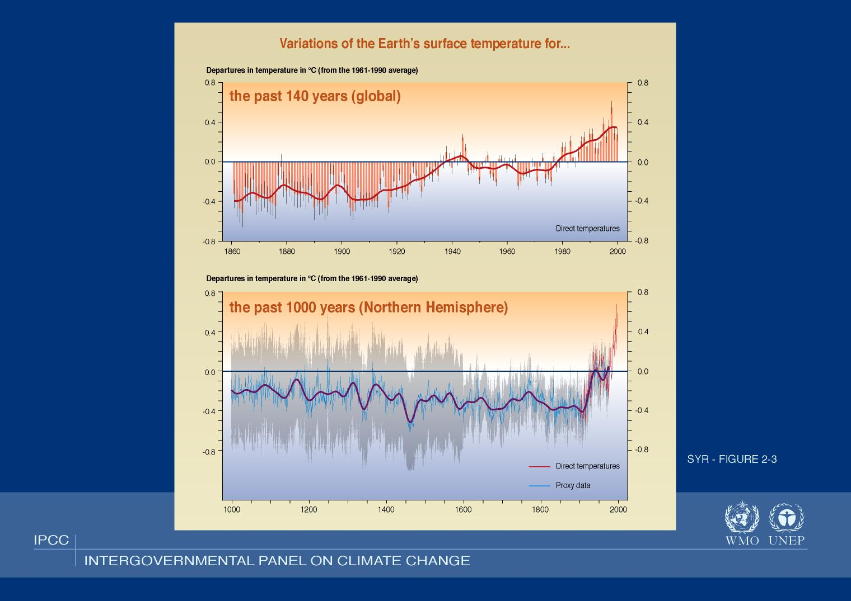
Notes:
Note tightening of the error bars because of increased confidence in the data.
Proxies – tree rings, boreholes, ice cores
There is a new ice core from Antarctica that goes back 800,000 years!

Slide 8

Medieval Warm Period (~800-1300)
Image Credit: Robert A. Rohde,
Global Warming Art
Notes:
The medieval warm period and little ice age are labeled at roughly the times when they are historically believed to occur, though it is still disputed whether these were truly global or only regional events.
http://upload.wikimedia.org/wikipedia/commons/c/c1/2000_Year_Temperature_Comparison.png
Temperature variations during the preceding 12000 years. Note that present day is placed at the left hand side
This image is a comparison of 10 different published reconstructions of mean temperature changes during the last 2000 years. More recent reconstructions are plotted towards the front and in redder colors, older reconstructions appear towards the back and in bluer colors. An instrumental history of temperature is also shown in black. The single, unsmoothed annual value for 2004 is also shown for comparison.
For the purposes of this comparison, the author is agnostic as to which, if any, of the reconstructions of global mean temperature is an accurate reflection of temperature fluctuations during the last 2000 years. This plot is a fair representation of the range of reconstructions appearing in the published scientific literature. For each reconstruction, the raw data has been decadally smoothed with a σ = 5 yr Gaussian weighted moving average. Also, each reconstruction was adjusted so that its mean matched the mean of the instrumental record during the period of overlap. The variance (i.e. the scale of fluctuations) was not adjusted (except in one case noted below).
Except as noted below, all original data for this comparison comes from [1] and links therein. It should also be noted that many reconstructions of past climate report substantial error bars, which are not represented on this figure.
Reconstructions
The reconstructions used, in order from oldest to most recent publication are:
(dark blue 1000-1991): P.D. Jones, K.R. Briffa, T.P. Barnett, and S.F.B. Tett (1998). High-resolution Palaeoclimatic Records for the last Millennium: Interpretation, Integration and Comparison with General Circulation Model Control-run Temperatures, The Holocene, 8: 455-471.
(blue 1000-1980): M.E. Mann, R.S. Bradley, and M.K. Hughes (1999). Northern Hemisphere Temperatures During the Past Millennium: Inferences, Uncertainties, and Limitations, Geophysical Research Letters, 26(6): 759-762.
(light blue 1000-1965): Crowley and Lowery (2000). Northern Hemisphere Temperature Reconstruction, Ambio, 29: 51-54. Modified as published in Crowley (2000). Causes of Climate Change Over the Past 1000 Years, Science, 289: 270-277.
(lightest blue 1402-1960): K.R. Briffa, T.J. Osborn, F.H. Schweingruber, I.C. Harris, P.D. Jones, S.G. Shiyatov, S.G. and E.A. Vaganov (2001). Low-frequency temperature variations from a northern tree-ring density network, J. Geophys. Res., 106: 2929-2941.
(light green 831-1992): J. Esper, E.R. Cook, and F.H. Schweingruber (2002). Low-Frequency Signals in Long Tree-Ring Chronologies for Reconstructing Past Temperature Variability, Science, 295(5563): 2250-2253.
(yellow 200-1980): M.E. Mann and P.D. Jones (2003). Global Surface Temperatures over the Past Two Millennia, Geophysical Research Letters, 30(15): 1820. DOI:10.1029/2003GL017814.
(orange 200-1995): P.D. Jones and M.E. Mann (2004). Climate Over Past Millennia, Reviews of Geophysics, 42: RG2002. DOI:10.1029/2003RG000143
(red-orange 1500-1980): S. Huang (2004). Merging Information from Different Resources for New Insights into Climate Change in the Past and Future, Geophys. Res Lett., 31: L13205. DOI:10.1029/2004GL019781
(red 1-1979): A. Moberg, D.M. Sonechkin, K. Holmgren, N.M. Datsenko and W. Karlén (2005). Highly variable Northern Hemisphere temperatures reconstructed from low- and high-resolution proxy data, Nature, 443: 613-617. DOI:10.1038/nature03265
(dark red 1600-1990): J.H. Oerlemans (2005). Extracting a Climate Signal from 169 Glacier Records, Science, 308: 675-677. DOI:10.1126/science.1107046
(black 1856-2004): Instrumental data was jointly compiled by the w:Climatic Research Unit and the UK Meteorological Office Hadley Centre. Global Annual Average data set TaveGL2v [2] was used.
Documentation for the most recent update of the CRU/Hadley instrumental data set appears in: P.D. Jones and A. Moberg (2003). Hemispheric and large-scale surface air temperature variations: An extensive revision and an update to 2001, Journal of Climate, 16: 206-223.
Copyright
The original version of this figure was prepared by Robert A. Rohde from publicly available data, and is incorporated into the Global Warming Art project.

Slide 9
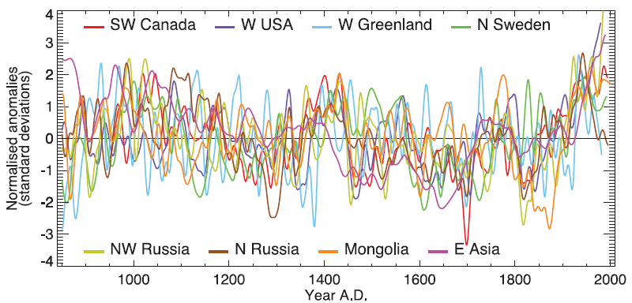
Medieval Warm Period (~800-1300)
IPCC 2007

Slide 10
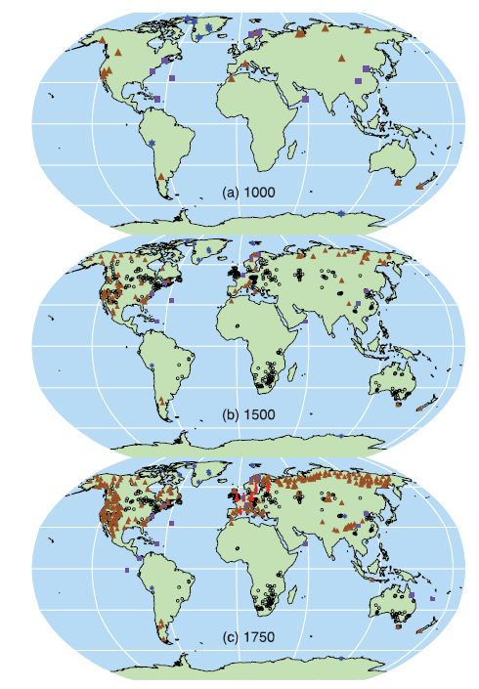
Proxy Records
–
Where do they come from?
IPCC 2007

Slide 11

Medieval Warm Period (~800-1300)
(a.k.a. Medieval Climate Optimum)
Notes:
Pinot blanc - http://www.its.edu.mt/images/big_white_pinotblanc_grapes.jpg

Slide 12
Medieval Warm Period (~800-1300)
Image Credit: Robert A. Rohde,
Global Warming Art
Notes:
The medieval warm period and little ice age are labeled at roughly the times when they are historically believed to occur, though it is still disputed whether these were truly global or only regional events.
http://upload.wikimedia.org/wikipedia/commons/c/c1/2000_Year_Temperature_Comparison.png
Temperature variations during the preceding 12000 years. Note that present day is placed at the left hand side
This image is a comparison of 10 different published reconstructions of mean temperature changes during the last 2000 years. More recent reconstructions are plotted towards the front and in redder colors, older reconstructions appear towards the back and in bluer colors. An instrumental history of temperature is also shown in black. The single, unsmoothed annual value for 2004 is also shown for comparison.
For the purposes of this comparison, the author is agnostic as to which, if any, of the reconstructions of global mean temperature is an accurate reflection of temperature fluctuations during the last 2000 years. This plot is a fair representation of the range of reconstructions appearing in the published scientific literature. For each reconstruction, the raw data has been decadally smoothed with a σ = 5 yr Gaussian weighted moving average. Also, each reconstruction was adjusted so that its mean matched the mean of the instrumental record during the period of overlap. The variance (i.e. the scale of fluctuations) was not adjusted (except in one case noted below).
Except as noted below, all original data for this comparison comes from [1] and links therein. It should also be noted that many reconstructions of past climate report substantial error bars, which are not represented on this figure.
Reconstructions
The reconstructions used, in order from oldest to most recent publication are:
(dark blue 1000-1991): P.D. Jones, K.R. Briffa, T.P. Barnett, and S.F.B. Tett (1998). High-resolution Palaeoclimatic Records for the last Millennium: Interpretation, Integration and Comparison with General Circulation Model Control-run Temperatures, The Holocene, 8: 455-471.
(blue 1000-1980): M.E. Mann, R.S. Bradley, and M.K. Hughes (1999). Northern Hemisphere Temperatures During the Past Millennium: Inferences, Uncertainties, and Limitations, Geophysical Research Letters, 26(6): 759-762.
(light blue 1000-1965): Crowley and Lowery (2000). Northern Hemisphere Temperature Reconstruction, Ambio, 29: 51-54. Modified as published in Crowley (2000). Causes of Climate Change Over the Past 1000 Years, Science, 289: 270-277.
(lightest blue 1402-1960): K.R. Briffa, T.J. Osborn, F.H. Schweingruber, I.C. Harris, P.D. Jones, S.G. Shiyatov, S.G. and E.A. Vaganov (2001). Low-frequency temperature variations from a northern tree-ring density network, J. Geophys. Res., 106: 2929-2941.
(light green 831-1992): J. Esper, E.R. Cook, and F.H. Schweingruber (2002). Low-Frequency Signals in Long Tree-Ring Chronologies for Reconstructing Past Temperature Variability, Science, 295(5563): 2250-2253.
(yellow 200-1980): M.E. Mann and P.D. Jones (2003). Global Surface Temperatures over the Past Two Millennia, Geophysical Research Letters, 30(15): 1820. DOI:10.1029/2003GL017814.
(orange 200-1995): P.D. Jones and M.E. Mann (2004). Climate Over Past Millennia, Reviews of Geophysics, 42: RG2002. DOI:10.1029/2003RG000143
(red-orange 1500-1980): S. Huang (2004). Merging Information from Different Resources for New Insights into Climate Change in the Past and Future, Geophys. Res Lett., 31: L13205. DOI:10.1029/2004GL019781
(red 1-1979): A. Moberg, D.M. Sonechkin, K. Holmgren, N.M. Datsenko and W. Karlén (2005). Highly variable Northern Hemisphere temperatures reconstructed from low- and high-resolution proxy data, Nature, 443: 613-617. DOI:10.1038/nature03265
(dark red 1600-1990): J.H. Oerlemans (2005). Extracting a Climate Signal from 169 Glacier Records, Science, 308: 675-677. DOI:10.1126/science.1107046
(black 1856-2004): Instrumental data was jointly compiled by the w:Climatic Research Unit and the UK Meteorological Office Hadley Centre. Global Annual Average data set TaveGL2v [2] was used.
Documentation for the most recent update of the CRU/Hadley instrumental data set appears in: P.D. Jones and A. Moberg (2003). Hemispheric and large-scale surface air temperature variations: An extensive revision and an update to 2001, Journal of Climate, 16: 206-223.
Copyright
The original version of this figure was prepared by Robert A. Rohde from publicly available data, and is incorporated into the Global Warming Art project.

Slide 13
Medieval Warm Period (~800-1300)
Scattered evidence exists in Europe and the high latitudes surrounding the North Atlantic.
  Cultivation of Greenland & Iceland
  Grapes in England?
  Medieval temperatures were probably 1-2°C above early 20th century levels at various European locations
  Evidence in Japan, Alaska
  Regional in nature
    There were both warmer and colder areas
Drought was evident in western U.S. (Anasazi), Central America (Mayan) & Africa

Slide 14
Medieval Warm Period (~800-1300)
“Evidence is not sufficient to support a conclusion that hemispheric mean temperatures were as warm, or the extent of warm regions as expansive, as those in the 20th century as a whole, during any period in medieval times.” (IPCC 2007)

Slide 15
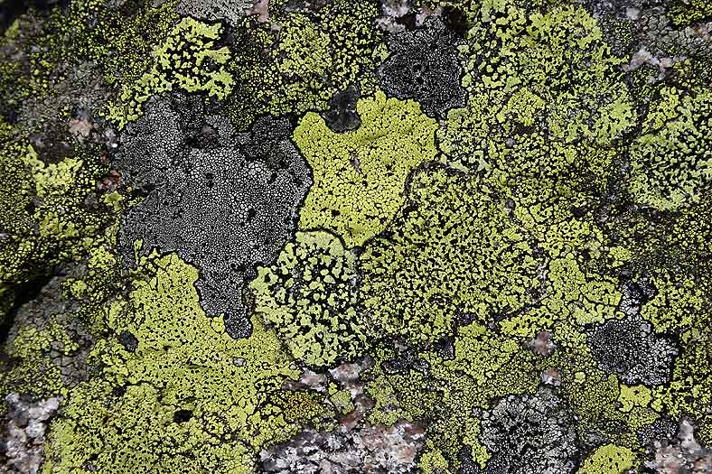
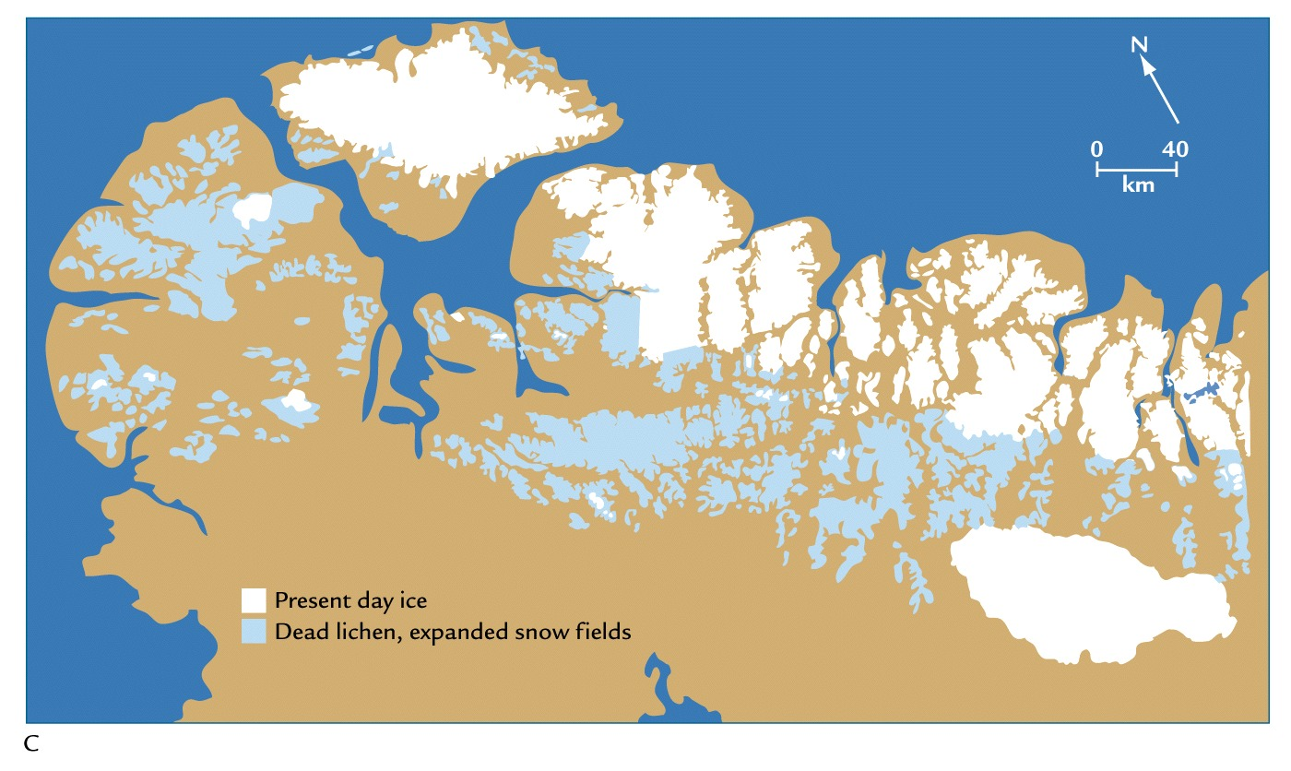
The Little Ice Age (1400-1900)
Notes:
The Little Ice Age (LIA) was a period of cooling occurring after a warmer era known as the Medieval climate optimum. Climatologists and historians find it difficult to agree on either the start or end dates of this period. Some confine the Little Ice Age to approximately the 16th century to the mid 19th century.
Evidence – lichen die-offs – burial beneath snow fields that blocked sunlight (they can take extreme cold).
Lichen image from http://www.arcticimages.com/extra_images_for_the_arctic_book.htm

Slide 16
The Little Ice Age (1400-1900)
Image Credit: Robert A. Rohde,
Global Warming Art
Notes:
http://upload.wikimedia.org/wikipedia/commons/c/c1/2000_Year_Temperature_Comparison.png
Temperature variations during the preceding 12000 years. Note that present day is placed at the left hand side
This image is a comparison of 10 different published reconstructions of mean temperature changes during the last 2000 years. More recent reconstructions are plotted towards the front and in redder colors, older reconstructions appear towards the back and in bluer colors. An instrumental history of temperature is also shown in black. The single, unsmoothed annual value for 2004 is also shown for comparison.
For the purposes of this comparison, the author is agnostic as to which, if any, of the reconstructions of global mean temperature is an accurate reflection of temperature fluctuations during the last 2000 years. This plot is a fair representation of the range of reconstructions appearing in the published scientific literature. For each reconstruction, the raw data has been decadally smoothed with a σ = 5 yr Gaussian weighted moving average. Also, each reconstruction was adjusted so that its mean matched the mean of the instrumental record during the period of overlap. The variance (i.e. the scale of fluctuations) was not adjusted (except in one case noted below).
Except as noted below, all original data for this comparison comes from [1] and links therein. It should also be noted that many reconstructions of past climate report substantial error bars, which are not represented on this figure.
Reconstructions
The reconstructions used, in order from oldest to most recent publication are:
(dark blue 1000-1991): P.D. Jones, K.R. Briffa, T.P. Barnett, and S.F.B. Tett (1998). High-resolution Palaeoclimatic Records for the last Millennium: Interpretation, Integration and Comparison with General Circulation Model Control-run Temperatures, The Holocene, 8: 455-471.
(blue 1000-1980): M.E. Mann, R.S. Bradley, and M.K. Hughes (1999). Northern Hemisphere Temperatures During the Past Millennium: Inferences, Uncertainties, and Limitations, Geophysical Research Letters, 26(6): 759-762.
(light blue 1000-1965): Crowley and Lowery (2000). Northern Hemisphere Temperature Reconstruction, Ambio, 29: 51-54. Modified as published in Crowley (2000). Causes of Climate Change Over the Past 1000 Years, Science, 289: 270-277.
(lightest blue 1402-1960): K.R. Briffa, T.J. Osborn, F.H. Schweingruber, I.C. Harris, P.D. Jones, S.G. Shiyatov, S.G. and E.A. Vaganov (2001). Low-frequency temperature variations from a northern tree-ring density network, J. Geophys. Res., 106: 2929-2941.
(light green 831-1992): J. Esper, E.R. Cook, and F.H. Schweingruber (2002). Low-Frequency Signals in Long Tree-Ring Chronologies for Reconstructing Past Temperature Variability, Science, 295(5563): 2250-2253.
(yellow 200-1980): M.E. Mann and P.D. Jones (2003). Global Surface Temperatures over the Past Two Millennia, Geophysical Research Letters, 30(15): 1820. DOI:10.1029/2003GL017814.
(orange 200-1995): P.D. Jones and M.E. Mann (2004). Climate Over Past Millennia, Reviews of Geophysics, 42: RG2002. DOI:10.1029/2003RG000143
(red-orange 1500-1980): S. Huang (2004). Merging Information from Different Resources for New Insights into Climate Change in the Past and Future, Geophys. Res Lett., 31: L13205. DOI:10.1029/2004GL019781
(red 1-1979): A. Moberg, D.M. Sonechkin, K. Holmgren, N.M. Datsenko and W. Karlén (2005). Highly variable Northern Hemisphere temperatures reconstructed from low- and high-resolution proxy data, Nature, 443: 613-617. DOI:10.1038/nature03265
(dark red 1600-1990): J.H. Oerlemans (2005). Extracting a Climate Signal from 169 Glacier Records, Science, 308: 675-677. DOI:10.1126/science.1107046
(black 1856-2004): Instrumental data was jointly compiled by the w:Climatic Research Unit and the UK Meteorological Office Hadley Centre. Global Annual Average data set TaveGL2v [2] was used.
Documentation for the most recent update of the CRU/Hadley instrumental data set appears in: P.D. Jones and A. Moberg (2003). Hemispheric and large-scale surface air temperature variations: An extensive revision and an update to 2001, Journal of Climate, 16: 206-223.
Copyright
The original version of this figure was prepared by Robert A. Rohde from publicly available data, and is incorporated into the Global Warming Art project.

Slide 17
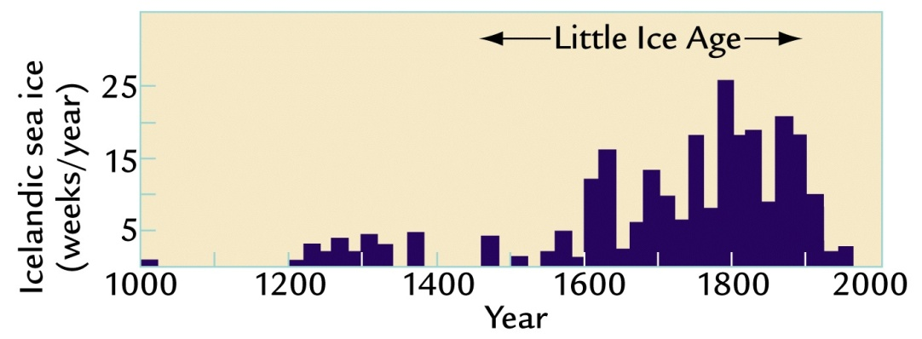
Little Ice Age (1400-1900)
A modest cooling of the Northern Hemisphere of less than 1°C
  Glaciers grow in Europe (1000 m lower than in 1850s)
  Sea ice expansion
Three minima, each separated by slight warming intervals beginning
  About 1650
  About 1770
  About 1850
Initially believed to be a global phenomenon; now less clear

Slide 18
Little Ice Age (1400-1900)
Colder winters & shorter growing season meant crop failure and localized famine in northern regions of Europe
  Great Famine of 1315-1317 (full recovery in 1322)
  By the 1700s, cultivated land (MWP) in Iceland was covered by ice
Settlements in Greenland were abandoned
  Marginal climate?
  Conflicts with native peoples?
Large-scale advances of glaciers
Not a “true” ice age since major ice sheets did not form

Slide 19
Proposed causes of climate change from 1000-1850
Orbital forcing
  Decreasing summer insolation (tilt and precession cycles)
  Only explains about half the amount observed in reconstruction for northern hemisphere (0.1°C)
Millennial bipolar seesaw
  Insufficient data to test
Solar variability
  Maunder Minimum
  11-year Sunspot cycle
  Recent research minimizes this effect
Notes:
No physical link between low sunspot activity and cooling temperatures; coincidence is suggestive of a connection

Slide 20
The Little Ice Age (1400-1900)
Image Credit: Robert A. Rohde,
Global Warming Art
Notes:
http://upload.wikimedia.org/wikipedia/commons/c/c1/2000_Year_Temperature_Comparison.png
Temperature variations during the preceding 12000 years. Note that present day is placed at the left hand side
This image is a comparison of 10 different published reconstructions of mean temperature changes during the last 2000 years. More recent reconstructions are plotted towards the front and in redder colors, older reconstructions appear towards the back and in bluer colors. An instrumental history of temperature is also shown in black. The single, unsmoothed annual value for 2004 is also shown for comparison.
For the purposes of this comparison, the author is agnostic as to which, if any, of the reconstructions of global mean temperature is an accurate reflection of temperature fluctuations during the last 2000 years. This plot is a fair representation of the range of reconstructions appearing in the published scientific literature. For each reconstruction, the raw data has been decadally smoothed with a σ = 5 yr Gaussian weighted moving average. Also, each reconstruction was adjusted so that its mean matched the mean of the instrumental record during the period of overlap. The variance (i.e. the scale of fluctuations) was not adjusted (except in one case noted below).
Except as noted below, all original data for this comparison comes from [1] and links therein. It should also be noted that many reconstructions of past climate report substantial error bars, which are not represented on this figure.
Reconstructions
The reconstructions used, in order from oldest to most recent publication are:
(dark blue 1000-1991): P.D. Jones, K.R. Briffa, T.P. Barnett, and S.F.B. Tett (1998). High-resolution Palaeoclimatic Records for the last Millennium: Interpretation, Integration and Comparison with General Circulation Model Control-run Temperatures, The Holocene, 8: 455-471.
(blue 1000-1980): M.E. Mann, R.S. Bradley, and M.K. Hughes (1999). Northern Hemisphere Temperatures During the Past Millennium: Inferences, Uncertainties, and Limitations, Geophysical Research Letters, 26(6): 759-762.
(light blue 1000-1965): Crowley and Lowery (2000). Northern Hemisphere Temperature Reconstruction, Ambio, 29: 51-54. Modified as published in Crowley (2000). Causes of Climate Change Over the Past 1000 Years, Science, 289: 270-277.
(lightest blue 1402-1960): K.R. Briffa, T.J. Osborn, F.H. Schweingruber, I.C. Harris, P.D. Jones, S.G. Shiyatov, S.G. and E.A. Vaganov (2001). Low-frequency temperature variations from a northern tree-ring density network, J. Geophys. Res., 106: 2929-2941.
(light green 831-1992): J. Esper, E.R. Cook, and F.H. Schweingruber (2002). Low-Frequency Signals in Long Tree-Ring Chronologies for Reconstructing Past Temperature Variability, Science, 295(5563): 2250-2253.
(yellow 200-1980): M.E. Mann and P.D. Jones (2003). Global Surface Temperatures over the Past Two Millennia, Geophysical Research Letters, 30(15): 1820. DOI:10.1029/2003GL017814.
(orange 200-1995): P.D. Jones and M.E. Mann (2004). Climate Over Past Millennia, Reviews of Geophysics, 42: RG2002. DOI:10.1029/2003RG000143
(red-orange 1500-1980): S. Huang (2004). Merging Information from Different Resources for New Insights into Climate Change in the Past and Future, Geophys. Res Lett., 31: L13205. DOI:10.1029/2004GL019781
(red 1-1979): A. Moberg, D.M. Sonechkin, K. Holmgren, N.M. Datsenko and W. Karlén (2005). Highly variable Northern Hemisphere temperatures reconstructed from low- and high-resolution proxy data, Nature, 443: 613-617. DOI:10.1038/nature03265
(dark red 1600-1990): J.H. Oerlemans (2005). Extracting a Climate Signal from 169 Glacier Records, Science, 308: 675-677. DOI:10.1126/science.1107046
(black 1856-2004): Instrumental data was jointly compiled by the w:Climatic Research Unit and the UK Meteorological Office Hadley Centre. Global Annual Average data set TaveGL2v [2] was used.
Documentation for the most recent update of the CRU/Hadley instrumental data set appears in: P.D. Jones and A. Moberg (2003). Hemispheric and large-scale surface air temperature variations: An extensive revision and an update to 2001, Journal of Climate, 16: 206-223.
Copyright
The original version of this figure was prepared by Robert A. Rohde from publicly available data, and is incorporated into the Global Warming Art project.

Slide 21
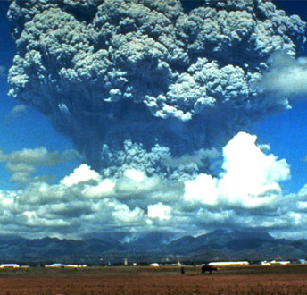
Proposed causes of climate change from 1000-1850
Volcanic eruptions
  Sulfate aerosols
  The more frequent clusters of eruptions after 1300 could have constributed to the small cooling trend in the LIA
Greenhouse-Gases
  Drop in CO₂ concentration by 7-8 ppm from 100-1200 to 1600-1800
    Solar-volcanic changes
    Anthropogenic hypothesis
      Reforestation of agricultural land
      The “Black Death” (bubonic plague)
      The American Pandemic (host of diseases)
Notes:
Picture credit: http://www.pbs.org/wgbh/nova/sun/dimm-nf.html

Slide 22
Proposed causes of climate change from 1000-1850
Evidence for MWP is uncertain
  Fewer records; larger uncertainties
Estimated cooling from 1000 years ago into the LIA is small
Any or all of several factors could have played a causal role
Far greater geographic coverage is needed to define the global climatic response
  Notion of MWA & LIA is valid for trends across eastern Canada, Greenland, Iceland, northern Europe – what about rest of earth’s surface (90-95%)?
No such ambiguity exists about the large, rapid and global warming since 1850

Slide 23
Medieval Warm Period (~800-1300)
IPCC 2007

Slide 24
Proposed causes of climate change from 1000-1850
Evidence for MWP is uncertain
  Fewer records; larger uncertainties
Estimated cooling from 1000 years ago into the LIA is small
Any or all of several factors could have played a causal role
Far greater geographic coverage is needed to define the global climatic response
  Notion of MWA & LIA is valid for trends across eastern Canada, Greenland, Iceland, northern Europe – what about rest of earth’s surface (90-95%)?
No such ambiguity exists about the large, rapid and global warming since 1850

Slide 25
Notes:
Note tightening of the error bars because of increased confidence in the data.
Proxies – tree rings, boreholes, ice cores
There is a new ice core from Antarctica that goes back 800,000 years!

Slide 26
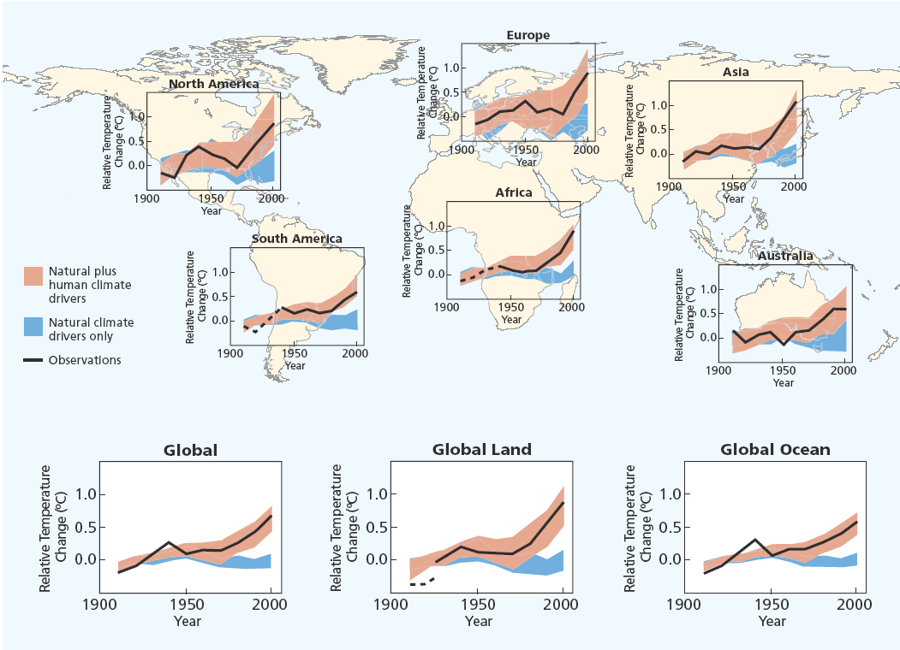
Source: IPCC Climate Change 2007: The Physical Science Basis—Summary for Policymakers.

Slide 27
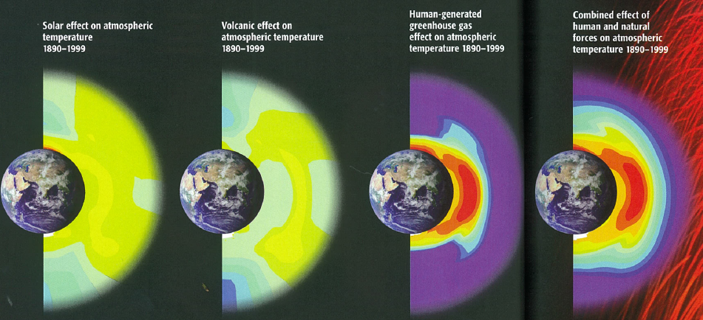
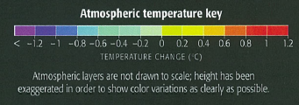
Atmospheric Fingerprints
1890-1999
Mann & Kump, 2008
Notes:
Pattern of expected changes:
Increased solar output is predicted to warm essentially the whole atmosphree
Volcanoes are expected to slightly cool the lower atmosphere and slightly warm the mid-level atmosphere
Human-generated GHGs warm the lower atmosphere at the expense of cooling the stratosphere and above.
Combining all of the effects together (far right) looks a lot like the impacts of human activity and matches the pattern of change we’ve seen in recent decades.

Slide 28
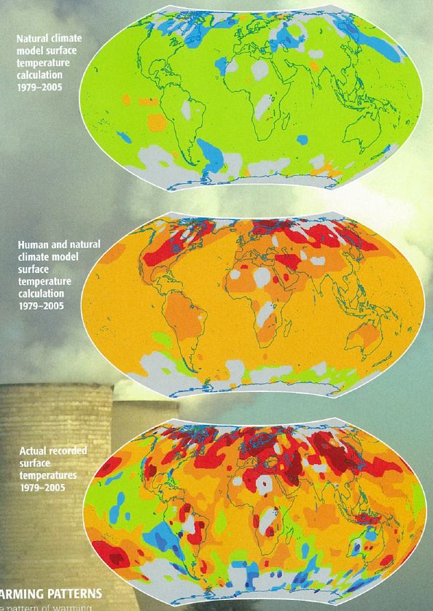
“Fingerprints”
Human and Natural Impacts on Climate,
1975-2005
Mann & Kump, 2008
Notes:
The pattern of warming (bottom panel) is not reflected in models that only take into account the impacts of natural forces alone (top).
It corresponds closely (but not exactly) to a map of combined human and natural impacts. Why is it not perfect match?

Slide 29
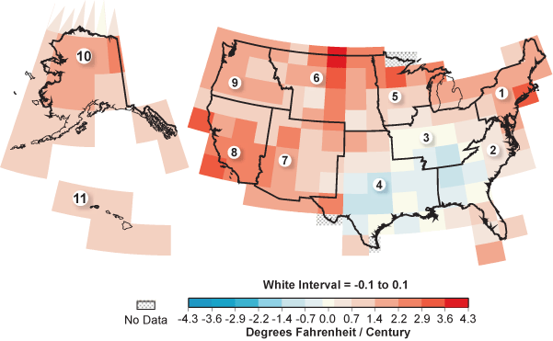

U.S. Mean Temperature Trends: 1901 - 2003
Data courtesy NOAA's National Climatic Data Center
Notes:
Astonishingly, every single year since 1992 is in the current list of the 20 warmest years on record.[1,2]

Slide 30
Temperature Trends: 1880 to 2000
(Hansen et al., Journal of Geophysical Research, 2001)

Slide 31
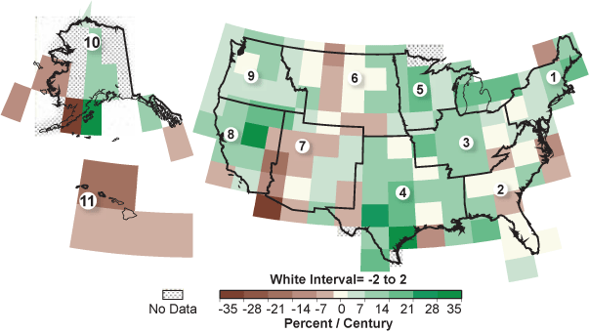
U.S. Precipitation Trends: 1895 - 2003
Data courtesy NOAA's National Climatic Data Center

Slide 32
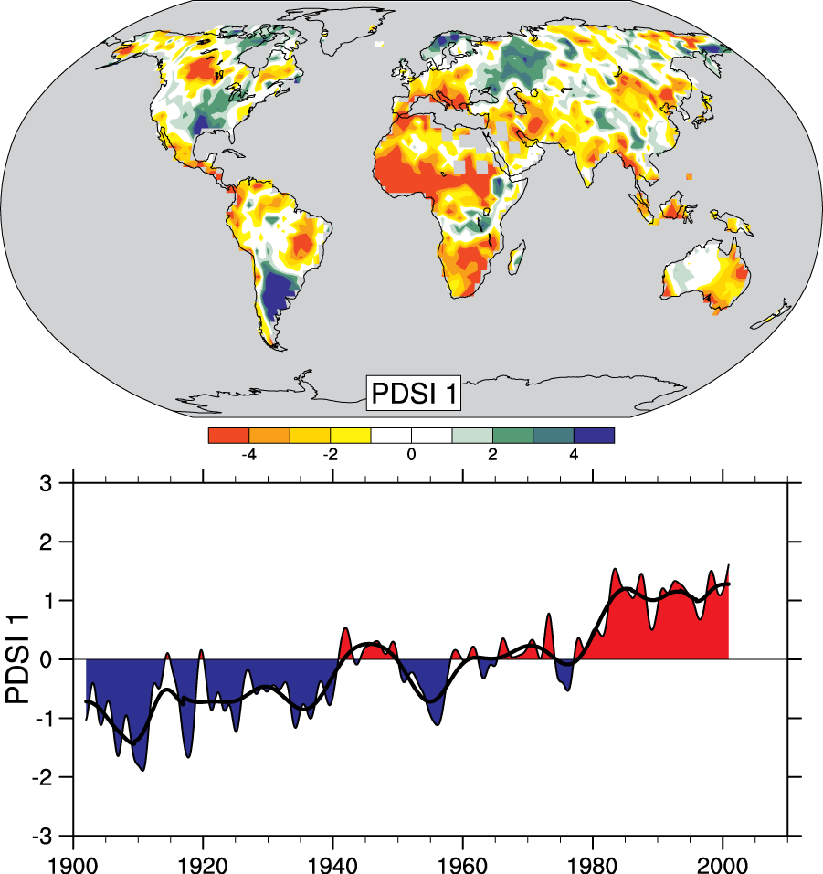
Drought is increasing most places
Mainly decrease in rain over land in tropics and subtropics, but enhanced by increased atmospheric demand with warming
The most important spatial pattern (top) of the monthly Palmer Drought Severity Index (PDSI) for 1900 to 2002.
The time series (below) accounts for most of the trend in PDSI.

Slide 33
Global Dimming or
“Long Term Trends in Solar Radiation”
Faith Ann Heinsch
NTSG, College of Forestry & Conservation
The University of Montana
February 28, 2006

Slide 34
What is global dimming?
Global dimming is the gradual reduction in the amount of global direct irradiance at the Earth's surface,
  measurements began in the 1950s.
    most data are from NH and all taken on land
    Data quality?
Effect varies by location
  Worldwide: ~4% reduction during 1960–1990
Notes:
Independent research in Israel and the Netherlands in the late 1980s showed an apparent reduction in the amount of sunlight, despite widespread evidence that the climate was actually becoming hotter (see global warming). The rate of dimming varies around the world but is on average estimated at around 2–3% per decade, with the possibility that the trend reversed in the early 1990s. It is difficult to make a precise measurement, due to the difficulty in accurately calibrating the instruments used, and the problem of spatial coverage. Nonetheless, the effect is almost certainly present.
A reduction in downward solar radiation of about 4% or about 7W/m2 from 1961 to 1990 was found at stations worldwide by Gilgen et al., (1998). Gilgen et al. did a quick analysis and used all the available data with increasingly shorter records for their trend statistics. Stanhill and Cohen (2001) calculated a stronger reduction of about 8% per decade. The reason for the discrepancy might be that only 30 records were used in the latter study and it seems only the ones with the declining trend. My own analysis was based on 110 continuously recording stations worldwide from 1961 to 1990 (Liepert 2002). I confirmed Gilgen et al.'s estimate of a reduction of about 4% in three decades. Since the late 1980s a recovery seems to be occurring but the studies demonstrating this are not yet published. (Liepart, http://www.realclimate.org/index.php?p=110)

Slide 35
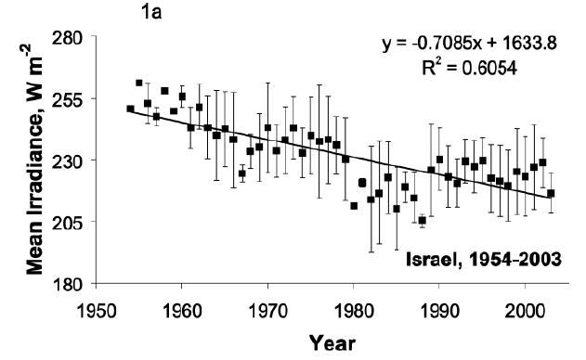
50 years of Radiation Data - Israel
Notes:
Fifty years of global radiation measurements in Israel, 1954–2003. Based on 233 mean
annual values of Eg↓ measured with calibrated thermopile pyranometers at 20 sites, the spatial
variation around the mean annual values is indicated by vertical bars representing ±1 standard
deviation, W m-2.

Slide 36
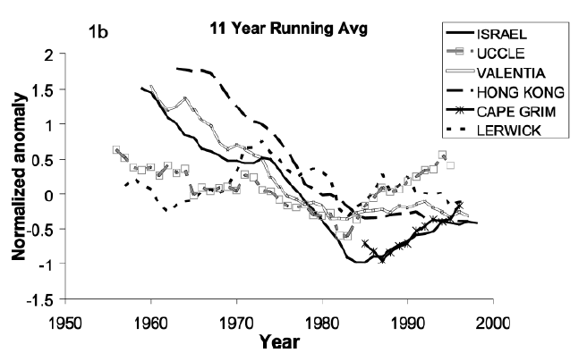
Incoming Shortwave Radiation
Anomalies in the annual mean
Notes:
Eleven-year running mean of normalized anomalies of annual means of Eg↓
measured with calibrated thermopile pyranometers at Israel, 1954–2003; Uccle, Belgium, 1951–2000;
Valentia, Ireland, 1955–2002; Hong Kong, China, 1958–2000; Cape Grim, Australia, 1980–2001; and
Lerwick, United Kingdom, 1952–2002

Slide 37
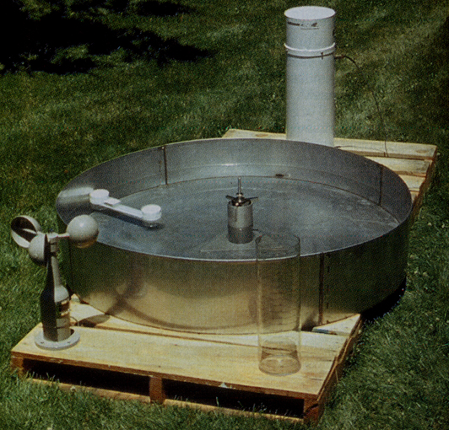
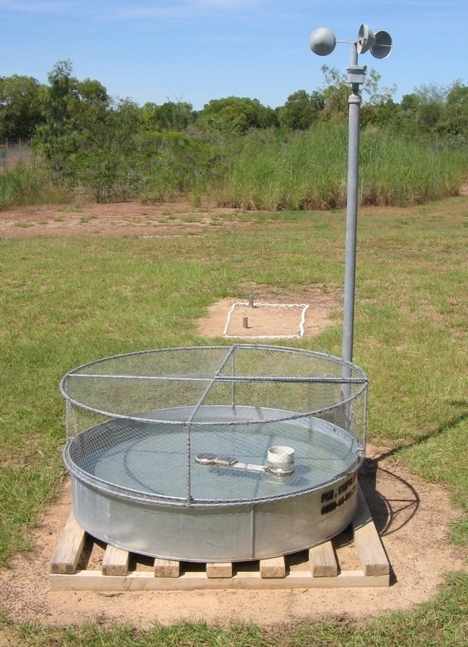
Supporting Evidence
Worldwide decline in the “pan evaporation rate.”
  Sunlight, humidity, and wind are dominant factors

Slide 38
Where does it come from?
Effect of global dimming is probably due in part to the increased presence of aerosol particles in the atmosphere.
    Aerosol particles and other particulate pollutants absorb solar energy and reflect sunlight back into space.
    Increased pollution, resulting in more particulates, creates clouds with a greater number of smaller droplets, making them more reflective.
Global warming
  Water vapor and cloud feedback
    Same effect as aerosols, but different cause

Slide 39
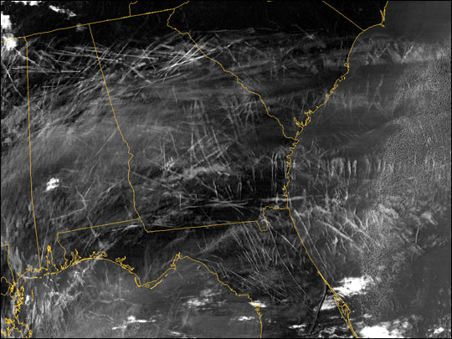

Aircraft Contrails, Jan 29 2004 MODIS
Notes:
Aircraft contrails
constant air traffic meant that this could not be tested.
Sept. 11, 2001
near-total shutdown of civil air traffic for three days
rare opportunity in which to observe the climate of the US absent from the effect of contrails.
An increase in diurnal temperature variation of >1 °C was observed in some parts of the U.S.
Aircraft contrails may have been raising nighttime temperatures and/or lowering daytime temperatures by much more than previously thought

Slide 40
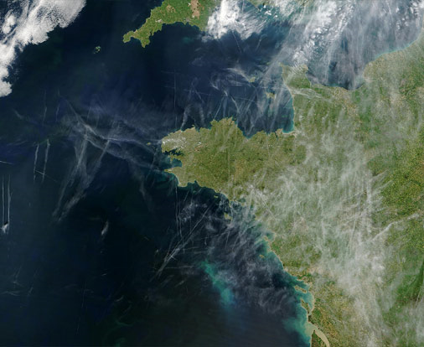
Aircraft Contrails over Europe
Notes:
Look at difference between land/ocean…

Slide 41
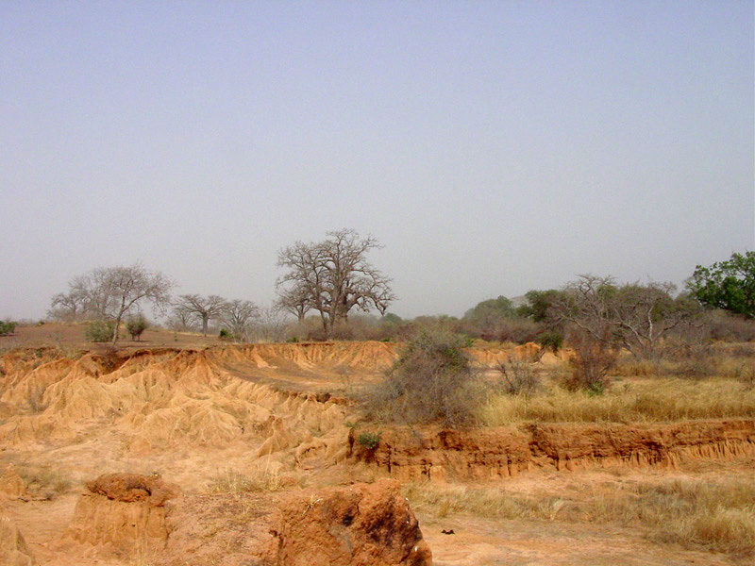
Effects are mostly regional
Regions that are downwind from major sources of air pollution (specifically sulfur dioxide emissions) have generally cooled.
  may help explain the cooling of the Eastern U.S. relative to the warming Western U.S.
Extreme regional effect
  the Sahel
Notes:
The Sahel is the transition zone between the Sahara desert and the more humid tropical regions of Africa. Sahel comes from the Arabian "sahil", meaning "edge" or "coastline". The Sahel is the northern part of the transitional climatic zone with a precipitation of 150 to 450 mm and 8 to 10 months without any rainfall. As regards vegetation, the Sahel consists of semi-desert in the north and the Sahel savanna in the south. In this area the plant life is predominantly briars, shrubs and single trees, mostly Acacia albida and Acacia senegal. More vegetation grows after rainfall, but the plants very soon wither in the desiccated soil. The biggest problem of the Sahel region is desertification.
Modeling Exercise:
Pollution from Europe & NA affects cloud properties in the NH
the clouds reflected more sunlight back to space cooling the oceans of the northern hemisphere
The result? Tropical rain bands moved southward
A cause of droughts in the Sahel, in the 1970s and 1980s?
Disrupted the monsoon cycle
Potential for air pollution to have far reaching effects on rainfall
50 million people affected
Asia also has a monsoon cycle
What if it had a similar impact on the Asian monsoons?
3.6 billion people or roughly half the world's population

Slide 42
Trend Reversal – 1990-2006
The “dimming” trend had reversed
  likely that part of this change, particularly over Europe, is due to decreases in pollution.
Most developed nations have done more to reduce aerosols released into the atmosphere than to reduce CO₂ emissions.
Notes:
It may be suggested that increasing aerosol might be a possible solution to global warming. However, aerosol has negative effects (acid rain) which is why nations have made efforts to reduce it. Also, the aerosol has a very short lifetime (weeks).

Slide 43
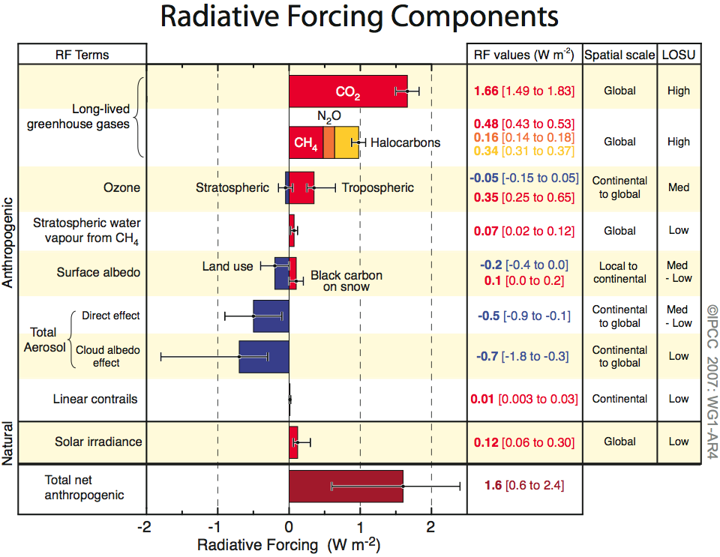
Human and Natural Drivers of Climate Change

Slide 44
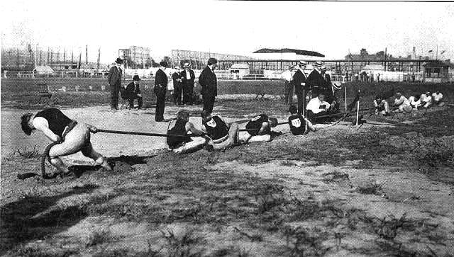
Effects on Climate Systems
Climate change, to the current date, appears to have been a tug of war, really, between two manmade pollutants.
  greenhouse gases are pulling the system towards a warmer state (+2.6-3.0 W m⁻²)
  particles from pollution that are cooling it down (-1.5 W m⁻²)
JAMES HANSEN: “If the particle forcing is what we estimate, that would imply that removing that forcing would cause a global warming of more than 1°C. That's more than the warming that we've seen already, so this is a huge factor.”
Notes:
Some scientists now consider that the effects of global dimming have masked the effect of global warming to some extent
resolving global dimming may lead to increases in predictions of future temperature rise
Image (copyright expired) from http://en.wikipedia.org/wiki/Image:1904_tug_of_war.jpg.

Slide 45
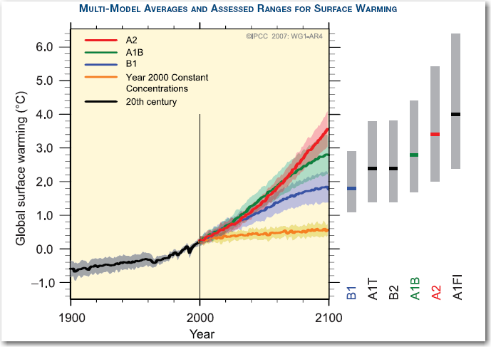
Notes:
Lowest temperatures currently projected for the end of the century represent the lowest scenario the IPCC chose to evaluate (the “B1” scenario).
B1 assumes mid-century peak in global population, rapid change toward service and information technology, shift towards clean and resource-efficient technologies.
Highest temperatures projected represent the highest scenario that the IPCC chose to evaluate (A1F1).
A1F1 assumes mid-century peak in global population, rapid economic growth, “fossil-intensive” energy production and consumption.

