Slide 1
Solar and Wind Energy
The physical resource, technologies, and social/environmental issues
Ashley Preston
Energy Technology

Slide 2
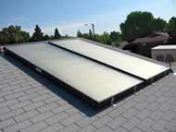
Roof Mounted Solar Hot Water System
Typically, a homeowner might save up to $500.00 in the first year on water heating. Should pay for itself in 4-7 years.

Slide 3
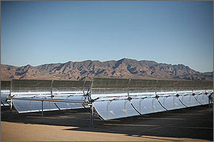
Solar Parabolic Trough Concentrator Array near Boulder City NV
A section of the parabolic troughs from the Nevada Solar One project near Boulder City, Nevada. The site covers about 300 acres and contains 760 mirror arrays.
Credit: Acciona Solar
Concentrating solar power (CSP) technologies use USDOE EERE

Slide 4
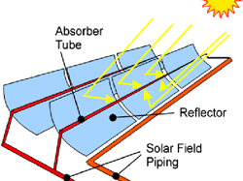
Figure 1. A solar collector assembly
Parabolic trough collector systems on solar trackers.

Slide 5
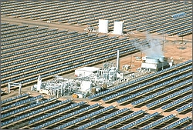
Solar Electric Generating Systems (SEGS)
The SEGS IV parabolic trough power plant in Kramer Junction, California.
Credit: Sandia National Laboratories
Notes:
All of the SEGS (solar electric generating system) plants and most new projects are planning to use steam Rankine power cycles. These power plants have power cycles very similar to those used for many coal, nuclear, or natural gas-fired steam power plants.
The 80-MWe SEGS plants use a regenerative reheat steam turbine cycle that has a gross steam cycle efficiency approaching 38% with high-pressure steam conditions of 100bar, and 370°C. The power cycle uses a solar steam generator in place of the conventional boiler fired by natural gas, coal, or waste heat from nuclear fission. Otherwise the power cycle is very similar with the following components:
Organic Rankine Cycle
The organic Rankine cycles (ORCs) use an organic fluid—such as butane or pentane—instead of water, like a steam Rankine cycle.

Slide 6
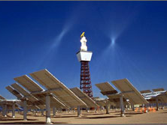
Power Tower
Heliostats reflect and direct sunlight onto the receiver at the Solar Two power tower in California.
Credit: Sandia National Laboratories / PIX 06051
Notes:
A parabolic trough power plant's solar field consists of a large, modular array of single-axis-tracking parabolic trough solar collectors. Many parallel rows of these solar collectors span across the solar field, usually aligned on a north-south horizontal axis.
The basic component of a parabolic trough solar field is the solar collector assembly or SCA. A solar field consists of hundreds or potentially thousands of solar collector assemblies. Each solar collector assembly is an independently tracking, parabolic trough solar collector composed of the following key subsystems

Slide 7
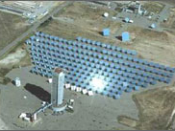
Solar Thermal Power Tower
Aerial view of part of the National Solar Thermal Test Facility at Sandia National Laboratories, Albuquerque, New Mexico.
Credit: Sandia National Laboratories

Slide 8
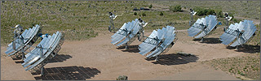
These dish/Stirling units are being tested at Sandia National Laboratories in Albuquerque, New Mexico.
Credit: Sandia National Laboratories
Dish Solar Field R&D
The dish/engine solar field consists of a dish structure, the associated mirrors, and an engine at the focal point of the mirrored dish. Our R&D aims to support industry as it develops dish/Stirling systems for utility- and distributed-energy markets.

Slide 9
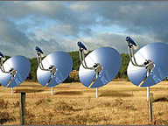
Concentrated Solar Power Distributed Generation
Four Infinia dish/Stirling systems are demonstrating that CSP can provide distributed power generation. I-2 kW scale
Credit: Infinia Corporation

Slide 10
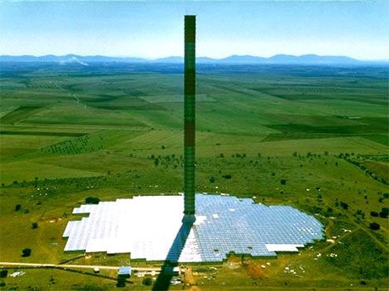
Solar Chimney
Figure 1 The small-scale pilot Solar Tower plant constructed in Manzanares Spain consistently generated 50kW. It operated between 1982 and 1989.
(© 2001-2005 EnviroMission Ltd; RISE)
Notes:
A solar tower power station is designed to generate conditions for hot winds to flow through turbines to produce electricity continuously. The sun’s radiation heats air under a greenhouse-like collector, which then rises as a hot wind through large turbines at the base of a tower to produce electricity.

Slide 11
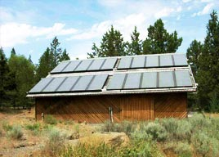
A standard PV array
Oregon Solar Energy Industries Association file photo

Slide 12
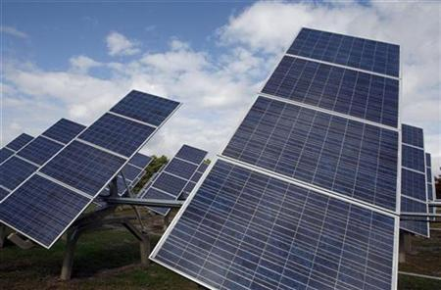
Free standing, tracking solar panels

Slide 13

Photovoltaic Roofing Shingles
These roof shingles are coated with PV cells made of amorphous silicon. When installation is complete, the PV shingles look much like ordinary roofing shingles, but they generate electricity.
The U.S. Department of Energy works to provide clean,
These roof shingles are coated with PV cells made of amorphous silicon. When installation is complete, the PV shingles look much like ordinary roofing shingles, but they generate electricity.
Photo credit: USDOE EERE

Slide 14
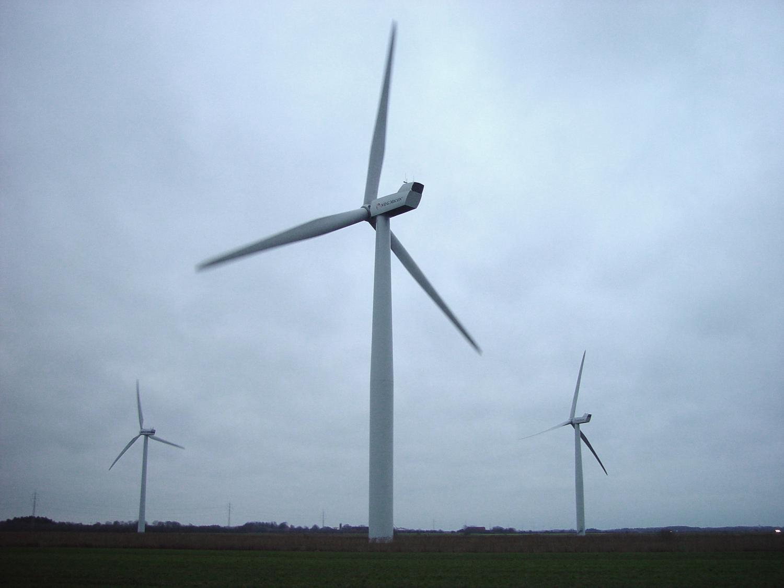
Wind Technology

Slide 15
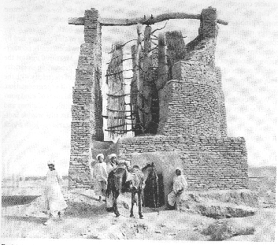
Early “WINDMILL” in Afghanistan (900AD)
Notes:
First windmills were found in Persia.
They were vertical axis and were used to grind grains and seeds. They were kind of like a waterwheel turned on its side. Most of the paddles were covered by a wall and wind would run through a narrow opening to push the blades.

Slide 16
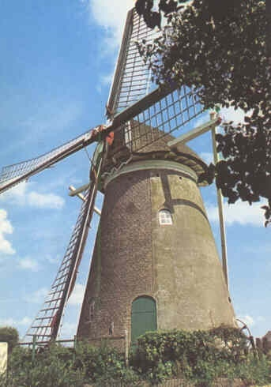
Dutch windmill
Notes:
Many have seen the Dutch windmills. Used to grind grains, seeds, pump water, saw lumber…these were fairly sophisticated devices. Used to cover much of New England coastline.

Slide 17
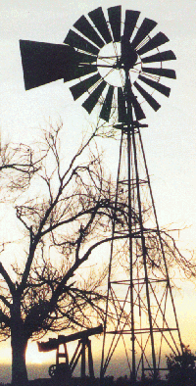
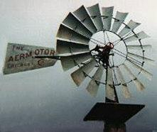
Multibladed Wind Pump
Notes:
Water pumpers were (and still are) a common site on farms in the Midwest and West. These devices pump water into a pond or cistern when it is windy and can be used at any time. Notice the blades on this device and compare them to electrical generating wind turbines are they the same or different?

Slide 18
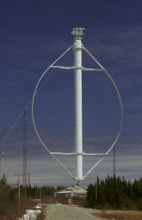
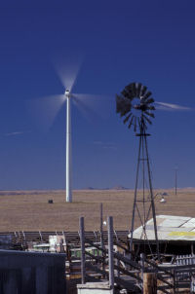
Orientation
Turbines can be categorized into two overarching classes based on the orientation of the rotor
Vertical Axis Horizontal Axis
Notes:
Turbine can spin on a vertical axis or a horizontal axis

Slide 19
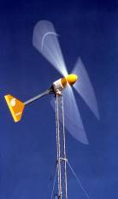
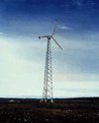
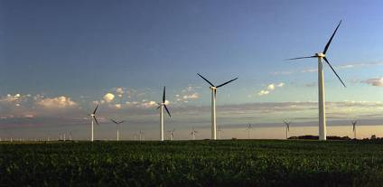
Types of Electricity Generating Windmills
Small (≤10 kW)
Homes
Farms
Remote Applications
(e.g. water pumping, telecom sites, icemaking)
Intermediate
(10-250 kW)
Village Power
Hybrid Systems
Distributed Power
Large (250 kW - 2+MW)
Central Station Wind Farms
Distributed Power

Slide 20
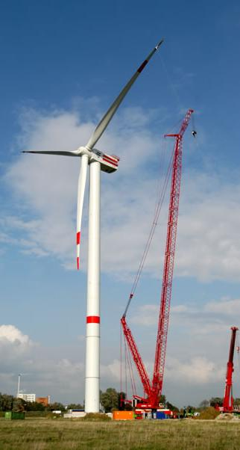
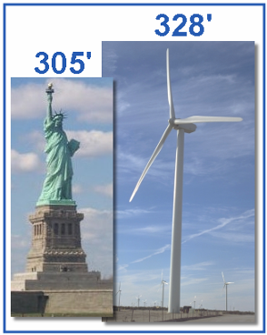
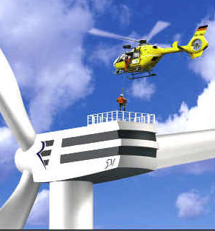
Large Wind Turbines
450’ base to blade
Each blade 112’
Span greater than 747
163+ tons total
Foundation 20+ feet deep
Rated at 1.5 – 5 megawatt
Supply at least 350 homes

Slide 21
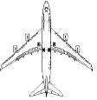
Wind Turbine Technology
North Wind HR3
rating: 3 kW
rotor: 5 m
hub height: 15 m
North Wind 100
rating 100 kW
rotor: 19.1 m
hub height: 25 m
Lagerwey LW58
rating: 750 kW
rotor: 58 m
hub height: 65 m
Enercon E-66
rating: 1800 kW
rotor: 70 m
hub height: 85 m
Enercon E-112
rating: 4000 kW
rotor: 112 m
hub height: 100 m
Boeing 747
wing span: 69.8m
length: 73.5 m
Comparative Scale for a Range of Wind Turbines

Slide 22
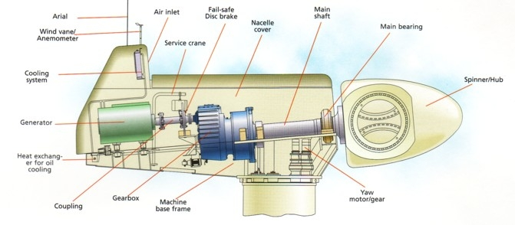
Inside a Wind Turbine

Slide 23
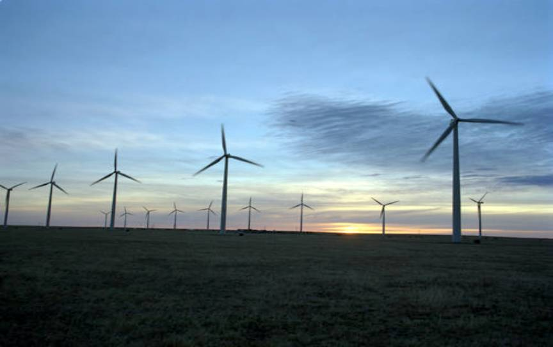
Notes:
Wind Farm in the MidWest

Slide 24
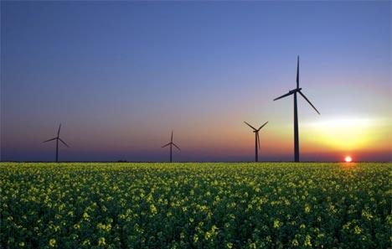
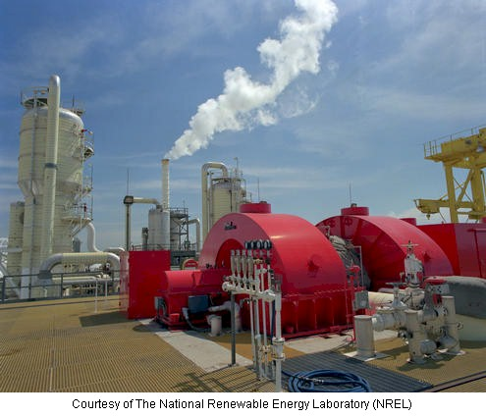
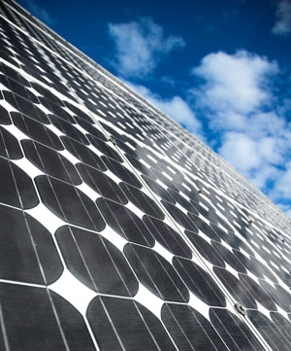
What is “Renewable Energy?”

Slide 25
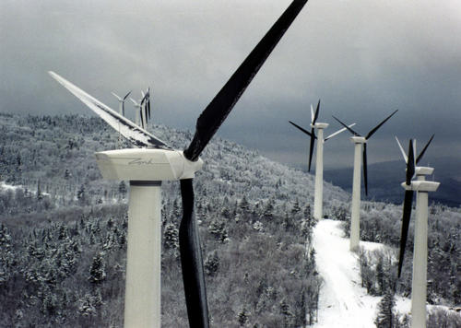
Windfarm 2
Notes:
Windfarm in VT called Searsburg…one of the first windfarms in the Northeast. Wind farm development in VT is very contentious now in VT.. Notice the black blades. Why do they do that……to reduce ice build up in cold weather.
More info head tohttp://www.gmpvt.com/whoweare/searsburg.shtml

Slide 26
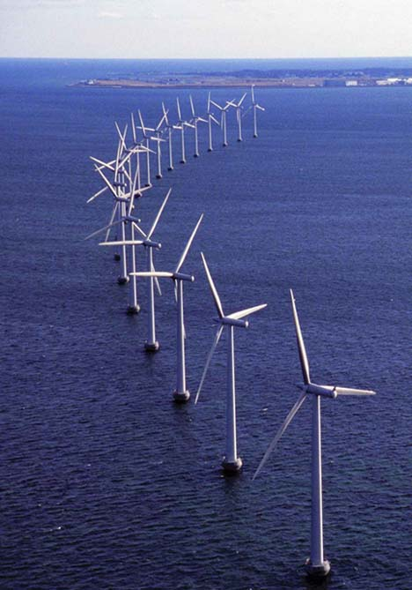
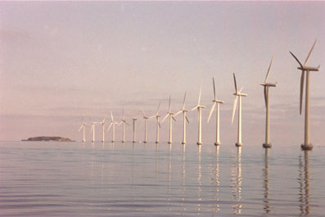
Middelgrunden
Notes:
There are quiet a few offshore wind farms in Europe near Holland, England, Ireland, Sweden and the Denmark.
This one is off the coast of Copehagen.

Slide 27
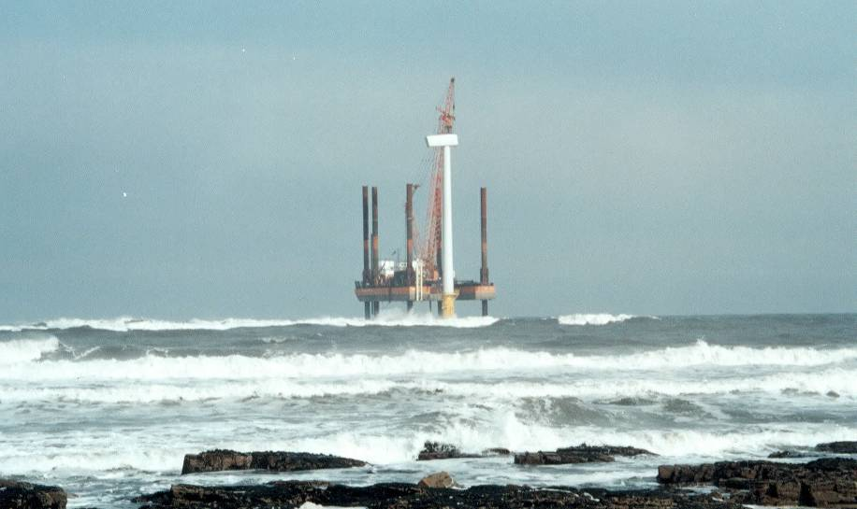
Off-Shore Windfarms
Notes:
Many developers would like to move windfarms offshore because the wind are faster, smoother and they can be close to major population centers on the coast. This is very controversial in the US….we have a few planned offshore farms…CapeWind and Long Island…but nothing installed.
Major complaints about offshore are related visual impact, navigation impact and lack of history.
Check http://www.capewind.org/

Slide 28
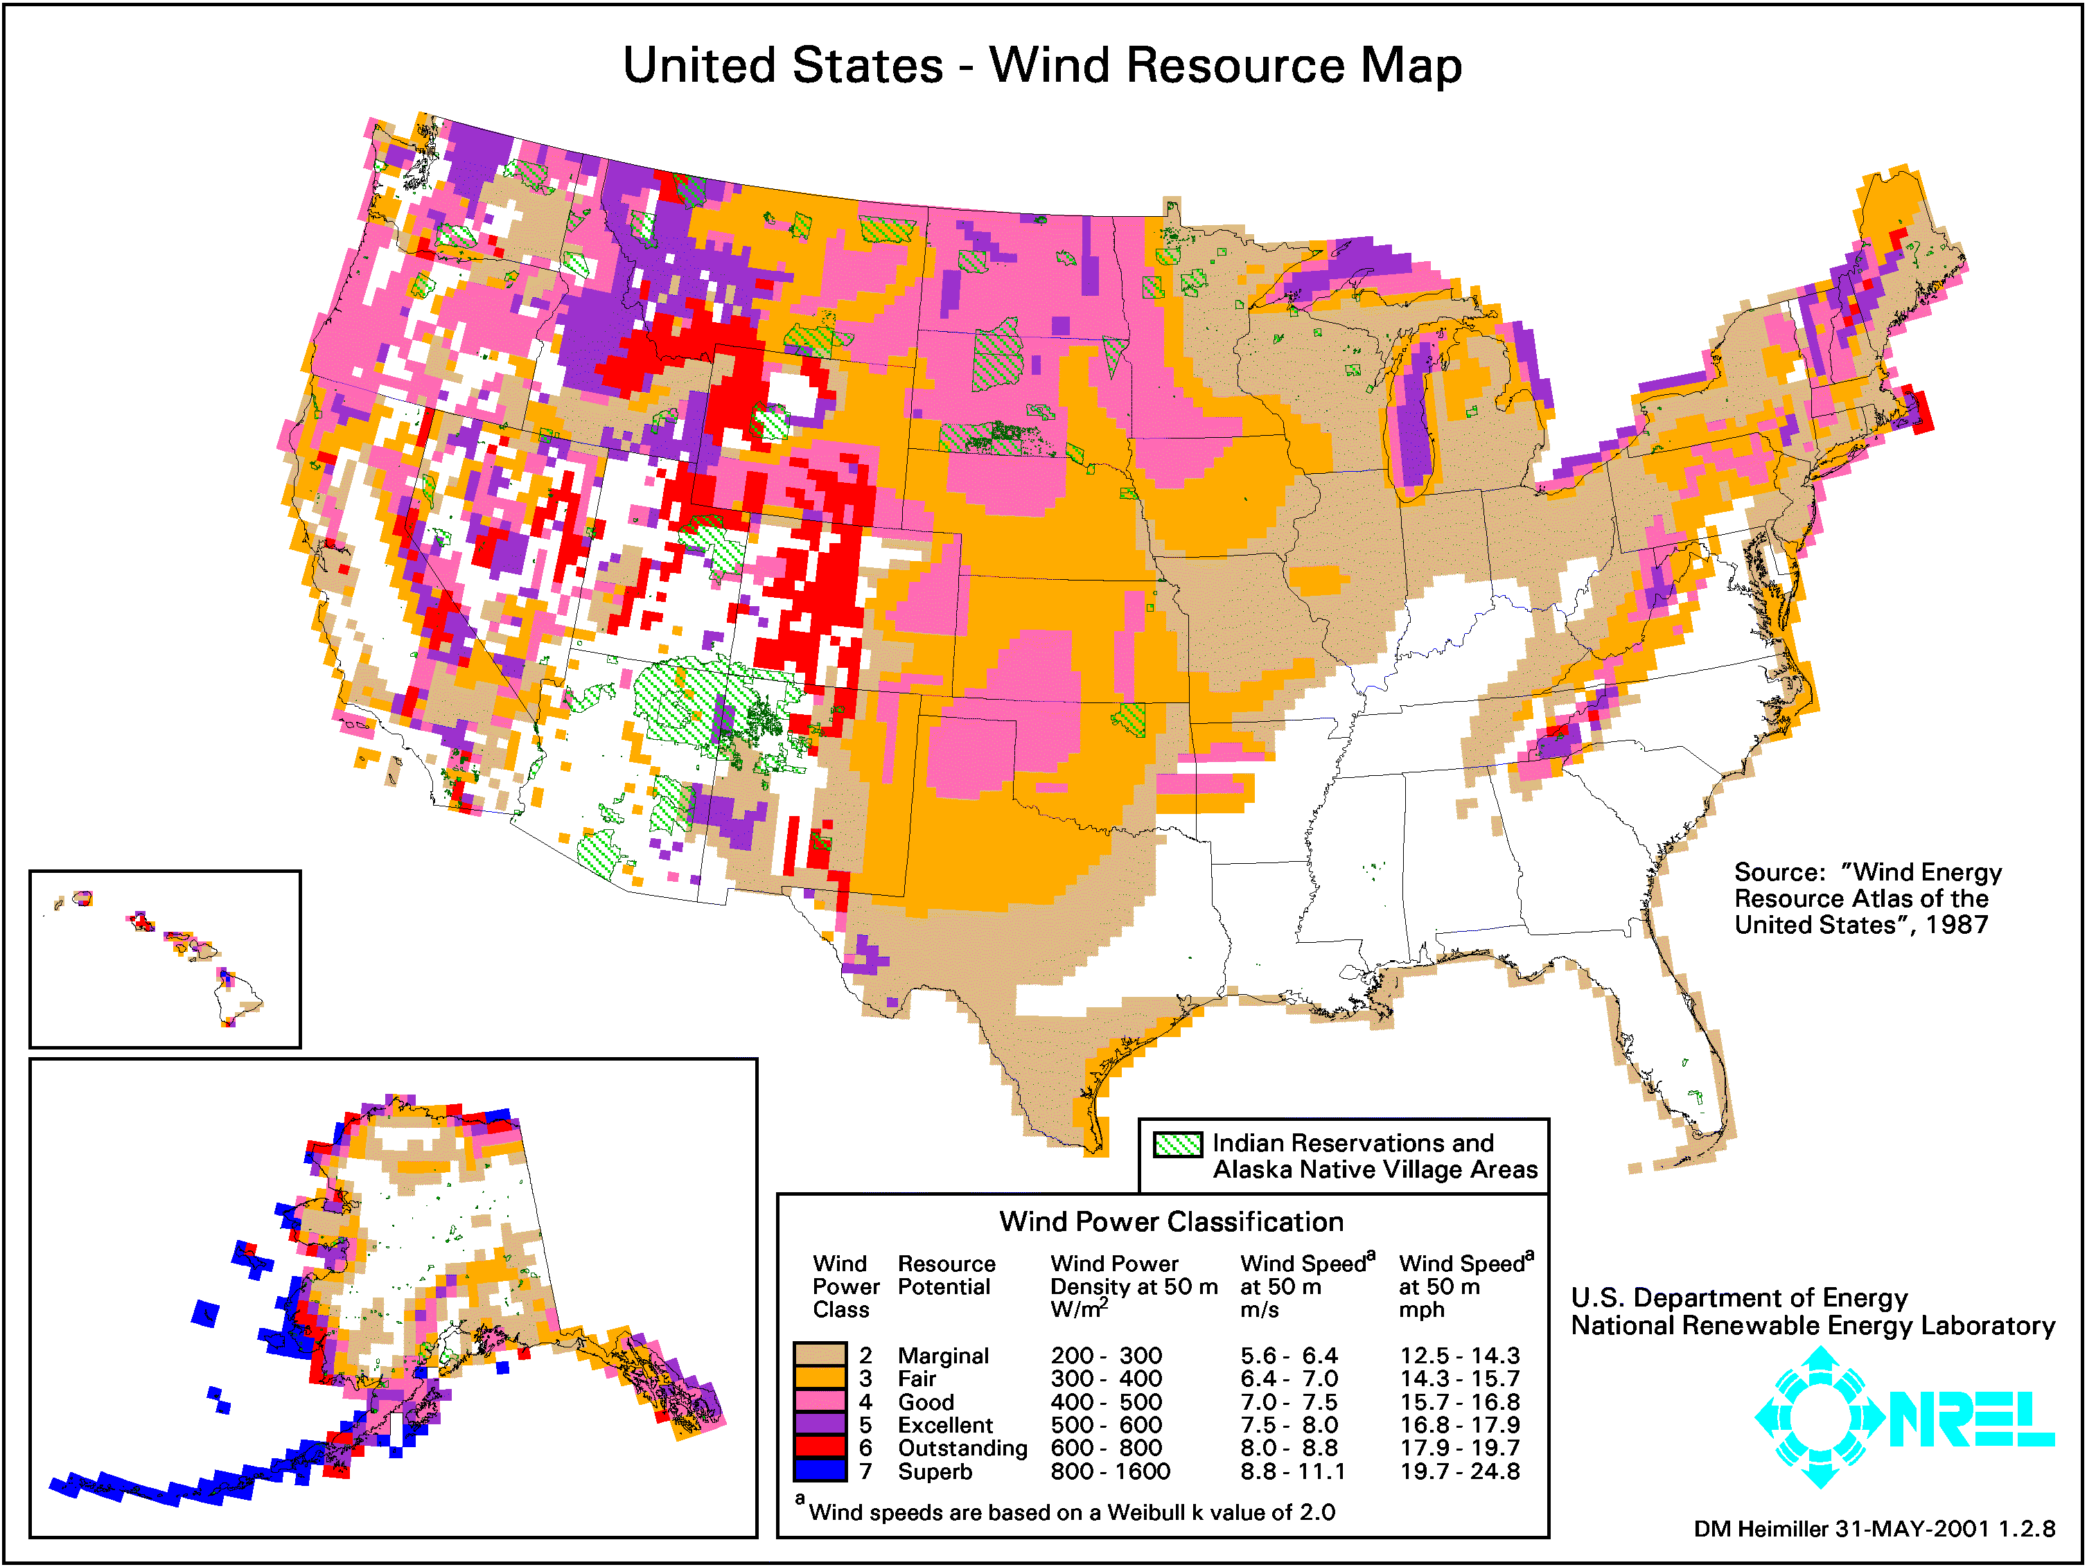
Notes:
Notice where the winds are the strongest….
MN, ND, SD called the Saudia Arabia of windpower…if we saturated these state with wind turbine we could generate at most of energy used in the US…Why have we not done this? Tranmission is one major problem need to match load with generation…how would we get all the power out of there?
Why don’t we put lots of wind farms in the rockies? Lots of wind but very hard to get at 60 meter long blade to the continental divide….logisitics of these large machines is very challenging!

Slide 29
FACT:

Slide 30
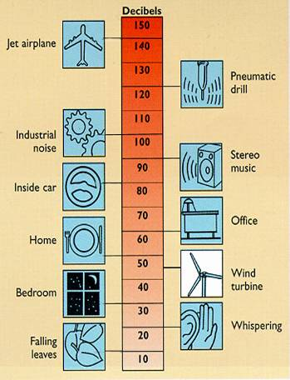
Impacts of Wind Power:
Noise
Modern turbines are relatively quiet
Rule of thumb – stay about 3x hub-height away from houses
Go to Hull or Searsburg & listen!
Note: Searsburg turbines are
older & a bit louder than many modern turbines
Notes:
Many people think wind turbines are noisy.
While this may have been true in the past (it is still somewhat true on older smaller devices)…newer larger devices are much quieter.

Slide 31
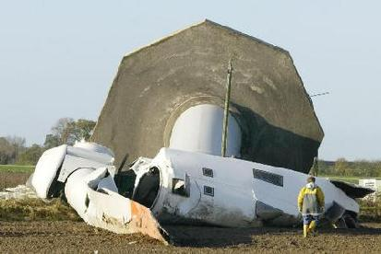
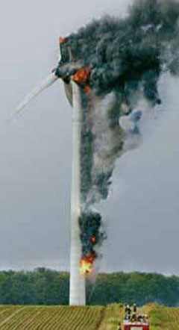
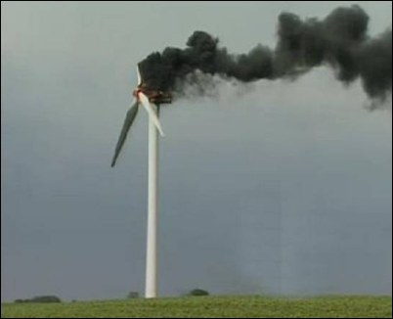
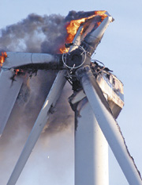
Carnage!
Notes:
The Kidwind Project
www.kidwind.org
Copyright 2008

Slide 32
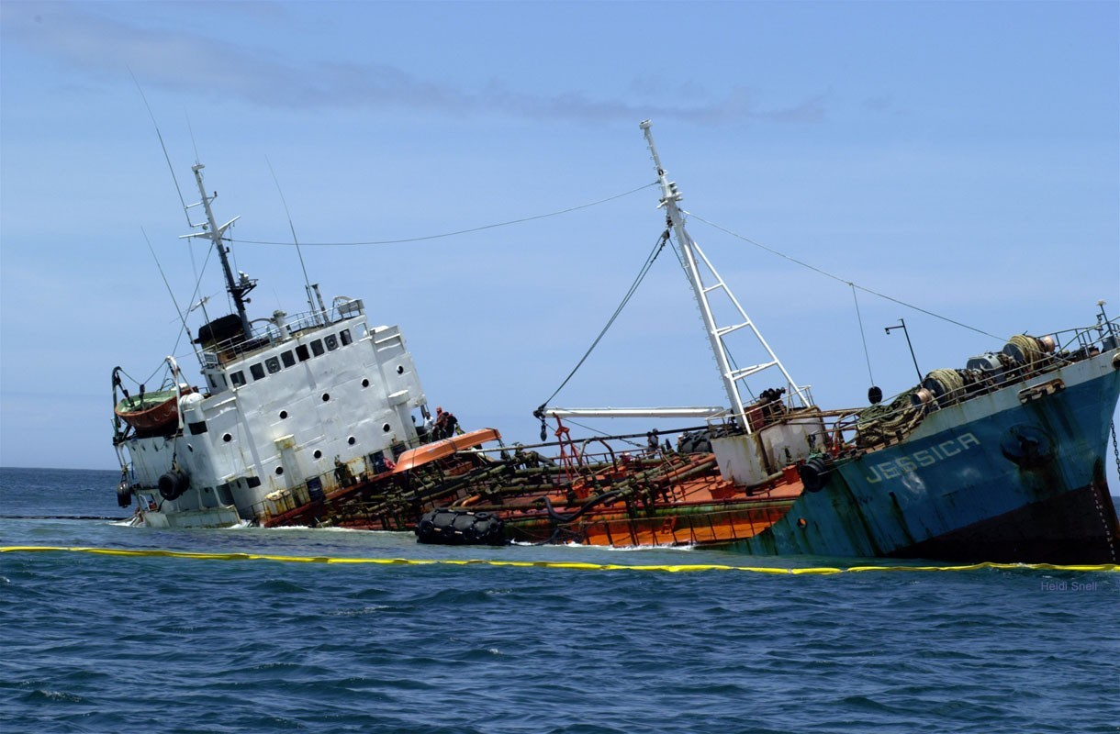

Slide 33
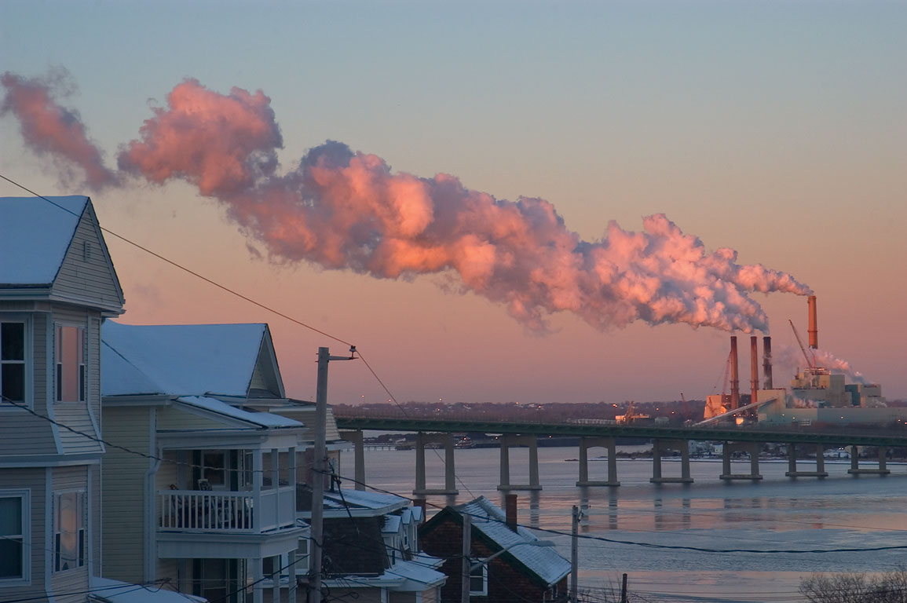
Notes:
People often complain about the aesthetics of wind turbines. So, which aesthetic do you prefer?

Slide 34
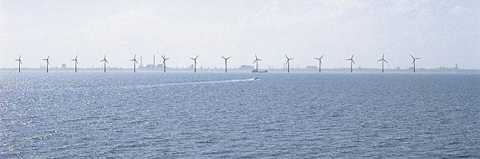
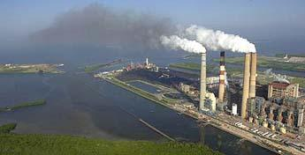
What do you want in your backyard?
Notes:
We also need to change students perceptions about what the future may look like and the limits of this technology.
Wind will never be “base load” for the grid. The wind farm above is capable of generating 15-20Mw of electricity at full capacity. The oil fired facility below is at 300Mw. Most Nuclear plants are at 600-1000Mw…
Must keep the scale in mind….a very aggressive wind program can generate 10-20% of our power needs. To move towards a green future we are going to need mix of sources and also a great deal of energy efficiency….Wind cannot do it all.

Slide 35
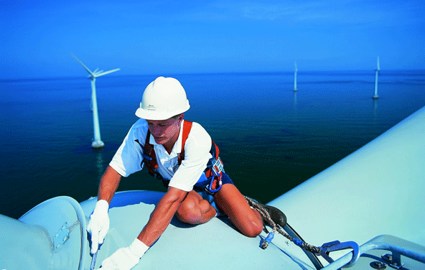
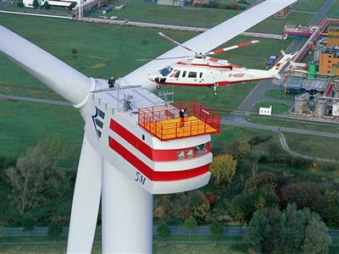
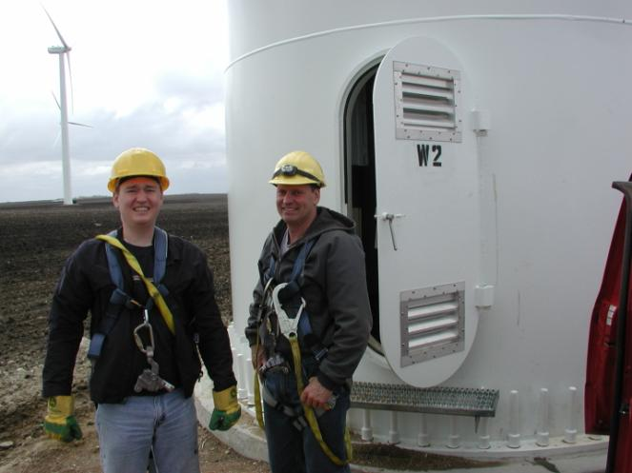
Operations/Maintenance

Slide 36
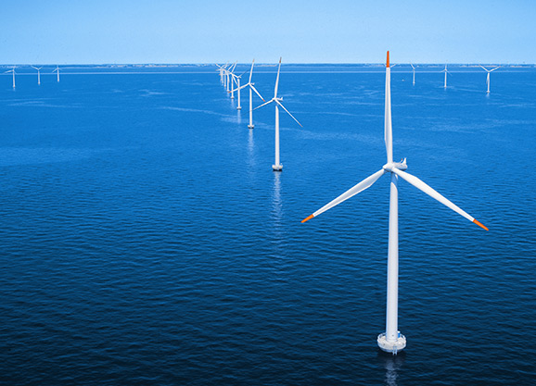
Joe Rand
The Kidwind Project
joe@kidwind.org
Notes:
Slides 14-36 are courtesy of The Kidwind Project

