Slide 1
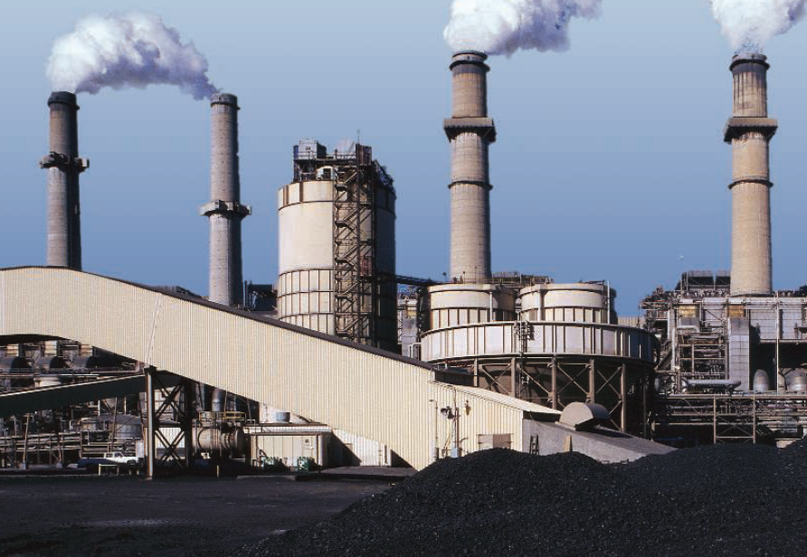
Clean Coal Technology
Dr. Faith Ann Heinsch & Ryan Anderson
December 2, 2008
Climate Change: Science and Society

Slide 2
Fuel needed to run a 100-W light bulb for one year (876 kWh, or 3153.6 MJ)
(The fuel quantities below assume 100% conversion efficiency. As most power generation/distribution systems only achieve 30% - 35% efficiency, the actual quantity of fuel used to power a 100 W light bulb in your home will be about three times the quantity shown.)
166 kg of wood
117 to 210 kg (257 to 462 lb) of coal
73.34 kg (161.6 lb) of kerosene
78.8m³, of natural gas
58 kg of Methane
.006 kg (.014 lb) of uranium

Slide 3
Types of Coal (in order of C Content)
Anthracite
  Carbon content (86-98%); Heat value = 15,000 BTUs/lb
  Most frequently associated with home heating
  7.3 billion tons of reserves in the U.S.; mostly in 11 northeastern PA counties
Bituminous
  Carbon content = 45-86%; Heat value = 10,500 – 15,500 BTUs/lb
  Most frequently used to generate electricity and make coke for steel industry
  Most plentiful form of coal in U.S.
Sub-bituminous
  Carbon content = 35-45%; Heat value = 8,300 – 13,000 BTUs/lb
  Lower sulfur content than other types = cleaner burning
  Reserves in half-dozen Western US states and Alaska
Lignite
  Carbon content = 25-35%; Heat value = 4,000-8,300 BTUs/lb
  Mainly used for electric power generation
  Sometimes called brown coal; Geologically young
Notes:
Energy Value of Coal (http://en.wikipedia.org/wiki/Energy_value_of_coal)
The energy value of coal, or the fuel content, is the amount of potential energy in coal that can be converted into actual heating ability. The value can be calculated and compared with different grades of coal or even other materials. Materials of different grades will produce differing amounts of heat for a given mass.
While chemistry provides methods of calculating the heating value of a certain amount of a substance, there is a difference between this theoretical value and its application to real coal. The grade of a sample of coal does not precisely define its chemical composition, so calculating the actual usefulness of coal as a fuel requires determining its proximate and ultimate analysis (see "Chemical Composition" below).
Chemical Composition
Chemical composition of the coal is defined in terms of its proximate and ultimate (elemental) analyses. The parameters of proximate analysis are moisture, volatile matter, ash, and fixed carbon. Elemental or ultimate analysis encompasses the quantitative determination of carbon, hydrogen, nitrogen, sulfur and oxygen within the coal. Additionally, specific physical and mechanical properties of coal and particular carbonization properties are also determined.
The calorific value Q of coal is the heat liberated by its complete combustion with oxygen. Q is a complex function of the elemental composition of the coal. Q can be determined experimentally using calorimeters. Dulong suggests the following approximate formula for Q when the oxygen content is less than 10%:
Q = 337C + 1442(H - O/8) + 93S,
where C is the mass percent of carbon, H is the mass percent of hydrogen, O is the mass percent of oxygen, and S is the mass percent of sulfur in the coal. With these constants, Q is given in kilojoules per kilogram.
1 BTU/lb = ~2326 J/kb (depends slightly on temperature)

Slide 4
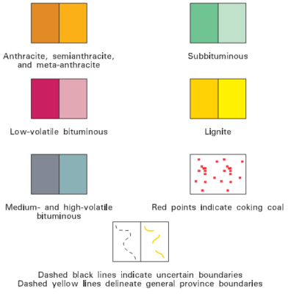
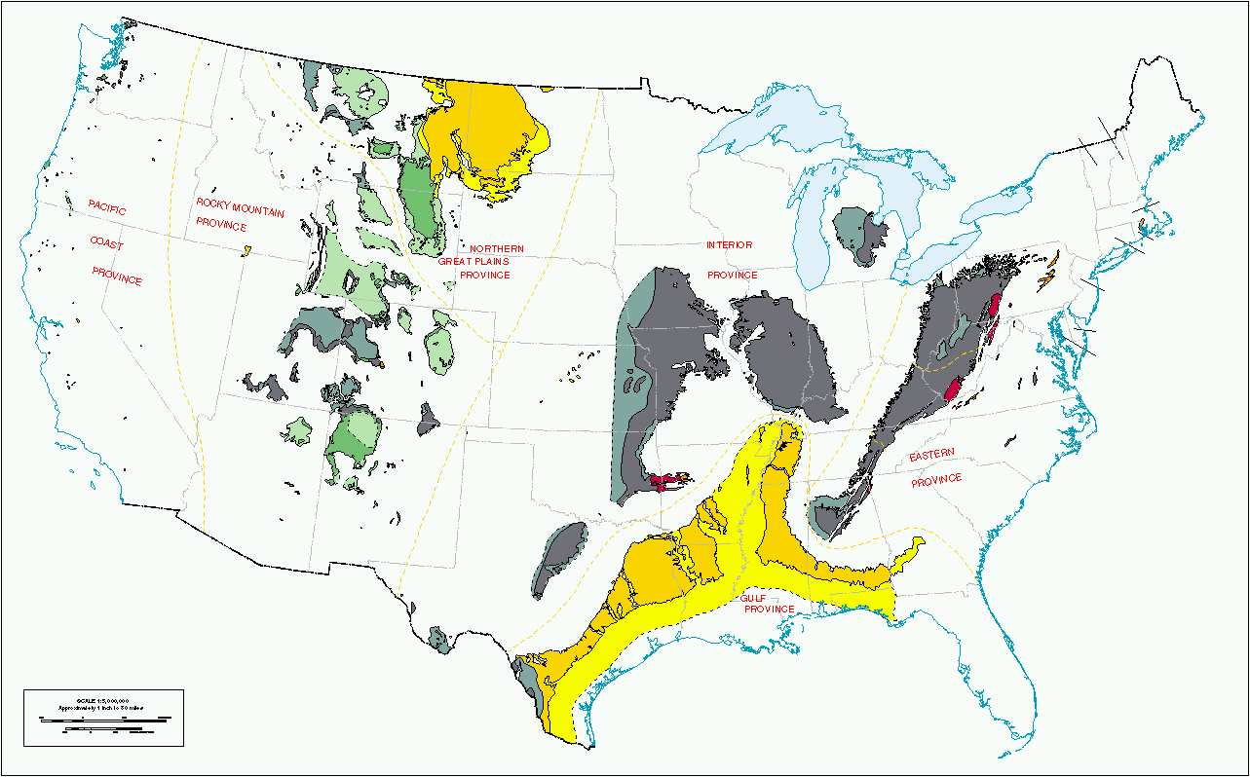

U.S. Coal Regions
U.S. Proved recoverable coal reserves at the end of 2006
111,338 million tonnes of Bituminous & Anthracite
135,035 million tonnes of Sub-Bituminous & lignite
Notes:
Deep color represents areas known to contain coal beds that are of commercial value at the present time or that may be of value in the future. In general, the minimum thicknesses included are 14 inches for anthracite and bituminous coal, and 30 inches for sub-bituminous coal and lignite.
Light color represents areas of doubtful value for coal. These may be divided into three classes:
areas containing thin or irregular beds, which generally have little or no value, but which locally may be thick enough to mine,
areas in which the coal is poor in quality, and
areas where information on the thickness and quality of coal beds is meager or lacking.

Slide 5
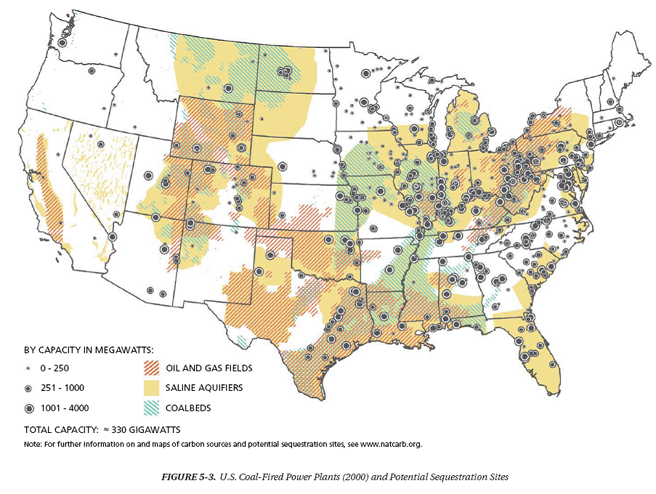
Notes:
http://bookofanswers.blogspot.com/2008/05/us-coal-fired-power-plants-2000.html

Slide 6
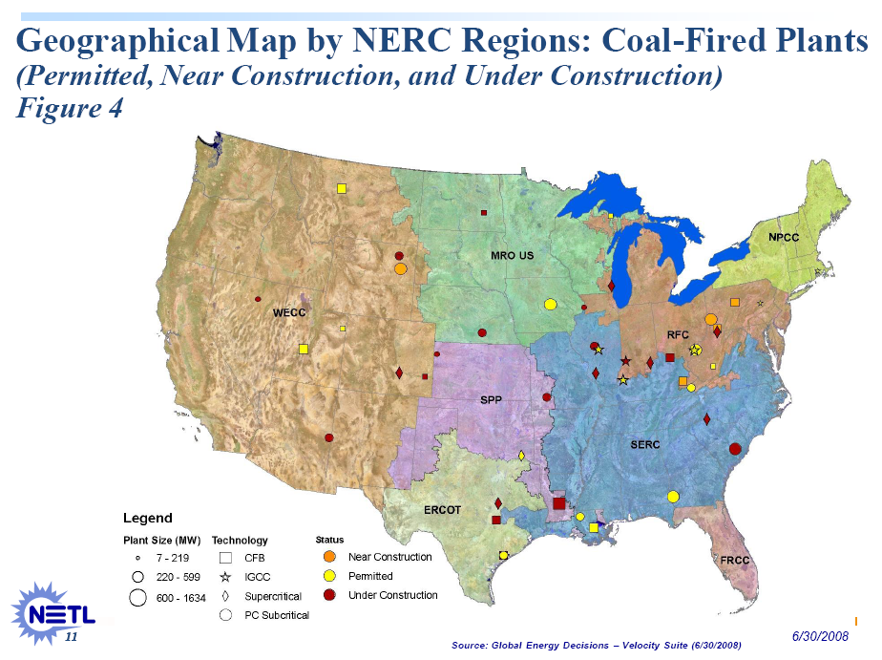
Notes:
http://www.netl.doe.gov/coal/refshelf/ncp.pdf
151 plants are currently permitted, near construction or under construction in the U.S.

Slide 7
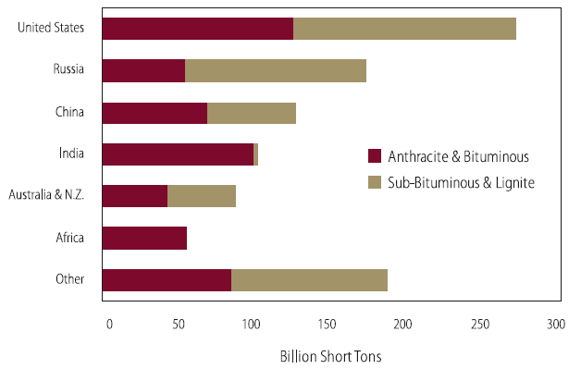
The Future of Coal, MIT, 2007
Notes:
China = 12%
China, India and the U.S. — none of them restricted by Kyoto — are planning to build more than 850 new coal-fired energy plants over the next few years. China set to build 562 new coal plants.
It is estimated that the average American still pollutes between five and six times more than the average Chinese person. (BBC News, June 19, 2007)

Slide 8
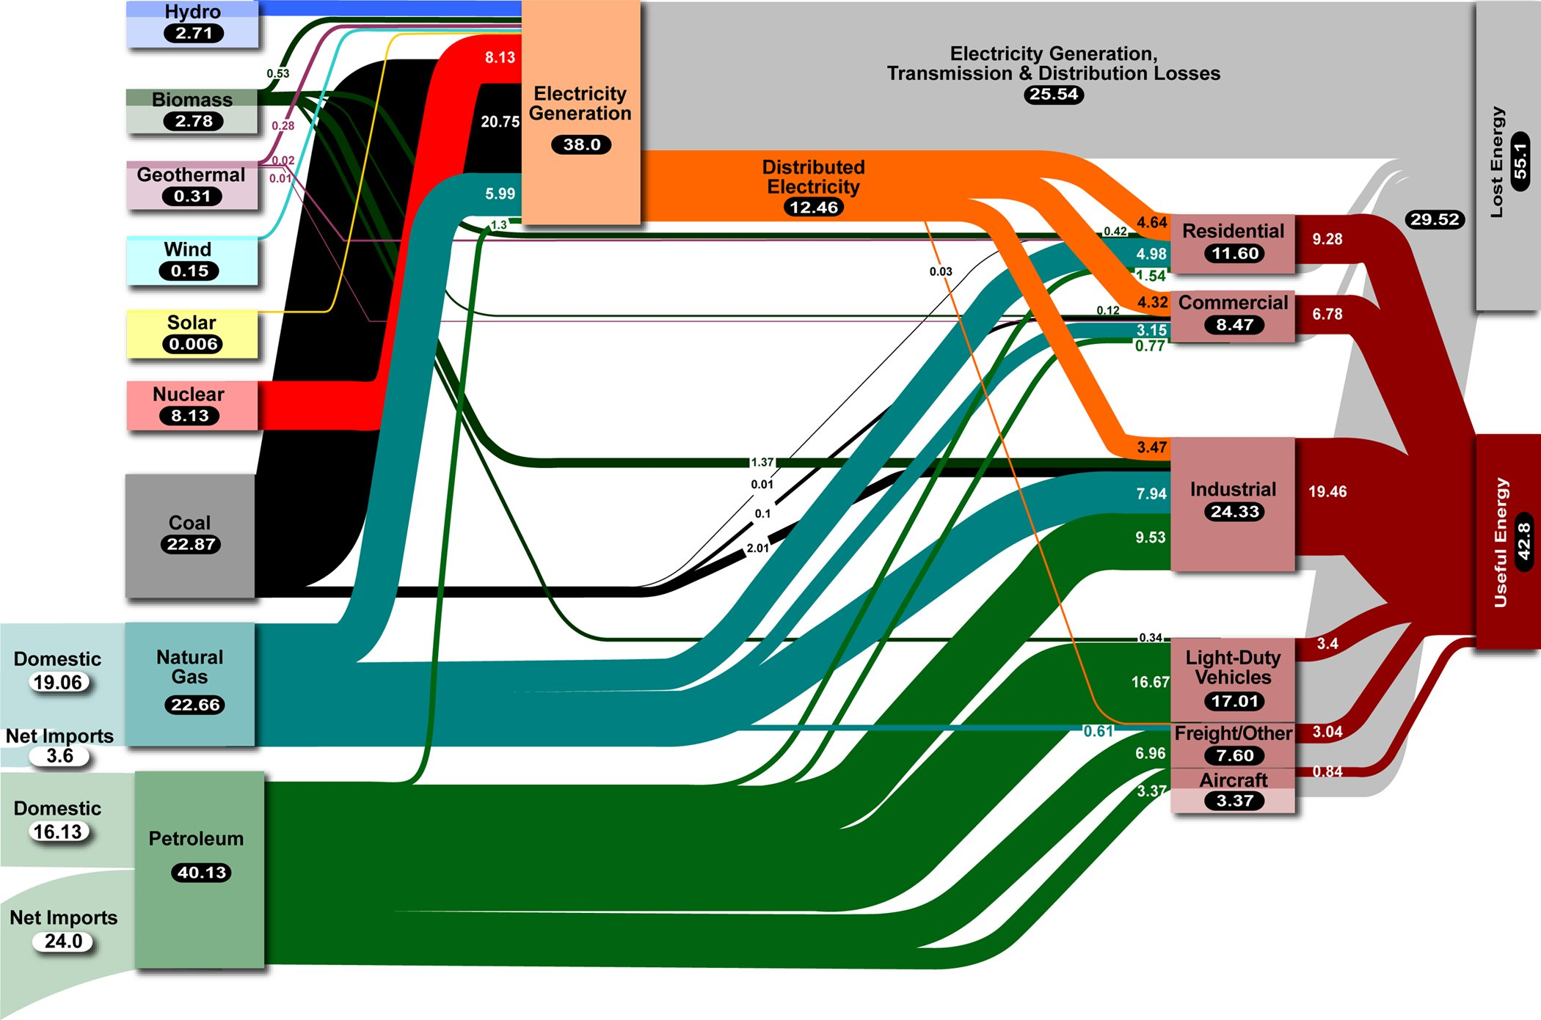
https://eed.llnl.gov/flow/images/LLNL_Energy_Chart300.jpg

Slide 9
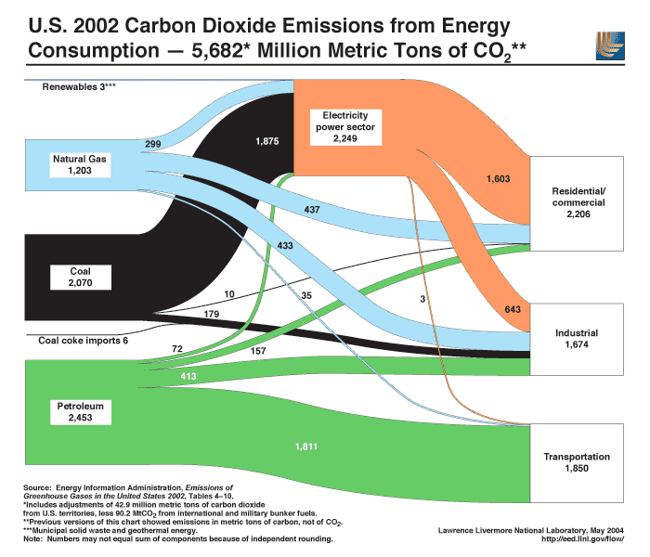

Slide 10
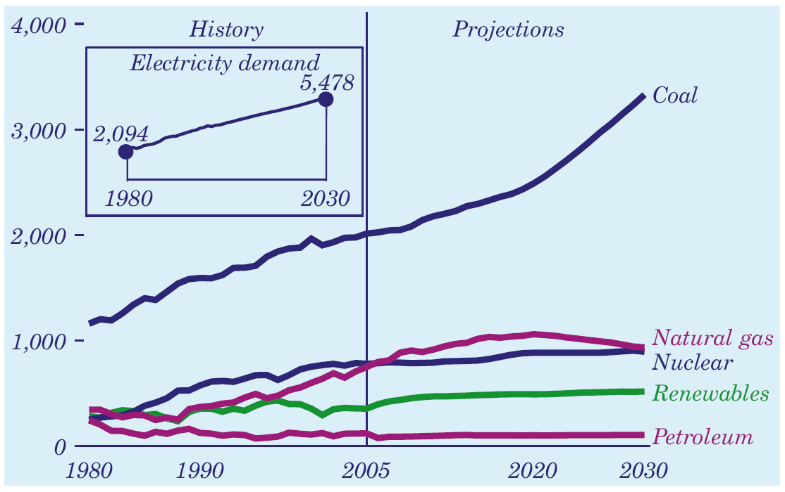

Slide 11
The Future of Coal, MIT, 2007

Slide 12
But…
Carbon intensity of Coal is Very High
(92g CO2/MJ)
One typical plant = 3 million tons/year CO2
US produces 1.5 billion tons/year from coal burning power plants
If 60% of the US CO2 from coal were captured for sequestration, it would be 20 million barrels a day
The Future of Coal, MIT, 2007

Slide 13
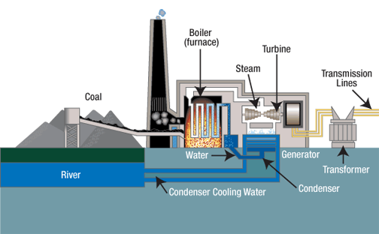
Sub-critical Coal-Fired Power Plant
http://www.tva.gov/power/coalart.htm
Notes:
http://www.tva.gov/power/coalart.htm

Slide 14
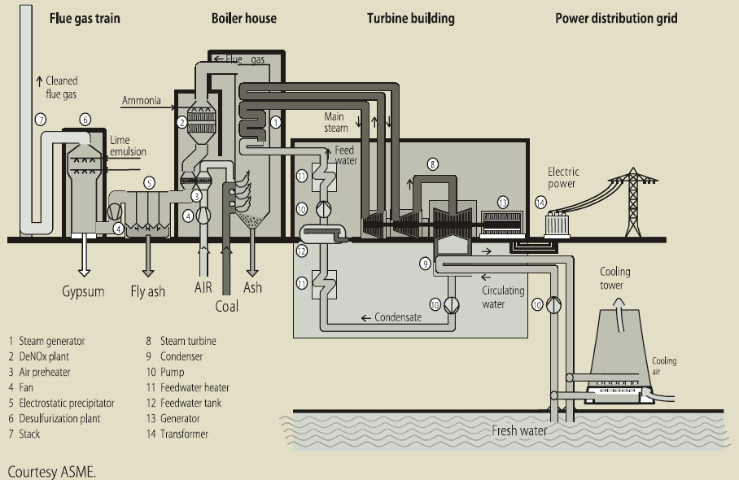
Sub-critical Pulverized Coal System
Notes:
Standard coal fired power plant
Sub-critical pulverized coal system

Slide 15
Generating Efficiency
Thermal Energy in Fuel
Electricity Produced
Influenced By:
Fuel Source
Plant Design
Environment
Lower efficiency = More coal burned per unit electricity produced.

Slide 16
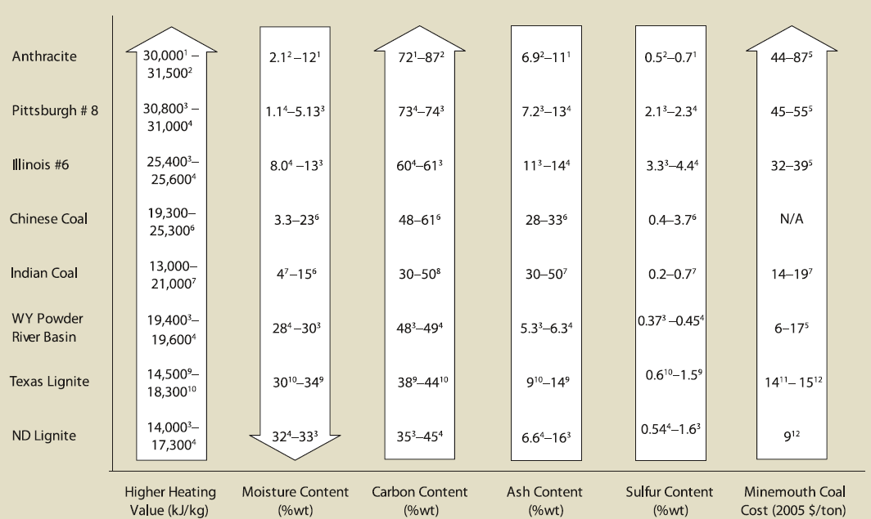
Coal Types
The Future of Coal, MIT, 2007
Notes:
Generating efficiency is different for different types of coal
Different properties
Higher heating value = generating capacity
Others = “how much it pollutes”
More C = more energy, but more water = less energy

Slide 17
Plant Design
 | Pressure | Temperature | Efficiency
Subcritical | <22.0 Mpa (16.5) | 550C (540C) | 33%-37% (34%)
Supercritical | >22.0 Mpa (24.3) | >550C (565C) | 37%-40% (38%)
Ultra-Supercritical | Up to 32 Mpa | 610C | 43.30%
The Future of Coal, MIT, 2007
Notes:
Differ in T/P they elevate steam to to generate electricity
Higher T/P = more energy
need higher standards to reach these (engineering to withstand)

Slide 18
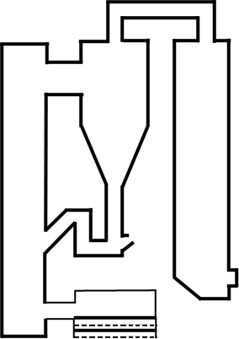
Fluidized Bed Combustion
convective pass
(backpass)
cyclone
secondary
air
To haghouse
Or ESP
coal and
limestone
fluidized bed
heat exchanger
bottom ash
primary air
fluidizing air
Notes:
Higher efficiency technology
FBC = coal ground to very fine particles, combust in air, air blows it up, turbulent stream, burn more completely/cleanly than if sitting there
More surf area exposed to heat
FBC plants are more flexible than conventional plants in that they can be fired on coal and biomass, among other fuels. Fluidized beds suspend solid fuels on upward-blowing jets of air during the combustion process. The result is a turbulent mixing of gas and solids. The tumbling action, much like a bubbling fluid, provides more effective chemical reactions and heat transfer.
ESP = electrostatic precipitator

Slide 19
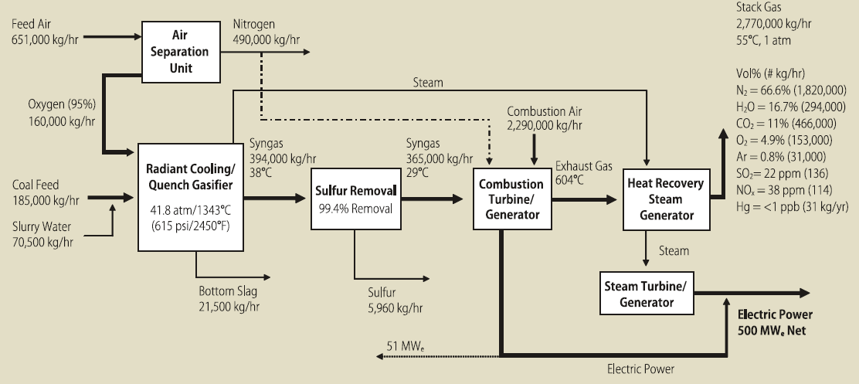
Gasification (IGCC)
Coal + H₂O → H₂ + CO
The Future of Coal, MIT, 2007
Notes:
IGCC is the big new thing – really, really expensive and energy intensive
don’t burn coal directly – create H to burn for energy; create CO as by-product
Producing steam from radiant cooling & burn H gas to produce steam in turbine
Both into steam generator to
See The Future of Coal

Slide 20
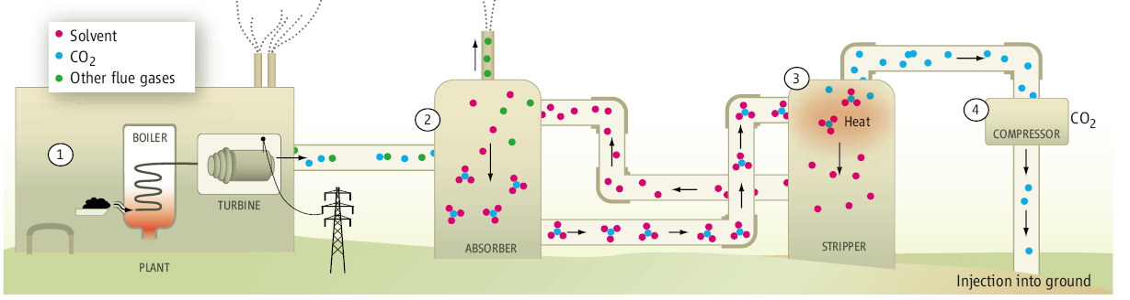
Post – Combustion CO₂ Capture
Kintisch Science 317:184-186
HO
NH₂
Banerjee et al. Science 319:939-943
Notes:
Science paper – different way to capture C
HO-NH2 (amine) is molecule that typically captures CO2; heat it up, releases CO2 (liquify and do whatever)
energy intensive to regenerate amine
New more complicated molecule – if it works, much less energy intensive way to get out the CO2
ZIF = zeolitic imidazolate frameworks
The adsorption isotherms for all three ZIFs show a disproportionately high affinity and capacity for CO₂ (SOM text S5), with ZIF-69 outperforming ZIF-68 and ZIF-70, as well as the state-of-the-art material BPL carbon. Adsorption is completely reversible, and we calculate that 1 liter of ZIF-69 can store 82.6 liters (162 g) of CO₂ at 273 K.

Slide 21
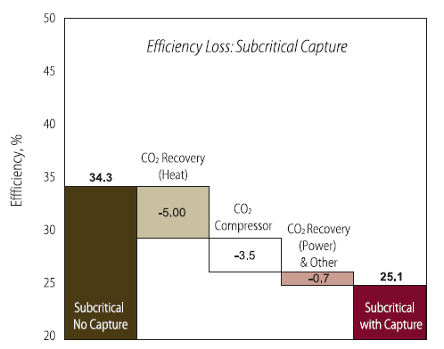
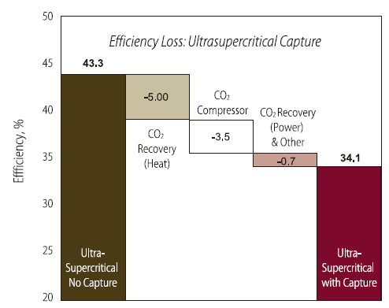
Energy Cost of CO₂ Capture
73 % of original efficiency
79% of original efficiency
The Future of Coal, MIT, 2007

Slide 22
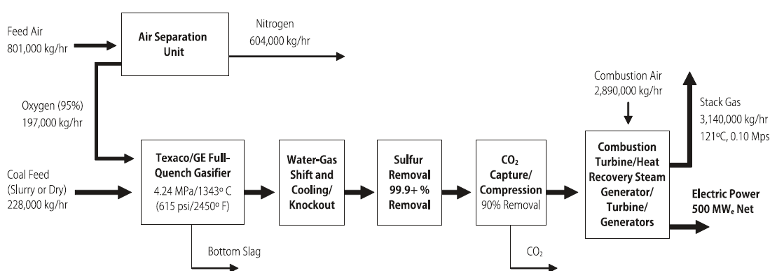
IGCC Pre-Combustion CO₂ Capture
Coal + H₂O → H₂ + CO
CO + H₂O →H₂ + CO₂
The Future of Coal, MIT, 2007
Notes:
Gasifier -> for IGCC
Gasification step => H2 & (CO, CO2) – capture here instead of after combustion (when mixed with sulfur) – more pure, less energy to capture
Still not cost-competitive

Slide 23
The Future of Coal, MIT, 2007
Notes:
Construction costs of the different types of plants
Units are $/kW h or something like that.
Add CO2 capture to any of these, cost almost doubles
More efficient plants, still more expensive
IGCC most expensive of any of them, but cheapest of CO2 capture (move to these not likely to happen until CO2 sequestration mandated)

Slide 24
The Future of Coal, MIT, 2007

Slide 25


Carbon Cost at Which Capture Becomes Competitive
Subcritical : $41.3/ton
Supercritical: $40.4/ton
Ultra-supercritical: $41.4/ton
Fluidized bed combustion: $39.7/ton
IGCC:$19.3/ton
Spring 2008
Fall 2008
The Future of Coal, MIT, 2007
Notes:
C cost on free market to make these technologies competitive
Update graph

Slide 26
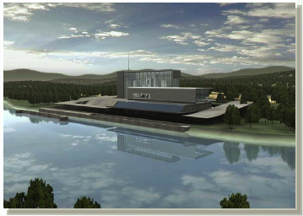
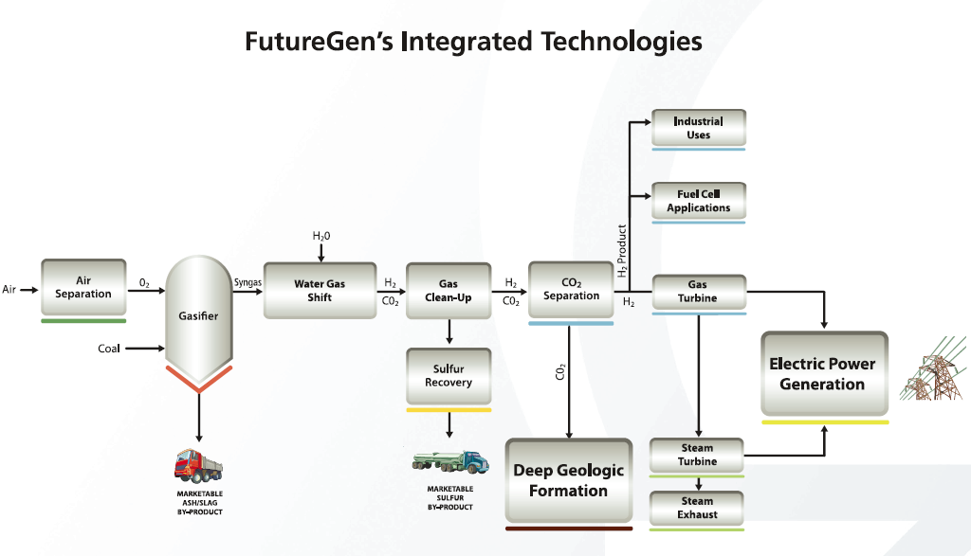
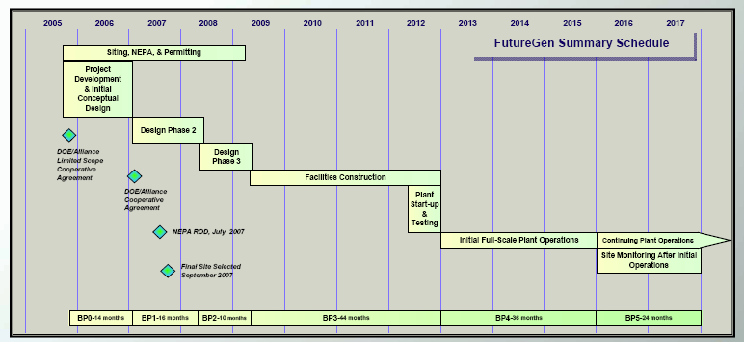

Slide 27


Slide 28
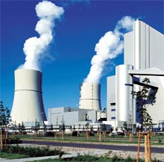
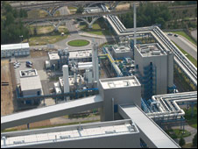
Spremberg, Germany
First test plant for CCS
30 MW plant, cost $70m Euros
  U.S. Average = 976 MW
CO2 separated, condensed,
transported to gas field,
forced 1,000 m underground
Larger demonstration project
slated for 2015
Notes:
Front image: http://www.technologyreview.com/Biztech/21397/?nlid=1353&a=f
Overhead image: http://news.bbc.co.uk/2/hi/science/nature/7584151.stm
Regular plants produce 1,700 MW energy
U.S. Average: http://www.netl.doe.gov/coal/refshelf/ncp.pdf, slide 9

Slide 29
Conclusions
World power demands are expected to rise 60% by 2030.
Coal is a huge part of global energy use and is likely to remain important
Technology exists to remove 90% of CO₂, 99% of sulfur dioxide, 99% of particulates, and 90% No_{x}
Costs of implementing these technologies are large and possibly prohibitive

