Slide 1
European Union Perspectives on Climate Change
Ulrich Kamp
Department of Geography

Slide 2
Outline
Environmental Awareness in the European Union
EU GHG Emissions
The EU and Climate Change
The U.S. in the View of the EU
Taking Sustainability Seriously

Slide 3
Part 1 Environmental Awareness in the European Union

Slide 4
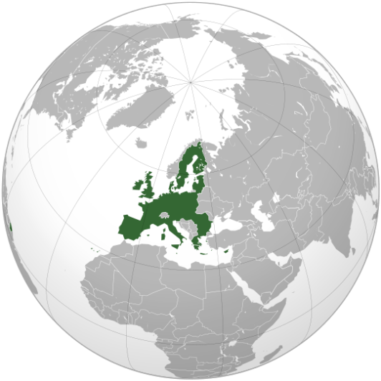
What is the European Union?
A unique economic and political partnership between 27 democratic European countries with 495 million citizens.

Slide 5
EU Legislation
the European Parliament
(representing the people of Europe)
the Council of the European Union
(representing national governments)
the European Commission
(representing the common EU interest).

Slide 6
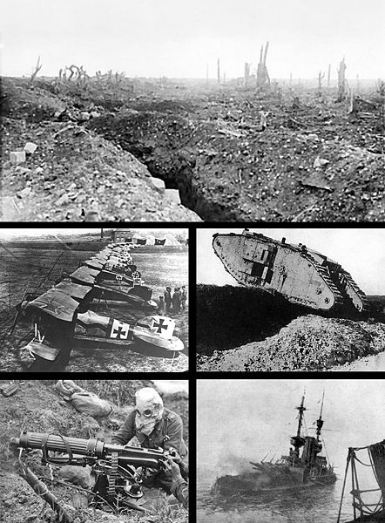
Enough! The “Pre-History” of the European Union

Slide 7
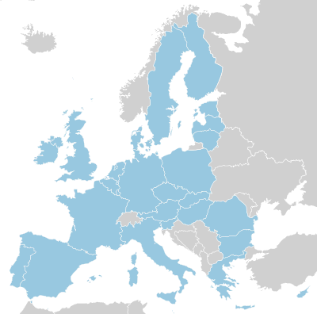
History of the European Union From 6 to 27

Slide 8
History of the European Union
1945-1959: A peaceful Europe – the beginnings of cooperation
1960-1969: The “Swinging Sixties” – a period of economic growth
1970-1979: A growing community – the first enlargement
1980-1989: The changing face of Europe – the fall of the Berlin Wall
1990-1999: A Europe without frontiers
2000-today: A decade of further expansion

Slide 9
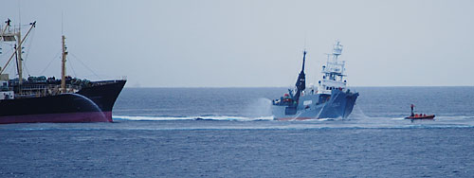
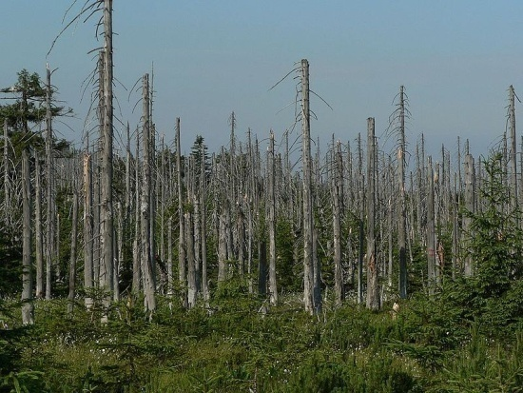
History in Europe
1970-1979: Oil Crisis; “Acid Rain”; Greenpeace

Slide 10
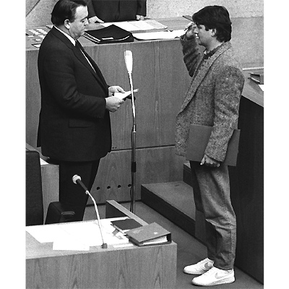
History in Europe
1980-1989: “The Greens”
1980: Foundation
Since 1983: Part of German Parliament
1998-2005: Part of German Government

Slide 11
History in Europe
1990-1999: “The Green Point”
1990: Introduction of Dual Waste Management System in Germany.
Today: Introduced in 23 other European countries.

Slide 12
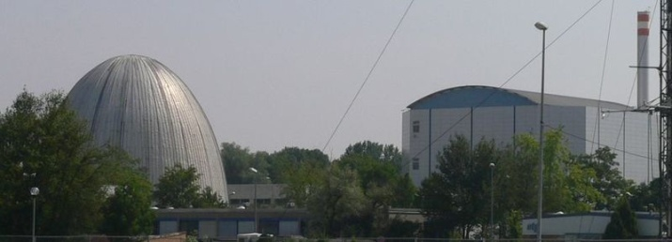
History in Europe
2000-today: Phasing out of Nuclear Power
1978: Austria
1980: Sweden
1987: Italy
1999: Belgium
2000: Germany

Slide 13
Part 2 EU GHG Emissions

Slide 14
Global GHG Emissions
Seven largest emitters:
U.S., EU, China, Russia, Japan, India, Canada.
Account for >70% of energy-related CO2 in 2004.

Slide 15
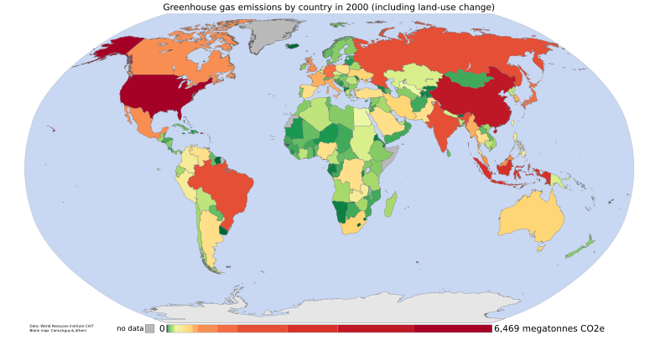
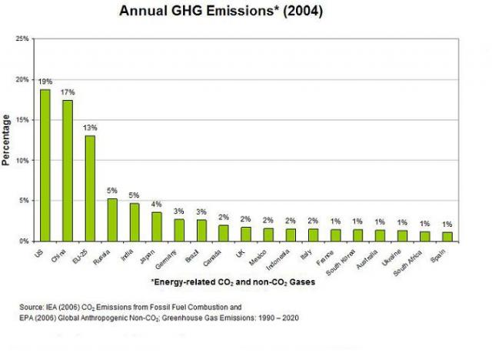
Global GHG / CO₂ Emissions

Slide 16
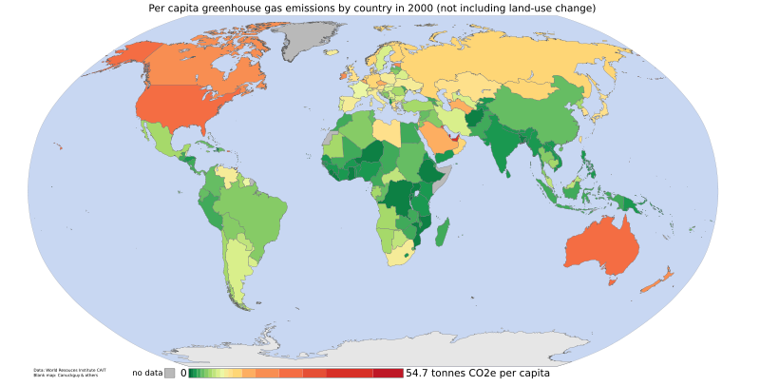
Global CO₂ Emissions per capita / tons of CO₂ per capita

Slide 17
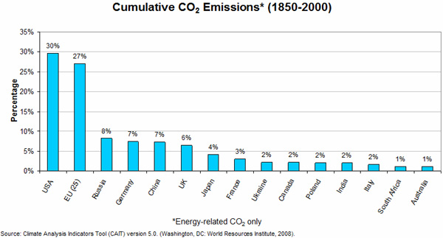
Cumulative CO₂ Emissions 1850-2000 (Energy-related CO₂ only)

Slide 18
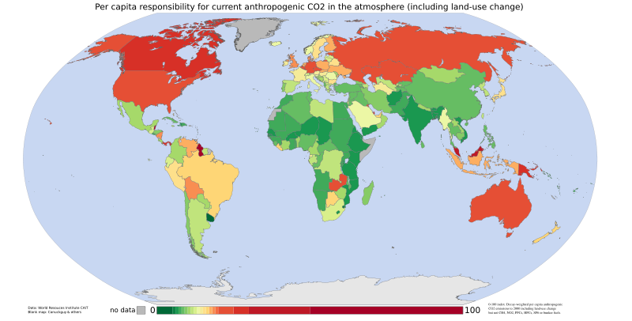
Global CO₂ Emissions 1950-2000, per capita responsibility

Slide 19
Global CO₂ Intensity 2002, (Tons of CO₂ per $1,000 of GDP)

Slide 20
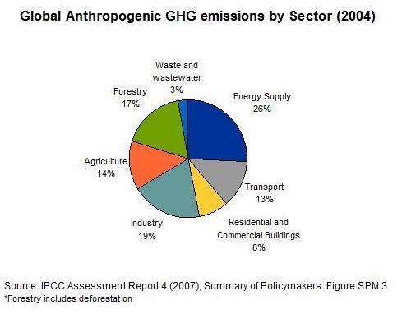
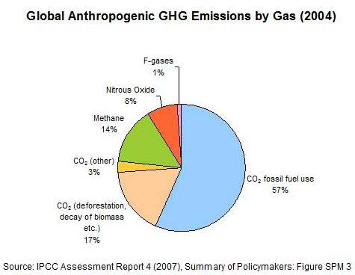
Global GHG Emissions 2004, by sector and by gas

Slide 21
Part 3 The Eu and Climate Change

Slide 22
The EU and Climate Change Official European Commission Website
“Climate change is already happening and represents one of the greatest environmental, social and economic threats facing the planet. The European Union is committed to working constructively for a global agreement to control climate change, and is leading the way by taking ambitious action of its own. The warming of the climate system is unequivocal, as is now evident from observations of increases in global average air and ocean temperatures, widespread melting of snow and ice, and rising global mean sea level. The Earth's average surface temperature has risen by 0.76° C since 1850. Most of the warming that has occurred over the last 50 years is very likely to have been caused by human activities.”

Slide 23
Climate Change Initiatives
1979: Geneva Convention
1987: Montreal Protocol
1991: First strategy to limit CO2 and improve energy efficiency
1992: 'Earth Summit’, Rio
1997: Kyoto Protocol.
1998: EU-15 signs Kyoto Protocol.
2000: European Climate Change Program (ECCP I)
2001: EU-15 ratifies Kyoto Protocol.
2001: Clean Air For Europe (CAFE) programme
2005: European Climate Change Program (ECCP II)
2005: Clean Air Strategy

Slide 24
Climate Change Impacts in EU
Many mountain plant species may face extinction
Increasing water demand for agriculture
Glacier retreat
Extreme weather events are projected to increase
Human health is also significantly affected

Slide 25
Impacts in Germany by 2100
Increase of temperature of 0.9° C in last 100 years (0.7 ° C globally); 1.5 ° C in the Alps.
Increase of temperature of up to 4 ° C.
Up to 30% less summer precipitation → more and stronger heat waves and droughts.
Up to 30% more winter precipitation → more and higher floods in spring.
Total melting of all Alps glaciers possible → flooding and water scarcity.

Slide 26
EU calls for…
Pro-active adaptation measures needed
Improved monitoring and reporting of data
More spatial and socio-economic scenarios
Better information on vulnerability

Slide 27
Solutions
EU Greenhouse Gas Emission Trading Scheme (EU ETS)
Greenhouse Gas Emissions Allowance Trading Scheme
Landfill of Waste Directive
Intelligent Energy for Europe Program
Renewable Electricity Directive
Biofuels Directive
Agreement with Automakers
“Carbon tax”

Slide 28
The EU and the Kyoto Protocol 2008-2012
EU-15 must reduce emissions by 8% compared to base year 1990. Some member states defined domestic targets beyond the Kyoto target in addition. No collective target for EU-27. Ten out of twelve new member states have individual commitments to reduce emissions to 6-8% below base level.
Buy credits from emission-saving projects carried out in third countries
Aforestation and reforestation activities
Additional policies and measures
EU Emissions Trading System

Slide 29
Climate Change and the Economy
By Sir Nicholas Stern, former chief economist of the World Bank
“Stern Review on the Economics of Climate Change”, 2006
One percent of global gross domestic product (GDP) per annum
Greatest and widest-ranging market failure ever seen
Environmental taxes

Slide 30
Emission Trading Scheme (ETS)
Limitation of emissions from ~ 10,500 industrial facilities across Europe that together produce ~ 50% of EU’s CO2 emissions.
Large CO2 emitters must monitor and annually report their emissions; obliged every year to return an amount of emission allowances to the government that is equivalent to their CO₂ emissions in that year. Emission allowance prices between 7 and 30 Euros.
Excess emissions in 2008-2012 incur penalty (100 Euro per ton CO2) and must be made up in next phase.
Will continue beyond 2012 with or without new international climate agreements.

Slide 31
Emission Trading Scheme (ETS)
Operators may reassign or trade allowances by several means:
privately, moving allowances between operators within a company and across national borders.
over the counter, using a broker to privately match buyers and sellers.
trading on the spot market of one of Europe's climate exchanges (the most liquid being the European Climate Exchange).

Slide 32
Global GHG Emissions Trends
EU-15 -2.7% (1990-2006)
EU-27 -10.8% (1990-2006)
Germany -18% (1990-2005)
U.S. +16% (1990-2005)

Slide 33
Global GHG Emissions Trends Projections against 2004
Japan -5% by 2010.
EU steady by 2010.
U.S. +8% by 2010 and +25% by 2025.
China +50% by 2025.
India +80% by 2025.

Slide 34
The EU and Post-Kyoto after 2012 - Reactions
Many EU member states expressed concerns about EU Parliament ‘s vote for using profits from emission trade exclusively for climate protection activities/initiatives.
Italy against stricter conditions.
Germany against stricter CO2 emission limit (120 g/km) for new cars in 2012 (Germany: 2015).

Slide 35
Part 4 U.S. in the view of the EU

Slide 36
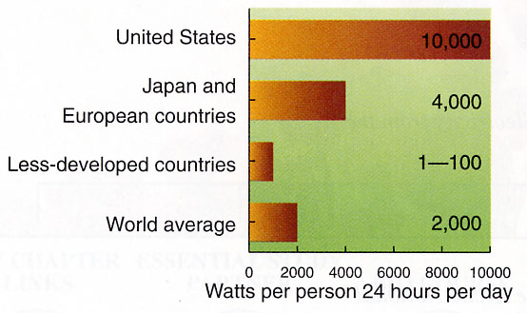
Energy Consumption per capita per day

Slide 37
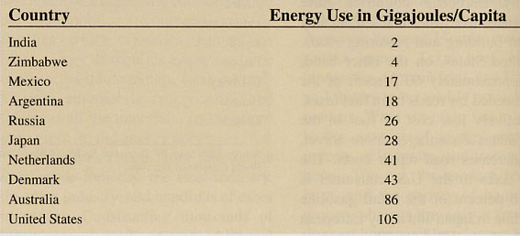
Energy Use for Transportation in gigajoules per capita

Slide 38
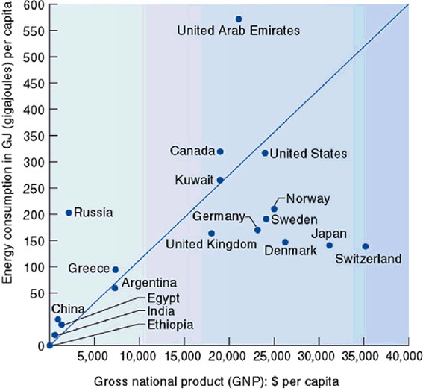
Energy Consumption and GDP

Slide 39
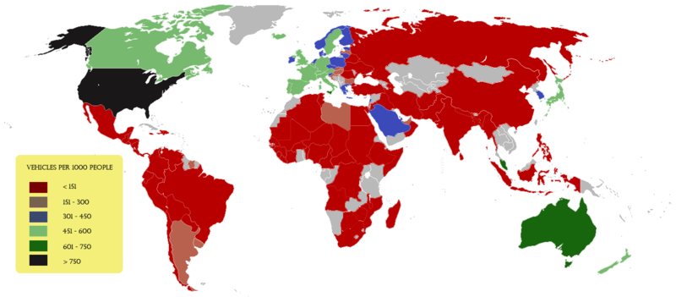
Passenger Cars and Population Vehicles per 1,000 people

Slide 40
US-Americans and Their Cars
35 % of all cars and trucks in the world in 1999 (= 212 million vehicles).
2 trillion miles per year – as much as the rest of the world combined.
until 2008, California used more gasoline than any other sovereign nation (other than the U.S.)

Slide 41
Transportation Mode for Land-based Trips
Europe U.S.A. World
Walking/Bicycling 40-50 % 2 %
Mass Transit 10 % 3 %
Automobile 40-50 % 95 % 10 %

Slide 42
U.S. Environmentalism 20th century
First Wave (1901-1909): T. Roosevelt; National Conservation Commission
Second Wave (1930s): F. Roosevelt; “Dust Bowl”; Alice Hamilton; Aldo Leopold
Third Wave (1960-1980): Nixon, Ford, Carter; Rachel Carson; Paul Ehrlich; “Earth Day”; Clean Air Act; Environmental Protection Agency (EPA)
Fourth Wave (1980-2000): Clinton and Gore; Sustainable Revolution?; Lester Brown; Worldwatch Institute; “Earth Summit” in Rio de Janeiro; “Agenda 21”

Slide 43
U.S. Environmentalism? 20th century
Bush (sen.) Administration: President Bush attends Rio, but is against any deadlines.
Clinton Administration: Vice-President Gore attends Kyoto and signs the willingness for ratification, but is against any deadlines.
Bush (jun.) Administration: Leaves Kyoto Protocol. Secretary of State attends Johannesburg.
Obama Administration: ???

Slide 44
U.S. Clear Sky Initiative
Presented as the Bush administration’s climate change plan in Feb 2002.
Reducing its "greenhouse gas (GHG) intensity" 18% over the next 10 years. GHG intensity is the ratio of greenhouse gas emissions to economic output.
The goal is to lower the rate of emissions from an estimated 183 mt per million dollars of GDP in 2002 to 151 mt in 2012. In other words, emissions would continue to increase as the economy grows, but at a slower rate than would be the case in a "business-as-usual" scenario.

Slide 45
U.S. Clear Sky Initiative
White House:
"By significantly slowing the growth of greenhouse gases, this policy will put America on a path toward stabilizing GHG concentrations in the atmosphere in the long run, while sustaining economic growth.“
House Democratic Leader Richard Gephardt (Missouri):
"Simply translated, its goal is to slow the growth in greenhouse gas emissions. I remind the administration that the global objective is to cut greenhouse gas emissions."

Slide 46
Clear Sky Initiative Reactions from Europe
EU Environment Commissioner Margot Wallstrom said Bush's policy could lead the United States to break a long-standing commitment to stabilize greenhouse emissions. “It seems that President Bush's proposals will not lead to a reduction of greenhouse gas emissions but allow a significant increase. This raises the question whether the U.S. will be able to meet its commitments under the U.N. Framework Convention on Climate Change,” Wallstrom said.
German Environment Minister Juergen Trittin echoed the sentiment of many pro-Kyoto countries by welcoming the long-awaited announcement of a U.S. policy on global warming, but decrying its content. “I welcome the fact that with this program President Bush has recognized the need for measures to tackle climate change; however at first glance the contents look disappointing,” he said.

Slide 47
Clear Sky Initiative Reactions from Europe
Chris Hewett, of Britain's Institute for Public Policy Research, said: “In climate change terms (setting efficiency targets) is nonsense, it won't help at all. The science is absolutely clear that we have to reduce emissions (…) Britain has proved that you can cut emissions and still have a very healthy economy. There is no inextricable link between CO2 emissions and economic growth.”
“It's really shocking...it's a bit like saying: 'wealth is for us today in 2002 and we will leave the problems for our children or for people in Africa or Asia',” said Belgium's Green Party Energy Minister Olivier Deleuze. Deleuze led the European Union delegation at talks last year which secured support from most of the rest of the world to push on with Kyoto without the United States. “It's a policy that's not very moral, I feel,” he said.

Slide 48
Part 5 Taking Sustainability Seriously

Slide 49
Taking Sustainability Seriously
physical environment and the people
social issues
function of civil society
character of the civil society
sustainability initiatives
communitarian principles
political process
changing the fabric of civil society

Slide 50
Taking Sustainability Seriously
political will
greater public involvement
participatory processes
shared community values

Slide 51
The “Three Deadly Sins”
Tragedy of the commons
Not-in-my-backyard (NIMBY) syndrome
Transboundary shifting of environmental impacts
“rampant individualism”
“rational consumers”
“You can’t always get what you want”. (Rolling Stones).

Slide 52
Taking Sustainability Seriously Press Release, 13 March 2008
“Europeans put the environment centre stage”
protect the environment
quality of life
climate change
priority over economic competitiveness
decisions at European Union level

Slide 53
U.S. and Communitarian Values
U.S. history does not provide an unfettered tradition of libertarian values, but rather it provides an understanding of individual freedoms as being constraint by community concerns.
Liberalism has fostered the evolution of communities without shared values.
(from K.E. Portney, 2003, “Taking Sustainable Cities Seriously”)

Slide 54
America – where did all your values go?

