Slide 1
Policy Options
The basic climate change policy approaches under consideration for the United States are: 1) Cap and Trade: A market based system where the right to pollute is either sold or given away to industry by government and then those rights can be traded in a free market. 2) Carbon Tax: Those that mine or develop carbon sources and release carbon into the atmosphere pay a tax to the government on their production or release in proportion to the amount of carbon produced or released.

Slide 2
Politics
Taxes are VERY unpopular
Free market mechanisms have bi-partisan support
Appeal to conservatives
Promise reductions
Create a new industry: carbon traders
Therefore, cap and trade has dominated the discussion

Slide 3
Allocation Options
Bill | Lieberman-McCain 2007 | Bingaman-Specter Draft 2007 | Kerry-Snowe 2007 | Sanders-Boxer 2007 | Udall-Petri 2006 | Obama Admin. 2009
Allocation | Some percent auctioned, balance allocated free | 10% auctioned, 55% free (but gradually phased out), 29% to states, 5% for agric. sequestration, 1% early reduction | Some percent auctioned, balance allocated free | No allocation set, any allowances not allocated to covered entities should be given to non-covered entities | 20% free, 20% to states (reduced yearly), remaining 60% to Treasury, Energy Dept, and State Dept | 100% auctioned-revenue to federal govt- $646 billion revenue rebated to consumers

Slide 4
Banking
Banking allows emitters to carry over unused allowances into the next cap period
Emitters can either reduce emissions below the cap and hold the allowances that they generate if there is free allocation OR
Emitters can buy extra allowances gambling that the price is lower now than it will be next period- this reduces the allowances available on the market for others

Slide 5
Banking Proposals
Bills | Lieberman-McCain 2007 | Bingaman-Specter Draft 2007 | Sanders-Boxer 2007 | Markey-Waxman 2009
Banking | Allowed | Allowed | Not allowed | Allowed-unlimited

Slide 6
Borrowing
Borrowing is allowing emitters to borrow from future years to satisfy current allowance needs
Allows higher emissions now, with the presumption that emissions will be reduced in the year borrowed from
Likely that there will be appeals for relief in years borrowed from- delays compliance

Slide 7
Borrowing
Bill | Lieberman-McCain 2007 | Sanders-Boxer 2007 | Bingaman-Specter Draft 2007 | Kerry-Snowe 2007
Borrowing Provisions | Borrowing up to 25% | No borrowing provided for | No borrowing provided for | No borrowing provided for

Slide 8
Safety Valve
Places a cap on the price of allowances=price controls
Converts from cap and trade to a flat tax in reality
Reduces the internalizing of emission costs and allows less cost efficient emitters to persist

Slide 9
Safety Valve Provisions
Bill | Lieberman-McCain 2007 | Bingaman-Specter Draft 2007 | Udall-Petrie 2006 | Sanders-Boxer 2007
Safety valve provision | No safety valve | Government issues more allowances if reach $7 per ton | Price capped at $25/ton of carbon (<$7 per ton of CO2) | No safety valve

Slide 10
Offsets
Allows substitution of credits for reducing emissions in uncovered sectors
Issue is verifying that the reductions would not have happened without the investment and that the reductions do indeed occur

Slide 11
Offset Provisions
Bill | Lieberman-McCain 2007 | Sanders-Boxer 2007 | Waxman 2006 | Bingaman-Specter Draft 2007
Offset provisions | Can offset up to 30% with sequestration and other offsets | No offsets but credits for sequestration | No offsets, no sequestration credits | Unlimited offsets allowed

Slide 12
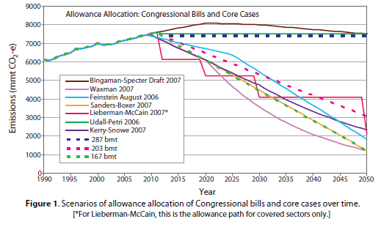
Last Session Bills

Slide 13
Current Session
American Clean Energy and Security Act
Waxman and Markey developed
Cap and trade system:
Regulates electric utilities, oil companies, large industrial sources that emit 25,000+ tons of CO2 equivalent (85% of GHG emissions)
3% below 2005 by 2012, 20% below 2005 by 2020 and 83% below 2005 in 2050
Allows banking and one year of borrowing
Offsetting allowed( 5 tons offset/4 tons credit)

Slide 14
ACESA continued
Energy Efficiency: incentives, harmonization and rebates
Utility energy efficiency: companies must demonstrate customer savings (1% by 2012 to 15% by 2015 for electricity)
Clean Energy
Renewable Energy: retail energy suppliers must have 6% renewable in 2012- 25% in 2025
Carbon Capture: demonstration program, incentives and performance standards for new coal plants 1,100 tons per megawatt limit on GHG, then 800 tons
Clean Fuels and Vehicles: low carbon fuel standard
And more! Adaptation, consumer assistance, green jobs/training, rebates for additional costs over other countries

Slide 15
Boxer Climate Principles
1. Reduce emissions to levels guided by science to avoid dangerous global warming.
2. Set short and long term emissions targets that are certain and enforceable, with periodic review of the climate science and adjustments to targets and policies as necessary to meet emissions reduction targets.
3. Ensure that state and local entities continue pioneering efforts to address global warming.
4. Establish a transparent and accountable market-based system that efficiently reduces carbon emissions.

Slide 16
Boxer Climate Principles (cont’d)
5. Use revenues from the carbon market to:
- Keep consumers whole as our nation transitions to clean energy;
- Invest in clean energy technologies and energy efficiency measures;
- Assist states, localities and tribes in addressing and adapting to global warming impacts;
- Assist workers, businesses and communities, including manufacturing states, in the transition to a clean energy economy;
- Support efforts to conserve wildlife and natural systems threatened by global warming; and
- Work with the international community, including faith leaders, to provide support to developing nations in responding and adapting to global warming. In addition to other benefits, these actions will help avoid the threats to international stability and national security posed by global warming.

Slide 17
Boxer Climate Principles (cont’d)
6. Ensure a level global playing field, by providing incentives for emission reductions and effective deterrents so that countries contribute their fair share to the international effort to combat global warming.

Slide 18
Public Attitudes
Constituent perceptions drive political decisions- need to be re-elected
Special interest group lobbying does as well, but without public support there is risk to politicians

Slide 19
Voters View Renewable Energy as the Best Solution
What are the ONE or TWO most important things that can be done to solve America’s energy problems and high gas prices?
How to Address America’s Energy Problems
What the Government Should Do About the High Gas Prices
Greenburg Quinlan Rosner Research Survey, June 2006

Slide 20
Recent Public Perception
Has it changed?
What does it mean for moving solutions forward?

Slide 21
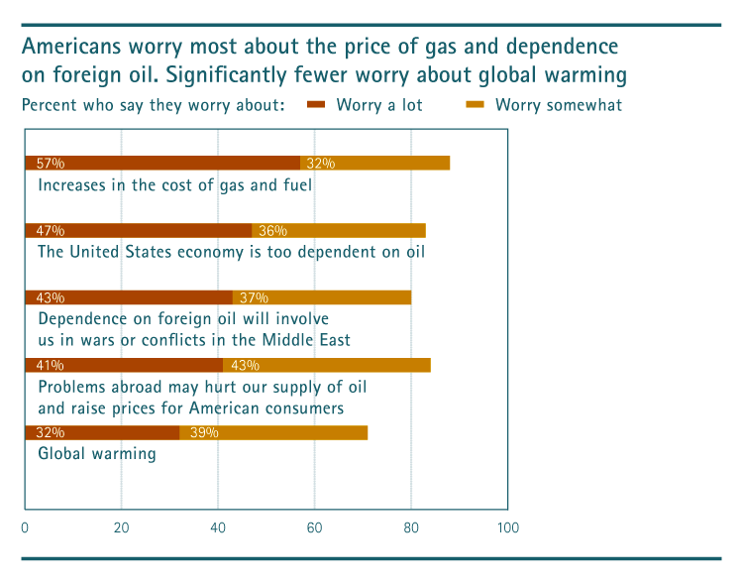
Public Attitudes

Slide 22
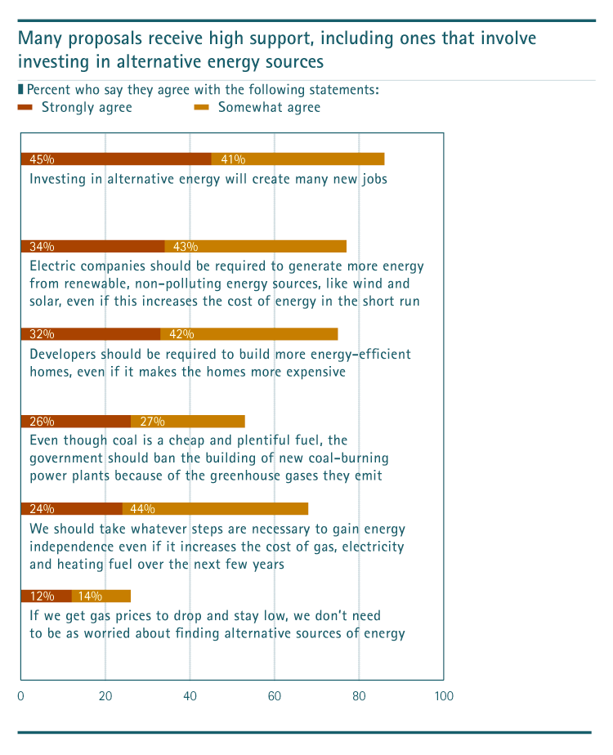

Slide 23
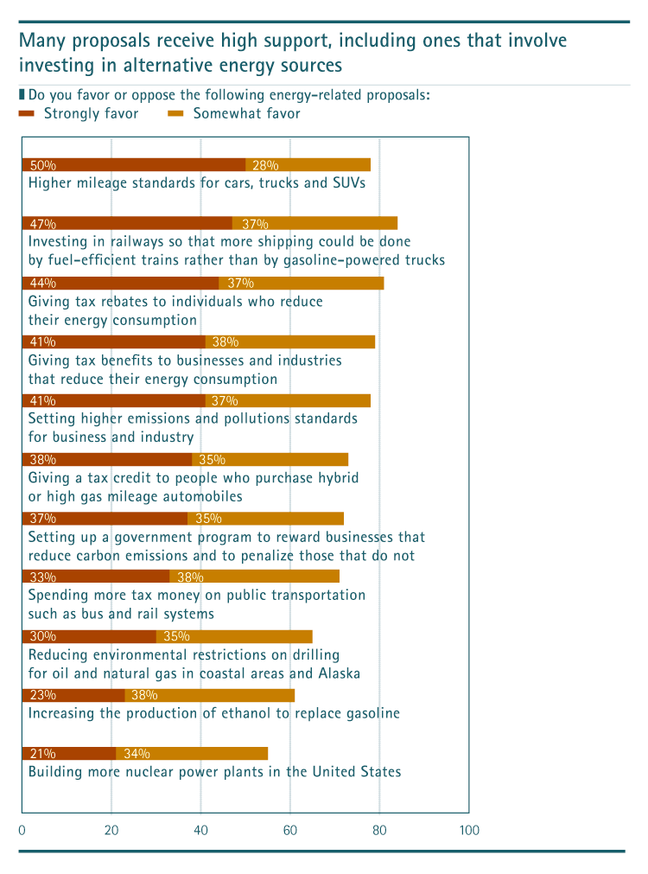

Slide 25
Solutions-Personal (willingness)
Cut back on leisure driving Very 39% Somewhat 39%
Have a 55 mph speed limit Very 37% Somewhat 27%
>½ the time:
Carpool Very 32% Somewhat 23%
Use public transit Very 25% Somewhat 19%
Bike or walk Very 20% Somewhat 20%

Slide 26
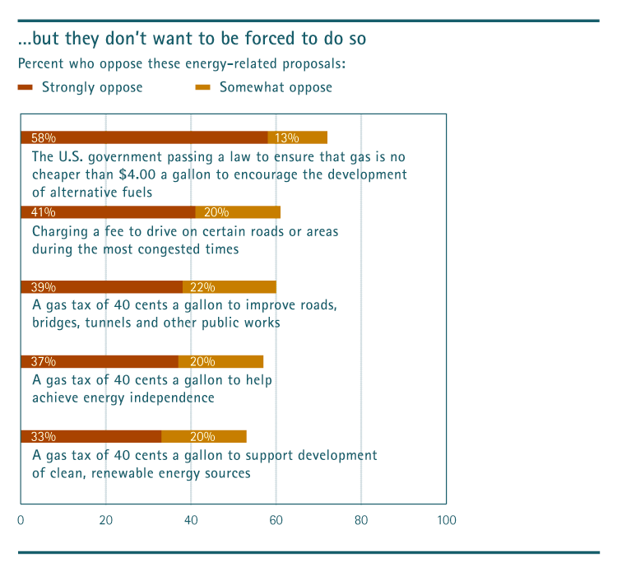

Slide 27
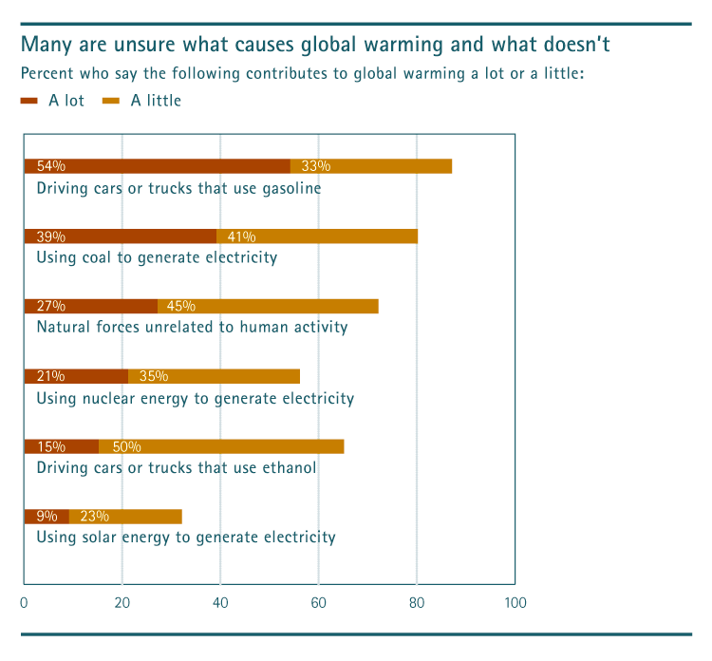

Slide 28
Major Public Attitude Groups
Disengaged (19%): not connected to energy issue
Climate Change Doubters (17%): reject idea
The Anxious (40%): know enough to be worried (91% worry “a lot” about cost of electricity)
The Greens (24%): worry about all elements of the energy problem

Slide 29
Common Ground?
Both the Anxious and the Greens support alternative energy, but for entirely different reasons
The Anxious believe with heavy investment alternative energy could be a major part of our energy consumption in 10 years or less (85%)
The Greens believe we need to find alternative energy sources even if gas stays low (>90%, 77% strongly

