Slide 1
Greening the Grid:
Making Powerful Choices
Bill Drummond
Western Montana Electric G&T Cooperative
April 22, 2009

Slide 2
Frames of Reference
Deal in MegaWatts, Kilowatts, MegaWatt-hours, KiloWatt-hours
10 - 100 W bulb plugged in for 1 hour = 1 KWh
Average NWE customer uses 750 KWh/month
MWh = 1000 KWh; 10,000 100 W bulb for 1 hr
Typical customer uses 0.75 MW/mo
1 MW of generation ≈ 750 homes

Slide 3
Frames of Reference
1000 MW of generation ≈ Seattle
Colstrip coal plants = 2094 MW; ≈ 2 X Seattle
Typical coal plant 500-800 MW
Typical nuclear plant ~ 1000 MW
Wind turbine 1.5 – 3 MW

Slide 4
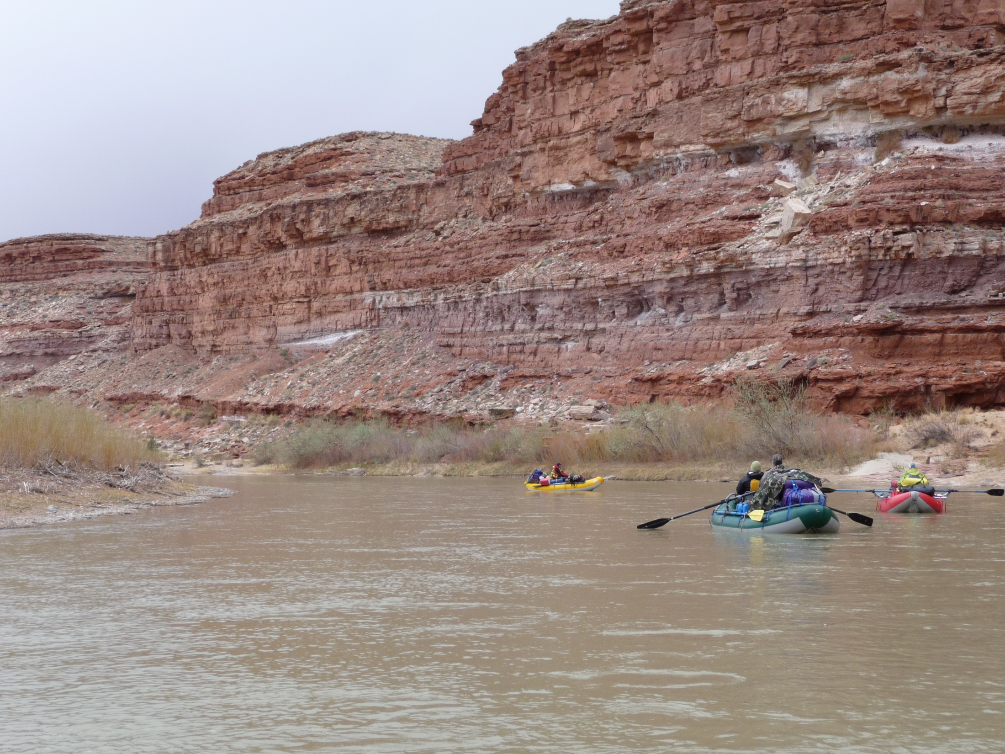

Slide 5
Sources of Generation
 | United States | Pacific Northwest
Coal | 50% | 13%
Nuclear | 19% | 6%
Natural gas | 22% | 8%
Hydro | 6% | 54%
Renewables | 3% | 10%
Sources: U.S.: 2007 Energy Information Administration
PNW: 2008 PNUCC Northwest Regional Forecast

Slide 6
Resource Alternatives – Near-term
Coal
Energy Efficiency
Transmission, transmission, transmission
Wind
Combustion Turbines
Nuclear
Geothermal
Solar
  Hot water heating
  Photovoltaic
  Concentrated solar (central station)

Slide 7
1st Policy Question
Objections by some states and other interested parties have often stalled major transmission projects. Is it appropriate for the federal government to exercise eminent domain authority to force a state to allow development of a transmission line that will carry green power? Is the same true regardless of the generation source?

Slide 8
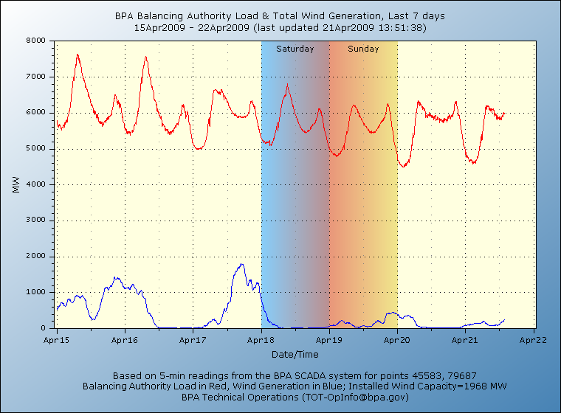

Slide 11
2nd Policy Question
In the past, Montana has built major parts of its economy on exploitation of its natural resources for out of state beneficiaries, including mining, timber, coal and power developments. Should Montana continue this pattern and develop large wind generation projects to serve out of state loads thus reducing GHG production nationally but despoiling our landscape?

Slide 12
Alternatives Long-term
Energy Efficiency
Transmission, transmission, transmission
Wind with storage
Solar
Nuclear
Coal with capture & sequestration
Smart Grid
Wave/Tidal
Nano-technologies

Slide 13
3rd Policy Question
It’s just before Christmas and you are standing at the hardware store looking at LED Christmas lights, which happen to cost 3-4X what the incandescent strings cost but use far less energy. You look up and there standing next to you is a world-renowned expert on global warming contemplating the same decision. Which light string do you buy?

Slide 14
Interesting websites/articles
“Use Energy, Get Rich, Save the Planet” by John Tierney: http://www.nytimes.com/2009/04/21/science/earth/21tier.html?ref=science
Wind generation site: http://www.transmission.bpa.gov/business/operations/Wind/baltwg.aspx
Green tags: www.b_e_f.org

