Slide 1
The Economics of Climate Change
Faith Ann Heinsch
April 3, 2008

Slide 2
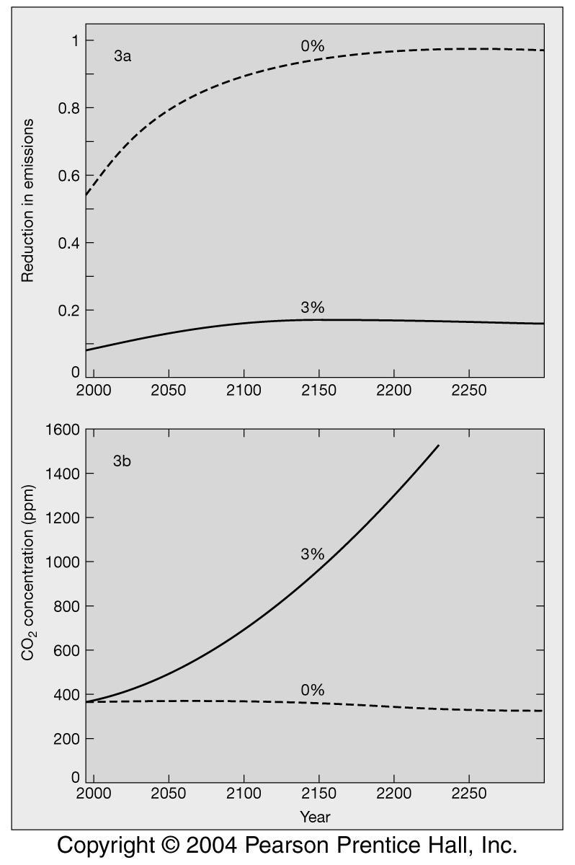
Economics of Climate Change
Intergenerational equity: benefiting from things for which future generations will have to pay; discounting costs and benefits
Other equity issues: “Developing” vs. “developed” countries: Who is more responsible, those who emitted in the past, or those who will emit in the future?
Externalized costs: Some of the costs associated with “a product” are paid for by society in general, not the polluter. So, cost of cleaning up are not included in the price.
Notes:
There is a high price to delay: accepting more climate change & higher mitigation costs.

Slide 3
Intergenerational Equity (Justice)
GOAL: To achieve a fair and effective global response to climate change.
Is this correct? Or is it inadequate?
Notes:
Shue says it is inadequate - the notion of “fairness” does not adequately characterize the current generation’s moral obligation to future generations.

Slide 4
Intergenerational Justice
Shue says, “Our moral offense, it seems to me, goes well beyond unfairness. It constitutes the infliction of harm, a violation of what is arguably the most fundamental moral principle of all: Do no harm.”
2 reasons why failure to act is worse than an unfair shirking of responsibility:
Delay is likely to magnify severity.
Historical choices can be irreversible.

Slide 5
Intergenerational Justice (Fairness)
“How and to what extent can the present generation harm future generations?”
“In what ways should the interests of subsequent generations guide present decisions?”

Slide 6
Intergenerational Justice (Fairness)
“Given our limited knowledge of people who will live in the future, how should we relate to them under conditions of risk and uncertainty?”
“What motivations should we have for fulfilling our duties to future people, given that we know neither their individual identities nor their particular preferences?”

Slide 7
Economics of Climate Change
ECONOMICS
population growth & economic growth as climate-change drivers
costs of abatement, adaptation, and impacts
consequences of alternative regimes of action & inaction for economic growth, employment, trade

Slide 8
Economics of Climate Change
There is much more uncertainty about damages than about abatement costs.
The link between changes in GHG concentration and climate change is uncertain, as is the link between the change in climate and the associated ecosystem change and the effect on the quality of life and economic activity.
Types of evidence of economic costs of temperature change:
experimental, e.g. grow plants in experimental plots, changing carbon and temperature and
cross-sectional statistical (hedonic) models.
These estimate the relation between agricultural productivity and climate.
These estimates ignore “catastrophic” changes. They find that global warming has small economic effects.

Slide 9
Several (older) damage estimates for the US
Nordhaus, Cine, Fankhauser and Tol estimate cost to "current" (e.g. early to mid 90's) US economy of doubling GHG concentrations.
Many of these studies were based on evidence from a 1989 EPA report.
These estimates are for the cost to the US 1990 economy of doubling GHG concentrations.
(There is no reason to assume that the cost to the economy in 2050 would be comparable to cost today – although it might be.)
The estimates range from 0.1-0.9 % of annual GNP. Most of the damages in Agriculture, Water, and Coastal regions.

Slide 10
Forward-looking estimates - US
Meldesohn and Neuman (1999) attempted to estimate the cost on the future economy that will exist when GHG concentrations are doubled (2060).
This creates even more uncertainty, since we don't know what the economy will look like 100 years from now, but it addresses a more relevant question.
This study attempts to include the effect of adaptation, which will reduce the damages. It also includes the effect of carbon fertilization which converts annual agricultural damages of $11 billion into benefits of $10 billion.
The study also attempts to include other benefits, e.g. fruits and vegetables do better in warmer climates; some timber species will be grown in new areas.
Study finds that the benefits to agriculture swamp the costs, at moderate (2.5 °C) increases in temperature (and 7% increase in precipitation): net US benefits are $19.8 billion 1998 dollars.
If temperature increases to 5°C, estimated annual damages are $10 billion 1998 dollars. (Compare estimates of federal costs from Katarina in excess of $200 billion).

Slide 11
Global damage estimates from 2.5-5°C Increase
Estimates depend on the regional change of climate. Most models assume that precipitation increases in most places; temperatures increase everywhere, but most strongly in higher latitudes.
Most damage estimates from the mid 1990s are in the range of 1 - 2 % of GDP, although for some countries there are much higher estimates (9 - 21% for India).
Damage estimates from late 90s and early 2000’s are much smaller - a fraction of 1% of world GDP. Some regions continue to gain from warming, but gain is again small, a fraction of 1% of GDP.
Agriculture, energy and water are the important sectors for damages.
Recent studies show smaller costs to coasts regions (compared to earlier studies) because they assume that responses (e.g. better sea walls) are spread out over a century.
Distribution of costs and benefits are unequal.
Define rich country as those with per capita income greater than $10,000 (1998 dollars).

Slide 12
Annual Costs and Benefits (1998 dollars) for rich and poor
 | 2.5°C Warmer | 5°C Warmer
Rich | $18-$45 billion benefit | $10-$26 billion benefit
Poor | $60-$80 billion benefit | $20-$80 billion damages
Notes:
Why damage estimates so small?
• Mendelsohn claims that the evidence suggests a global warming presents steadily increasing risk,
not a threshold phenomenon.
• Most models assume that change is gradual, and that damages can be mitigated by adaptation.
• These models (typically) recommend that only modest near-term efforts should be made to reduce GHG emissions.

Slide 13
Economic Issues Related to Climate Change
Predictions are often based on average global temperature rise (Why?)
Representing “climate damage” as a smoothly rising curve
BUT, economics and markets are volatile
Markets delay & the over-react ➔ panic
Supply crises are likely to trigger recession, depression
Notes:
William R. Cline, senior fellow jointly at Peterson Institute for International Economics and Center for Global Development in Washington, DC.
1992 publication: The Economics of Global Warming
Developed the DICE model (Dynamic Integrated Model of Climate and the Economy)

Slide 14
Current economic models
Based on slow, steady economic growth with stable political systems
Most projections cover only a few years; at most a few decades
Forced to work with averages of phenomena that are (in reality) highly variable
e.g., temperature projections, emissions, costs of abatement, climate sensitivity

Slide 15
Current economic models
Mathematical functions play significant emphasis on inputs (discounting)
Minor variations of inputs frequently result in significant changes in model outcomes
Cline designates pessimistic, moderate, and optimistic temperature inputs that vary by a total of only 1.2°C over 100 years
Traditionally have avoided catastrophic events in analysis
Throw them on top of data as added incentive to act on existing data
Notes:
DICE - despite the serious threats to the global economy posed by climate change, little should be done to reduce carbon emissions in the near future; that controls on carbon should be put into effect in an increasing, but gradual manner, starting several decades from now. This conclusion has withstood the many modifications Nordhaus and others have made to the climate science embodied in DICE. Their idea is not that climate change shouldn't be taken seriously, but that it would be more equitable (and efficient) to invest in physical and human capital now, so as to build up the productive base of economies (including, especialy, poor countries), and divert funds to meet the problems of climate change at a later year. These conclusions are reached on the basis of an explicit assumption that global GDP per capita will continue to grow over the next 100 years and more even under business as usual, an assumption that the Review would appear to make as well.
- Dasgupta

Slide 16
Current economic models
Fail to account for asymmetry in timing of costs and benefits of action
Improperly account for lifespan benfits of abatement
Discount rates indicate we’d be better off investing recources allocated for CO2
Investments last 10-15 years vs. abatement, which extends multiple centuries
Skewed towards costs of mitigation rather than benefits of abatement
Do not reflect difficulty of performing cost-benefit analysis under disaster conditions
Notes:
Complications of disaster CBA
• Supply and demand responses behave differently under chaotic conditions
– Outside aid and sympathy alter supply and demand conditions
– Actors may value reinvestment at a short-term cost rather than disturb established supply chains, example: Toyota
• Variable effects on capital stocks greatly impact recovery rates
• Available reinvestment and ability to implement new technology also impacts recovery rates
• Multiple factors affect the extent of economic damages
– Location, vulnerability of population, infrastructure, preparedness etc.
• Populations are increasingly concentrated in high risk areas (Rasmussen 2004)
• Economic valuations of human life are often based on a person’s lifetime economic contributions
– Is this a valid measure when it is the marginalized that are most directly impacted by the effects of climate change?
Disasters create irrational economic behavior
• Insurance premiums and deductibles of coastal
properties are skyrocketing due to costs of
hurricane Katrina (Treaster NYT 2006)
– Premiums rise $35,000 to $430,000
– Deductibles rise $5000 to $125,000
– Billions in equity lost thru impact on housing prices
– Lost equity = lost collateral for rebuilding
• Stock market crashes in general all reflect
irrational consumer and financial institution
behavior

Slide 17
Economic Bottom Line
Due to high variability in the economic impacts of disasters, the potential costs of climate change could be significantly greater than what is reflected by existing economic models
The dramatic limitations of our existing models must be accounted for before valid prioritization of climate change policies can occur

Slide 18
The Stern Review
Commissioned by the Chancellor of the Exchequer
Assess the evidence and
build understanding
of the economics of climate change.
International perspective
Political document
Notes:
Uses the PAGE model

Slide 19
The Stern Review
Climate change presents a unique challenge for economics
It is the “greatest and widest-ranging market failure ever seen.”
Economic analysis must be
global
deal with long time horizons
have economics of risk and uncertainty at centre stage
examine possibility of major, non-marginal change

Slide 20
The Stern Review
Central Thesis
The benefits of strong, early action on climate change outweigh the costs.
What we do now can have only limited effect on climate over the next 40-50 years.
What we do in the next 10-20 years can have a profound effect on climate in the 2nd half of this century and beyond.
The less mitigation we do now, the greater the difficulty of continuing to adapt in the future.
Notes:
DICE Model (Cline) suggests investment in CC mitigation yields marginal returns
Main difference is in importance of future generations
Stern report estimates much higher damages, and accordingly calls for greater effort to reduce GHG emissions.

Slide 21
The Stern Review
Analyses
Consider physical impacts of climate change on economy, on human life, and on the environment
Use economic models to
Integrated assessment models to estimate economic impacts of climate change
Macro-economic models to represent costs & effects of transition to low-carbon energy system for the economy as a whole.
Use comparisons of current level and future trajectories of the ‘social cost of carbon’ with the marginal abatement cost

Slide 22
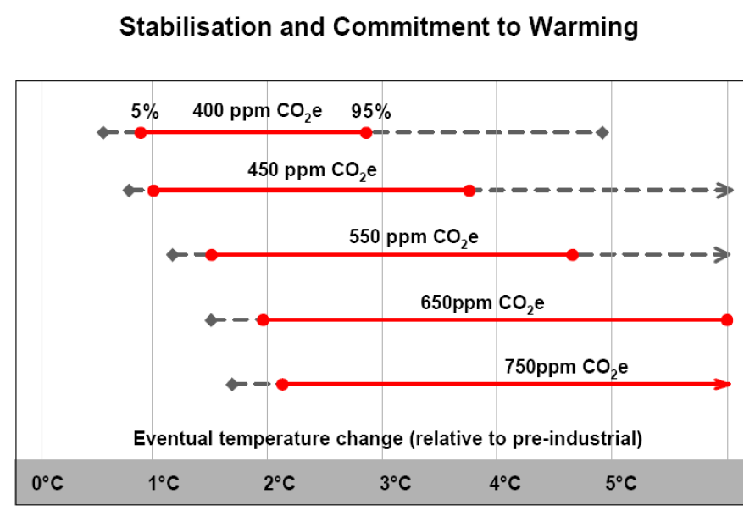
Notes:
Figure 2 Stabilisation levels and probability ranges for temperature increases
The figure illustrates the types of impacts that could be experienced as the world comes into equilibrium with more greenhouse gases.
The top panel shows the range of temperatures projected at stabilisation levels between 400ppm and 750ppm CO₂e at equilibrium. The solid horizontal lines indicate the 5 - 95% range based on climate sensitivity estimates from the IPCC 2001² and a recent Hadley Centre ensemble study³. The vertical line indicates the mean of the 50th percentile point. The dashed lines show the 5 - 95% range based on eleven recent studies⁴.

Slide 23
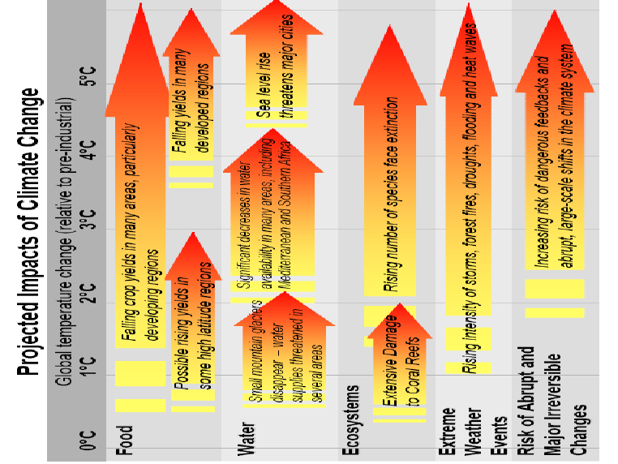
Notes:
Figure 2 Stabilisation levels and probability ranges for temperature increases
The figure illustrates the types of impacts that could be experienced as the world comes into equilibrium with more greenhouse gases.
The bottom panel illustrates the range of impacts expected at different levels of warming. The relationship between global average temperature changes and regional climate changes is very uncertain, especially with regard to changes in precipitation (see Box 4.2). This figure shows potential changes based on current scientific literature.

Slide 24
Stern’s estimates of damages of temperature change
Earlier models used scenario of 2-3°C warming, predicting losses equal to 0-3% of annual gross world product (GWP)
Recent evidence suggests greater climate change, possible 5-6 degrees. Existing IAMs show a loss (including only market losses) of over 5% of GWP at these levels.
Including non-market losses (direct impacts on health and environment) increases estimate to 15% of GWP.
Costs fall disproportionately on poor. Weighting these costs more heavily increases estimate to 20% of GWP.

Slide 25
Vulnerability of Poor Regions
Poor regions already tend to be warmer and suffer from higher variability of rainfall.
Further warming will bring few benefits to these regions
Heavy dependence on agriculture.
Poverty makes it difficult for these regions to invest in adaptation/mitigation.
Rising sea levels and other climate-related events could spur mass migration.

Slide 26
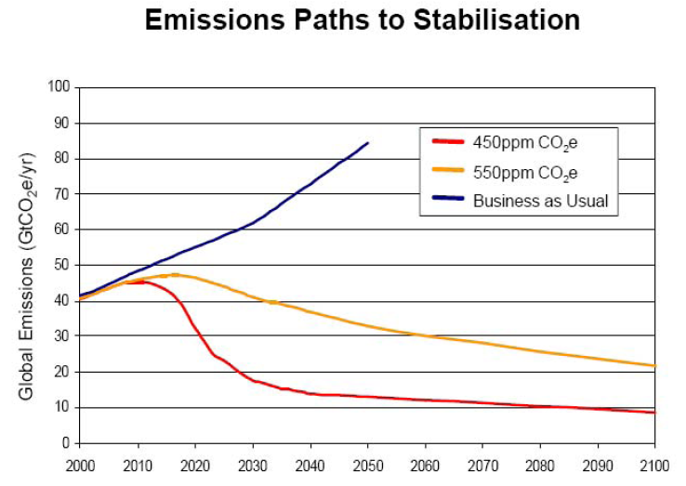
Notes:
Stabilization at or below 550 ppm CO2e would require globa emissions to peak in the next 10-20 years, then fall at a rate of 1-3% / year. By 2050, global emissions need to be around 25% below current levels (in the context of an economy that may be 3-4 times larger than todays – emissions per unit GDP would need to be one-quarter of current levels by 2050.
To stabilize at 450 ppm CO2e, without overshooting, global emissions would need to peak in the next 10 years nad then fall at more than 5% per year, reaching 70% below current levels by 2050.
Figure 3 Illustrative emissions paths to stabilise at 550ppm CO2e.
The figure shows six illustrative paths to stabilisation at 550ppm CO2e. The rates of emissions cuts given in the legend are the maximum 10-year average rate of decline of global emissions. The figure shows that delaying emissions cuts (shifting the peak to the right) means that emissions must be reduced more rapidly to achieve the same stabilisation goal. The rate of emissions cuts is also very sensitive to the height of the peak. For example, if emissions peak at 48 GtCO2 rather than 52 GtCO2 in 2020, the rate of cuts is reduced from 2.5%/yr to 1.5%/yr.

Slide 27
Cost Estimates of Stabilization
Stabilization at or below 550ppm requires emissions to peak within the next 10-20 years and then fall at an annual rate of 1-3%.
Global emissions by 2050 would have to be 25% below current levels
Since world economy may be 3-4 times current size by 2050, emissions per $ output in 2050 would have to be ¼ of current levels.
They estimate that this would cost about 1% of GWP.
They conclude that a stabilization target of 550 ppm is reasonable; a more ambitious target might be too costly.
Notes:
However, Hanson warns we need to stabilize at 350 PPM!
And stabilisation at 450 may be out of reach, given we are likely to reach this level within 10 years.
Anything higher than 550 ppm CO2e substantially increase the risks of very harmful impacts while reducing the expected costs of mitication by comparatively little. Anything lower than 450 ppm CO2e would impose very high adjustment costs in the near term for small gains (?) and may not even be feasible, not least because of past delays in taking strong action.
Uncertainty is an argument for more, not less, demanding goal, because of the size of the adverse climate-change impacts in the worst-case scenarios.

Slide 28
How do we cut emissions?
Stern suggests four ways.
Reducing demand for emissions-intensive goods & services
Increased efficiency, which can save both money & emissions
Action on non-energy emissions, such as avoiding deforestation
Switching to lower-carbon technologies for power, heat, and transport
Costs differ considerably depending on which combination of methods is used, and in which sector.
Notes:
Power sector will have to be at least 60% and perhaps as much as 75% decarbonized by 2050 to stabilize at or below 550 ppm CO2e.
Deep cuts in transport are more difficult short-term, but will ultimately be needed. Many of the technologies needed to achieve this already exist, but the priority is to bring down their costs so they are competitive with fossil-fuel alternatives under a carbon-pricing policy regime.
Based on 2 methods of estimating costs (resource costs of measures vs. BAU & macroeconomic models), central estimate is that stabilisation of GHG at levels of 500-550 ppm CO2e will cost, on average, 1% annual global GDP by 2050 (Range: -1% [net gain] to 3.5%). This is significant, but is fully consistent with continued growth and development, in contrast with unabated climate change, which will eventually pose significant threats to growth.

Slide 29
Policies to reduce emissions should be based on 3 essential elements
Carbon pricing
Tax, trading, regulation
Those who produce GHGs are bringing about climate change, thereby imposing costs on the world and future generations, but do not face full consequences of action themselves
Technology policy
Full spectrum from research & development to demonstration & early-stage deployment
Closer collaboration between government & industry
Costs of technology are likely to fall over time
Removal of barriers to behavioral change
Lack of reliable information, transaction costs, behavioral & organizational inertia
Regulatory measures can play powerful role (e.g., minimum standards for buildings, appliances)
Information policies, including labeling and sharing
Fostering shared understanding of nature of climate change and its consequences
Adaptation policy is also crucial, but has been under-emphasized in many countries

Slide 30
CCX Overview
Unprecedented voluntary GHG emission reduction and trading pilot program administered by 100+ companies and organizations
Total member emissions = ~240 million metric tons CO2 equivalent (~4% US CO2 emissions)
Member commitment to reduce GHG emissions below a “baseline” (average 1998-2001 levels):
1% in 2003
2% in 2004
3% in 2005
4% in 2006
4.25% in 2007*
4.5% in 2008*
5% in 2009*
6% in 2010*
Current Baseline = 155 MMTCE
Reduction or offset of ~46MMTCE during 2003-2010
Current price on CCX = $5.75 / MMTCE
Price on ECX = ~$24.90 / MMTCE (04/02/08)
*Extension Period

