Slide 1
Climate Change of the Next 100 Years
Or: Where Do We Go From Here?
Notes:
Part of climate change is already “in the pipeline”.

Slide 2
Models Used in the AR4
Atmosphere-Ocean General Circulation Models (AOGCMs)
  Most common, 23 models
  More comprehensive
  Notable progress in many areas
Earth System Models of Intermediate Complexity (EMICs)
  Simplified representation
  More evaluation than in previous ARs
  Useful when AOGCMs can’t be used
    Long-term climate projections (beyond those that can be modeled with AOGCMs)
    Large ensemble runs

Slide 3
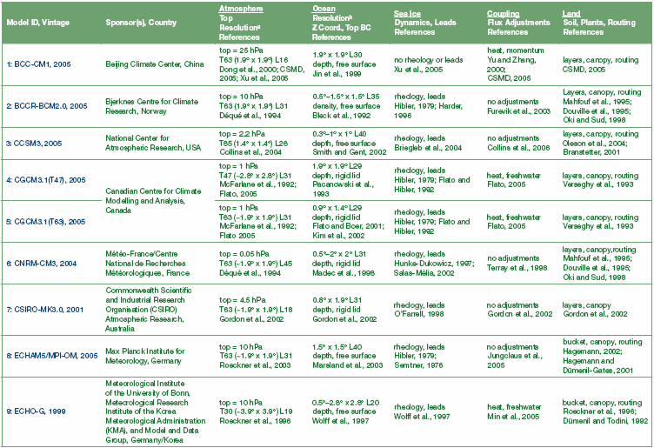
Models Used in the AR4

Slide 4
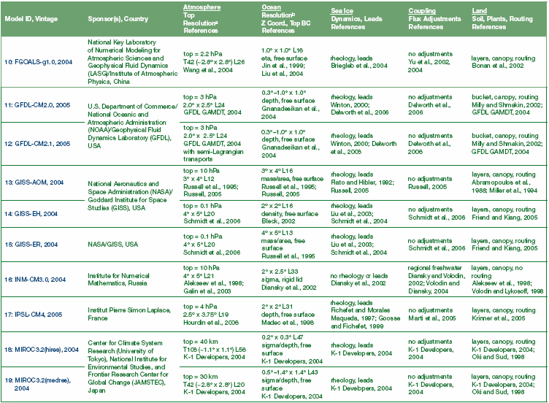
Models Used in the AR4

Slide 5
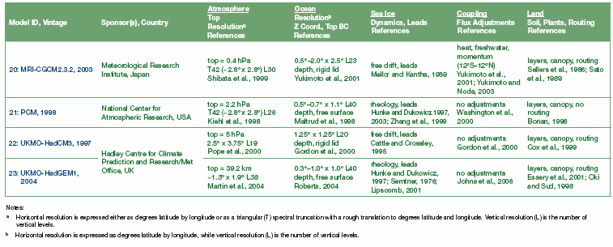
Models Used in the AR4

Slide 6
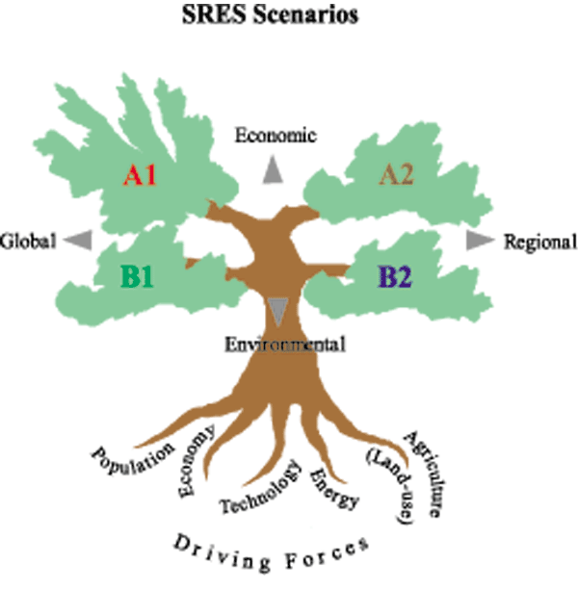
Special Report on Emissions Scenarios
(SRES)
Prepared for IPCC Third Assessment Report (TAR)
  Also used in AR4
Replaces IS92 scenarios used in 2nd assessment report
Futures are generally more
affluent than today
Considers
  Greenhouse gases: CO₂, CH₄, N₂O,
  HFC, and other gases (CO,
  NMVOCs, NO_{x})
  Other gases: Sulfur

Slide 7
Special Report on Emissions Scenarios
(SRES)
Available at http://www.grida.no/climate/ipcc/emission/
4 storylines
  Consider future greenhouse gas pollution, land-use change, and other driving forces
  Peak Oil is not discussed
  Do not include additional climate initiatives (e.g., UNFCCC or Kyoto Protocol emissions targets
40 different scenarios, grouped by family into the storylines
  These are not predictions or forecasts!
  There is NO “best guess” scenario
  Scenarios are NOT policy recommendations
6 scenario groups are considered equally sound and span a wide range of uncertainty

Slide 8
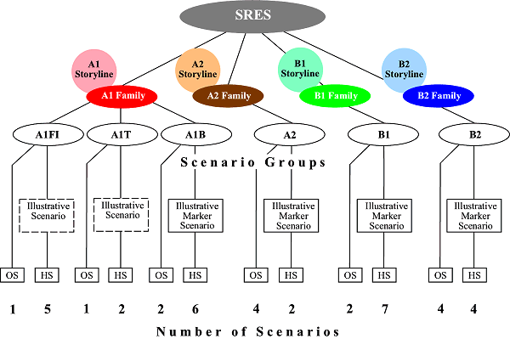
Special Report on Emissions Scenarios
http://www.grida.no/climate/ipcc/emission/index.htm

Slide 9
Special Report on Emissions Scenarios
(SRES): Why storylines?
To help the writing team to think more coherently about the complex interplay among scenario driving forces within each and across alternative scenarios;
To make it easier to explain the scenarios to the various user communities by providing a narrative description of alternative futures that goes beyond quantitative scenario features;
To make the scenarios more useful, in particular to analysts who contribute to IPCC WGII and WGIII;
  The social, political, and technological context described in the scenario storylines is all-important in analyzing the effects of policies either to adapt to climate change or to reduce GHG emissions; and
To provide a guide for additional assumptions to be made in detailed climate impact and mitigation analyses
  At present no single model or scenario can possibly respond to the wide variety of informational and data needs of the different user communities of long-term emissions scenarios.

Slide 10
SRES: A1 Storyline – A more integrated world
Rapid economic growth (~3%/year to 2100)
  Strong commitment to market-based solutions
Global population reaches 9 billion in 2050 and gradually declines
Quick spread of new and efficient technologies
  High rates of investment and innovation at national & international level
Convergent world
  Income and way of life converge between regions
  Extensive social and cultural interactions worldwide
Notes:
In the A1 scenario family, demographic and economic trends are closely linked, as affluence is correlated with long life and small families (low mortality and low fertility). Global population grows to some nine billion by 2050 and declines to about seven billion by 2100. Average age increases, with the needs of retired people met mainly through their accumulated savings in private pension system

Slide 11
SRES: A1 Storyline Subsets
A1F1
  Emphasis on fossil fuels
A1B
  Balanced emphasis on all energy sources
A1T
  Emphasis on on-fossil energy sources

Slide 12
SRES: A2 Storyline – A more divided world
World of independently operating, self-reliant nations (lower trade flow, less international cooperation)
Continuously increasing population (15 billion by 2100)
Regionally oriented economic development
  Self-reliance and preservation of local identities
Slower and more fragmented technological changes and improvements to per capita income
  Primary changes in agricultural productivity to feed the 15 billion

Slide 13
SRES: B1 Storyline – A more integrated, more ecologically friendly world
High level of environmental and social consciousness; globally coherent approach to more sustainable development
Rapid economic growth as in A1, but with rapid changes towards a service and information economy
Global population reaches 9 billion in 2050 and gradually declines as in A1
Reductions in material intensity and the introduction of clean and resource efficient technologies
  Smooth transition to alternative energy systems as conventional oil and gas resources decline
Emphasis on global solutions to economic, social and environmental stability

Slide 14
SRES: B2 Storyline – A more divided, but more ecologically friendly world
Increased concern for environmental and social sustainability compared to A2, with shift to local and regional decisions
Continuously increasing population, but at a slower rate than in A2
Emphasis on local, rather than global, solutions to economic, social and environmental stability
Intermediate levels of economic development
Less rapid and more fragmented technological change than in B1 & A1.

Slide 15
Six Modeling Approaches For
Developing Emissions Scenarios
Multi-model approach for developing emissions scenarios.
40 scenarios were developed using 6 models:
  Asian Pacific Integrated Model (AIM)
    National Institute of Environmental Studies, Japan
  Atmospheric Stabilization Framework Model (ASF)
    ICF Consulting, USA
  Integrated Model to Assess the Greenhouse Effect (IMAGE)
    National Institute for Public Heath and Environmental Hygiene in connection with Dutch Bureau for Economic Policy Analysis Worldscan Model, the Netherlands
  Multiregional Approach for Resource and Industry Allocation (MARIA)
    Science University of Tokyo, Japan
  Model for Energy Supply Strategy Alternatives and their General Environmental Impact (MESSAGE)
    International Institute of Applied Systems Analysis, Austria
  Mini Climate Assessment Model (MiniCAM)
    Pacific Northwest National Laboratory, USA
Notes:
6 models are representative of approaches to emissions scenario modeling and the different integrated assessment frameworks used in the scenario literature; include both macro-economic (top-down) and systems-engineering (bottom-up) models.
Some modeling teams developed scenarios to reflect all 4 storylines; some presented scenarios for fewer storylines.

Slide 16
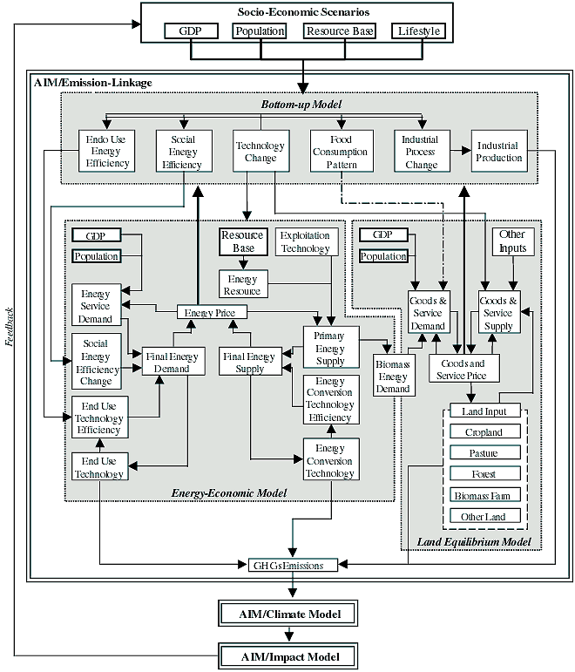
Asian Pacific Integrated Model (AIM)
Notes:
The Asian Pacific Integrated Model (AIM) is a large-scale computer simulation model for scenario analyses of greenhouse gas (GHG) emissions and the impacts of global warming in the Asian-Pacific region. This model is being developed mainly to examine global warming response measures in the region, but it is linked to a world model so that it is possible to make global estimates.
AIM comprises three main models –
the GHG emission model (AIM/emission),
the global climate change model (AIM/climate), and
the climate change impact model (AIM/impact).
The AIM-based quantification was conducted as an Asian collaborative project using a new linked version of the AIM/emission model, which covers the world but has a more detailed structure for the Asian-Pacific region than for other regions. The new linked version couples bottom-up models and top-down models (Figure IV-1).

Slide 17
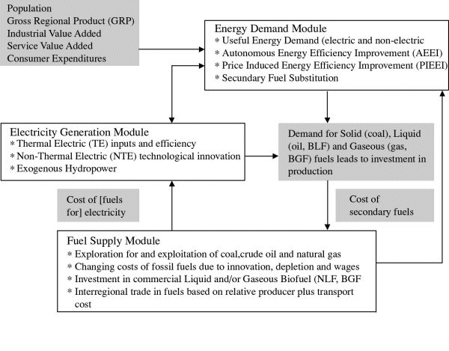
The Atmospheric Stabilization Framework Model (ASF)
Notes:
The current version of ASF includes energy, agricultural, and deforestation GHG emissions and atmospheric models and provides emission estimates for nine world regions (Tables IV-1 and IV-2).
In the ASF model balancing the supply and demand for energy is achieved ultimately by adjusting energy prices. Energy prices differ by region to reflect regional market conditions, and by type of energy to reflect supply constraints, conversion costs, and the value of the energy to end users. ASF estimates the supply-demand balance by an iterative search technique to determine supply prices. These supply prices, which energy producers charge for the fuel at the wellhead or at the mine, are used to estimate the secondary energy prices in each region. These secondary prices are based on the supply price for the marginal export region, the interregional transportation cost, refining and distribution costs, and regional tax policies. For electricity, the secondary prices reflect the relative proportions of each fuel used to produce the electricity, the secondary prices of those fuels, the non-fossil costs of converting the fuels into electricity, and the conversion efficiency.
The agricultural ASF model estimates the production of major agricultural products, such as meat, milk, and grain, which is driven by population and gross national product (GNP) growth. This model is linked with the ASF deforestation model, which estimates the area of land deforested annually as a function of population growth and demand for agricultural products.
The ASF GHG emissions model uses outputs of the energy, agricultural, and deforestation models to estimate GHG emissions in each ASF region. These emissions are estimated by mapping GHG emission sources to the corresponding emission drivers and changing them according to changes in these drivers. For example, CH4 emissions from landfills are mapped to population, while CO2 emissions from cement production are mapped to GNP.
Finally, the ASF atmospheric model uses GHG emission estimates to calculate GHG concentrations, and corresponding radiative forcing and temperature effects. A detailed description of the ASF is provided in the ASF 1990 Report to Congress (Lashof and Tirpak, 1990), and recent applications of the model are reported in Pepper et al. (1998) and Sankovski et al. (2000).

Slide 18
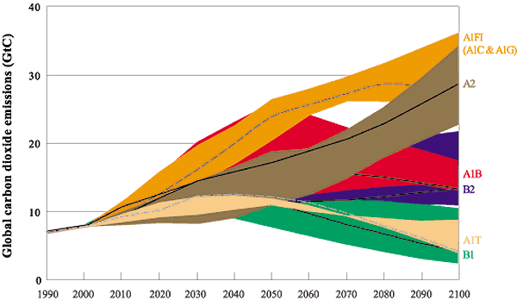
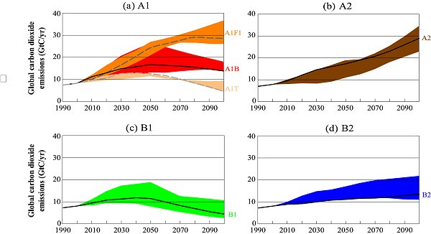
Global annual CO₂ emissions – all sources
(6 scenario groups)
Notes:
Figure SPM-3: Total global annual CO2 emissions from all sources (energy, industry, and land-use change) from 1990 to 2100 (in gigatonnes of carbon (GtC/yr) for the families and six scenario groups. The 40 SRES scenarios are presented by the four families (A1, A2, B1, and B2) and six scenario groups: the fossil-intensive A1FI (comprising the high-coal and high-oil-and-gas scenarios), the predominantly non-fossil fuel A1T, the balanced A1B in Figure SPM-3a; A2 in Figure SPM-3b; B1 in Figure SPM-3c, and B2 in Figure SPM-3d. Each colored emission band shows the range of harmonized and non-harmonized scenarios within each group. For each of the six scenario groups an illustrative scenario is provided, including the four illustrative marker scenarios (A1, A2, B1, B2, solid lines) and two illustrative scenarios for A1FI and A1T (dashed lines).

Slide 19
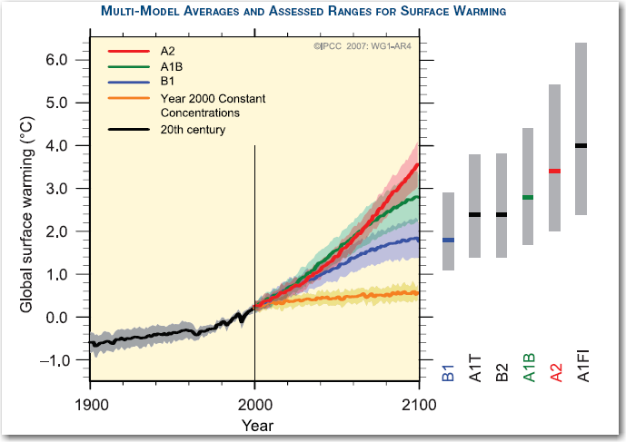
Notes:
Lowest temperatures currently projected for the end of the century represent the lowest scenario the IPCC chose to evaluate (the “B1” scenario).
B1 assumes mid-century peak in global population, rapid change toward service and information technology, shift towards clean and resource-efficient technologies.
Highest temperatures projected represent the highest scenario that the IPCC chose to evaluate (A1F1).
A1F1 assumes mid-century peak in global population, rapid economic growth, “fossil-intensive” energy production and consumption.

Slide 20

Rising Temperatures
Full range of projected temperature increase is 1.1-6.4°C (2-11.5°F)
Best estimate range is 1.8-4.0 °C (1.8-4.0°F)
Warming is expected to be greatest over land and at most high northern latitudes
  Least over Southern Ocean and parts of North Atlantic Ocean
Source: IPCC Climate Change 2007: The Physical Science Basis—Summary for Policymakers.
Notes:
Image from Australian government on http://www.livescience.com/environment/top10_global_warming_results-1.html.

Slide 21
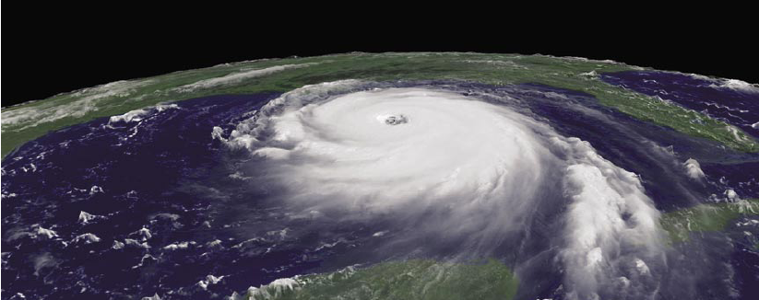
Increasingly Severe Weather
Tropical cyclones (hurricanes and typhoons) are likely to become more intense, with higher peak wind speeds and heavier precipitation associated with warmer tropical seas.
Source: IPCC Climate Change 2007: The Physical Science Basis—Summary for Policymakers.
NOAA

Slide 22
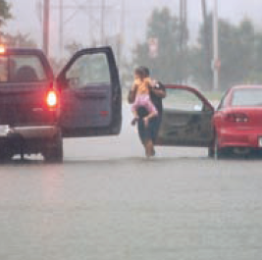
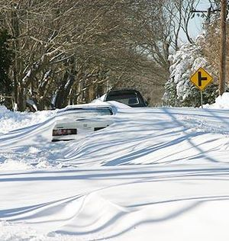
Increasingly Severe Weather
Increases in the amount of high latitude precipitation are very likely.
Associated Press
en.wikipedia.org/wiki/North_American_blizzard_of_2005
Source: IPCC Climate Change 2007: The Physical Science Basis—Summary for Policymakers.
Notes:
Extreme heavy precipitation are very likely to continue becoming more frequent.

Slide 23
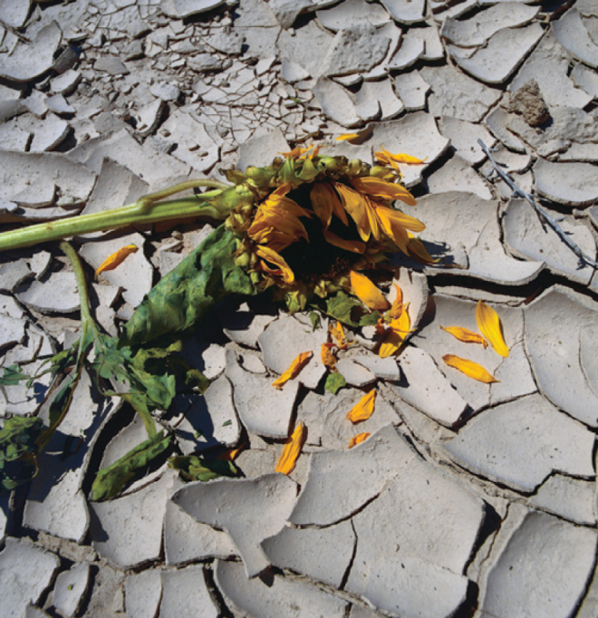
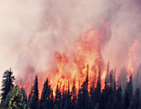
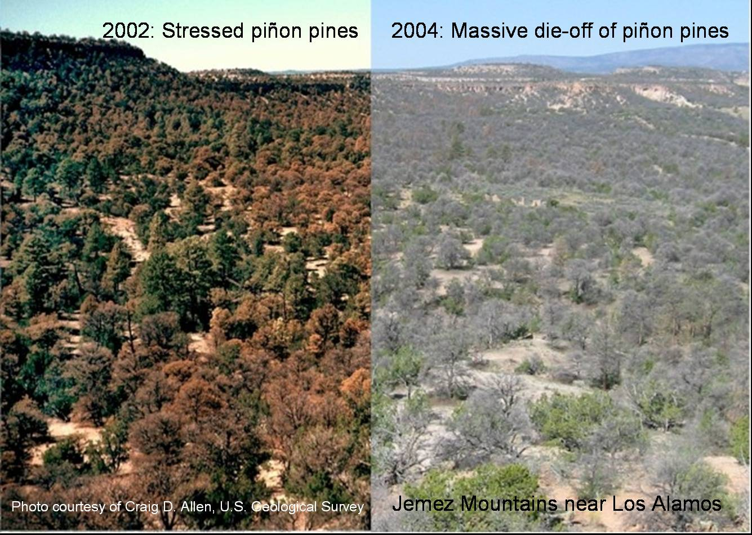
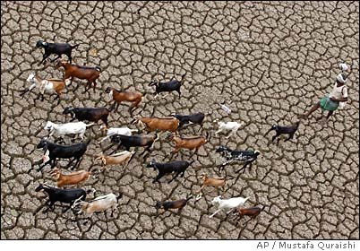
Drought
National Park Service
©INDEX OPEN
Decreases in precipitation are likely in most subtropical land regions
Source: IPCC Climate Change 2007: The Physical Science Basis—Summary for Policymakers.
Notes:
Extreme heat and heat waves are very likely to continue becoming more frequent.

Slide 24
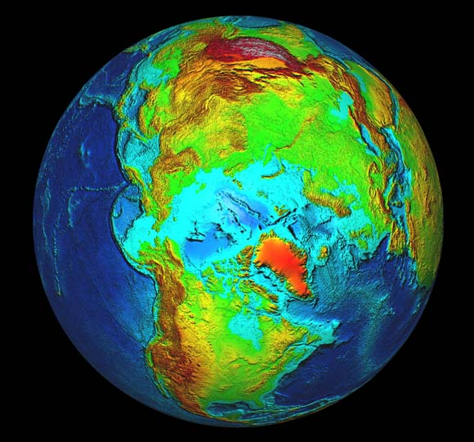
Melting Ice
•Sea ice is projected to shrink in both the Arctic and Antarctic under all
model simulations.
Some projections show that by the latter part of the century, late-summer Arctic sea ice will disappear almost entirely.
NOAA
Source: IPCC Climate Change 2007: The Physical Science Basis—Summary for Policymakers.

Slide 25
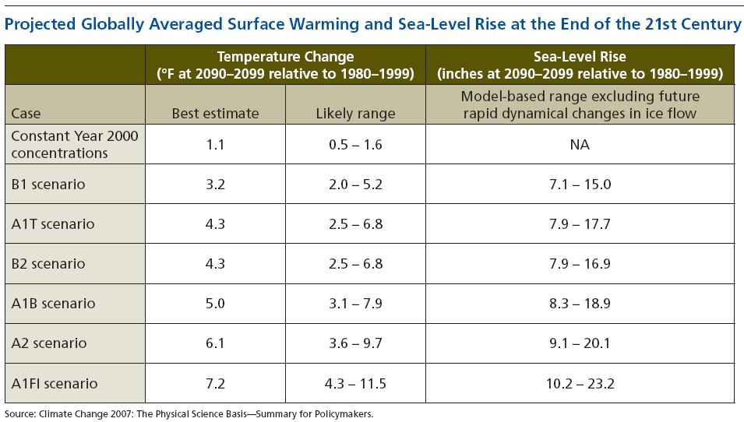
Relative temperature change in °C is equal to °F / 1.8. 1” = 2.54 cm.
For example, the B2 Scenario has the best estimate of temperature change of 2.4 °C and a sea level rise of 20-43 cm by 2090-2099.

Slide 26
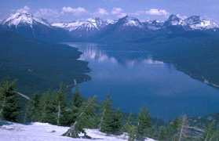
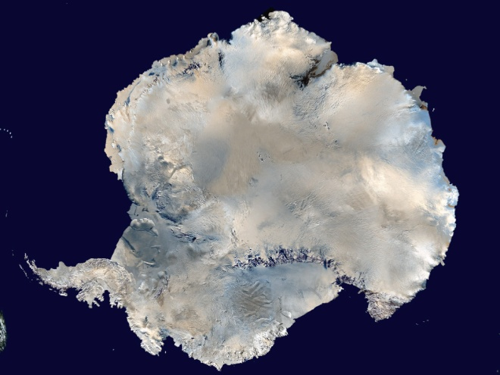
Sea-level Rise Projections Include:
•ocean expansion resulting from increased water temperatures;
meltwater runoff from mountain glaciers around the world; and
a contribution due to increased ice flow from Greenland and Antarctica at the rates observed for 1993-2003.
National Park Service
NASA
Source: IPCC Climate Change 2007: The Physical Science Basis—Summary for Policymakers.
Notes:
Compared with its prior assessment, the IPCC has used improved statistical methods for calculating several factors that contribute to global sea-level rise.
These factors include:
• ocean expansion resulting from increased water temperatures;
• meltwater runoff from mountain glaciers around the world; and
• meltwater runoff and calving (breaking off ) of ice from the Greenland and Antarctica ice sheets.

Slide 27
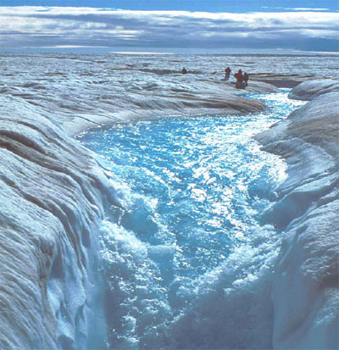
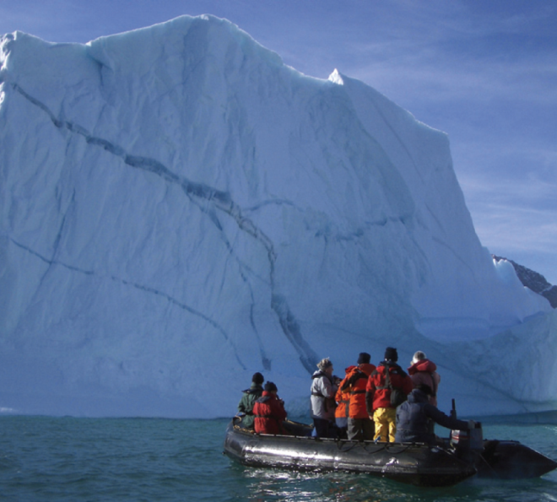
Sea-level Rise Projections DO NOT Include:
• Ice sheet instability
Carbon dioxide uptake changes
IPCC: “Larger values cannot be excluded, but understanding of these effects is too limited to assess their likelihood or provide a best estimate or an upper bound for sea-level rise.”
Photo Roger Braithwaite
iStockphoto.com
Source: IPCC Climate Change 2007: The Physical Science Basis—Summary for Policymakers.
Notes:
Ice sheet instability. Recent observations show that meltwater can run down cracks in the ice and lubricate the bottom of ice sheets, resulting in faster ice flow and increased movement of large ice chunks into the ocean. This process, and others related to ice flow dynamics, directly contributes to sea-level rise.
Carbon dioxide uptake. Evidence suggests that warming tends to reduce land and ocean uptake of atmospheric carbon dioxide, increasing the portion of carbon dioxide emissions that remain in the atmosphere. This would result in further warming and cause additional sea-level rise.
While calling attention to these processes, which could result in a significantly higher global sea-level than that projected in its new report, the IPCC is careful to alert policy makers to the limits of our current ability to quantify these mechanisms: “Larger values cannot be excluded, but understanding of these effects is too limited to assess their likelihood or provide a best estimate or an upper bound for sea-level rise.”
Also, if the observed contributions from the Greenland and Antarctic ice sheets between 1992 and 2003, the IPCC states, “were to grow linearly with global average temperature change,” the upper ranges of sea-level rise would increase by 3.9 to 7.9 inches (0.1 to 0.2 meters). In other words, in this example, the upper range for sea-level rise would be 31 inches (0.79 meters).

Slide 28
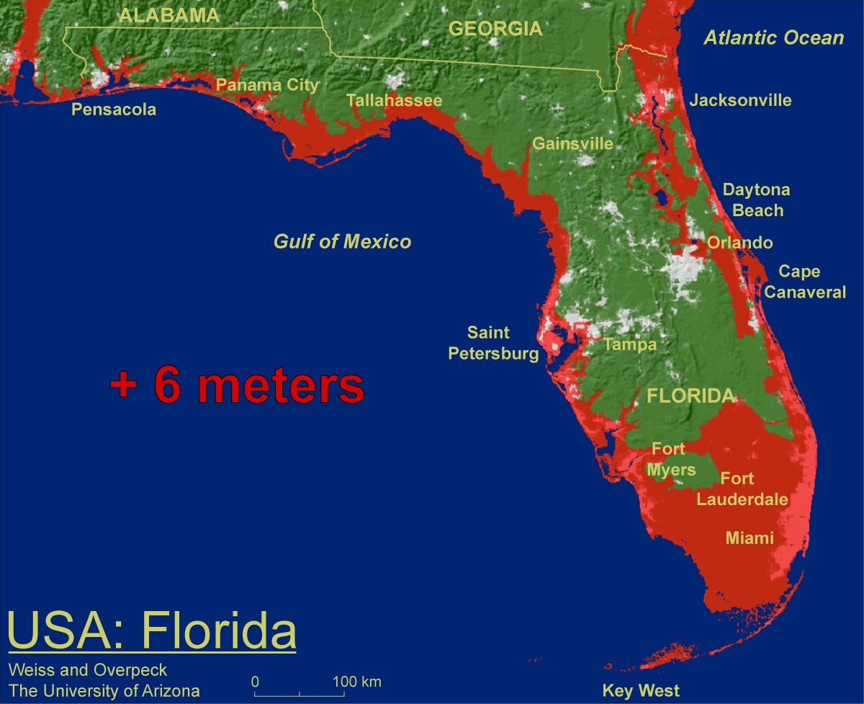
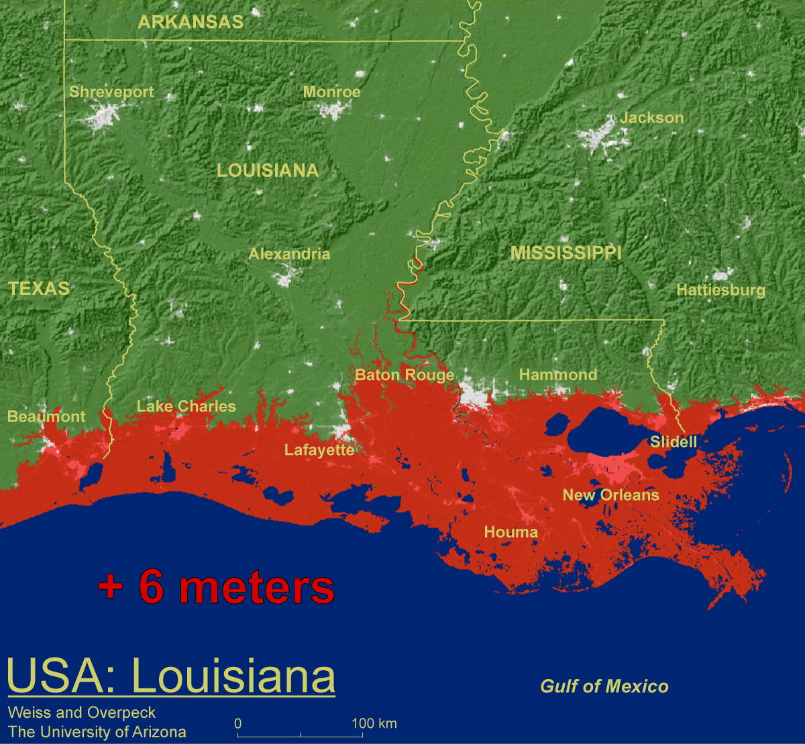
Threshold risks:
Some models do suggest that sustained warming between 2-7ºF above today’s global average temperature would initiate irreversible melting of the Greenland ice sheet—which could ultimately contribute about 23 feet to sea-level rise.
+ 19.7 feet
Weiss and Overpeck U. Arizona
+ 19.7 feet
Source: IPCC Climate Change 2007: The Physical Science Basis—Summary for Policymakers.
Notes:
Some models do suggest that sustained warming between 2 and 7 degrees Fahrenheit above today’s global average temperature would initiate irreversible melting of the Greenland ice sheet—which could ultimately contribute about 23 feet to sea-level rise. This threshold is similar to the IPCC’s best estimate range for temperature increase by the end of this century. The risk for crossing this threshold could occur within our generation, while the consequences would be felt by future generations.

Slide 29
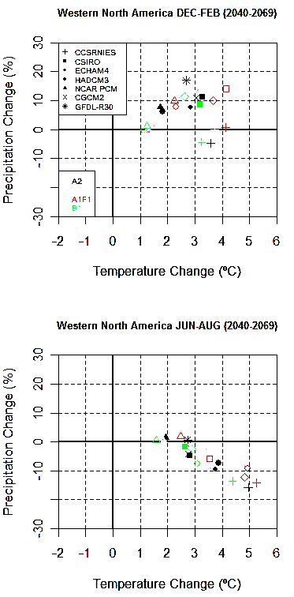
IPCC 4th Assessment GCMs
All Year
3°C (5.4°F) warmer
BUT
Winter – wetter
Summer – drier

Slide 30
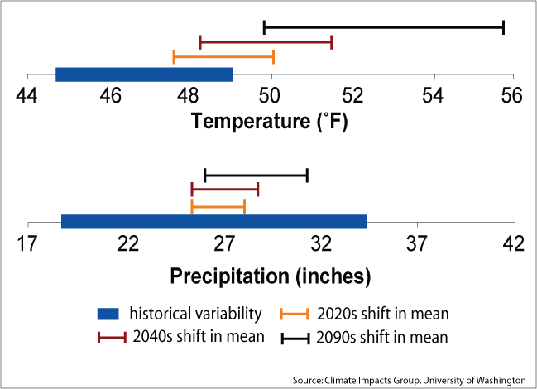

Comparing Projected Change in Mean with
20th Century Variability
Notes:
Species that are primarily sensitive to temperature are likely to continue facing new conditions during the 21st century. Species sensitive primarily to precipitation have likely already experienced the range of conditions they could face in the 21st century.

Slide 31
Naturalized Columbia River streamflow,
The Dalles, OR
30-50% less water in summer
Predicted flow in 2050s
Present flow
100,000 cubic feet per second
Oct
Nov
Dec
Jan
Feb
Mar
Apr
May
Jun
Jul
Aug
Sep
Notes:
http://www.cses.washington.edu/cig/pnwc/pnwwater.shtml
Figure 3 Naturalized Columbia River streamflow at The Dalles (dashed) and in 2050, as simulated by several climate models. The blue band indicates the upper and lower bounds of projected average streamflow in the 2050s. Note the higher winter flows, reduced spring/summer flows, and the shift in the timing of peak spring flows earlier into the spring season. The effects of the Columbia River dams on streamflow have been removed.

Slide 32
MONTANA FOR THE NEXT 50 YEARS
EXPECTED MONTANA ECOSYSTEM TRENDS
- Earlier crop planting dates
More forest/range/crop productivity
Decreased deer/elk winterkill
Hibernating animals?
Increased forest insect/disease trends
More aquatic ecosystem degradation,
low dissolved O₂, high water temps
More aquatic recreation limits

Slide 33
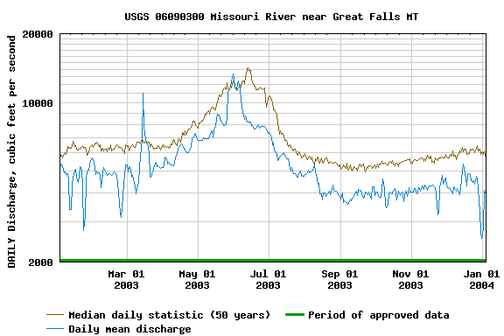

Montana’s Streamflow is decreasing and peaking earlier

Slide 34
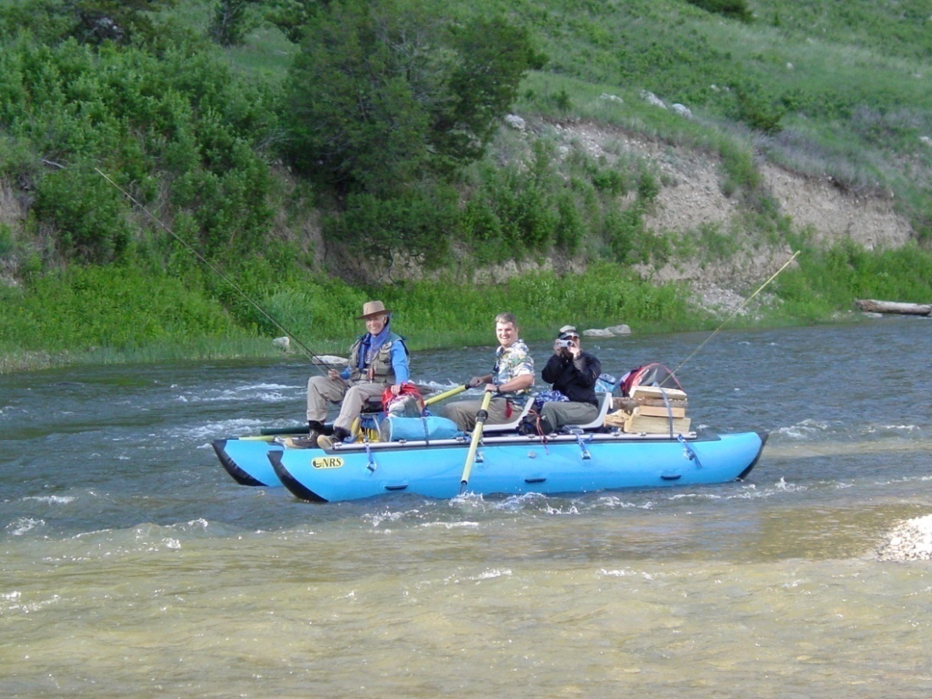
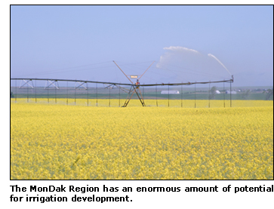
By 2050 Global Climate Models project Montana to be 5°F warmer in summer, but receive 10% less rainfall
Water Management
Recreation versus Agriculture

Slide 35
Land Water Balance Tipping Points
(Growing Seasons)
2005
Increasing
1950
Decreasing
2005
Pest Epidemics
Wildfire
Higher LAI, ET, NPP
Forest Mortality
Higher Streamflows
Low Streamflows
Streambank Erosion
Reduced Nutrient Cycling
Insect-borne diseases
Lower NPP
Human Health
Biodiversity?
Improved wildlife habitat?
Invasives?
Biodiversity?

Slide 36
MONTANA FOR THE NEXT 50 YEARS
EXPECTED MONTANA CLIMATE TRENDS
Shorter, milder winters
Earlier snowmelt
Longer growing seasons
Decreasing summer streamflows
More drought and fire danger
Precipitation???

