Slide 1
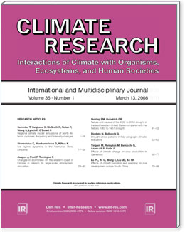
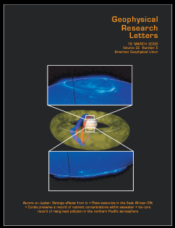
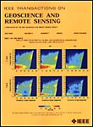
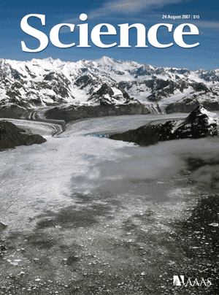
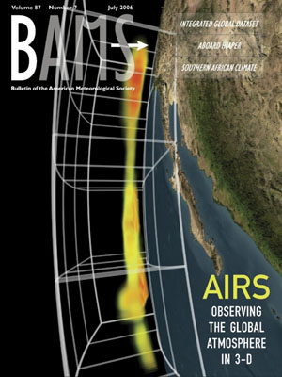
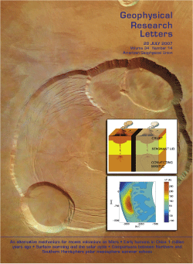
“…there is a scientific consensus on the reality of anthropogenic climate change.” Oreskas, N. 2004. The Scientific Consensus on Climate Change. Science (306):1686
In an analysis of 928 papers on global climate change published in refereed scientific journals between 1993 and 2003 NONE OF THE PAPERS disagreed on the scientific consensus position.
“Many details about climate interactions are not well understood, and there are ample grounds for continued research to provide a better basis for understanding climate dynamics. The question of what to do about climate change is also still open. But there is a scientific consensus on the reality of anthropogenic climate change. Climate scientists have repeatedly tried to make this clear. It is time for the rest of us to listen.” Oreskas, N. 2004

Slide 2
The 5 STAGES OF CLIMATE GRIEF -Steve Running
DENIAL - It is NOT getting warmer, or It is NOT our fault
ANGER – I do NOT want to change my lifestyle
BARGAINING – Warming will make it nicer…
DEPRESSION – It’s too late, we’re doomed
ACCEPTANCE – LETS GET TO WORK,
WE CAN DO IT – We have to…
Apologies to E. Kubler-Ross
http://www.ntsg.umt.edu/files/5StagesClimateGrief.htm

Slide 3
Scientists hopeful despite climate signs By SETH BORENSTEIN, AP Science Writer Sun Sep 23, 2007, 7:31 PM ET
Michael Mann, Penn State U: "Sometimes we fear that we are delivering too morose a message and not conveying enough that there is reason for optimism."
Andrew Weaver, U. of Victoria: "It's hard at times….You can't give up hope because what else is there in life if you give up hope? When you give up hope, that's quitting and scientists don't like to quit."
James Hansen, NASA: "I am always surprised when people get depressed rather than energized to do something. It's not too late to stabilize climate.…I am not about to give up”
David Myers, Hope College (psychologist): "Human beings are remarkably resilient….To do what climate researchers are doing takes enough optimism to sustain their hope and enough realism to create their concern."

