Slide 1

To Receive Honors Credit for this class…
You must register for FOR295-80A (CRN 74798) to get honors credit for this course.
  Forestry students can also enroll in this section without being registered for Honors Credit.
If you are not registered in FOR295, you can
change your schedule until 4:30 p.m. on Sept.
15 using Cyberbear.
From Sept. 15 – Oct. 6, you can change the options by filling out a drop/add form. There is a $10 charge for each drop and each add during this time (a total of $20 to change sections!). You also need your
Advisor’s Signature.
Notes:
1

Slide 2
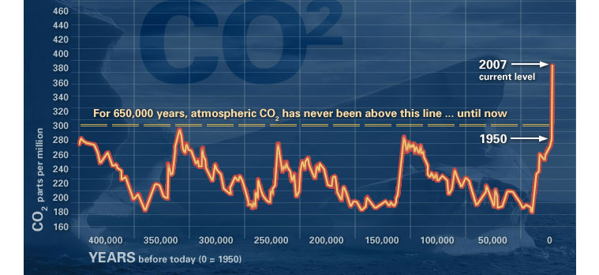

Slide 3


Slide 4
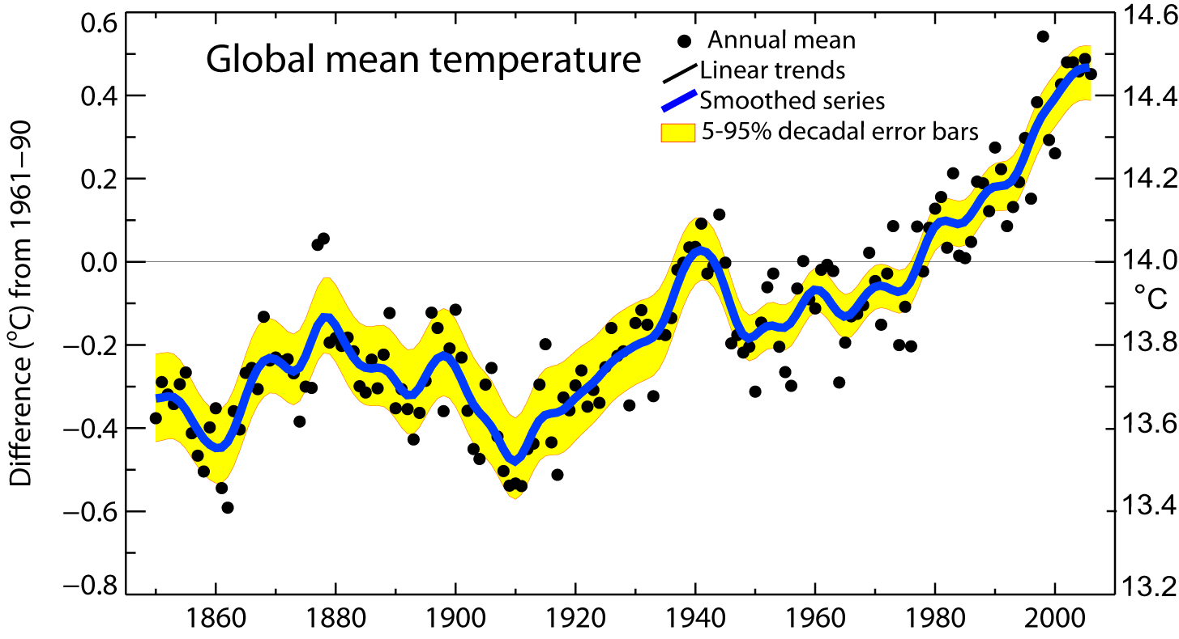
Global mean temperatures are rising faster with time
Warmest 12 years:
1998,2005,2003,2002,2004,2006, 2001,1997,1995,1999,1990,2000
Period Rate
Years °/decade
50 0.128±0.026
100 0.074±0.018

Slide 5
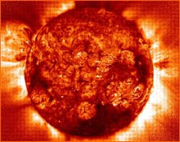
The Earth’s Energy Balance

Slide 6
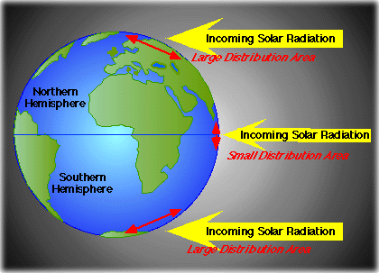
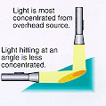
Light is most concentrated from an overhead source
Light hitting at an angle is less concentrated

Slide 7
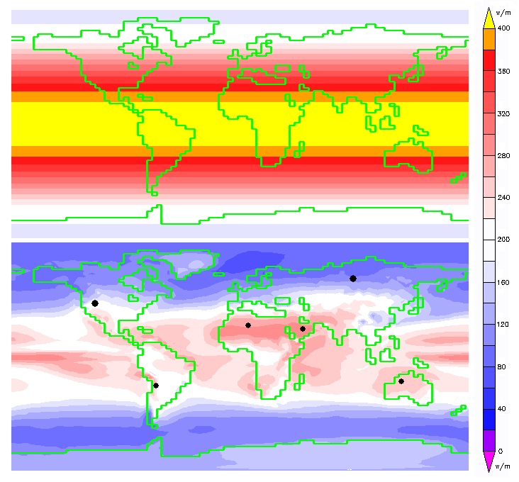
Annual Average Insolation
Top
Of
Atmosphere
Earth’s
Surface
Notes:
Annual average insolation at the top of the atmosphere (above) is markedly higher that at Earth's surface (below). The black dots represent the land area required to replace the total primary energy supply with electricity from solar cells.

Slide 8
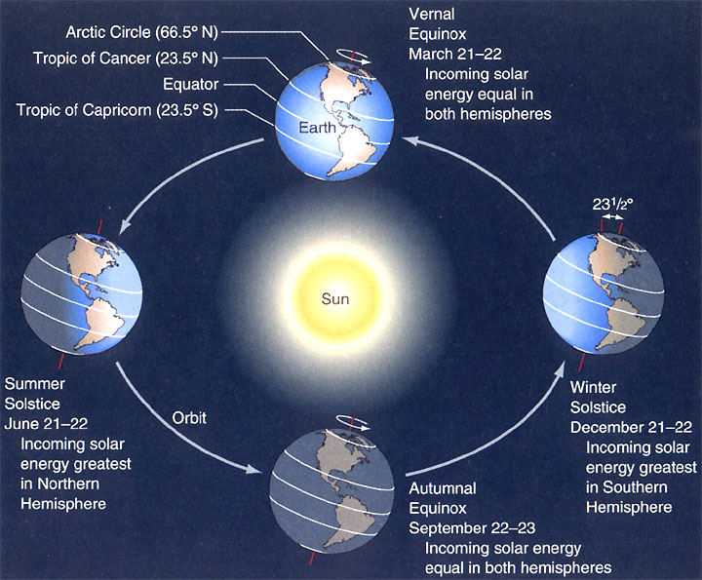
Notes:
Why are there seasons? Basically, it is because the Earth is tilted at 23.5°.
At the Vernal and Autumnal Equinox, energy hits the Earth equally in both hemispheres.
At the summer solstice, incoming solar energy is greatest in the Northern Hemisphere (sun is perpendicular to Earth at the Tropic of Cancer).
At the winter solstice, incoming solar energy is greatest in the Southern Hemisphere (sun is perpendicular to Earth at the Tropic of Capricorn).
The Arctic Circle defines the circle on the earth above which, on December 21, the sun doesn’t rise above the horizon.
The Antarctic Circle defines the point on the earth above which, on June 21, the sun doesn’t rise above the horizon.
In the tropics,there is no real change in daylength => no real change in incoming energy => no seasonal change in temperature.
Seasonality comes from the monsoon season.
June-September in India
November-April in Australia

Slide 9
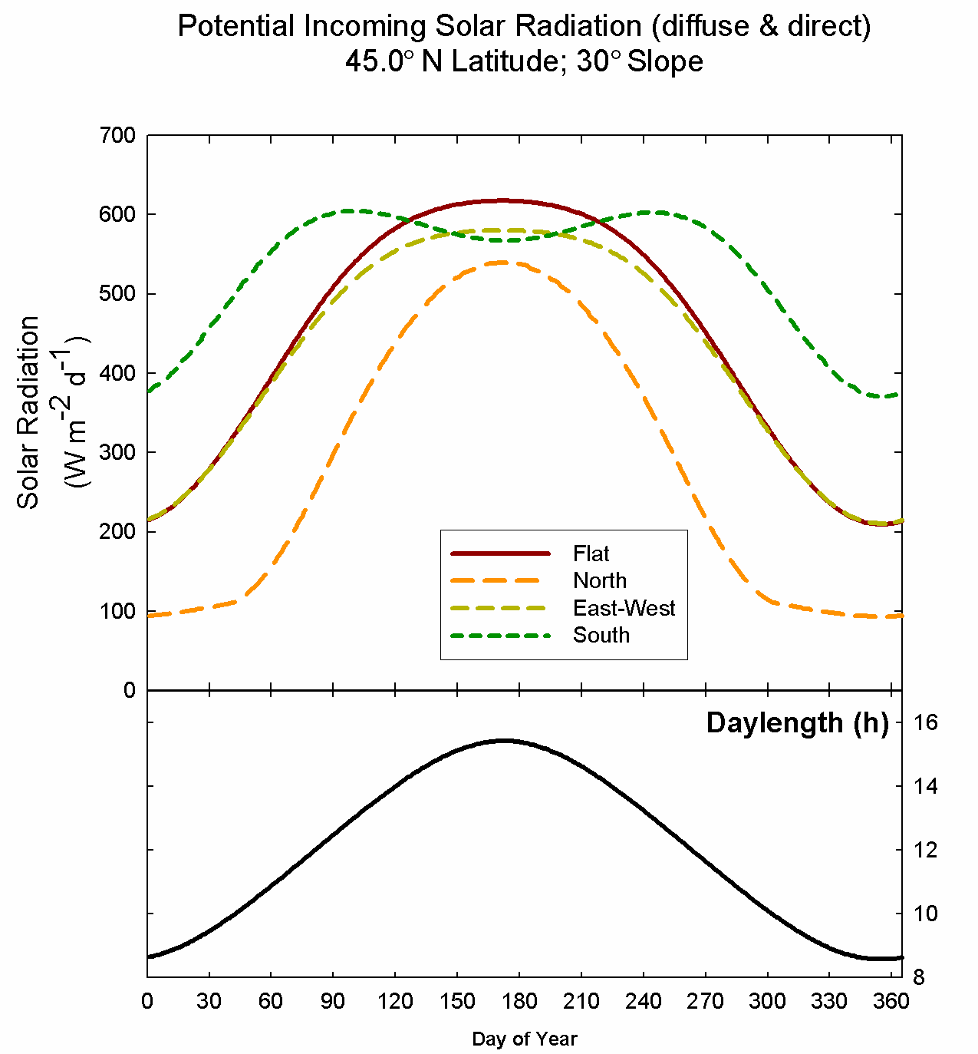

Slide 10
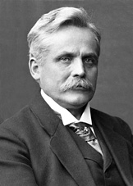
Important Radiation Laws & Concepts
Wien’s Law
λ_{m} (μm) = 2897 / T
λ_{m} ≡ wavelength of maximum intensity; the higher the temperature, the shorter the wavelength & the more intense the light
Wilhelm Wien
(1864-1928)
Notes:
Wien’s law explains the relationship between the temperature and the wavelength of an object.
So, for the earth, temperature is 300 K, meaning the wavelength is ~ 10 microns.
The sun has a T = 6000K, so it’s wavelength is ~0.5 microns.
The law is named for Wilhelm Wien, who formulated the relationship in 1893 based on a thermodynamic argument.

Slide 11
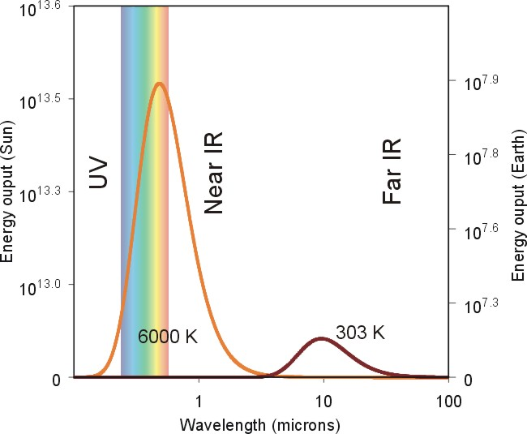
Solar radiation
Earth radiation
Notes:
We are primarily concerned with two types of radiation – the short-wave (visible/nearIR) from the sun and the thermal (long-wave) from the earth.
We need to think of this as a spectrum. A good example is a wood stove in a dark room.
Notice that much of the radiation from the sun is in the visible and near infrared range. In fact, about ½ of all of the energy from the sun is in the visible, also called Photosynthetically Active Radiation (PAR).
Both the Earth and the Sun emit electromagnetic radiation (e.g. light) that closely follows a blackbody spectrum, and which can be predicted based solely on their respective temperatures. For the sun, these emissions peak in the visible region and correspond to a temperature of ~5500 K. Emissions from the Earth vary following variations in temperature across different locations and altitudes, but always peak in the infrared. The bulk of emissions from the Earth radiate from within the colder regions of the atmosphere rather than from the surface directly, and give the Earth an average emission temperature of about 250 K (-20 °C) (Kiehl and Trenberth 1997).

Slide 12
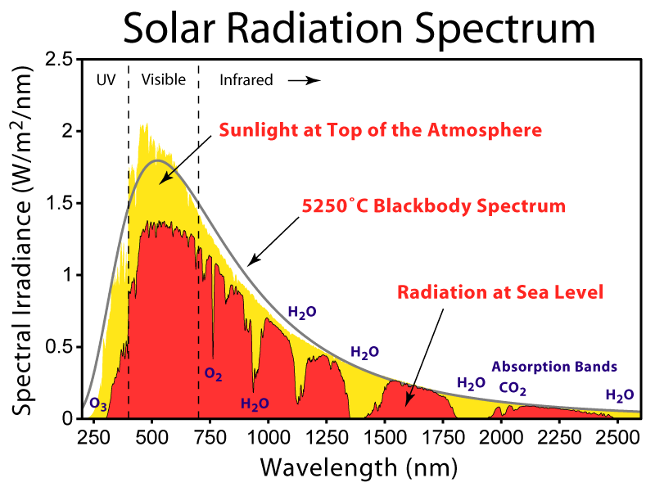

Slide 13
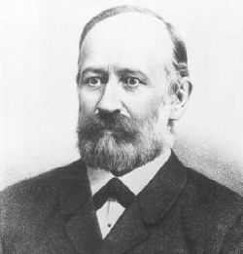

Important Radiation Laws & Concepts
Stefan-Boltzmann Law
E = σ × T⁴
Jožef Stefan
(1835-1893)
Ludwig Boltzmann
(1844-1906)
Notes:
Everything above absolute 0 (0K) emits energy at a rate to the 4th power of its temperature.
So, if it is warmer, it emits much more energy. Since it is at the 4th power, the relationship
Shoots up quickly as the temperature increases. It is easy to see why the sun (6000K) (hot) emits much
more than the earth (300K).
The law was deduced by Jožef Stefan (1835-1893) in 1879 on the basis of experimental measurements made by John Tyndall and was derived from theoretical considerations, using thermodynamics, by Ludwig Boltzmann (1844-1906) in 1884

Slide 14

Radiation
Radiation
Conduction
Convection
Notes:
There are 3 ways in which energy transfer occurs:
Radiation – transfer through the air (e.g., sun)
Conduction – transfer along/between objects (e.g., touch a hot poker)
Convection – movement caused by convective air movement (e.g., thermals from a stove)
When it is cold, you don’t feel or see any thermal energy coming from it. As you begin to pile on the logs, though, you can start feeling the energy. If you keep adding logs, then it will eventually start to glow a reddish tint.
If you switch to coal, it can eventually get white-hot (visible), but then, you’d better leave, b/c your house is about to explode!

Slide 15

Important Radiation Laws & Concepts
Net radiation
Rn = incoming – outgoing
Rn = (1- α)I_{s} + E_{L} σT⁴(surface) - σ T⁴(sky)
α is albedo, which is the
reflectivity of a surface
fresh snow has a high albedo (0.9)
dark forest has a low albedo (0.05 – 0.15)
light colored soils are in between (0.4 – 0.5)
mean albedo for earth ≈ 0.36
Notes:
Here is what happens to our tree energy-wise.
Total incoming =
direct shortwave radiation from the sun,
diffuse shortwave radiation from the sky,
reflected shortwave radiation from nearby surfaces,
longwave radiation from atmospheric emission,
longwave radiation from nearby surfaces.
Total outgoing = longwave radiation from the surface
Photosynthesis <1% of total incident shortwave solar radiation, so we ignore it.

Slide 16
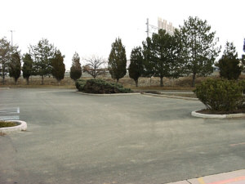
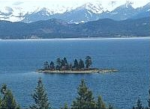
Bowen Ratio
β = H / λE
β = 10 / 1 = 10
β = 10 / 100 = 0.1
Notes:
Now, scientists have come up with a way to determine which of the two
ways of energy loss is dominated – Bowen ratio
Think of a parking lot – really hot. This is because most of the heat is used to
heat up the parking lot
The lake is much cooler, ~90% of the energy is used to evaporate water from
the surface.
While the parking lot will warm tremendously in one afternoon, the lake will
take months to warm up (Flathead Lake from 32°F [mid-April]
to 76 ° F [late July]).

Slide 17

RADIATION TRANSFER
REFLECTION
TRANSMISSION
ABSORPTION

Slide 18
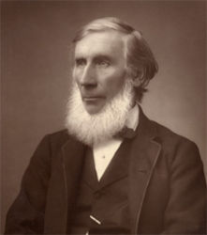
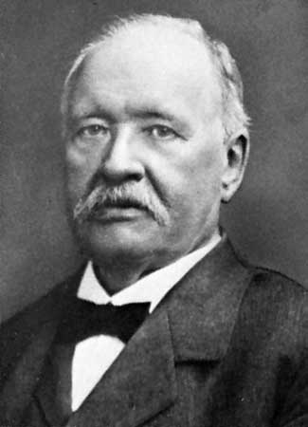
John Tyndall
Svante
Arrhenius
Notes:
Tyndall, in 1859, demonstrated that in addition to water vapour, carbonic acid (H2CO3) – the form of CO2 dissolved in water – can absorb a great deal of heat energy. He linked this to the possibility of changes in climate, trying to explain why glaciers could advance and retreat.
Experimental verification of work done by Saussure, Fourier, and Pouillet, among others, who had the intuition that “the rays from the sun and fixed stars could reach the earth through the atmosphere more easily than the rays emanating from the earth could get back into space.”
Arrhenius, in 1896, published his theory to explain the ice ages, first speculated that levels of CO2 in the atmosphere could substantially alter surface temperature through the greenhouse effect.

Slide 19

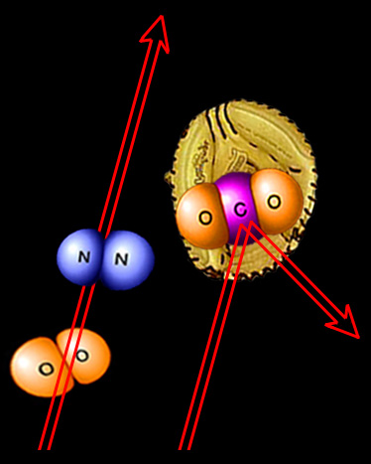
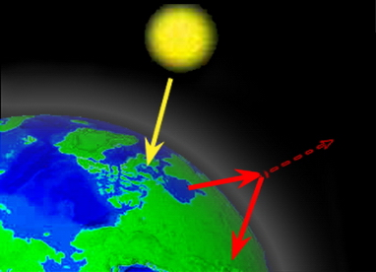
Pollution is the Primary Cause
The “Greenhouse gases” (e.g., carbon dioxide, methane, nitrous oxide, CFC’s) trap heat in the earth’s atmosphere.
Greenhouse gases in atmosphere
Solar energy passes through
Infrared
Radiation
Global Warming: The Greatest Threat © 2006 Deborah L. Williams
Science understood
since 1859 - John Tyndall
Radiant
heat is trapped
Diagrams: Jennifer Allen
Diagrams © Jennifer Allen

Slide 20
Greenhouse Gases
Water vapor (H₂O)
Carbon dioxide (CO₂)
Methane (CH₄)
Other - Direct
  Nitrous oxide (N₂O)
  Fluorocarbons
Other - Indirect
  Carbon monoxide (CO)
  Nitrogen oxides (NO_{x})
Notes:
Water Vapor:
most abundant and important
varies in concentration from nearly 0% (deserts) – 4% (tropical ocean areas) of lower atmosphere
particularly effective at absorbing long-wave radation from earth’s surface
Think: cloud cover affecting temperature
Most abundant GHG, but not considered in anthropogenic climate change because the atmosphere is so efficient at getting rid of “excess” water vapor through precipitation. Any human influence is “quickly” corrected.
CO2:
2nd most important GHG, 0.038% of atmosphere (380 PPM)
Disproportionately large influence on temperature regulation
Largest emission of GHGs in US (82%)
Projected to grow to 0.06% (600 PPM) by 2050 with a globally averaged temperature increase of 1.5-4.5-deg C (2.7-8.0-deg F) in a very short period of time
Fossil fuel emission is only significant source of atmospheric CO2 that is non-natural.
Normally released over millions of years
Important sinks:
Sedimentary rock (geologic time scale) – “Lithification”, very slow, not relevant to current issue
Oceans – have 52X as much C as atmosphere; 19X as much C as combined soils/biosphere; marine phytoplankton take in CO2, release C that eventually sinks to ocean floor and undergoes lithification
Soils – partially decomposed organic matter (humus)
Biosphere (actively growing vegetation, litter) – stores C as it grows
CH4:

Slide 21
Greenhouse Gases – Water Vapor
Most abundant and important GHG
Keeps earth warm enough for liquid water to form
Varies in concentration in the lower atmosphere from nearly 0% to 4%
Not considered important in anthropogenic climate change
  Naturally correcting
Notes:
Water Vapor:
most abundant and important
varies in concentration from nearly 0% (deserts) – 4% (tropical ocean areas) of lower atmosphere
particularly effective at absorbing long-wave radation from earth’s surface
Think: cloud cover affecting temperature
Most abundant GHG, but not considered in anthropogenic climate change because the atmosphere is so efficient at getting rid of “excess” water vapor through precipitation. Any human influence is “quickly” corrected.

Slide 22
Greenhouse Gases – CO₂
2nd most important GHG
  0.038% (380 ppm)
Largest emission of GHG in US (82% of all GHGs)
  Fossil fuel emission is only significant source of “non-natural” CO₂
Projected to grow to to 0.06% (600 ppm) by 2050
Sinks:
  Sedimentary rock – “Lithification”
    Very slow, not relevant to current climate change
  Ocean
    52X as much C as atmosphere; 19X as much as soils + biosphere
    Marine phytoplankton
  Soils – humus
  Biosphere – actively growing vegetation (esp. forests)
    30% of earth is land, 30% of land is forests (9% of earth)
    Most important are tropical forests
Notes:
CO2:
2nd most important GHG, 0.038% of atmosphere (380 PPM)
Disproportionately large influence on temperature regulation
Largest emission of GHGs in US (82%)
Projected to grow to 0.06% (600 PPM) by 2050 with a globally averaged temperature increase of 1.5-4.5-deg C (2.7-8.0-deg F) in a very short period of time
Fossil fuel emission is only significant source of atmospheric CO2 that is non-natural.
Normally released over millions of years
Important sinks:
Sedimentary rock (geologic time scale) – “Lithification”, very slow, not relevant to current issue
Oceans – have 52X as much C as atmosphere; 19X as much C as combined soils/biosphere; marine phytoplankton take in CO2, release C that eventually sinks to ocean floor and undergoes lithification
Soils – partially decomposed organic matter (humus)
Biosphere (actively growing vegetation, litter) – stores C as it grows
Most important are tropical forests (seasonality outside tropics limits utility

Slide 23
Greenhouse Gases – CH₄
Until recently it was assumed to play a minor role
  Concentration is 1.7 ppm (0.00017%)
10X more efficient than CO₂ as a GHG
Increased greatly since Industrial Revolution
  Around 0.8 ppm for 160,000 years prior
Net emissions of CH₄
Methane hydrates
Notes:
CH4:
Methanogens are recognized for their role in maintaining the earth’s early “thermostat”.
Doubling in past 200 years – far more rapid than increase in CO2
Details only understood for a decade

Slide 24
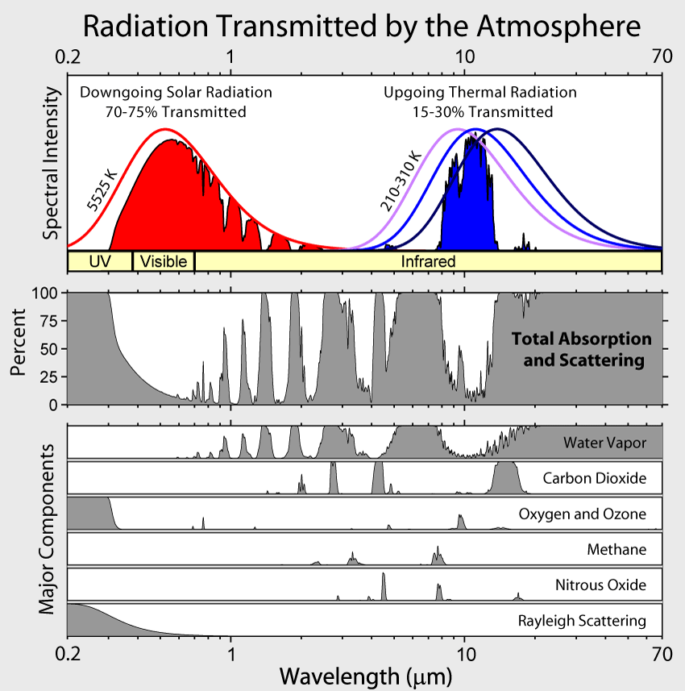
Peak emission of energy from earth and atmosphere at 10 μm.
Wavelength at which GHGs absorb and emit radation, cloudless conditions | Primary Greenhouse Gas
4-5 μm | CO₂
5-8 μm | H₂O vapor (nearly complete at 5-6 μm)
8-13 μm | Atmospheric window
9.4-9.8 μm 13-17 μm | O₃ (strong) O₂ (strong)
17-24 μm | O₂ & H₂O vapor, partially transparent
>24 μm | H₂O vapor (complete)
Image Credit: Robert A. Rohde,
Global Warming Art
Table Credit: Rohli & Vega
Climatology, 2008
Notes:
Absorption bands in the Earth's atmosphere (middle panel) and the effect that this has on both solar radiation and upgoing thermal radiation (top panel).
Individual absorption spectrum for major greenhouse gases plus Rayleigh scattering are shown in the lower panel.
Position and number of absorption bands are determined by the chemical properties of the gases present.
In the present atmosphere, water vapor is the most significant of these greenhouse gases, followed by carbon dioxide and various other minor greenhouse gases. In addition, Rayleigh scattering, the physical process that makes the sky blue, also disperses some incoming sunlight. Collectively these processes capture and redistribute 25-30% of the energy in direct sunlight passing through the atmosphere.
In contrast, greenhouse gases capture 70-85% of the energy in upgoing thermal radiation emitted from the Earth surface. This disparity is a major factor in creating the greenhouse effect, whereby thermal energy is trapped near the Earth's surface warming the planet.
The greenhouse effect is an essential physical process, mediated primarily by water vapor, that warms the Earth approximately 32 °C (Lashof 1989), allowing the planet to be habitable and maintain abundant liquid water.
In contrast global warming, involves a small increase in average temperatures mediated in large part by a few percent increase in the greenhouse effect. This increase is primarily caused by large increases in carbon dioxide (+35% concentration since 1700), methane (+150%) and nitrous oxide (+20%) [1]. These gases, in combination with a water vapor feedback [2], provide the small increase in the greenhouse effect blamed for anthropogenic global warming.
It should be noted that while some bands are saturated (i.e. 100% of radiation in that band is absorbed), that does not imply that further increases in greenhouse gas concentration have no effect on that band. Rather additional greenhouse gases will cause the radiation to be captured closer to the Earth's surface which still increases warming. However rather than doubling as concentrations double, the overall effect proceeds only by small increments giving rise to a logarithmic progression rather than a linear one.

Slide 25
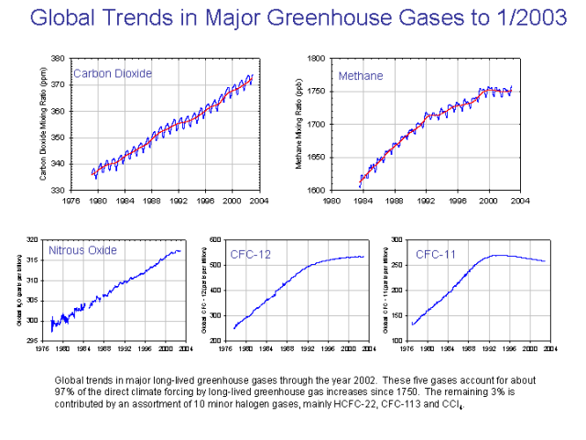
Image Credit: Robert A. Rohde,
Global Warming Art
Notes:
This figure shows the relative fraction of man-made greenhouse gases coming from each of eight categories of sources, as estimated by the Emission Database for Global Atmospheric Research version 3.2, fast track 2000 project. These values are intended to provide a snapshot of global annual greenhouse gas emissions in the year 2000.
The top panel shows the sum over all greenhouse gases, weighted by their global warming potential over the next 100 years. This consists of 72% carbon dioxide, 18% methane, 8% nitrous oxide and 1% other gases. Lower panels show the comparable information for each of these three primary greenhouse gases, with the same coloring of sectors as used in the top chart. Segments with less than 1% fraction are not labeled.
The increase in greenhouse gas concentrations in the Earth's atmosphere is believed to be the primary cause of global warming.

Slide 26
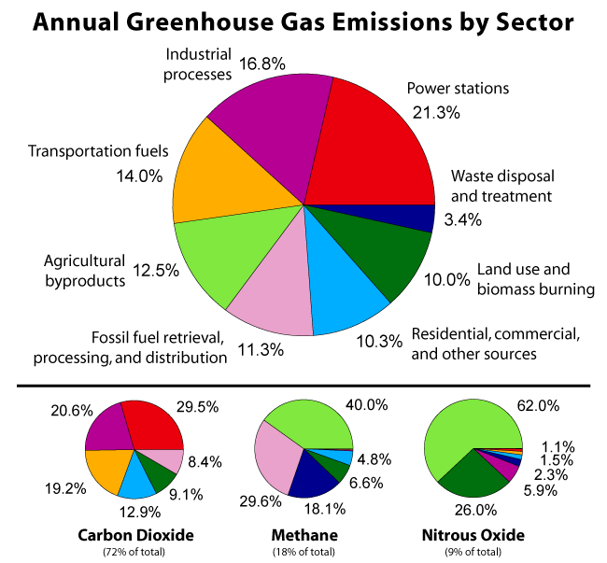
Image Credit: Robert A. Rohde,
Global Warming Art
Notes:
This figure shows the relative fraction of man-made greenhouse gases coming from each of eight categories of sources, as estimated by the Emission Database for Global Atmospheric Research version 3.2, fast track 2000 project. These values are intended to provide a snapshot of global annual greenhouse gas emissions in the year 2000.
The top panel shows the sum over all greenhouse gases, weighted by their global warming potential over the next 100 years. This consists of 72% carbon dioxide, 18% methane, 8% nitrous oxide and 1% other gases. Lower panels show the comparable information for each of these three primary greenhouse gases, with the same coloring of sectors as used in the top chart. Segments with less than 1% fraction are not labeled.
The increase in greenhouse gas concentrations in the Earth's atmosphere is believed to be the primary cause of global warming.

Slide 27
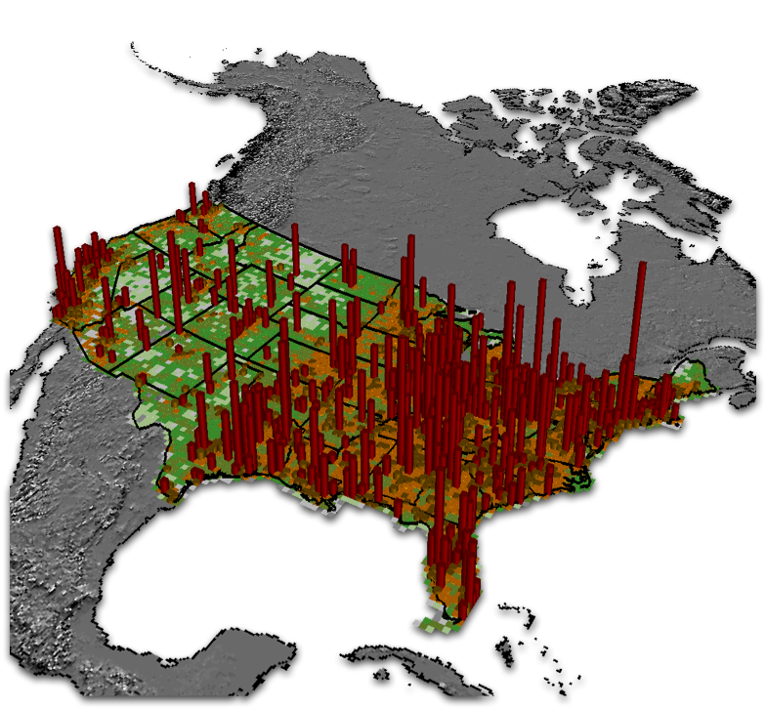
Daily Fossil Fuel Emissions , Jan 3 2002
K. Gurney, Purdue Univ.

Slide 28



Partition of Anthropogenic Carbon Emissions into Sinks
[2000-2006]
45% of all CO₂ emissions accumulated in the atmosphere
The Airborne Fraction
The fraction of the annual anthropogenic emissions that remains in the atmosphere
55% were removed by natural sinks
Ocean removes _ 24%
Land removes _ 30%
Canadell et al. 2007, PNAS

Slide 29
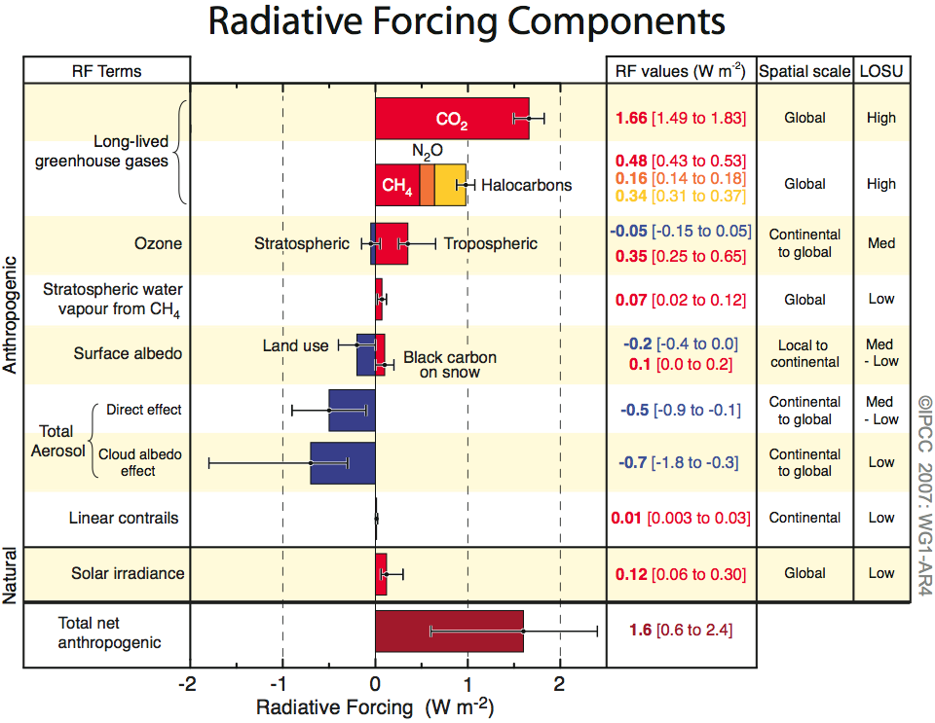
Human and Natural Drivers of Climate Change
1.6 W m⁻² warms like 1.6 Xmas tree lights over every m² on Earth.
Carbon dioxide is causing the bulk of the forcing, and it lives a long time in our atmosphere so every year of emission means commitments to climate change for future generations.

Slide 30
The Greenhouse Model http://ccl.northwestern.edu/netlogo/models/ClimateChange
Tinker, R. and Wilensky, U. (2007)
The Greenhouse Model is not a climate model; it is an energy balance model.
Notes:
30

