Slide 1
CLIMATE CHANGE CURE?: By running the flue gas from Moss Landing's mammoth smokestacks through ocean water, a new company can make cement from carbon dioxide pollution.
The turbines at Moss Landing power plant on the California coast burn through natural gas to pump out more than 1,000 megawatts of electric power. The 700-degree Fahrenheit (370-degree Celsius) fumes left over contain at least 30,000 parts per million of carbon dioxide (CO2)—.
Today, this flue gas wafts up and out of the power plant's enormous smokestacks, but by simply bubbling it through the nearby seawater, a new California-based company called Calera says it can use more than 90 percent of that CO2 to make something useful: cement.
It's a twist that could make a polluting substance into a way to reduce greenhouse gases. Cement, which is mostly commonly composed of calcium silicates, requires heating limestone and other ingredients to 2,640 degrees F (1,450 degrees C) by burning fossil fuels and is the third largest source of greenhouse gas pollution in the U.S., according to the U.S. Environmental Protection Agency. Making one ton of cement results in the emission of roughly one ton of CO2—and in some cases much more.
Calera's process takes the idea a step forward by storing the CO2 in a useful product. The U.S. used more than 122 million metric tons of Portland cement in 2006, according to the Portland Cement Association (PCA), an industry group, and China used at least 800 million metric tons.
The Calera process essentially mimics marine cement, which is produced by coral when making their shells and reefs, taking the calcium and magnesium in seawater and using it to form carbonates at normal temperatures and pressures. "We are turning CO2 into carbonic acid and then making carbonate," Constantz says. "All we need is water and pollution."

Slide 2
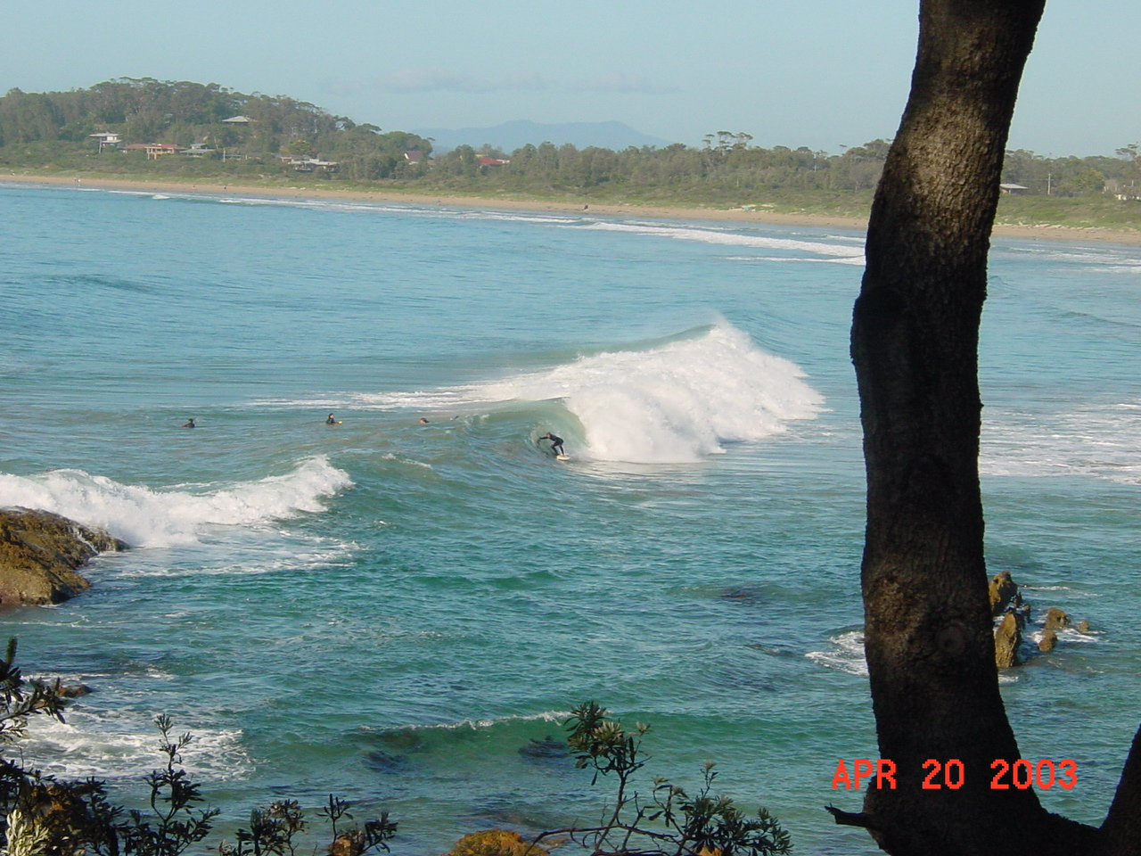
Global Change and Oceans
Textbook pages 106 - 127

Slide 3
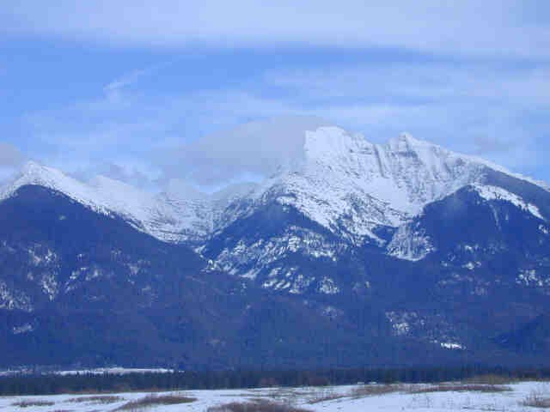
WEATHER: Meteorological conditions of the next Day – Month
CLIMATE: Long term conditions of the Meteorology over Years - Decades

Slide 4
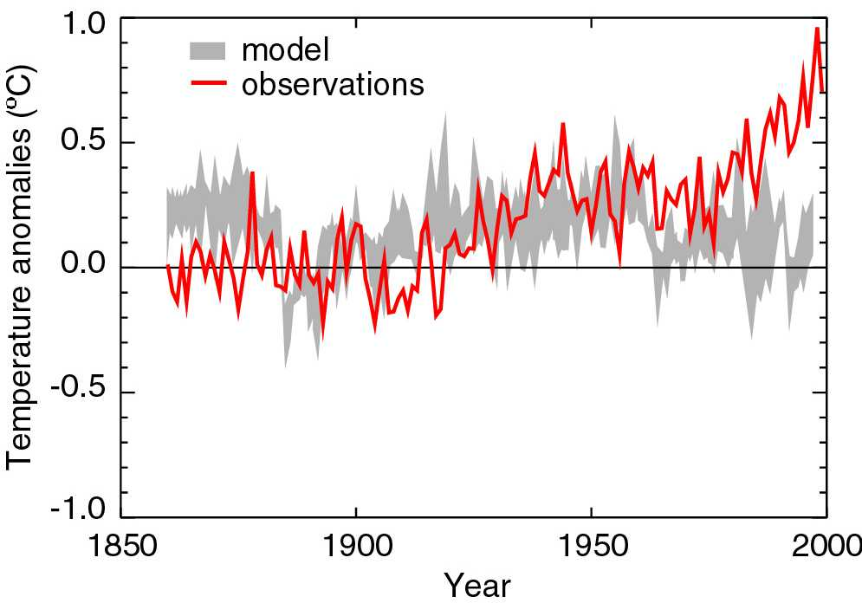
“Simulations of the response to natural forcings alone … do not explain the warming in the second half of the century” SPM
Stott et al, Science 2000

Slide 5
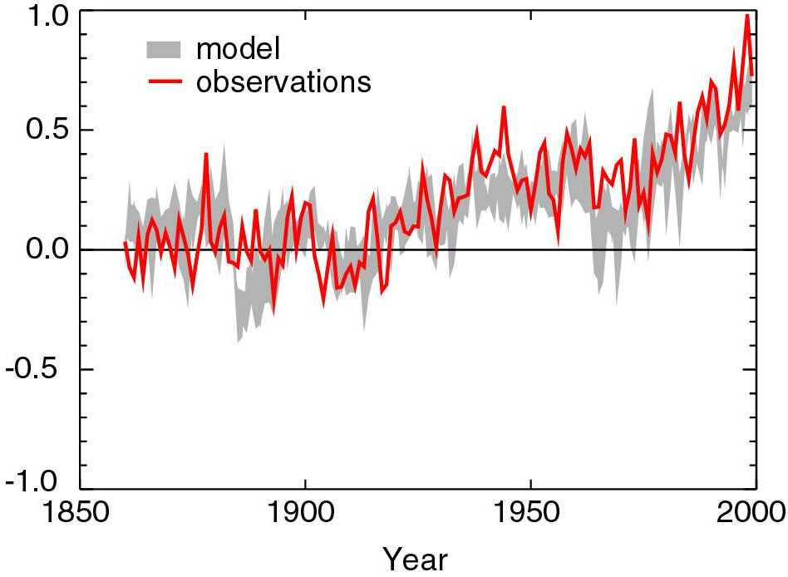
“..model estimates that take into account both greenhouse gases and sulphate aerosols are consistent with observations over this period” SPM
Stott et al, Science 2000

Slide 6
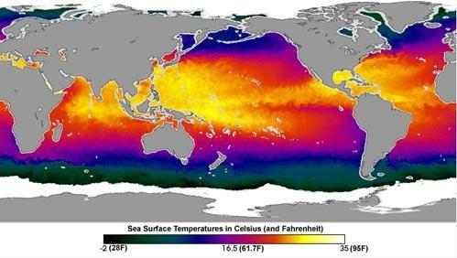
OCEAN SURFACE TEMPERATURES
70% OF LAND IS IN NORTHERN HEMISPHERE

Slide 7
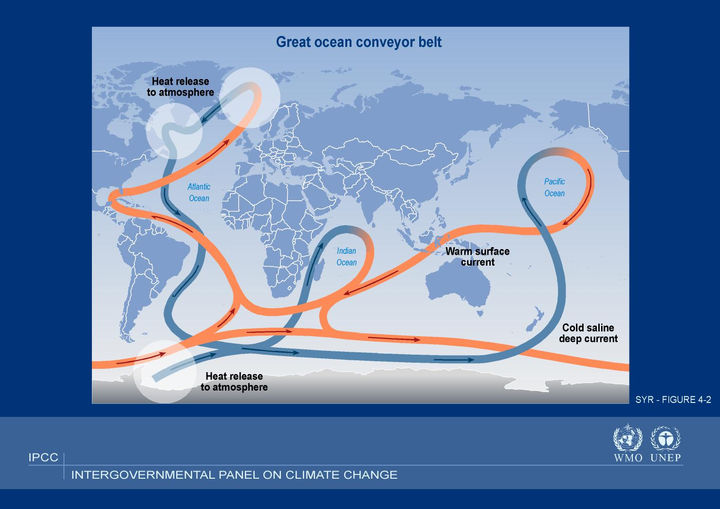

Slide 8
Comparison of the heat balance of the climate system
Levitus et al (2001). Science Vol. 292, pp. 268.
90%

Slide 9
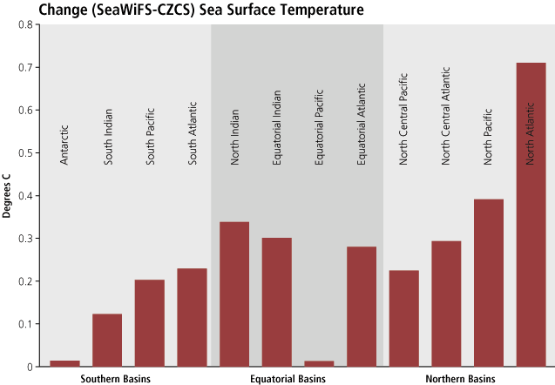
[1979 – 2002]

Slide 10
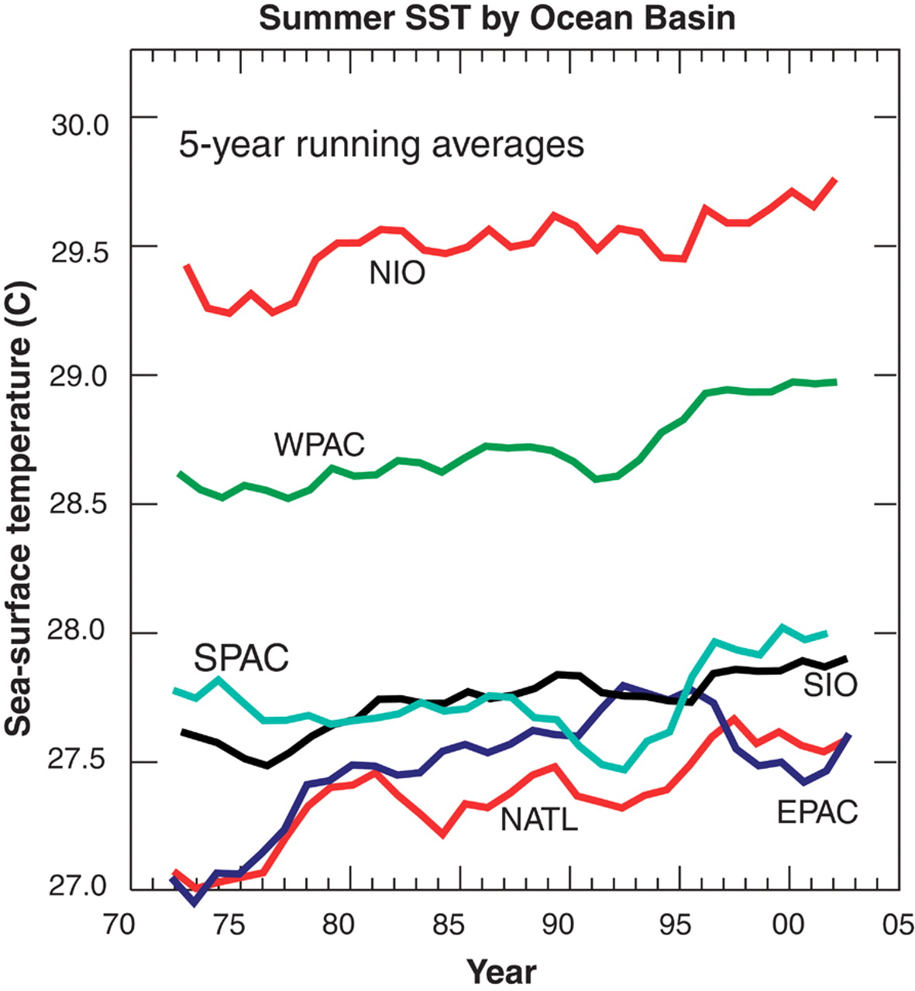
Webster et al
Science
Sept 16, 2005

Slide 11
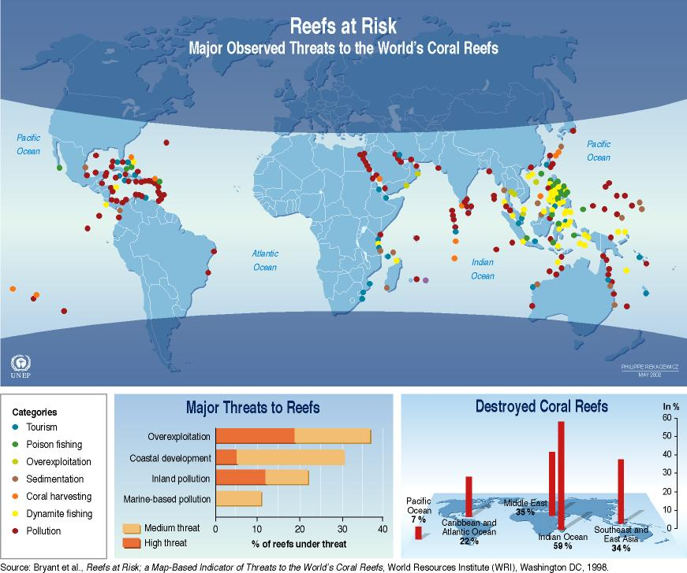
Locations of Coral Reef Bleaching

Slide 12
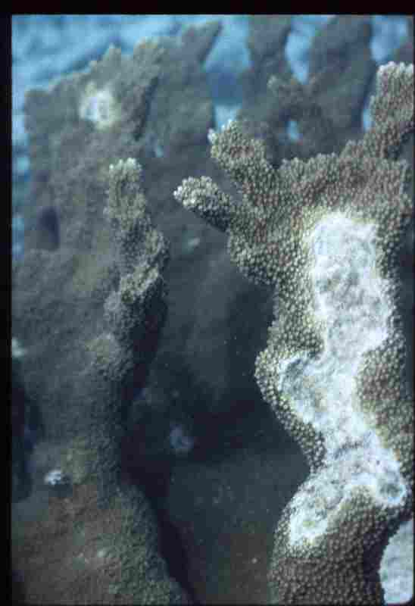

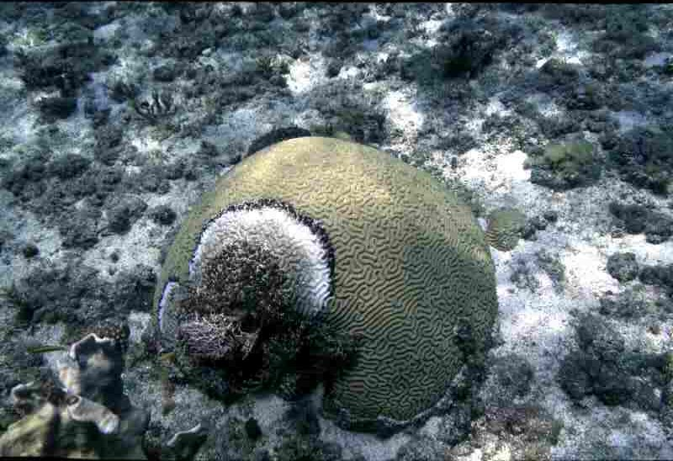
BLEACHING OF CORAL REEFS BY OCEAN TEMPS > 85deg

Slide 13

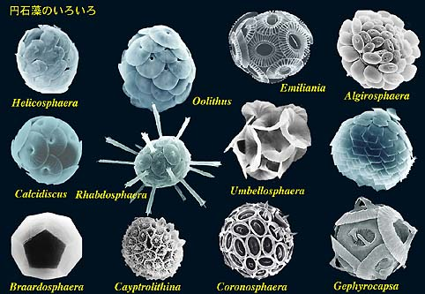
Ocean acidification
CO₂ is corrosive to the shells and skeletons of many marine organisms
Corals
Calcareous plankton
Photo: Missouri Botanical Gardens
http://www.biol.tsukuba.ac.jp/~inouye

Slide 14
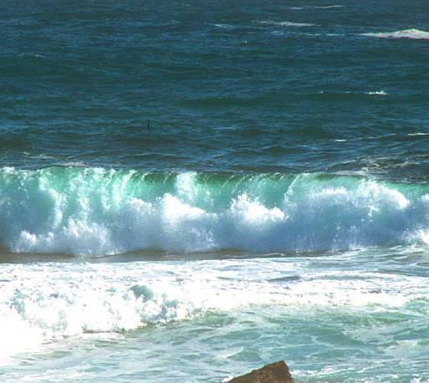
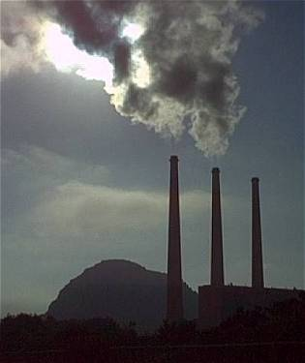
Ocean Acidification
Over the last 200 years, about 50% of all CO₂ produced on earth has been absorbed by the ocean.
(Royal Society 6/05)
Remains in the atmosphere (greenhouse gas)
Dissolves in sea water
CO₂ + H₂0 HCO₃⁻ + H⁺
Global Warming: The Greatest Threat © 2006 Deborah L. Williams
CO₂
(ACID)
CO₂
Water becomes more acidic.

Slide 15
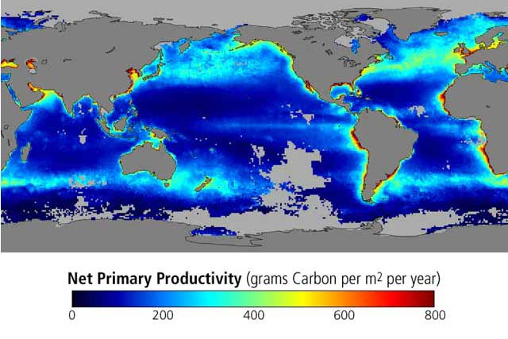

Slide 16
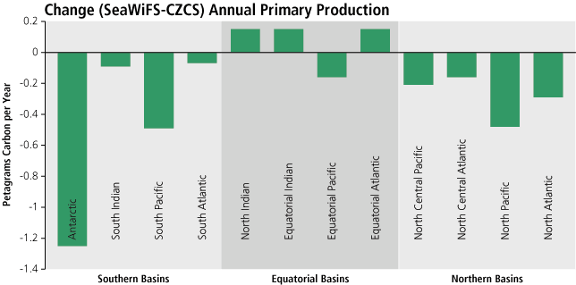
CHANGE IN OCEAN NPP [1979 – 2002]

Slide 17
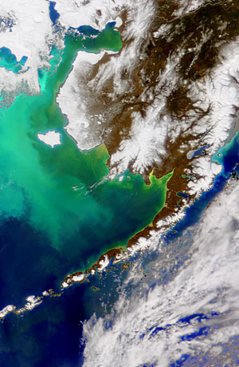
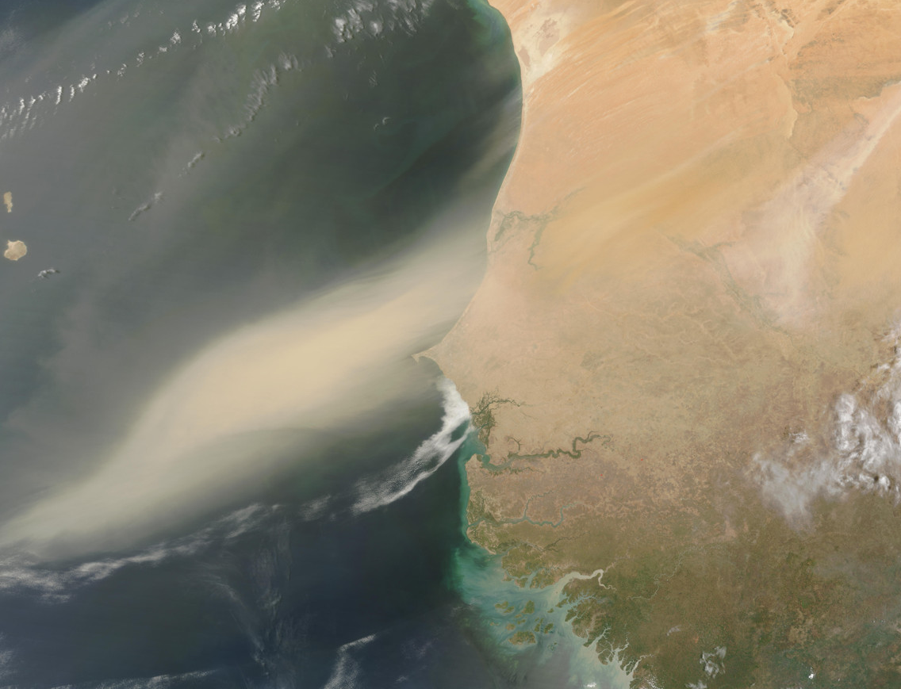
Iron in the Oceans
Sources of naturally occurring iron
  Volcanic coastal shelves
  Dust in blown in from land
  Upwellings
Role in ecosystems
  Key nutrient that helps
  plants take up nitrogen

Slide 18
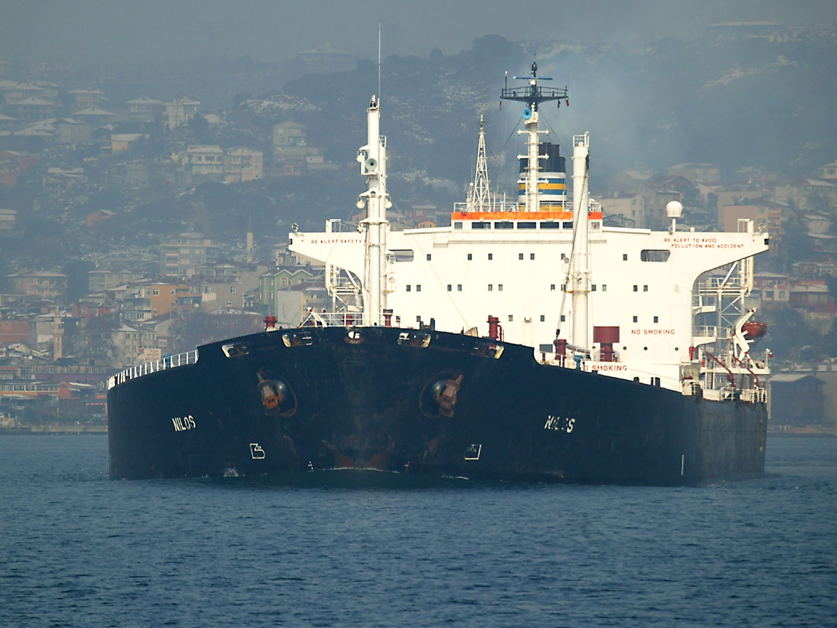
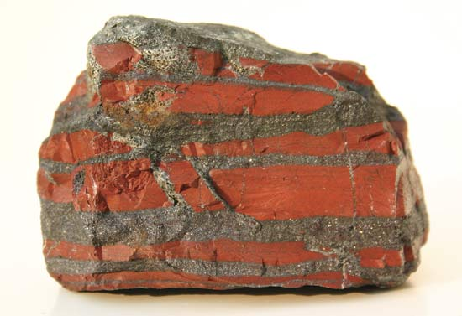
“Give me a few oil tankers full of iron, and I’ll give you an ice age.”
– John Martin, WHOI Scientist

Slide 19
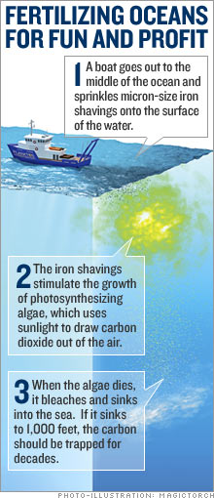
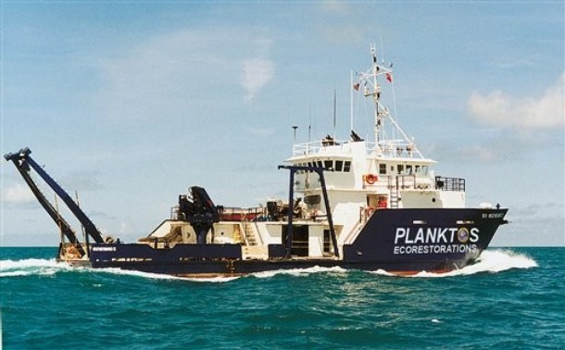
Cashing in on Carbon Offsets
Climos taking over with $3.5 million in funding
Planktos bottom up after Galapagos proposal

Slide 20
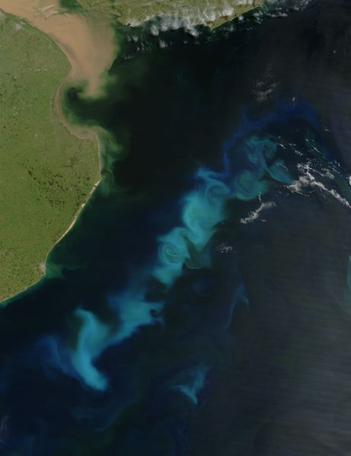
Will the Carbon stay sequestered long enough to help?

Slide 21
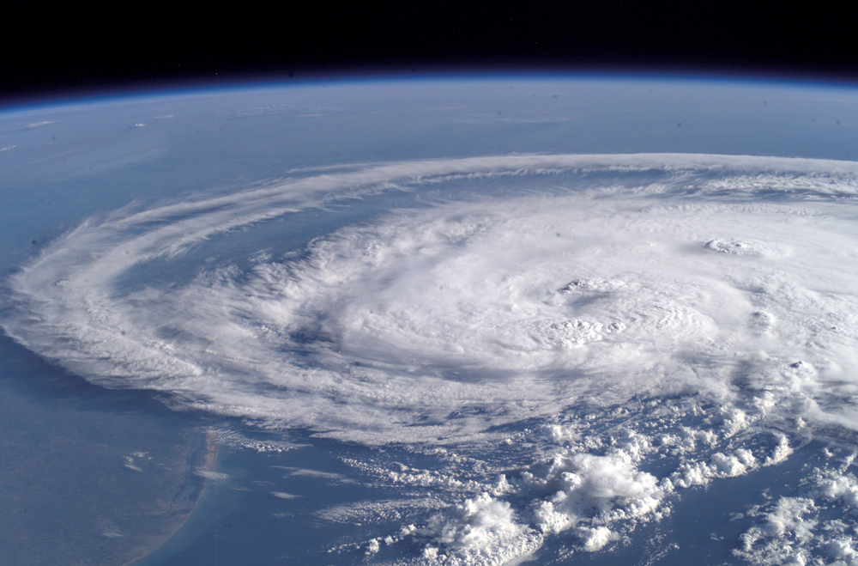

Slide 22
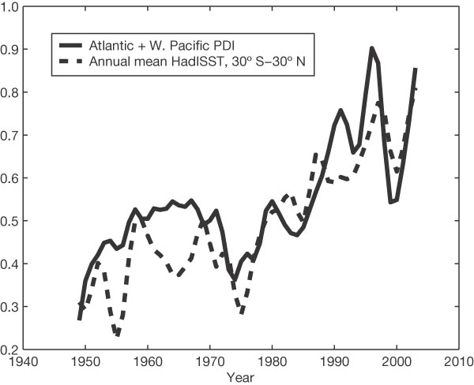
Increase in Hurricane Intensity
PDI = Potential Destructiveness Index
Emanuel, Nature 4 August 2005

Slide 23
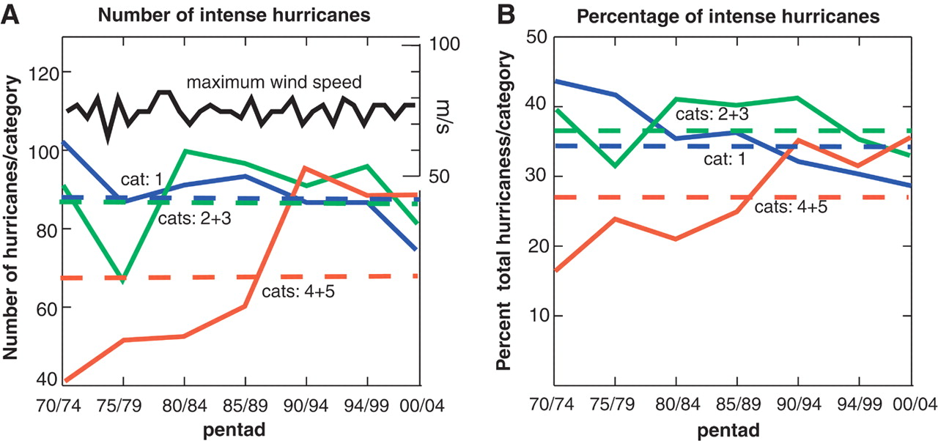
Increase in Category 4-5 Hurricanes 1970 - 2004
Webster et al, Science, Sept 16 2005

Slide 24
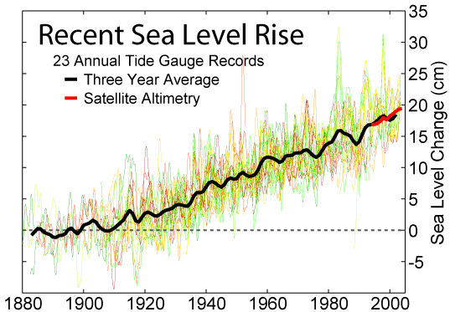

Slide 25
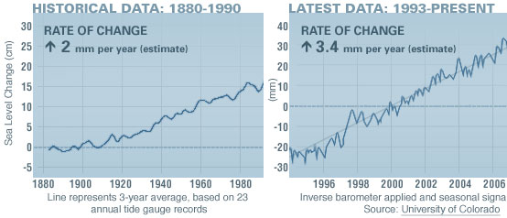

Slide 26
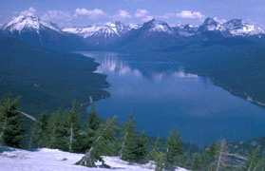
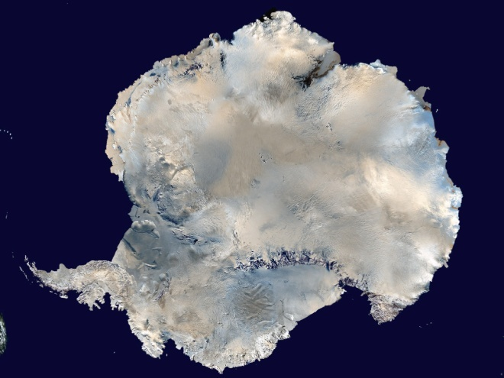
Sea-level Rise Projections Include:
•ocean expansion resulting from increased water temperatures;
meltwater runoff from mountain glaciers around the world; and
a contribution due to increased ice flow from Greenland and Antarctica at the rates observed for 1993-2003.
National Park Service
NASA
Source: IPCC Climate Change 2007: The Physical Science Basis—Summary for Policymakers.
Notes:
26
Compared with its prior assessment, the IPCC has used improved statistical methods for calculating several factors that contribute to global sea-level rise.
These factors include:
• ocean expansion resulting from increased water temperatures;
• meltwater runoff from mountain glaciers around the world; and
• meltwater runoff and calving (breaking off ) of ice from the Greenland and Antarctica ice sheets.

