Slide 1
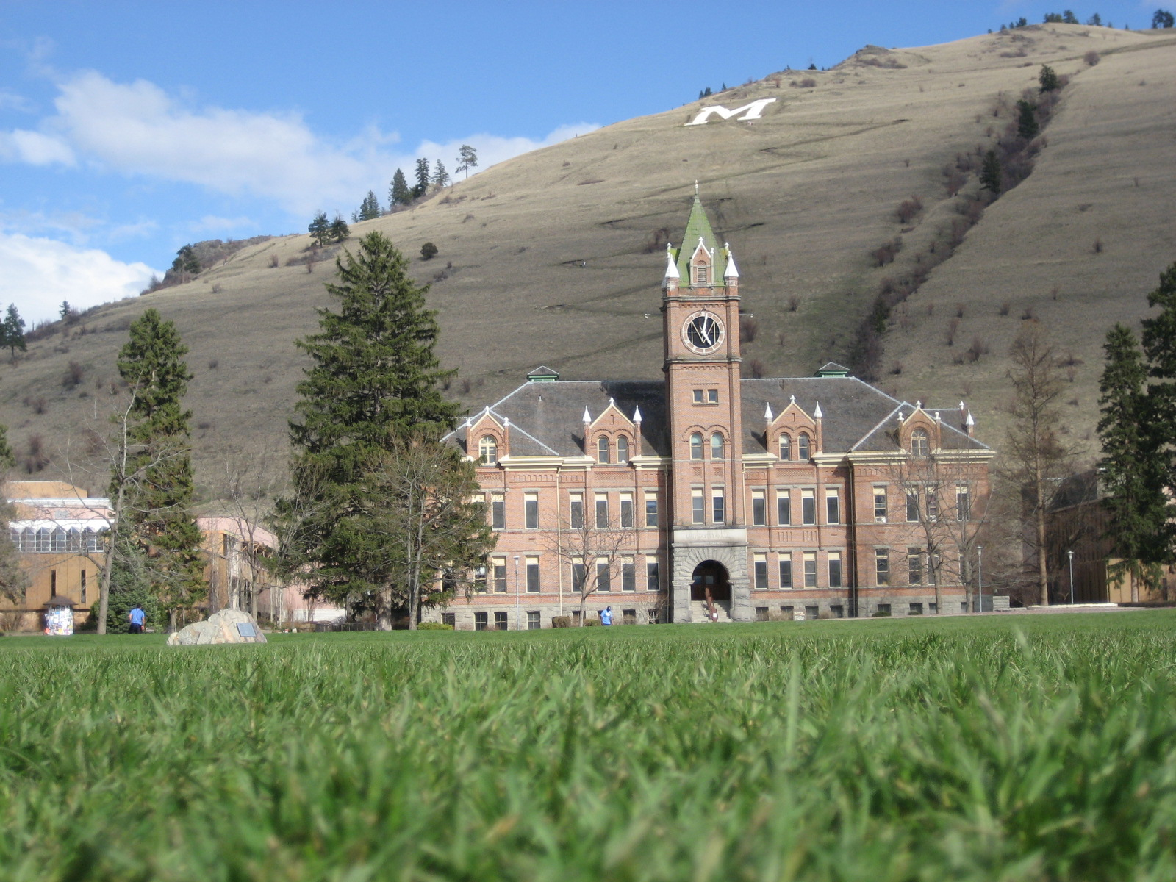
R.E.L.F.
Revolving Energy Loan Fund
www.UMRELF.info

Slide 2
What is RELF?
The Revolving Energy Loan Fund will be created through an OPTIONAL $4 per semester per student fee.
The money will go toward funding sustainable initiatives on campus.
These initiatives will be projects that enable the University to save money through reduced utility consumption.
www.UMRELF.info

Slide 3
How Does RELF Work?
www.UMRELF.info

Slide 4
Optional Student Fee
RELF
Significant Energy and Money Savings
Projects that Save Money
www.UMRELF.info

Slide 5
Why Vote For RELF?
Help fund students who take the initiative in “Greening UM”
Has the potential to save the University and the Students millions of dollars.
Great investment of student funds
www.UMRELF.info

Slide 6
Does RELF Work?
www.UMRELF.info

Slide 7
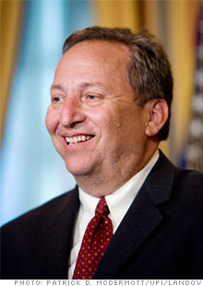
Was the President of Harvard from July 1, 2001 – June 30, 2006
Currently Director of National Economic Council under President Obama
2006:
Larry Summers
“
The best investment in the University is not the endowment but the Green Loan Fund,
”
Harvard’s version of RELF
$25.9 Billion
Endowment!
Harvard’s endowment averages a Return of Investment of 15% year over year
www.UMRELF.info

Slide 8
UM needs RELF
Facility Services has outlined $25 million worth of projects that would increase campus efficiency.
There are lots of opportunities for students to save money and the environment at the same time!
www.UMRELF.info

Slide 9
Vote Yes! for RELF
Please
SENATE BILL 50
Voting will take place on Cyberbear from April 29th – April 30th.
www.UMRELF.info

Slide 10
Vote TODAY!
The Primary Election for ASUM Executives is today.
Vote for a Green Candidate

Slide 11
www.UMRELF.info

