Slide 1
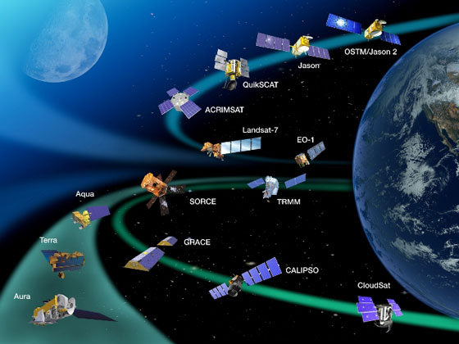
Remote Sensing Principles and Applications
April 15, 17 2013
Youngwook Kim

Slide 2
What is Remote Sensing?
The measurement or acquisition of information of some property of an object or phenomenon, by a recording device that is not physical or intimate contact with the object or phenomenon under study (ASPRS 1983)
Acquisition of information about the condition and/or the state of a target by a sensor that is not in direct physical contact with it (Asrar 1989)
Remote sensing (RS) is the acquisition of information about an object or phenomenon without making physical contact with the object. In modern usage, the term generally refers to the use of aerial sensor technologies to detect and classify objects on Earth (both on the surface, and in the atmosphere and oceans) by means of propagated signals (e.g. electromagnetic radiation emitted from aircraft or satellites) (Wikipedia)

Slide 3
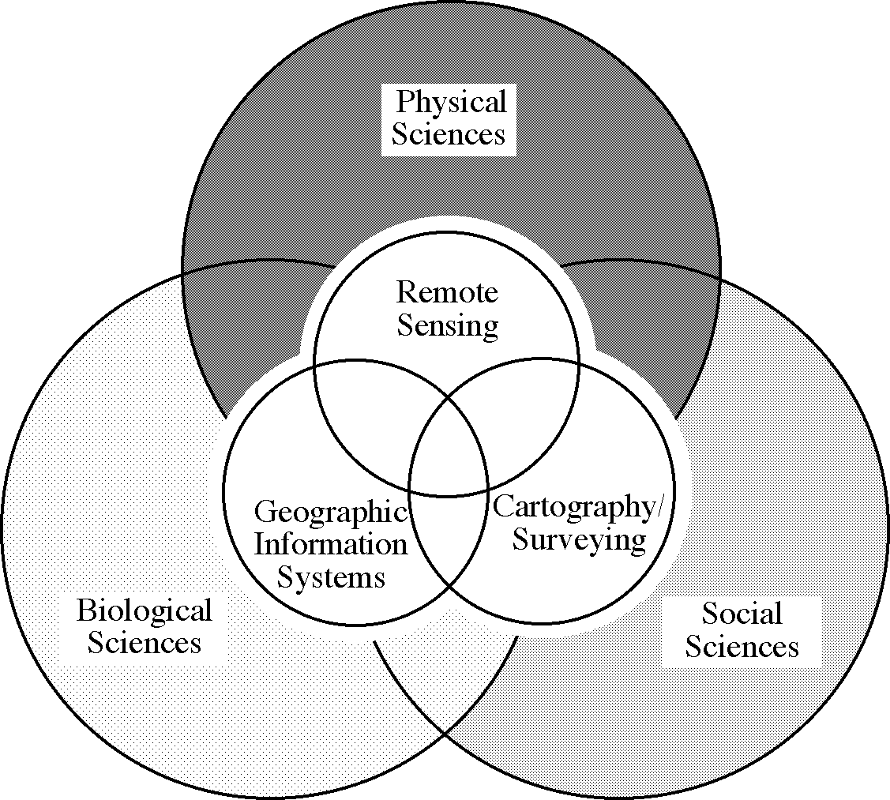
Where is Remote Sensing?
Three-way interaction model between spatial science as used in the physical, biological, and social sciences
Jensen, 2000

Slide 4
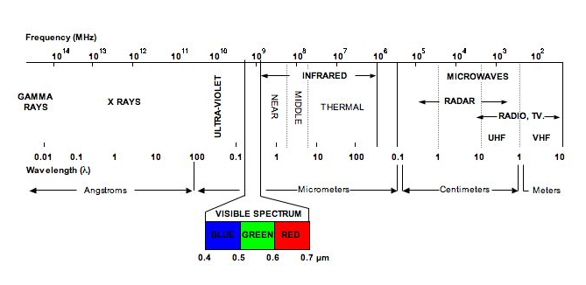
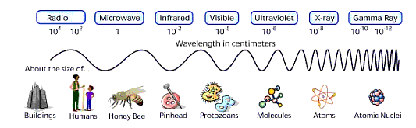
What is remote sensing useful?
A synoptic view of a large area
Access to regions that are not accessible to in situ. Approaches
Global coverage
Periodical monitoring
Collecting data at wavelengths that our eyes do not respond

Slide 5
Electromagnetic Spectrum
Ultraviolet (UV) – less than 0.35 µm
Visible – 0.35 to 0.70 µm (350 to 700 nm)
Near Infrared (NIR) – 0.7 to 1.1 µm
Shortwave Infrared (SWIR) – 1.1 to 2.5 µm
Thermal Infrared (TIR) – 8.0 to 16.0 µm
●Also called LWIR
●Emissive portion of the spectrum
Visible and near infrared (VNIR) – 0.35 to 1.1 µm (region over which silicon detector work well)
Solar reflective – VNIR and SWIR – 0.35 to 2.5 µm (region where reflected solar energy dominates the problem)
Microwave region – 1 mm to 1 m (300 GHz to 300 MHz)

Slide 6
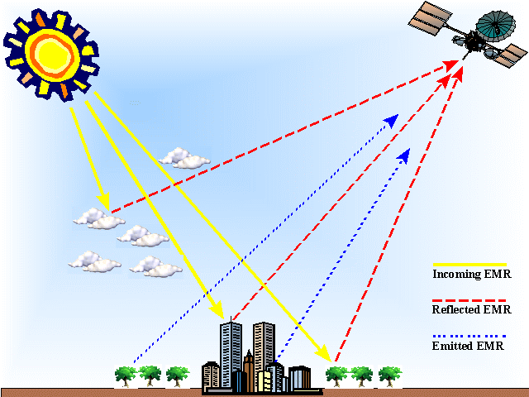
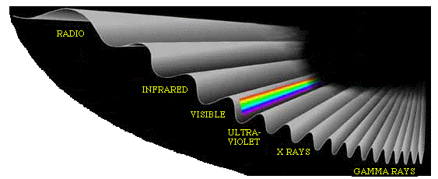
The Concept of Remote Sensing
Sun
Sensor
EMR
Objects
Energy recorded by remote sensing systems undergoes fundamental interactions that should be understood to properly interpret the remotely sensed data
The remotely sensed energy (EMR) comes from the Sun
●is radiated by atomic particles from the Sun (source),
●propagates through the vacuum of space at the speed of light,
●interacts with the Earth’s atmosphere
●interacts with the Earth’s surface
●interacts with the Earth’s atmosphere once again, and
●finally reaches the remote sensor
Notes:
We can illustrate the main elements of a remote sensing system with a simple example involving the following components; an energy source (the Sun), an observed object (a tree), a sensor (our eye), and the flow of electromagnetic energy from the Sun to the object and to the sensor. In this example, we are able to observe the tree by means of reflected sunlight and we could have also employed artificial sources of light to illuminate the tree (e.g., a flashlight). Our eyes can also sense the energy that originates from and is emitted from the object itself, as in the case of fires. In remote sensing we often consider three ways of ‘sensing’ information about an object: (a) by reflection, (b) by emission, and (c) by combined emission-reflection (Fig. 2.1.). The first of the three is the most important in remote sensing since it utilizes sunlight, the main source of energy on our planet. The Sun illuminates the Earth’s surface, which in turn reflects a portion of this energy back to space in a manner dependent on the composition and structure of the land cover present on the surface. The reflected electromagnetic energy is detected by the orbiting, space-based sensor, which then records and transmits this signal to a receiving station or satellite dish.
In general, the flow of energy from one place to another may also occur through convection, conduction, and latent energy in addition to electromagnetic radiation. In remote sensing, we mostly focus on the measurement and information content of the electromagnetic radiation signal. The remotely-sensed information, however, may be coupled with the other energy terms to yield measures of evapotranspiration, photosynthesis, and soil moisture.

Slide 7
Effect of the Atmosphere on Radiation
Atmosphere can refract, scatter, and absorb
Refraction refers to the bending of radiation from its original path
●Only a major factor in long path lengths through the atmosphere
Scattering refers to the redirection of radiation after interaction with a particle in the atmosphere
●a function of the wavelength of the incident radiation and the size of a particle (e.g., gas molecule, dust, water vapor) encountered
Absorption is the incorporation of the radiation within the particle to alter the energy state of the particle
●Gaseous absorption and aerosol absorption
●Gases that cause the largest impact to RS are CO2, H2O, and O3
▪Wavelengths (<0.3 µm) are almost completely absorbed (e.g., O3)
▪CO2: greenhouse gas (infrared radiation absorption)
▪H2O: NIR, SWIR, far-infrared and microwave regions
Scattering and Absorption are referred to as attenuation or extinction
Infrared Atmospheric window (8-12 µm) can penetrate the earth’s atmosphere
Notes:
Rayleigh scattering occurs when the diameter of the matter (usually air molecules) are many times smaller than the incident electromagnetic radiation. This type of scattering is named after the English physicist who offered the first coherent explanation for it. All scattering is accomplished through absorption and re-emission of radiation by atoms or molecules in the manner described in the discussion on radiation from atomic structures. It is impossible to predict the direction in which a specific atom or molecule will emit a photon, hence scattering.
Rayleigh scattering is responsible for red sunsets. Since the atmosphere is a thin shell of gravitationally bound gas surrounding the solid Earth, sunlight must pass through a longer slant path of air at sunset (or sunrise) than at noon. Since the violet and blue wavelengths are scattered even more during their now-longer path through the air than when the Sun is overhead, what we see when we look toward the Sun is the residue - the wavelengths of sunlight that are hardly scattered away at all, especially the oranges and reds (Sagan, 1994).
Mie scattering takes place when there are essentially spherical particles present in the atmosphere with diameters approximately equal to the wavelength of radiation being considered. For visible light, water vapor, dust, and other particles ranging from a few tenths of a micrometer to several micrometers in diameter are the main scattering agents. The amount of scatter is greater than Rayleigh scatter and the wavelengths scattered are longer.
Pollution also contributes to beautiful sunsets and sunrises. The greater the amount of smoke and dust particles in the atmospheric column, the more violet and blue light will be scattered away and only the longer orange and red wavelength light will reach our eyes.
Non-selective scattering is produced when there are particles in the atmosphere several times the diameter of the radiation being transmitted. This type of scattering is non-selective, i.e. all wavelengths of light are scattered, not just blue, green, or red. Thus, water droplets, which make up clouds and fog banks, scatter all wavelengths of visible light equally well, causing the cloud to appear white (a mixture of all colors of light in approximately equal quantities produces white).
Scattering can severely reduce the information content of remotely sensed data to the point that the imagery looses contrast and it is difficult to differentiate one object from another.

Slide 8
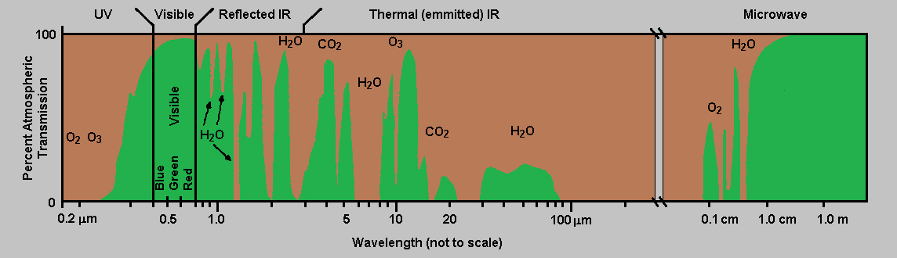
Atmospheric Transmittance
Transmittance: the fraction of incident EMR at a specified wavelength that passes through a sample (e.g., Earth atmosphere)
How well the atmosphere lets radiation pass will determine what measurements of the surface can be made
Spectral regions with poor transmittance are good for atmospheric sensing, not good for terrestrial remote sensing

Slide 9
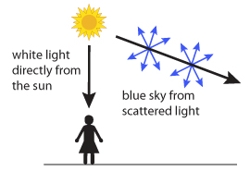
Quiz #1
Why are the sky blue?
Answer: scattering. As EMR moves through the atmosphere, most of the longer wavelengths pass straight. Little of the red, orange and yellow light is affected by the air
Notes:
Scattering, well, Rayleigh scattering, to be more precise.

Slide 10
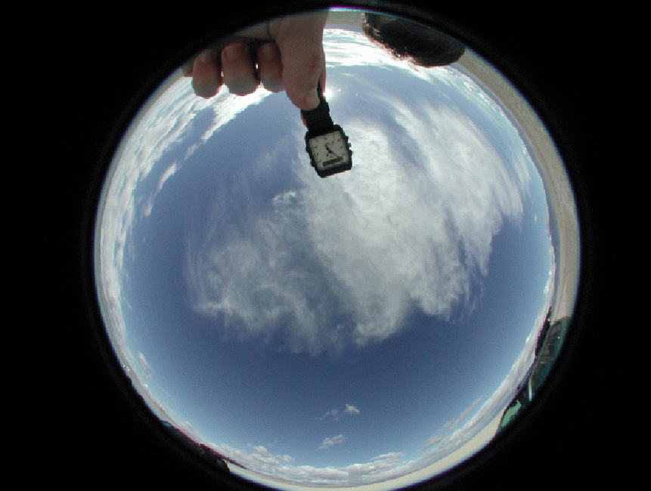
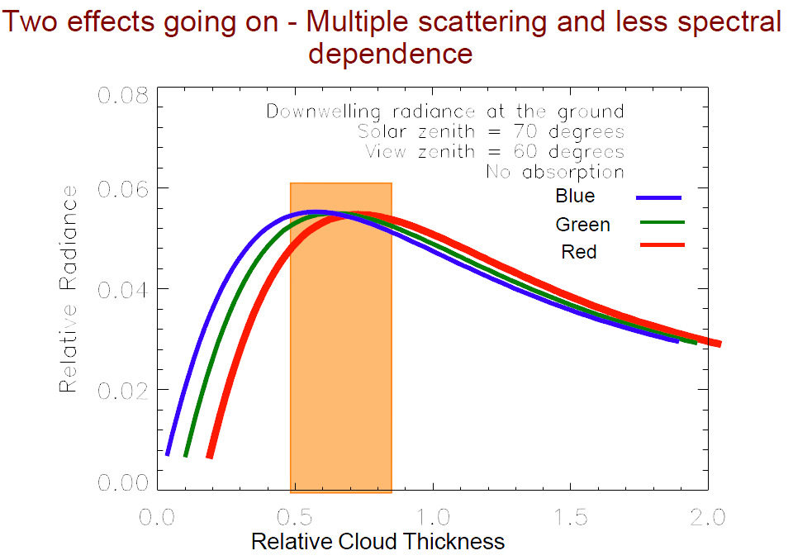
Quiz #2
Why are clouds white?

Slide 11
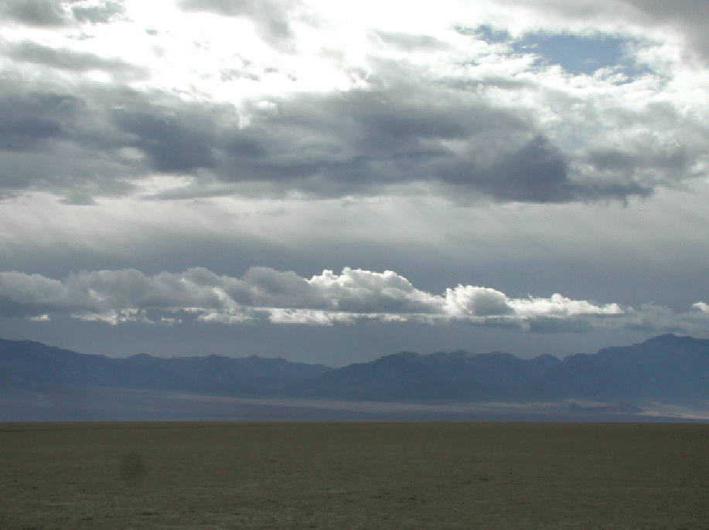
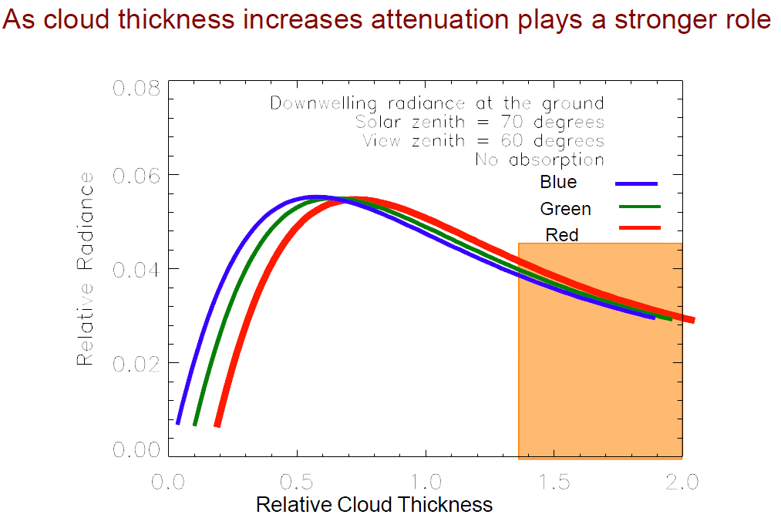
Quiz #3
Why are clouds white?

Slide 12
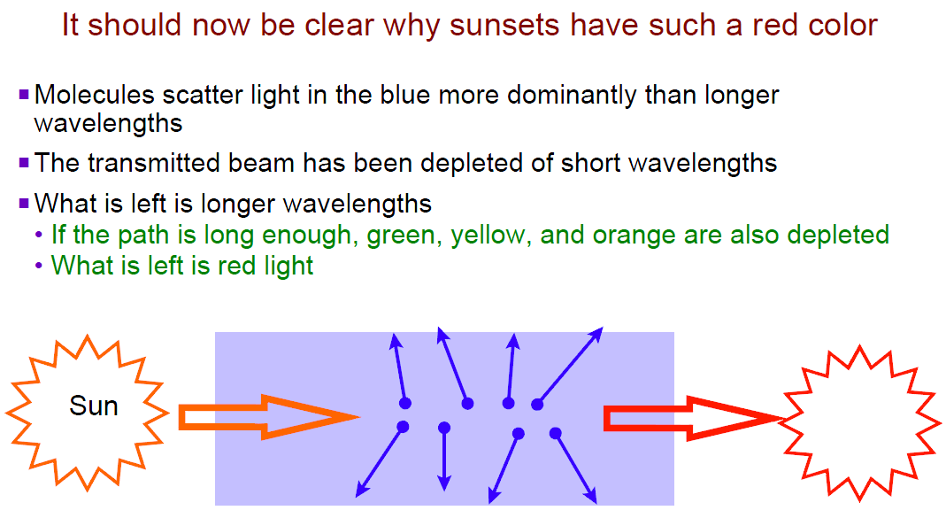
Quiz #4
Why are sunsets red?

Slide 13
Resolution
Four basic types- Spatial, Temporal, Radiometric, Spectral
Temporal resolution
●Frequency of the data collection (repeat cycle and revisit time)
●How long the sensor is on over target (integration time or shutter speed)
●Mission lifetime or operation period
Radiometric resolution
●Sampling changes in energy levels
●Smallest detectable change in energy
●Minimum and maximum detectable energy levels (Dynamic Range)
Spectral resolution
●Band spacing
●Narrowest band width
●Overall spectral coverage
Spatial resolution
●Spatial sampling of data points (Ground sampling interval – GSI)
●Smallest area sampled (Pixel size, Ground Instantaneous Filed of View-GIFOV, Ground Sampling Distance-GSD)
●Full area covered by the sensor (swath width)

Slide 14
Temporal Resolution
Remote Sensor Data Acquisition
June 1, 2001
June 17, 2002
July 3, 2003
16 days
Jensen, 2000

Slide 15
Radiometric Resolution
8-bit
(0 - 255)
0
0
9-bit
(0 - 511)
10-bit
(0 - 1023)
0
Jensen, 2000

Slide 16
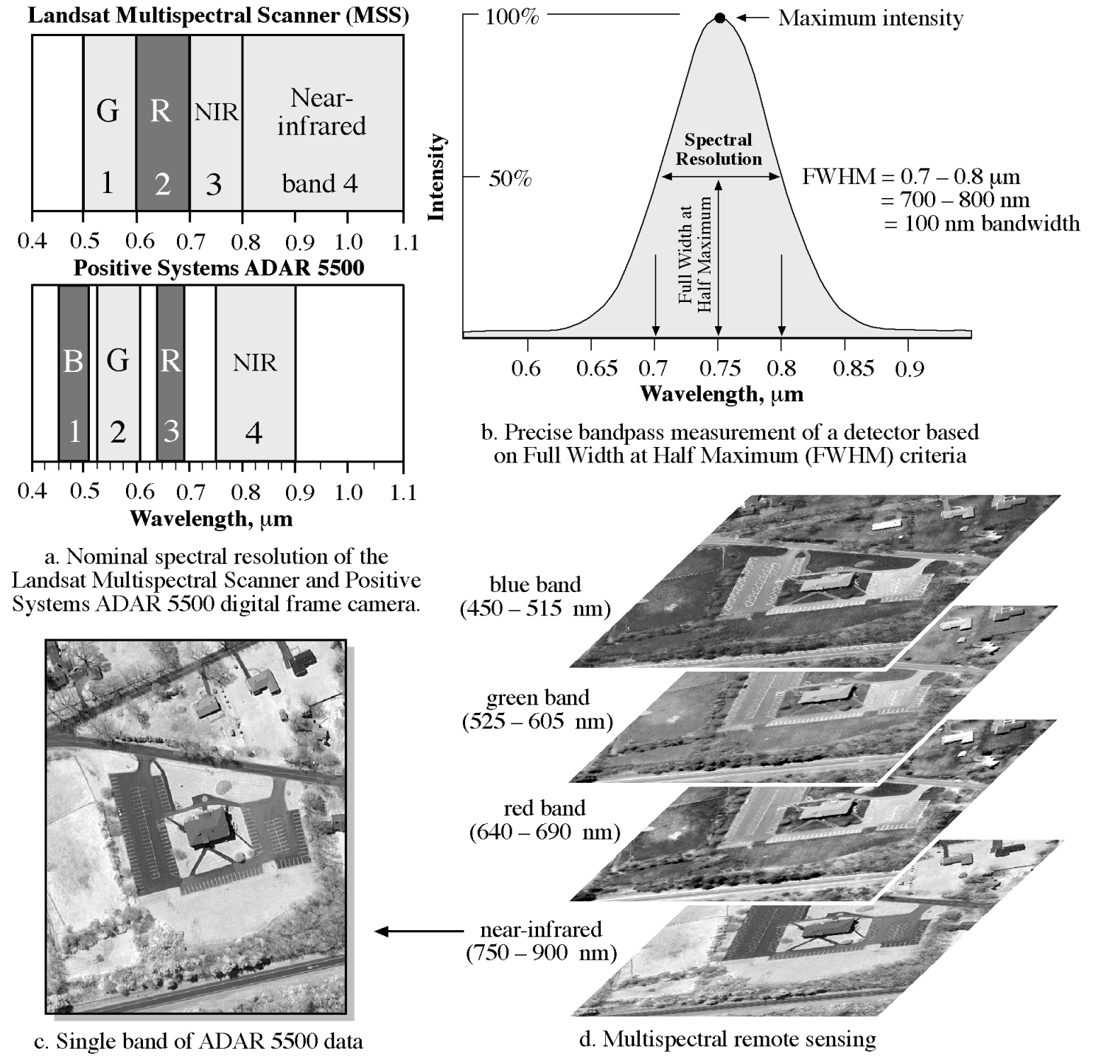
Spectral Resolution
Jensen, 2000

Slide 17
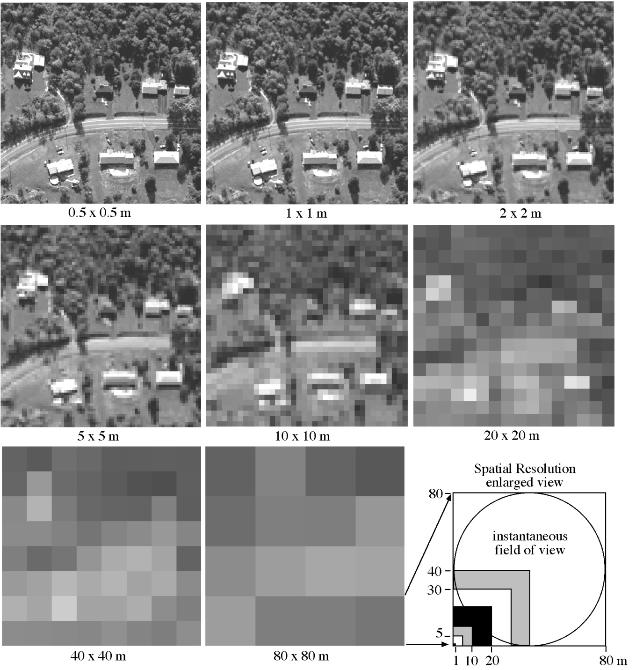
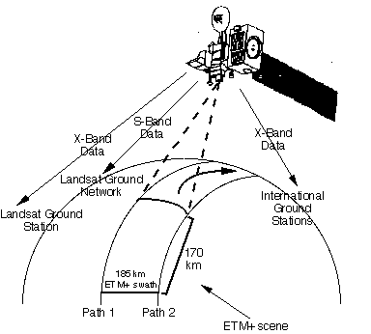
Spatial Resolution
Swath width refers to the strip of the Earth’s surface from which geographic data are collected by a moving vehicle such as a satellite, aircraft or ship in the course of swath mapping (Wikepedia)
Jensen, 2000
http://www.ntsg.umt.edu/node/659

Slide 18
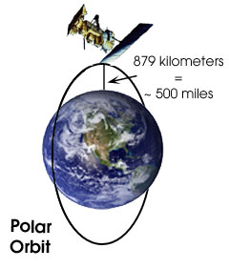
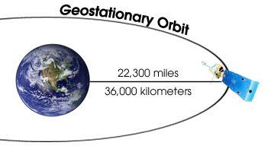
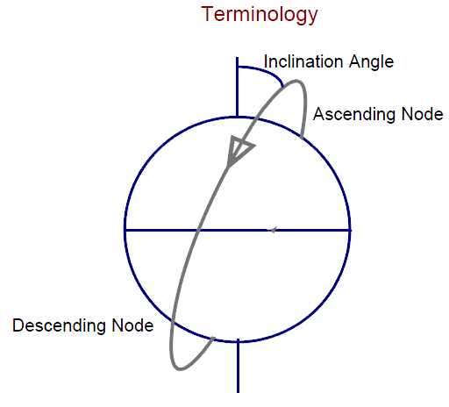
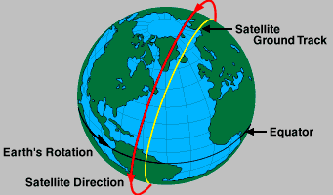
Satellite Orbits
Typical orbits are
Polar
Geo-synchronous
Sun-synchronous
Sun-synchronous orbit
http://www.ntsg.umt.edu/node/660

Slide 19
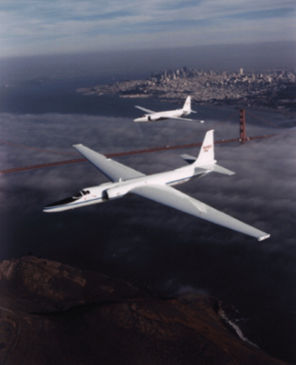
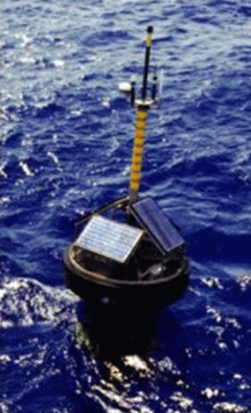
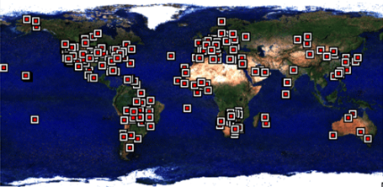
Other remote sensing
Aircraft-based sensors
Aeronet
Buoys
Notes:
Aeronet is a collection of ground-based radiometers viewing the sun and sky to derive information about dust content.
Ground-based does not always mean terrestrially-based.

Slide 20
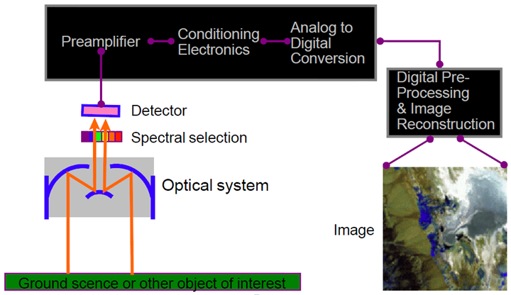
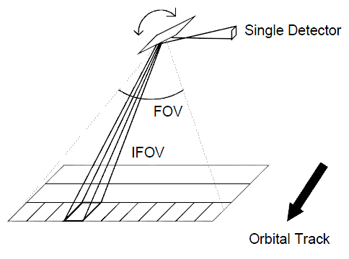
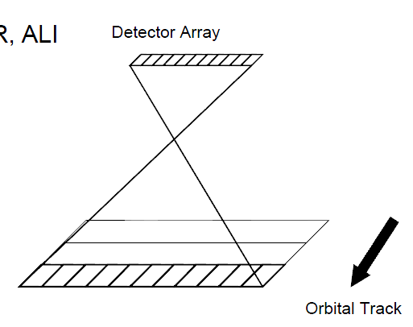
Sensor systems
Most satellite systems are now electro-optical systems (not film based) and all EO systems have similar characteristics
Scanning systems
Whiskbroom
MSS,
TM
ETM+
Pushbroom
SPOT
ASTER
ALI
Notes:
Whiskbroom: Approach is common to narrow swath sensors since it reduces wasted
portions of the scan line
Pushbroom: Used primarily for small swath widths since large swaths would require a
large number of detectors

Slide 21
Calibrations and corrections
Types of calibration- Geometric and Radiometric
Geometric calibration: pixels location in latitude and longitude and height
Radiometric calibration allows the sensor output to be converted to an absolute scale
VNIR/SWIR atmospheric correction
Sun angle is a critical factor in the VNIR/SWIR
Proper atmospheric correction in the VNIR/SWIR allows direct comparison to two scenes to determine changes in surface characteristics
●Removes effects due to view and solar angles
●Changes in atmospheric conditions are taken into account (aerosol amounts, water vapor content, etc)

Slide 22
Current Satellite Systems and Sensors
http://svs.gsfc.nasa.gov/vis/a000000/a003800/a003892/index.html
Notes:
NASA currently has a fleet of 16 remote sensing observatories orbiting Earth. The satellites include components of the A-Train (Terra, Aqua, Aura, CloudSat, CALIPSO), two satellites launched in 2011 (Aquarius, Suomi NPP), and nine others (ACRIMSAT, SORCE, GRACE, Jason-1 and 2, Landsat 7, QuikSCAT, TRMM, and EO-1). These satellites measure tropical rainfall, solar irradiance, clouds, sea surface height, ocean salinity, and other aspects of the global environment. Together, they provide a perspective of the Earth as a system.

Slide 23
Current Satellite Systems and Sensors
Multispectral Remote Sensing is the collection of reflected, emitted, or backscattered energy from an object or area of interest in multiple bands of the electromagnetic spectrum.
Landsat, MODIS, SPOT, ASTER, IKONOS, Quickbird
Hyperspectral Remote Sensing involves data collection in hundreds of bands.
AVIRIS (Air-borne), Hyperion (Space-borne)
Active and passive microwave sensors

Slide 24
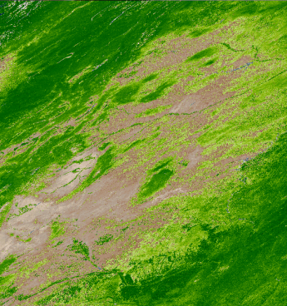
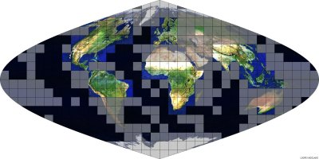
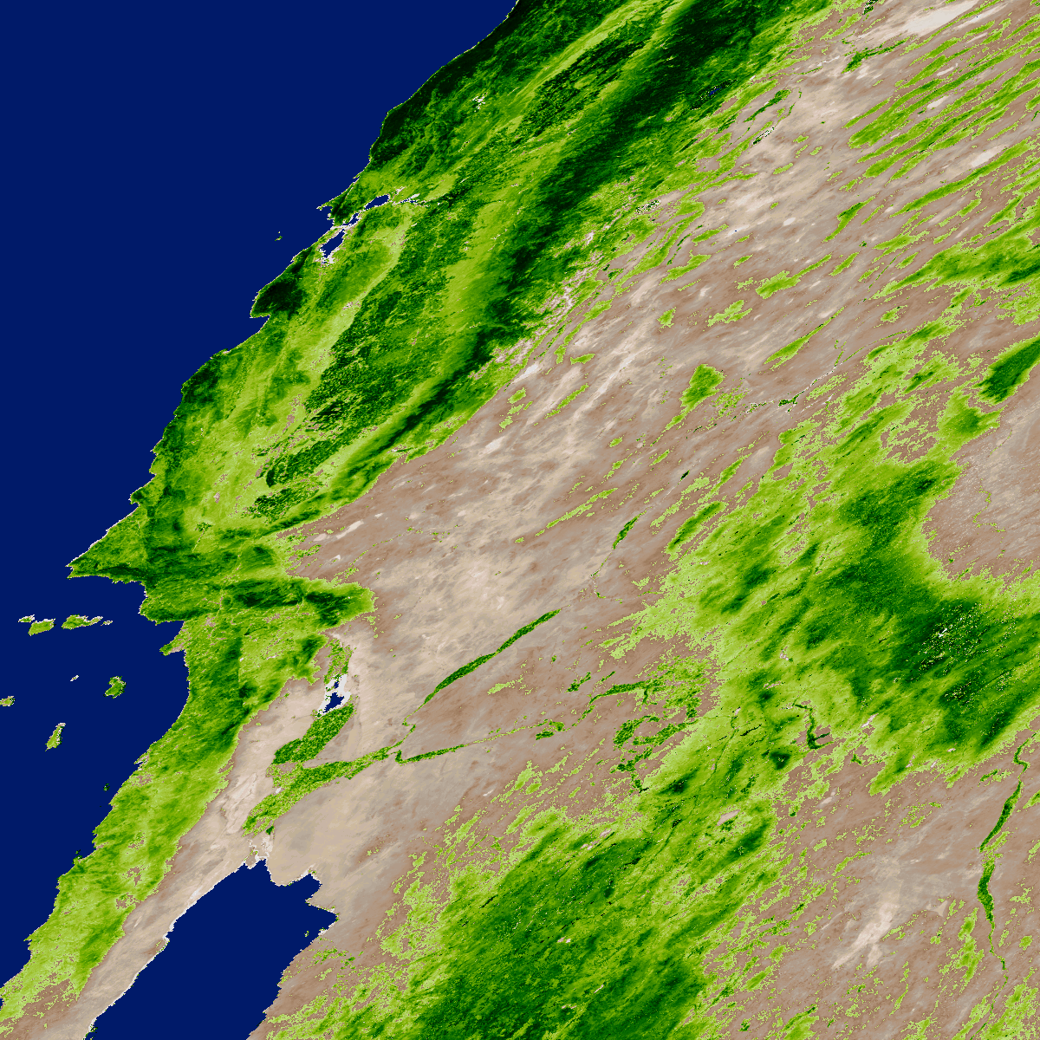
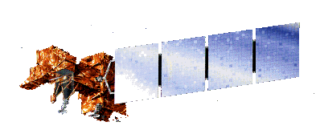
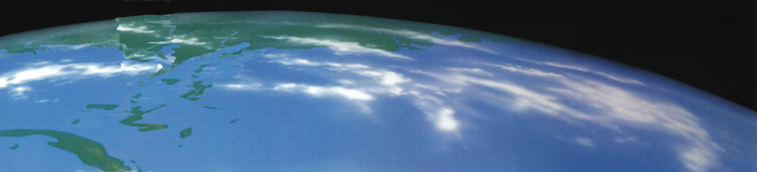
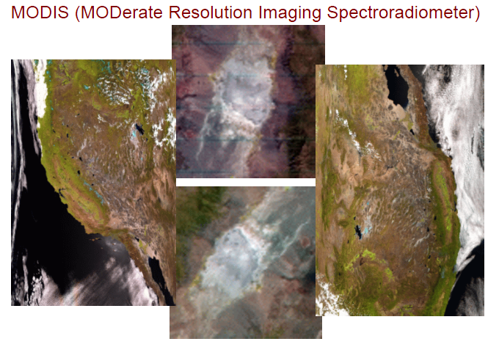
Multispectral sensors: Moderate and coarse resolution
MODIS
Moderate Resolution Imaging Spectroradiometer
Platform: EOS Terra and Aqua
Pixel resolution: 250, 500, and 1000 m (~6 km at edge)
Overpass times: 10:30 (Terra) and 13:30 (Aqua)
Spectral bands: 36
Started: 2000
Terra-MODIS
TerraMODIS
swath Coverage 2330km
Notes:
Global change research investigates the underlying processes of change and their manifestation, the impacts and the prediction of change.
Monitoring of land cover and land use is an important element of the NASA Earth Science Enterprise.
Provide important inputs to parameterize or validate ecosystem process models. High quality, consistent and well-calibrated satellite measurements are needed if we are to detect and monitor changes and trends in these variables.
Developing the next-generation data sets for global change research

Slide 25
MODIS
Global change research investigates the underlying processes of change and their manifestation, the impacts and the prediction of change
Monitoring of land cover and land use is an important element of the NASA Earth Science Enterprise
Provide important inputs to parameterize or validate ecosystem process models. High quality, consistent and well-calibrated satellite measurements are needed if we are to detect and monitor changes and trends in these variables
Developing the next-generation data sets for global change research

Slide 26
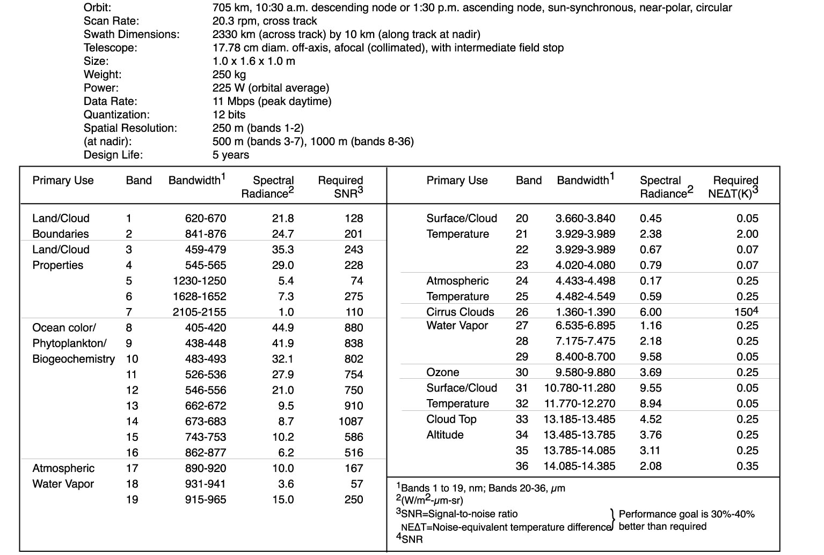
MODIS Key Specifications
(MODIS Instruments are meeting specs)

Slide 27
MODIS Products
MOD01 Level-1A Radiance Counts
MOD02 Level-1B Calibrated Relocated Radiances
-also Level 1B “subsampled” 5kmX5km pro
MOD03 Geolocation Data Set
MOD04 Aerosol Product
MOD05 Total Precipitable Water
MOD06 Cloud Product
MOD07 Atmospheric Profiles
MOD08 Gridded Atmospheric Product (Level 3)
MOD09 Atmospherically-corrected Surface
Reflectance
MOD10 Snow Cover
MOD11 Land Surface Temperature & Emissivity
MOD12 Land Cover/Land Cover Change
MOD13 Vegetation Indices
MOD14 Thermal Anomalies, Fires & Biomass
Burning
MOD15 Leaf Area Index & FPAR
MOD16 Surface Resistance & Evapotranspiration
MOD17 Vegetation Production, Net Primary
Productivity
MOD18 Normalized Water-leaving Radiance
MOD19 Pigment Concentration
MOD20 Chlorophyll Fluorescence
MOD21 Chlorophyll_a Pigment Concentration
MOD22 Photosynthetically Active Radiation (PAR)
MOD23 Suspended-Solids Conc, Ocean Water
MOD24 Organic Matter Concentration
MOD25 Coccolith Concentration
MOD26 Ocean Water Attenuation Coefficient
MOD27 Ocean Primary Productivity
MOD28 Sea Surface Temperature
MOD29 Sea Ice Cover
MOD30 Temperature and Moisture
Profiles
MOD32 Processing Framework & Match-
up
Database
MOD33 Gridded Snow Cover
MOD34 Gridded Vegetation Indices
MOD35 Cloud Mask
MOD36 Total Absorption Coefficient
MOD37 Ocean Aerosol Properties
MOD39 Clear Water Epsilon
MOD43 Albedo 16-day L3
MOD44 Vegetation Cover Conversion

Slide 28
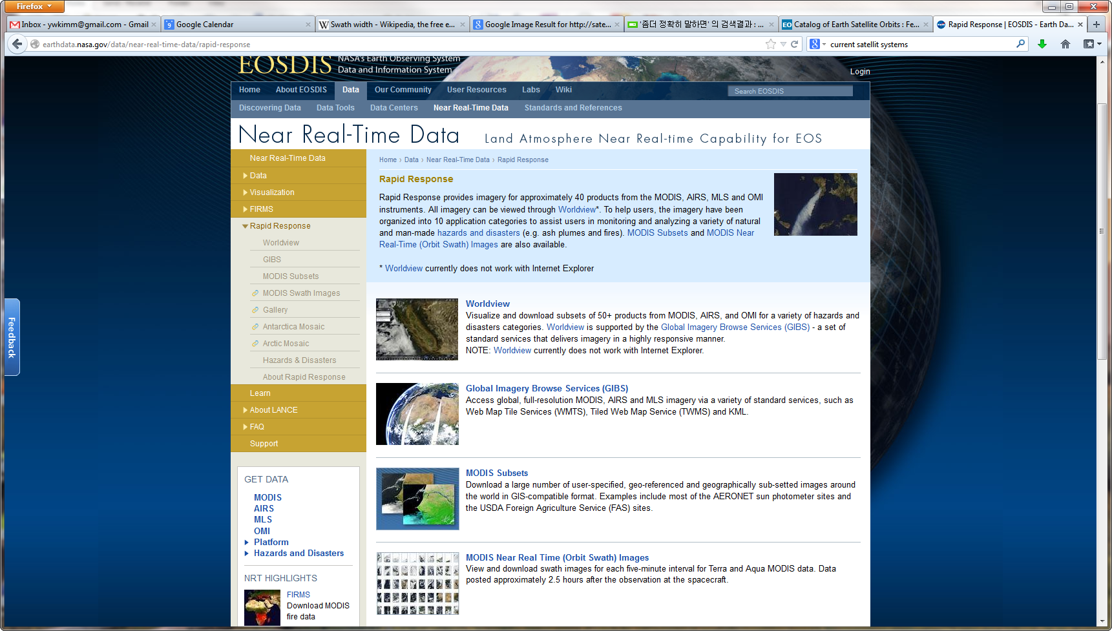
Near Real-time Data
http://earthdata.nasa.gov/data/near-real-time-data/rapid-response

Slide 29
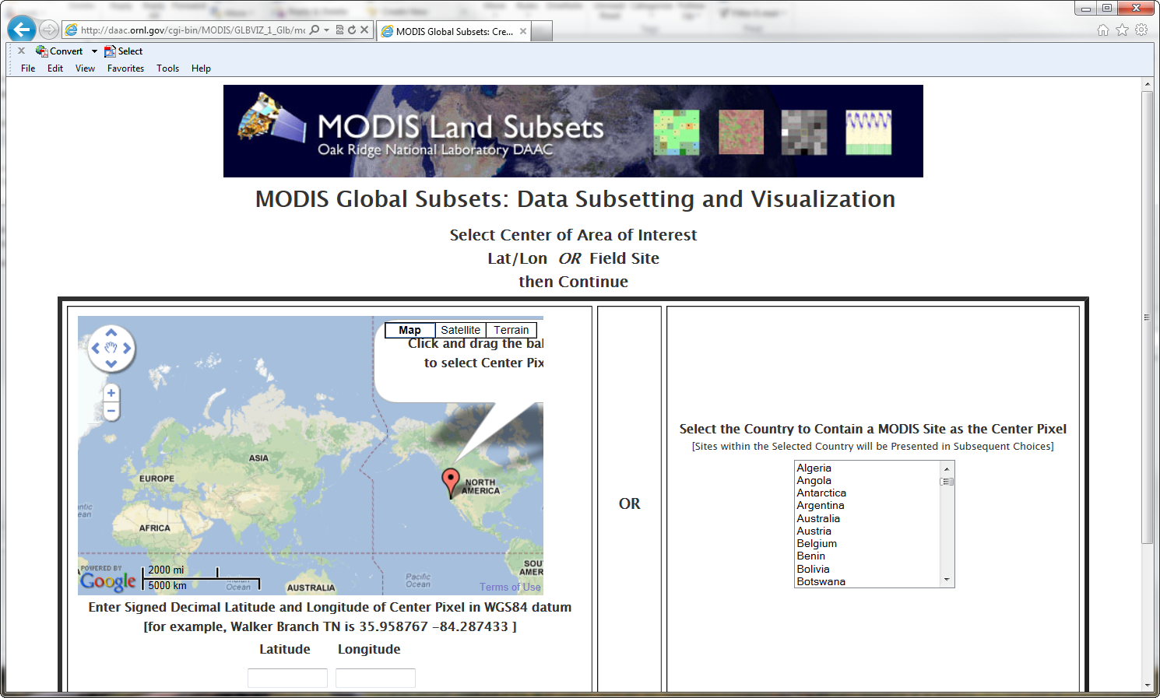
MODIS Land Subsets
http://daac.ornl.gov/cgi-bin/MODIS/GLBVIZ_1_Glb/modis_subset_order_global_col5.pl

Slide 30
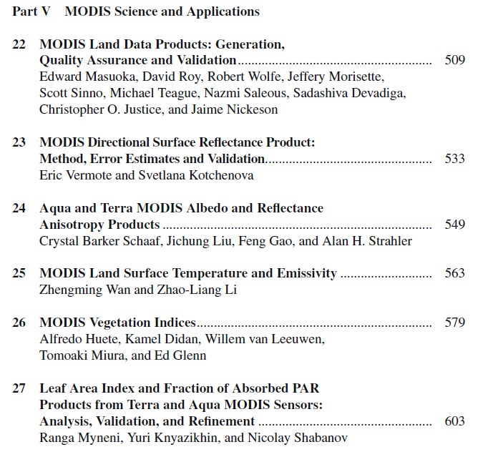
Land Remote Sensing and Global Environmental Change

Slide 31
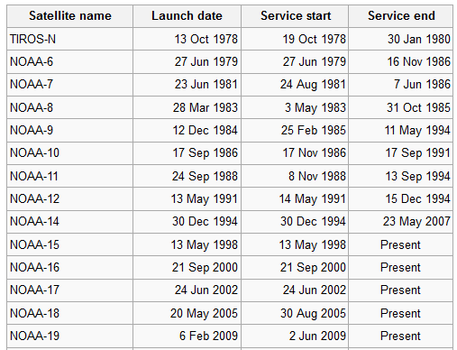
AVHRR
The Advanced Very High Resolution Radiometer (AVHRR) is a broad-band, four or five channel (depending on the model) scanner, sensing in the visible, near-infrared, and thermal infrared portions of the electromagnetic spectrum. This sensor is carried on NOAA's Polar Orbiting Environmental Satellites (POES), beginning with TIROS-N in 1978.
Wikipedia

Slide 32
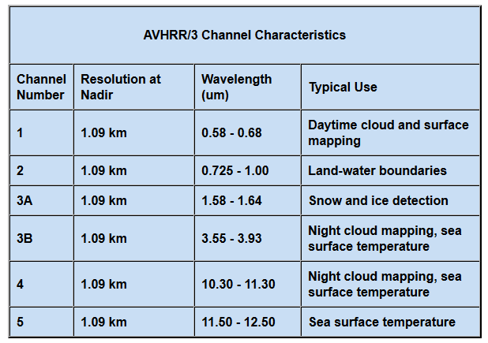
AVHRR Spectral Characteristics
http://noaasis.noaa.gov/NOAASIS/ml/avhrr.html

Slide 33
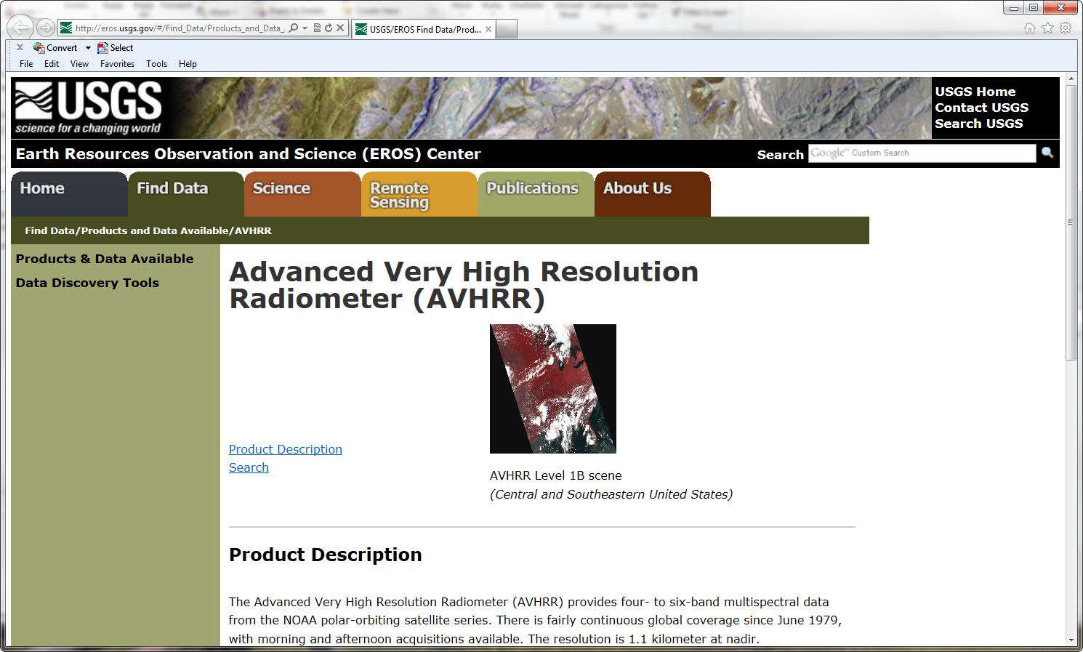
AVHRR Data
http://eros.usgs.gov/#/Find_Data/Products_and_Data_Available/AVHRR

Slide 34
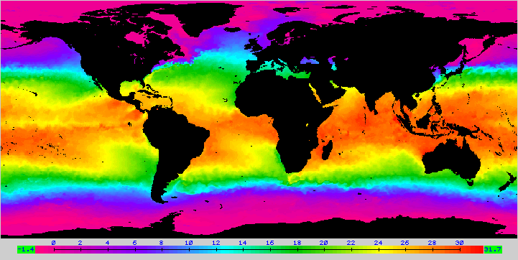
Worldwide Sea-surface Temperature (SST) Map
Derived From NOAA-14 AVHRR Data
Three-day composite of thermal infrared data centered on March 4, 1999.
Jensen, 2000

Slide 35
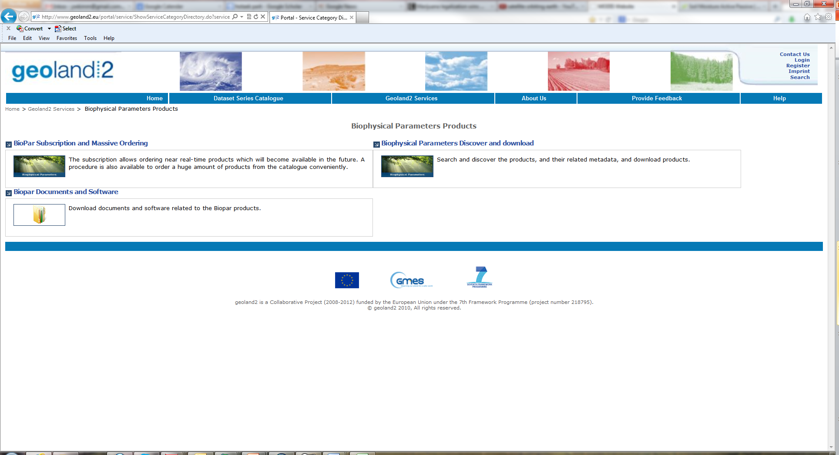
SPOT-VGT Data
Satellite Pour l’Observation de la Terre Vegetation
http://www.geoland2.eu/portal/service/ShowServiceCategoryDirectory.do?serviceRootCategoryId=CA80C881

Slide 36
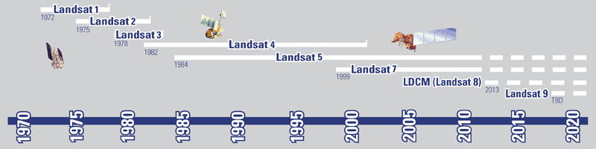
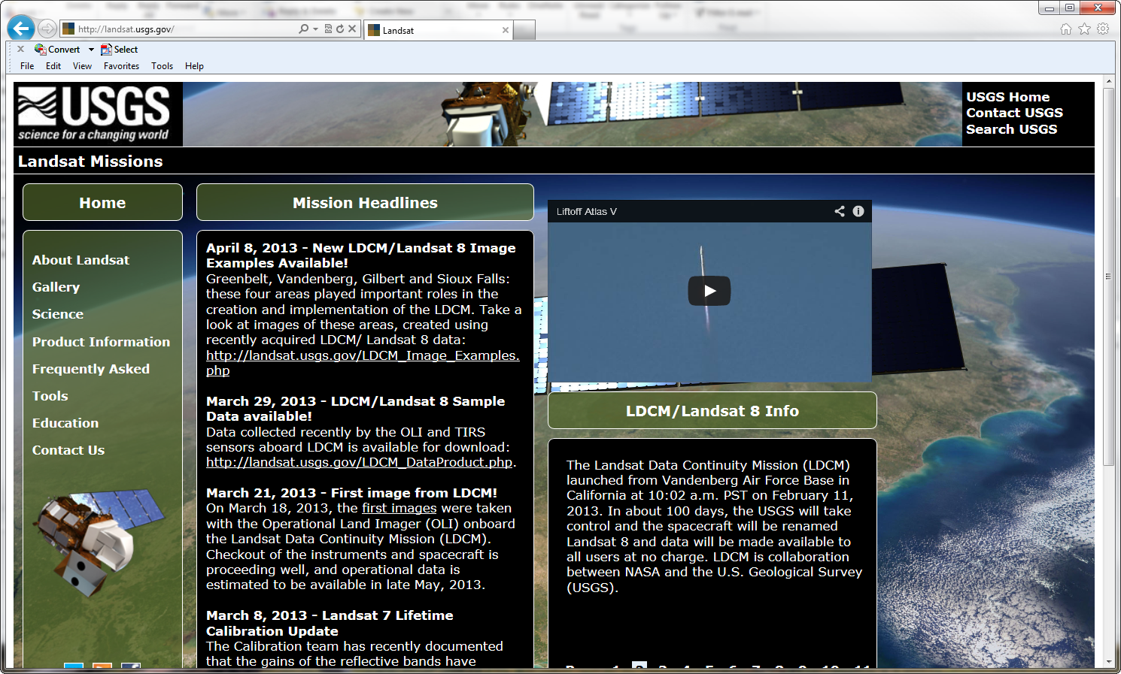
Multispectral sensors: Fine resolution sensors
http://landsat.usgs.gov/

Slide 37
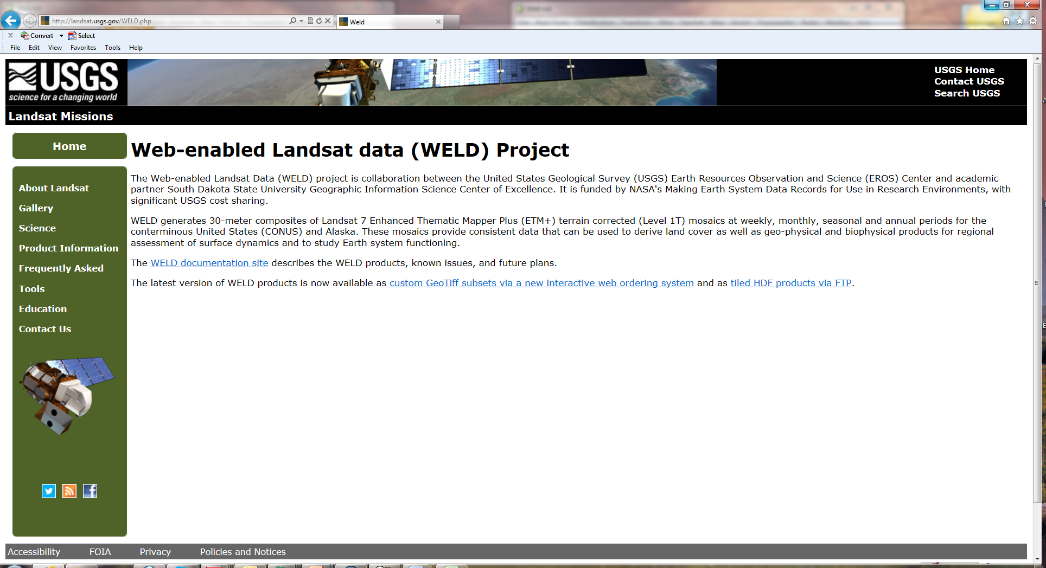
Web-enabled Landsat data (WELD)
http://landsat.usgs.gov/WELD.php

Slide 38
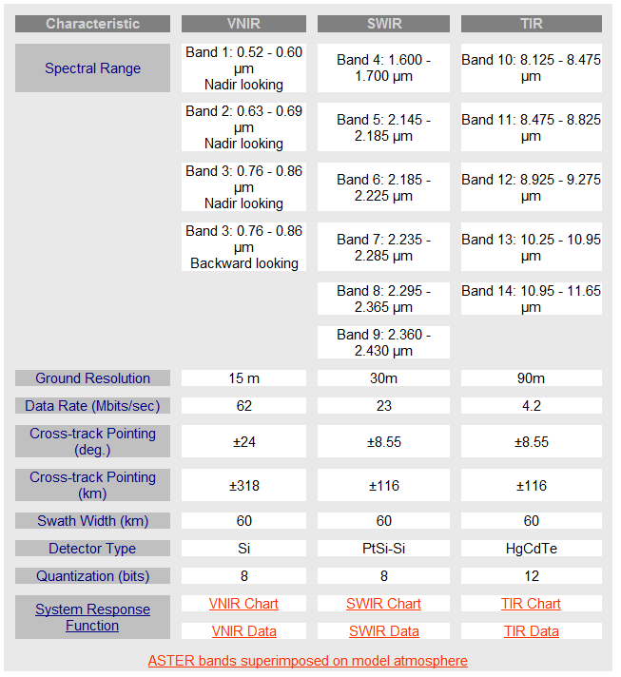
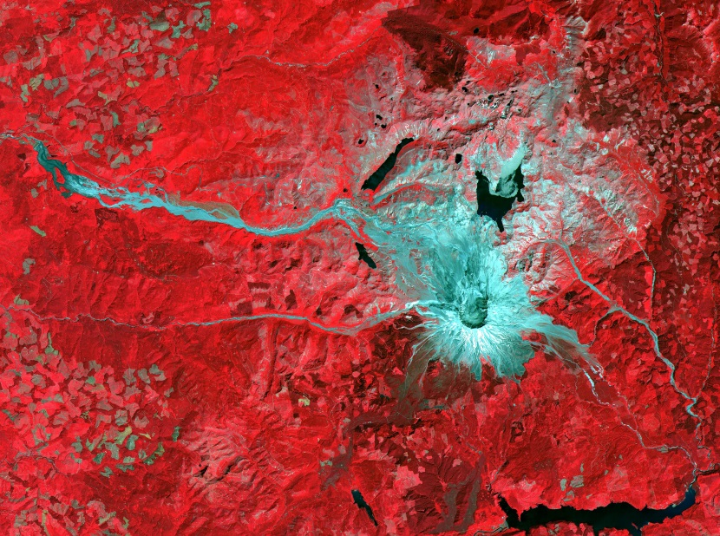
ASTER
Advanced Spaceborne Thermal Emission and Reflection Radiometer
Mt. St. Helens volcano in Washington, Aug 8 2000
http://asterweb.jpl.nasa.gov/

Slide 39
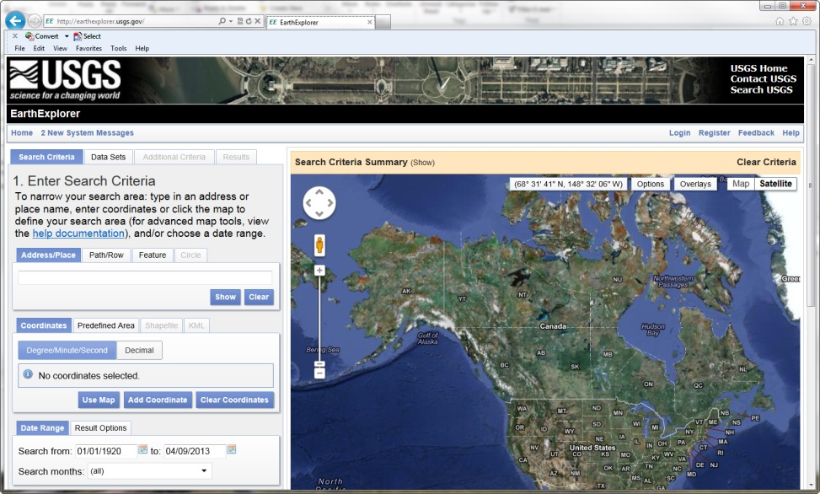
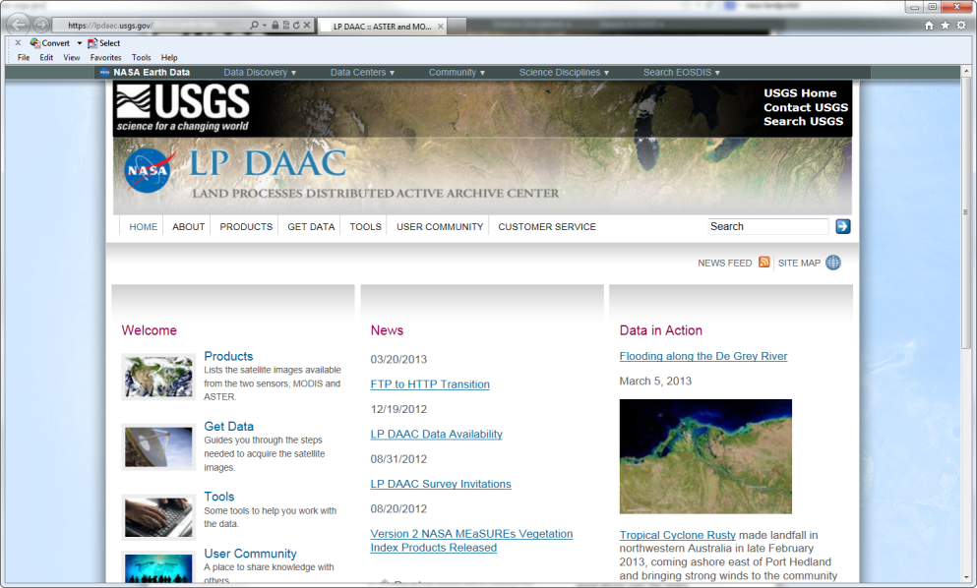
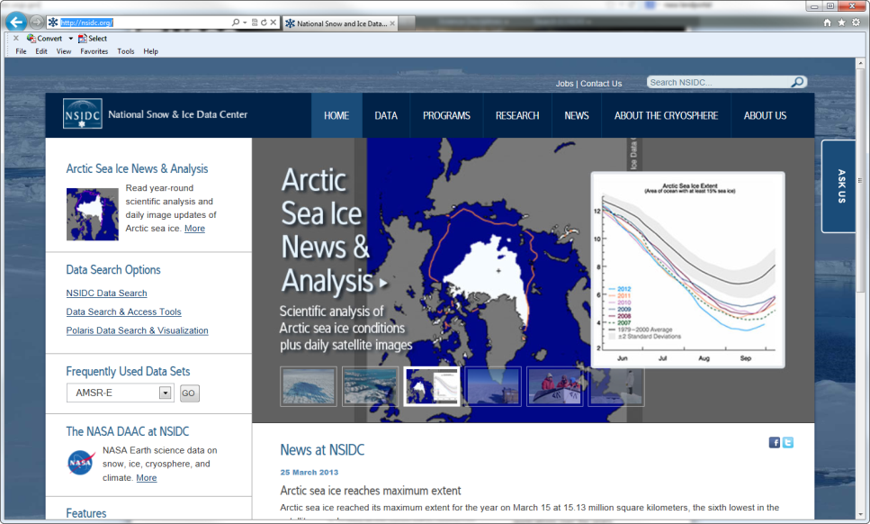
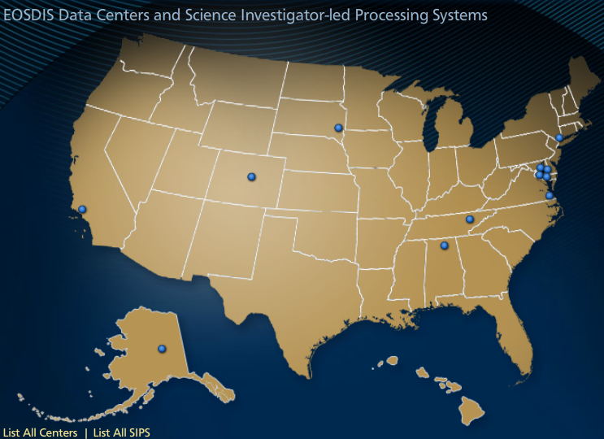
DAAC (Distributed Active Archive Center)
http://earthexplorer.usgs.gov/
https://lpdaac.usgs.gov/
http://nsidc.org/
http://earthdata.nasa.gov/
EODIS Data Centers Map
Notes:
In August, 2005 Hurricane Katrina devastated the Southern U.S. coast and the resulting damage was the costliest storm damage in U.S. history. Portions of Landsat satellite data, acquired and processed by the U.S. Geological Survey illustrate the extent of the flooding in the New Orleans area and the long term impact of the storm. In the September, 2005 image dark tones represent flooded areas of the city. By October, 2005 significant areas are drying; however, the light brown tones represent areas where vegetation (trees, lawns, parks) has been destroyed. By September, 2009 the brown tones are replaced with more green colors, representing new growth of vegetation as neighborhoods rebuild. Federal, state and local officials use the Landsat data to monitor the effects of change and will use the imagery for planning of rehabilitating the region.

Slide 40


Multispectral sensors: Finer spatial resolution sensors
IKONOS Imagery of Columbia, SC Obtained on October 28, 2000
Panchromatic 1 x 1 m
Pan-sharpened multispectral 4 x 4 m
Jensen, 2004

Slide 41

Quickbird
http://www.satimagingcorp.com/galleryimages/quickbird-ukraine.jpg

Slide 42


Hyperspectral sensors
Collect and process information from across the electromagnetic spectrum
Deals with imaging narrow bands over a continuous spectral range

Slide 43

Why Hyperspectral data?
Wider bands decrease our ability to distinguish reflectance features
Dry plant materials lack the pronounced spectral contrast between NIR and Red band that distinguish green plant and soils
Hyperspectral sensors collect data within wavelength regions where there are cellulose and lignin absorption features that can be used to distinguish soils from senescent vegetation or wood

Slide 44


What is spectral response?
In remote sensing, it is not desirable to design a system that responds equally energy at all wavelengths equally
Spectral response is a cascade of all elements that limit the sensor’s output to a specific spectral region
Spectral variability of the surface (either reflectance or emissivity) allows for determining information about the material
●Vegetation vs. Asphalt
●Grass vs. wheat
●Stressed vegetation vs. healthy veg.
VIs are based on this shift
Notes:
Figure 24. Spectral mixture modeling with hyperspectral image data collected by the NASA AVIRIS sensor over a grassland region of Kansas, USA allowed for the detection and mapping of biophysical properties related to land cover and land use (Wessman et al. 1997). Spectral graphs highlight some of the dominant land covers depicted in the analysis.

Slide 45


AVIRIS
Airborne Visible/Infrared Imaging Spectrometer
Platform: Airplane (Twin-otter and ER2)
Pixel resolution: 5m (Twin-otter) and 20m (ER2)
Spectral bands: 224 with 10nm bandwidth

Slide 46


Active and passive sensors
Passive sensors rely on the ultimate source of energy being supplied by something external to the sensor while active systems use their own source of energy to supply the energy that is measured
Passive case
Radar, including synthetic aperture radar (SAR), and lidar: the most common active approaches in remote sensing
Active systems can readily use wavelengths unaffected by clouds
Types
●Imaging radar: similar to a photograph taken by a camera, but taken radar waves (e.g., RADARSAT-1, SAR instrument)
●Non-imaging radar: measures the amount of backscatter, scatterometer (e.g., QuikSCAT)
●Altimetry: measures the time it takes to return to the sensor from sending a pulse of radar energy toward the earth (e.g., ICESat)

Slide 47
Digital Image Processing

Slide 48

Image Processing
Jensen, 2004

Slide 49


Change Detection
Some of the data are fairly static, they do not change over time
Conversely, some biophysical materials and human-made features are dynamic, changing rapidly
Types
●Temporal and spatial changes
Change detection algorithms
●image algebra (differencing, rationing)
●multi-date composite image
●cross-correlation
Sun City near Hilton Head, SC
Jan 22 1994
Sep 23 1996
2.5x
2.5m

Slide 50
Digital Image Processing Software Systems
Major Commercial Systems
Major Public Domain Systems
ENVI
ERDAS Imagine
Leica Photogrammetry Suite
- IDRISI
- ER Mapper
PCI Geomatica
eCognition
- GRASS
- MultiSpec (LARS Purdue)
DLGView
fGIS
OpenEV
NSIDC DataViewer
HDFView
Panoply

Slide 51
Remote Sensing Applications

Slide 52


Remote Sensing Applications
Vegetation Indices
Radiometric measures of the amount, structure, and condition of vegetation,
Precise monitoring tool
  phenology
  inter-annual variations
Serve as intermediaries in the assessment of various biophysical parameters
  green cover,
  biomass,
  leaf area index (LAI),
  fAPAR
  chlorophyll conc.

Slide 53

Theoretical Basis
With increasing presence of active, p.s. vegetation
  reflectance in the red (chlorophyll absorption) with simultaneously increasing reflectance in the NIR (leaf structure).
We can ratio the 2 spectral regions, linearly combine them, use derivatives, or some combination of above.

Slide 54


CMG MOD13C1
Annual average EVI
https://lpdaac.usgs.gov/products/modis_products_table/mod13c1

Slide 55
NDVI Applications
The NDVI has been widely used in various operational applications, including
  famine early warning systems,
  land cover classification,
  health and epidemiology,
  drought detection,
  land degradation,
  deforestation,
  change detection and monitoring.

Slide 56







MODIS Global GPP/NPP
http://ntsg.umt.edu/project/mod17
GPP: Gross primary production (gC/m2/d)
PAR: Photosynthetically active radiation
FPAR: Fraction of PAR
: Net photosynthesis, an intermediate variable between GPP and NPP
: Light use efficiency parameter (gC/MJ)
: Maintenance respiration from living leaves and fine roots (gC/m2/d)
: Downward surface solar shortwave radiation (MJ/m2/d)
: Maximum e under optimal conditions (gC/MJ)
: Annual maintenance respiration from living wood (gC/m2/d)
: Daily minimum temperature scalar
: Vapor pressure deficits (VPD) scalar
NPP: Annual net primary production (gC/m2/yr)
Notes:
MODIS GPP/NPP is the first continuous satellite-derived dataset monitoring global vegetation productivity. Continuous and accurate measurements of terrestrial NPP at the global
scale are possible using satellite data. Since early 2000, for the first time, the
MODIS sensors onboard the Terra and Aqua satellites, have operationally provided
scientists with near real-time global terrestrial gross primary production (GPP) and
net photosynthesis (PsnNet) data. These data are provided at 1 km spatial resolution
and an 8-day interval, and annual NPP covers 109,782,756 km2 of vegetated land.
These GPP, PsnNet and NPP products are collectively known as MOD17 and are
part of a larger suite of MODIS land products (Justice et al. 2002), one of the core
Earth System or Climate Data Records (ESDR or CDR). These products have improved based on extensive validation and calibration
activities by the MODIS science team. The Collection-5 (C5) MODIS data are
being reprocessed by NASA in 2007 and will have higher quality than the previous
collections.

Slide 57


MODIS Global Evapotranspiration
http://ntsg.umt.edu/project/mod16
The MOD16 ET algorithm is based on the Penman-Monteith equation (Monteith, 1965)
Terrestrial ET includes evaporation from wet and moist soil, from rain water intercepted by the canopy + the transpiration through stomata on plant leaves and stems

Slide 58

NASA’s Earth Observing System Data and Information System
http://earthdata.nasa.gov/our-community/community-data-system-programs/measures-projects

Slide 59

Landscape Freeze/Thaw Dynamics
http://freezethaw.ntsg.umt.edu/

Slide 60


Phenology
https://usanpn.org/
http://phenology.arizona.edu/

Slide 61

Global Vegetation Health Monitoring
http://www.star.nesdis.noaa.gov/smcd/emb/vci/VH/vh_browse.php

Slide 62



US Drought Monitoring
http://drought.unl.edu

Slide 63

Global Fire Monitoring
http://www.globalfiredata.org/

Slide 64

Global Land Cover Mapping
http://www.bu.edu/lcsc/data-documentation/

Slide 65

MODIS Land Cover Mapping
https://lpdaac.usgs.gov/products/modis_products_table/mcd12c1

Slide 66


Global Land Cover Facility
http://www.landcover.org/data/
MODIS Vegetation Continuous Fields
-indicating the combination of tree and herbaceous vegetation cover and bare ground

Slide 67


Global Cropland Mapping
https://powellcenter.usgs.gov/globalcroplandwater/

Slide 68

NASA LCLUC Program
http://lcluc.umd.edu/

Slide 69

Natural hazards
http://earthobservatory.nasa.gov/NaturalHazards/

Slide 70



Socio-economic Applications
Socioeconomic Characteristics
Energy Demand and Conservation
Temporal Resolution
Konso village in southern Ethiopia
Single and multiple family residences in Columbia, S. C.
Daytime high resolution (0.3 x 0.3 m) aerial photography of a gymnasium
Nighttime 0.3 x 0.3 m thermal infrared
imagery (8 - 14 μm)
Temporal Spatial
Resolution Resolution
S1 - local population estimation 5 - 7 years 0.3 - 5 m
S2 - regional/national population estimation 5 - 15 years 5 - 20 m
S3 - quality of life indicators 5 - 10 years 0.3 - 0.5 m
Temporal Spatial
Resolution Resolution
E1 - energy demand and production potential 1 - 5 years 0.3 - 1 m
E2 - building insulation surveys 1 - 5 years 1 - 5 m

Slide 71


Archaeology
http://weather.msfc.nasa.gov/archeology/
http://www.satimagingcorp.com/svc/archaeology.html

Slide 72
Data visualization

Slide 73



Data visualization
http://svs.gsfc.nasa.gov/
http://sciencebulletins.amnh.org/
http://earthobservatory.nasa.gov/

Slide 74
Useful web references
•Federation of American Scientists
http://www.fas.org/irp/imint/docs/rst/Front/tofc.html
•CRISP
http://www.crisp.nus.edu.sg/~research/tutorial/rsmain.htm
•"Fundamentals of Remote Sensing Tutorial Notes:"
http://www.nrcan.gc.ca/earth-sciences/geography-boundary/remote-sensing/fundamentals/1430
•NOAA Center for Satellite Applications and Research
http://www.orbit.nesdis.noaa.gov/star/index.html
•NASA Earth Observatory
http://earthobservatory.nasa.gov
•Science @ NASA
http://science.hq.nasa.gov/

