Slide 1
Energy Budget Principles
NRSM 532,
Spring 2014

Slide 2
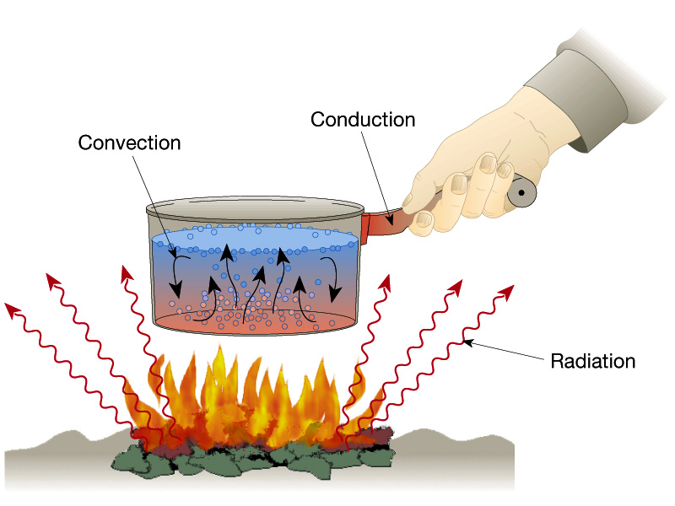
Heat Energy Transfers in 3 Ways
Conduction
Molecule-to-molecule transfer
Convection
Heat energy transferred by movement
Radiation
The transfer of heat by the movement of electromagnetic waves
Does not require a medium

Slide 3
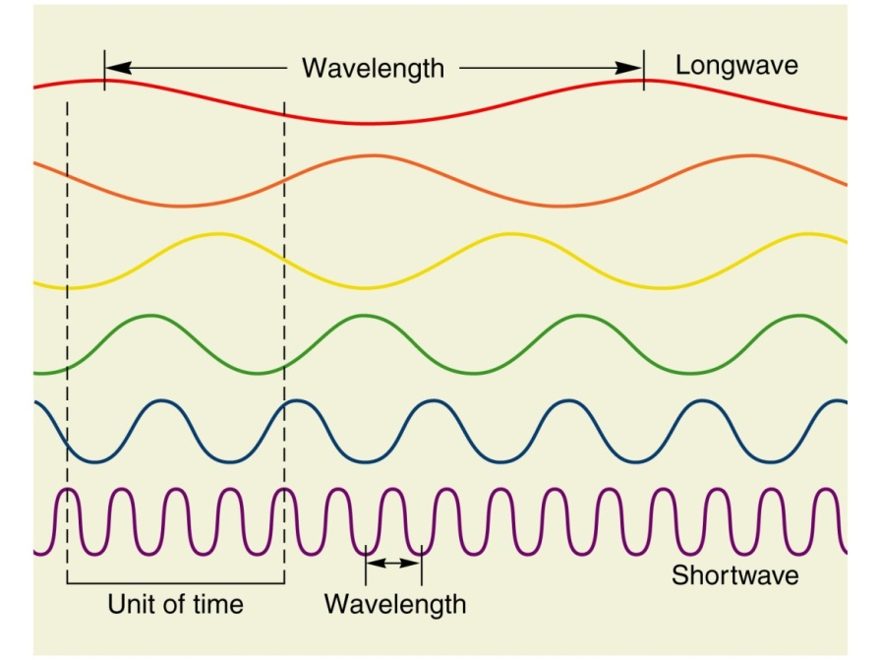
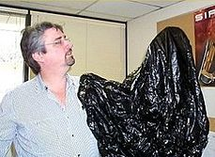
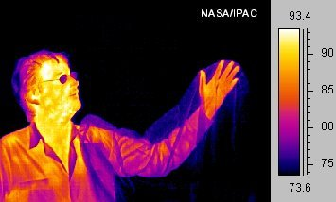
Electromagnetic (EM) Radiation
All objects emit electromagnetic radiation!!

Slide 4
Important Radiation Laws & Concepts
Wien’s Law
λ_{m} = b / T
A black body* will emit radiation at a wavelength (λ) inversely proportional to the black body’s temperature (T):
Constant of proportionality
*A black body is an idealized physical body that absorbs all incident electromagnetic radiation, regardless of frequency or angle of incidence.

Slide 5
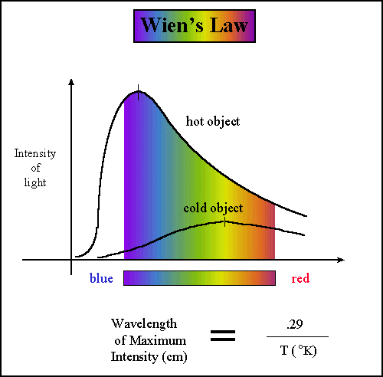

Slide 6
EM Spectrum
Shortwave Radiation
Shorter than 3 μm
Visible, UV, x-rays, etc.
Emitted from the Sun
Longwave Radiation
Longer than 3 μm
Thermal, microwave, radar, etc.
Emitted from Earth

Slide 7
Important Radiation Laws & Concepts
Stefan-Boltzmann Law
ψ = σT⁴
Total energy radiated by a black body* (Ψ) is directly proportional to the fourth power of the black body’s temperature (T):
Constant of proportionality
*A black body is an idealized physical body that absorbs all incident electromagnetic radiation, regardless of frequency or angle of incidence.

Slide 8
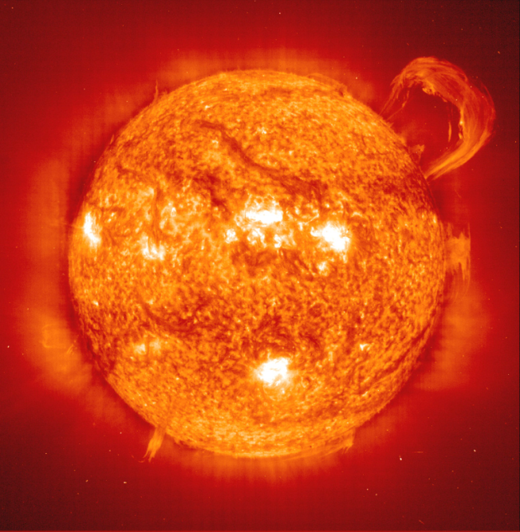
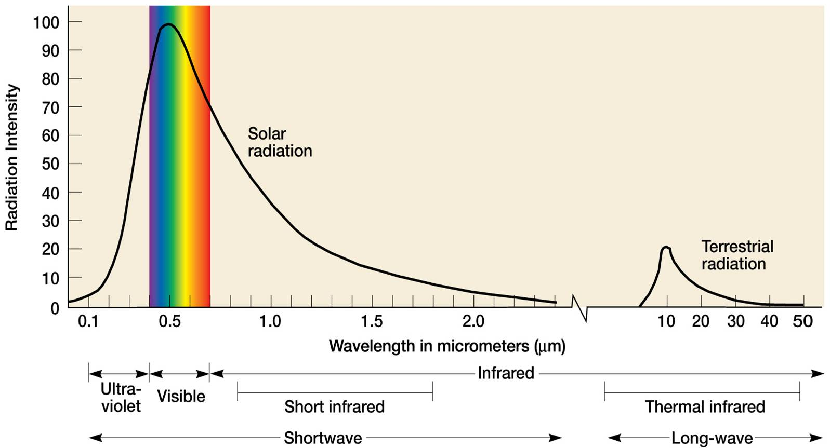
The Sun
Surface temperature
~5505 °C (9941 °F)

Slide 9
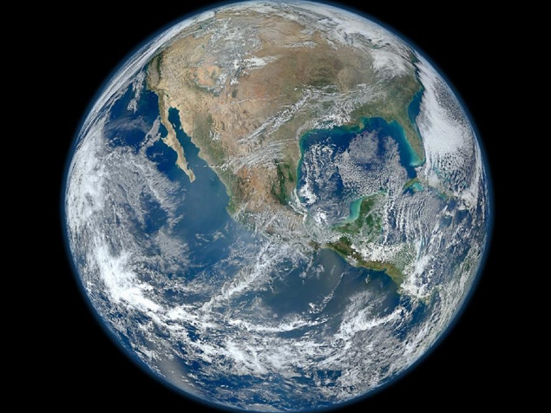
The Earth
Surface temperature
~15 °C (59 °F)

Slide 10
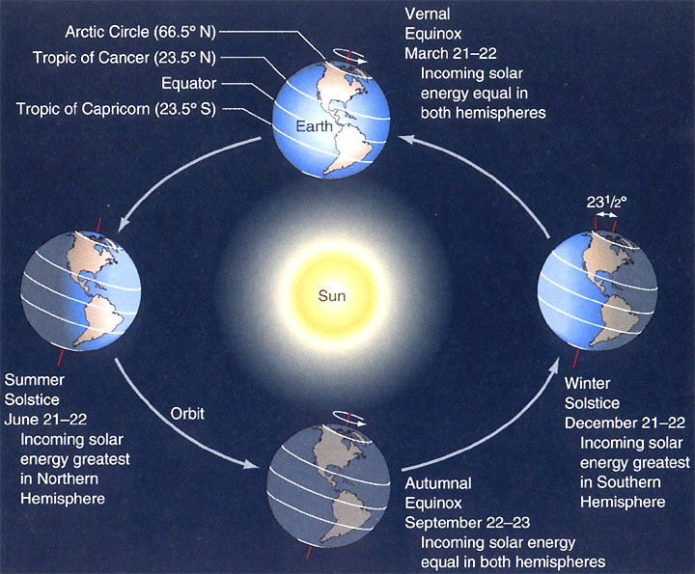

Slide 11
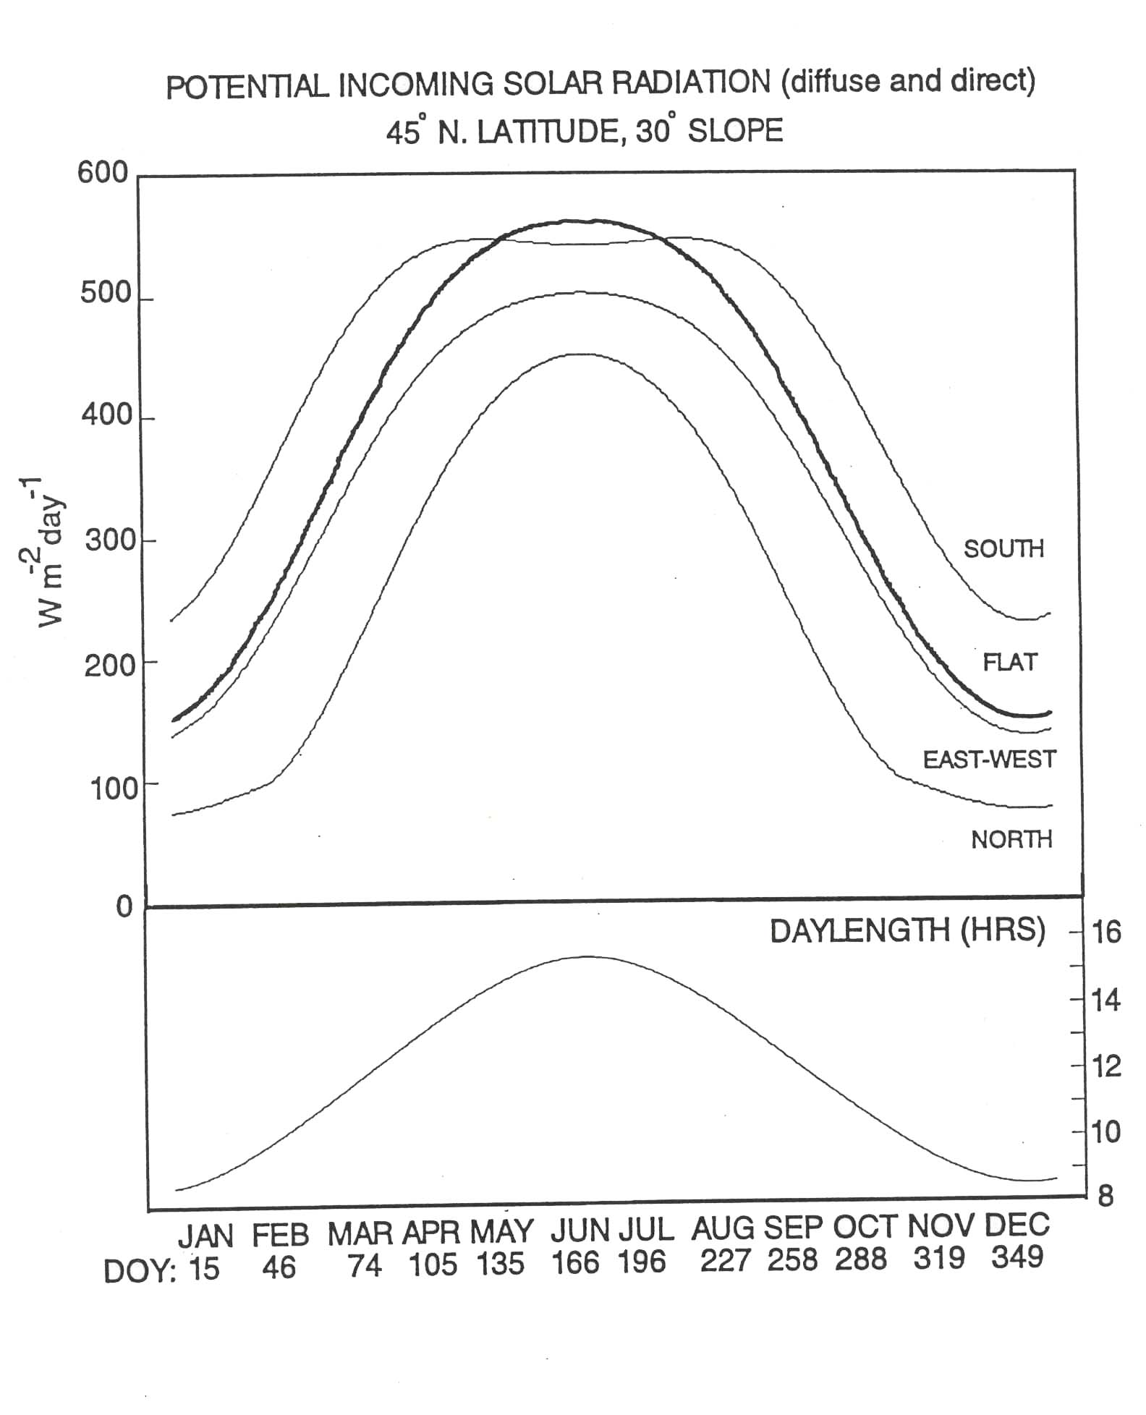

Slide 12
Insolation: Solar Radiation Striking the earth’s Surface
I = S cos(Z)
I = insolation
S ~ 1000 W m⁻² (clear day solar insolation on a surface
perpendicular to incoming solar radiation.
This value actually varies greatly due to
atmospheric variables.)
Z = Zenith Angle (the angle from the zenith (point directly
overhead) to the Sun’s position in the sky.
The zenith angle is dependent upon
latitude, solar declination angle, and time
of day.

Slide 13
Insolation: Zenith Angle
Z = cos⁻¹ {sin(Latitude) sin(Solar Decl.) +
cos (Latitude) cos(Solar Decl.) cos H}
Latitude = latitude at site of interest (Missoula ~46°)
Solar Decl. = solar declination
At Vernal Equinox (Mar. 21/22) = 0°
At Summer Solstice (Jun. 21/22) = +23.5°
At Autumnal Equinox (Sept. 21/22) = 0°
At Winter Solstice (Dec. 21/22) = -23.5°
H = hour angle = 15° X (Time – 12)
This is the angle of radiation due to the time of day
Time is given in solar time as the hour of day from
midnight.

Slide 14
Albedo

Slide 15
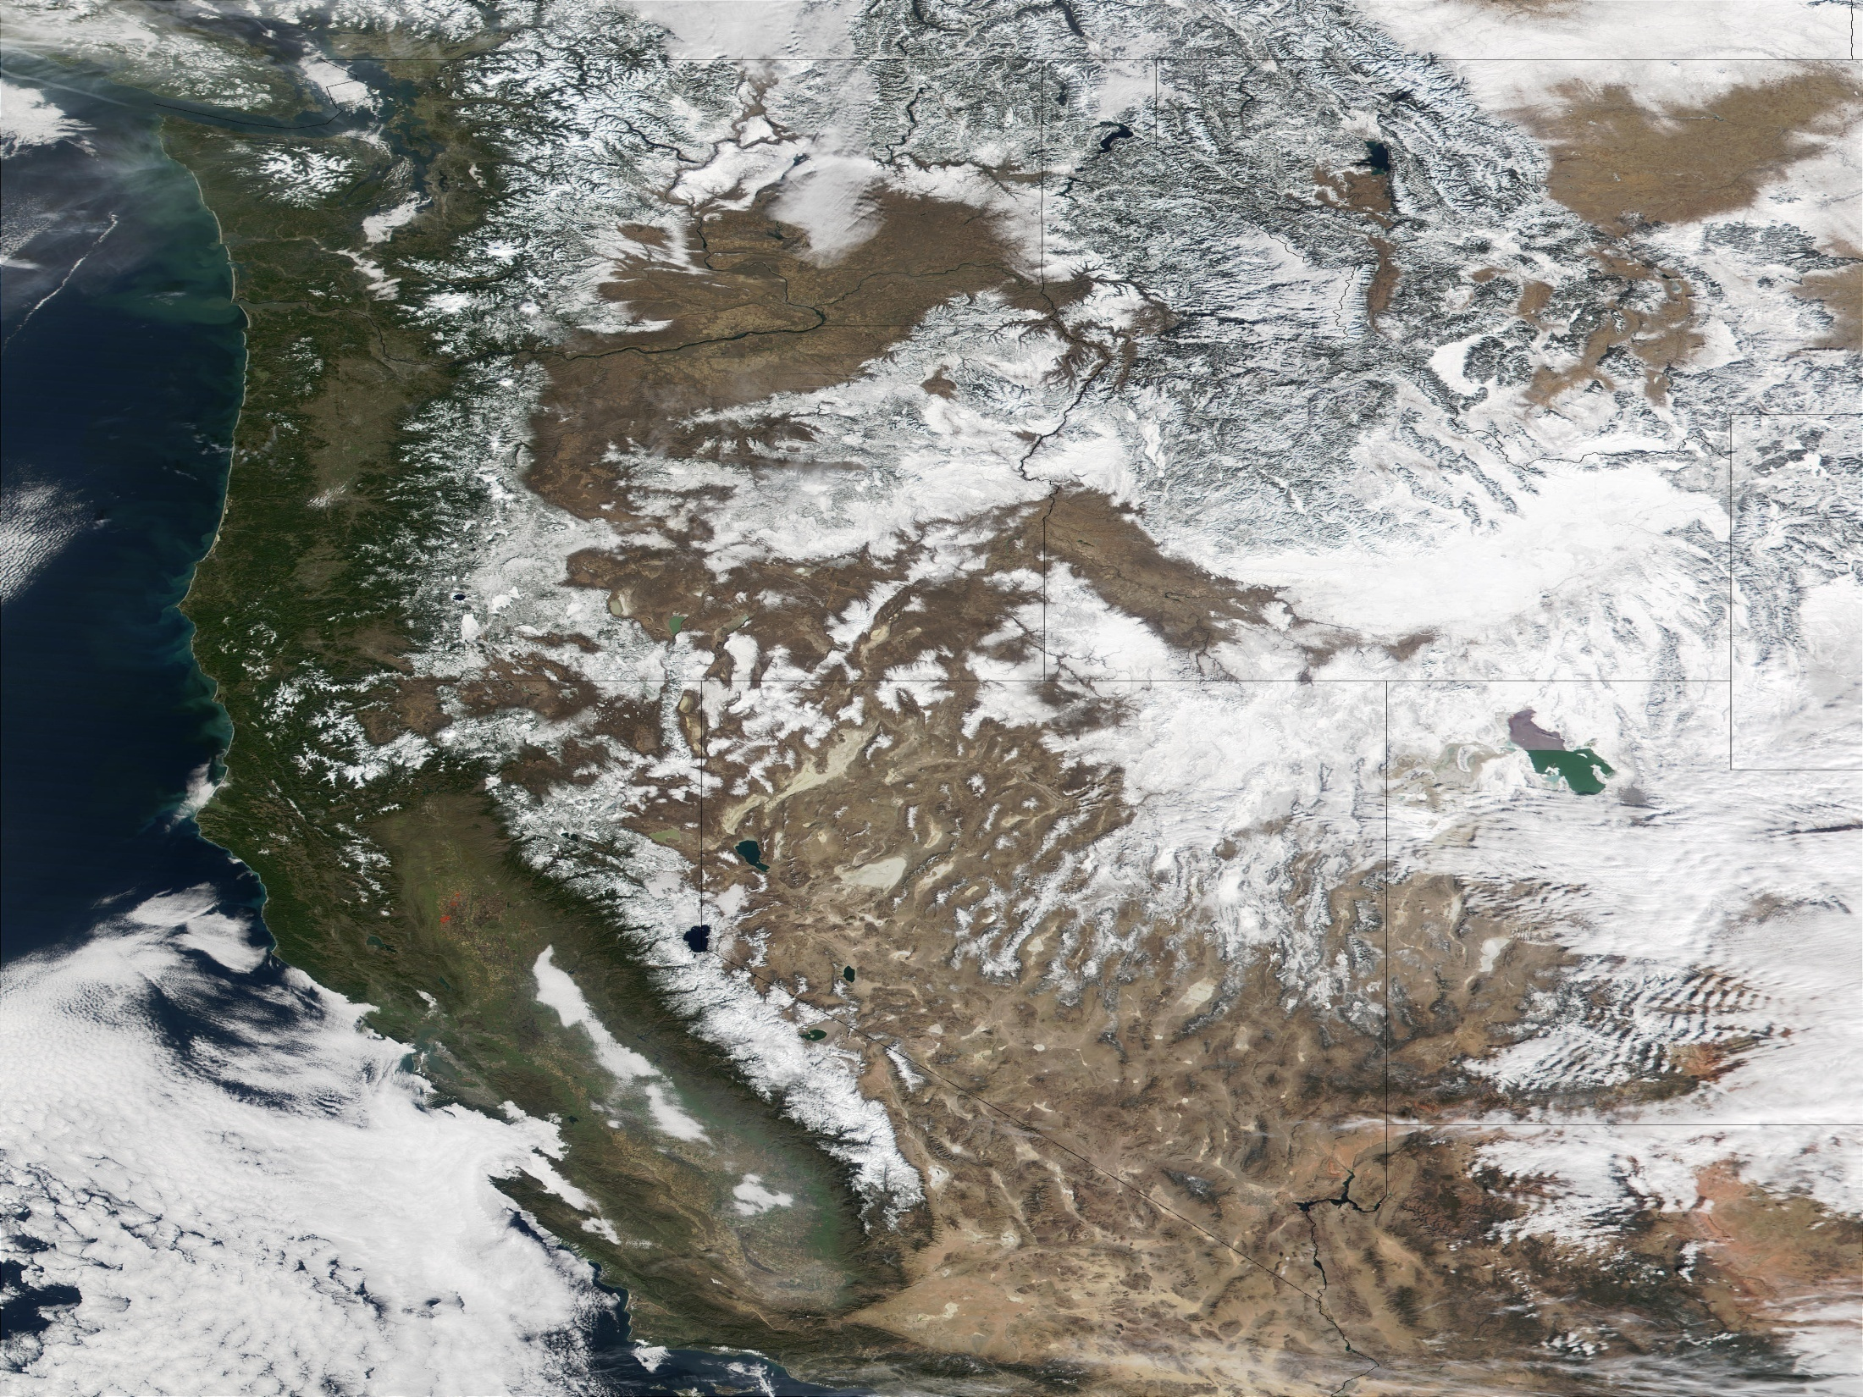

Slide 16
Solar (Shortwave) Radiation
GHG
GHG
DUST
Terrestrial (Longwave) Radiation

Slide 17
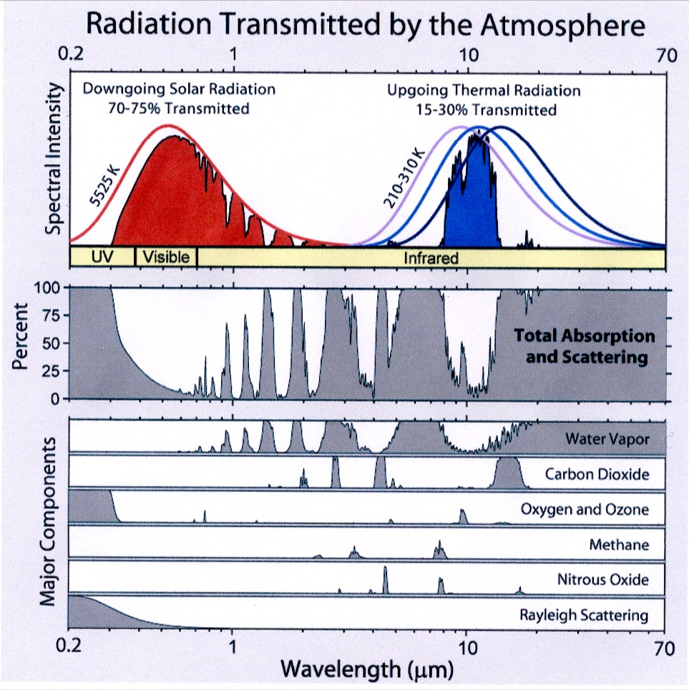
Greenhouse Gases
Water Vapor
~3 pph maximum
Most important GHG
Equilibrium temp.
-20 °C (-4 °F)
Observed temp.
15 °C (59 °F)
Only changing by about 1% / decade.
Notes:
What is absorption??

Slide 18
Greenhouse Gases
Carbon Dioxide
~394 ppm
1-3 ppm annually
Produced by:
Fossil fuel combustion
Animal Respiration
Plant Respiration

Slide 19
Greenhouse Gases
Ozone
~34 ppb
Forms only secondarily
Roughly 34 ppb
Global increase of roughly 30% since industrial revolution.
Notes:
Ozone

Slide 20
Greenhouse Gases
Methane
2ppm
A by-product of agriculture and farming, vehicles, factories, …
25x more potent than CO2
1/3 contribution to global warming relative to CO2

Slide 21
Greenhouse Gases
Nitrous Oxide
300 ppb
By product of agriculture and industry
300x more potent than CO2
Relatively long atmospheric residency time

Slide 22
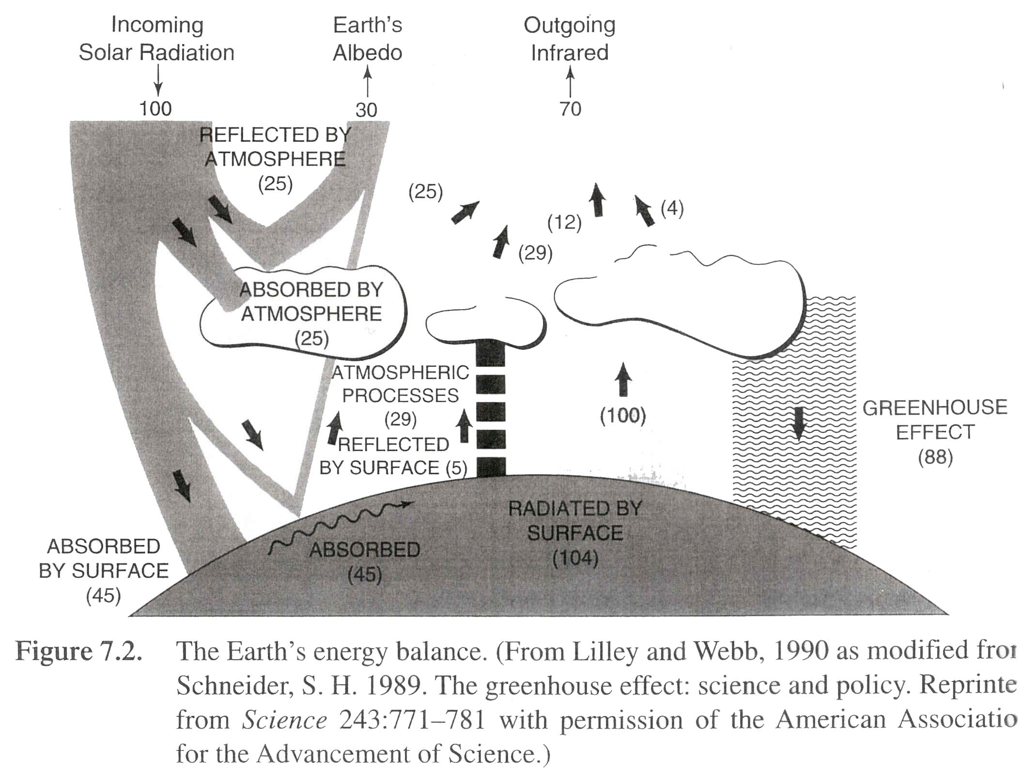

Slide 23
Important Radiation Laws & Concepts
Net radiation
Rn = (1- α)I_{s} + E_{L} δT⁴(surface) - δT⁴(sky)
Absorbed Radiation
Downward Longwave
Terrestrial Emission
Surface Energy Balance
Rn – G = H + λE
Soil
Sensible
Latent
Bowen Ratio
β = H / λE

Slide 24
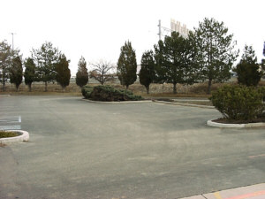
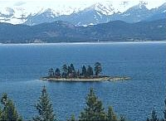
Bowen Ratio
β = H / λE
β = 10 / 1 = 10
β = 10 / 100 = 0.1

Slide 25
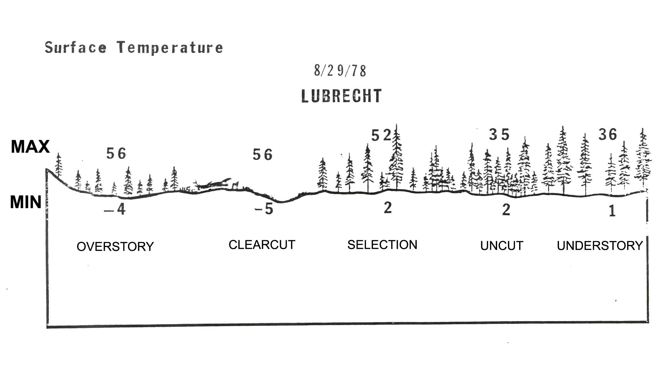

Slide 26
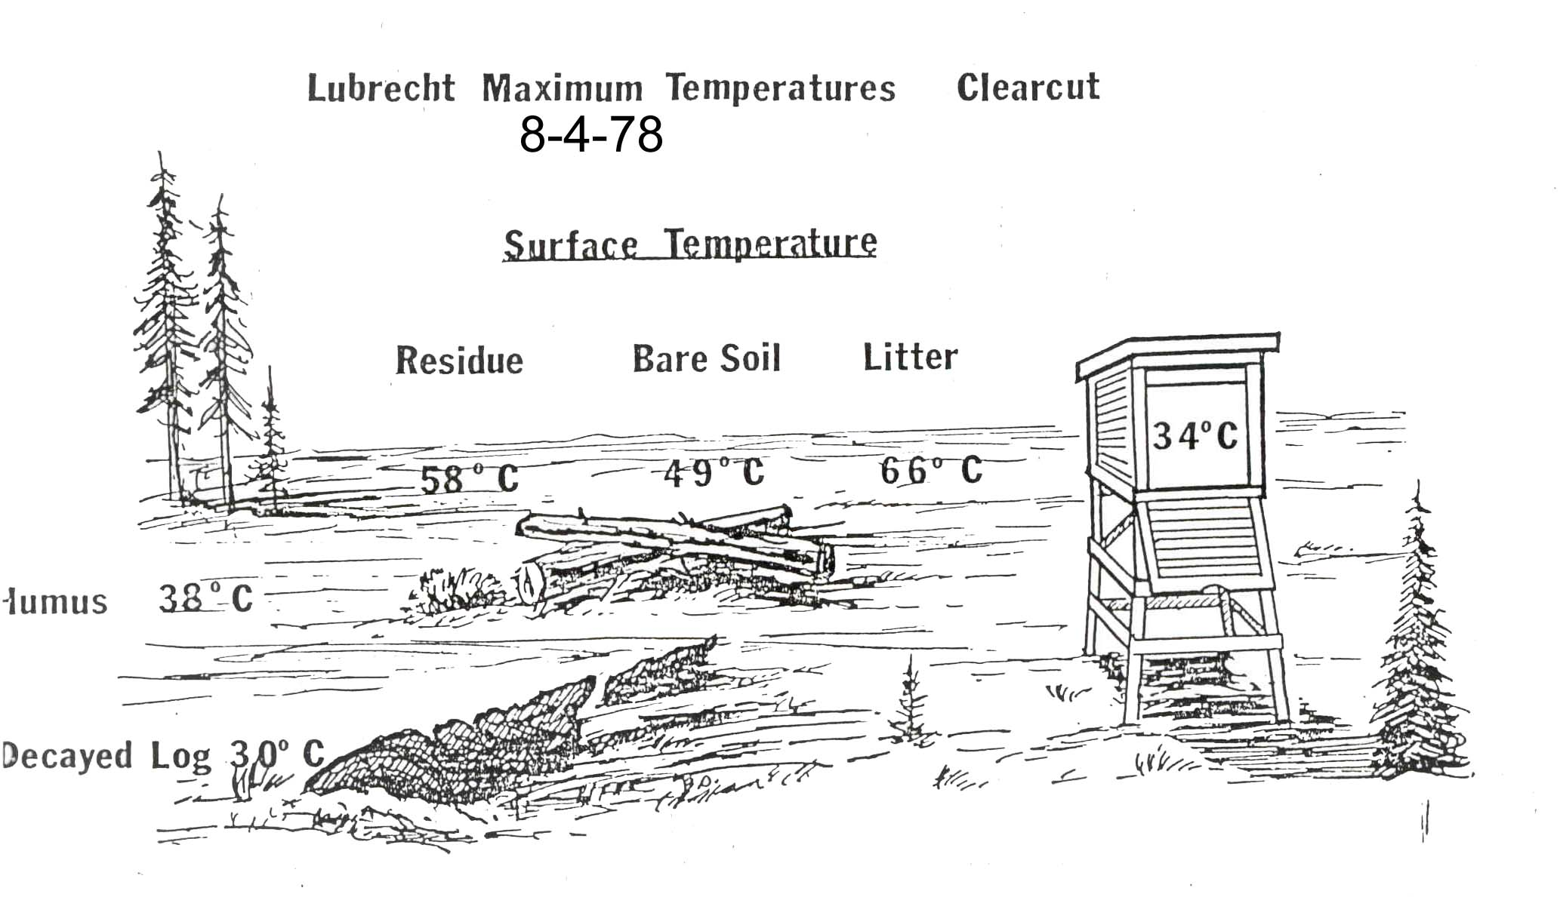

Slide 27
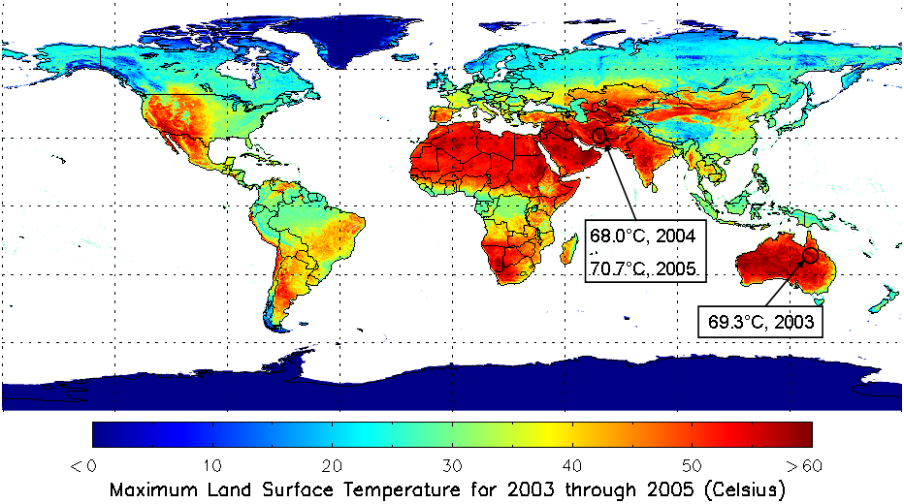
HOTTEST PLACES ON EARTH

Slide 28
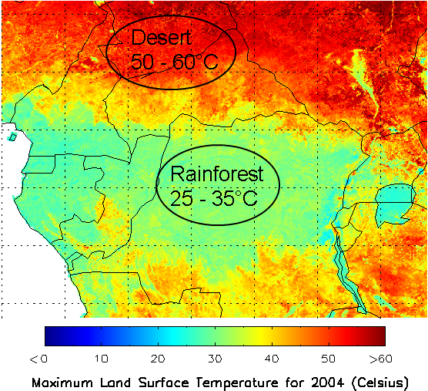

Slide 29
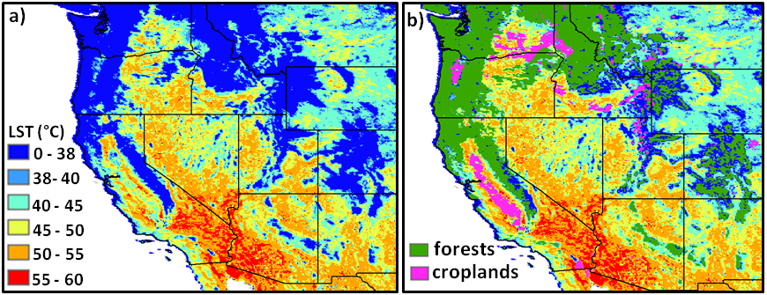
Relationship between LST and Vegetation Cover

Slide 30
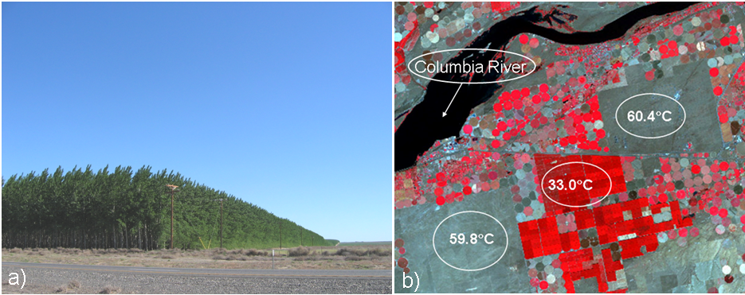
Surface Temperature Extremes

Slide 31
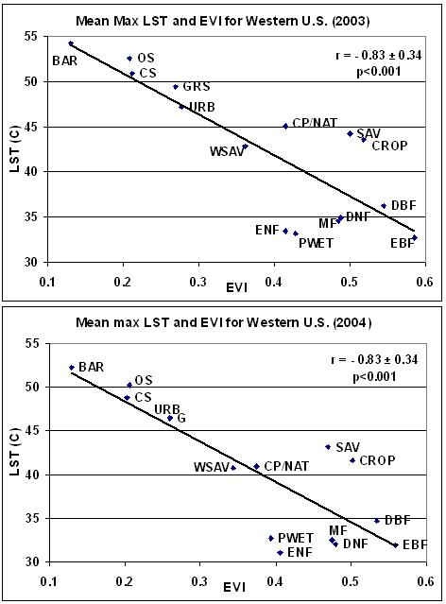

Slide 32
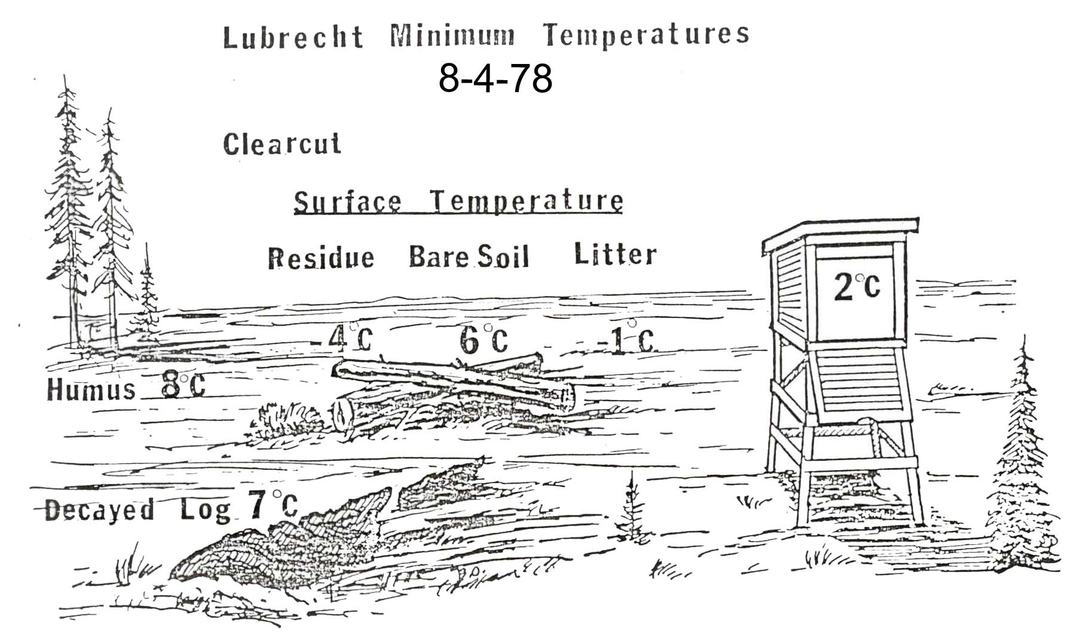

Slide 33
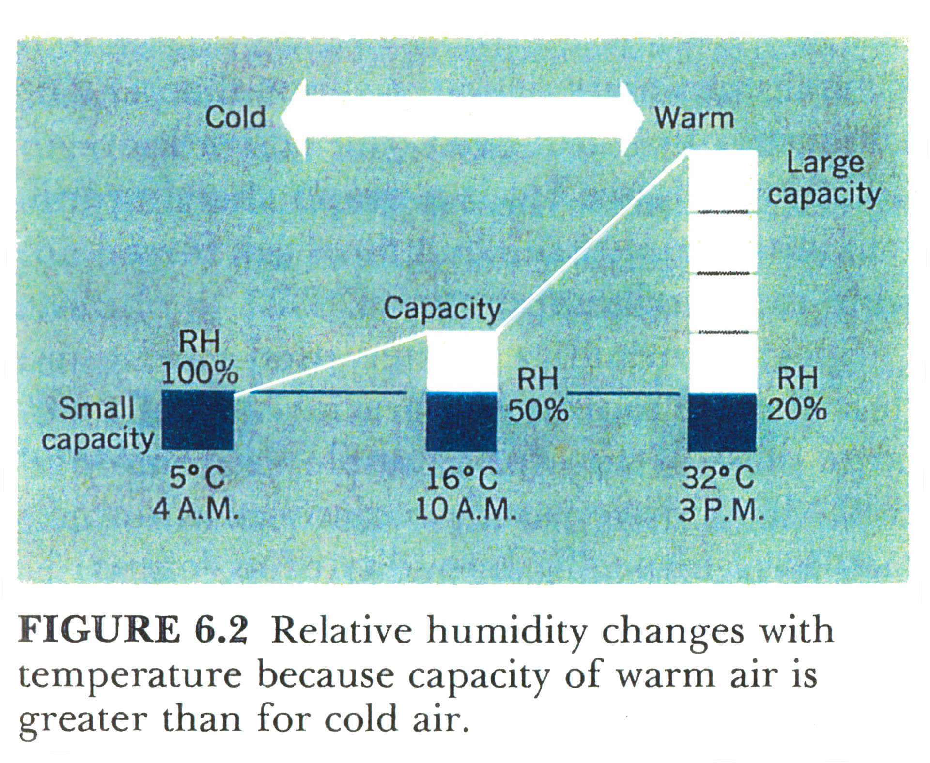

Slide 35
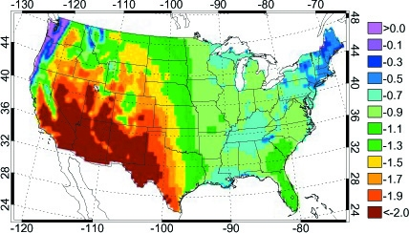
Geographic Variation in Annual Water Balance
(Precip - Potential ET, meters per year)

Slide 36
PENMAN-MONTEITH equation for Evapotranspiration
THE PROBLEM
Temperature + Precipitation
does NOT tell the integrated land water balance
1-d Land Water Balance = Precipitation – Evapotranspiration
Watershed Balance = Precip – (ET + Runoff)
Solar radiation
Air
Temperature
Humidity
Windspeed
Veg Leaf Area

