Slide 1
ECOSYSTEM MODEL EVALUATION TEMPLATE
Model Name/Host Institution/URL
Biome-BGC, NTSG University of Montana
http://www.ntsg.umt.edu/project/biome-bgc
Domain/Objective
Biome-BGC is a computer model that simulates the storage and fluxes of water, carbon, and nitrogen within the vegetation, litter, and soil components of a terrestrial ecosystem
Key Assumptions
Species not defined, individual plants not defined, LAI key variable, simple N budget
Temporal/Spatial Scale
Daily timestep/ 1-d, spatially undefined so can be computed for any area with a gridded computation

Slide 2
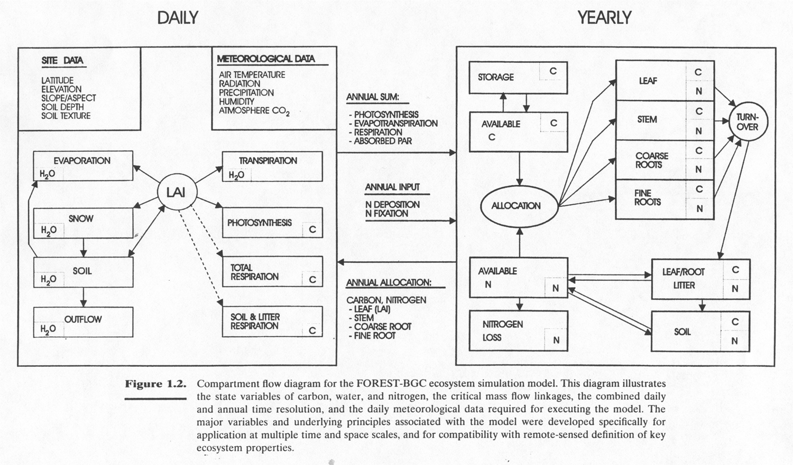
Input Drivers
Daily maximum temperature (°C)
Daily minimum temperature (°C)
Daylight average temperature (°C)
Daily total precipitation (cm)
Daylight average partial pressure of water vapor (Pa)
Daylight average shortwave radiant flux density (W/m²)
Daylength (s)
Key Outputs
Daily soil water, snowmelt, evaporation, transpiration;
Daily photosynthesis, maintenence respiration, decomposition
Yearly carbon allocation, plant growth, litter turnover, mortality

Slide 3
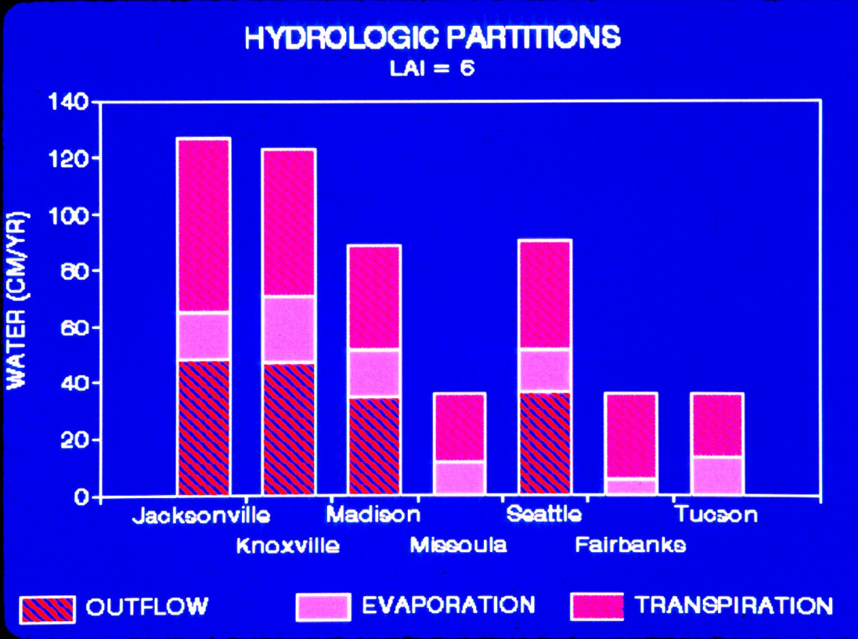
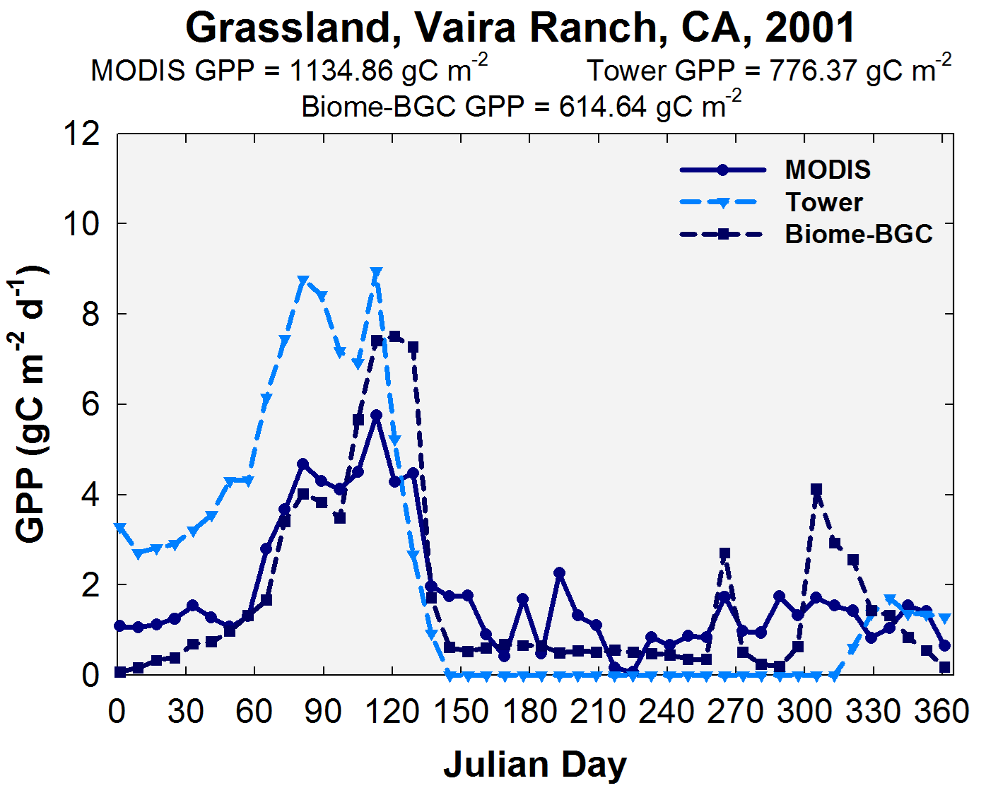
Testing/Validation, Examples of a result

